Slide 1

Name of Your Outcome
Quarterly Progress Meeting - May 2017
Presenter’s Name,
Organization and
Role in Relation to the Outcome
Notes:
BACKGROUND: The Strategic Review System is the Chesapeake Bay Partnership's committed adaptive management process to regularly review progress at meeting our Watershed Agreement Outcomes and make appropriate changes. In recognition of the fact that our Outcomes vary considerably, there is no single review process that will fit all Outcomes. However, there is value in ensuring some level of consistency in how we review and discuss our Outcomes. The “Guide to your Quarterly Progress Meeting” and this powerpoint template are intended to provide that level of consistency, while also providing the necessary level of flexibility to adapt the process to your specific Outcome’s needs. The “Guide” provides specific instructions that we expect the Outcome’s lead GIT or Workgroup to follow in conducting the review. This powerpoint template provides a consistent format for presenting only the most important issues resulting from that review to the Management Board at the Quarterly Progress Meeting.
Both documents address four basic questions:
What are our assumptions?
Are we doing what we said we would do?
Are our actions having the expected effect?
How should we adapt?
We understand that you could spend your entire allotted time to any one of these questions. Please keep in mind that the Management Board is trusting that your GIT or Workgroup followed the process outlined in the Guide, and that the issues that you present in this powerpoint are limited to only those high points from that review that you need to bring to the Management Board’s attention and get their feedback.
INSTRUCTIONS: Use this presentation to highlight important AND, BUT, THEREFORE stories that the Management Board should hear, based on GIT analysis using the provided materials.
Find photos on our Flickr site: https://www.flickr.com/photos/29388462@N06/sets/
You can also browse photos by category on our website: http://www.chesapeakebay.net/photos
Find charts and data at ChesapeakeProgress.com.

Slide 2
Through the Chesapeake Bay Watershed Agreement, the Chesapeake Bay Program has committed to…
Goal: (title only)
Outcome:
(language from Agreement)
Relevant Photo
Notes:
INSTRUCTIONS: Add the title of your goal, the language of your outcome from the 2014 Agreement (copy and paste), and a relevant photo, if it all fits. If desired, talking points could include more contextual information, e.g. the importance of the outcome, historic trends, partners, etc.

Slide 3

What We Want
Identify the ask(s) to the Management Board up front! Use a picture to illustrate your point.
Notes:
INSTRUCTIONS: Identify the ask(s) for the Management Board up front, or clue them in to what you will be asking them later. All of the information in your presentation should support this. If you don’t necessarily have an ask, identify a few key points you want the Management Board to walk away with, and structure your presentation around those points.

Slide 4
Setting the Stage:
What are our assumptions?
1
Notes:
[section header, no action required] The section that follows should provide some brief historical context for the Bay Program’s work toward this outcome. Add slides as needed while being mindful of the time you have.

Slide 5
Logic Behind Our Outcome
Following the Decision Framework:
Factors Influencing Success
Current Efforts and Gaps
Management Approaches
Notes:
INSTRUCTIONS: Describe the factors, efforts & gaps, and management approaches that are relevant to your ask or key takeaway. You could use the analysis and insight gained from your logic table to consider questions like,
What are my critical factors originally identified in the Management Strategy?
What did I originally identify in the Management Strategy as gaps in existing programs that addressed those factors?
What were the management approaches I chose for my strategy and workplan to address those gaps?
REMEMBER: Prioritize the information you want to present based on your story, ask, or key takeaway.

Slide 6
Progress:
Are we doing what we said we would do?
2
Notes:
[section header, no action required] This second section provides the AND part of the AND, BUT, THEREFORE story structure. This section provides an opportunity to talk about your progress. Use indicator data and charts from ChesapeakeProgress.com where available. If you do not have an indicator, fill in with other relevant information, charts, tables, etc. about your management approaches and workplan actions.

Slide 7
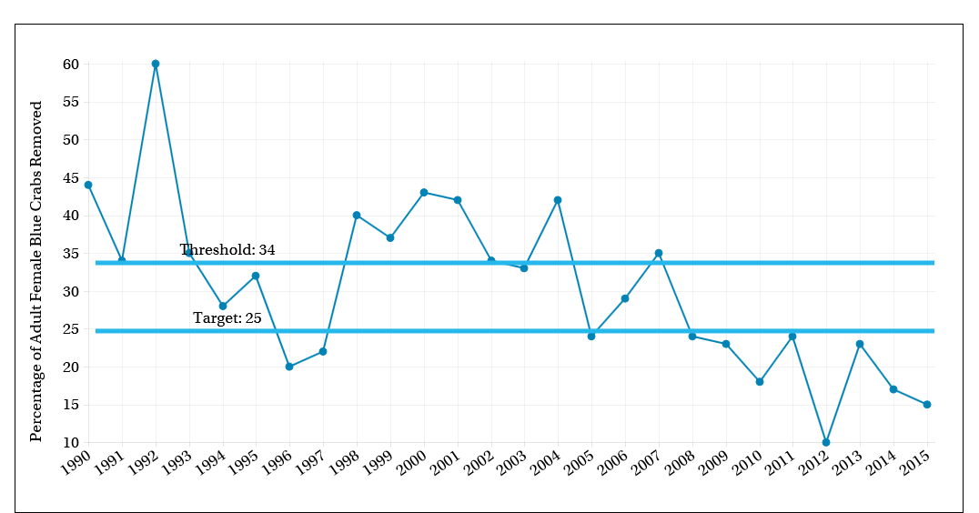
What is our progress?
Notes:
INSTRUCTIONS: Copy and paste progress chart from: http://www.chesapeakeprogress.com/. If no chart is available, use pictures, other charts, maps, or text to explain Progress.
Talking Points:
Discussion Question 1: Are you on track to achieve your Outcome by the identified date?
What is your target? What does this target represent? (e.g., the achievement we believed could be made within a particular timeframe; the achievement we believed would be necessary for an Outcome’s intent to be satisfied; etc.)?

Slide 8
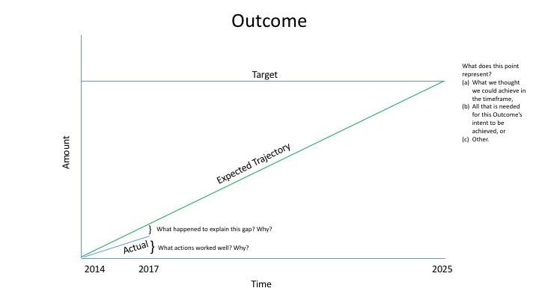
Are we on track?
Notes:
INSTRUCTIONS: This optional graphic was provided to coordinators and staffers (email sent by Emily Freeman on March 24) as Annotated Process Graphic PowerPoint file. You can edit the graph in that file and include here. Alternatively, you can leave this out of the presentation and include other charts, pictures, maps, or information to answer the questions below.
Talking Points:
Discussion Question 1 (continued)
What is your anticipated deadline? What is your anticipated trajectory?
What actual progress has been made thus far?
What could explain any existing gap(s) between your actual progress and anticipated trajectory?

Slide 9
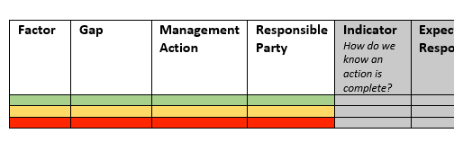
Analysis
Pro Tip: Use the content from your table to identify the challenges to discuss in this section!
(Don’t forget to delete these notes when you’re done!)
Discussion Question 2: Which actions were most critical in progress thus far? Why? [Indicate which influencing factors these actions were meant to manage.]
    Discussion Question 3: Which management actions will be the most critical to your progress in the future? Why? [Indicate which influencing factors these actions were meant to manage.]
      Based on this analysis, what management approaches will be carried forward? What new management approaches are necessary?
      What gaps have been filled, and how will we build on this in the future?
Notes:
INSTRUCTIONS: consider these questions and include those that are most relevant to your outcome.

Slide 10
Challenges:
Are our actions having the expected effect?
3
Notes:
[section header, no action required] This second section provides the BUT part of the AND, BUT, THEREFORE story structure. This section provides an opportunity to talk about your challenges, based on your analysis using the logic table and the discussion questions in the SRS Quarterly Meeting Guide.

Slide 11
Challenges
Discussion Question 4: What scientific, fiscal or policy-related developments or lessons learned (if any) have changed your logic or assumptions about your Outcome?
Did any factor, gap, or management approach present a challenge?
Did an unforeseen factor influence your ability to move forward with an approach?
Pro Tip: Use the content from your table to identify the challenges to discuss in this section!
(Don’t forget to delete these notes when you’re done!)
Notes:
INSTRUCTIONS: This is the BUT part of the story. Consider the questions above and share something about a challenge encountered, or new information gathered, or a new approach identified, that calls for a change to the existing approach or strategy. You can discuss your plans to address this challenge, or you can talk more broadly about how your workgroup or GIT will work to determine how to address the challenge.
Keep in mind – we are not asking you to paste your Logic Table into this slide! The Logic Table provided in the “Guide” is intended to lead you through a standardized thought process that ensures all Outcomes are reviewed similarly. The Management Board is trusting that your GIT or Workgroup went through that process. All they are looking for here is a presentation of your most important conclusions from that process.

Slide 12
Adaptations:
How should we adapt?
4
Notes:
[section header, no action required] This second section provides the THEREFORE part of the AND, BUT, THEREFORE story structure. This section provides an opportunity to talk about your adaptations and next steps, based on your analysis using the logic table and the discussion questions in the SRS Quarterly Meeting Guide.

Slide 13
Based on what we’ve learned, we plan to…
Discussion Question 5: What (if anything) would you recommend changing about your management approach at this time? Will these changes lead you to add, edit or remove content in your work plan?
Pro Tip: Use the content from your table to identify the challenges to discuss in this section!
(Don’t forget to delete these notes when you’re done!)
Notes:
INSTRUCTIONS: This is the THEREFORE piece of the story! Tell the Management Board what you’re going to do with the new information, research, resources, understanding of factors, etc. Refer back to the logic table that you competed—this content could come from the Adaptation column, if you got that far in the table, or it could be a realization that you gained working within the first columns of factors, gaps, approaches, actions and responsible parties.

Slide 14










Agreement Goals and Outcomes
Sustainable Fisheries
Vital Habitats Goal
Blue Crab Abundance
Blue Crab Management
Oyster
Forage Fish
Fish Habitat
Wetlands
Black Duck
Stream Health
Brook Trout
Fish Passage
Submerged Aquatic Vegetation (SAV)
Forest Buffer
Tree Canopy
Water Quality Goal
Toxic Contaminants Goal
2017 Watershed Implementation Plans (WIP)
2025 WIP
Water Quality Standards Attainment and Monitoring
Toxic Contaminants Research Toxic Contaminants Policy and Prevention
Healthy Watersheds Goal
Stewardship Goal
Healthy Waters
Citizen Stewardship
Local Leadership
Diversity
Land Conservation Goal
Public Access Goal
Protected Lands
Land Use Methods and
Metrics Development
Land Use Options Evaluation
Public Access Site Development
Environmental Literacy Goal
Climate Resiliency Goal
Student
Sustainable Schools
Environmental Literacy Planning
Monitoring and Assessment
Adaptation Outcome
Notes:
Optional slide if you think it contributes to your message
INSTRUCTIONS: Highlight with bold green text the outcomes which impact your outcome, or which your outcome impacts. (taken from Bruce Vogt’s March 2017 PSC presentation on oysters)

Slide 15
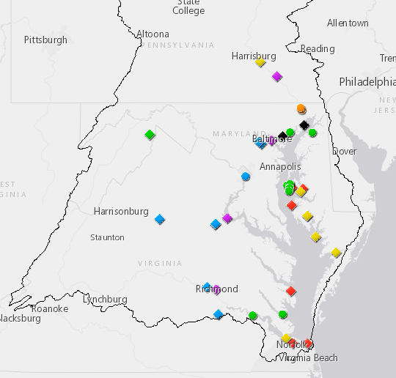
Cross-Outcome
Considerations
ProTip: Ask the Cross-GIT Mapping project team for help including a relevant map in your presentation. (Don’t forget to delete these notes when you’re done!)
Notes:
INSTRUCTIONS: Highlight your past collaboration and future opportunities to collaborate across GITs.
Talking Points:
Discussion Question 6: What opportunities exist to collaborate across GITs? Can we target conservation or restoration work to yield co-benefits that would address multiple factors or support multiple actions across outcomes?

Slide 16
What We Want
Identify the ask to the Management Board up front! Use a picture to illustrate your point.
Notes:
INSTRUCTIONS: Reiterate the ask for the Management Board. If you don’t necessarily have an ask, identify a few key points you want the Management Board to walk away with.
Talking Points:
Discussion Question 7: What is needed from the Management Board to continue or accelerate your progress? (Multiple asks of the Management Board should be prioritized where possible. )

Slide 17
Discussion
Presentation template by SlidesCarnival.
Notes:
[time for discussion at the end of the presentation, before the next outcome presentation]

