Slide 1

Chesapeake Bay Hydrodynamic Modeling: A Proactive STAC Workshop
Workshop Steering Committee:
Carl Cerco
Carl Friedrichs (STAC)
Marjy Friedrichs (STAC)
Raleigh Hood
David Jasinski
Wen Long
Kevin Sellner (STAC)
Time: 9-10 June 2011
Location: Smithsonian Environmental Research Center
Edgewater, Maryland

Slide 2
TMDL Modeling Framework
Notes:
Before talking about the workshop specifics, I thought I’d just include this slide of the TMDL modeling framework, to emphasize again the portion of this framework that this workshop was focusing on. In our STAC meetings, I find we hear a lot about the watershed model and the airshed and land use change models that go into the watershed model, but we hear somewhat less about the CB model, which is what I’m going to be talking about today.

Slide 3
TMDL Modeling Framework
CB model used for
TMDLs was last
reviewed in 1999
CB model was calibrated
for 1991-2000

Slide 4
Workshop Justification
CBPO initiated discussions of a
“Next Generation Chesapeake Bay Model”
CBPO is planning for a fully calibrated and operational new model by 2015
USACE has suggested that the CBP transition to using the USACE Adaptive Hydraulics Model (ADH; currently two-dimensional)
An ideal time for a community-wide discussion
as to what a “Next Generation Bay Model” should entail

Slide 5
Workshop Objectives
Review existing state-of-the-art estuarine
hydrodynamic models
Compare relative skill of various CB models
Compare strengths/weaknesses of various models
Assess how model differences affect water quality simulations
What should a “Next Generation Bay Model” entail?

Slide 6
Workshop Specifics
Roughly 40 participants from:
Chesapeake Bay Program
Chesapeake Community Modeling Program
U.S. IOOS Modeling Testbed Project
Other universities from across U.S.

Slide 7
Workshop Agenda

Slide 8
Workshop Agenda

Slide 9
Six Distinct 3-D Estuarine Hydrodynamic Models
Configured for Chesapeake Bay:
CH3D (the CBP model)
ROMS (three separate configurations)
EFDC
Not yet configured for Chesapeake Bay:
sECOM
FVCOM
ADH (only 2-D in Bay so far)

Slide 10
Six Distinct 3-D Estuarine Hydrodynamic Models
Configured for Chesapeake Bay:
CH3D
ROMS (three separate configurations)
EFDC
Not yet configured for Chesapeake Bay:
sECOM
FVCOM
ADH (only 2-D in Bay so far)

Slide 11
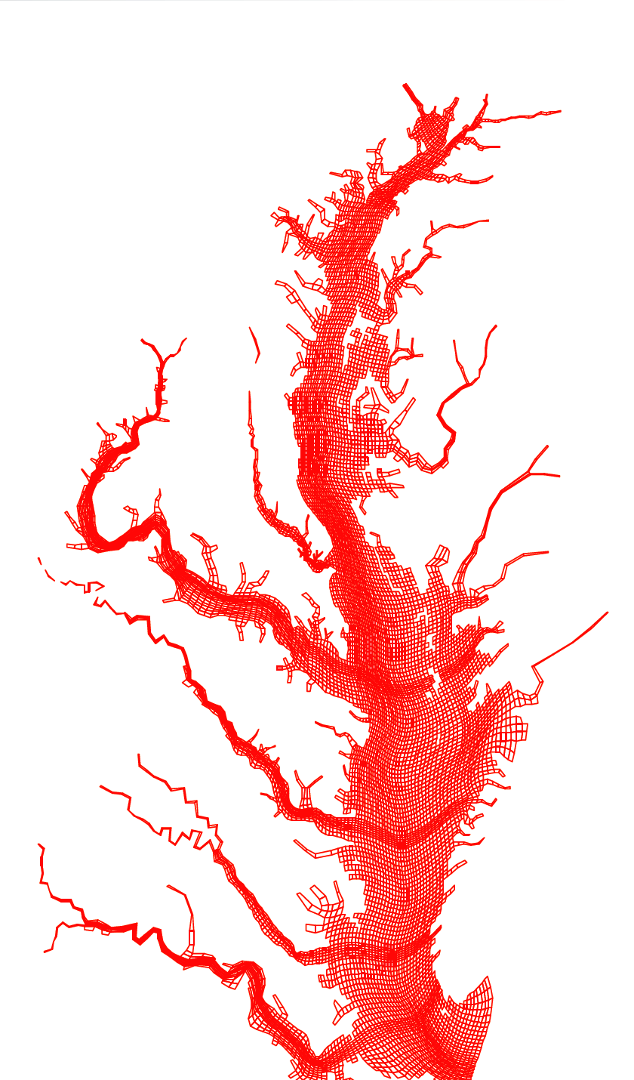
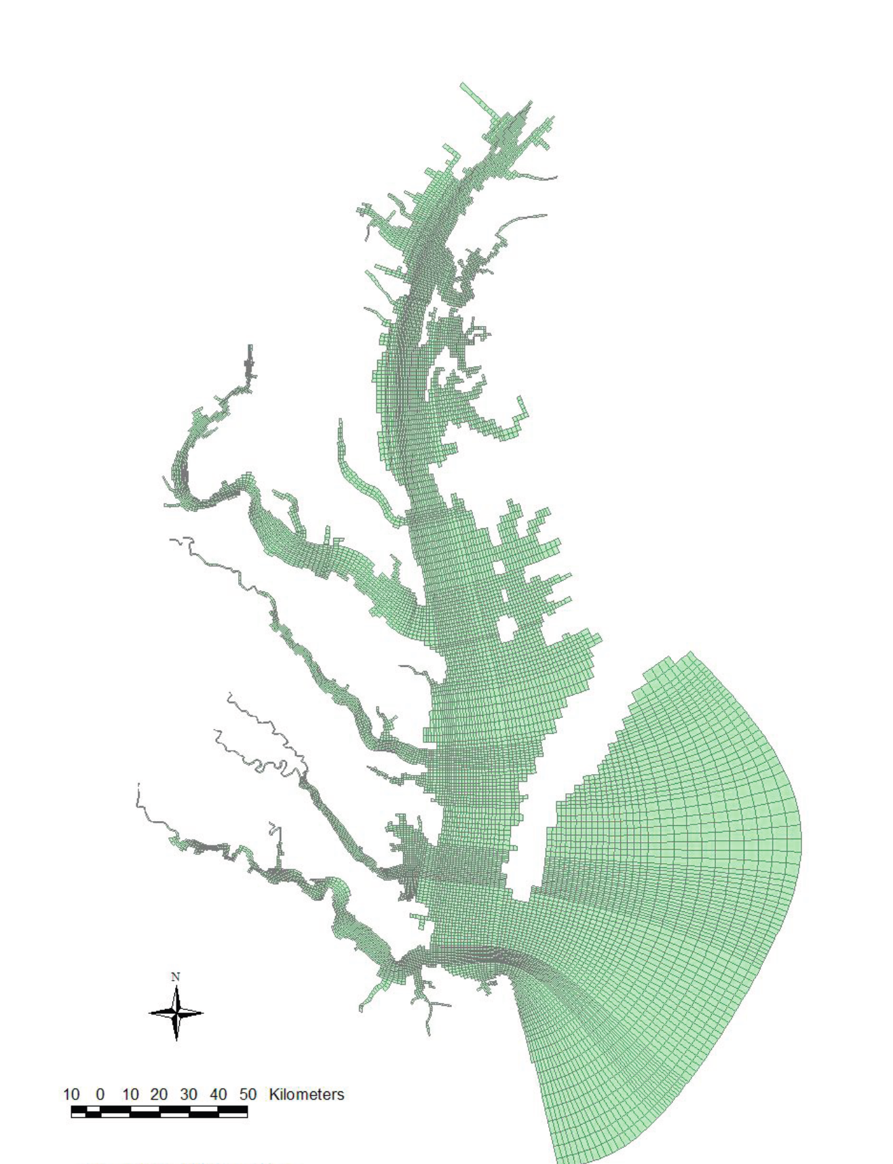
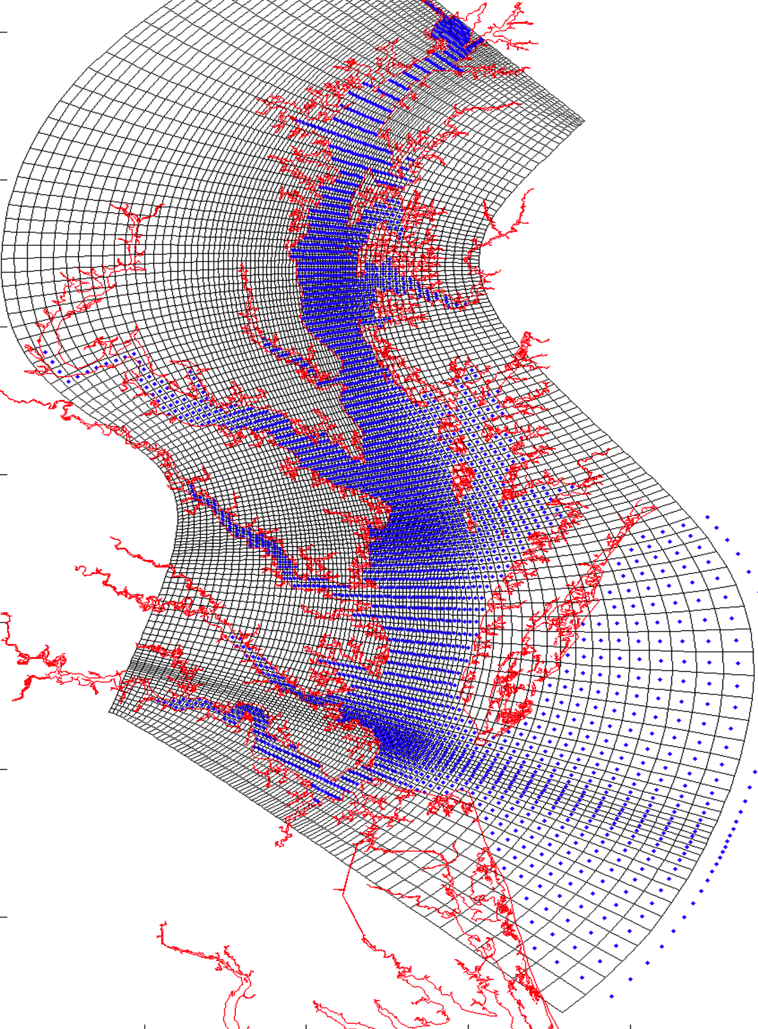
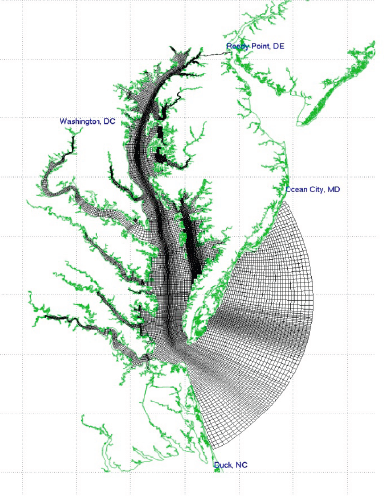
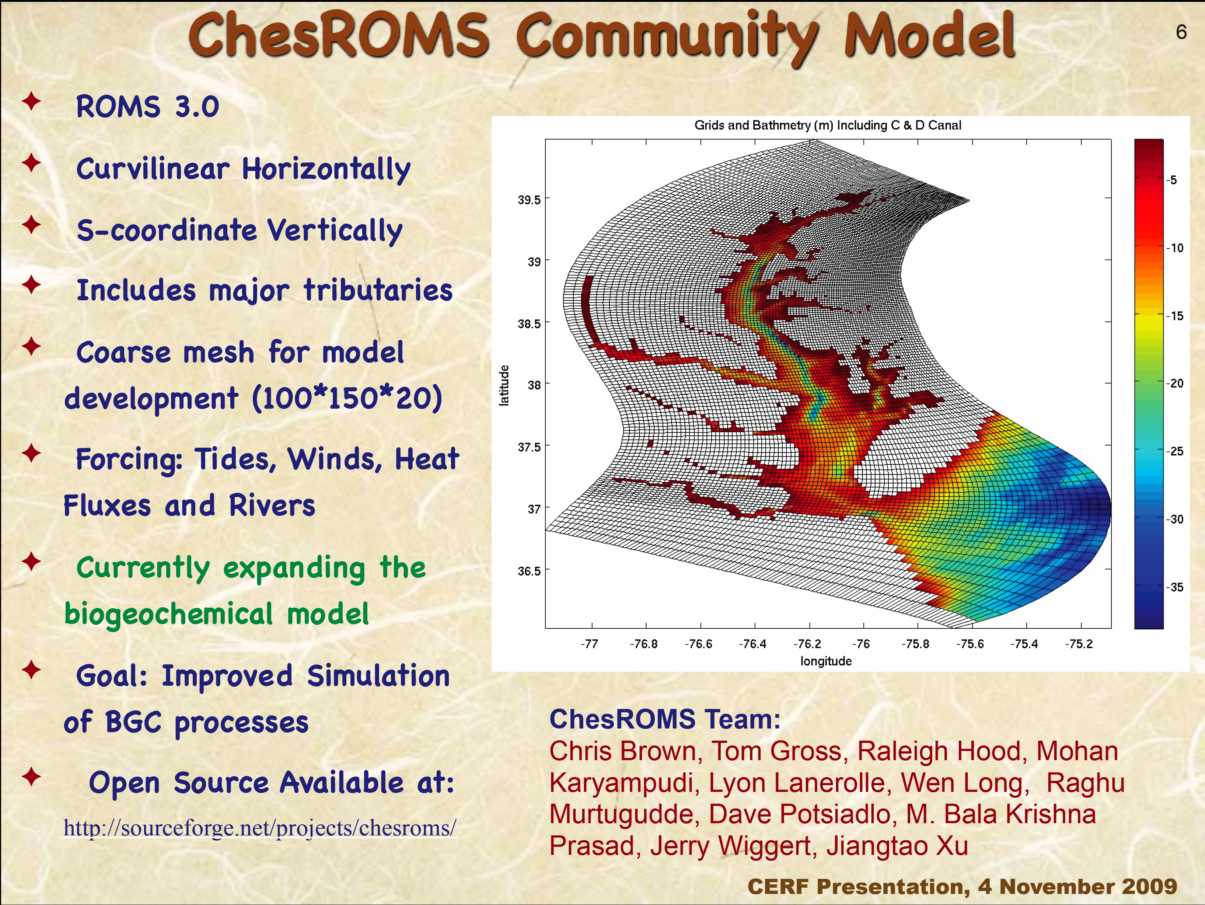
Five Hydrodynamic Models Configured for the Bay
CH3D
Cerco & Wang
USACE
EFDC
Shen
VIMS
UMCES-ROMS
Li & Li
UMCES
CBOFS (ROMS)
Lanerolle & Xu
NOAA
ChesROMS
Long & Hood
UMCES

Slide 12
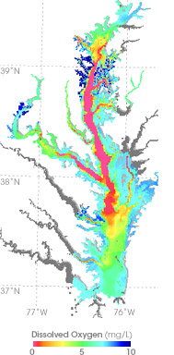
Hydrodynamic Model Skill
How well do the models represent the mean and variability of stratification and dissolved oxygen at
~40 CBP stations
in 2004 and 2005?
= ~40 CBP stations used in
this model-data comparison

Slide 13
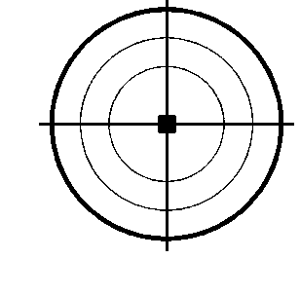
Relative model skill: Target diagrams
Model skill = Distance from Origin
symbol at origin → model fits observations perfectly
bias
y > 0:
overestimates
mean
1
1
variability
-1
1
-1
x > 0
overestimates
variability
-1
-1
Jolliff et al., 2009

Slide 14
Relative model skill: Target diagrams
Model skill = Distance from Origin
symbol at origin → model fits observations perfectly
bias
y > 0:
overestimates
mean
1
1
variability
-1
1
-1
x > 0
overestimates
variability
-1
-1
Jolliff et al., 2009

Slide 15
2004 Bottom Salinity
bias [psu]
unbiased
RMSD
[psu]
CH3D, EFDC reproduce bottom salinity best

Slide 16
2004 Stratification
bias [psu/m]
unbiased
RMSD
[psu/m]
CH3D, EFDC underestimate stratification less than the ROMS models

Slide 17
2004 Hypoxic Volume
bias [mg/L]
unbiased
RMSD
[mg/L]
CBP model does well, but other models do equally well

Slide 18
Sensitivity Experiments
Use ROMS and EFDC to test sensitivity of hydrodynamic skill to:
Vertical grid resolution
Horizontal grid resolution
Vertical advection scheme
Atmospheric forcing – winds
Freshwater inflow
Coastal boundary condition
Mixing/turbulence closure

Slide 19
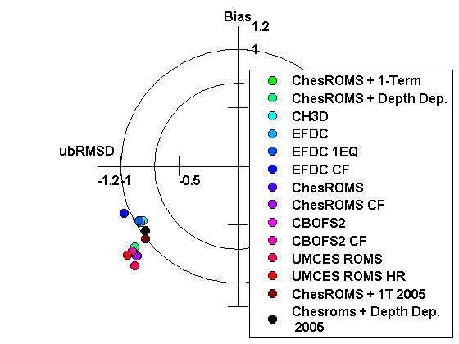
Sensitivity Experiments
Maximum
Stratification
CH3D,
EFDC
ROMS
Stratification is insensitive to horizontal/vertical grid resolution, freshwater inflow, coastal boundary, atmospheric forcing

Slide 20
Sensitivity Experiments
Maximum
Stratification
ROMS with
new TKE
parameter
ROMS
Stratification is insensitive to horizontal/vertical grid resolution, freshwater inflow, coastal boundary, atmospheric forcing

Slide 21
Sensitivity Experiments
Maximum
Stratification
ROMS with
new TKE
parameter
ROMS
Stratification is sensitive to minimum TKE parameter
used in turbulence closure scheme
Notes:
Learn a lot from comparing model skill; learn a lot from sensitivity experiments like this, and it’s really a problem that we can’t do these kind of experiments with CH3D. Why can we do these with ROMS? Not only can anyone get the code, but it is a community model, meaning lots of folks are running the model, so we have lots of people doing these experiments simultaneously, lots of support, documentation, etc.. More than just putting the code on a site and allowing folks to download it.

Slide 22
Sensitivity Experiments
Modeled stratification is not highly sensitive to:
- choice of wind forcing
- choice of river flow
- grid resolution
- coastal boundary condition
Modeled stratification is most sensitive to:
- turbulence closure parameterizations
- advection scheme
Only possible because:
- quantitatively assessing model skill
- multiple open source, community models
- large group of people from multiple institutions,
all collaborating on CB modeling issues
Notes:
Learn a lot from comparing model skill; learn a lot from sensitivity experiments like this, and it’s really a problem that we can’t do these kind of experiments with CH3D. Why can we do these with ROMS? Not only can anyone get the code, but it is a community model, meaning lots of folks are running the model, so we have lots of people doing these experiments simultaneously, lots of support, documentation, etc.. More than just putting the code on a site and allowing folks to download it.

Slide 23
Five Recommendations for how CBP should proceed with future modeling efforts
Assess model skill
Use multiple models
Use open source community models
Implement models in a modular fashion
Form a Chesapeake Modeling Laboratory to enable the above, as suggested in the NRC report; extension of CCMP
Establish an ad-hoc modeling advisory committee to
advise CBP on future modeling efforts
Notes:
Multi-model average does best
Gives you uncertainties; scenario studies
Limnotech example
CML is a logical mechanism for carrying out these recommendations; could build off the existing chesapeake community modeling program
Recommend forming an adhoc modeling advisory committee that is separate from, but sanctioned by the CBP, and this advisory committee would advise the CBP on future modeling activities and insure that these recommendations are consdidered

Slide 24
Recent STAC Discussions on CBP Modeling
1. National Academy of Sciences Report
2. STAC LimnoTech Review
3. CB Hydrodyn. Modeling Workshop Report
→ Future of Modeling Letter
from STAC (Oct. 2011)

Slide 25
STAC Future of Modeling Letter:
Recommendations
STAC strongly recommends that any future hydrodynamic/water quality model shall be selected through quantitative skill assessment and an independent peer review process
STAC strongly encourages the EPA to direct a portion of its modeling funds each year to the modeling community to develop and run multiple hydrodynamic/water quality models. The output from these multiple models shall then be routinely compared to the EPA regulatory model output to build scientist, management, and other stakeholder confidence in the model, which is critical for generating support for the appropriate use of public funds in meeting TMDLs across the region.

Slide 26
Recommendations for inclusion of multiple models
1. National Academy of Sciences Report
2. STAC LimnoTech Review
3. CB Hydrodyn. Modeling Workshop Report
4. Future of CBP Modeling Letter from STAC

Slide 27
Vision for Using Multiple Models in the CBP Modeling Suite
CBP model continue to be used as the sole regulatory model for management decisions
Several other community models, partially supported by CBP, to be used for comparison and R&D. This would:
- Demonstrate that the CBP model is equally as skillful as a range of models routinely used in modeling the system
- Bolster community-wide (management and academic) support for the TMDL Modeling Framework
Notes:
Vision of how the inclusion of multiple models could be advantageous for the CBP modeling suite and the CBP itself

Slide 28
Next steps…
At the Nov. 2011 Modeling Workgroup meeting, a USACE demonstration project for Gunston Cove was proposed for transitioning the 2-D ADH model into a 3-D configuration for improving hydro+WQ simulations in < 3m waters
At its Dec. 2011 meeting, STAC felt that this would be an ideal opportunity for the CBP to implement a prototype multiple modeling strategy as has been suggested in multiple recent CBP reports and reviews
Notes:
Vision of how the inclusion of multiple models could be advantageous for the CBP modeling suite and the CBP itself

Slide 29
Next steps…
We surveyed the U.S. estuarine modeling community and found 4 or 5 modeling groups that would jump at an opportunity to participate in a Gunston Cove model intercomparison experiment, even if only limited funding were available
Are we sure that ADH is the hydrodynamic model that is best suited for these < 3m waters? What about these other 4-5 community models?
→ Forthcoming Letter from STAC (~Jan. 2012)
Notes:
Vision of how the inclusion of multiple models could be advantageous for the CBP modeling suite and the CBP itself

Slide 30
Vision for Using Multiple Models in the CBP Modeling Suite
CBP model to be used as the sole regulatory model for management decisions
Several other community models, partially supported by CBP, to be used for comparison and R&D. This would:
- Demonstrate that the CBP model is equally as skillful as a range of models routinely used in modeling the system
- Bolster community-wide (management and academic) support for the TMDL Modeling Framework
Notes:
Vision of how the inclusion of multiple models could be advantageous for the CBP modeling suite and the CBP itself

Slide 31
Extra Slides

Slide 32
2004 Bottom DO
bias [mg/L]
unbiased
RMSD
[mg/L]
CBP model does well, but other models do equally well

Slide 33
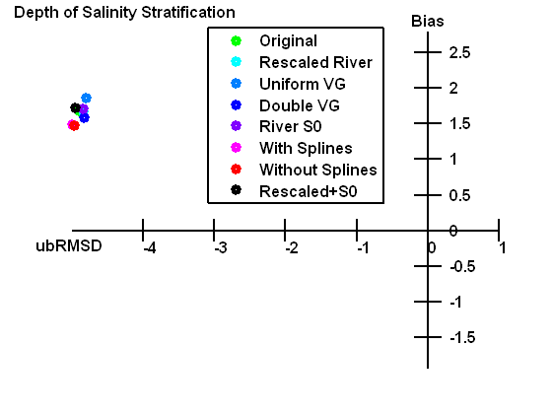
Sensitivity Experiments
Depth of max
stratification
0.2
-0.8
-0.6
-0.4
-0.2
-0.2
-0.2
Stratification is insensitive to: vertical grid resolution and freshwater river input

