Slide 1

STAC Water Temperature Workshop 1
February 2022 FWG Meeting
Katie Brownson
US Forest Service

Slide 2
Overview of the day
Session 1: Drivers of increasing water temperatures
Session 2: Ecological impacts of increasing water temperatures
Session 3: Management implications

Slide 3
Non-tidal water temperature
Streamflow
Heat transfer from channel substrate
Channel temperature buffering capacity
Runoff temperature
Direct solar radiation
Sources of water (farm ponds, municipal, mining and industrial discharge, snowmelt, etc.)
Upstream and riparian land use
Withdrawals (from surface or groundwater)
Upstream and riparian land use
Rainfall
Ambient air temperature
Hyporheic exchange
Underlying geology
Local hydrology (presence of dams, floodplain connectivity, etc.)
Groundwater inputs
Substrate composition (bedrock vs. gravel)
Hyporheic exchange
Residence time in hyporheic zone
Groundwater inputs
Air temperature
Surface area: volume ratio
Channel form
Stream size
Canopy cover
Groundwater temperature
Degree of infiltration
Degree of infiltration
Baseflow
Hydraulic resistance
Large woody debris
Instream vegetation
Water clarity
Degree of infiltration
Groundwater residence time
Legacy sediment

Slide 4
Issues with the conceptual model
Accounting for variation in the importance of drivers depending on location within the watershed and the dominant land use
Addressing issues of scale (both spatial and temporal)
Avoiding oversimplification- how to account for interrelationships and complex biological factors
Connecting drivers with management activities and land use decisions

Slide 5
Riparian forest buffer planting and conservation
Shading
Air temperature
Infiltration
Streamflow
Management actions
Management impacts
Water temp drivers
Large woody debris
Groundwater inputs
Channel buffering capacity
Evapotranspiration
Runoff temperature
Riparian land use
Strength of cooling effect- High
Certainty- High

Slide 6
Upland tree/forest planting and conservation
Infiltration
Groundwater inputs
Streamflow
Upland land use
Management action
Management impact
Water temperature driver
Runoff temperature
Strength of cooling effect- Medium/Low
Certainty- Medium

Slide 7
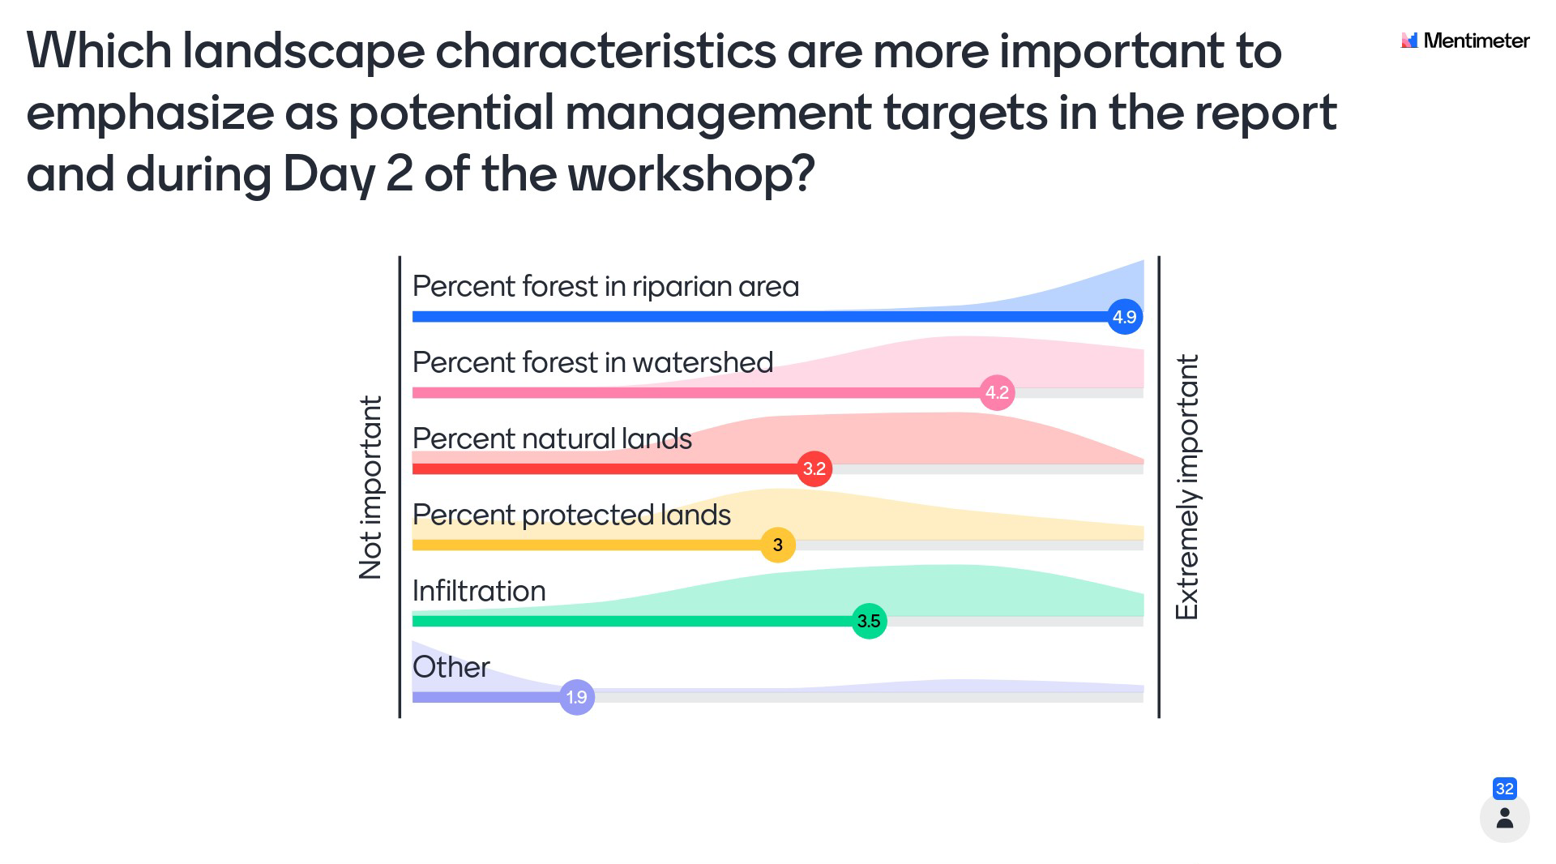

Slide 8
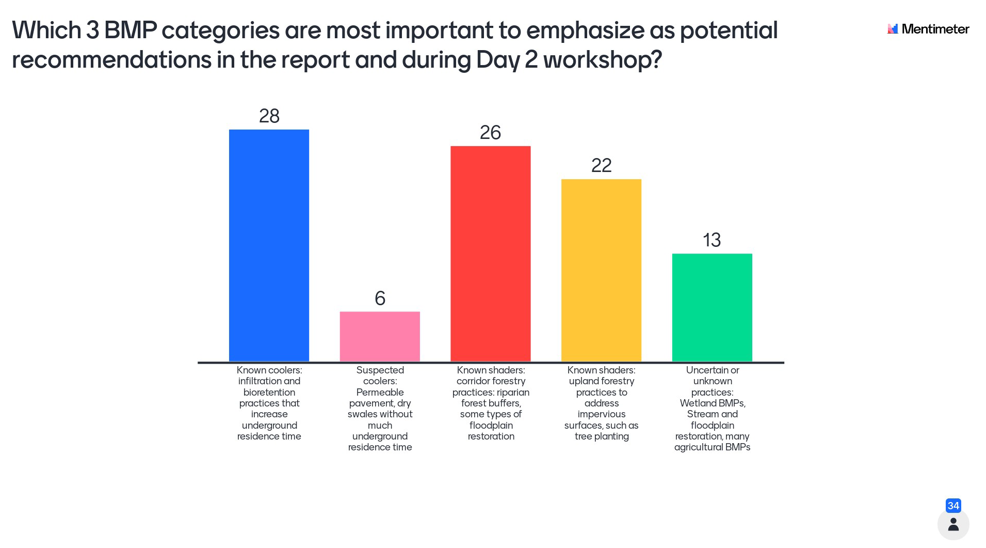

Slide 9
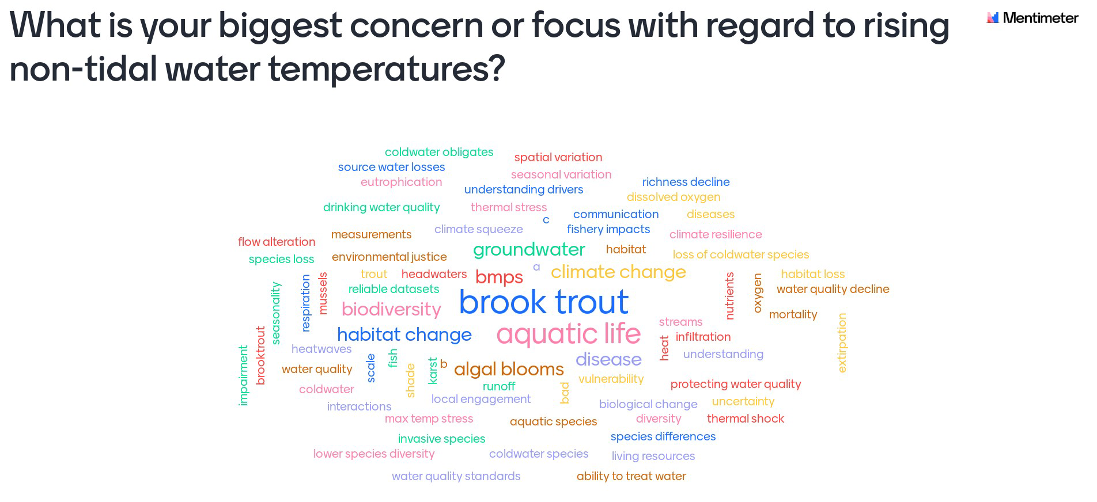

Slide 10
Draft management recommendations: Practices
Ensure rivers and streams are well buffered
Encourage implementation of “coolers” and “shaders” upstream
Minimize loss of existing forests
Discourage implementation of heating BMPs, especially in watersheds with coldwater habitats
Use habitat restoration to improve connectivity between suitable habitat patches and improve access to thermal refugia

Slide 11
Draft management recommendations: Science support
Improve understanding of the temperature impacts of BMPs
Improve understanding of the ecological impacts of incorporating temperature refugia into stream restoration design
Improve water temperature monitoring
  Need higher-frequency continuous monitoring
  Need monitoring at the air/water interface
  Improve understanding of ecological implications of rising water temperature
Improve modeling and decision support tools
  Incorporate temperature into the CHWA
  Improve capability to model local water temperature and water temperature impacts of BMPs

Slide 12
Discussion
Are there additional forestry-related recommendations we should consider adding?
Is there additional nuance we could/should add to these recommendations?
Other comments or suggestions?

