Slide 1
Quantification of BMP Impacts on CBP Management Strategies
Fostering Chesapeake Stewardship Goal Implementation Team Meeting
June 1, 2016

Slide 2


Contract
Tetra Tech awarded contract from Chesapeake Bay Trust
James Davis-Martin, Project Technical Lead
Mark Sievers, Tetra Tech Lead and Urban Lead
Steve Dressing, Agriculture Lead

Slide 3
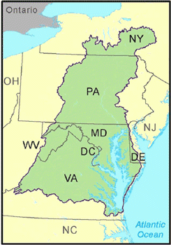
Goal
To quantify the effect the Bay Model’s best management practices (BMPs) have on each management strategy to better enable jurisdictions, localities, and others to assess the impact of their watershed implementation plans on all management strategies (co-benefits or unintended consequences)

Slide 4
Intended Result
A matrix that assigns each BMP (or BMP group) an impact score for each management strategy or outcome
Management Strategy | BMP 1 | BMP 2 | BMP 3 | Etc.
A | -X to +X | -X to +X | -X to +X | -X to +X
B | -X to +X | -X to +X | -X to +X | -X to +X
C | -X to +X | -X to +X | -X to +X | -X to +X
Etc. | -X to +X | -X to +X | -X to +X | -X to +X

Slide 5

Process
Early involvement of management strategy teams
General input on project
BMPs of concern
Impacts (positive and negative) of BMPs on management strategies
Ideas on assigning BMP impact scores
Information sources

Slide 6

Process
Develop narrative guidelines for assigning impact scores
Review each management strategy, focusing on the Factors Influencing Success section, to help identify and assess the factors for which BMP impacts are of greatest concern
Technical memorandum on the rationale for the guidelines
GIT and management strategy team review

Slide 7
Process
Group BMPs
Ensure consistency in assessing BMP impacts based on common features and application
Simplify presentation of results in tabular format
Matrix with all Management Strategies and BMPs

Slide 8

Process
Gather information
Management strategies
Management strategy team and GIT members
Inform and focus the search for information used in scoring impacts
BMP Panel reports
Scientific literature
Toxic contaminants study
Best professional judgment

Slide 9

Process
Assign impact scores to BMP groupings
Develop draft project report for review and comment
Final report
Final impact scores
Rationale behind the BMP groupings
Impact scoring guidelines
Appendix with a literature listing

Slide 10
Tentative Timeline
Task # | Task Description | May | Jun | Jul | Aug | Sep | Oct | Nov | Dec | Jan | Feb | Mar
1 | BMP List and Groupings |  | ✓ | ✓
2 | Impact Score Guidelines |  | ✓ | ✓
3 | Management Strategy Team Meetings | ✓ | ✓ | ✓ | ✓ | ✓ | ✓ | ✓
4 | Literature Search |  | ✓ | ✓ | ✓ | ✓ | ✓ | ✓
5 | Literature Review and Scoring |  |  |  | ✓ | ✓ | ✓ | ✓ | ✓ | ✓
6 | Final Documentation |  |  |  |  |  |  |  |  | ✓ | ✓ | ✓

Slide 11
Management Strategies
Stewardship GIT
Citizen Stewardship
Protected Lands
Public Access Site Development
Not Addressing
Students
Sustainable Schools
Environmental Literacy Planning

Slide 12
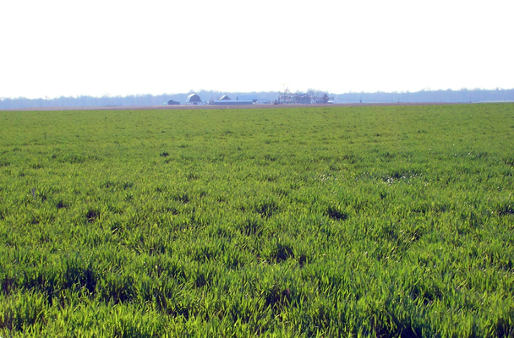
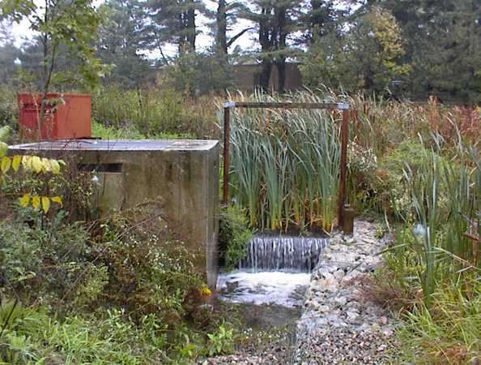
BMPs
All 453 Approved BMPs
Group BMPs with similar function and potential impacts to help simplify analysis and result presentation
Example: Cover crop
Pending Phase 6 BMPs (26 currently under development or in review)

Slide 13
Questions for You
Suggestions on impact score guidelines or how we might group BMPs in our scoring matrix?
Which specific BMP (or BMP groups) do you feel would have the greatest impact (positive or negative) on management strategy goals?
What do you think their impacts might be?
Do you feel they would have a great impact (positive or negative)?
What are the top impacts that concern you?

Slide 14

Questions for You
Do you have any information sources that you can provide us or direct us to for this project?
Are there specific individuals on the GIT or management strategy team we should contact for assistance?

Slide 15

Communications
Send all information and inquiries to Mark Sievers, Tetra Tech
mark.e.sievers@tetratech.com
703-385-2605

Slide 16

Discussion

