Slide 1

Achieving the Goal of Stewardship
2014 Chesapeake Watershed Agreement

Slide 2

Meeting Purpose and Agenda
Review task at hand
Seek feedback on what would be the most useful for Bay Community
Ensure this effort builds on, complements related measurement/tracking efforts
Notes:
Jamie

Slide 3

What is the Stewardship Goal?
“Increase the number and diversity of local citizen stewards and local governments that actively support and carry out conservation and restoration activities that achieve healthy local streams, rivers and a vibrant Chesapeake Bay.”
Notes:
Amy/Kristin

Slide 4
Why is this outcome important?
It is the people part of the new Bay Agreement
Restoration actions must be widespread-- a thousand cuts/a thousand solutions.
Local government needs support from its residents to act.
Many other outcomes and management strategies also rely on broad grass roots action.
This has not been a direct emphasis of the Chesapeake Bay Program in the past.
Notes:
Amy/Kristin

Slide 5
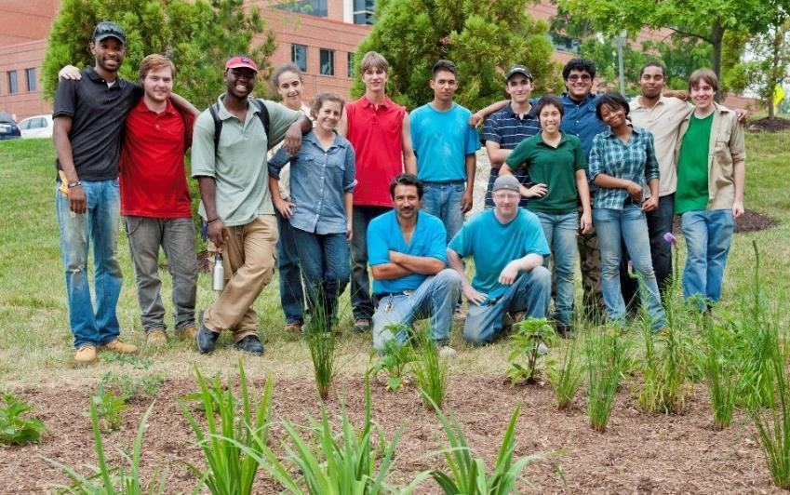
Citizen Stewardship Outcome
Increase the number and diversity of trained and mobilized citizen volunteers with the knowledge and skills needed to enhance the health of their local watersheds.
Notes:
Amy/Kristin

Slide 6
Citizen Stewardship Framework
Increasing citizen actions for watershed health
Community Leaders/ Champions
Mobilize/Increase
Volunteerism/ Collective Community Action
Knowledge & skills
Individual Citizen Actions
and Behaviors
Increasingly Environmentally Literate Population (Elit Goal)
Notes:
Amy/Jamie

Slide 7

















Examples
Community Leaders Taking Action
Community Conservation Projects by Volunteers
Changing Behavior/Adopting BMPs
Notes:
Amy/Jamie

Slide 8

Why Measure Progress?
Collect and share data that is useful to practitioners in informing program design and improvements
Predict/quantify/prioritize the water quality and other engagement values of stewardship programs and citizen actions.
Provide an accurate and easily (relatively) scalable baseline of stewardship actions
Increase/maintain support for investments in citizen stewardship efforts.
Notes:
Jamie

Slide 9
How do we Measure Progress?
Community Leaders/ Champions
Mobilize/ Increase
Stewardship Index
Tracking Data?
Volunteerism/ Collective Community Action
Tracking Data?
Knowledge & skills
Individual Citizen Actions
and Behaviors
Behavior Index, Tracking Data?
Increasingly Environmentally Literate Population (Elit Goal)
ELIT Tool
Notes:
Jamie

Slide 10
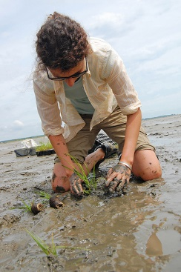
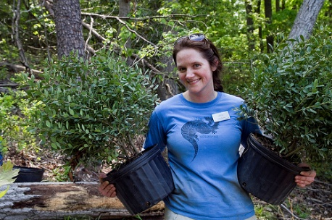
Photos Courtesy Chesapeake Bay Program
STEWARDSHIP INDEX
Notes:
Transition to Steve
Acknowledge need to measure all three levels of stewardship. Explain why we are starting with behavior.

Slide 11
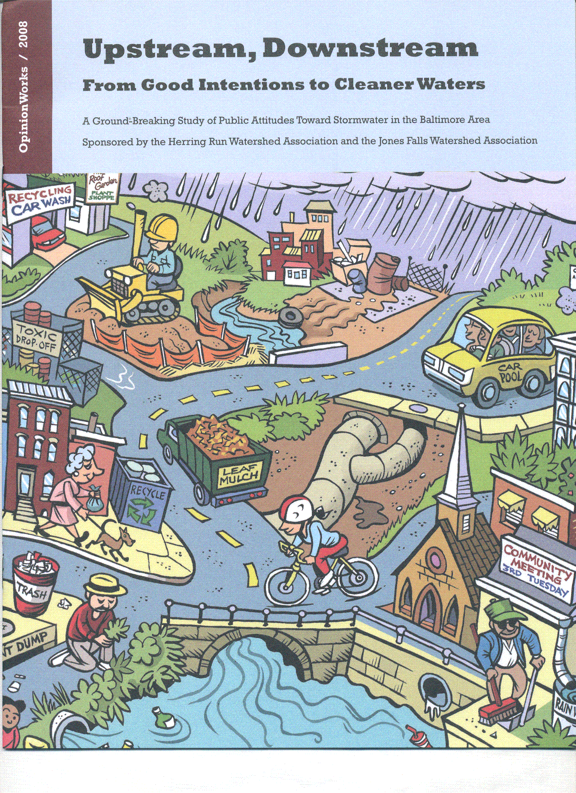

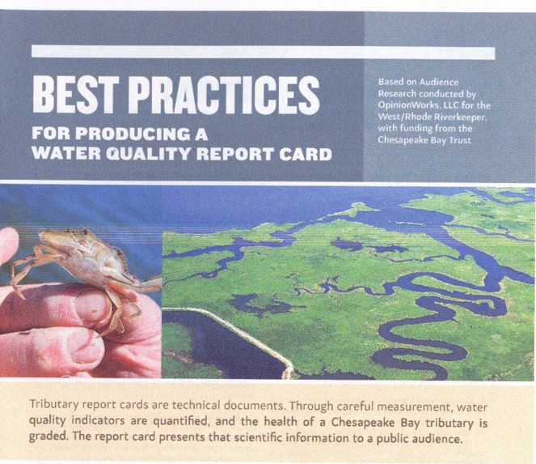
Annapolis-based, since 2001
Measure perceptions, behaviors
Random samples, focus groups
Chesapeake Bay Trust
Extensive work assessing public behavior
District Department of the Environment
Resident/business reaction to 5-cent bag fee
Virginia Cooperative Extension
Attitudes about sustainable lawn care
Delaware Nature Society
Citizen attitudes about proposed clean water fee
Horizon Foundation & Partners
Complex study on health behavior & risk factors
The Baltimore Sun newspaper (2007-present)
Notes:
Steve: Brief credentialing

Slide 12
Will People Be Taxed When It Rains?
“Is it true or false to say that the {stormwater fee/rain tax} will tax people for the rain
that falls on their rooftops and driveways?” (Maryland voters; Feb 28 – Mar 8, 2015)
Notes:
Steve: Just a quick sideline to demonstrate random sampling and because this group should know this number.

Slide 13
Engaging the Public in Stewardship Can Water Pollution be Fixed?
Maryland
“When you think about pollution in our local waters, do you think the problem can be fixed or is it too difficult?” (Maryland voters; Feb 28 – Mar 8, 2015)
Notes:
Steve: Fresh numbers to demonstrate that the vast majority of the public is willing to be engaged in stewardship.

Slide 14
Engaging the Public in Stewardship Can Water Pollution be Fixed?
Delaware
“When you think about pollution in our local waters, do you think the problem can be fixed or is it too difficult?” (Delaware adults; Dec 3 – 9, 2014)
Notes:
Steve: Fresh numbers to demonstrate that the vast majority of the public is willing to be engaged in stewardship.

Slide 15
“If I knew what to do
to help clean up the water,
I would do a lot more.”
– Focus Group Participant

Slide 16
What Could the Index Tell Us?
Assess penetration of behaviors
Assess likelihood of future adoption
Identify trends by audience or behavior
Segment this by jurisdiction, audience
Inform behavior selection for NGOs, jurisdictions
Identify “Show Me, Help Me, Make Me” audience segments to inform social marketing
Demonstrate progress to stakeholders, public
Notes:
Steve: Review possible purposes if behavior index to seed group’s thinking/discussion.

Slide 17

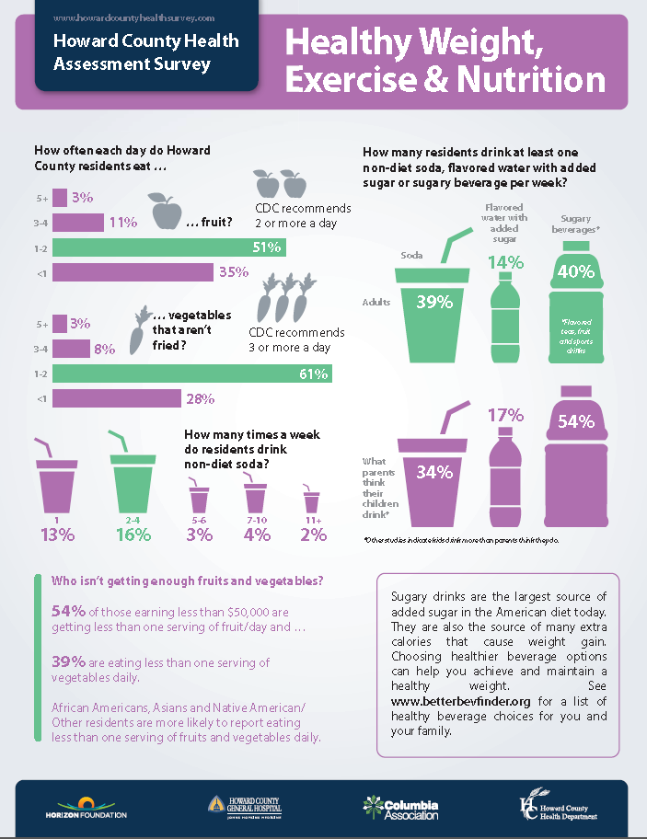

Behavioral Risk Factor Surveillance System
Mandated all 50 states
Telephone data collection
Used for many critical public health decisions
13,011 interviews in MD (2013)
7,398 in VA (2012)
19,958 in PA (2012)
OpinionWorks reproduces
this methodology with
2,000 bi-lingual interviews
in Howard County, MD
for health advocates
Notes:
Steve: Brief overview of CDC-mandated public health data collection and uses.

Slide 18

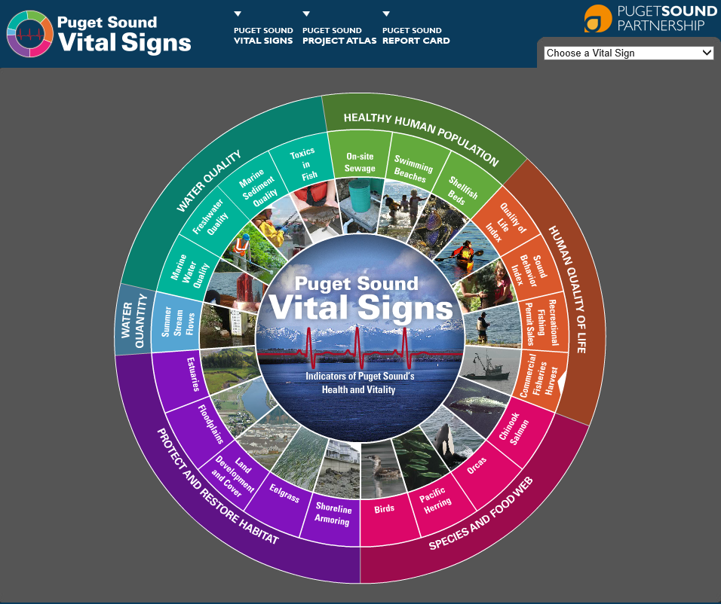
Puget Sound
Behavior Index
Assesses 28 behaviors
Telephone data collection
Stratified for 12 jurisdictions
Conducted biennially
3,131 interviews (2013)
Drives decision-making
Measures progress
Great attention focused on SBI
Notes:
Steve: Brief overview of Puget Sound Behavior Index.

Slide 19
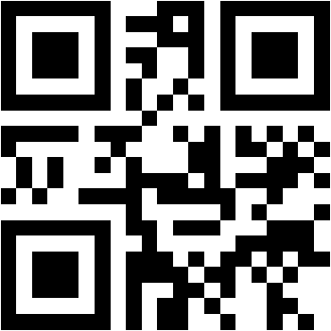
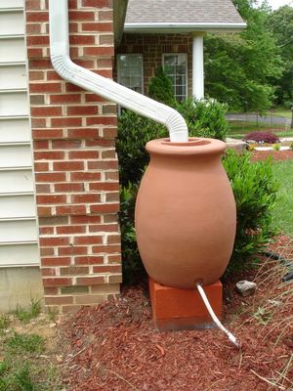
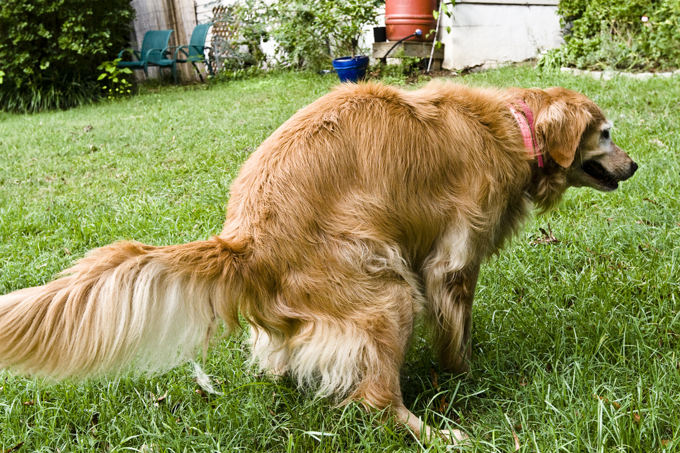

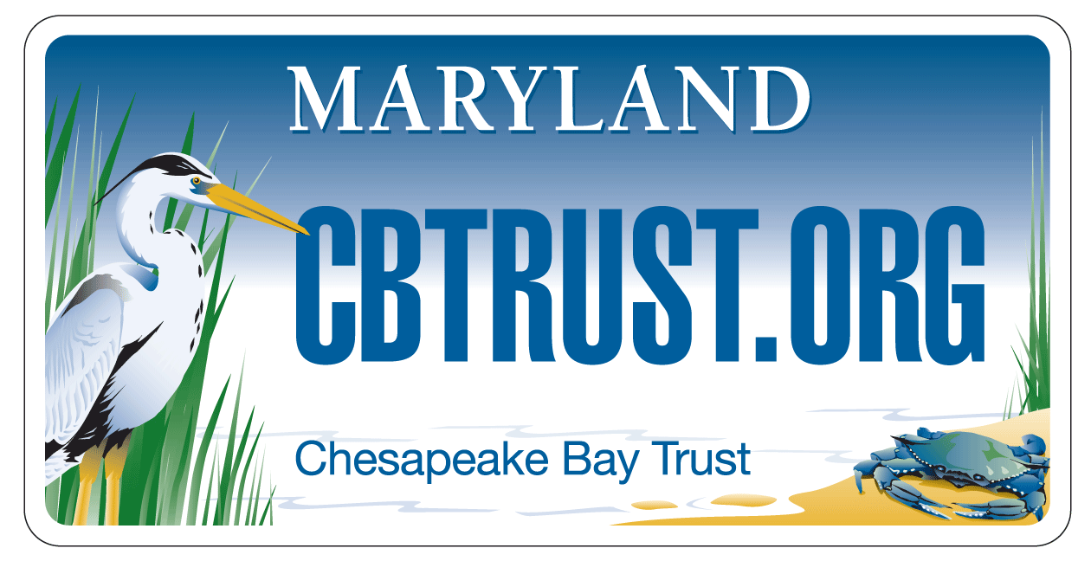
www.BaySurvey.org
Notes:
Steve: Mention BaySurvey.org as predecessor to upcoming behavior index.

Slide 20
BAY STEWARDSHIP INDEX
SCOPE
Ultimately measure all 3 levels of stewardship
Pilot scope under this budget
Road map for Leadership and Volunteer levels
Design/pilot data collection for Behavior level
Notes:
Steve: Overview of overall scope

Slide 21
BEHAVIOR INDEX
Telephone-based probability sample
Landline and cell phones
English and Spanish as needed
2,000+ interviews
Behavior selection
Methodology and scale
Questionnaire development and testing
Field interviewing
Index calculation
Notes:
Steve: Behavior index scope

Slide 22
TIMELINE
Phase 1: Develop Framework
(March – April)
Phase 2: Develop Behavior Survey Tool
(April – June)
Phase 3: Field Interviewing
(July – Aug)
Phase 4: Analysis & Presentation/
Recommendations for Follow-up
(Sept – Nov)
Notes:
Steve: Project timeline

Slide 23
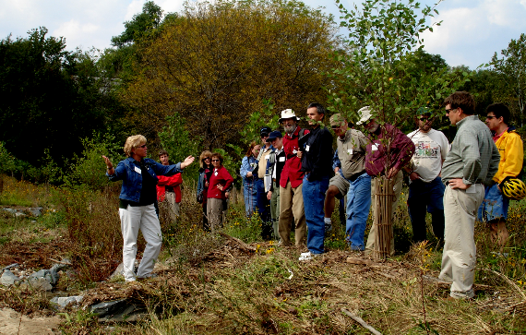
Citizen Stewardship – Key points
Increase the number and diversity of trained and mobilized citizen volunteers with the knowledge and skills needed to enhance the health of their local watersheds.
Citizen stewards
Individual Behaviors
Volunteers
Local champions
Notes:
Thought we would put this up at the beginning of the feedback session as a reminder of what we are measuring progress against.
Discussion questions will be facilitated here.

Slide 24
Next Steps
Next Meeting – Late April/May
Presentation of existing measurement/tracking efforts relevant to this work
Present DRAFT indicator framework
Seek feedback on development of the behavior index
Other ways to stay engaged
Notes:
Jamie will conclude meeting with this slide

