Slide 1
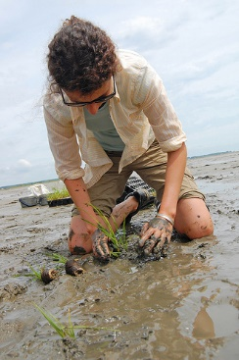
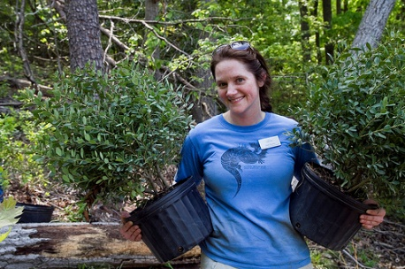
Photos Courtesy Chesapeake Bay Program
Chesapeake Bay
Stewardship
Indicator
Notes:
Kacey

Slide 2

Stewardship Outcome
“Increase the number and diversity of trained and mobilized citizen volunteers with the knowledge and skills needed to enhance the health of their local watersheds.”
Notes:
Kacey

Slide 3
Citizen Stewardship Framework
Increasing citizen actions for watershed health
Community Leaders/ Champions
Mobilize/Increase
Volunteerism/ Collective Community Action
Knowledge & skills
Individual Citizen Actions
and Behaviors
Increasingly Environmentally Literate Population (Elit Goal)
Notes:
Kacey

Slide 4

Why Measure Stewardship?
Track progress in engaging the public
Design social marketing campaigns for BMP adoption and behavior change
Improve strategic communications to build public support for Bay restoration work
Prioritize investments in citizen-led action
Improve local decision-making
Notes:
Kacey

Slide 5
Stewardship Behavior
Criteria
Involves individual decision-making
Is repetitive and can be tracked over time
Can be broadly adopted
Not just by experts
Not pre-emergent
Has an impact on water health
And/or will engage the public
Notes:
Kacey

Slide 6
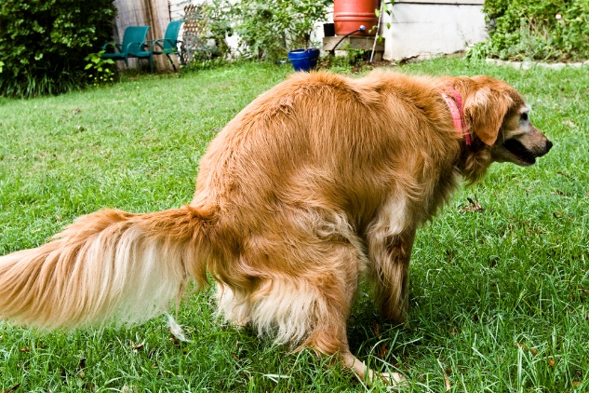
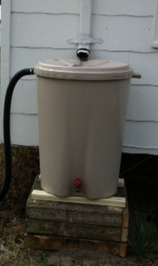
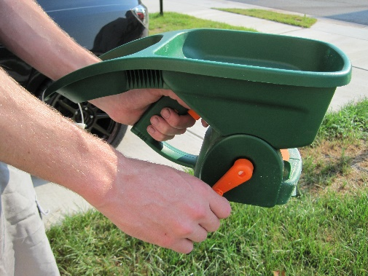
Measured Behaviors
Pet waste (2: on property/off property)
Leaves/Lawn clippings (2)
Litter (2: drop/pick-up)
Fats, grease/Medicines down the drain (2)
Fertilizer use/keep off hard surfaces (2)
Pesticide/Herbicide use (2)
Conservation landscaping
Rain garden installation
Septic system
Tree planting
Downspout redirect
Rain barrel/Connected, emptied (2)
Water conservation
Notes:
Kacey

Slide 7
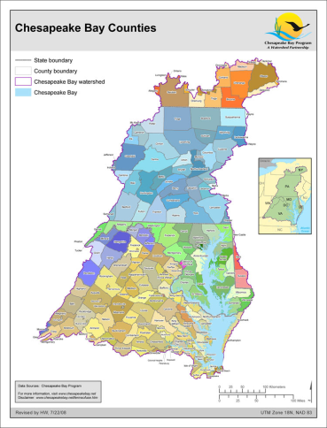
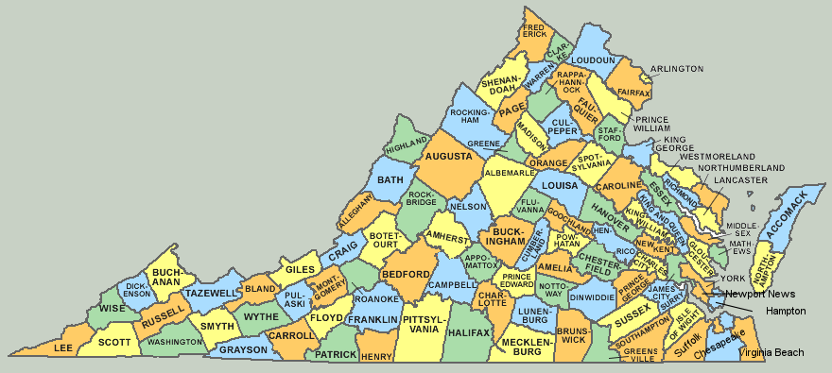
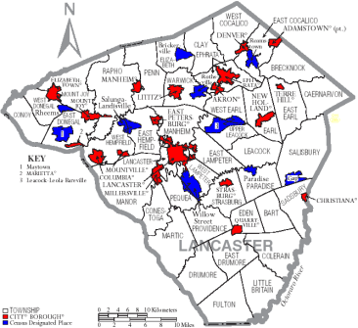
What This Survey Tool Can Do
Measure and track Stewardship progress.
Inform smart behavior selection for practitioners.
Segment data by major jurisdiction, demographic.
Be a resource for other Bay Program priorities: Access, Diversity.
Notes:
Kacey

Slide 8
What This Survey Tool is Not
The citizen stewardship index will NOT verify implementation of behaviors or practices per Bay Program protocols. Other tools like the Smart Tracker exist for this purpose.
It will NOT answer why questions.
It will NOT measure public policy preferences.
It will not measure perceptions and attitudes, except those that directly drive stewardship behavior.
Notes:
Kacey

Slide 9
Citizen Stewardship Indicator
Sampling Methodology
 | 2017 Baseline
 | All states statistically significant N=5,212
VA | 1,001 (±3.1%)
MD | 1,005 (±3.1%)
PA | 1,003 (±3.1%)
DC | 801 (±3.5%)
WV | 600 (±4.0%)
NY | 400 (±4.9%)
DE | 402 (±4.9%)
Fielded March – May 2017
13-minute interview
Wireless and Landline
Spanish language interviewing
Notes:
Steve

Slide 10
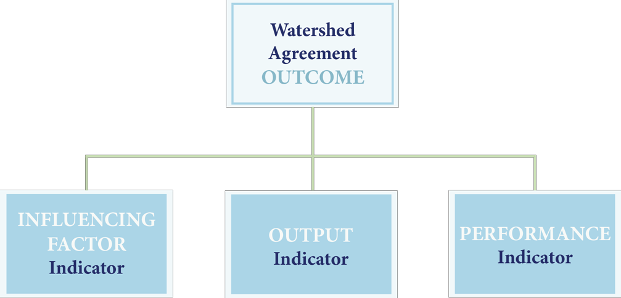
Chesapeake Bay Program Indicators Framework
Approved November 2015 Management Board Meeting
Information Support
Three information types are needed to support adaptive management and communication needs.
Influencing Factors – What KEY influencing factors are impacting the achievement of an outcome?
Outputs – Are we doing what we said we would do in our work plans and management strategies?
Performance – Are we achieving the outcome?

Slide 11
Citizen Stewardship Indicator
Survey Content
Stewardship Behaviors: Personal Actions
Volunteering: Collective Actions
Civic Engagement: Advocating
Likelihood to Take Personal Actions
Likelihood to Volunteer and Advocate
Individual Engagement: Motivating Attitudes

Slide 12
If people work together, water pollution around here can be fixed. Level of Agreement
Citizen Stewardship Indicator: 2017 Final Baywide Data
86% agree

Slide 13
My actions contribute to water pollution where I live. Level of Agreement
Citizen Stewardship Indicator: 2017 Final Baywide Data
35% agree

Slide 14
Volunteerism
Citizen Stewardship Indicator: 2017 Final Baywide Data

Slide 15
Individual Behavior
Measurement
Notes:
Kacey

Slide 16
Negative Behaviors
Citizen Stewardship Indicator: 2017 Final Baywide Data
Desired = Never/No, or Seldom

Slide 17
Positive Behaviors: Higher Tier
Citizen Stewardship Indicator: 2017 Final Baywide Data
Desired = Always/Very Frequently/Yes Sometimes

Slide 18
Positive Behaviors: Lower Tier
Citizen Stewardship Indicator: 2017 Final Baywide Data
Desired = Always/Very Frequently/Yes Sometimes

Slide 19
Segmentation Opportunities
Jurisdiction
Age
Educational attainment
Health status (self-assessed)
Household size, presence of children
Home ownership
Housing type
Community size
Agriculture
Religious affiliation, worship frequency
Race/ethnicity
Household income
Gender

Slide 20
Focus Behavior: Picking up Dog Waste
Citizen Stewardship Indicator: 2017 Final Baywide Data
For each of the following things, please tell me if you never, seldom, sometimes,
usually, or always do it.
Pick up your dog’s waste and dispose of it in the trash when you are…
…On your own property.
…Off your property.

Slide 21
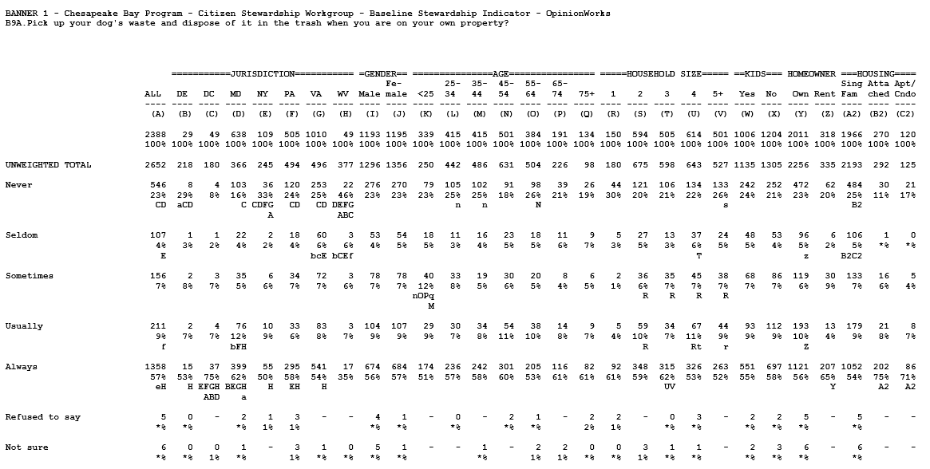

Slide 22
Focus Behavior: Picking up Dog Waste
Citizen Stewardship Indicator: 2017 Final Baywide Data
For each of the following things, please tell me if you never, seldom, sometimes,
usually, or always do it.
Pick up your dog’s waste and dispose of it in the trash when you are…
…On your own property.

Slide 23
Behaviors More Susceptible to Change Asked Only of Those Not Taking the Desired Action Today
Citizen Stewardship Indicator: 2017 Final Baywide Data
Looking forward over the next year or so, how likely are you to do each of these things using the scale
(rotate high to low/low to high): [very likely, somewhat likely, (or) not likely]?

Slide 24
Behaviors Less Susceptible to Change Asked Only of Those Not Taking the Desired Action Today
Citizen Stewardship Indicator: 2017 Final Baywide Data
Looking forward over the next year or so, how likely are you to do each of these things using the scale
(rotate high to low/low to high): [very likely, somewhat likely, (or) not likely]?

Slide 25
Focus Behavior: Picking up Dog Waste “Very Likely” to Begin Picking Up
Citizen Stewardship Indicator: 2017 Final Baywide Data
Looking forward over the next year or so, how likely are you to do each of these things using the scale very likely, somewhat likely, or not likely?
Pick up your dog’s waste and dispose of it in the trash when you are…
…On your own property.

Slide 26
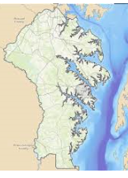
Behaviors Susceptible to Change Asked Only of Those Not Taking the Desired Action Today
Citizen Stewardship Indicator: Anne Arundel County
Looking forward over the next year or so, how likely are you to do each of these things using the scale
(rotate high to low/low to high): [very likely, somewhat likely, (or) not likely]?

Slide 27
Stewardship Score:
Performance Indicator
Individual Behavior¹ | 38.49
Volunteerism² | 22.63
Civic Engagement³ | 18.51
Rollup | 24.15
Bay-wide, based on 2017 Baseline data to date
¹19 behaviors, weighted for water impact and % of population that could perform each behavior
²Volunteered, given money for water restoration, or aware of a group in their local community
³Spoken out on behalf of an environmental cause

Slide 28
Influencing Factors
Scoring
Individual Behavior Likelihood¹ | 24.83
Volunteerism/Civic Engagement Likelihood² | 61.79
Individual Engagement³ | 62.02
Bay-wide, based on 2017 Baseline Data
¹19 behaviors, weighted broadly for water impact and % of population that could perform each behavior
²Three predictive factors
³Contextual factors predictive of individual engagement

Slide 29
Choosing the Right Behavior to Influence
Behavior Weighting:
Impact of the Behavior on Water Quality
x
Inverse of the Penetration (Level of Adoption) in the Community
x
Likelihood the Public will Adopt the Behavior
Notes:
Steve/Kacey

Slide 30
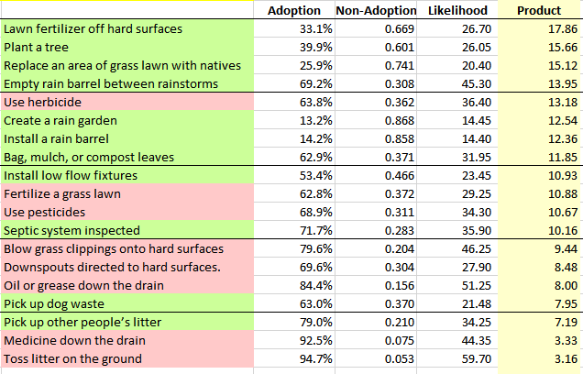
Citizen Stewardship Indicator: 2017 Final Baywide Data
Adoption = Percentage of the population performing a positive behavior
(at least sometimes) or not performing a negative behavior (seldom or never)
Notes:
Steve/Kacey

Slide 31
Recommendations: Behavior Adoption
Behavior Weighting must be completed with impact data
Recommendations:
Funders, Local governments, NGOs need the behavior weighting formula to be completed in order to further inform behavior change campaign efforts
Notes:
Kacey

Slide 32
Recommendations: Behavior Adoption
Behaviors that have a significant positive impact on clean water are less commonly adopted than behaviors that have a comparatively minor impact on clean water. Recommendations:
Local governments and NGOs need to be trained to:
understand audience needs and methods for gaining insight
Increase willingness to work with the priority audience
design programs that provide innovative services that are designed to overcome audience barriers to behavior adoption
Notes:
Kacey

Slide 33
Recommendations: Behavior Adoption
Behaviors that have a significant positive impact on clean water are less commonly adopted than behaviors that have a comparatively minor impact on clean water. Recommendations:
Increasing effective behavior change campaign design and sharing through regional forums
Encourage and incentivize regional common branding across jurisdictions
Increase use of social science tools, such as social diffusion and social normative messaging
Notes:
Kacey

Slide 34
Recommendations: Civic Engagement
Less than half of people actively get involved in their community and of those a very small percentage are involved related to environmental issues.
Recommendations:
NGOs need skill building on community engagement models and when to employ them; there a number of successful engagement models that: build coalitions, engage the faith community, and involve residents
Notes:
Kacey

Slide 35
Recommendations: Volunteerism
Only 32% of public can name an organization in their area that is cleaning and protecting the natural environment
Recommendations:
NGOs need training to create informed communications campaigns to target audiences
Innovate new ways to connect people with opportunities in their community - concept test new volunteerism program models
Notes:
Kacey

Slide 36
Stewardship Indicator Accessibility
Overview of data access methods:
Methodology document
Raw data
On-line Public Dashboard – In process
Segment data
Create correlations
Customize reports
Notes:
Kacey

