Slide 1

Achieving the Goal of Stewardship
2014 Chesapeake Watershed Agreement

Slide 2

Meeting Purpose and Agenda
Review task at hand
Seek feedback on what would be the most useful for Bay Community
Ensure this effort builds on, complements related measurement/tracking efforts
Notes:
Jamie

Slide 3

What is the Stewardship Goal?
“Increase the number and diversity of local citizen stewards and local governments that actively support and carry out conservation and restoration activities that achieve healthy local streams, rivers and a vibrant Chesapeake Bay.”
Notes:
Amy/Kristin

Slide 4
Why is this outcome important?
It is the people part of the new Bay Agreement
Restoration actions must be widespread-- a thousand cuts/a thousand solutions.
Local government needs support from its residents to act.
Many other outcomes and management strategies also rely on broad grass roots action.
This has not been a direct emphasis of the Chesapeake Bay Program in the past.
Notes:
Amy/Kristin

Slide 5
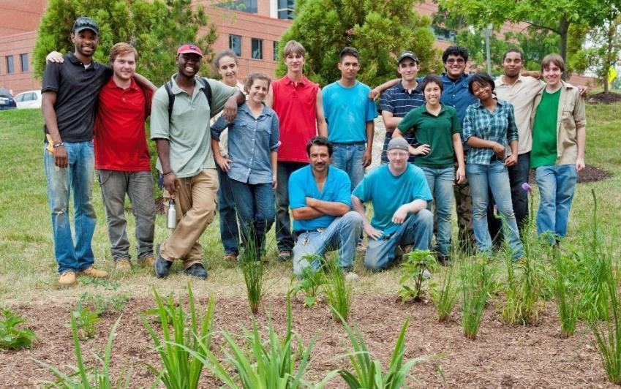
Citizen Stewardship Outcome
Increase the number and diversity of trained and mobilized citizen volunteers with the knowledge and skills needed to enhance the health of their local watersheds.
Notes:
Amy/Kristin

Slide 6
Citizen Stewardship Framework
Increasing citizen actions for watershed health
Community Leaders/ Champions
Mobilize/Increase
Volunteerism/ Collective Community Action
Knowledge & skills
Individual Citizen Actions
and Behaviors
Increasingly Environmentally Literate Population (Elit Goal)
Notes:
Amy/Jamie

Slide 7

















Examples
Community Leaders Taking Action
Community Conservation Projects by Volunteers
Changing Behavior/Adopting BMPs
Notes:
Amy/Jamie

Slide 8

Why Measure Progress?
Collect and share data that is useful to practitioners in informing program design and improvements
Predict/quantify/prioritize the water quality and other engagement values of stewardship programs and citizen actions.
Provide an accurate and easily (relatively) scalable baseline of stewardship actions
Increase/maintain support for investments in citizen stewardship efforts.
Notes:
Jamie

Slide 9
How do we Measure Progress?
Community Leaders/ Champions
Mobilize/ Increase
Stewardship Index
Tracking Data?
Volunteerism/ Collective Community Action
Tracking Data?
Knowledge & skills
Individual Citizen Actions
and Behaviors
Behavior Index, Tracking Data?
Increasingly Environmentally Literate Population (Elit Goal)
ELIT Tool
Notes:
Jamie

Slide 10
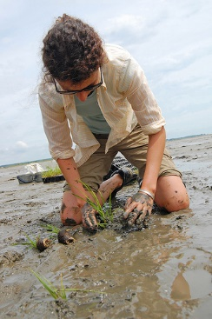
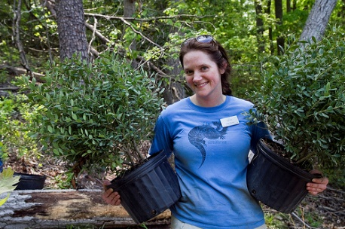
Photos Courtesy Chesapeake Bay Program
STEWARDSHIP
INDICATOR
Notes:
Transition to Steve

Slide 11
MEASURING STEWARDSHIP:
PROJECT SCOPE OF WORK
Community Leaders/ Champions
Product 1
Develop and field trackable Behavior Index
Volunteerism/ Collective Community Action
(Behavior Index)
Knowledge & skills
Individual Citizen Actions
and Behaviors
Behavior Index
Notes:
Product 1 is Behavior Index.
Will do a good job of measuring individual actions through a population-based sample.
Can do a modest job of measuring volunteerism (self-reported).

Slide 12
BEHAVIOR INDEX
Telephone-based probability sample
Landline and cell phones
English and Spanish as needed
2,000+ interviews
Behavior selection
Methodology and scale
Questionnaire development and testing
Field interviewing
Index calculation
Notes:
Review Behavior Index method.

Slide 13
MEASURING STEWARDSHIP:
PROJECT SCOPE OF WORK
Community Leaders/ Champions
Product 2
Road Map:
How to measure these two levels
with accuracy
Volunteerism/ Collective Community Action
Knowledge & skills
Individual Citizen Actions
and Behaviors
Behavior Index
Notes:
Product 2 is a “road map” to accurately measure the top two levels of stewardship.

Slide 14
TIMELINE
Phase 1: Develop Framework
(March – April)
Phase 2: Develop Behavior Survey Tool & Road Map
(April – June)
Phase 3: Field Interviewing
(July – Sept)
Phase 4: Analysis & Presentation/
Recommendations for Follow-up
(Sept – Nov)
Notes:
We are ending Phase 1 and entering Phase 2.

Slide 15
What Could the Index Tell Us?
Inform Choosing the Right Behavior
Impact of the Behavior on Water Quality
x
Penetration (Level of Adoption) in the Community
x
Likelihood the Public will Adopt the Behavior
Notes:
One very useful outcome of creating the behavior index will be more informed selection by practitioners of behaviors to impact.

Slide 16
What are We Measuring?
Physical Practices (BMPs & Behaviors)
Civic Engagement (Voting, Weighing in, Etc.)
Attitudes (Concerns, Affinities, Etc.)
Volunteerism
Leadership
Notes:
Overview of the areas we will measure through this project.
Note that volunteerism will be measured partially on the

Slide 17
PRESENTATION
OF RELATED EFFORTS
Notes:
We have reviewed examples nationally (and beyond) to inform our decision-making around these questions of measurement.

Slide 18

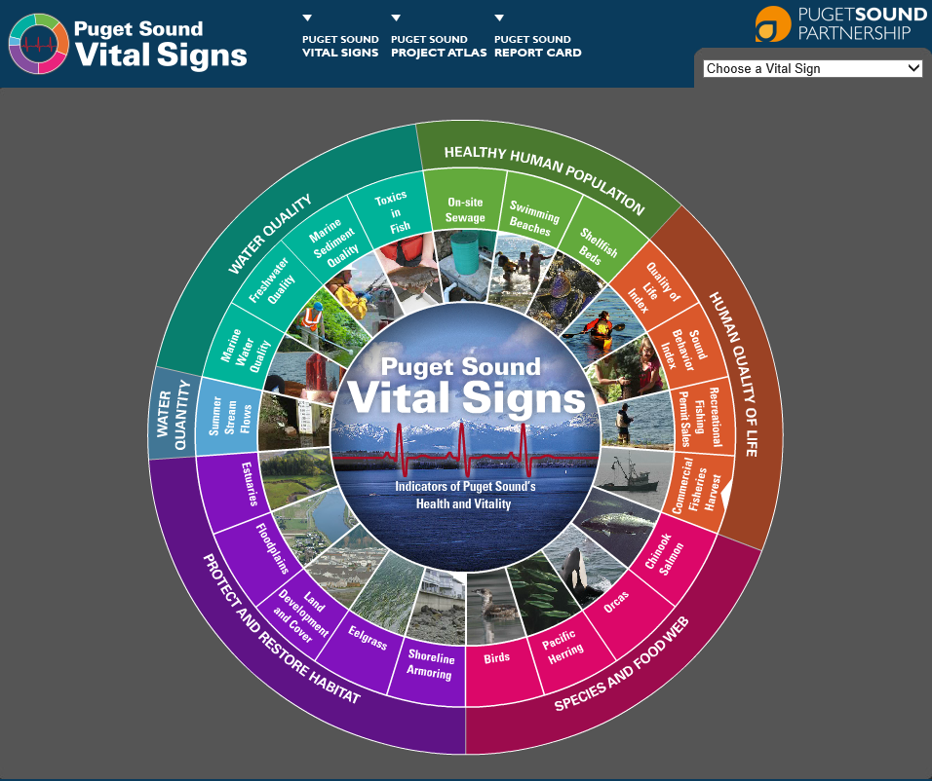
Puget Sound
Behavior Index
Assesses 28 behaviors
Telephone data collection
Stratified for 12 jurisdictions
Conducted biennially
3,131 interviews (2013)
Drives decision-making
Measures progress (2011, 2013, 2015)
Great attention focused on SBI
Notes:
Reminder that Puget Sound Behavior Index is the pioneer.

Slide 19
Puget Sound Behavior Index
Measures both positive and negative behaviors.
18-minute instrument (!)
Scale: Never, Seldom, Sometimes, Usually, Always
Measures impact more than behavior
Notes:
Scope and method.

Slide 20
Puget Sound Behavior Index
Risk in boiling it down to a single index.
2011 = 1.00
2013 = 0.83
2015 = ?.??
Guard against externalities.
Notes:
There is some risk depending on how the index moves. Take that into account in the design.

Slide 21
Puget Sound Behavior Index
Think longitudinally.
Choose measures that will move.
Swap them in and out?
If yes: Index will stay more current.
If yes: Index will jump around more.
Notes:
Must think down the road when designing the Index.

Slide 22

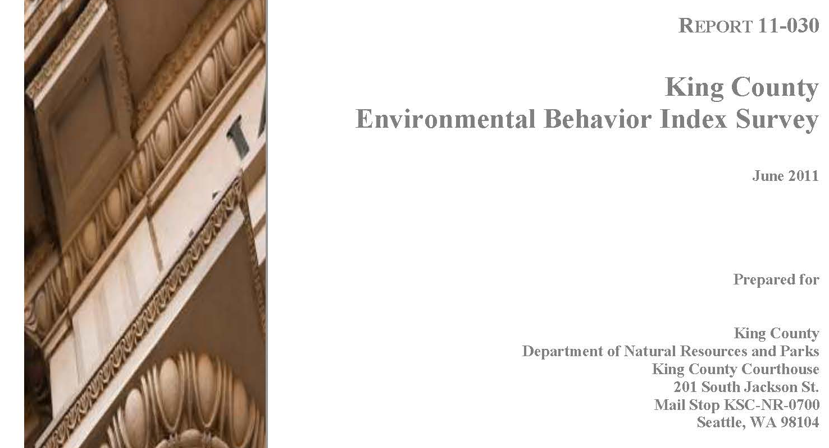
Measured 2006, 2008, 2011
Assesses 21 behaviors
Also includes some self-assessment
Blended telephone and addressed-based online data collection
1,816 interviews (2011; approx. 2/3 phone, 1/3 web)
Notes:
King County’s EBI pre-dates Sound Behavior Index.

Slide 23
King County
Environmental Behavior Survey
Multiple questions per behavior.
What do you do?
Frequency: Most or some of the time
Ever considered the target behavior?
Notes:
A lengthy and varied questionnaire. Less standardization than SBI.

Slide 24
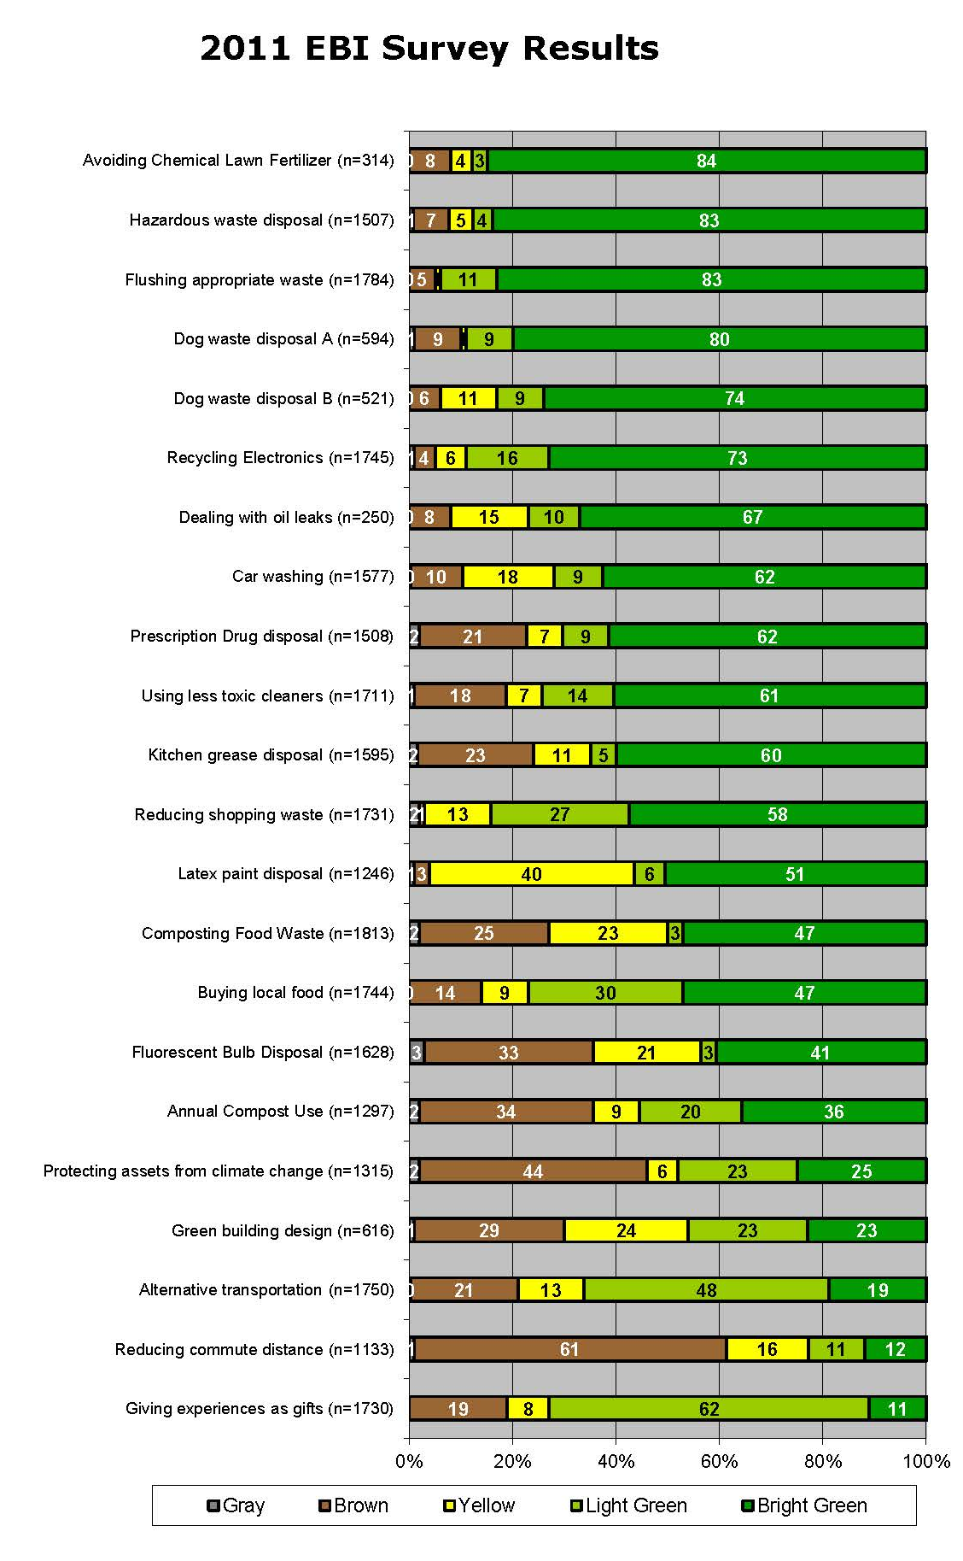
King County
Environmental Behavior Survey
Does not boil down into an index
Color-coded system.
Bright Green, Light Green, Yellow,
Brown, Gray
Notes:
Color-coded system.
Harder to interpret.

Slide 25

“an international research approach to measure
and monitor consumer progress towards environmentally sustainable consumption.”
Notes:
Greendex is a project of National Geographic.
An attempt to create a global consumption index.

Slide 26
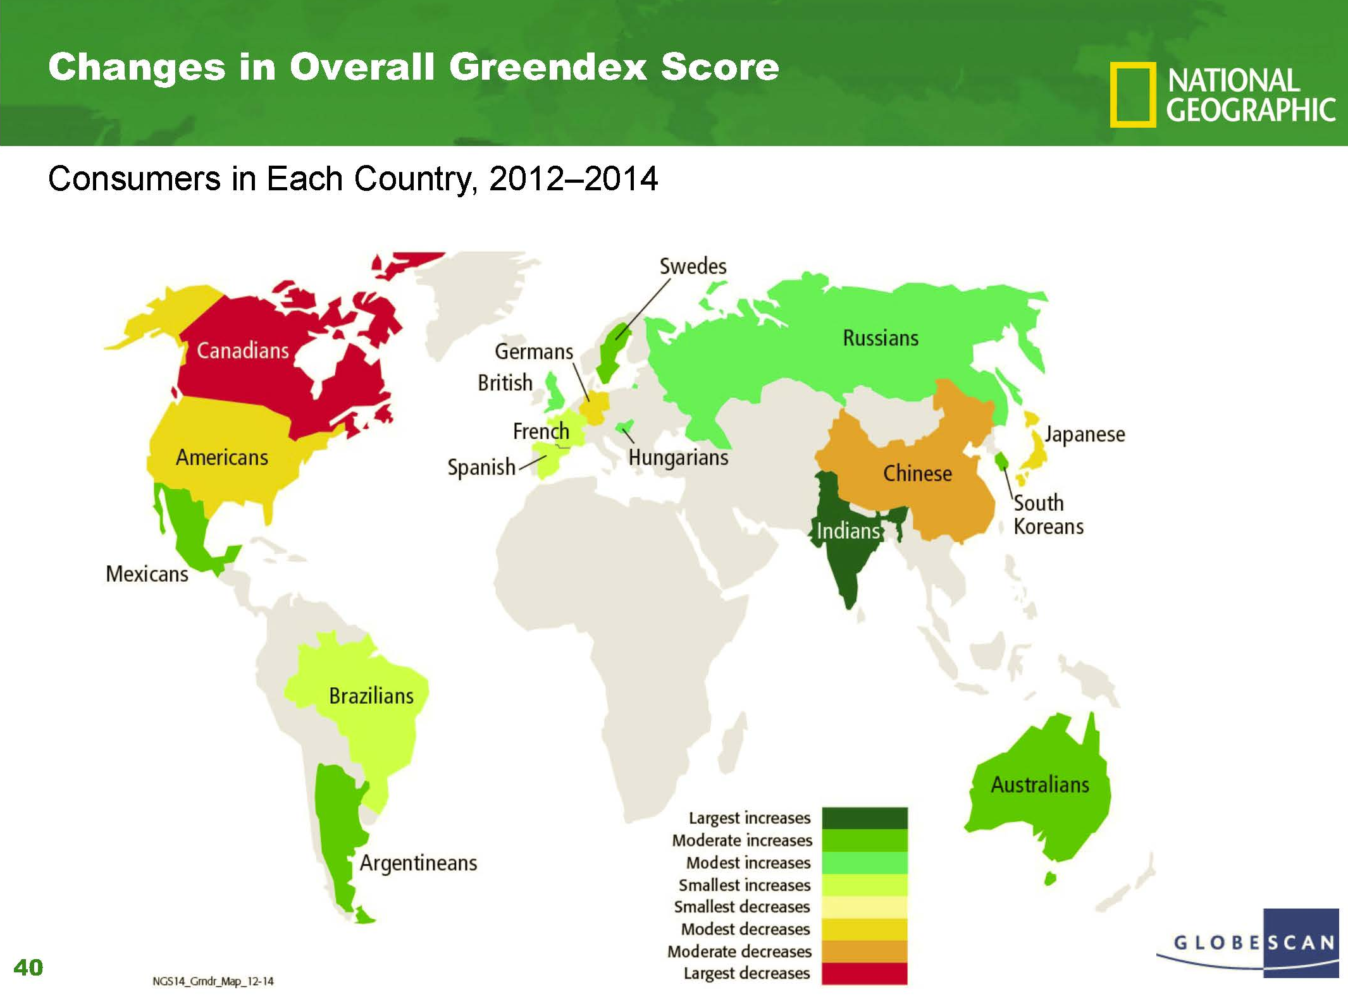
“Greendex”
Impact index.
Higher enviro impact = lower score.
Maximum score = 100.
Scoring method implies it is possible to be perfectly sustainable; authors admit this was not their intent.
Interviews collected through online panels; 1,000/country.
Notes:
Impact index; several implications.

Slide 27
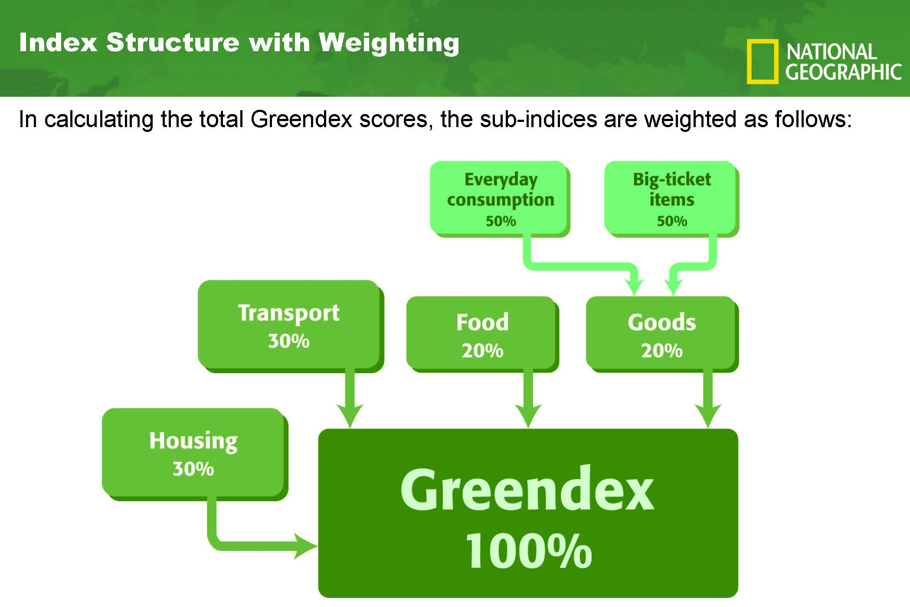
Meta-index with 4 sub-indices.
Internally weighted.
65 variables.
Notes:
Meta-index format helps protect against negative movement.

Slide 28
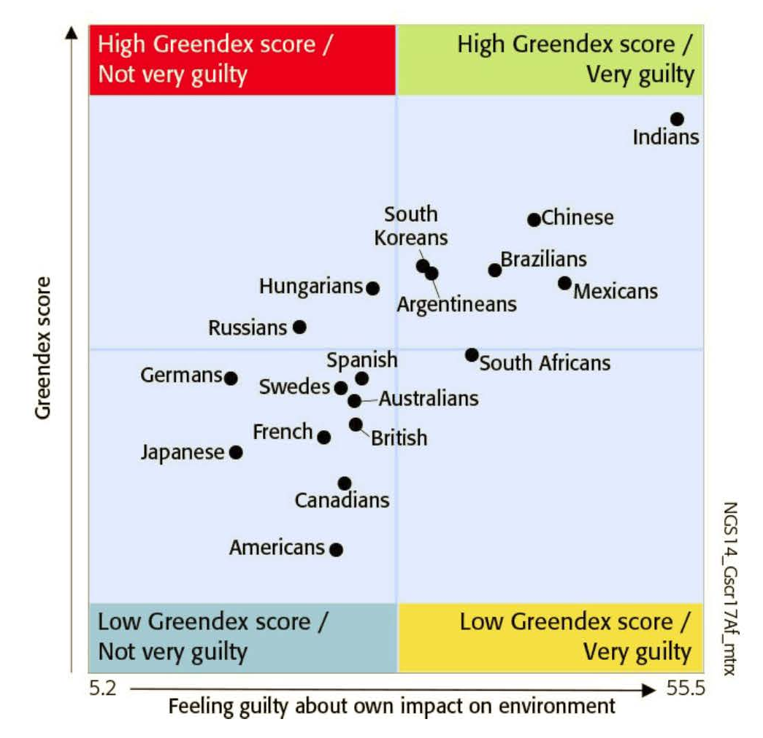
Notes:
Fun things you can do with data.
Americans feel little guilt.

Slide 29
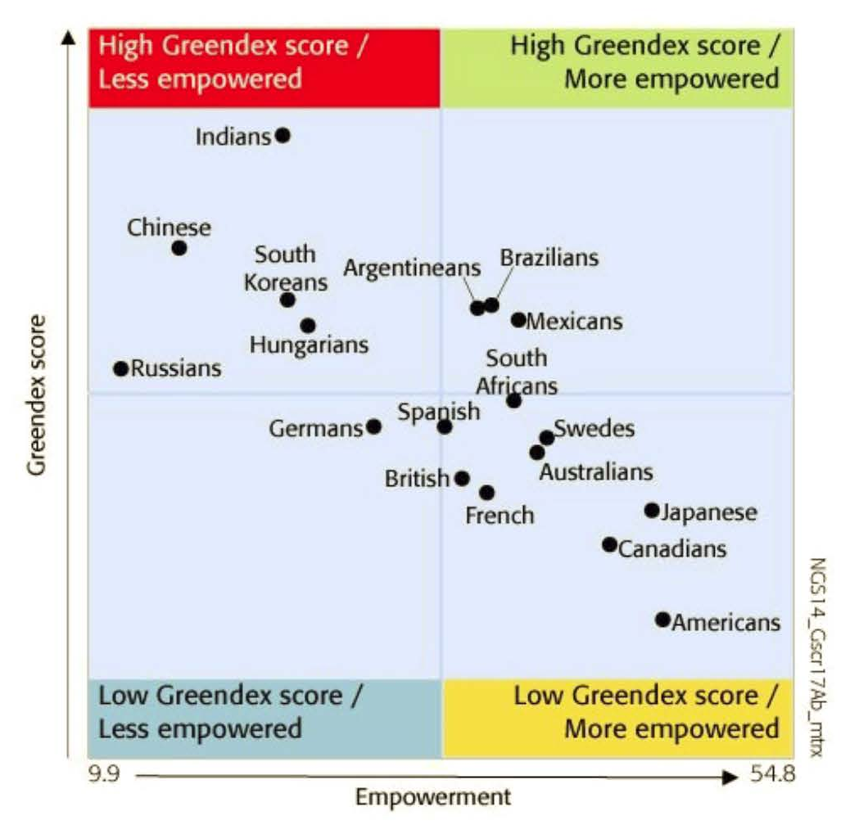
Notes:
Fun things you can do with data.
Americans feel very empowered.

Slide 30
CIVIC ENGAGEMENT
& ATTITUDINAL
MEASUREMENT
Notes:
Let’s look at some examples of civic engagement and attitudinal measurement.

Slide 31

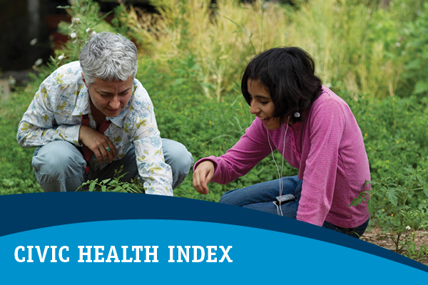
National Conference on Citizenship
Congressionally chartered
Measuring civic health nationwide
Expanded previous Census Bureau measures
Now measuring:
Voting behavior
Participation in groups
Civic discussion
Public trust
Paying attention to current events
General volunteerism
Charitable giving
Notes:
Introduce NCoC measurement.

Slide 32
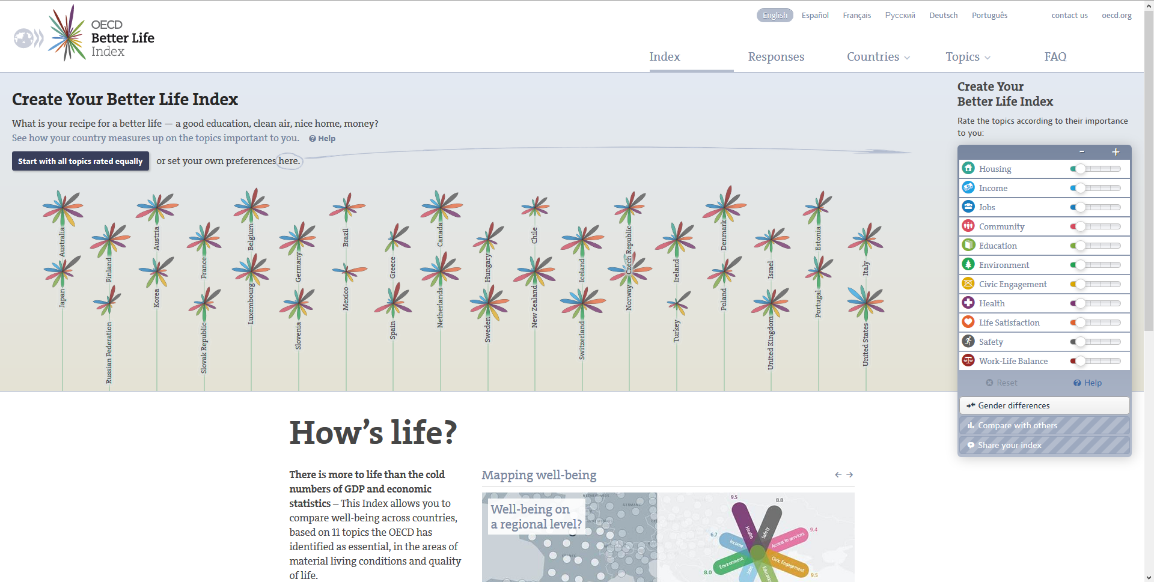
Organization for Economic Cooperation and Development
Better Life Index
Extremely Powerful
Can be customized, localized
Notes:
OECD Better Life Index very powerful measurement.

Slide 33
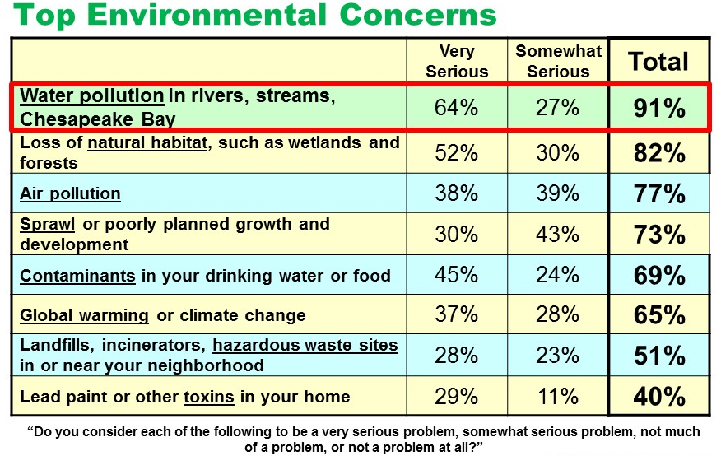
Attitudinal Measurement
Choose a short list of relevant measures.
Self-assessment of affinity for water protection
Level of concern for specific priorities
Notes:
A limited number of broad attitudinal questions may be appropriate on the pilot indicator.

Slide 34
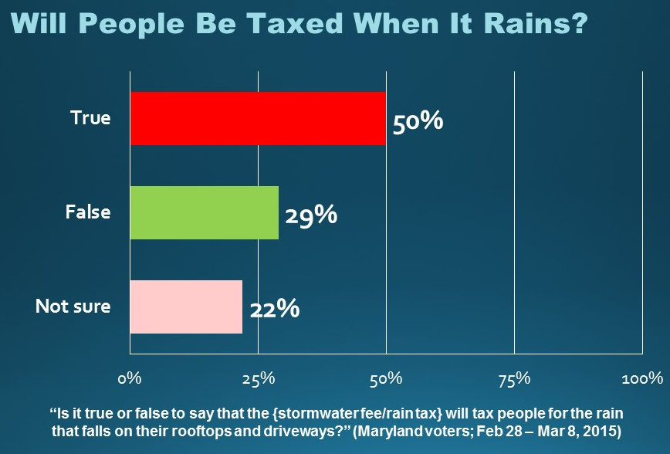
Attitudinal Measurement
What it is not (in this context).
Public policy preferences.
Hot buttons or directional measurements.
Notes:
We are not measuring policy preferences or public opinion.

Slide 35
VOLUNTEERISM
&
LEADERSHIP
Corporation for National Service
Notes:
Several examples of volunteerism measurement. Still examining them.

Slide 36
FORKS IN THE ROAD
Notes:
Several examples of volunteerism measurement. Still examining them.

Slide 37
What are We Measuring?
Physical Practices (BMPs & Behaviors)
Civic Engagement (Voting, Weighing in, Etc.)
Attitudes (Concerns, Affinities, Etc.)
Volunteerism
Leadership
Notes:
Refresh the major areas and invite feedback.

Slide 38
NEXT STEPS
Notes:
Let’s look at some examples of civic engagement and attitudinal measurement.

