Slide 1



Stream Health Outcome
Chesapeake Basin-wide Index of Biotic Integrity (“Chessie BIBI”) for Streams
Claire Buchanan
Interstate Commission on the Potomac River Basin
CBP Habitat Goal Implementation Team
October 14, 2015 meeting

Slide 2
Update and Refine Index
Management Approach 1, #1
Updated database (add 2011–present data)
Metric and index calculations
Index sensitivity
Bioregion under-representation
Genus-level metrics
Final Report expected September 2016

Slide 3
Establish 2008 Baseline and Trend Approach
Management Approach 1, #2
Required for CBP goal:
Continually improve stream health and function throughout the watershed. Improve health and function of 10 percent of stream miles above the 2008 baseline for the Chesapeake Bay watershed.
Will be done in conjunction with Technical Advisory Group
Results will be included in September 2016 Final Report

Slide 4
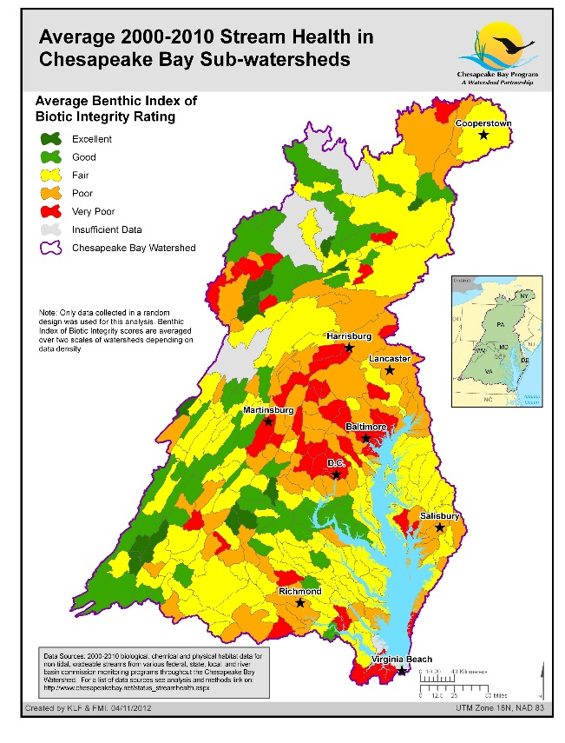
Q: How to report stream health for an entire region? Measure change?
"Figures often beguile me, particularly when I have the arranging of them myself; in which case the remark attributed to Disraeli would often apply with justice and force: 'There are three kinds of lies: lies, damned lies, and statistics.'“
Mark Twain (1906)
from Chapters From My Autobiography

Slide 5
Q: How to report stream health for an entire region? Measure change?
Three examples from the same hypothetical data set
Samples from 26 random-stratified sites are collected in 5 hypothetical watersheds (A-E), and represent an entire region
Several overlapping monitoring programs collected the data
Watersheds C and D have small areas but lots of samples. Watersheds A and E are larger but each only has a few samples
A
Station Rankings
Excellent
Good
Fair
Poor
Very Poor
B
C
D
E
Notes:
Hypothetical river basin with 5 watersheds and 26 monitoring station results.
This is a fair representation of the situation in Chesapeake Bay region, where several counties with large urban areas also monitor stream biota:
Higher resolution (+)
Biased by urban results (-)

Slide 6
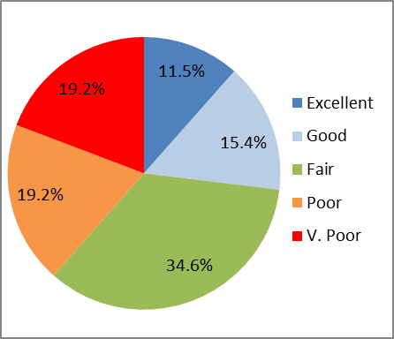
Example C
Simple summation - current CBP pie chart method
Watershed | Watershed area | # Excellent | # Good | # Fair | # Poor | # V. Poor
A | 100 | 1 | 1
B | 75 | 1 |  | 2
C | 70 | 1 | 2 | 3 | 1
D | 80 |  |  | 3 | 3 | 4
E | 140 |  | 1 | 1 | 1 | 1
SUM |  | 3 | 4 | 9 | 5 | 5
% |  | 11.5% | 15.4% | 34.6% | 19.2% | 19.2%
A
B
C
D
Conclusion:
38.5% of stream sites are Poor or Very Poor
61.5% are Fair or better
E
Notes:
Example C (current CBP method with no area-weighting)
CBP currently reports stream health this way. It simply sums up the number of sites in each rating category with no regard to the area that the rating represents.
In this example –
38.5% are Poor or Very Poor
61.5% are Fair, Good, or Excellent

Slide 7
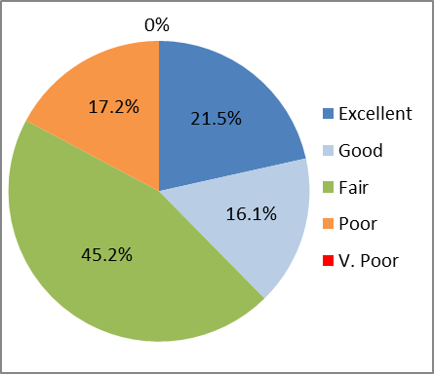
Example B
Area-weighting by watershed area using the average score – current CBP mapping approach
Watershed | Watershed area | % of total area | Average BIBI score | Ranking | Avg Score x Area
A | 100 | 21.5% | 71 | Excellent | 7100
B | 75 | 16.1% | 54 | Good | 4050
C | 70 | 15.1% | 49 | Fair | 2030
D | 80 | 17.2% | 22 | Poor | 1760
E | 140 | 30.1% | 33 | Fair | 4620
SUM | 465 | 100% |  |  | 19630
A
B
C
D
Conclusion:
17.2% of region’s area has an average score of Poor; none are V. Poor
82.8% has an average score of Fair or better
Area-weight average for region is 45.1% (Fair)
E
Notes:
Example B (area-weighting by watershed area)
The % of the entire area in each rating category is decided by the rating of the average score for each watershed and the watershed’s area. So,
Excellent: 21.5% (watershed A’s area as % of total area)
Good: 16.1% (watershed B’s area as % of total area)
Fair: 45.2% (watershed C and E’s areas summed as % of total area)
Poor: 17.2% (watershed D’s area as % of total area)
V. Poor: 0% (none of the watersheds had an average score that rated V. Poor)
In this example –
82.8% are Fair, Good, or Excellent
17.2% are Poor or Very Poor
We can also calculate a single, area-weighted score for the entire region:
calculate the average score of each watershed
multiply that number by that watershed’s area
sum all the values of [average score * watershed area] and
divide by total area to get the area-weighted score for the entire region
In this example, the area-weighted score for the entire region is 45.08, which classifies as Fair.

Slide 8
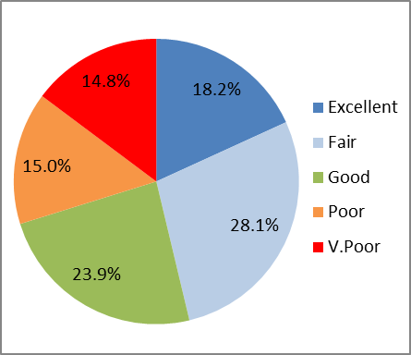
Example A
Weighting by stream miles using proportions of scores
Watershed | Tot # Stream Miles | # Excellent | # Good | # Fair | # Poor | # V. Poor
A | 159 | 1 | 1
B | 98 | 1 |  | 2
C | 83 | 1 | 2 | 3 | 1
D | 102 |  |  | 3 | 3 | 4
E | 240 |  | 1 | 1 | 1 | 1
SUM | 682 | 18.2% | 28.1% | 23.9% | 15.0% | 14.8%
A
B
C
D
Conclusion:
29.8% of stream miles are Poor or V. Poor
60.2% are Fair or better
Mile-weighted average score for region is 45.2% (Fair)
E
Notes:
Example A (weighting by stream miles)
If we assume the sample results in each watershed represent the overall condition of each watershed’s streams, then we can weight each sample by a proportion of the total stream miles in the watershed. For example:
Watershed A: each of the 2 scores is weighted by 79.5 (from 2 samples representing 159 total stream miles)
Watershed B: each of the 3 scores is weighted by 32.667 (from 3 samples representing 98 total stream miles)
Watershed C: each of the 7 scores is weighted by 11.857 (from 7 samples representing 83 total stream miles)
Watershed D: each of the 10 scores is weighted by 10.2 (from 10 samples representing 102 total stream miles)
Watershed E: each of the 4 scores is weighted by 60 (from 4 samples representing 240 total stream miles)
Sum all the individual, mile-weighted scores in each rating category and divide by the total stream miles represented in that rating category to get the proportion of stream miles in each rating category.
Rating Sum of Miles % of Total
Represented Miles
Excellent 124 18.2%
Good 191.5 28.1%
Fair 163.2 23.9%
Poor 102.5 15.0%
V.Poor 100.8 14.8%
Total 682 100%
In this example,
70.2% are Fair, Good, or Excellent
29.8% are Poor or Very Poor
Sum all the individual mile-weighted scores and divide by total stream miles to get a mile-weighted score for the entire region.
= 30812 / 682
= 45.18 or “Fair”

Slide 9
Question being addressed: | “Poor” or “Very Poor” | “Fair” or better
C. How many monitoring sites are ….? | 38.5% | 61.5%
B. How much area of an entire region has an average condition of ….? | 17.2% | 82.8%
A. How many stream miles in the entire region are probably ….? | 29.8% | 70.2%
1. You are stuck with the data you have...
2. The choice of statistic -- and how that statistic is calculated -- will reflect the underlying question. Be sure of the underlying question.

Slide 10
 | 2015 |  |  |  |  |  |  |  |  |  |  |  | 2016
Activity | Jan | Feb | Mar | Apr | May | Jun | Jul | Aug | Sep | Oct | Nov | Dec | Jan | Feb | Mar | Apr | May | Jun | Jul | Aug | Sep
Update Database (#1)
Metric and Index Calculations (#2)
Index Sensitivity (#3)
Bioregion Under-Representation (#4)
Genus-level metrics (#5)
2008 Baseline
Trends (Measure Change)
Confer with TAG
Draft and Final Reports

Slide 11

QUESTIONS?

Slide 12
Example data
Watershed | Station | Station Score | W'shed Avg Score | Stream miles in watershed | Stream miles represented by station | Station Rating
A | 1 | 66 | 71 | 159 | 79.5 | Good
A | 2 | 76 | 71 | 159 | 79.5 | Excellent
B | 3 | 35 | 54 | 98 | 32.667 | Fair
B | 4 | 42 | 54 | 98 | 32.667 | Fair
B | 5 | 85 | 54 | 98 | 32.667 | Excellent
C | 6 | 70 | 49 | 83 | 11.857 | Excellent
C | 7 | 55 | 49 | 83 | 11.857 | Good
C | 8 | 55 | 49 | 83 | 11.857 | Good
C | 9 | 46 | 49 | 83 | 11.857 | Fair
C | 10 | 45 | 49 | 83 | 11.857 | Fair
C | 11 | 49 | 49 | 83 | 11.857 | Fair
C | 12 | 23 | 49 | 83 | 11.857 | Poor
D | 13 | 39 | 22 | 102 | 10.2 | Fair
D | 14 | 40 | 22 | 102 | 10.2 | Fair
D | 15 | 32 | 22 | 102 | 10.2 | Fair
D | 16 | 20 | 22 | 102 | 10.2 | Poor
D | 17 | 24 | 22 | 102 | 10.2 | Poor
D | 18 | 29 | 22 | 102 | 10.2 | Poor
D | 19 | 8 | 22 | 102 | 10.2 | V.Poor
D | 20 | 10 | 22 | 102 | 10.2 | V.Poor
D | 21 | 4 | 22 | 102 | 10.2 | V.Poor
D | 22 | 14 | 22 | 102 | 10.2 | V.Poor
E | 23 | 58 | 33 | 240 | 60 | Good
E | 24 | 40 | 33 | 240 | 60 | Fair
E | 25 | 25 | 33 | 240 | 60 | Poor
E | 26 | 9 | 33 | 240 | 60 | V.Poor

