Slide 1
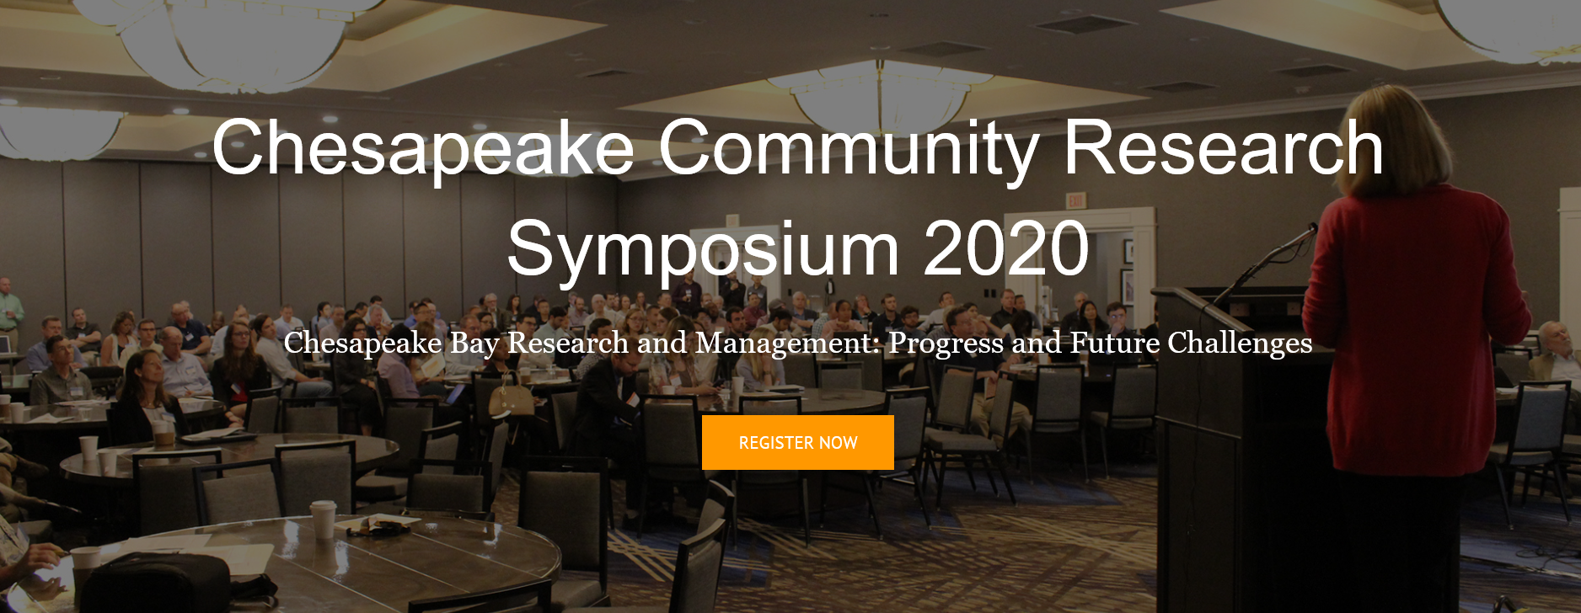
Session 16: Approaches for Maintaining and Improving Chesapeake Bay Stream and Watershed Health
The Maintain Healthy Watersheds Goal Implementation Team (GIT) and Stream Health Workgroup of the Vital Habitat GIT at the Chesapeake Bay Program are collaborating to better understand direct measures of stream health and function and how The Chesapeake Watershed Assessment may inform stream function, health, stressors, and vulnerability. These two teams have a shared goal to increase the stream health and functions of healthy waters and watersheds. The Stream Health workgroup is working to improve and implement the Bay-wide Index of Biotic Integrity metric (Chessie-BIBI) to better track and report incremental improvements at a finer scale. We will demonstrate how these efforts can complement each other towards meeting shared goals. In this session, we propose to explore the current state of the science in maintaining and improving stream and watershed health across the Chesapeake Bay Watershed. We plan to discuss emerging approaches for assessment and tracking of conditions, including consideration of key stressors such as climate change and land use. In addition, advances in stream restoration and the current status of restoration policy will be addressed. Understanding the resilience or vulnerability of stream systems is important to setting expectations and taking steps to meet Bay conservation and restoration goals. Presentations by technical experts on the following topics will be followed by discussion involving all presenters.
June 8 – 10, 2020 Virtual Symposium
Registration is Free and Open
https://ccmp2020.chesapeake.org/

Slide 2



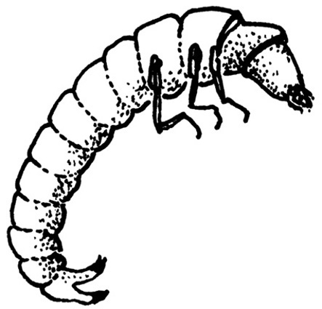
Stream Health Work Group Work Plan
Identify an appropriate suite of metrics to measure the multiple facets of stream health to complement the baywide Chessie BIBI
Action 1.3: Identify practicable metrics which are consistent with both BMP verification guidance to credit projects for N, P, and sediment load reductions as well as stream functional improvements to use in assessing overall improvement in stream health. Incorporate these recommendations into BMP Verification Plans.

Slide 3
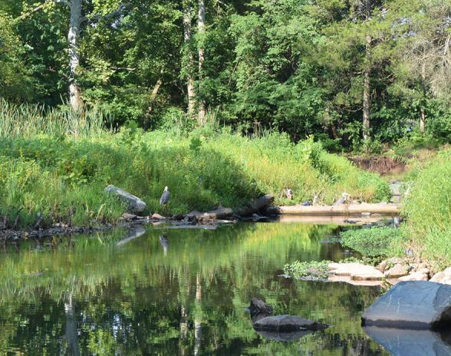
A multi-metric approach to track and report stream health
Claire Buchanan
Matt Cashman
Peter Claggett
Renee Thompson
Kelly Maloney
Rosemary Fanelli
Chris Ruck
LeAnne Astin
Jonathan Witt
Matt Meyers
Julianna Greenburg
Nora Jackson
SHWG Meeting
May 15, 2020
https://www.fairfaxcounty.gov/health/pools/swimming-natural-waters

Slide 4
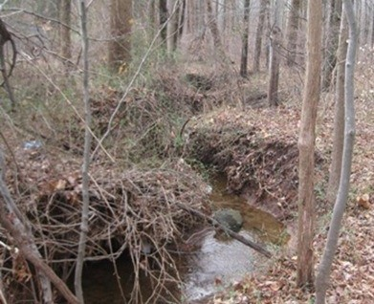
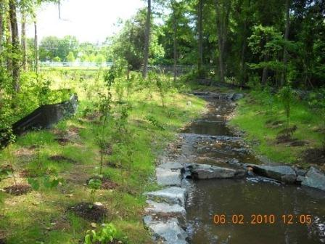
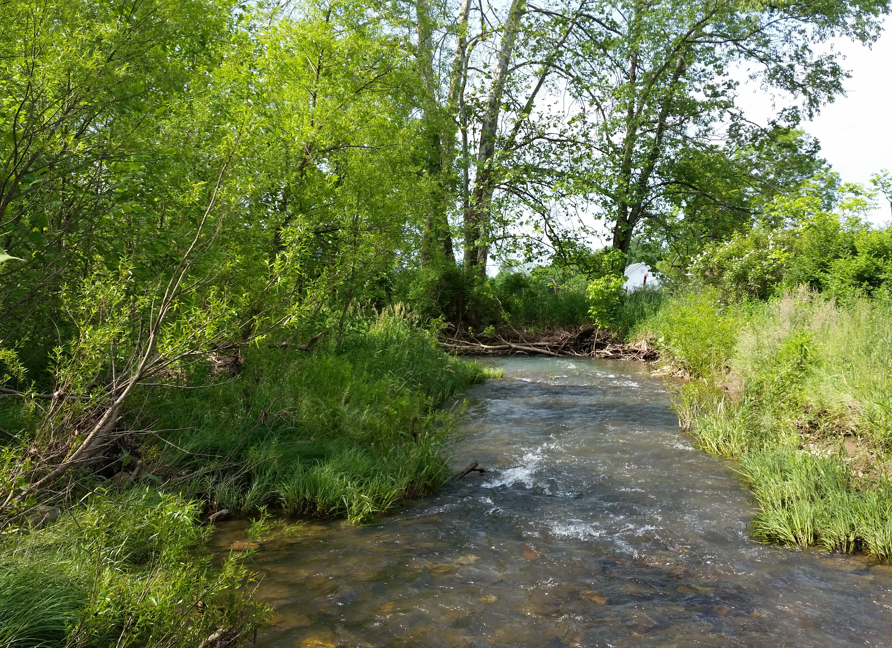
Overall Purpose
Explore opportunities to broaden use of metrics to assess stream health for the Bay Watershed
Understand current efforts to document and, or evaluate stream health
Coordinate efforts with Healthy Watersheds GIT
Long term effort
Improve communication on what we mean by ‘stream health’
Definition & terminology
Track and Report
https://www.fairfaxcounty.gov/soil-water-conservation/enjoy-restore-streams/

Slide 5
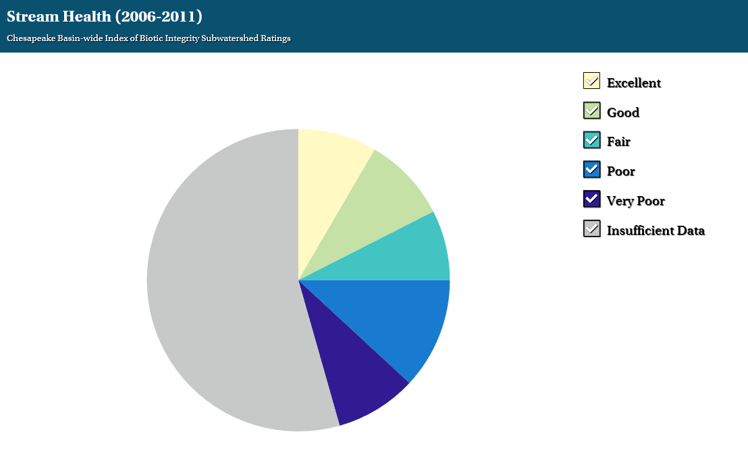
Stream Health Outcome
Continually improve stream health and function throughout the watershed. Improve health and function of 10 percent of stream miles above the 2008 baseline for the Chesapeake Bay watershed.
“Chessie BIBI” is the metric used to report and track stream health
a benthic, multi-metric indicator of stream health
25.1%
54.4%
20.5%

Slide 6
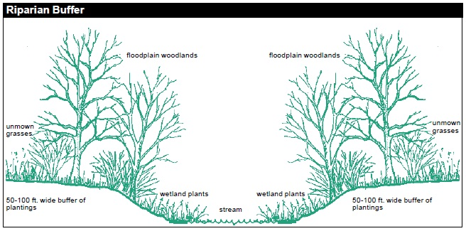
Stream Health
Stream-Riparian-Floodplain System
groundwater
groundwater
Source: Adapted from https://www.fairfaxcounty.gov/soil-water-conservation/you-your-land-beyond-your-yard

Slide 7
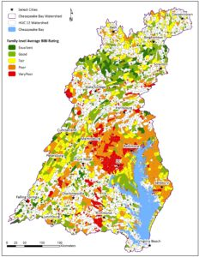
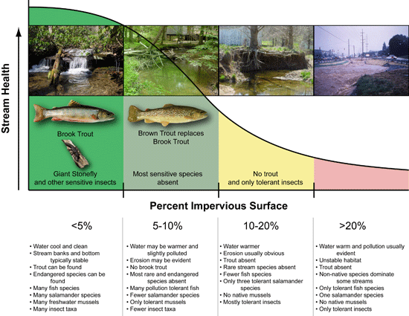
Baywide 64,000 sq mile
Catchments < 10 sq mile
Source: https://www.potomacriver.org/?s=chessie+bibi
https://dnr.maryland.gov/streams/Pages/streamhealth/How-Impervious-Surface-Impacts-Stream-Health.aspx

Slide 8
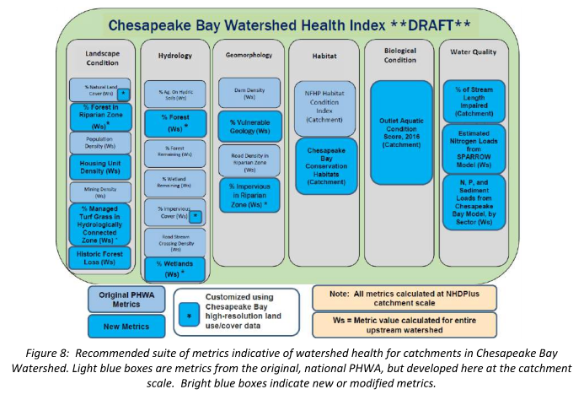
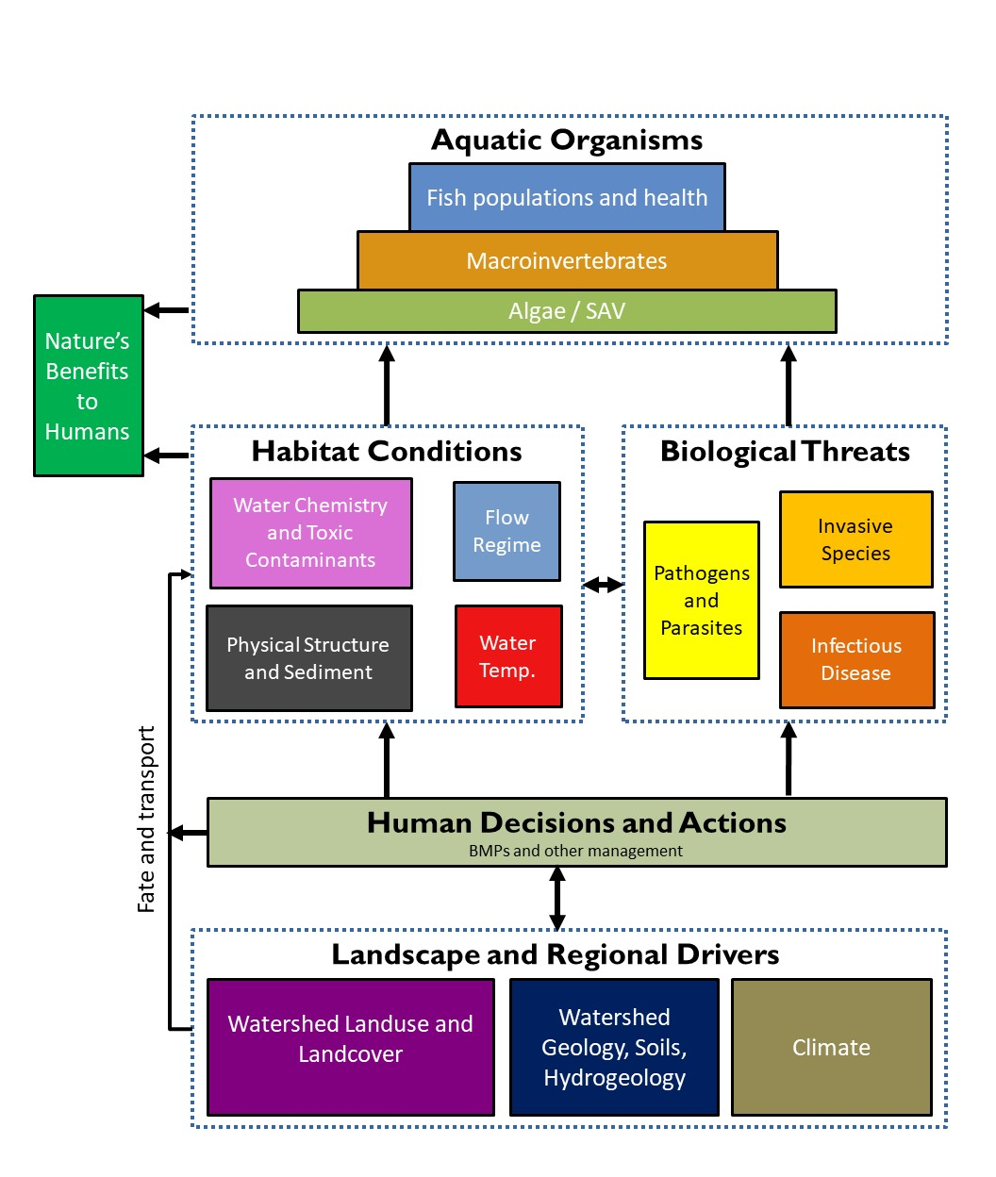
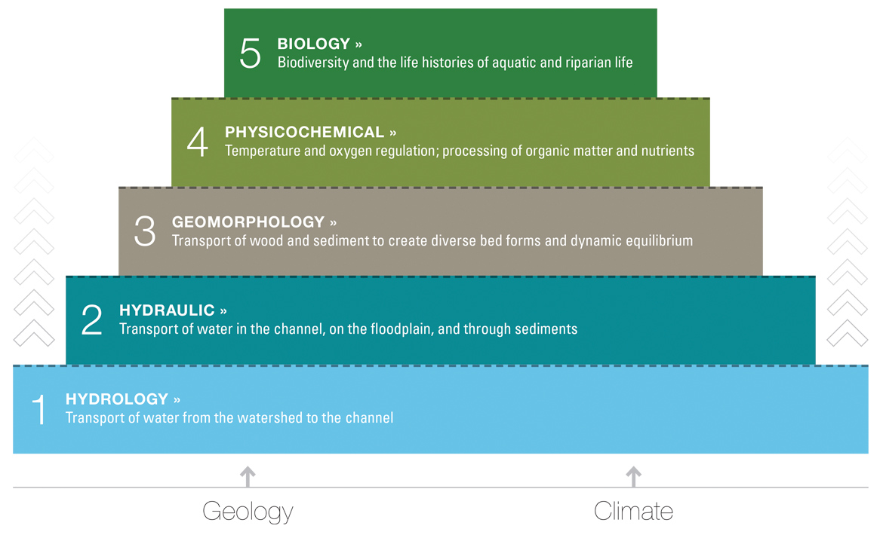
Summary of Current & Proposed Work
Development of Chessie BIBI index (Buchanan/ICPRB)
Applications of the Chessie BIBI & streamflow alteration (Buchanan, Moltz et al/ICPRB)
Fish Habitat Assessment (STAC workshop)
Chesapeake Bay Healthy Watersheds Assessment (CBHWA)
CBHWA and USGS
USGS (multiple contributors)
Status and Trends (biotic conditions, instream stressors, land use land cover)
Regional Assessments (watershed wide stream assessments/predictive models)
Focal Studies
Literature reviews, data summaries, statistical analyses
(USGS, Fairfax County)
Stream Team Studies (USGS)
Field data collection to explain detailed mechanisms in diagram

Slide 9
What does stream health mean to the Bay Program, the SHWG and its membership?
Develop framework to broaden suite of metrics to evaluate stream health
Long-term effort that would provide needed information for Phase 3 of the ‘stressors’ project
Multiple work underway related to through the Healthy Watersheds GIT, USGS, local government (e.g. Fairfax County, others)
Two Key Questions:
At what scale should we be measuring/evaluating stream health?
Trends across the Bay watershed
Impact of management actions, both conservation and restoration
At what scale and what data is needed to describe stream health to inform management actions and bay-wide trends?

Slide 10
Benefits of a multi-metric approach
Track and report the trajectory or trends in stream health that aligns with different stream functions.
Evaluate the degree to which the stream ecosystem is recovering with time, and what interventions may be needed to improve degraded streams or maintain high quality streams.
Provide decision makers, modelers, managers with a more dynamic outlook on stream health
Inform management actions and design approaches
Support other Bay Agreement Outcomes
Looking Forward to Our Discussions!

