Slide 1

Stream Health
Quarterly Progress Meeting - May 2017
Rich Starr
Environmental Planning and Restoration, LLC
Mike Lovegreen
Upper Susquehanna Coalition
Workgroup Co-Chairs
Notes:
BACKGROUND: The Strategic Review System is the Chesapeake Bay Partnership's committed adaptive management process to regularly review progress at meeting our Watershed Agreement Outcomes and make appropriate changes. In recognition of the fact that our Outcomes vary considerably, there is no single review process that will fit all Outcomes. However, there is value in ensuring some level of consistency in how we review and discuss our Outcomes. The “Guide to your Quarterly Progress Meeting” and this powerpoint template are intended to provide that level of consistency, while also providing the necessary level of flexibility to adapt the process to your specific Outcome’s needs. The “Guide” provides specific instructions that we expect the Outcome’s lead GIT or Workgroup to follow in conducting the review. This powerpoint template provides a consistent format for presenting only the most important issues resulting from that review to the Management Board at the Quarterly Progress Meeting.
Both documents address four basic questions:
What are our assumptions?
Are we doing what we said we would do?
Are our actions having the expected effect?
How should we adapt?
We understand that you could spend your entire allotted time to any one of these questions. Please keep in mind that the Management Board is trusting that your GIT or Workgroup followed the process outlined in the Guide, and that the issues that you present in this powerpoint are limited to only those high points from that review that you need to bring to the Management Board’s attention and get their feedback.
INSTRUCTIONS: Use this presentation to highlight important AND, BUT, THEREFORE stories that the Management Board should hear, based on GIT analysis using the provided materials.
Find photos on our Flickr site: https://www.flickr.com/photos/29388462@N06/sets/
You can also browse photos by category on our website: http://www.chesapeakebay.net/photos
Find charts and data at ChesapeakeProgress.com.

Slide 2
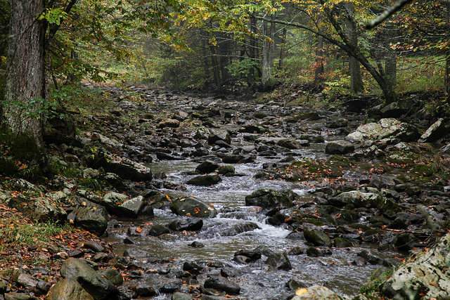
Through the Chesapeake Bay Watershed Agreement, the Chesapeake Bay Program has committed to…
Goal: Vital Habitats
Outcome:
Continually improve stream health and function throughout the watershed. Improve health and function of 10 percent of stream miles above the 2008 baseline for the Chesapeake Bay watershed.
Notes:
INSTRUCTIONS: Add the title of your goal, the language of your outcome from the 2014 Agreement (copy and paste), and a relevant photo, if it all fits. If desired, talking points could include more contextual information, e.g. the importance of the outcome, historic trends, partners, etc.

Slide 3
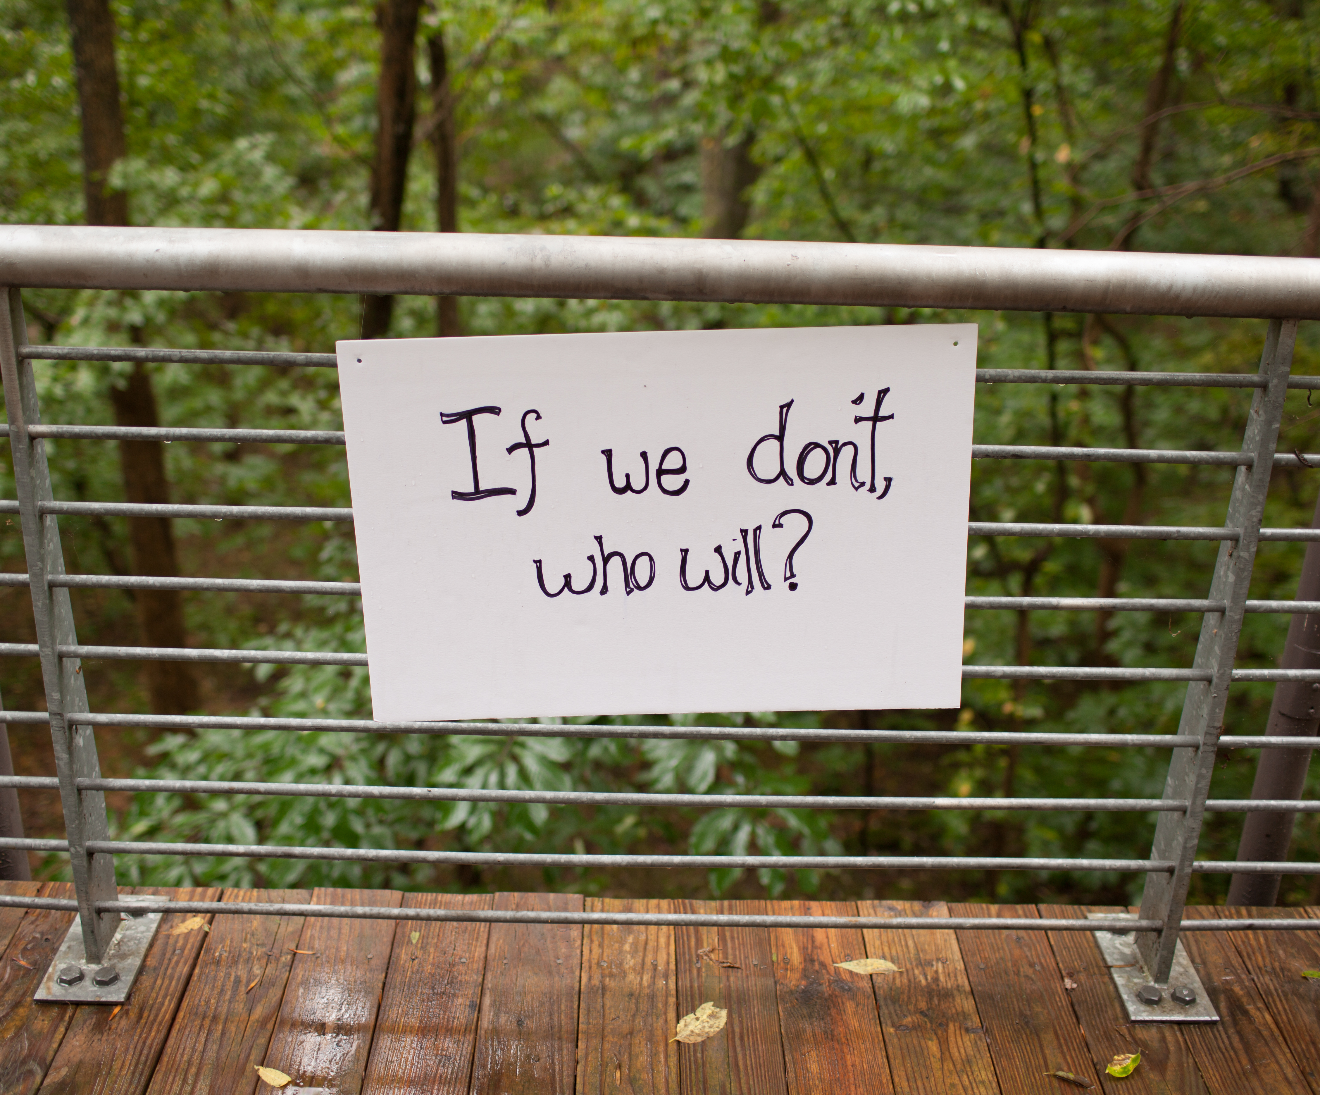
What We Want
Active leadership and involvement in accomplishing biennial workplan tasks.
Funding to establish the 2008 baseline and document progress towards our Outcome
Notes:
INSTRUCTIONS: Identify the ask(s) for the Management Board up front, or clue them in to what you will be asking them later. All of the information in your presentation should support this. If you don’t necessarily have an ask, identify a few key points you want the Management Board to walk away with, and structure your presentation around those points.
We need MB’s assistance in setting staff involvement expectations

Slide 4
Setting the Stage: What are our assumptions?
1
Notes:
[section header, no action required] The section that follows should provide some brief historical context for the Bay Program’s work toward this outcome. Add slides as needed while being mindful of the time you have.

Slide 5
Logic Behind Our Outcome
Identify stressors
Implement actions to remove stressors
Restore process/ functional uplift
Increase stream health and function
Notes:
INSTRUCTIONS: Describe the factors, efforts & gaps, and management approaches that are relevant to your ask or key takeaway. You could use the analysis and insight gained from your logic table to consider questions like,
What are my critical factors originally identified in the Management Strategy?
What did I originally identify in the Management Strategy as gaps in existing programs that addressed those factors?
What were the management approaches I chose for my strategy and workplan to address those gaps?
REMEMBER: Prioritize the information you want to present based on your story, ask, or key takeaway.
SH Mstrat figure

Slide 6
Logic Behind Our Outcome
Identify stressors
Implement actions to remove stressors
Restore process/ functional uplift
Increase stream health and function
Understanding Factors Influencing:
Management Actions
Identification of indicators/ assessment parameters to documents measurable change in stream function
Monitoring & assessing progress to increase stream health and function
Ecological Stressors & Factors
Policy & Administration
Scientific Knowledge & Application of Research
Notes:
INSTRUCTIONS: Describe the factors, efforts & gaps, and management approaches that are relevant to your ask or key takeaway. You could use the analysis and insight gained from your logic table to consider questions like,
What are my critical factors originally identified in the Management Strategy?
What did I originally identify in the Management Strategy as gaps in existing programs that addressed those factors?
What were the management approaches I chose for my strategy and workplan to address those gaps?
REMEMBER: Prioritize the information you want to present based on your story, ask, or key takeaway.
SH Mstrat figure

Slide 7
Progress: Are we doing what we said we would do?
2
Notes:
[section header, no action required] This second section provides the AND part of the AND, BUT, THEREFORE story structure. This section provides an opportunity to talk about your progress. Use indicator data and charts from ChesapeakeProgress.com where available. If you do not have an indicator, fill in with other relevant information, charts, tables, etc. about your management approaches and workplan actions.

Slide 8
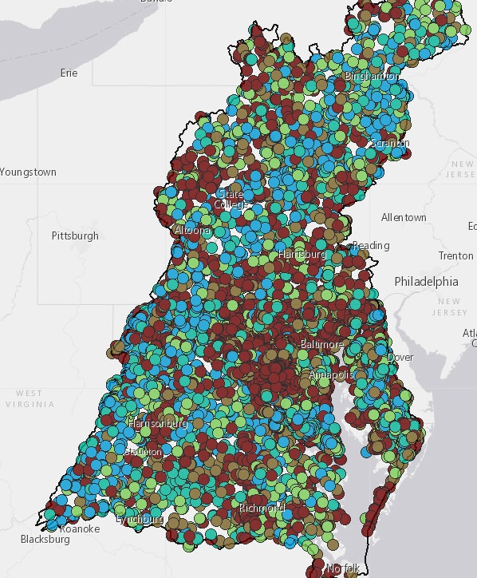
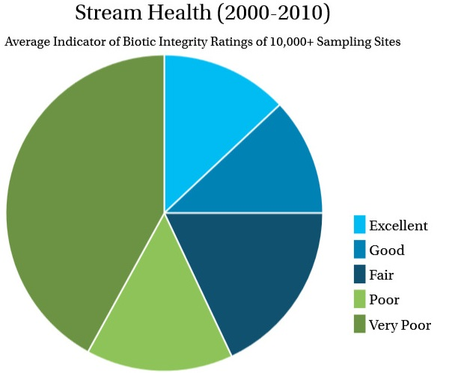
What is our status?
Our goal is to is to improve health and function of 10 percent of stream miles above the 2008 baseline
Data has been submitted by states to CBP
Notes:
Discussion Question 1: Are you on track to achieve your Outcome by the identified date?
What is your target? What does this target represent? (e.g., the achievement we believed could be made within a particular timeframe; the achievement we believed would be necessary for an Outcome’s intent to be satisfied; etc.)?
Our goal is to is to improve health and function of 10 percent of stream miles above the 2008 baseline. This improvement of health and function will be measured by the Chesapeake Basin-wide Index of Biotic Integrity, or Chessie BIBI. The BIBI was just refined by ICPRB and we hope to work with them to establish the 2008 baseline. BIBI scores from 2000 to 2010 are shown on the left with sampling locations shown on the right. As of now we cannot track trends but with the BIBI refinement and upcoming establishment of the baseline we will be able to show progress towards our outcome.

Slide 9
Are we on track?
Indicator is in development
Data conversion necessary
ICPRB has made a recommendation on how to move forward
SHWG needs to review proposal and provide implementation recommendations
Notes:
INSTRUCTIONS: This optional graphic was provided to coordinators and staffers (email sent by Emily Freeman on March 24) as Annotated Process Graphic PowerPoint file. You can edit the graph in that file and include here. Alternatively, you can leave this out of the presentation and include other charts, pictures, maps, or information to answer the questions below.
Talking Points:
Discussion Question 1 (continued)
What is your anticipated deadline? What is your anticipated trajectory?
What actual progress has been made thus far?
What could explain any existing gap(s) between your actual progress and anticipated trajectory?
Data has been submitted by states.
As of now we cannot track trends but with the BIBI refinement and upcoming establishment of the baseline we will be able to show progress towards our outcome.
Data must be converted into stream miles to document improvement and show progress toward our outcome.
ICPRB has made a recommendation on how to go about the establishment of the 2008 baseline.
The Stream Health Workgroup will need to review the proposal and provide implementation recommendations before this task may begin.

Slide 10
Analysis
Most critical progress so far:
States provided data for Chessie BIBI
Database established
Most critical for future progress:
Establish the 2008 Baseline
Permit process
Increased knowledge of stream functions
Transfer of knowledge into guidelines
Trainings on use of guidelines
Biological incentives associated with TMDL
Notes:
INSTRUCTIONS: consider these questions and include those that are most relevant to your outcome.
Discussion Question 2: Which actions were most critical in progress thus far? Why? [Indicate which influencing factors these actions were meant to manage.]
Discussion Question 3: Which management actions will be the most critical to your progress in the future? Why? [Indicate which influencing factors these actions were meant to manage.]
Based on this analysis, what management approaches will be carried forward? What new management approaches are necessary?
What gaps have been filled, and how will we build on this in the future?
2: Data provided by states & BIBI refinement
3: Establishment of a 2008 baseline and documenting progress, completing action items identified in workplan that will improve on the ground implementation.
Gaps filled: permitting? Work from MDE. Gaining information from states.
Gap need answered: Consensus on how to define stream health and function improvement based on the data provided by states.
What data do we want to use to show progress?
Management approaches do not need to be changed. They are the right ones to show improvement, document progress, and assist states in on the ground implementation
On the ground gaps: improve the permitting process, develop guidelines for restoration and provide training on those guidelines
Have a better understanding of stream functions and develop guidelines and recommendations and conduct trainings from this better understanding
Biological incentives associated with TMDL

Slide 11
Challenges: Are our actions having the expected effect?
3
Notes:
[section header, no action required] This second section provides the BUT part of the AND, BUT, THEREFORE story structure. This section provides an opportunity to talk about your challenges, based on your analysis using the logic table and the discussion questions in the SRS Quarterly Meeting Guide.

Slide 12
Challenges
Funding to establish the 2008 baseline
Active/committed workgroup member participation and follow-through on workplan actions
Ecological factors and stressors
Policy and administrative factors that limit implementation potential
Scientific knowledge and application of research
Notes:
INSTRUCTIONS: This is the BUT part of the story. Consider the questions above and share something about a challenge encountered, or new information gathered, or a new approach identified, that calls for a change to the existing approach or strategy. You can discuss your plans to address this challenge, or you can talk more broadly about how your workgroup or GIT will work to determine how to address the challenge.
Talk about action plan successes in leveraging work with partners (CBT – pooled monitoring)
Dedicated positions for Fish Habitat, Fish Passage, and Urban Stormwater Workgroups

Slide 13
Adaptations: How should we adapt?
4
Notes:
[section header, no action required] This second section provides the THEREFORE part of the AND, BUT, THEREFORE story structure. This section provides an opportunity to talk about your adaptations and next steps, based on your analysis using the logic table and the discussion questions in the SRS Quarterly Meeting Guide.

Slide 14

Based on what we’ve learned, we plan to…
Revisit Bi-Annual Action Plan tasks and revise appropriately
Continue toward tasks in our robust workplan with active enrollment of workgroup members.
Notes:
INSTRUCTIONS: This is the THEREFORE piece of the story! Tell the Management Board what you’re going to do with the new information, research, resources, understanding of factors, etc. Refer back to the logic table that you competed—this content could come from the Adaptation column, if you got that far in the table, or it could be a realization that you gained working within the first columns of factors, gaps, approaches, actions and responsible parties.
Dependent upon active participation/funding. Need active enrollment to lead efforts. Workplan is strong but efforts to carry out have not been.

Slide 15










Agreement Goals and Outcomes
Sustainable Fisheries
Vital Habitats Goal
Blue Crab Abundance
Blue Crab Management
Oyster
Forage Fish
Fish Habitat
Wetlands
Black Duck
Stream Health
Brook Trout
Fish Passage
Submerged Aquatic Vegetation (SAV)
Forest Buffer
Tree Canopy
Water Quality Goal
Toxic Contaminants Goal
2017 Watershed Implementation Plans (WIP)
2025 WIP
Water Quality Standards Attainment and Monitoring
Toxic Contaminants Research Toxic Contaminants Policy and Prevention
Healthy Watersheds Goal
Stewardship Goal
Healthy Waters
Citizen Stewardship
Local Leadership
Diversity
Land Conservation Goal
Public Access Goal
Protected Lands
Land Use Methods and
Metrics Development
Land Use Options Evaluation
Public Access Site Development
Environmental Literacy Goal
Climate Resiliency Goal
Student
Sustainable Schools
Environmental Literacy Planning
Monitoring and Assessment
Adaptation Outcome
Notes:
Optional slide if you think it contributes to your message
INSTRUCTIONS: Highlight with bold green text the outcomes which impact your outcome, or which your outcome impacts. (taken from Bruce Vogt’s March 2017 PSC presentation on oysters)
FH STAC proposal to identify stressors
Potential to work with BT?

Slide 16
What We Want
Active leadership and involvement in accomplishing biennial workplan tasks.
Funding to establish the 2008 baseline and document progress towards our Outcome
Notes:
INSTRUCTIONS: Identify the ask(s) for the Management Board up front, or clue them in to what you will be asking them later. All of the information in your presentation should support this. If you don’t necessarily have an ask, identify a few key points you want the Management Board to walk away with, and structure your presentation around those points.
We need MB’s assistance in setting staff involvement expectations

Slide 17
Discussion
Presentation template by SlidesCarnival.
Notes:
[time for discussion at the end of the presentation, before the next outcome presentation]

