Slide 1
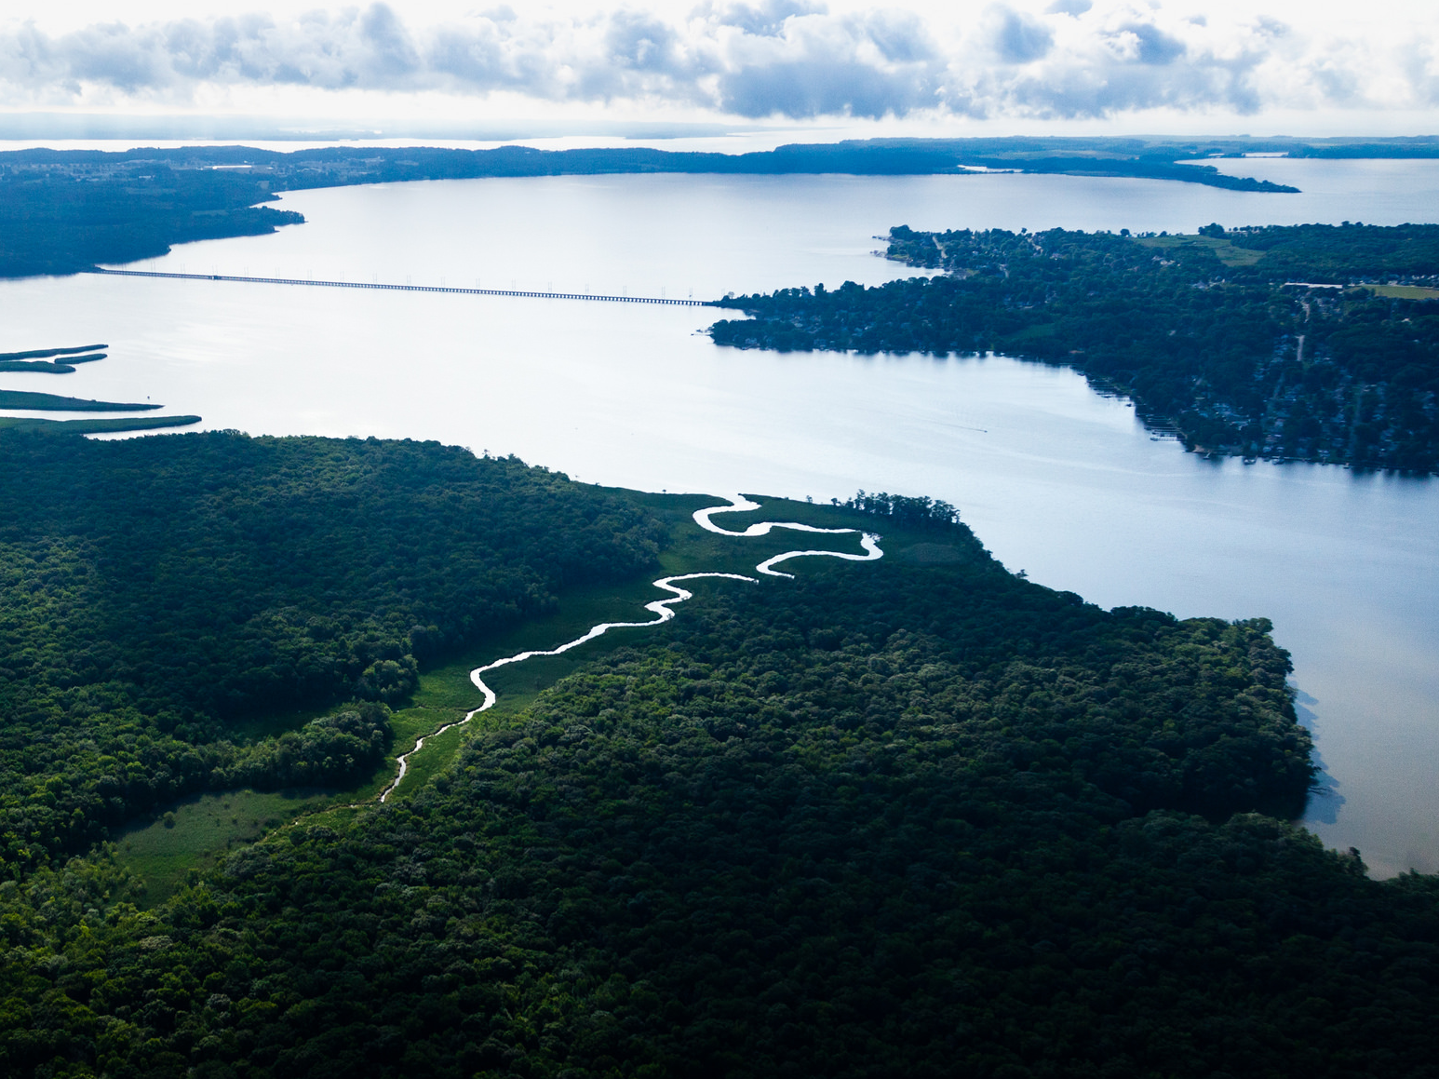

CMC: Who we are and how we can collaborate with the
Stream Health Workgroup
Stream Health Workgroup Meeting: October 25, 2016
Lea Rubin and Danielle Donkersloot of the Izaak Walton League of America
Photo courtesy of the Chesapeake Bay Program
Notes:
Anne:

Slide 2

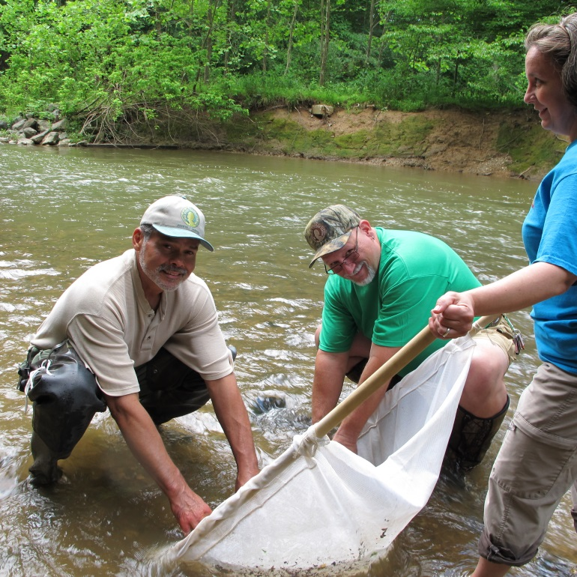
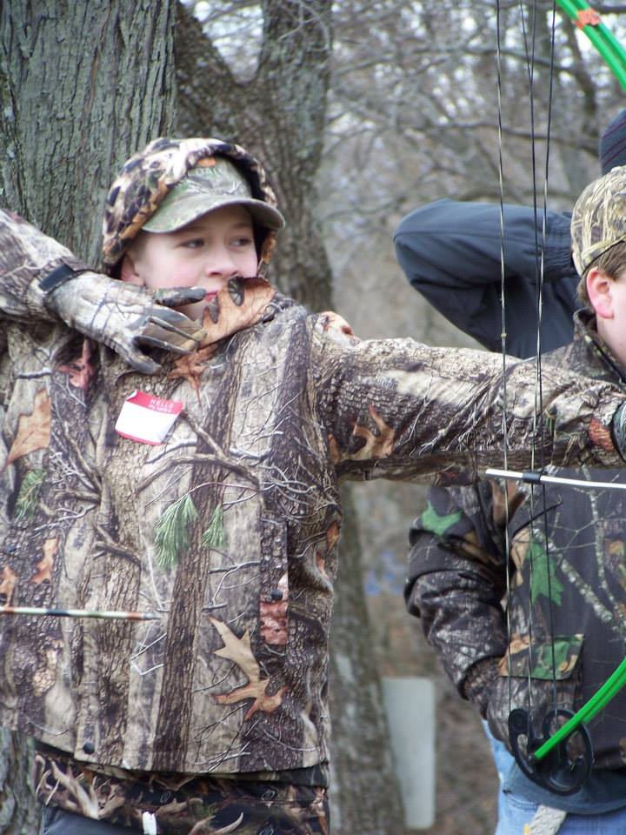
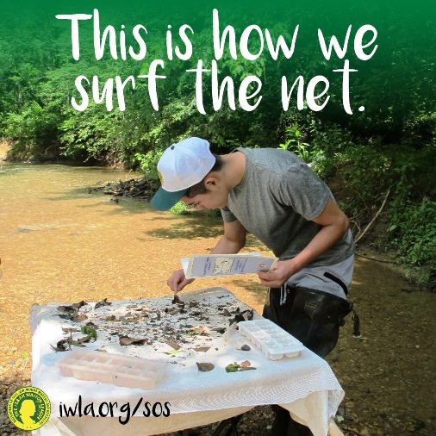
Izaak Walton League of America
A conservation organization interested in protecting natural resources and promoting outdoor recreation.
Notes:
Lea or Danielle

Slide 3

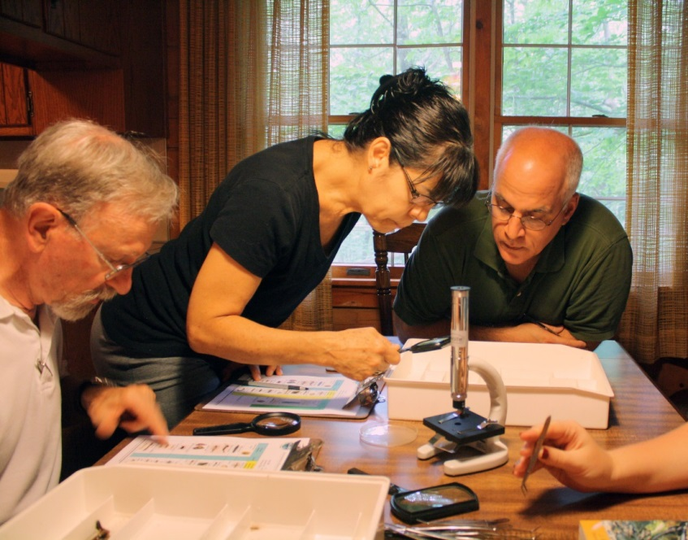
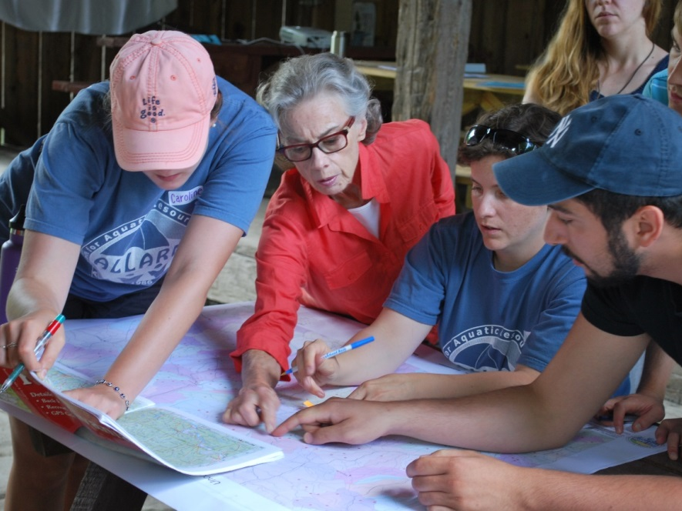
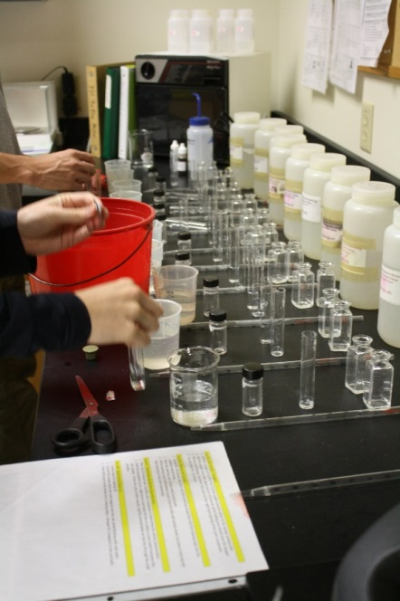
Alliance for Aquatic Resource Monitoring
Notes:
Julie

Slide 4
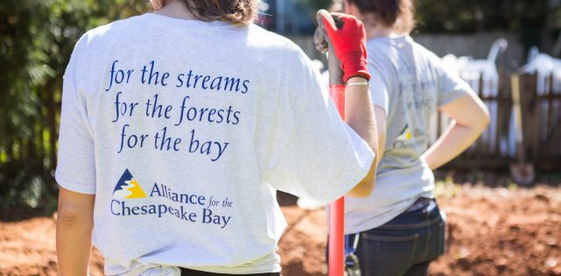
Alliance for the Chesapeake Bay
Notes:
Nissa

Slide 5




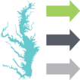



IAN Themes
COMMUNICATING SCIENCE EFFECTIVELY
REPORTING ECOSYSTEM STATUS
TEACHING & TRAINING
CATALYZING CONSERVATION OUTCOMES
ADVANCING CHESAPEAKE BAY RESTORATION
BUILDING STRATEGIC PARTNERSHIPS
CREATING GOOD CITIZENSHIP MODELS
Notes:
Caroline

Slide 6
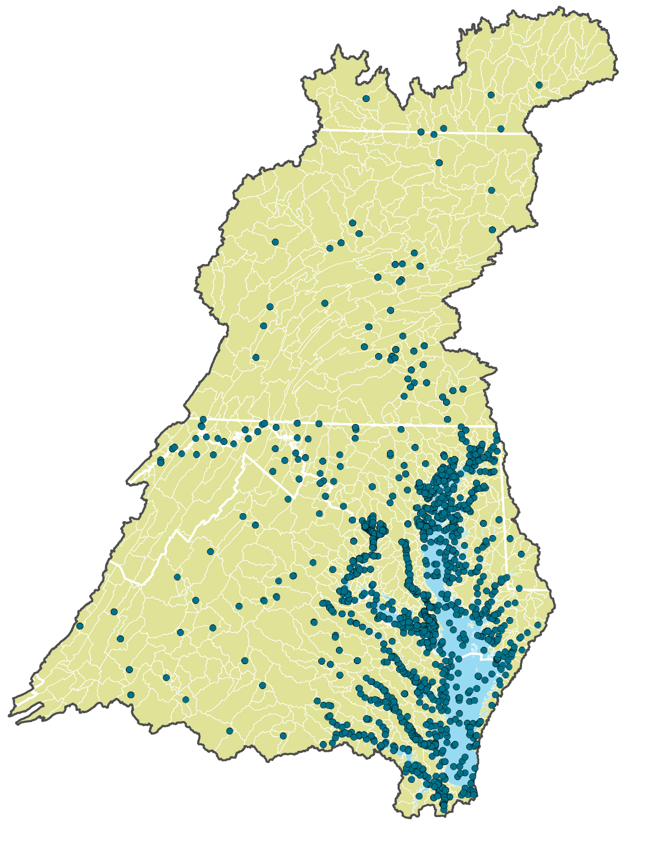
CBP monitoring sites
Notes:
First we can look at what traditional monitoring already exists…
The Chesapeake Bay Program Partnership’s Long-term water quality monitoring program has supported the assessment of Bay health, reinforced science-driven management, and led to understanding ecosystem response to natural and anthropogenic drivers. However, looking at this map you can see that this network, cannot monitor everywhere, all the time, and sometimes relies on one monitoring site to represent a large area of the watershed.
Then, where do you think volunteer and non-traditional data could fill in?

Slide 7
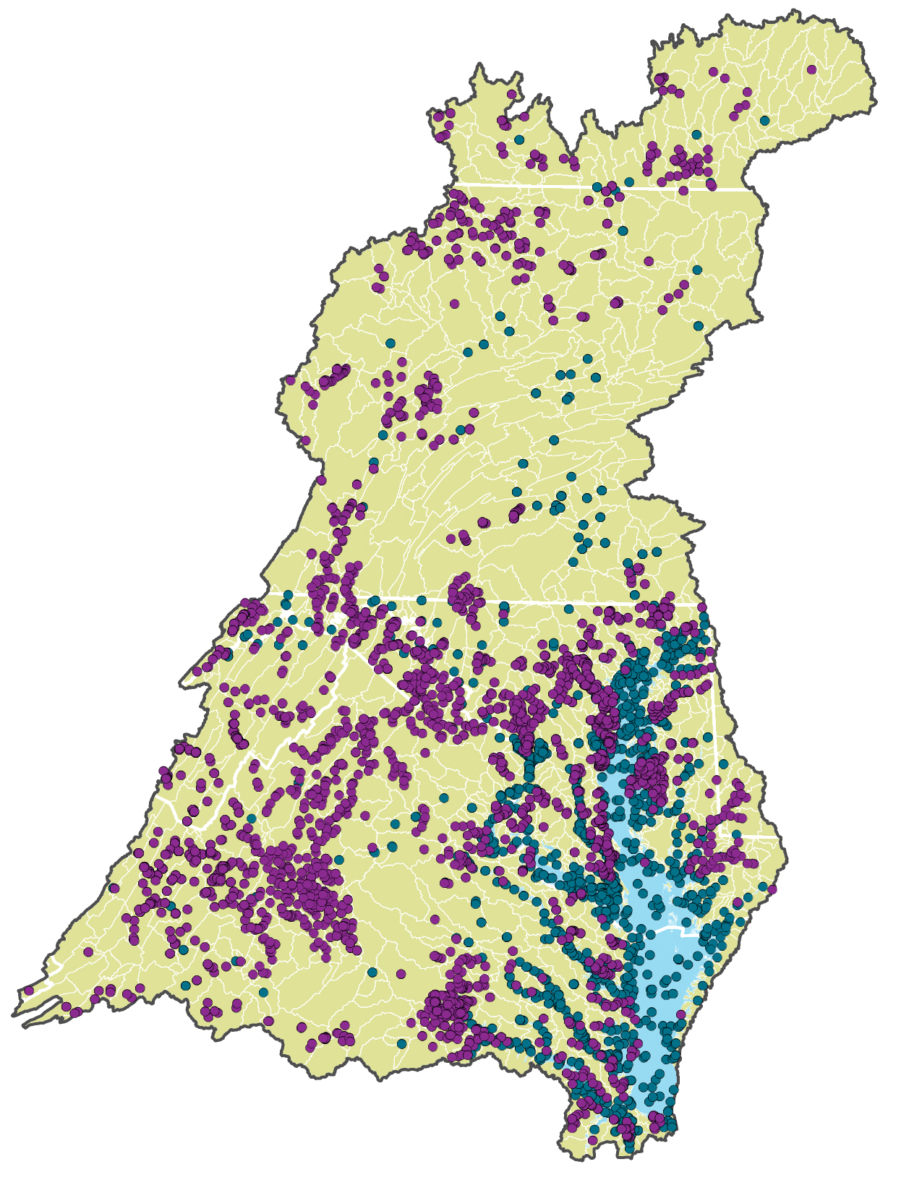
Preliminary site coordinates of non-traditional monitoring
Notes:
If you look at this map of monitoring groups that participated in our census this past spring you can see the possibilities of adding a significant amount of data to the monitoring network. Look how dense some of those monitoring points are, these groups are achieving spatial coverage that traditional monitoring can only day dream about.
The non-traditional monitoring groups at the purple points on the map represent a large array of data collectors. On this map we have volunteers of a home owner association collecting bacteria data on the streams in their community to encourage safe disposal of horse manure. There are paid RiverKeepers who go out weekly on their tributary and collect samples with the same rigor as the CBP. And there is a research university tracking stream health recovery from acid rain in the Blue Ridge headwaters.
All this data is of value and when we know of what quality it is, the uses for it can be applied in innumerable ways. One of which could be for the CBP to do their assessment work.
Lea: Now, here is Nick DiPasquale, the executive director of the CBP, and a huge supporter of the Chesapeake Monitoring Cooperative, who is going to speak to you about why the CBP has decided to invest in integrating volunteer and non-traditional monitoring data into the CBP.

Slide 8





Nontraditional and Volunteer
Monitoring Groups

Slide 9
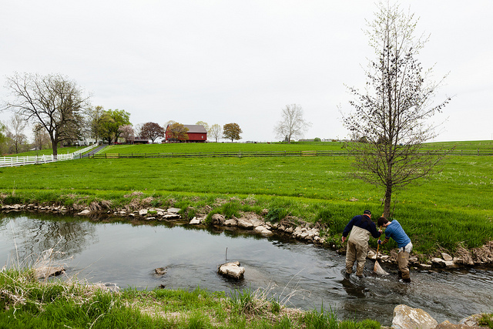
Vision
Our Vision: Chesapeake Monitoring Cooperative envisions a Chesapeake community where all data of known quality are used to inform watershed management decisions and restoration efforts.
Photo courtesy of the Chesapeake Bay Program
Notes:
The Chesapeake Monitoring Cooperative envisions a Chesapeake community where all data of known quality are used to inform watershed management decisions and restoration efforts.
And, therefore…

Slide 10
Mission
Our Mission: Chesapeake Monitoring Cooperative works with diverse partners to collect and share new and existing water quality data. Through this collaboration, we aim to develop a comprehensive understanding of Chesapeake Bay Watershed health.
Photo courtesy of the Chesapeake Bay Program
Notes:
Our mission is to work with diverse partners to collect and share new and existing water quality data. Through this collaboration, we aim to develop a comprehensive understanding of Chesapeake Bay Watershed health.
In order to do this…

Slide 11
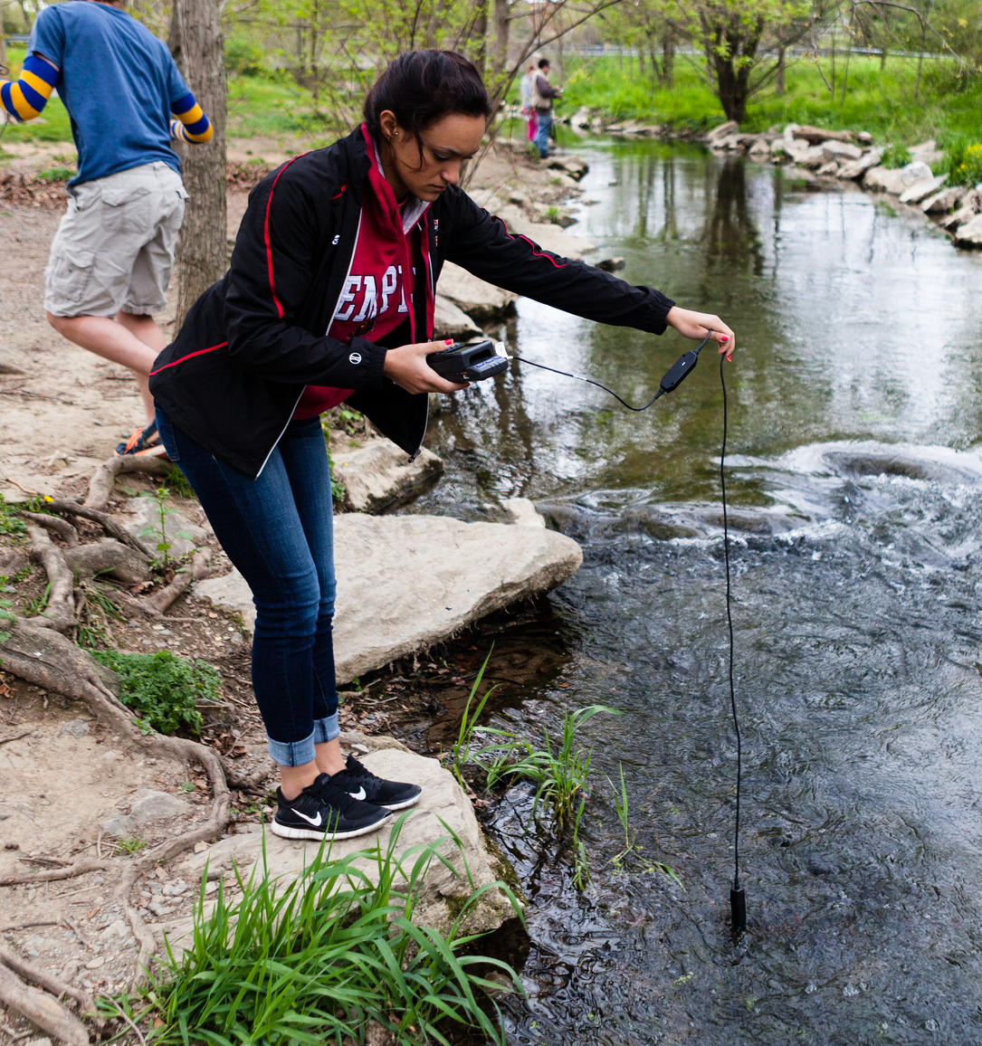
Needs within the Chesapeake Bay Watershed to make this happen
Comparability
Quality Assurance
Technical Support
Share Data
Collaboration
Photo courtesy of the Chesapeake Bay Program
Notes:
There are needs of the Chesapeake monitoring community that must to be met.
Available, consistent and comparable field and lab methodologies
A quality assurance program
Technical support and resources for volunteer and non-traditional monitoring groups
A central hub to share volunteer and non-traditional data in the Bay watershed that is user friendly and accessible to monitors and data users
Collaboration and communication between state and federal environmental agencies and the diverse monitoring groups that will make up the cooperative

Slide 12
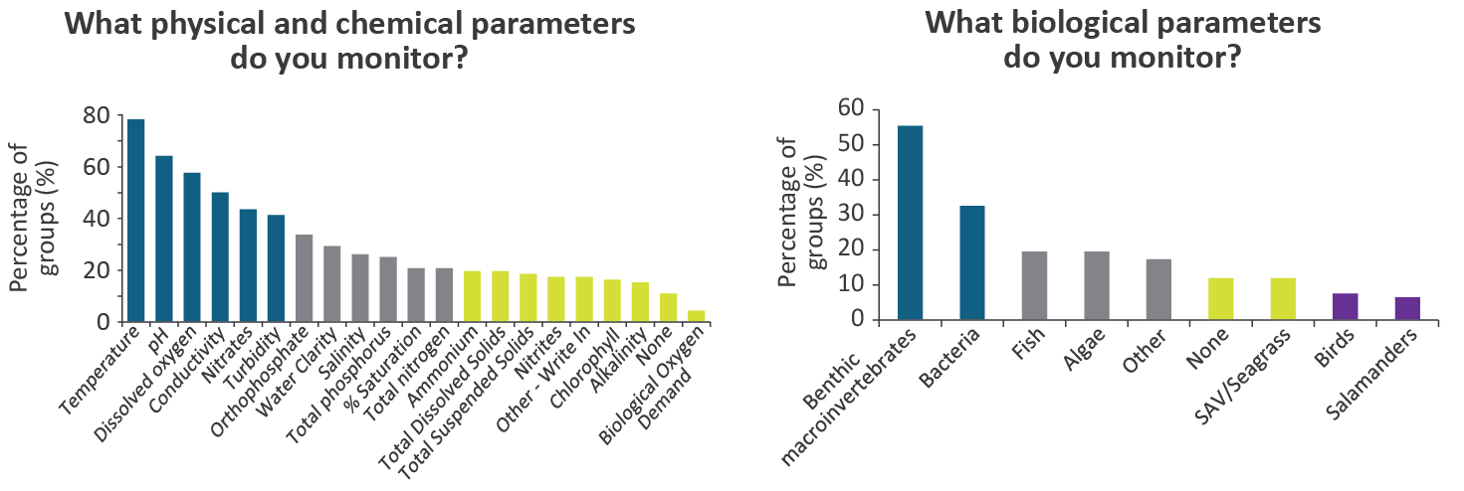
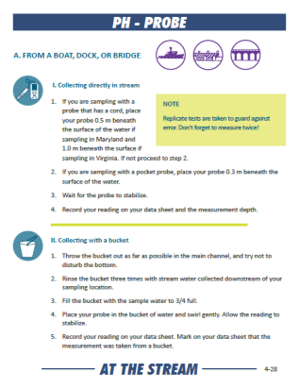
Comparability: consistent and comparable field and lab methodologies
Notes:
Based on the survey this summer, we determined the most popular physical, chemical, and biological parameters being monitors in the Bay watershed. Based on the most popular parameters measured and the most popular methods, coming soon, are visually appealing, and user friendly methods manuals that can be used by any monitoring group in the watershed to promote consistent and comparable methodologies.

Slide 13
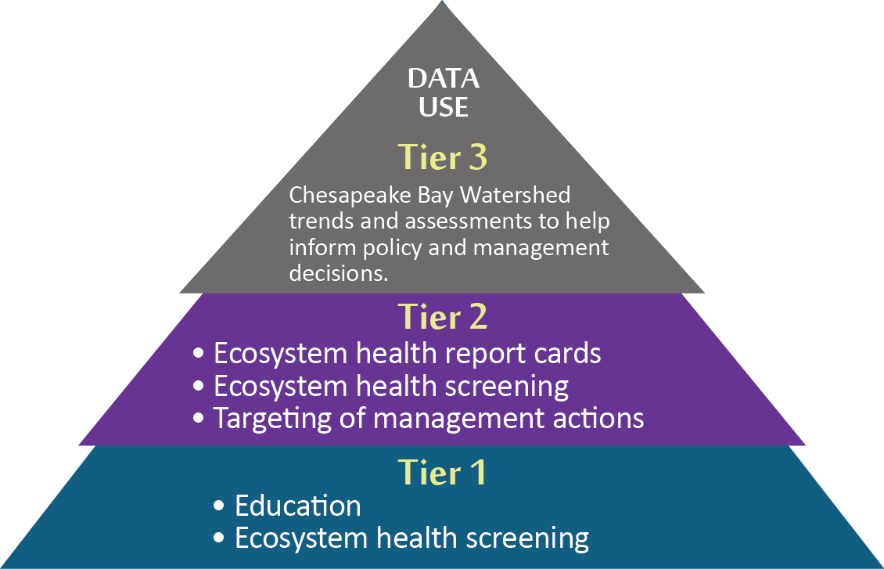
Quality Assurance: to classify data of known quality
Increasing QA standards

Slide 14
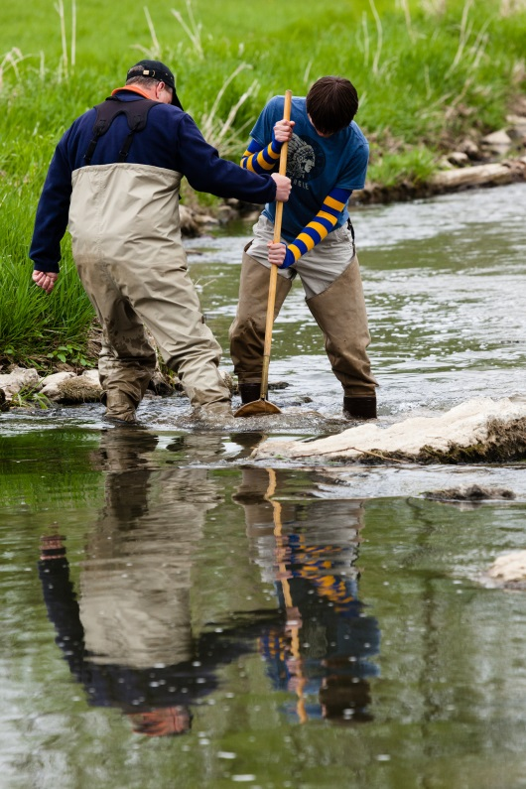
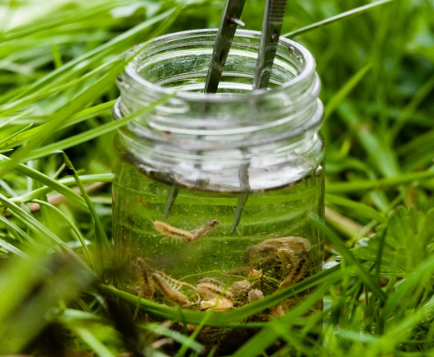
Technical support: and resources
Quality Assurance Project Plans
Data Quality Rubric
Training
Equipment
QA trouble shooting
Data interpretation and report card workshops
Photos courtesy of the Chesapeake Bay Program

Slide 15

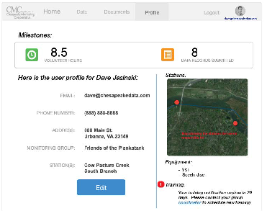
Share Data: A central database for Chesapeake volunteer monitoring data

Slide 16
Timeline
2016
2017
Winter Spring Summer
Today
Methods Manuals
Quality Assurance Project Plans
Data Quality Rubric
Training
Equipment
Database
Data Interpretation Workshops

Slide 17
States indicated priority areas and potential uses
Data gaps
Under-represented areas
Impaired waters
Higher frequency data required to get a more complete story of stream, river, or bay health
BMP effectiveness
BMP implementation plans
Report cards
Targeted restoration/“pollution hotspots”
Notes:
Lea

Slide 18
Biological Nontidal Monitoring
CMC Project leads for biological monitoring:

Slide 19
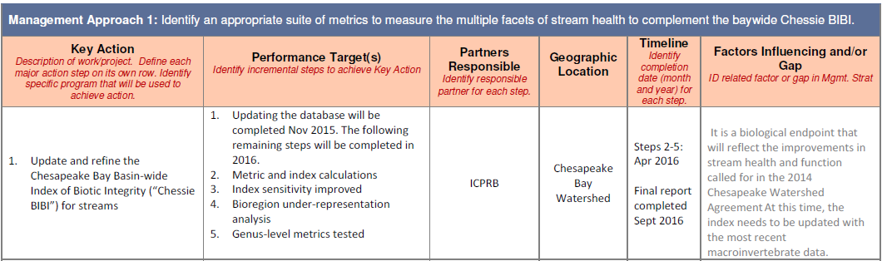
Key Action 1: Limestone Streams Coastal Plain Streams

Slide 20
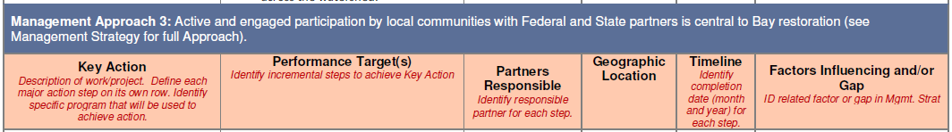
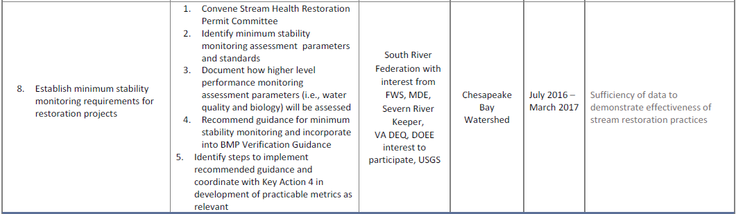
Key Action 8 BMP Effectiveness

Slide 21
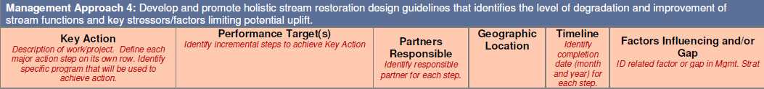
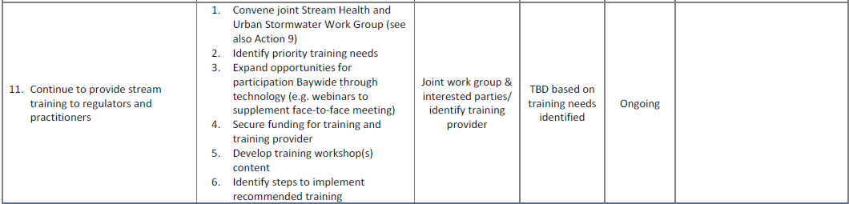
Key Action 1 Training/training needs

Slide 22
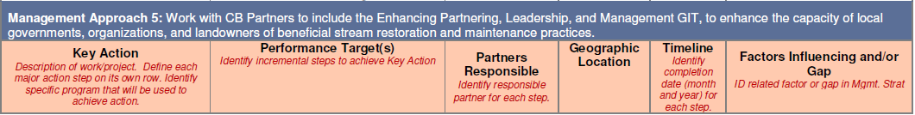
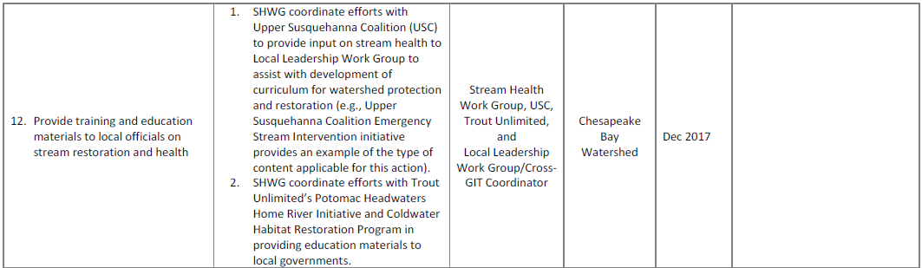
Key Action 12 Training and Education

Slide 23
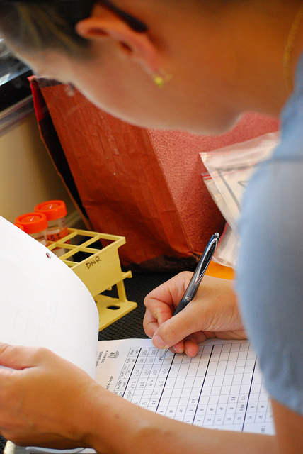

Thank you!
Project Coordinator:
Lea Rubin, lrubin@iwla.org
IWLA Clean Water Program Director:
Danielle Donkersloot, ddonkersloot@iwla.org
Sign up for our Newsletter @
ChesapeakeMonitoringCoop.org
Photo courtesy of the Chesapeake Bay Program

