Slide 1

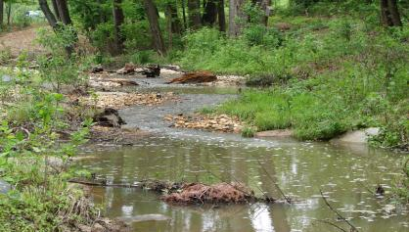
Stream Health Outcome
Biennial Workplan
Neely L. Law, PhD
Center for Watershed Protection
Chesapeake Bay Program Sediment & Stream Coordinator
Habitat Goal Implementation Team
Fall Meeting
October 14, 2015

Slide 2
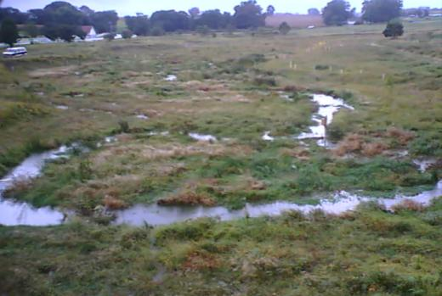
Stream Health Outcome
  Continually improve stream health and function throughout the watershed. Improve health and function of 10 percent of stream miles above the 2008 baseline for the Chesapeake Bay watershed.
Notes:
Stream Health Outcome ...It is a restoration-based outcome. There is also a Healthy Watersheds Outcome as part of the Agreement that states “100 percent of state-identified currently healthy waters and watersheds remain healthy”
“Marginal streams”

Slide 3
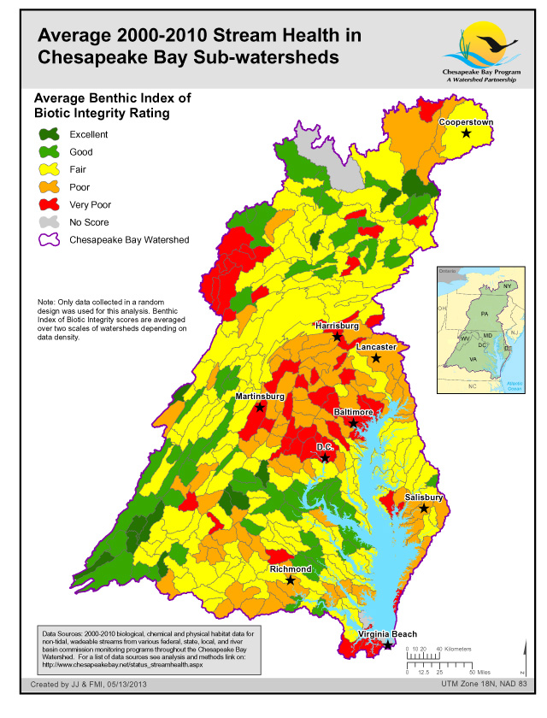
Chesapeake Basin-wide Index of Biotic Integrity for streams
“Chessie BIBI” stream health indicator
Biological endpoint
Function-based approach to define stream health
  Many ways to define....
2000 - 2010
http://www.chesapeakebay.net/indicators/indicator/health_of_freshwater_streams_in_the_chesapeake_bay_watershed

Slide 4
Stream Health
Watershed Implementation Plans (WIPs)
  Nutrients and Sediment Bay Health
 | 2009 Progress | 2011 Progress | 2013 Progress | 2025 WIP Commitment
Urban Stream Restoration | 165,375 | 208,509 | 385,190 (17%) | 2,332,664
Non-Urban Stream Restoration | 191,638 | 501,120 | 1,041,234 (92%) | 1,128,757
Total |  |  | 1,426,424 41% | 3,461,421
~ 700 miles

Slide 5
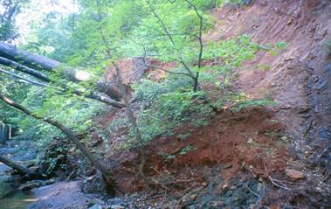
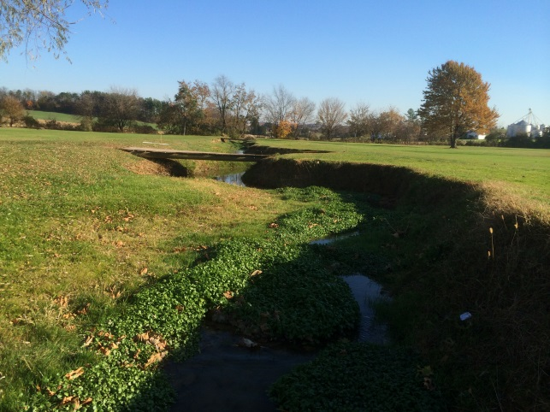
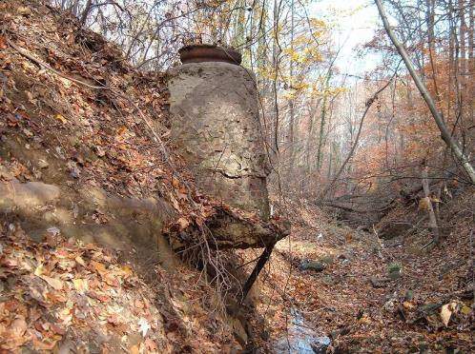
Stream Health
Local TMDLS for numerous chemical and physical, biological impairments

Slide 6
Strategic Approach
Adopts a holistic approach to improve stream health and functions .
Measurement
5 Key Strategies
13 Key Actions
Research
Permitting
Scientific-Based Project Process
Capacity-Building

Slide 7
Management Approach 1 - MEASUREMENT
  Identify appropriate suite of metrics for stream health to complement Chessie BIBI
Key Action
Update and refine the Chesapeake Bay Basin-wide Index of Biotic Integrity (“Chessie BIBI”) for streams
Establish 2008 baseline and approach for determining future trends (% change)
Determine and report progress on Chessie BIBI
Align metrics of functional lift with stream restoration protocols crediting projects for the Chesapeake Bay TMDL for nutrient and sediment reduction by incorporating recommendations from BMP Verification Committee for stream restoration into state Verification Plans

Slide 8
  Management Approach 2 - RESEARCH
  Provide funding and technical resources to support function lift for projects
Key Action
Implement pooled monitoring approach throughout Chesapeake Bay watershed
Identify use and best application of current and research-based monitoring efforts to advance implementation of stream restoration practices and projects

Slide 9
Management Approach 3 - PERMITTING
  Federal and State coordination with local communities in support of project implementation
Key Action
Health Work Group that brings practitioners, regulators and the regulated community together to resolve issues and find common ground to identify actions to streamline the stream restoration project permit review process
Work with federal, state regulatory agencies and local governments to develop recommendations to accept WIPs, MS4 restoration plan or other relevant site analyses as sufficient documentation for alternative site analysis in support of stream restoration permits
Develop a streamlined permit review process, which does not require changes to existing Federal and state laws and regulations, for stream restoration projects.
Establish minimum stability monitoring requirements for restoration projects

Slide 10
Management Approach 4 – SCIENTIFIC-BASED PROJECT PROCESS
Identifies level of stream function degradation and improvement and key stressor limiting potential lift
Key Action
Establish joint SHWG and USWG work group to align how the restoration/enhancement of stream functions translates to nitrogen, phosphorus, and sediment “credit‟ . Also use work group to address other technical issues identified in STAC Workshop on Sustainable Stream Restoration.
Reconciling Sediment TMDLs with other stressors identified by Stressor Identification Methods to assure sediment TMDLs implemented under MS4 permits address multiple stressors
Provide stream training to regulators and practitioners

Slide 11
Stream Health Outcome
Management Strategy
Management Approach 5 – CAPACITY-BUILDING
  Enhance capacity of local governments, organizations and landowners of beneficial stream restoration and maintenance practices

