Slide 1
Stream Health
Matt Meyers, Fairfax County
Neely Law, Center for Watershed Protection

Slide 2
Overview of updated key actions
What actions or performance targets have been removed? Have been added? Why?
Stream Health WG will reconvene December to review WP actions and performance targets
What will be the focus of your new Workplan?
Completion of work to develop and report on new Chessie BIBI baseline and progress (ICPRB lead)
Plan to evaluate other identified priority actions as a result of December meeting
How do these changes reflect the asks you presented to the MB?
No comment

Slide 3
Remaining gaps and barriers
What gaps and barriers will exist even after these key action updates? Why?
Past discussions identified WG leads to advance actions
Plan to evaluate continued interest, resources and technical assistance available to move forward on other identified priority actions as a result of December meeting

Slide 4
Addressing gaps and barriers
How do you plan on addressing these gaps/barriers?
ICPRB received funding to complete work to develop the Chessie BIBI baseline.
ICPRB will convene a workshop steering committee this Fall and organize the workshop later this year or early next year. The workshop objective is to establish a baseline to measure basin-wide progress in improving non-tidal stream health. T
Are these needs that the Habitat GIT or Management Board could address?
Stream Health Outcome in the 2014 Chesapeake Bay Agreement, which calls for program partners to:
“Continually improve stream health and function throughout the watershed. Improve health and function of ten percent of stream miles above the 2008 baseline for the watershed.”

Slide 5
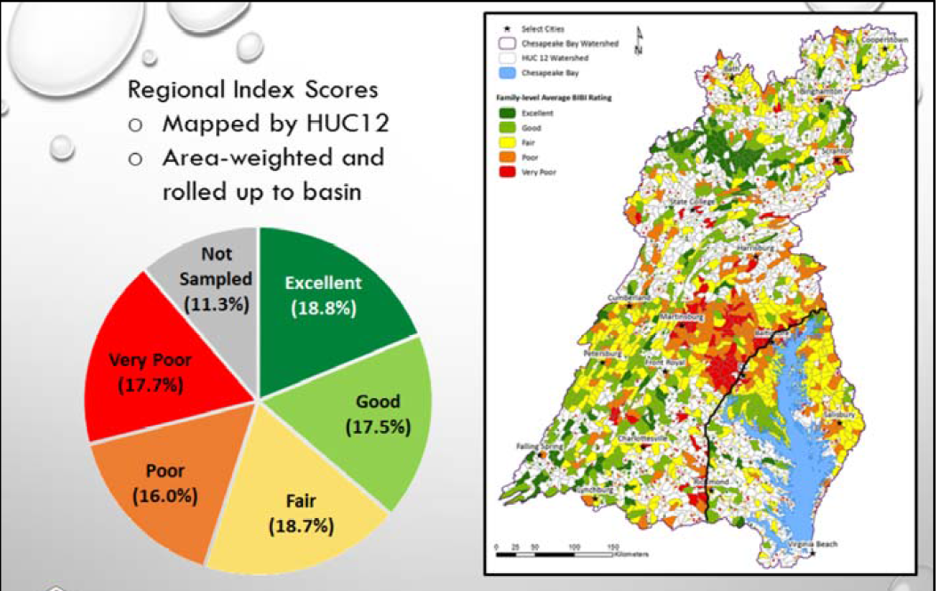
Chessie BIBI
Graphic provides example of mapped to HUC-12 (vs stream miles)
Description of Chessie BIBI from presentation by C. Buchanan and Z. Smith, March 2017.
https://www.potomacriver.org/wp-content/uploads/2014/12/Measuring-Biological-Health_FINAL_3-10-2017.pdf

Slide 6
Workplan Updates
3-5 Slides
~10 Minutes Each
Email to Paige (Hobaugh.paige@epa.gov) with Jennifer (Jennifer_greiner@fws.gov) and Margot (cumming.margot@epa.gov) cc’d by COB November 1st

