Slide 1
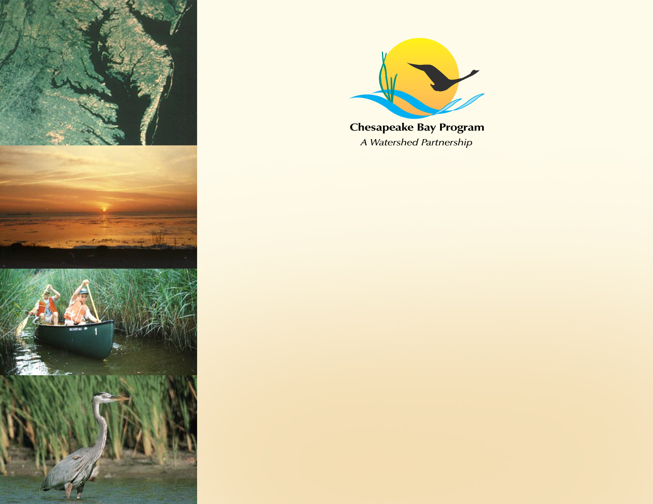
STAC Responsive Workshop Proposal:
Designing Sustainable Stream Restoration Projects
Presenters:
Jeff Horan, Habitat GIT Chair
Bill Stack, CWP
Scientific and Technical Advisory Committee Meeting
March 13, 2013

Slide 2

Workshop Title:
Designing Sustainable Stream Restoration Projects within the Chesapeake Bay Watershed
Workshop Objective:
Create agreement among practitioners, regulators and scientists on a common language and methods for designing sustainable stream restoration projects that improve the functional elements of stream health to address water quality, climatological impacts, physical and biological components within the stream and adjacent riparian zone.

Slide 3
Designing Sustainable Stream Restoration Projects within the Chesapeake Bay Watershed
Proposed Workshop Steering Committee:
Bill Stack, Center for Watershed Protection
Neely Law, Center for Watershed Protection
Jeff Horan, Chair Habitat GIT, USFWS
Jana Davis, Vice Chair Habitat GIT, Chesapeake Bay Trust
Rich Starr, USFWS
Denise Wardrop, Penn State (STAC)
Margaret Palmer, UMCES
Stephen Schoenholtz, VA Tech
Ron Klauda, MD DNR
Bill Seger, MD MDE
Jeff Hartranft, PADEP
Dave Goerman, PADEP
Scott Lowe, McCormick Taylor
Ward Oberholtzer, LandStudies
Joe Berg, Biohabitats
Solange Filoso, University of MD

Slide 4
Designing Sustainable Stream Restoration Projects within the Chesapeake Bay Watershed
The Workshop will:
1) Create a common understanding and common language among restoration practitioners, regulators and scientists; 2) Determine a uniform process for characterizing the degree of functional (biological) lift and/or loss in stream or riparian habitat associated with the various stream restoration protocols; 3) Identify best practices that can be incorporated into design to improve functional lift; 4) Engage the stream restoration community and provide a document from which to continue to build a consensus and guidance on stream restoration.

Slide 5
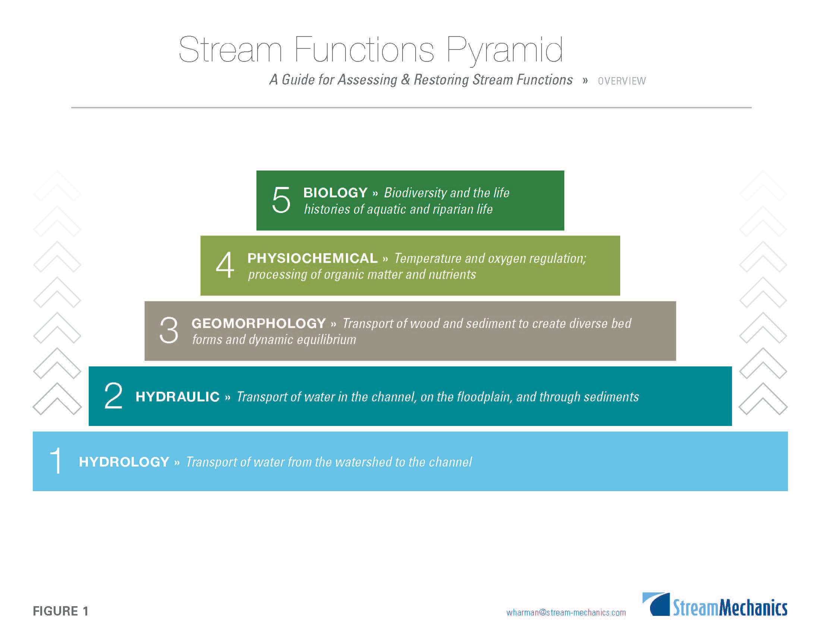
SITE SELECTION
REACH SCALE
IMPROVEMENTS
INDEPENDENT VARIABLES

Slide 6
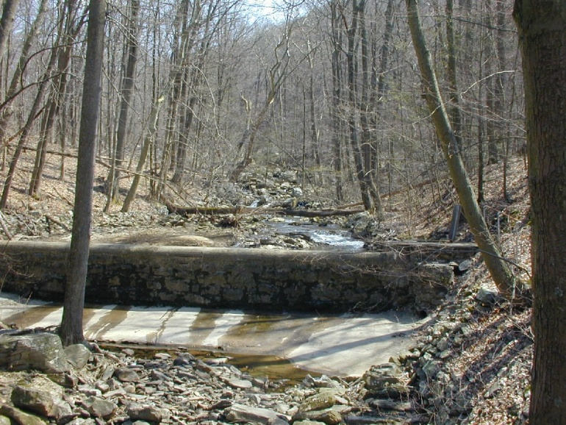
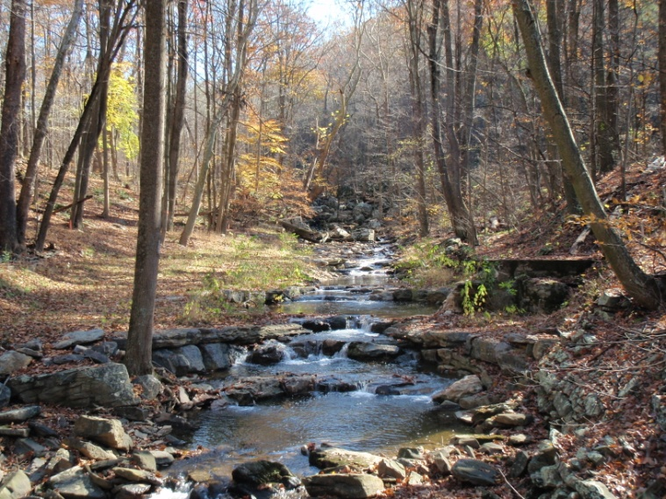
Workshop Questions:
BEFORE
What are the standards and methods used to determine stream functions that support in-stream and riparian ecosystem habitat?
How does the riparian corridor interact with the stream geomorphology to affect habitat function?
AFTER

Slide 7
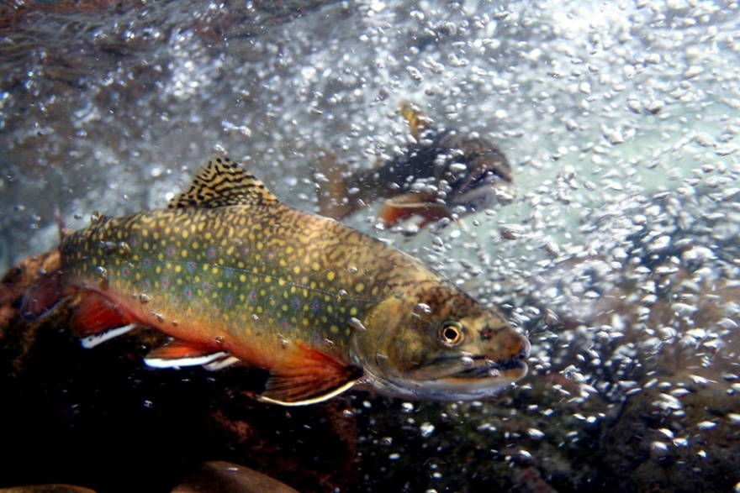
Workshop Questions:
3) What assessment tools are available to measure net gain or loss of stream functions and habitat conditions associated with stream instability to verify project success at the site, reach and watershed scale?
4) What design features are currently present in accepted stream restoration protocols that increase stream functions and habitat condition?

Slide 8
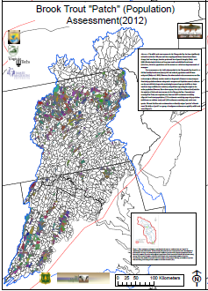
Workshop Questions:
5) How can the workshop facilitate use of stream restoration to support in-stream and riparian habitat goals?
How can this workshop facilitate the use of stream restoration to support tracking and verification?

Slide 9
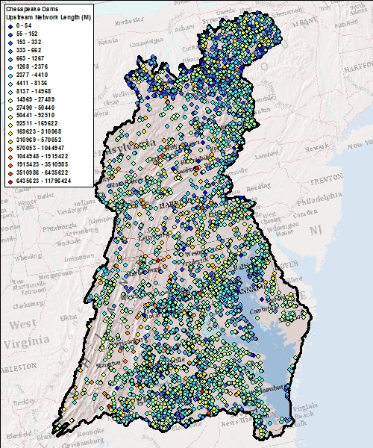
Workshop Outcome:
The workshop discussions and any consensus reached by workshop participants will form the basis of a guidance document for measuring stream habitat functional lift and/or loss associated with stream restoration and to identify best practices to improve functional lift. The consensus and guidance document will be produced within 90 days of the workshop.

