Slide 1
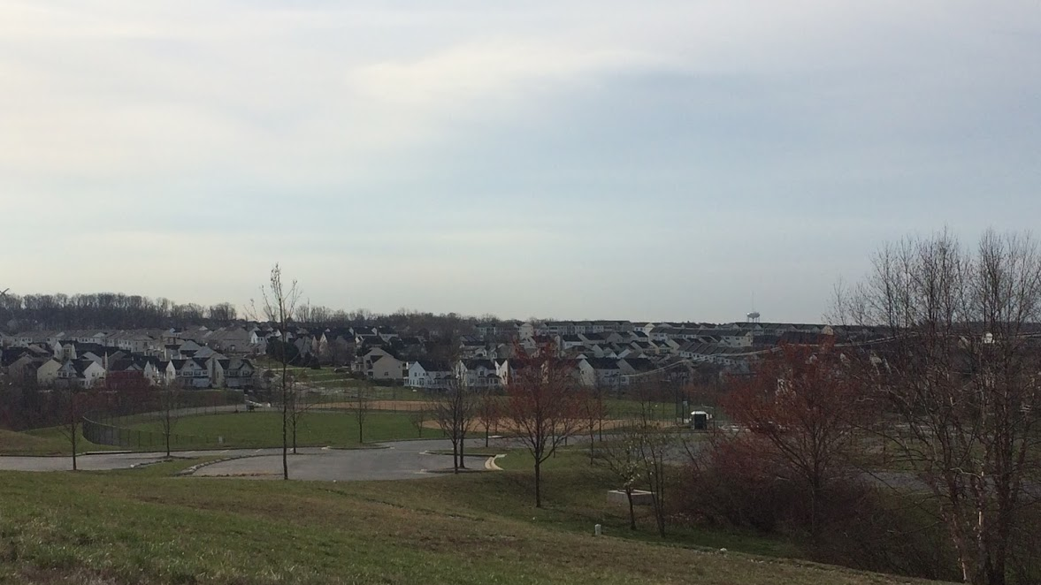
USGS/SHWG Stressor summary project update
Rosemary Fanelli, Matt Cashman, and Aaron Porter
U.S. Geological Survey
February 21, 2020

Slide 2

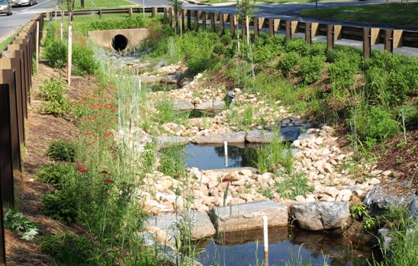
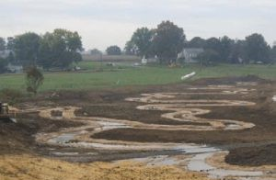
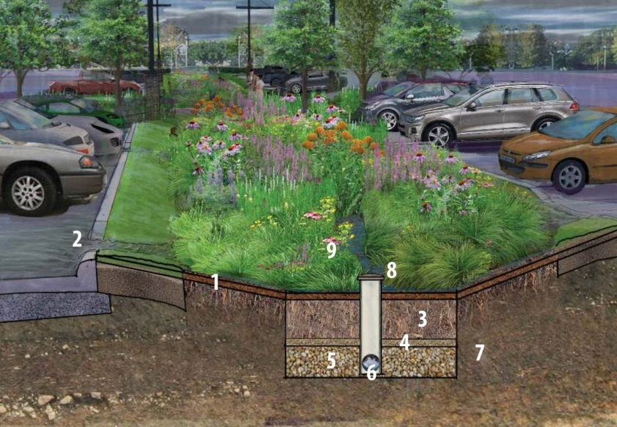
Motivation for stressor project
Regenerative stormwater conveyance
Jurisdictions in Chesapeake Bay watershed have invested heavily in management practices
Biological uplift often not observed despite watershed and stream restoration
More information is needed to understand key stressors prohibiting biological uplift in streams
Floodplain reconnection
Bioretention basins

Slide 3
Primary science questions
Which stressors and drivers most affect stream health?
Stressors = water quality, toxic contaminants, habitat suitability, altered flow, temperature, etc.
Drivers = Climate change, land use change, land use legacies
Which of these stressors can be changed through management activities, especially those that align with practices associated with existing TMDLs/new WIPs?
How is stream health changing following management implementation, and how can we better characterize the response (biological and non-biological)?

Slide 4
Primary science questions
Which stressors and drivers most affect stream health?
Stressors = water quality, toxic contaminants, habitat suitability, altered flow, temperature, etc.
Drivers = Climate change, land use change, land use legacies
Which of these stressors can be changed through management activities, especially those that align with practices associated with existing TMDLs/new WIPs?
How is stream health changing following management implementation, and how can we better characterize the response (biological and non-biological)?

Slide 5
Approach for Question 1
Question: Which stressors are most affecting stream health* in the Chesapeake Bay watershed?
Use existing information to summarize current understanding of the dominant stressors in specific landscape settings (agricultural, urban, mixed)
Summarize two sources of stressor information
Scientific literature through a structured literature review
Summarize stressors identified as responsible for causing impairment of streams through jurisdictional 303d lists
Synthesize results and communicate to SHWG & USGS
*Stream health = benthic IBI

Slide 6
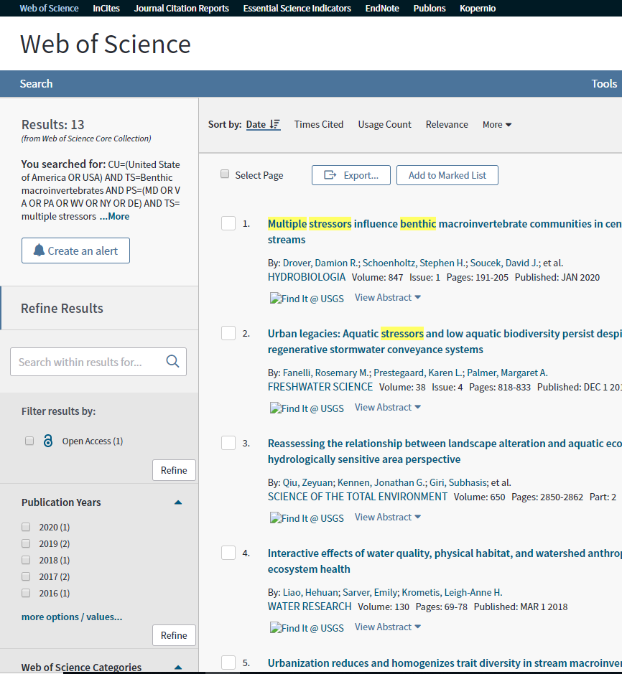
Literature review update
Establishing the work flow
Structure search strings to target papers in the literature
Establish inclusion and exclusion criteria for literature
Identify pertinent information to extract from the studies
Summarize and synthesize results

Slide 7
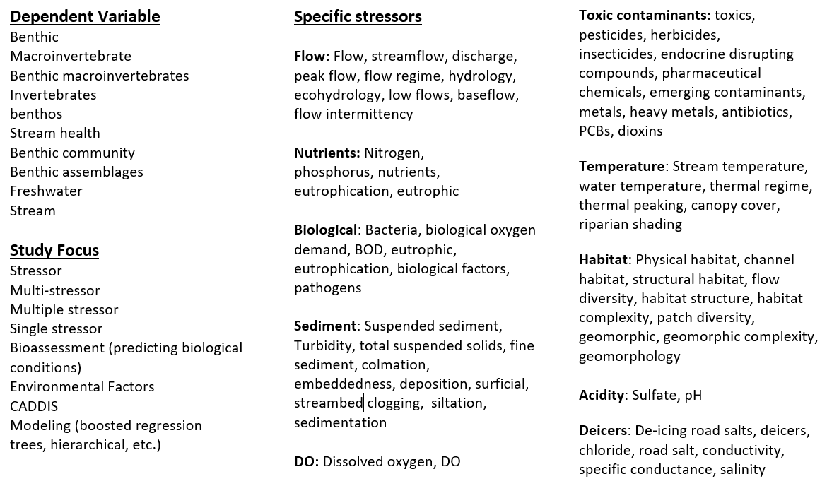
Structuring the literature search strings

Slide 8
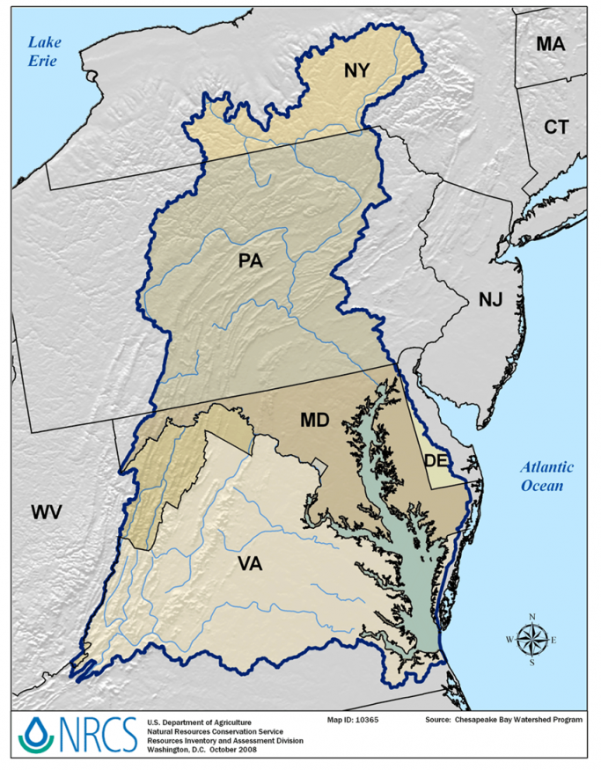
Establishing inclusion/exclusion criteria
Outside geographic scope (outside of eastern/mid-Atlantic United States)
Benthic macroinvertebrates not the response variable
Did not test the effects of one or more stressors
Not freshwater/non-tidal
Other paper/stressor-specific reasons

Slide 9
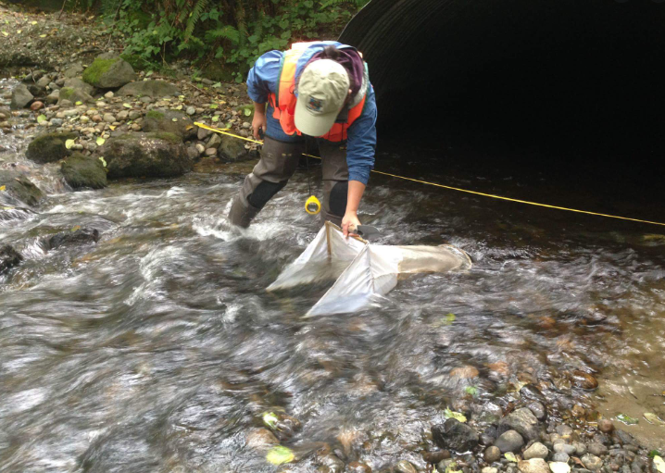
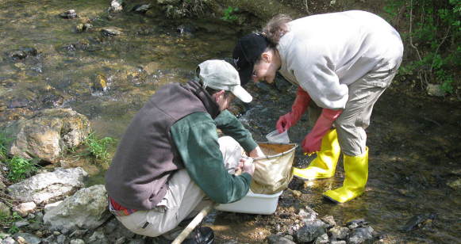
Extracting key information from selected literature
General paper information
Author, title, journal, etc.
General study design
Field-based study vs flume or mesocosm
Multiple or single stressor
Methodology
How response variable was measured (IBI, %EPT)
How stressor(s) were quantified
Key findings
Identified dominant stressor
Thresholds for detectable changes in stream health
Qualitative measures of changes in stream health
Study constraints/limitations

Slide 10
Summarize and synthesize results
What stressors are most important/have biggest impact
Summarized globally and within land use sectors (urban, ag, etc.)
How stressors and stream health are being measured/quantified
How the effect of the stressor(s) is measured (e.g., stats)
Evidence of stressor co-occurrence/stressor interactions
What are the ways this is being tested (e.g., study design)
Other information?
Need to include gray literature
Synthesize with results from 303d list summary

