Slide 1
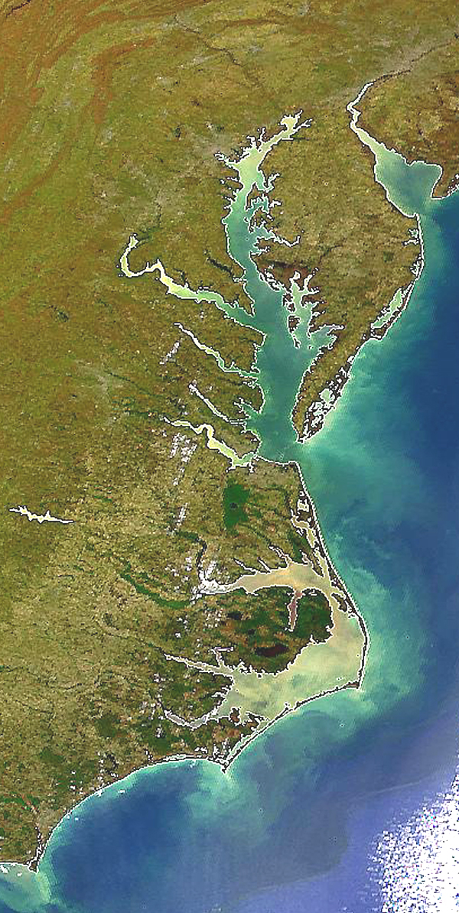

Updating Background Conditions and BMP Efficiencies
Jeff Sweeney
Environmental Protection Agency
Chesapeake Bay Program Office
jsweeney@chesapeakebay.net
410-267-9844
Milestone Workgroup Meeting
May 8, 2014

Slide 2

Milestone Evaluations
How changing background conditions influenced making / missing 2013 goals
Among 21 possible instances for all sources combined
[7 jurisdictions x (N, P and SED)], there were 0 cases where the assessment would have been different (meeting versus not meeting 2013 Milestone goals) because of different background conditions (2010 versus 2013).
Among 87 possible instances among major sources
[7 jurisdictions x (N, P and SED) x (Agriculture, Urban, Wastewater and Septic)], there were 9 cases where the assessment was different (meeting versus not meeting 2013 Milestone source goals) because of different background conditions (2010 versus 2013).

Slide 3
Milestone Evaluations
How changing BMP efficiencies influenced making/missing 2013 goals
Generally, changing BMP efficiencies had a greater effect on meeting/missing 2013 goals (for all sources combined and among sources) than changing background conditions ⇒ degree of influence depended on the jurisdiction
For evaluations, EPA was aware of the influence of changing BMP efficiencies in making/missing 2013 Milestones targets in cases where it made a difference.

Slide 4
Milestone Evaluations
The importance of programmatic progress and programmatic goals in Milestone evaluations
92% of the written Milestone evaluations address programmatic status and goals ⇒ only 8% of the written Milestone evaluations are a review/evaluation of the model load reductions
Various charts and tables for model loads and BMPs
EPA looking for strong connections between programmatic accomplishments and significant increases in the implementation rates of relevant BMPs.

Slide 5
Milestone Evaluations
The importance of programmatic progress and programmatic goals in Milestone evaluations
EPA looking for strong connections between programmatic goals and planned increases in the implementation rates of relevant BMPs.
Proposed downgrades of jurisdictional source sectors to a greater degree of EPA oversight were very much influenced by the lack of progress toward programmatic goals and weak future programmatic commitments. Model loads could substantiate the proposed downgrades, but not necessarily.

Slide 6
Milestone Evaluations
The importance of loading trajectories in Milestone evaluations
Very important – and importance increases with each evaluation through 2025
Importance of trends in monitoring data will also increase over time ⇒ attainment of water quality standards + non-tidal loads

Slide 7
Future Changes
Potential future changes to data and methods (May 2014 → 2015 Progress)
Revised Background Conditions – could change 2015 projections for background conditions after May 15th final Milestones
Updated agriculture LU and animal populations from 2012 Ag Census (received 5/2/14 and being processed)
Urban, other updates from 1) 2011 National Land Cover Dataset, 2) revised PA population projections, 3) U.S. Census Bureau’s 2013 population projections, 4) variety of county-specific land use datasets, 5) sewer service areas
Planning for incorporation of this data to be finished for state review in Sept, 2014.

Slide 8
Future Changes
2014 Progress and 2015 Progress scenarios could include this information on background conditions
Workgroups and WQGIT itself) is: When should updated information for forecasting background conditions be incorporated (see 3 options in attached paper)?
EPA will use just one scenario (2015 progress) in evaluation of Milestone achievement.
Jurisdictions can assess other variations of scenarios for their own purposes.

Slide 9
Future Changes
Potential future changes to data and methods (May 2014 → 2015 Progress)
Revised BMPs – greater concern with revised efficiencies than “new” BMPs
Agriculture = Levels 2 and 3 Nutrient Management, Conservation Tillage, Riparian Forest Buffers, Poultry Litter
Urban = Onsite BMPs, E&S, Urban Filter Strips and Stream Buffers, Urban Tree Planting/Canopy, Illicit Discharge, Shoreline Erosion Controls, Floating Wetlands, Algal Turf Scrubbers

Slide 10
Future Changes
VA proposal for addressing changes in BMP efficiencies
Apply updated BMP efficiencies immediately but retain the old versions through the end of the milestone cycle.
For progress submissions, jurisdictions would have the option to use the old BMP efficiencies (same as used for milestone development) or new BMP efficiencies (based on the latest science).

Slide 11
Future Changes
A response to VA proposal
It would be difficult to substantiate picking and choosing between old and new BMP efficiencies by jurisdiction by BMP, i.e., cherry-picking.
To-date, about 10 BMP categories have been introduced with either revised efficiencies or as “new” BMP categories to the model (with several levels of benefits within some categories) – after approval of Expert Panel recommendations based on latest science.

Slide 12
Milestone Evaluations
Changes to background conditions and BMP efficiencies will be decided by WQGIT after weighing pros and cons among its workgroups.
What the WQGIT is voting on needs to be clear.
The record needs to reflect specific decisions.
There should be discussions among participants from single state prior to the GIT.
It’s not likely that simply voting for changes that are beneficial (load reductions) and voting against changes that are not beneficial (load increases) would be acceptable.

Slide 13
Milestone Evaluations
If changes in background conditions or BMP efficiencies make it easier or harder for a jurisdiction to meet its goals, it doesn’t change the overall we’re aiming for.

Slide 14
Milestone Evaluations

