Slide 1

Update and Refinement of the Chesapeake
Basin-wide Index of Biotic Integrity
(Chessie BIBI) for Non-Tidal Streams
Technical Advisory Group Conference Call
Friday, 15 January 2013, 10am – noon
To join the call, dial conference line 866-299-3188 (toll-free). Enter the following code when prompted: 410-267-5731.
To view the meeting presentation via Adobe Connect, go to: https://epa.connectsolutions.com/streamhealthworkgroup/
(Note: Enter as Guest)
Meeting materials are posted at: http://www.chesapeakebay.net/calendar/event/23407

Slide 2
2014 Chesapeake Agreement
Stream Health Outcome
  Continually improve stream health and function throughout the watershed. Improve health and function of ten percent of stream miles above the 2008 baseline for the watershed.
Management Strategy refers to stream indicators:
  Track improvement in stream health and function with the Chesapeake Basin-wide Index of Biotic Integrity (Chessie BIBI).
  Develop additional indicators from routinely collected, non-biological monitoring data (land use, land cover, water quality)

Slide 3
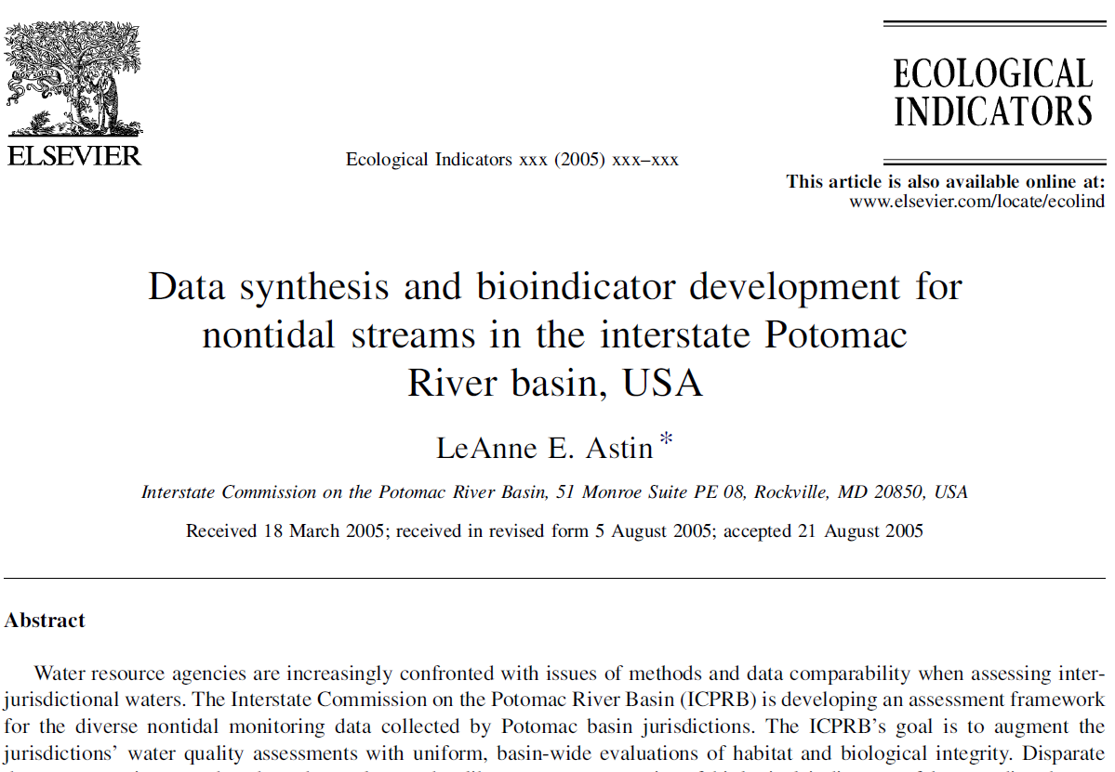

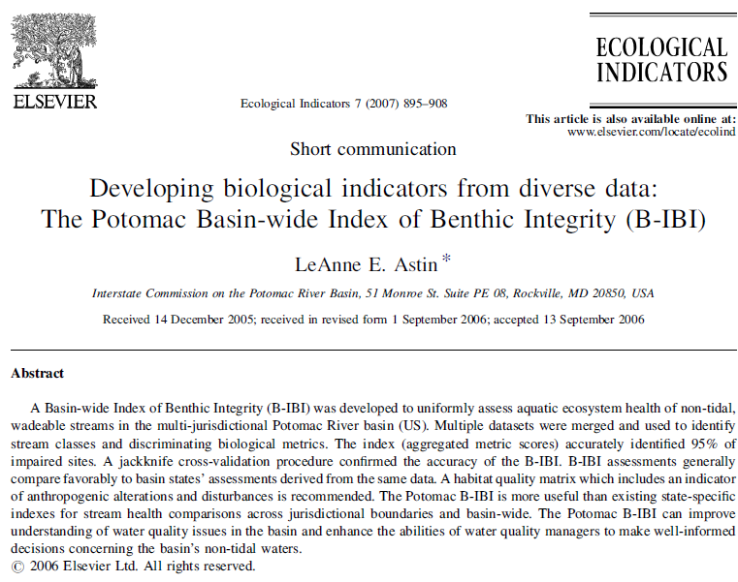
Chessie BIBI
Potomac index (2005, 2006) … … expanded to Chesapeake basin (2011)
www.potomacriver.org/Publications

Slide 4
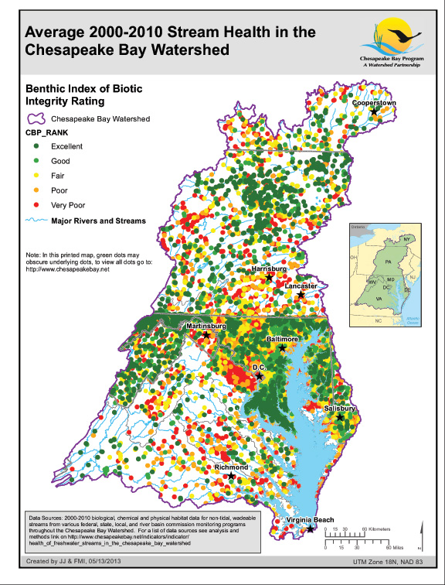
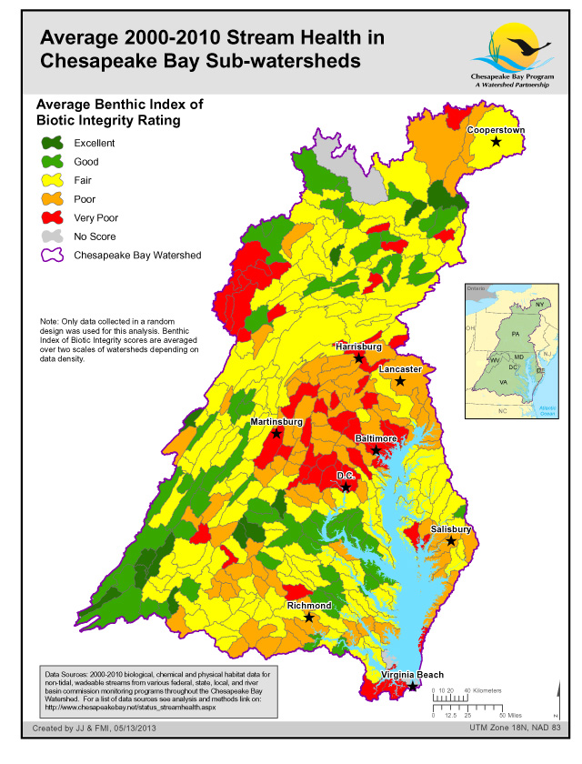
www.chesapeakebay.net/indicators/indicator/health_of_freshwater_
streams_in_the_chesapeake_bay_watershed

Slide 5
Current Project (2015-2016)
Objectives
  Update CBP database of non-tidal stream data
  Refine Chessie BIBI index
  Support Stream Health Wkgrp development of “2008 baseline” in “stream miles”
Funding
  ICPRB 117 grant “Water Quality/Living Resources Data Management and Analysis for the Chesapeake Bay Program”
Scope of Work *
ICPRB Staff
  Andrea Nagel, Zachary Smith, Claire Buchanan
  Mike Mallonee (ICPRB/CBP)

Slide 6
Technical Advisory Group
2010-2011 TAG
TAG guidance = a better built index
Transparency = general acceptance of index
Asking 2016 TAG to:
Review approaches for refining index
Provide feedback on key technical details
Participate in development of 2008 baseline later this year (if interested)

Slide 7
Outline
Update non-tidal stream biological database
Proposed approach for refining the index
BIBI2 R-Package

Slide 8
Update of non-tidal stream biological database
www.chesapeakebay.net/data/downloads/
watershed_wide_benthic_invertebrate_database

Slide 9
Record Count
* Does not include updated data for several counties.
SRBC data recently received n = 685, 2010 - 2013.

Slide 10
Record Count
9 years

Slide 11
Challenges of Updating Database
Source data are in different database structures & formats
  In-House
  EDAS (Tetra Tech)
  CBP
  Tables in pdf’s
Data management/accessibility of source data varies
Always some uncertainty in translation
→ Need a better way of doing this if CBP is serious about tracking indicators of stream health, including Chessie BIBI

Slide 12
Proposed approach for refining the Chessie BIBI index
Family-level
Genus-level

Slide 13
Proposed Approach
Section 1: R Statistical Software
Section 2: Supporting Tables
Section 3: Index Refinement
Section 4: Site Classification
Section 5: Metric Sensitivity and Scoring
Section 6: Taxa Indicator Analysis

Slide 14
Section 1: R Statistical Software
R and R studio
  Free and can be downloaded online
    https://www.rstudio.com/products/rstudio/download/
  More than 100 ecology related packages available on CRAN
    https://cran.r-project.org/web/views/Environmetrics.html

Slide 15
Section 1: R Statistical Software
Package
  “They (packages) include reusable R functions, the documentation that describes how to use them, and sample data.” (Wickham 2015)
  BIBI2 Package
Functions
  Allows the user to quickly and easily repeat a specific action (e.g. transformation or analysis)

Slide 16
Section 2: Supporting Tables
Tables necessary for data transformations and metric calculations
  The Master Taxa List
  The Taxa Attributes Table

Slide 17
Section 2: Master Taxa List
Integrated Taxonomic Identification System
  www.itis.gov
  Taxonomic Serial Number (TSN)
  Taxa not in ITIS database:
    If valid based on literature assigned a unique identification
    If the taxon was identified to a level not specified in the table it was rolled up to the next lowest taxonomic rank
      Complex: Libellulidae/Corduliidae

Slide 18
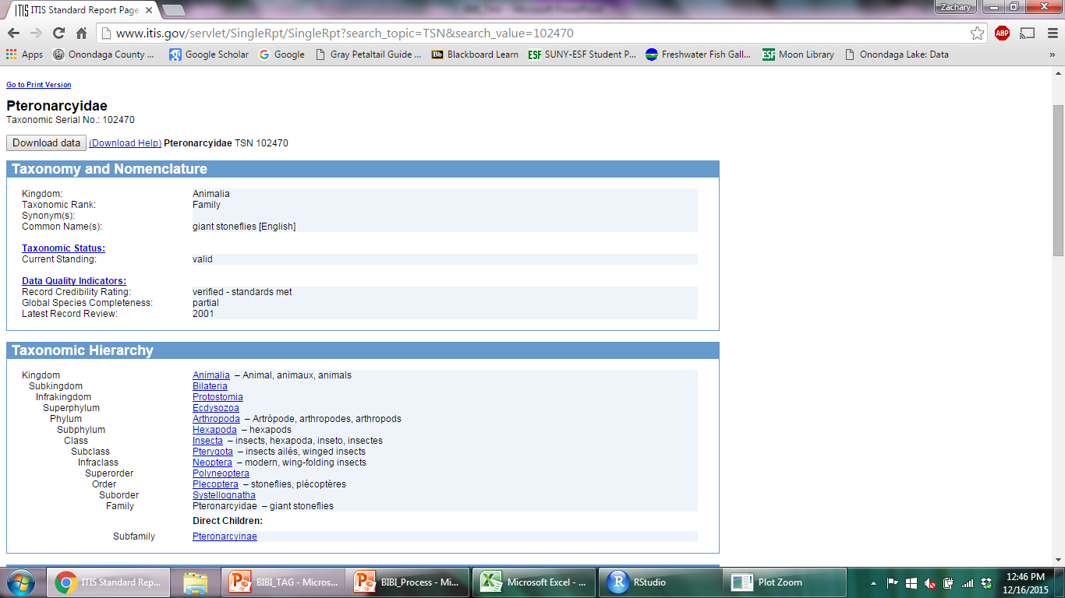

Slide 19
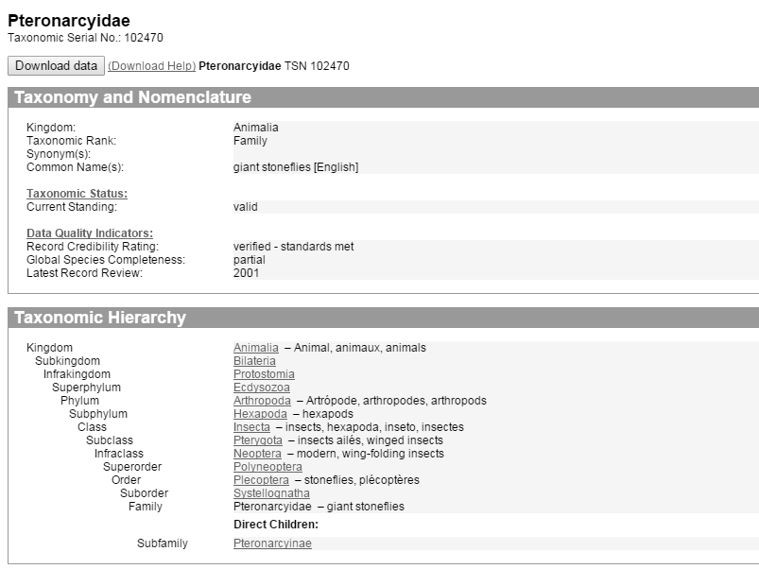

Slide 20
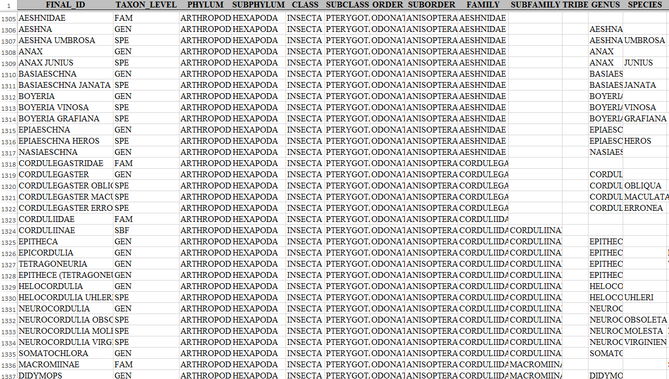
Section 2: Master Taxa List
Notes:
Matching taxonomic counts with the master list
The list can either be merged based on counts assigned a TSN or the final ID
Will merge some invalid TSN’s with current valid TSN
If the TSN was no longer valid it was included in the table but linked to the valid TSN
Spelling errors create major issues for matching
The merge then provides multiple taxonomic levels for the taxon and a valid TSN
Phylum, Subphylum, Class, Subclass, Order, Suborder, Family, Subfamily, Tribe, Genus, and species

Slide 21
Section 2: Master Taxa List
Enables the data counts to be transformed from a long data format to a wide data format for each taxonomic rank
  Bypasses the need to manually list each taxon necessary for metric calculations
  Easier to explore new metrics
    Ex: The percentage of Heptageniidae and Baetidae in a sample

Slide 22
Section 2: Long Data Frame
EVENT_ID | STATION | COUNT | ORDER | FAMILY | GENUS
1 | Stream_1 | 30 | Ephemeroptera | Heptageniidae | Epeorus
1 | Stream_1 | 70 | Plecoptera | Pteronarcyidae | Pteronarcys
2 | Stream_2 | 40 | Ephemeroptera | Heptageniidae | Epeorus
2 | Stream_2 | 30 | Ephemeroptera | Heptageniidae | Heptagenia
2 | Stream_2 | 30 | Ephemeroptera | Heptageniidae | Stenacron
3 | Stream_3 | 10 | Diptera | Chironomidae | Cricotopus
3 | Stream_3 | 10 | Ephemeroptera | Heptageniidae | Epeorus
3 | Stream_3 | 20 | Ephemeroptera | Baetidae | Baetis
3 | Stream_3 | 20 | Plecoptera | Pteronarcyidae | Pteronarcys
3 | Stream_3 | 40 | Diptera | Chironomidae | Chironomus
Notes:
Each row is representing a unique genus for each Event ID

Slide 23
Family Level: Wide Data Frame
EVENT_ID | STATION | Baetidae | Chironomidae | Heptageniidae | Pteronarcyidae
1 | Stream_1 | 0 | 0 | 30 | 70
2 | Stream_2 | 0 | 0 | 100 | 0
3 | Stream_3 | 20 | 50 | 10 | 20
Order Level: Wide Data Frame
EVENT_ID | STATION | Diptera | Ephemeroptera | Plecoptera
1 | Stream_1 | 0 | 30 | 70
2 | Stream_2 | 0 | 100 | 0
3 | Stream_3 | 50 | 30 | 20

Slide 24
Section 2: Update the Taxa Attribute Table
Table includes Family and Genus level Functional Feeding Groups (FFG), habits, and tolerance values
Tolerance values will be representative of each bioregion
  The mean tolerance value from all of the agencies which sample within a bioregion will be used to assign tolerance values to each taxon.
Notes:
We do not expect major differences but argue that if we are going to have unique metrics and scores for each bioregions, the tolerance values should also represent the bioregion.

Slide 25
Section 2: Taxa Attributes Table
Final ID | Agency A | Agency B | Agency C | Bioregion Tolerance Value
Genus A | 5 | 6 | 7 | 6
Genus B | 8 | 8 | 8 | 8
Genus C | 5 | 4 | 4 | 4.3
Genus D | 2 | 1 | 5 | 2.7 ???
Notes:
-How to handle large discrepancies in tolerance values?
-Tolerance values, Functional Feeding Groups (FFG), and habits
-2011 BIBI members of the TAG agreed upon a single set of attributes for each taxon in the Chesapeake Basin
-Currently developing attributes unique to each bioregion based on attributes assigned by agencies within a bioregion

Slide 26
Section 2: Discussion Point
Any volunteers who would like make a collaborative effort to update the taxa attributes table?
Is there a possibility of incorporating the USGS attribute tables…
  Vieira, N.K.M., N.L. Poff, D.M. Carlisle, S.R. Moulton II, M.K. Koski, and B.C.Kondratieff. 2006. A database of lotic invertebrate traits for North America: U.S. Geological Survey Data Series 187. Available at: http://pubs.water.usgs.gov/ds187
  Carlise, D.M., M.R. Meador, S.R. Moulton, II, and P.M. Ruhl, 2007, Estimation and application of indicator values for common macroinvertebrate genera and families of the United States. Ecological Indicators, 7:22-23.

Slide 27
Section 3: Index Refinement
Subsetting the data (for index refinement)
Classifying data into bioregions
Genus level analysis
Rarefaction

Slide 28
Section 3: Subsetting the Data
The data was subset to only include sites…
  Wadeable streams (Strahler order 1 – 4)
  Similar sampling method (kick-net)
  All necessary environmental variables have been measured
    Rapid habitat assessment, specific conductivity, pH, and DO

Slide 29
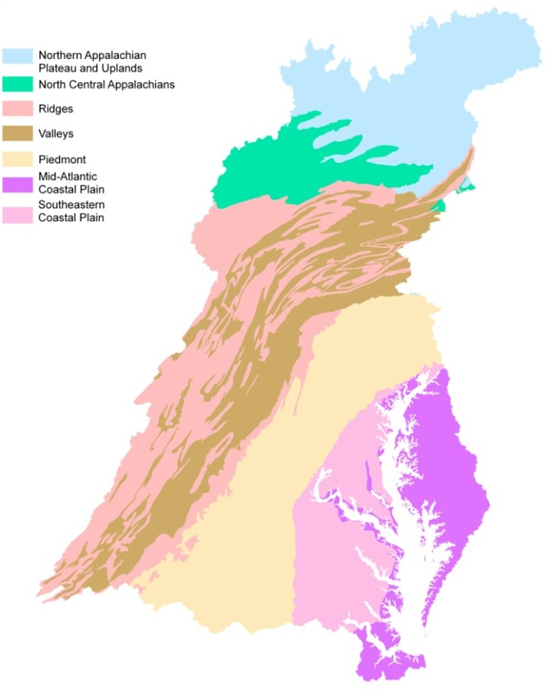
Section 3: Bioregions

Slide 30
Section 3: Genus Level Analysis
Not all agencies identify taxa to the genus level
Stations without genus level identification will be excluded from this analysis
The percentage of the organisms at a station identified to the genus level or beyond will be calculated
Stations with > 80% genus level identification will be used in the analysis
Notes:
Highlight that Family level metrics will be assessed as well as genus level metrics

Slide 31
Section 3: Rarefaction *
The standard sampling count differs between agency (e.g., 100, 200, 500)
Richness is positively correlated with sampling count
Rarefaction
  A random subsample without replacement
  Subsample by the lowest common denominator (100)

Slide 32
Section 3: Rarefaction

Slide 33
Section 3: Rarefaction and Vegan
Taxa | Raw Counts | rrarefy 1 | rrarefy 2 | rrarefy 3
A | 200 | 38 | 39 | 33
B | 195 | 30 | 30 | 31
C | 190 | 27 | 30 | 36
D | 10 | 3 | 0 | 0
E | 4 | 1 | 1 | 0
F | 3 | 0 | 0 | 0
G | 2 | 1 | 0 | 0
H | 1 | 0 | 0 | 0
Total | 605 | 100 | 100 | 100
Richness | 8 | 6 | 4 | 3
rarefy | 5.2
Notes:
-Vegan R-package
-Rarefy = richness if the sample were subsampled to x number of individuals
-Rrarefy = new assemblage matrix developed from subsample of x number of individuals without replacement
-The new matrix is different with each use of the function
-Difficult to develop thresholds on metrics that fluctuate with each use of the rrarefy function

Slide 34
Section 3: Community composition with each reiteration of the rrarefy function
Frequency
Community Composition

Slide 35
Section 3: Proposed Rarefaction Method
Taxa | Raw Count | Subset | Percentage | Rarefied Count
A | 200 | 200 | 33.22 | 34
B | 195 | 195 | 32.39 | 33
C | 190 | 190 | 31.56 | 32
D | 10 | 10 | 1.66 | 2
E | 4 | 4 | 0.66 | 1
F | 3 | 3 | 0.50 | 1
G | 2
H | 1
Total | 605 | 602 | 100.00 | 103
Richness | 8 | 6 | 6 | 6
rarefy | 5.2 (6)
Notes:
Proposed Rarefaction Modification
Use the rarefy function to find the richness value (s) represented at subsample size x
List the taxa in descending order based on counts
Remove the first s number of individuals
Represent the organisms as a proportion of subsample size x
Provides the same matrix with every time the function is utilized
Provides the taxa most likely to represent sample
If rrarefy was replicated infinitely the mean for each taxon would approach the proportion of the sample represented by the taxon

Slide 36
Section 4: Site Classification
Sites will be categorized into 1 of 3 classifications: Reference, Mixed, or Degraded
Environmental variables are used to define each classification
  Watershed variables
  Habitat variables
  Water quality variables

Slide 37
Section 5: Selecting and Scoring Metrics
Selecting metric thresholds for separating reference and degraded conditions
  Discrimination Efficiency
Eliminating redundant metrics
  Pearson correlation
Metric selection
  Metric types
Scoring metrics
  Optimal Discrimination Threshold

Slide 38
Section 5: Discrimination Efficiency
Deg
Ref
Frequency
15
25
50
Ref Percentiles
Metric Value
Notes:
-The metric score that best separates the reference and degraded data pools
-50 values based on reference percentile values are tested as a threshold
-If the metric decreases with disturbance, reference percentile values 0-50 are tested
-If the metric increases with disturbance, reference percentile values 50-100 are tested
-The threshold with that correctly identifies the greatest percentage of reference sites and degraded sites is selected

Slide 39
Section 5: Metric Redundancy
Checking for redundant metrics using Pearson correlation
  Correlation coefficient > 0.7 or < -0.7
If two metrics are correlated:
  The metric with lower optimal Discrimination Efficiency value is excluded from further analysis

Slide 40
Section 5: Metric Selection
Selecting metrics with the largest Discrimination Efficiency value
Metric Type:
  Diversity
  Composition
  Functional Feeding Group (FFG)
  Habit
  Tolerance

Slide 41
Section 5: Scoring Metrics
Bin 2
Bin 1
Bin 3
Deg
Ref
Frequency
15
25
50
REF Percentiles
Metric Value
Notes:
-The discrimination efficiency threshold creates the boundary that separates the poor condition (Bin 1) from the mixed condition (Bin 2)
-The best condition (Bin 3) is defined by the reference median
-If the metric decreases with disturbance then any score above the reference median is considered the best condition
-If the metric increases with disturbance then any score below the reference median is considered the best condition

Slide 42
Section 5: Scoring Metrics
Bin 1 receives a score of 0%
Bin 3 receives a score of 100%
Bin 2 receives a score from the equation:

Slide 43
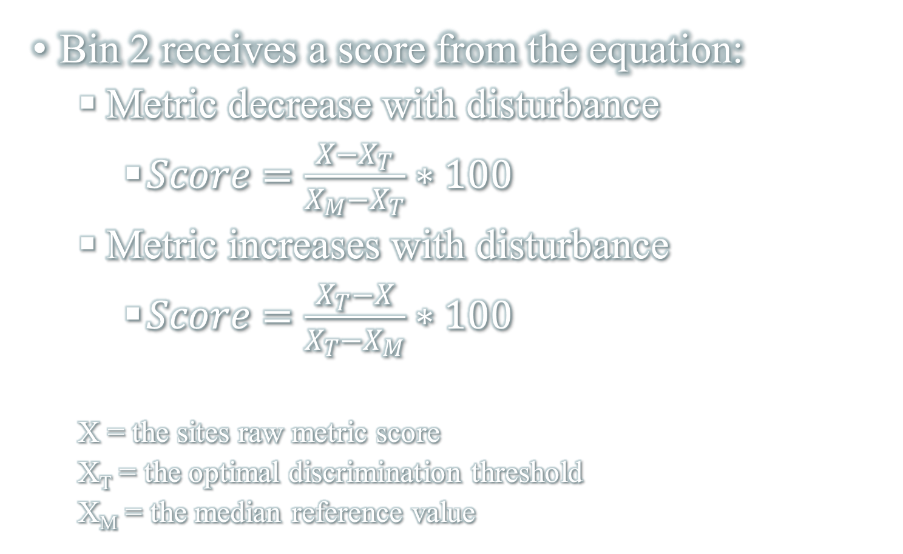
Section 5: Scoring Metrics
Bin 2 receives a score from the equation:
  Metric decrease with disturbance
    $Score=\frac{X−X_{T}}{X_{M}−X_{T}}∗100$
  Metric increases with disturbance
    $Score=\frac{X_{T}−X}{X_{T}−X_{M}}∗100$
  X = the sites raw metric score
  X_{T} = the optimal discrimination threshold
  X_{M} = the median reference value

Slide 44
Section 6: Taking the IBI One Step Further
IBI’s point to streams that are degraded but they typically do not suggest which factor(s) are driving the degradation
The taxa indicator analysis will be used to identify if certain genera, families, or orders are correlated with specific stressors
  R package: indicspecies (Caceres 2013)
  R package: TITAN2 (Baker and King 2015)

Slide 45
Summary
Joining the count data to the master taxa list and the taxa attributes table
Subsetting the data
  Wadeable streams, kick net samples, and all environmental parameters
Dividing the data into bioregions
Selecting the metrics and scoring the metrics specific to each bioregion
Merging the station scores for each bioregion into one final output

Slide 46
BIBI2
R Package
Benefits:
  Can be easily shared
  The functions run quickly
  A user manual will be built into the package
  The functions can be used to assess data unrelated to the Chessie BIBI

Slide 47
R Statistical Software
BIBI 2 package
  “They (packages) include reusable R functions, the documentation that describes how to use them, and sample data.” (Wickham 2015)
  Functions
    Allows the user to quickly and easily repeat a specific action (e.g. transformation or analysis)

Slide 48
Function
pct_dom1 <- function(Taxa.df) {
maxn <- function(n) function(p) order(p, decreasing = TRUE)[n]
n <- colnames(Taxa.df[(apply(Taxa.df[1:nrow(Taxa.df), ], 1, maxn(1)))])
DOM1 <- apply(Taxa.df[,3:ncol(Taxa.df)], 1, function(p) p[maxn(1)(p)])
return(DOM1 / rowSums(Taxa.df[,3:ncol(Taxa.df)]) * 100)
}
In Use
pct_dominant <- pct_dom1(Taxa.dataframe)

Slide 49
BIBI2 Demonstration…

