Slide 1

TAG Meeting 2
Zachary M. Smith
ICPRB
Conference Line: 866-299-3188 Code: 267-985-6222
Adobe Connect: https://epawebconferencing.acms.com/streamhealthworkgroup/
Meeting Website: http://www.chesapeakebay.net/calendar/event/23800

Slide 2
Objective
Update and refine the 2011 Chessie BIBI for Chesapeake Bay Program assessment purposes.

Slide 3
Outline
Section 1: Master Taxa List
Section 2: Site Classification
Section 3: Rarefaction
Section 4: Metric Sensitivity
Section 5: Redundancy Analysis
Section 6: Scoring Protocol
Section 7: Index Resolution

Slide 4
Master Taxa List
Taxa
  Freshwater Benthic Macroinvertebrates collected in the Chesapeake Bay watershed
    222 of families (151 insect families)
    760 of genera (621 insect genera)
  11 taxonomic ranks included (ITIS Link)
    Phylum, subphylum, class, subclass, order, suborder, family, subfamily, tribe, genus, and species

Slide 5
Master Taxa List
  Common Attributes
    Municipal Waste Tolerance Values
    Functional Feeding Groups (FFG)
    Habits
  EPA Attributes (USGS 2006, EPA 2012)
    Respiratory Type
    Voltinism
    Specific Stressors

Slide 6
Master Taxa List
Tolerance Values
  Mean tolerance values rounded to the nearest integer
  NAs not included
FFGs and Habits
  The most frequent occurring category
  If max frequencies were equal the categories were concatenated (e.g. SH, CG or CL, CB)

Slide 7
Tolerance Values (TV)
Source | % All Taxa | % Order | % Family | % Genus
EDAS_MD_TV | 8 | 0 | 0 | 18
RBP_MID_ATLANTIC_MACS_TV | 9 | 0 | 4 | 17
EDAS_NC_TV | 9 | 0 | 1 | 20
EDAS_DE_TV | 9 | 0 | 0 | 19
RBP_MIDWEST_OH_TV | 10 | 0 | 2 | 12
DC_TV | 11 | 12 | 16 | 19
EDAS_RBP_TV | 11 | 0 | 0 | 23
EDAS_ITIS_TV | 11 | 0 | 14 | 20
EDAS_KY_TV | 12 | 0 | 0 | 27
EDAS_PA_TV | 13 | 0 | 1 | 29
RBP_SOUTHEAST_NC_TV | 16 | 0 | 1 | 19
EDAS_WAB_TV | 17 | 0 | 1 | 37
EDAS_TV_FINAL | 20 | 0 | 38 | 32
EDAS_WV_TV | 20 | 0 | 36 | 32
EDAS_FAM_TV | 20 | 0 | 37 | 31
EPA_TV | 36 | 35 | 54 | 64
NYSDEC_TV | 53 | 23 | 54 | 56
BIBI_TV | 69 | 42 | 69 | 79
TV | Frequency
0 | 35
1 | 81
2 | 138
3 | 108
4 | 189
5 | 184
6 | 262
7 | 137
8 | 150
9 | 31
10 | 29
n = | 1,344

Slide 8
Functional Feeding Groups (FFG)
FFG | Frequency
CF,SC | 1
CF,SH | 1
CG,CF,PR,PH | 1
CG,PR,PH | 1
CG,SC,PR | 1
PR,PA | 1
SC,PR | 1
SH,OM | 1
SH,SC | 1
CG,CF,PR | 2
CG,SH | 2
PR,PH | 2
SH,PR | 2
CG,PR | 3
PA | 3
PH | 4
CG,CF | 5
SC,OM | 5
PR,OM | 7
CG,SC | 10
CG,OM | 12
OM | 16
SH | 135
CF | 145
SC | 172
PR | 423
CG | 443
Source | % All Taxa | % Order | % Family | % Genus
DC_FFG | 11 | 4 | 14 | 19
EDAS_KY_FFG | 13 | 0 | 0 | 29
EDAS_ITIS_FFG | 15 | 0 | 26 | 25
EDAS_FINAL | 19 | 0 | 41 | 30
EDAS_WV_FFG | 21 | 0 | 38 | 35
RBP_P_FFG | 32 | 21 | 31 | 43
EPA_FFG | 41 | 44 | 63 | 73
NYSDEC_FFG | 52 | 12 | 54 | 55
BIBI_FFG | 72 | 52 | 75 | 83

Slide 9
Habits
HABIT | Frequency
BU,SK | 1
CB,BU,SP | 1
CB,CN,BU | 1
SW,BU | 1
CB,BU | 2
CB,CN,SP | 2
CB,SK | 2
SW,SP | 2
CB,CN | 4
CB,SW | 4
CN,BU | 5
CB,SP | 7
CN,SP | 7
SW,CN | 8
BU,SP | 12
SK | 15
SW | 106
CB | 151
BU | 183
CN | 232
SP | 254
Source | % All Taxa | % Order | % Family | % Genus
EDAS_KY_HABIT | 4 | 0 | 0 | 9
DC_HABIT | 9 | 0 | 12 | 18
RBP_P_HABIT | 15 | 4 | 17 | 22
EDAS__FINAL | 16 | 0 | 2 | 35
EDAS_WV_HABIT | 21 | 0 | 34 | 34
HABIT_PRIM_ABBREV | 38 | 0 | 30 | 71
EPA_HABIT | 41 | 25 | 62 | 74
BIBI_HABIT | 51 | 25 | 65 | 82

Slide 10
Unclassified Taxa
Taxa without an assigned attribute
Find the percentage of taxa in each sample that are unclassified
If ≥ 10% of the taxa are unclassified the sample is removed from the metric calculation

Slide 11
Master Taxa List
Any further comments or question regarding the master taxa list?
  Do you approve of the averaging tolerance values?
  Do you approve of the concatenating FFGs and habits?
  Are there any other tables that could be appended?

Slide 12
BIBI Workflow
Site Classification
Metric Sensitivity
Redundancy Analysis
Metric Selection
Scoring Metrics
Metric Calculation

Slide 13
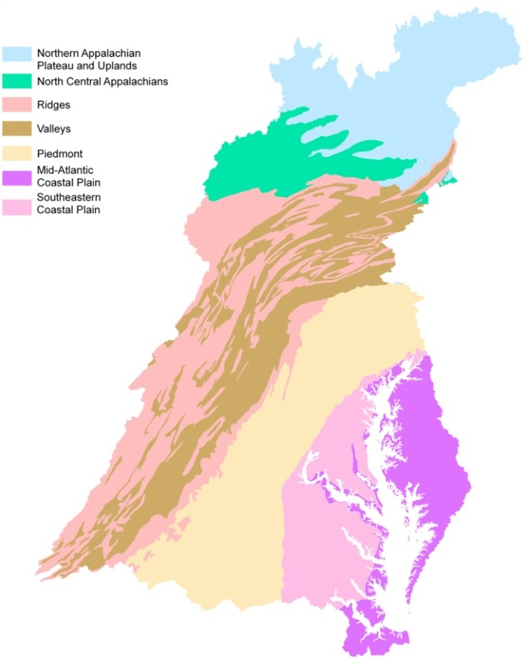
Site Classification
Classes in each bioregion (7)
  Reference
  Near Reference
  Minor Degradation
  Moderate Degradation
  Severe Degradation
  Mixed

Slide 14
Site Classification
Set reference standards
Standardize the impact of degradation
  Six Habitat Parameters
    ∑ x < 16 = 1
    ∑ x < 5 = 2
  Specific Conductivity
    x > 500 = 1
    x > 750 = 2
    x > 1,000 = 3
  pH
    x < 6 or x > 8 = 1
    x < 5 or x > 9 = 2

Slide 15
Site Classification
Sum the degradation scores
Rate on an even scale
  Reference:
    x = 0
  Near:
    1 ≤ x < 3
  Minor Degradation:
    3 ≤ x < 6
  Moderate Degradation:
    6 ≤ x < 9
  Severe Degradation:
    x ≥ 9

Slide 16
0
1
2
3
Specific Conductivity
500
750
1,000
2
1
0
Degradation Score
Rabid Habitat Assessment
5
16
2
1
0
1
2
pH
5
6
8
9

Slide 17
Class Gradient
100
IBI SCORE
50
0
REF
NEAR
MIN
MOD
SEV

Slide 18
Biological Condition Gradient
1
2
3
Biological Condition
4
5
6
Stressor Gradient

Slide 19
Biological Condition Gradient
1
Reference
2
Near Ref.
3
Biological Condition
Minor Deg.
4
Moderate Deg.
5
6
Severe Deg.
Stressor Gradient

Slide 20
Metric Calculation
Metrics
  78 metrics from the literature
  Percentage of each taxon
    > 1,000 metrics tested
    Most metrics are useless
New Metric | Common Metric | Bioregion
% Heptageniidae | % Ephemeroptera | Piedmont
% Systellognatha | % Plecoptera | Ridges
% Furcatergalia | % Ephemeroptera | Ridges

Slide 21
Rarefaction
Sampling without replacement
rrarefy function in the Vegan package
  “The random rarefaction is made without replacement so that the variance of rarefied communities is rather related to rarefaction proportion than to the size of the sample.”
  - Oksanen and O’Hara

Slide 22
Rarefaction
Frequency
Community Composition

Slide 23
 | Family | Count | % Abundance | Rarefied % Abundance
1 | EPHEMERELLIDAE | 488 | 33.38 | 33
2 | HYDROPSYCHIDAE | 285 | 19.49 | 19
3 | CHIRONOMIDAE | 142 | 9.71 | 10
4 | TAENIOPTERYGIDAE | 108 | 7.39 | 7
5 | BAETIDAE | 94 | 6.43 | 6
6 | LEPIDOSTOMATIDAE | 71 | 4.86 | 5
7 | LEPTOPHLEBIIDAE | 65 | 4.45 | 4
8 | TIPULIDAE | 65 | 4.45 | 4
9 | HEPTAGENIIDAE | 54 | 3.69 | 4
10 | CHLOROPERLIDAE | 19 | 1.30 | 1
11 | ISONYCHIIDAE | 18 | 1.23 | 1
12 | SPERCHONTIDAE | 18 | 1.23 | 1
13 | PHILOPOTAMIDAE | 13 | 0.89 | 1
14 | POLYCENTROPODIDAE | 13 | 0.89 | 1
15 | EMPIDIDAE | 9 | 0.62 | 1
16 | PERLODIDAE | 9 | 100 | 100
17 | CAPNIIDAE | 6
18 | HYDROPTILIDAE | 6
19 | GLOSSOSOMATIDAE | 4
20 | LUMBRICULIDAE | 4
21 | ATHERICIDAE | 2
22 | PERLIDAE | 2
23 | PSEPHENIDAE | 2
24 | LEUCTRIDAE | 1
25 | ODONTOCERIDAE | 1
26 | PLANARIIDAE | 1
27 | RHYACOPHILIDAE | 1
28 | SIMULIIDAE | 1

Slide 24
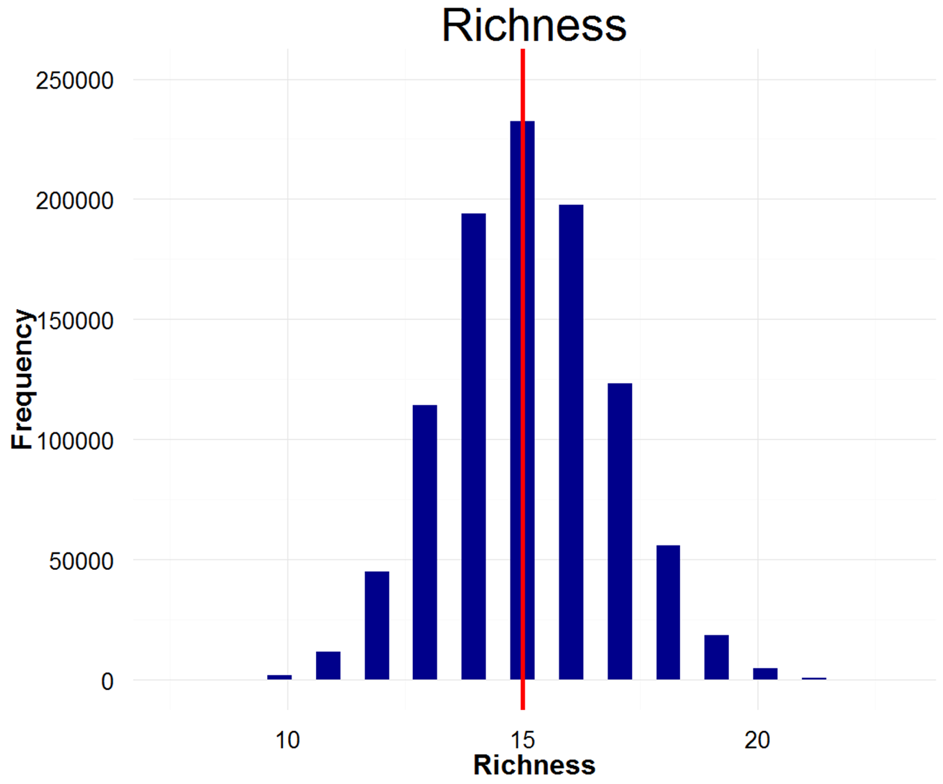
Min = 8 taxa
Median = 15 taxa
Max = 23 taxa

Slide 25
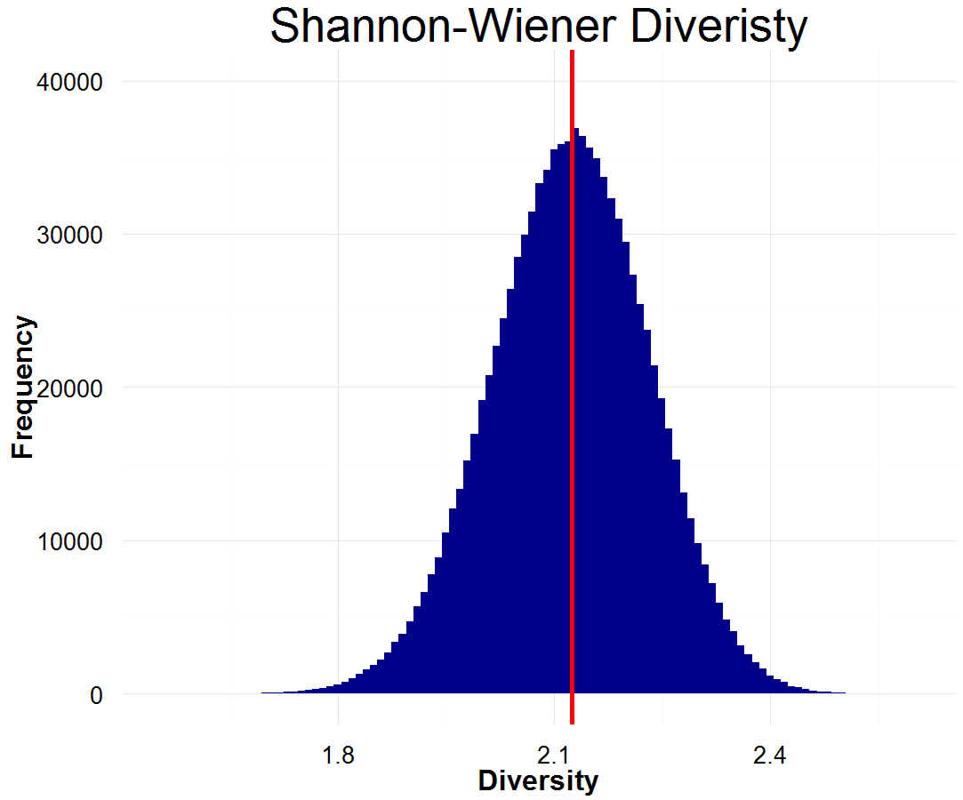
Min = 1.56
Median = 2.12
Max = 2.60

Slide 26
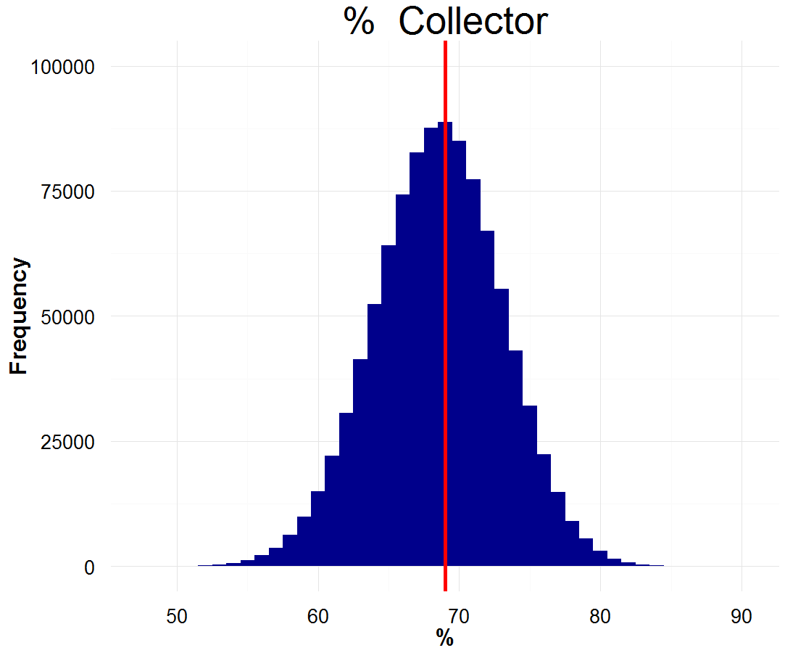
Min = 48%
Median = 69%
Max = 90%
True = 75%
n = 1052
n_{r}= 100

Slide 27
Redundancy Analysis Approaches
Scoring Protocol
Barbour et al. 1996
Quantile Threshold
Confusion Matrix Accuracy
Wilcoxon Rank Sum Test
Pairwise Confusion Matrix Accuracy
Categorical
All Gradient
Reference Threshold Gradient
Reference Gradient
Metric Sensitivity Approaches

Slide 28
Rarefaction Discussion

Slide 29
Metric Sensitivity
Objective: Identify metrics that best reflect a disturbance gradient
  Barbour et al. 1996
  Quantile Threshold
  Confusion Matrix Accuracy (CMA)

Slide 30
Barbour et al. 1996
Reference
Degraded
3 points
2 points
1 point
0 points

Slide 31
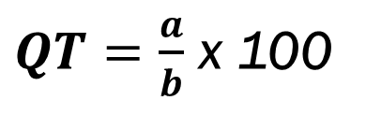
Quantile Threshold
$QT=\frac{a}{b}$ x 100
25%
Frequency
Metric Value

Slide 32
Confusion Matrix Accuracy (CMA)
15%
Frequency
Metric Value

Slide 33
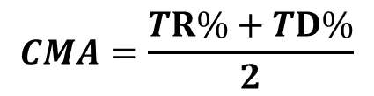
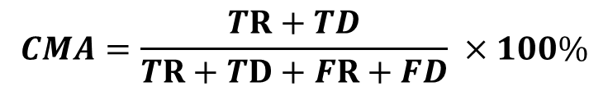
Confusion Matrix
 |  | Predicted Class
Actual Class
 |  | Reference | Degraded
 | Reference | True Reference (TR) | False Degraded (FD)
 | Degraded | False Reference (FR) | True Degraded (TD)
$$CMA=\frac{TR+TD}{TR+TD+FR+FD} ×100\%$$
$$CMA=\frac{TR\%+TD\%}{2}$$

Slide 34
Metric Sensitivity Discussion

Slide 35
Metric Sensitivity
Redundancy Analysis
Scoring Protocol
Barbour et al. 1996
Quantile Threshold
Confusion Matrix Accuracy
Wilcoxon Rank Sum Test
Pairwise Confusion Matrix Accuracy
Categorical
All Gradient
Reference Threshold Gradient
Reference Gradient

Slide 36
Redundancy Analysis
  Spearman Correlation (≤ -0.7 or ≥ 0.7)
Two methods:
  Wilcoxon Rank Sum Test
    Pairwise comparison between Reference and Severe Degradation
    The metric with the smaller p-value is held for further review
  CMA Pairwise Gradient
Class 1 | Class 2 | CMA
Reference | Near Reference | 73
Near Reference | Minor Degradation | 64
Minor Degradation | Moderate Degradation | 57
Moderate Degradation | Severe Degradation | 77
Severe Degradation | Reference | 92
 | Mean | 72.6

Slide 37
Redundancy Analysis
  Spearman Correlation (≤ -0.7 or ≥ 0.7)
Two methods:
  Wilcoxon Rank Sum Test
    Pairwise comparison between Reference and Severe Degradation
    The metric with the smaller p-value is held for further review
  CMA Pairwise Gradient
Class 1 | Class 2 | CMA
Reference | Near Reference | 73
Near Reference | Minor Degradation | 64
Minor Degradation | Moderate Degradation | 57
Moderate Degradation | Severe Degradation | 77
Severe Degradation | Reference | 92
 | Mean | 72.6

Slide 38
Redundancy Analysis Discussion

Slide 39
Metric Sensitivity
Redundancy Analysis
Scoring Protocol
Barbour et al. 1996
Quantile Threshold
Confusion Matrix Accuracy
Wilcoxon Rank Sum Test
Pairwise Confusion Matrix Accuracy
Categorical
All Gradient
Reference Threshold Gradient
Reference Gradient

Slide 40
Scoring Metrics
Categorical Scoring
  Three categories: 1, 3, and 5
  Metric decreases with degradation
    x > 50% = 5
    25% ≤ x ≤ 50% = 3
    x < 25% = 1
  Metric increases with degradation
    x < 50% = 5
    50% ≤ x ≤ 75% = 3
    x > 75% = 1
1
3
5
Frequency
Metric Value

Slide 41
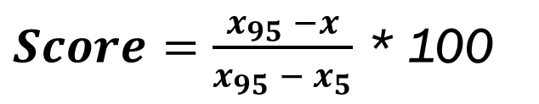
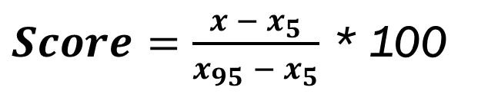
Gradient Scoring
Reference Gradient vs. All Gradient
  Decrease
    x ≤ 5% = 0
    x ≥ 95% = 100
    5% < x < 95%
  Increase
    x ≤ 5% = 100
    x ≥ 95% = 0
    5% < x < 95%
$Score=\frac{x − x_{5}}{x_{95} − x_{5}}$ * 100
$Score=\frac{x_{95} −x}{x_{95} − x_{5}}$ * 100

Slide 42
Reference Gradient
All Gradient
1 - 99
1 - 99
0
100
0
100
Frequency
Frequency
Metric Value
Metric Value

Slide 43
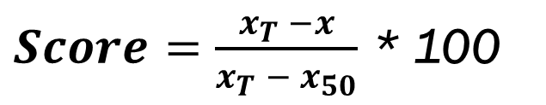
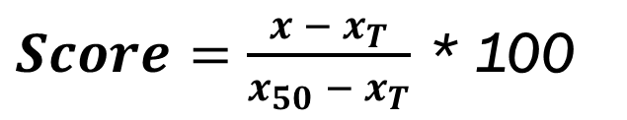
Threshold Gradient
Similar to the previous gradient approaches
  Decrease
    x ≥ 50% = 100
    x ≤ threshold% = 0
    threshold% < x < 50%
  Increase
    x ≤ 50% = 100
    x ≥ threshold% = 0
    50% < x < threshold%
$Score=\frac{x − x_{T}}{x_{50} − x_{T}}$ * 100
$Score=\frac{x_{T} −x}{x_{T} − x_{50}}$ * 100

Slide 44
Threshold Gradient
1 - 99
0
100
Threshold %
50%
Frequency
Metric Value

Slide 45
Threshold Gradient
100
80
60
IBI SCORE
40
20
0
REF
NEAR
MIN
MOD
SEV

Slide 46
Scoring Protocol Discussion

Slide 47
Metric Sensitivity Approach
Barbour et al. 1996
Quantile Threshold
Confusion Matrix Accuracy (CMA)
Redundancy Analysis Approach
Wilcoxon Rank Sum Test
Pairwise Confusion Matrix Accuracy (CMA)
Scoring Approach
Categorical
All Gradient
Ref. Gradient
Threshold Gradient

Slide 48
Metric Sensitivity Approach
Barbour et al. 1996
Quantile Threshold
Confusion Matrix Accuracy (CMA)
Redundancy Analysis Approach
Wilcoxon Rank Sum Test
Pairwise Confusion Matrix Accuracy (CMA)
Scoring Approach
Categorical
All Gradient
Ref. Gradient
Threshold Gradient

Slide 49
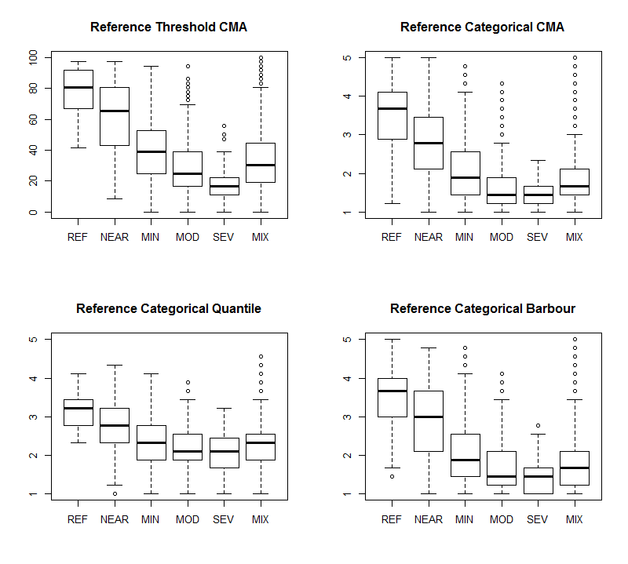
Barbour et al. 1996
Wilcoxon Redundancy Analysis
Categorical Score

Slide 50
Metric Sensitivity Approach
Barbour et al. 1996
Quantile Threshold
Confusion Matrix Accuracy (CMA)
Redundancy Analysis Approach
Wilcoxon Rank Sum Test
Pairwise Confusion Matrix Accuracy (CMA)
Scoring Approach
Categorical
All Gradient
Ref. Gradient
Threshold Gradient

Slide 51
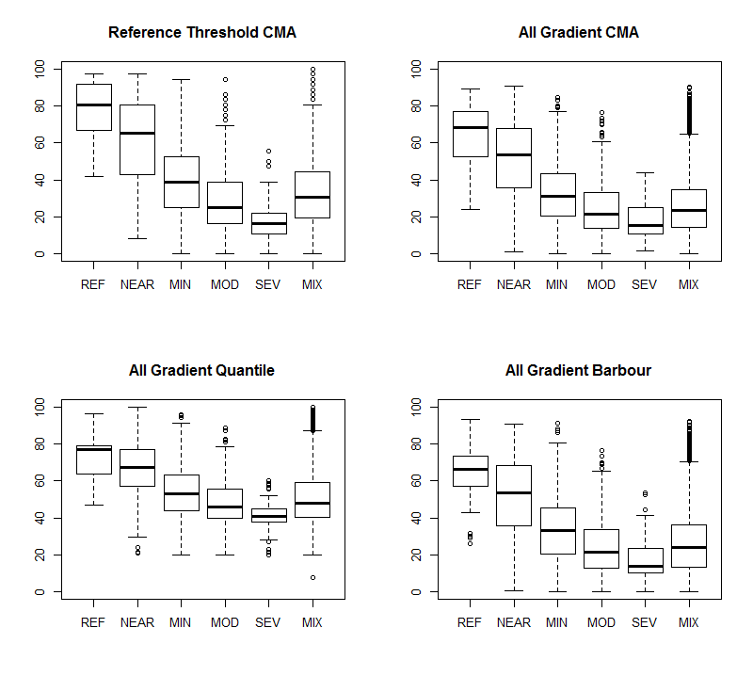
Quantile Threshold
Wilcoxon Redundancy Analysis
All Gradient Score

Slide 52
Metric Sensitivity Approach
Barbour et al. 1996
Quantile Threshold
Confusion Matrix Accuracy (CMA)
Redundancy Analysis Approach
Wilcoxon Rank Sum Test
Pairwise Confusion Matrix Accuracy (CMA)
Scoring Approach
Categorical
All Gradient
Ref. Gradient
Threshold Gradient

Slide 53
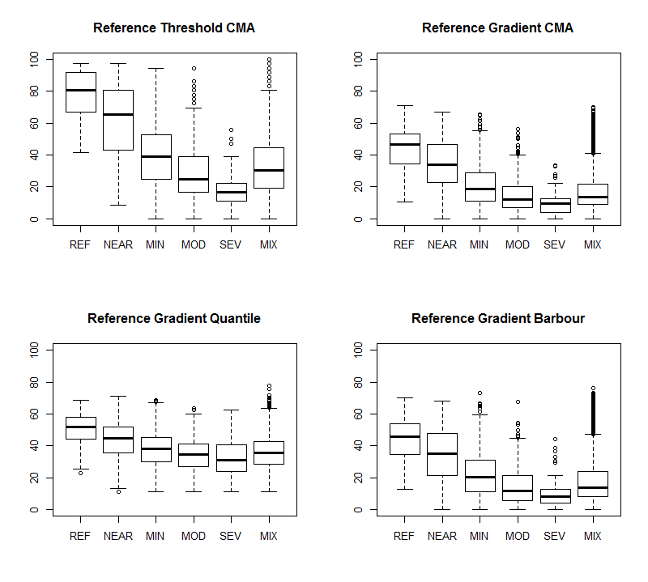
Confusion Matrix Accuracy
Wilcoxon Redundancy Analysis
Reference Gradient Score

Slide 54
n =
43
415
1,073
445
49
6,663

Slide 55
n =
43
415
1,073
445
49
6,663

Slide 56
n =
43
415
1,073
445
49
6,663

Slide 57
CMA
CMA Pairwise Gradient Redundancy Analysis
Threshold Gradient
CMA
Wilcoxon Redundancy Analysis
Reference Gradient

Slide 58
“Best” Metrics Piedmont
 | CMA Ref. Threshold | CMA Wilcoxon | DE Wilcoxon | Barbour Wilcoxon
1 | Menhinicks | % Retreat_Trichop | % Hyrop_EPT | % Retreat_Trichop
2 | HBI | % Mod_Tol | HBI | % Mod_Tol
3 | % EPT_Hydro_Baetid | % EPT | % EPT | % EPT
4 | % Corydalidae | % Corydalidae | % Corydalidae | % Corydalidae
5 | % Heptageniidae | % Pisciforma | % EPT_Rich_No_Tol | % Pisciforma
6 | % Isonychiidae | % Isonychiidae | % Isonychiidae | % Isonychiidae
7 | % Pterygota | % Non_Insect | % Non_Insect | % Non_Insect
8 | % Anisoptera | % Odonata | % Limestone | % Trichop_No_Tol
9 | % Perlidae | % Systellognatha | % Unionoida | % Sytellognatha

Slide 59
“Best” Metrics Piedmont
 | CMA Ref. Threshold | CMA Wilcoxon | DE Wilcoxon | Barbour Wilcoxon
1 | Menhinicks | % Retreat_Trichop | % Hyrop_EPT | % Retreat_Trichop
2 | HBI | % Mod_Tol | HBI | % Mod_Tol
3 | % EPT_Hydro_Baetid | % EPT | % EPT | % EPT
4 | % Corydalidae | % Corydalidae | % Corydalidae | % Corydalidae
5 | % Heptageniidae | % Pisciforma | % EPT_Rich_No_Tol | % Pisciforma
6 | % Isonychiidae | % Isonychiidae | % Isonychiidae | % Isonychiidae
7 | % Pterygota | % Non_Insect | % Non_Insect | % Non_Insect
8 | % Anisoptera | % Odonata | % Limestone | % Trichop_No_Tol
9 | % Perlidae | % Systellognatha | % Unionoida | % Sytellognatha

Slide 60
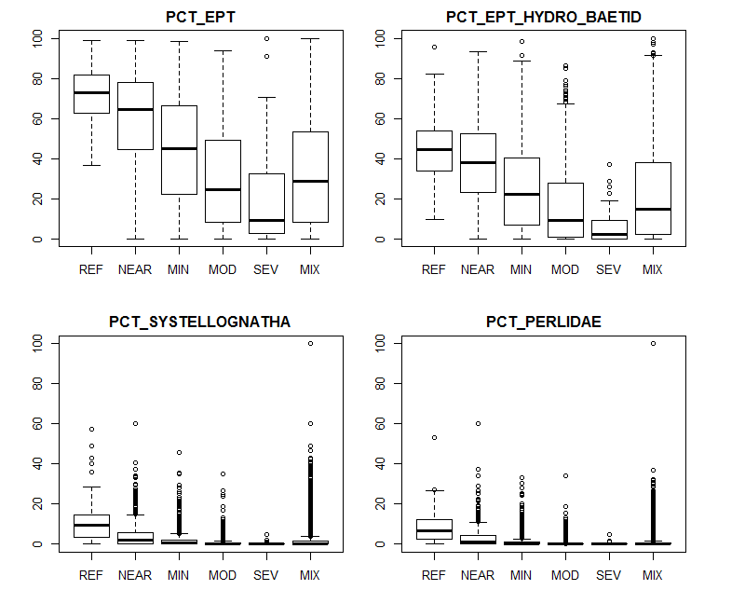
n =
43
415
1,073
445
49
6,663

Slide 61
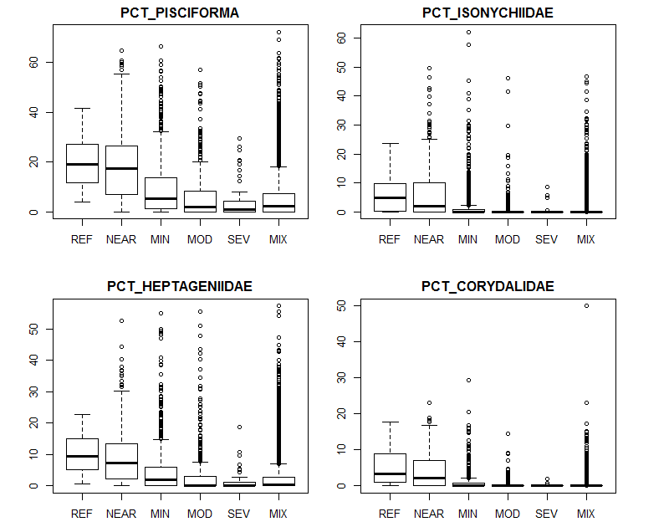
n =
43
415
1,073
445
49
6,663

Slide 62
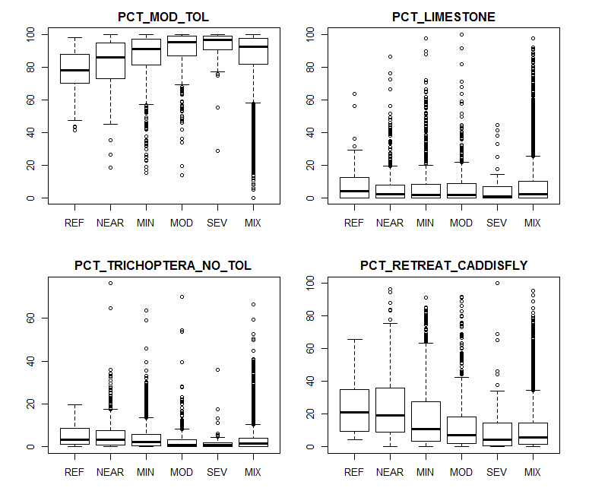
n =
43
415
1,073
445
49
6,663

Slide 63
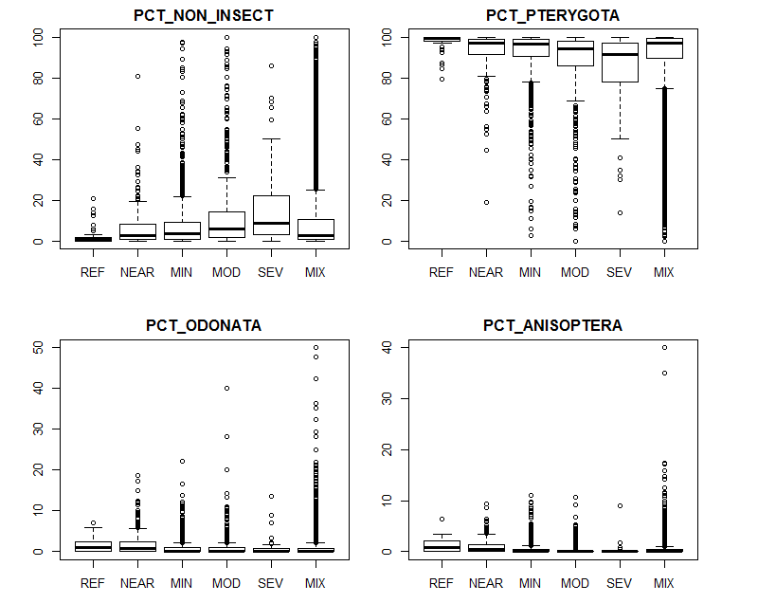
n =
43
415
1,073
445
49
6,663

Slide 64
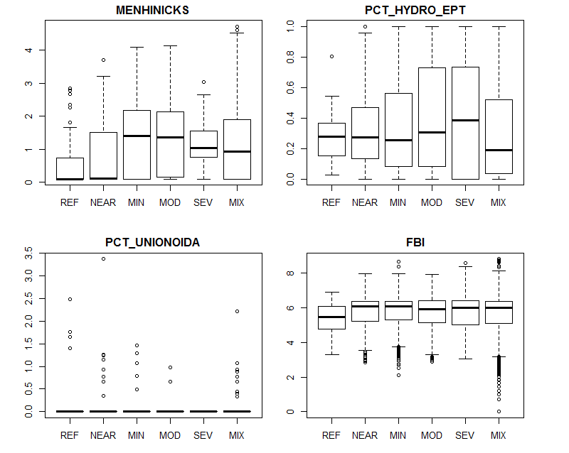
n =
43
415
1,073
445
49
6,663

Slide 65
Binary Sensitivity

Slide 66
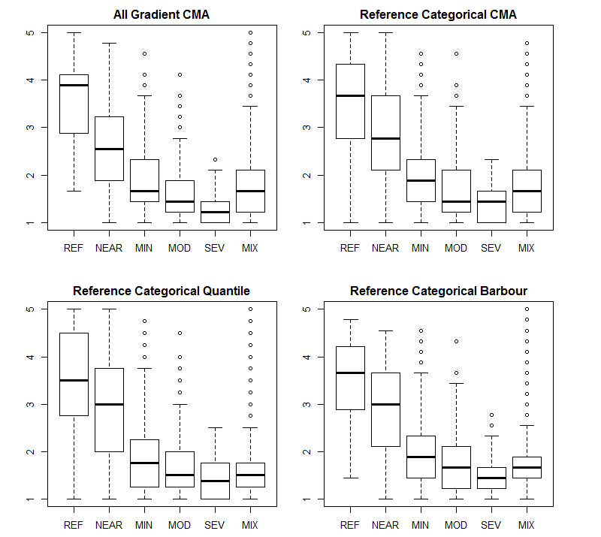

Slide 67
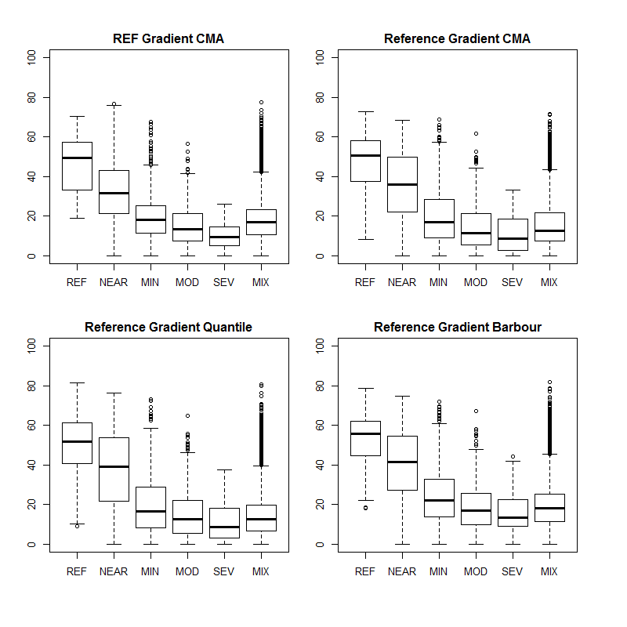

Slide 68
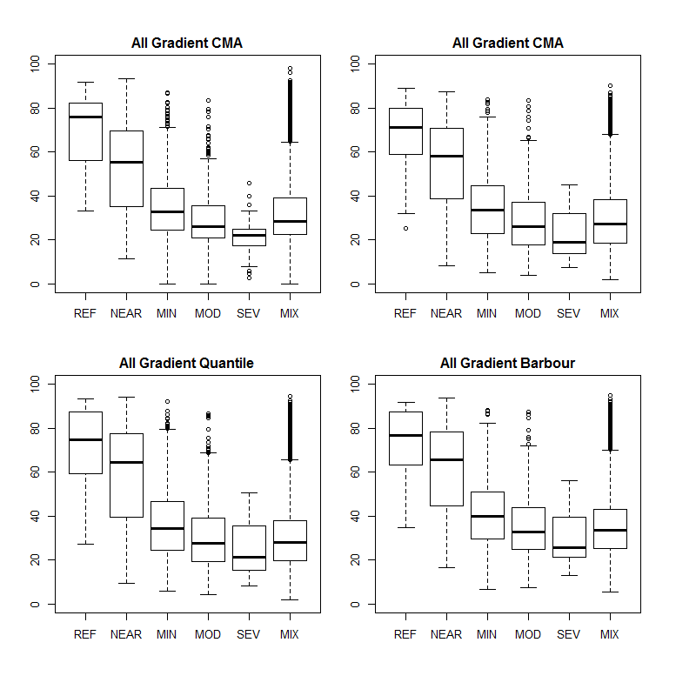

Slide 69
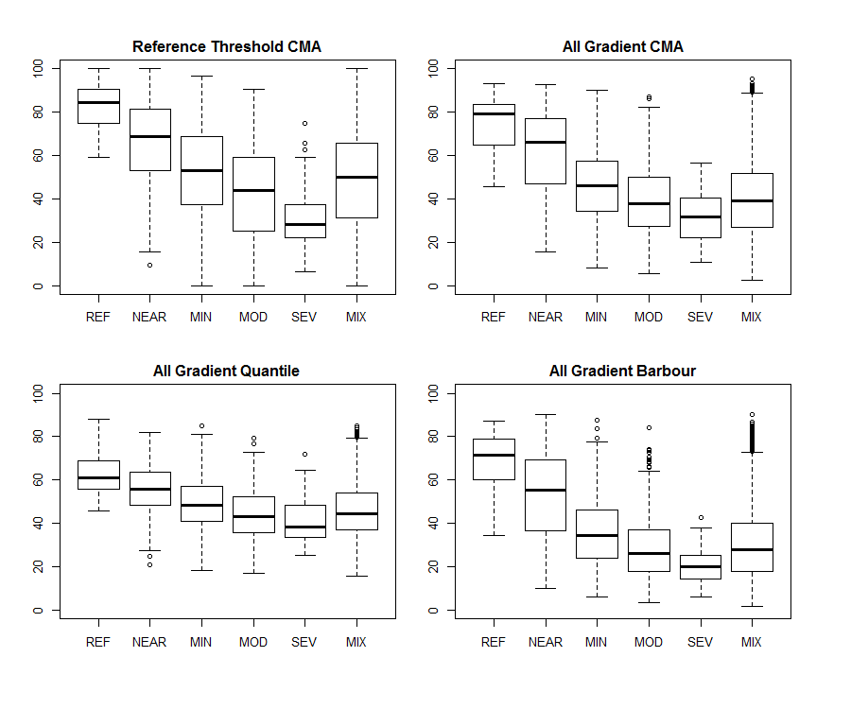
Binary
Threshold CMA

Slide 70
Index Resolution Type
Low Resolution
  Order Level Index
  Volunteer programs and in situ identification
Moderate Resolution
  Family Level Index
  Studies with limited funding and/or minimal macroinvertebrate identification experience.

Slide 71
Index Ranks
High Resolution
  Genus Level Index
  Studies with extensive funding and macroinvertebrate identification experience.
  Secondary indices identifying specific stressors

Slide 72
Metric Sensitivity Approach
Barbour et al. 1996
Quantile Threshold
Confusion Matrix Accuracy (CMA)
Redundancy Analysis Approach
Wilcoxon Rank Sum Test
Pairwise Confusion Matrix Accuracy (CMA)
Scoring Approach
Categorical
All Gradient
Ref. Gradient
Threshold Gradient

Slide 73
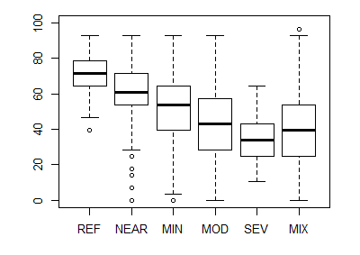
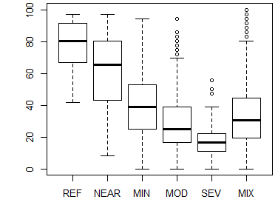
Order
Family
Genus

Slide 74
Final Remarks
Test for agency differences within each bioregion
  Sampling period differences
  Differences in taxa identified
Deal with unidentified taxa and unclassified taxa
  Missing tolerance values, FFG, or habits
Compare the 2011 indices to the 2016 indices

