Slide 1
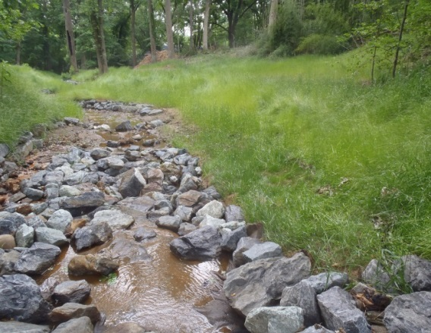
Takoma Park
Stormwater Management
Funding and Programs
Presented to the Local Government Advisory Committee, March 24, 2016

Slide 2
Takoma Park Land Uses
Located just outside the District of Columbia, Takoma Park is approximately 2 square miles with a population of 17,000.
92% developed

Slide 3
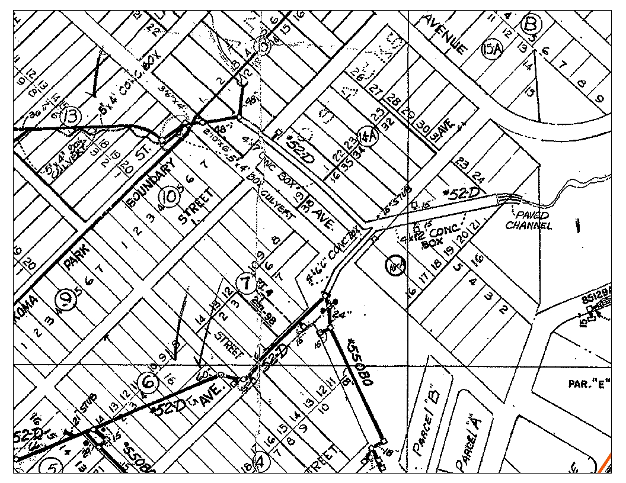
A Brief History of the Stormwater System
Takoma Park inherited the stormwater system in 1990.
- originally owned by WSSC
- MD ruled against utility ownership
- City considered County ownership
- City decided to take it over
Initial considerations:
- system mapped and inspection
- evaluation of structures
- wide variety of types:
hand stacked stone and slate tops
brick and cinder-block structures
clay, corrugated metal pipes, reinforced concrete
Initial Management:
- primary activity maintenance and cleaning
- 40%-60% of the budget from general tax fund, remainder budget surplus
The Council began considering alternative funding options and established the Stormwater Utility Fee in 1996.

Slide 4
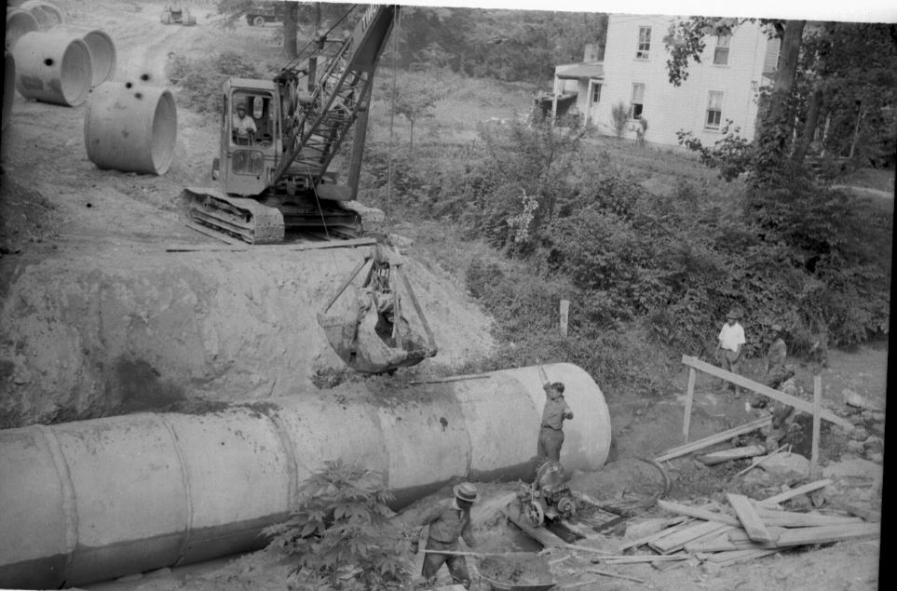
Why A Utility Fee?
● A dependable source of funding, less impacted by economic changes reflected in tax rates,
● A fair and equitable way of generating revenue,
● All property owners contribute - including tax exempt

Slide 5
Stormwater Utility Fee
Rate Structure
All single family properties billed the same amount
  The rate is based on the median impervious area of 1,228 sf, Called the ERU - equivalent residential unit.
All other developed properties billed on the actual impervious area
Square footage of impervious area / ERU X the base rate.
The original base rate in 1997 was $24, the current rate is $55.
Assessment of property types used the State Tax database records.
The amount of impervious area was calculated using digital maps with planimetric information gathered from aerial photographs illustrating building and pavement edges.

Slide 6
Property Types In Takoma Park
■ 86% - Single Family Residential
■ 14% - Other Developed
Multi-family - 5%
Commercial - 4%
Tax Exempt Properties - 5%
Percentage Of Impervious Area By Type
■ 37% - Single Family
■ 60% - Other Developed Property

Slide 7
Stormwater Management Budget
FY 1990
$200,000 annual budget
$60,000 capital costs
$140,000 for maintenance &
services
FY 2016
■ $684,750 annual budget
■ $137,000 capital costs
■ $168,750 grant funds
■ $244,000 maintenance & services
■ $135,000 personnel
Maintenance and services includes engineering design, video inspection of the system, pipe and inlet cleaning, repair of existing structures, water testing of dry weather outfalls and maintenance of bio-retention facilities
Capital costs include design and construction costs for new facilities
Personnel includes 50% of an engineer, 40% special project coordinator and 25% construction manager
Revenues: in FY 16 approximately $415,000 comes from the utility fee; grants and permit fees account for the remainder of annual revenue

Slide 8
Who Pays What ?
3,885 property owners billed each year,
3,443 are single family properties, 443 are other developed properties.
Single Family Properties represent 89% of the properties billed, and pay $189,255 - or 46% of the total.
Other Developed Properties represent 11% of the properties billed, and pay $224,658 - or 54% of the total.
The largest payer, the Washington Adventist University, pays $14,290.
The second largest payer, the Washington Adventist Hospital, pays $11,998.
19 commercial properties pay between $2,000 - $7,000 annually.

Slide 9

Lessons Learned Re: Utility Fee
■ Need to regularly remind property owners what is
being done with the Stormwater Fee.
■ Delinquency - must pursue non-payment
Options To Consider:
■ Fee Reduction Policy – provide a process for reducing the rate for when a property has installed on-site stormwater controls.
■ Incentive Program – provide a financial incentive (rebate) to encourage property owners to manage stormwater onsite, (rain gardens, down spout disconnects, tree planting and removal of impervious surfaces)
■ Update Impervious Analysis – using improved GIS and other technology,
the review of property features should be updated

Slide 10
WIP Phase II
Phase II WIP (Watershed Implementation Plan)
A planning process to achieve nutrient and sediment clean-up goals for the Chesapeake Bay. This initiative is overseen by the Maryland Department of the Environment. Jurisdictions submit an implementation plan and regular progress reports .
Municipalities not yet issued a Total Maximum Daily Load (TMDL) requirement for Nitrogen, Phosphorus, Sediments and trash. Currently those limits have been established for the Counties.
Takoma Park’s programmatic goal - provide stormwater treatment for run-off from 20% of existing impervious areas not treated.
The City intends to meet this goal by installing bio-retention and filtration facilities, providing for stream restoration, continuing a robust street sweeping program, and planting trees. The State requires reaching 60% of our goal by 2017 and 100% by 2025.
What does that mean?
The City’s total area is 1,280 acres, of which 397 acres are impervious
(roads 138 acres; buildings 158 acres; parking lots 85 acres; and sidewalks 16 acres
20% of 397 acres = 79 acres
Current Progress:
Provided treatment for 12.48 acres (50 facilities in place - bioretention, filtration, etc)
Completed stream restoration projects that provide 6 acres of treatment
Street sweeping provides an equivalent credit of 4.6 acres
Tree planting provides an average of equivalent credit of 2 acres annually
To date achieved credit for 31 acres of treatment
Notes:
A TMDL is the calculation of the maximum amount of pollution a body of water can receive and still meet state water quality standards.

Slide 11
NPDES MS4 Permit
National Pollution Discharge and Elimination System NPDES
Municipal Separate Storm Sewer System (MS4) – Phase II
The City received a 5 year permit in 2003, has been administratively extended
The permit requires the following six minimum control measures:
  Public Education and Outreach
  Stormwater Management BMP Implementation
  Illicit Discharge Detection and Elimination
  Construction Runoff Control
  Post Construction Stormwater Management
  Pollution Prevention and Good Housekeeping
The City is required to submit an annual report to the State

Slide 12
Control Measure 1
Public Education and Outreach
Public Participation/Involvement
  Bi-annual bulk buy program for tree planting
  Mark a drain campaign
  Sweep the Creek Program- Partnership with Friends of Sligo Creek
  Regular Newsletter articles
Web Page: Stormwater Page
Community Meetings

Slide 13
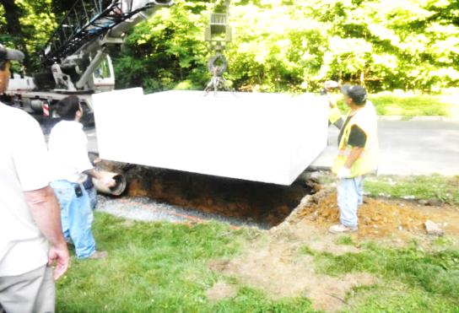
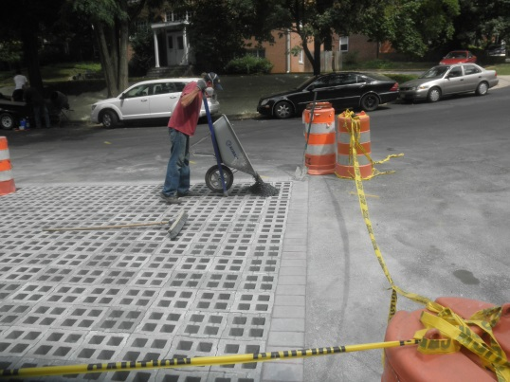
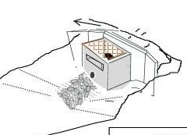
Control Measure 2:
Stormwater Management BMP Implementation
Since 2006 Takoma Park has planned, designed, and installed 50 Stormwater Best Management Practices (BMPs), mainly as Capital Improvement Projects funded through the SWM Fund:
  43 Bio-retention Facilities
  2 wetland modular systems
  2 filtration basins
  1 wet pond and 2 traffic circles with filtration and underdrain
  Stream restoration was completed for approximately 550 linear feet
Roanoke Avenue Permeable
Paver Filtration Basin
Baltimore Avenue Extended Detention Pond
Wetland Modular

Slide 14
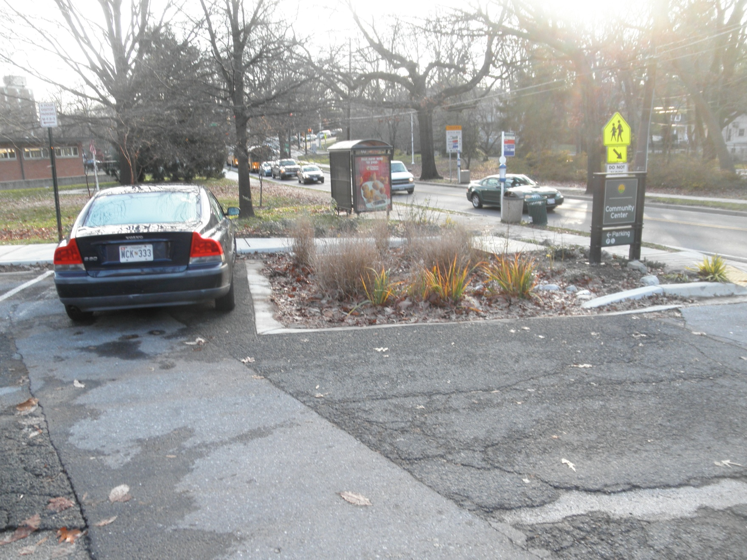
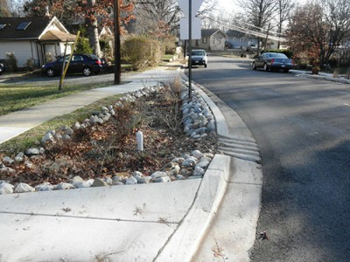
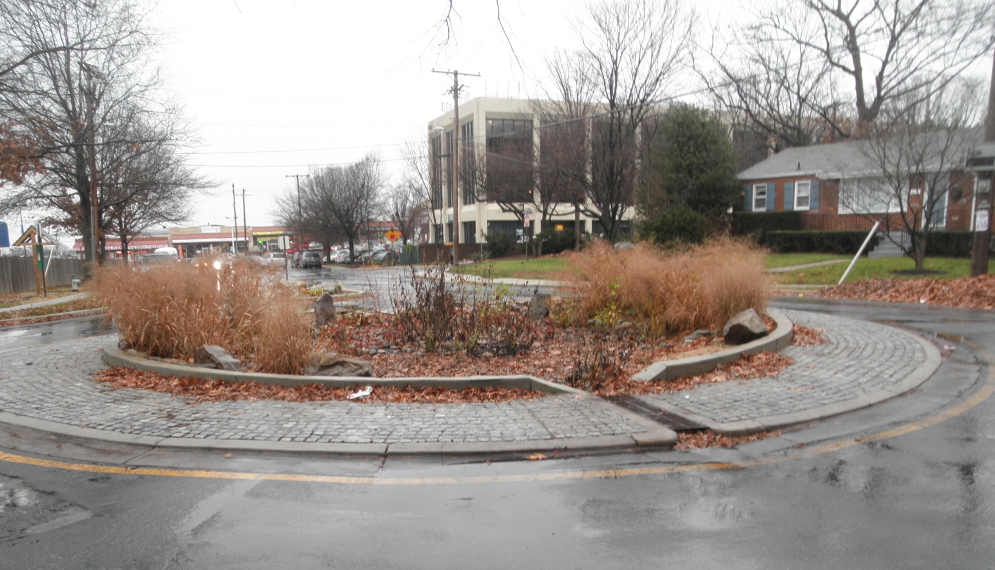
Stormwater Management BMP Implementation
Parking Lot Bioretention
Ritchie Avenue Bioretention
Prince George & Circle Bioretention
Kennewick & Kirklynn Circle

Slide 15
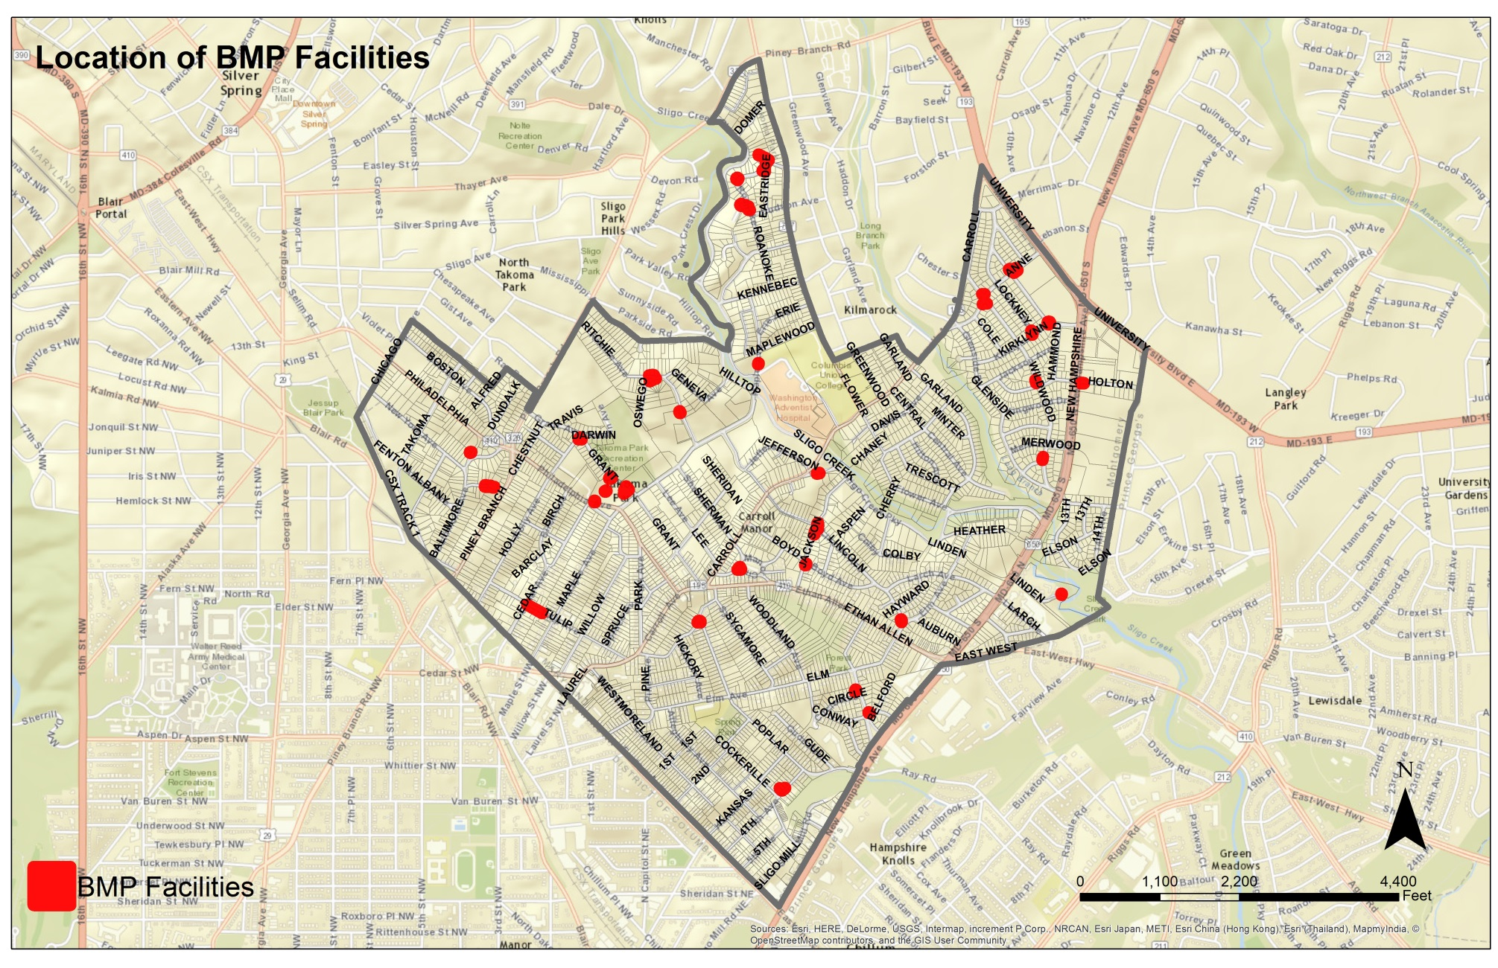
BMP Locations

Slide 16
Control Measure 3:
Illicit Discharge Detection & Elimination
  Reporting and Illicit Discharge Enforcement
    Through a MOU, enforcement authority was transferred to Montgomery County, July, 2006
    City staff respond to reports, investigate and inform County and MDE
  Outfall Illicit DischargeTesting
    Initial program in conjunction with Center For Watershed Protection investigated discharges into system at Maple Avenue outfalls to Sligo Creek
  Dry-weather testing of 15 outfall locations
    2007, 2010 and 2015

Slide 17
Control Measure 4:
Construction Run-off Control
Sediment and erosion control program are implemented through Montgomery County, Department of Permitting Services.
City staff routinely observe construction sites for erosion and sediment issues and follow up directly or notify the County when issues arise.

Slide 18
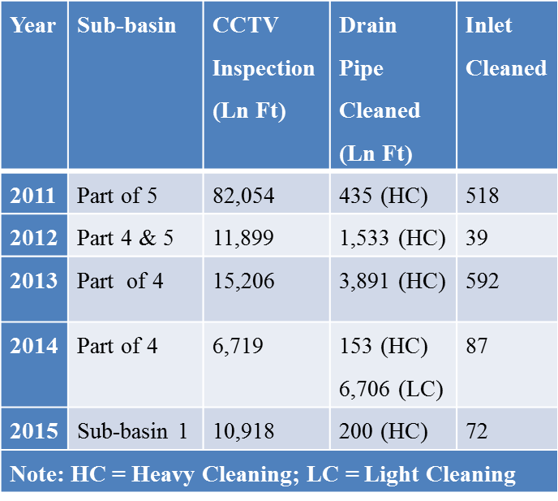
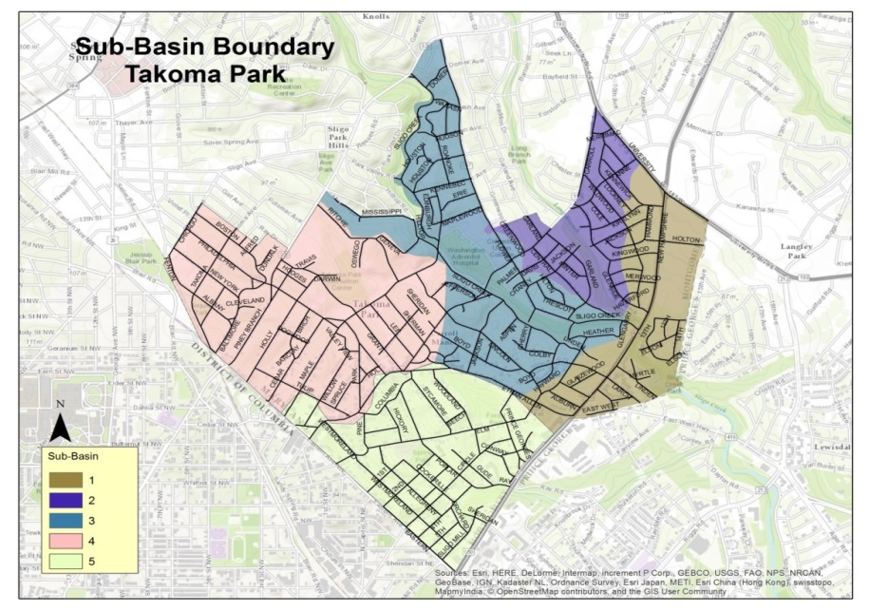
Control Measure 5:
Post-Construction Stormwater Management
Stormwater Management Plan Review and Inspection
– concept plan review and final permit approval
System Maintenance Projects:
  Annual video inspection cleaning
  System repairs & maintenance

Slide 19
Control Measure 6:
Pollution Prevention & Good Housekeeping
Street Sweeping:
  Total Regenerative Street Sweeping: 40 Acres per Year at 0.13 Impervious Acres Equivalent yields 4.6 acre equivalent
Tree Planting:
  About 100 – 120 trees annually yields 2 Acres equivalent
Vacuum Leaf Collection:
  Although it does not translate to credit in the NPDES or WIP program, the removal of leaves from the street plays a significant role in keeping leaf debris out of the system
New Initiatives:
  Safe Grow Law – bans the use of pesticides fro cosmetic lawn care
  Polystyrene Ban

Slide 20
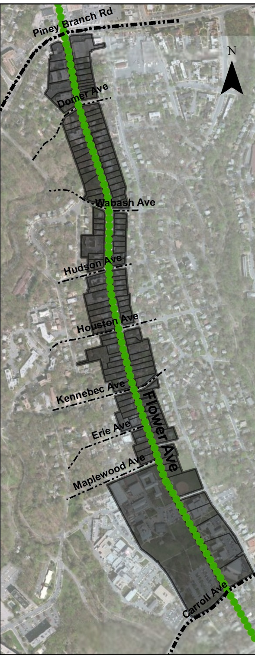
FLOWER AVENUE
GREEN STREET PROJECT

Slide 21
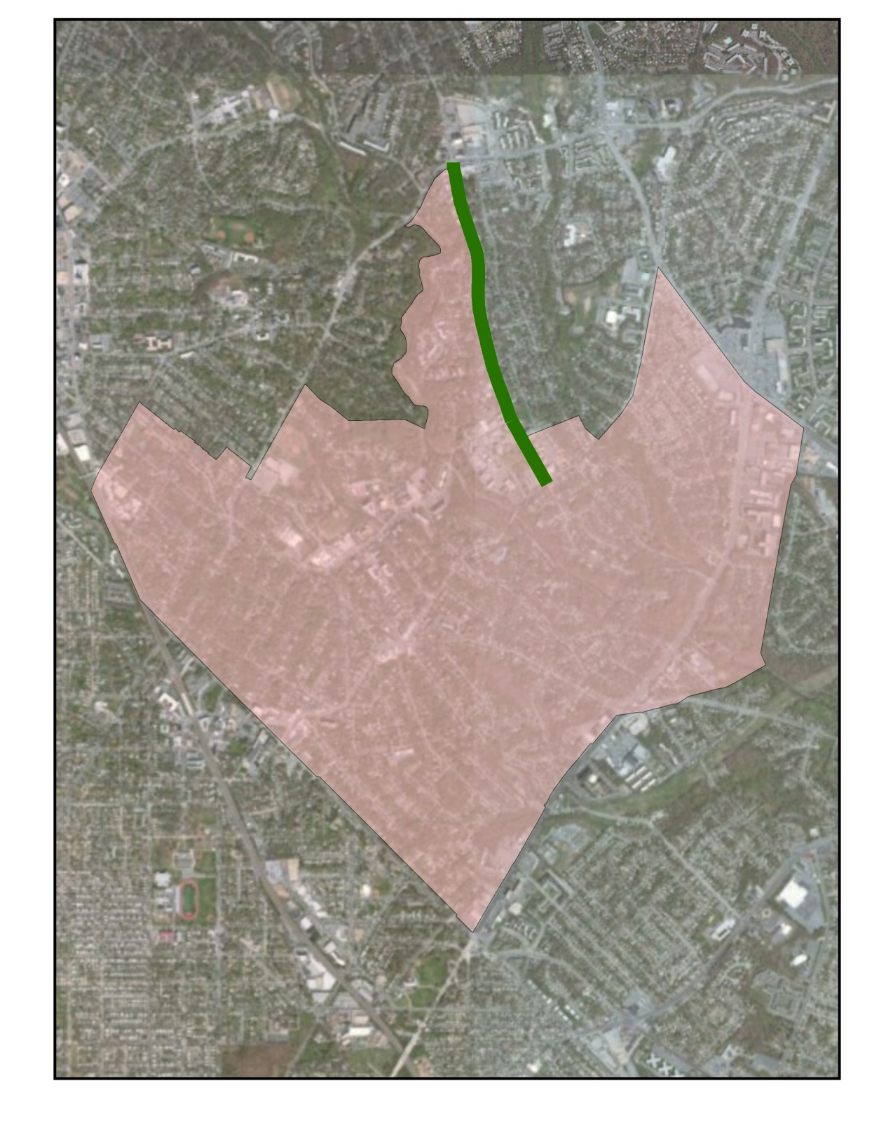
Flower Avenue
Northeast boundary of Takoma Park
A one mile long, 2-lane arterial with on-street parking on one side, average street width 28’
Largely residential with single family and multi-family properties and some commercial businesses
Concrete curb and sidewalk exists on the west side only
Previously a State road, Montgomery County to the east, City of Takoma Park to the west
Minimal existing stormwater infrastructure – 2 curbside inlets
21 bus stops, 4 bus lines
Antiquated utilities, including gas mains, water and sewer lines and street lighting

Slide 22
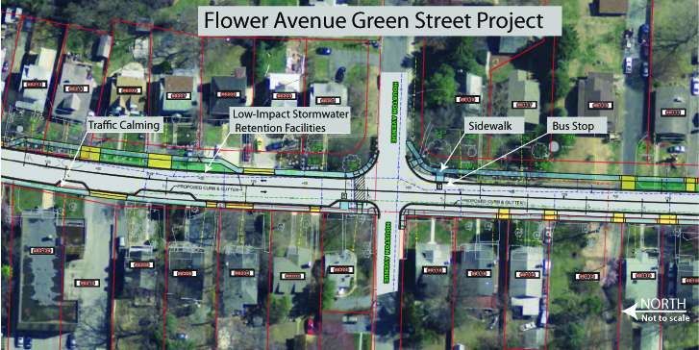
Green Street Design
Stormwater Infrastructure
Pedestrian access & safety
Energy-efficient lighting
Rain Garden
Bioretention
sidewalk
ADA Ramp
Crosswalk
Led decorative lamps
LED Street arms
Notes:
Flower Avenue project also includes new landscape / hardscape and improvements to pedestrian
access and safety: construction of new concrete sidewalk and curb/gutter on the east side; traffic
calming curb bump outs and ADA pedestrian ramp upgrades on the west side; relocation /
consolidation of bus stop locations, and pedestrian oriented energy-efficient lighting.

Slide 23
What Makes It A Green Project?
Energy Saving from LED conversion:
  Replace existing streetlights with LED fixtures (done!)
  Add new pedestrian level decorative streetlights on the east side to improve lighting
Pedestrian Access and Safety
  Traffic Calming : Narrowing at the intersections to improve pedestrian crossing distance and calm traffic
  Additional 4-way Stops proposed➢ Domer, Wabash and Kennebec
  New sidewalk on the east side, with marked crosswalks
  Relocation of bus stops to improve access, install benches where possible
Stormwater Management
  2,525 cubic feet of ESDv runoff volume treated through 7 new bio-retention structures
Tree Planting
Notes:
Additional bump outs ➢ Nearside of Domer Ave ➢ Between Division Street & Carroll Ave
21 stops today, Propose to reduce to 16 stops ➢ Eliminate 5 stops: – SB @ 8414 Flower Ave (# 22320) – NB @ 8415 Flower Ave (# 22286) – SB @ Erie Ave (# 17199) – SB @ Carroll Ave (# 22332) – NB @ Carroll Ave (# 22274) ➢ Relocate 5 stops: – SB @ Domer Ave: farside to nearside, B-4 (# 22318) – SB @ Wabash Ave: farside to nearside, B-7 (# 22321) – NB @ Hudson Ave: shift approx. 35 ft south, B-10 (# 22284) – SB @ Division St: move to Sta. 146+30, B-18 (# 22330) – NB @ Division St: move to Sta. 146+55, B-19 (# 22276)

Slide 24
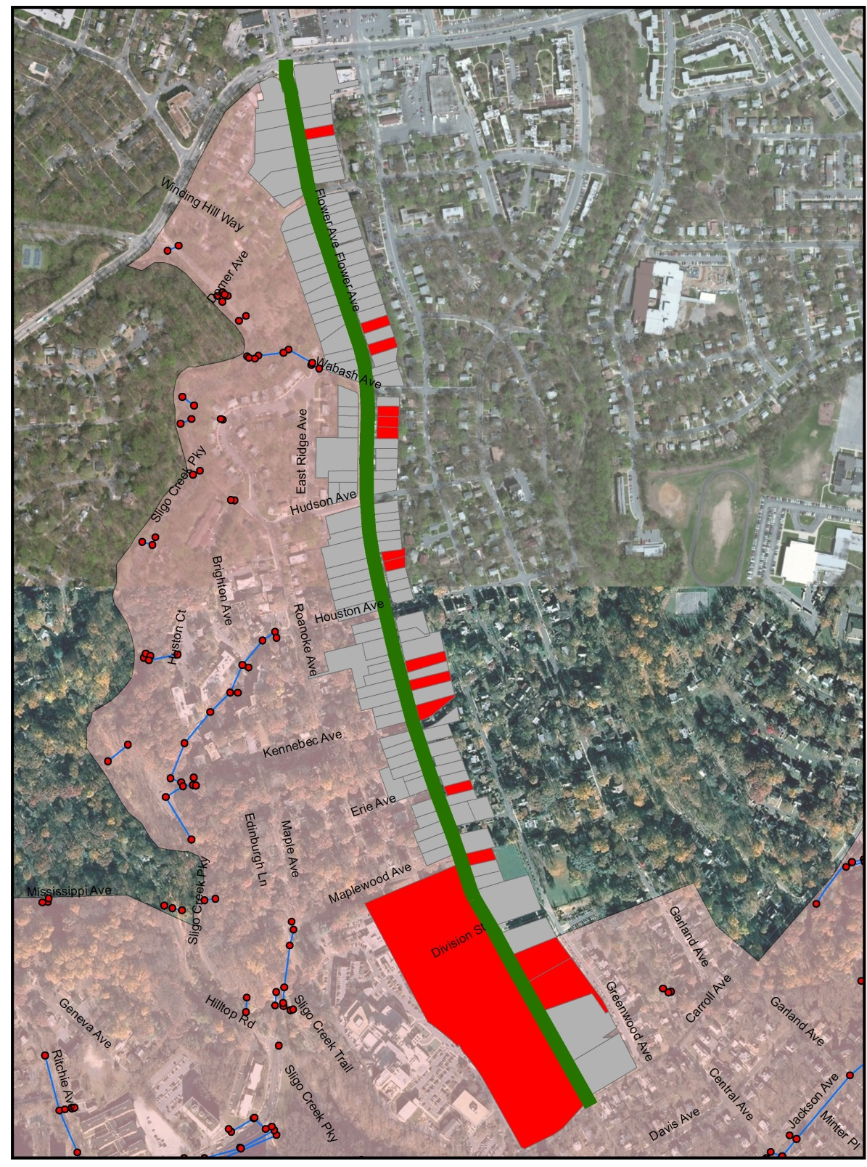
Stormwater Management
Initial design identified 21 possible locations
After review, 15 locations tested for infiltration
7 found to have suitable soils and infiltration rates
Major limiting factors
  Minimal right of way
  Existing underground utility infrastructure and clearance minimums required by the utilities
Will provide treatment for 50% of existing impervious area and 100% of new, net equivalent treatment of .6 acres
Notes:
Infiltration rates of 0.52-in/hr or less are not suitable for infiltration practices.
3,353 cubic feet

Slide 25
Cost Estimate
Items | Cost | Notes:
Design Cost | $527,125.60
Construction Cost | $3,068,210
Total | $3,595,336
Funding Source
SHA | $696,000 | - used for design and resurfacing
Montgomery County | $200,000 | - for sidewalk on east side
The Chesapeake Bay Trust | $20,000 | - for initial concept design
TAP Funding | $1,040,330 | - project construction
NFWF | $168,750 | - bioretention
CDBG | $77,500 | sidewalk ADA
Total | $2,202,580
Remaining Funds Needed | $1,392,756 | Likely City General Fund

Slide 26
Future Projects
In FY 16:
  150 linear feet of stream restoration near Hayward and Larch Avenues
  Bio-retention and pavement removal at Glaizewood Ave and Larch Ave
  Bio-retention at corner of Grant Ave and Holly Ave
  Installation of permeable pavement in portion of Community Center parking lot
Flower Avenue Green Street project to get underway in FY17.
Continuing to develop plans for two large projects:
- trash interceptor to collect floatables
- stream restoration of Takoma Branch near New Hampshire Ave

Slide 27
On To The Tour!

