Slide 1

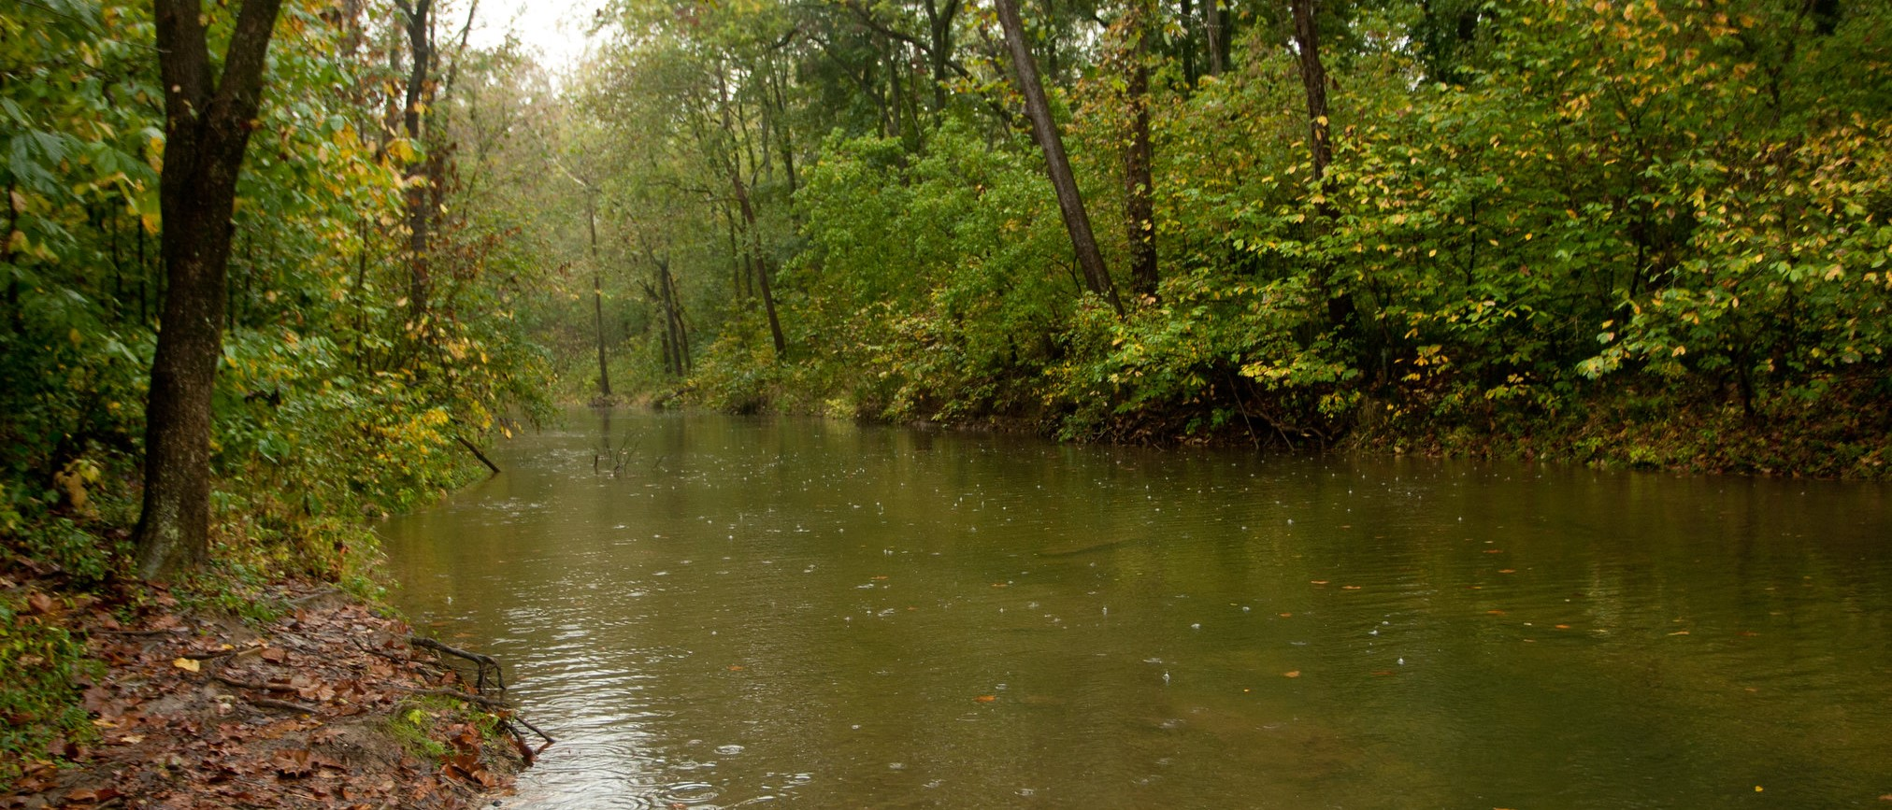
*Photo can be changed, this is only a placeholder.
Be sure to add photo credit
Forest Program
Trees are the answer
Photo Credit: Will Parson/Chesapeake Bay Program
Craig Highfield
Forest Program Director
Alliance for the Chesapeake Bay

Slide 2
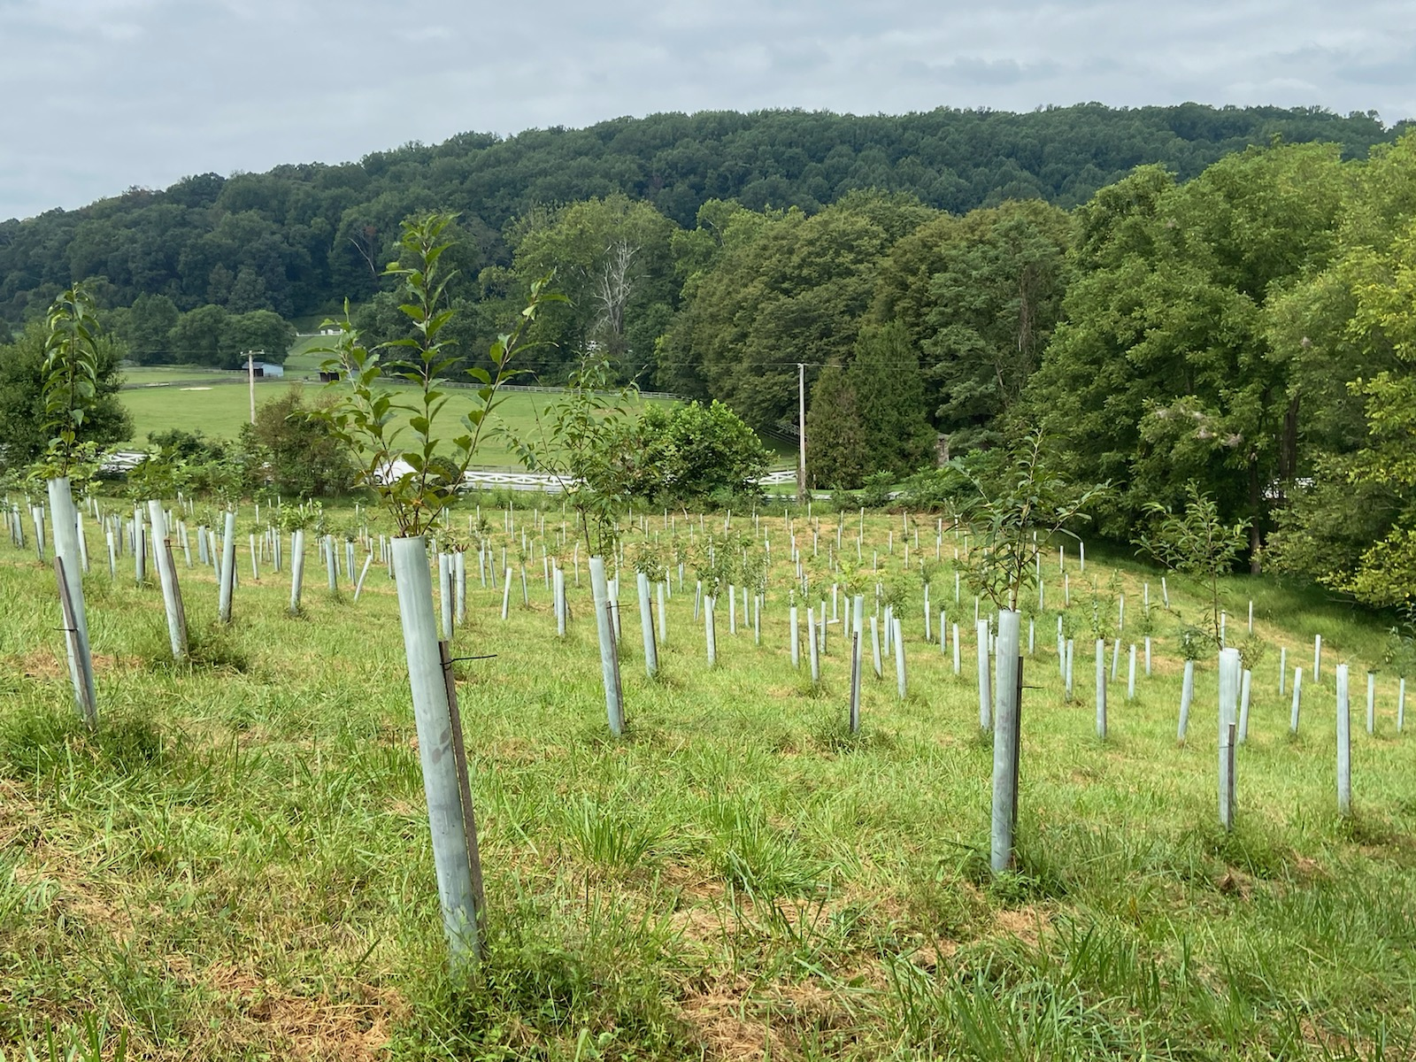
Reforestation Programs
Healthy Forests Healthy Waters
Healthy Streams Farm Stewardship
PA Riparian Buffer Program
PA Lawn Conversion Program
Chesapeake Forest Fund

Slide 3
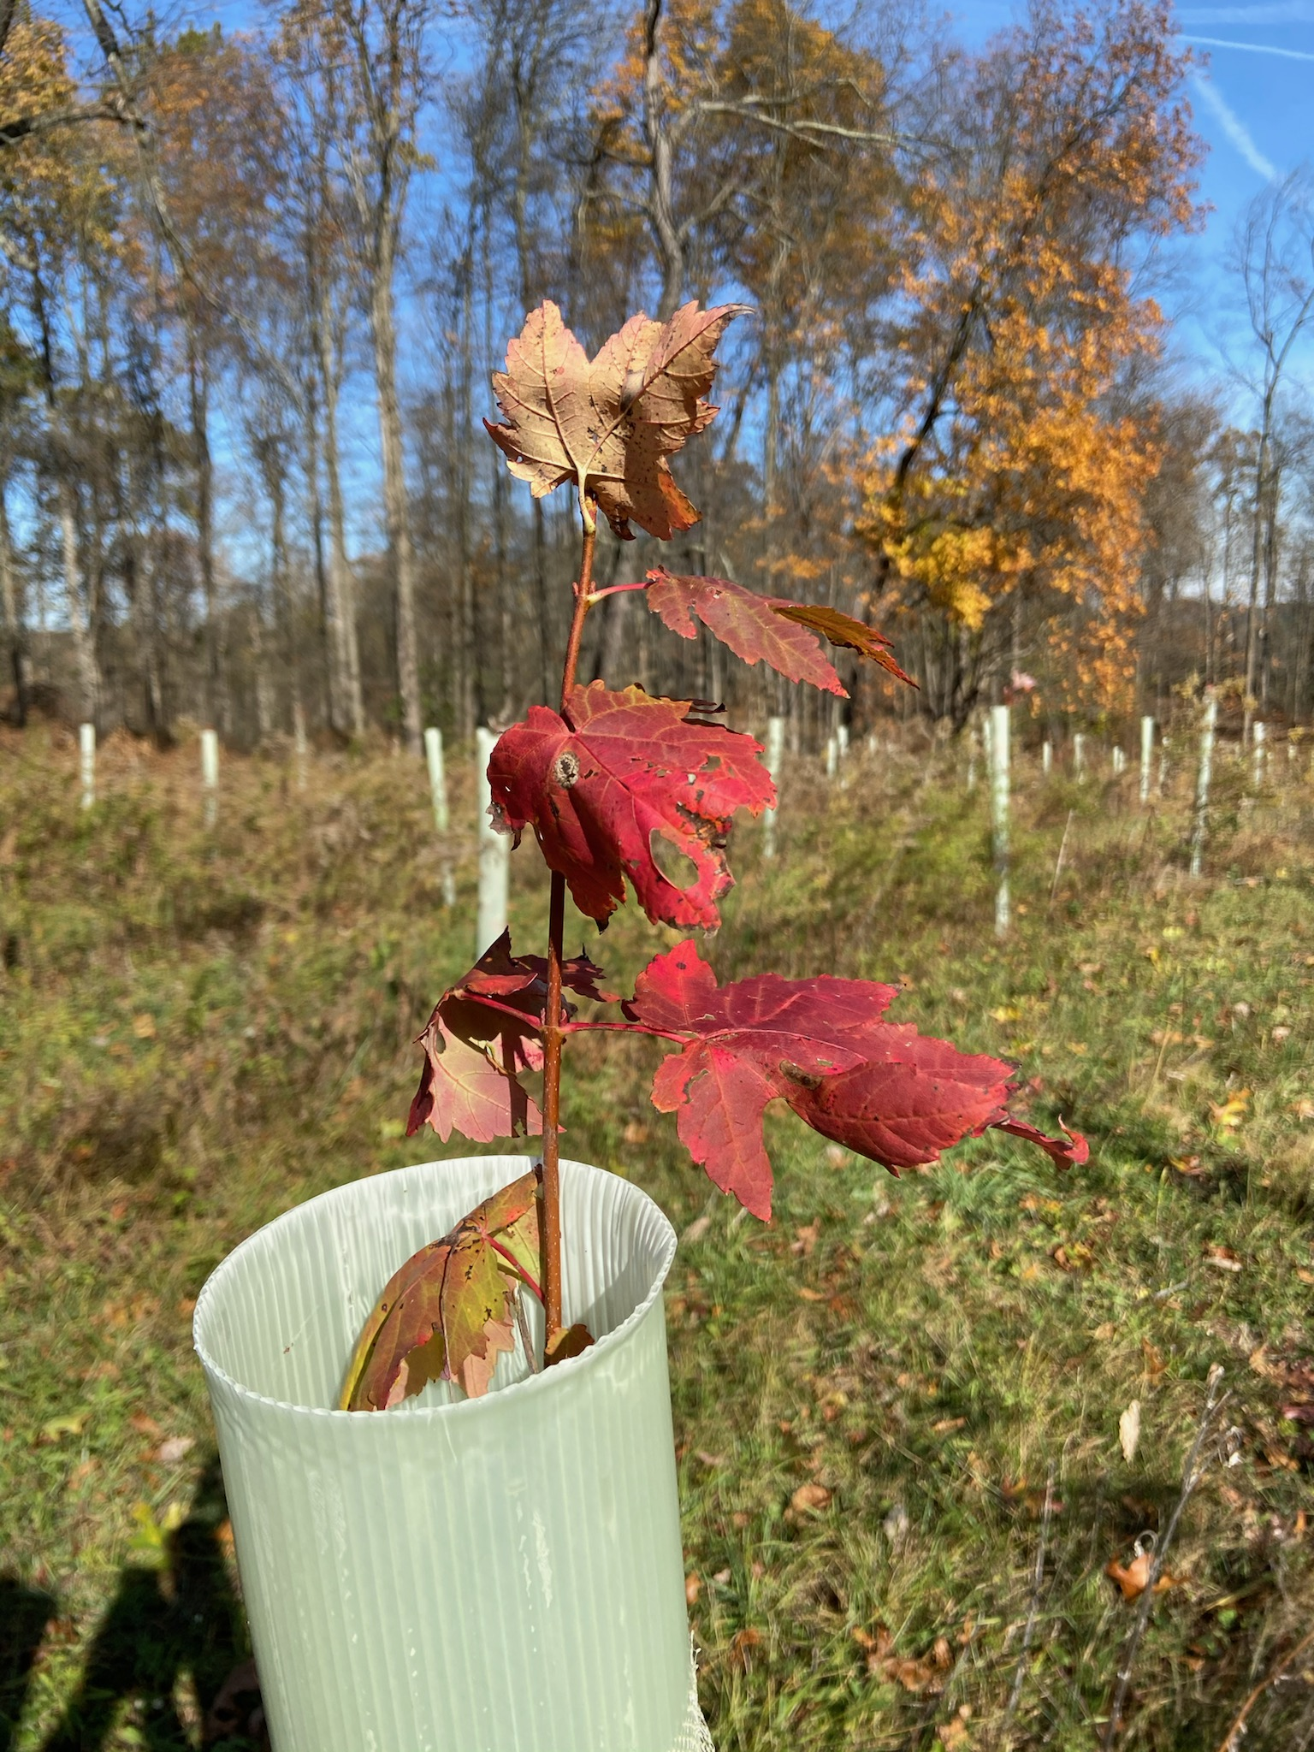
2019 – 2021
223 acres riparian buffers
474 acres of upland forest
230,010 trees planted

Slide 4
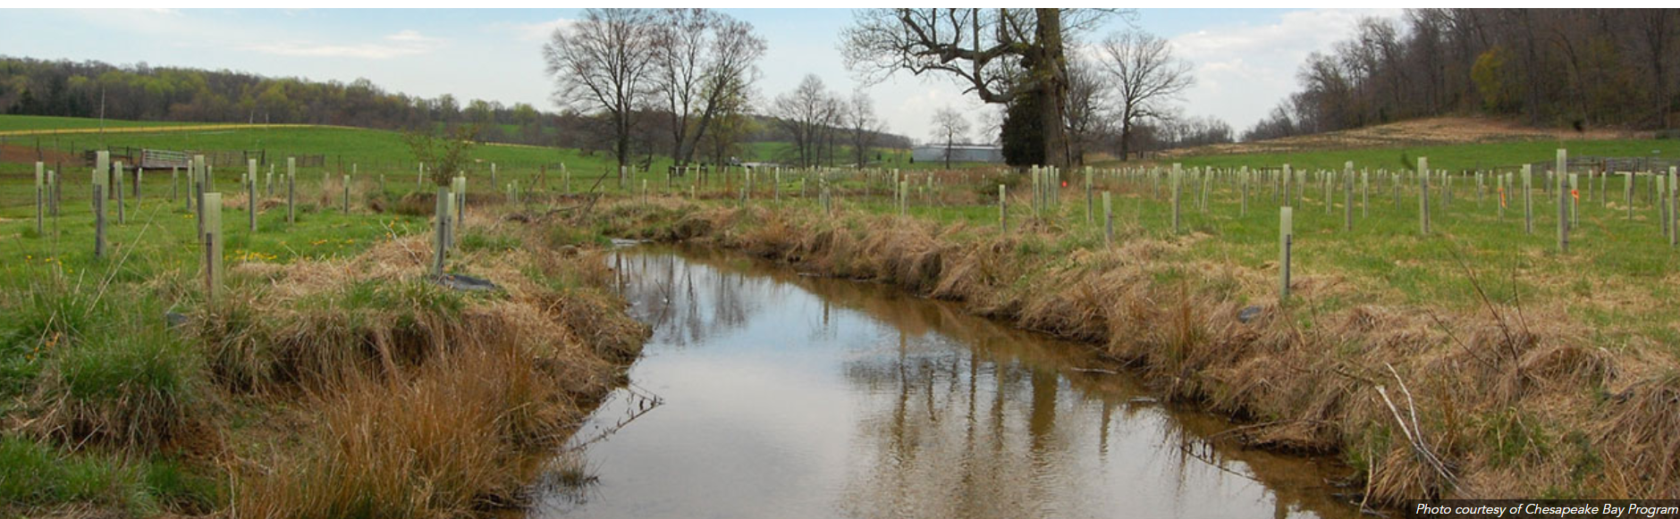
Essential
Leveraging technical and financial assistance
Providing turnkey service

Slide 5
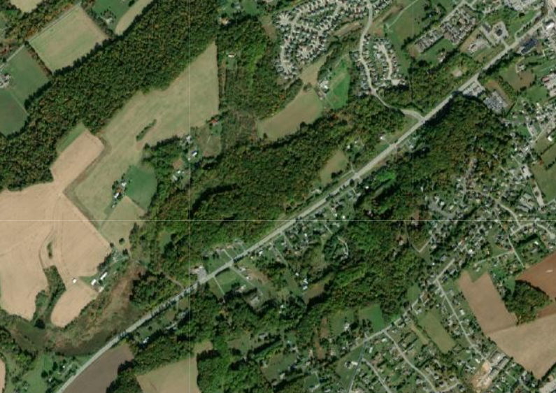

Slide 6
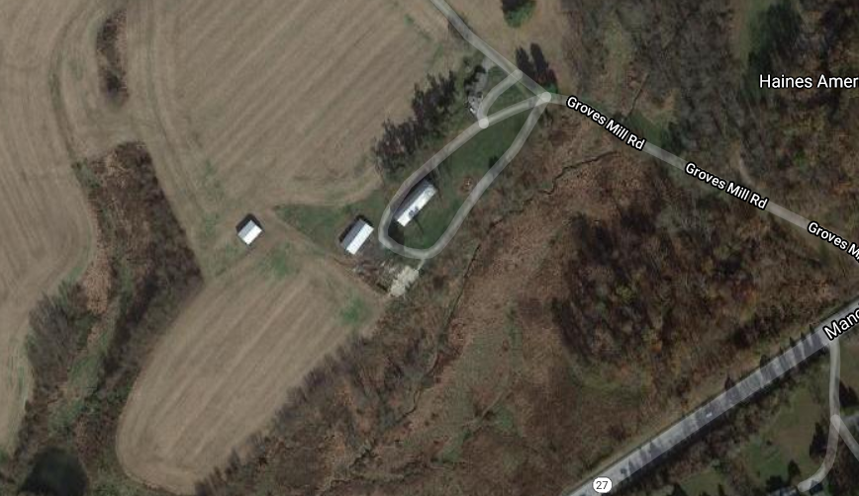

Slide 7








Slide 8
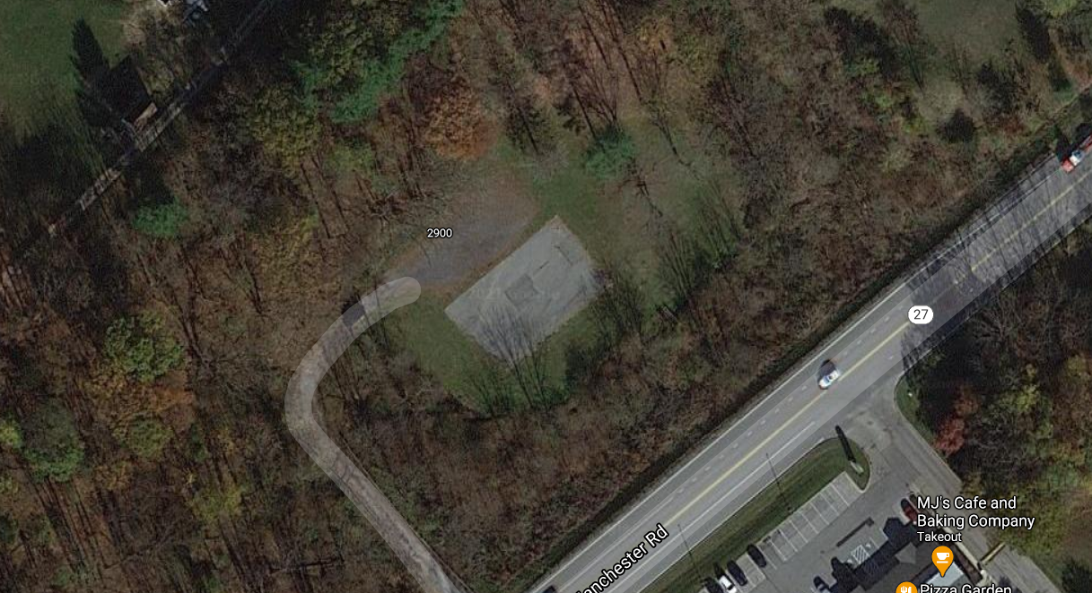

Slide 9




Slide 10
