Slide 1

The EPA and
Susquehanna River
Case Studies of Potential Impacts of EPA Budget Cuts

Slide 2
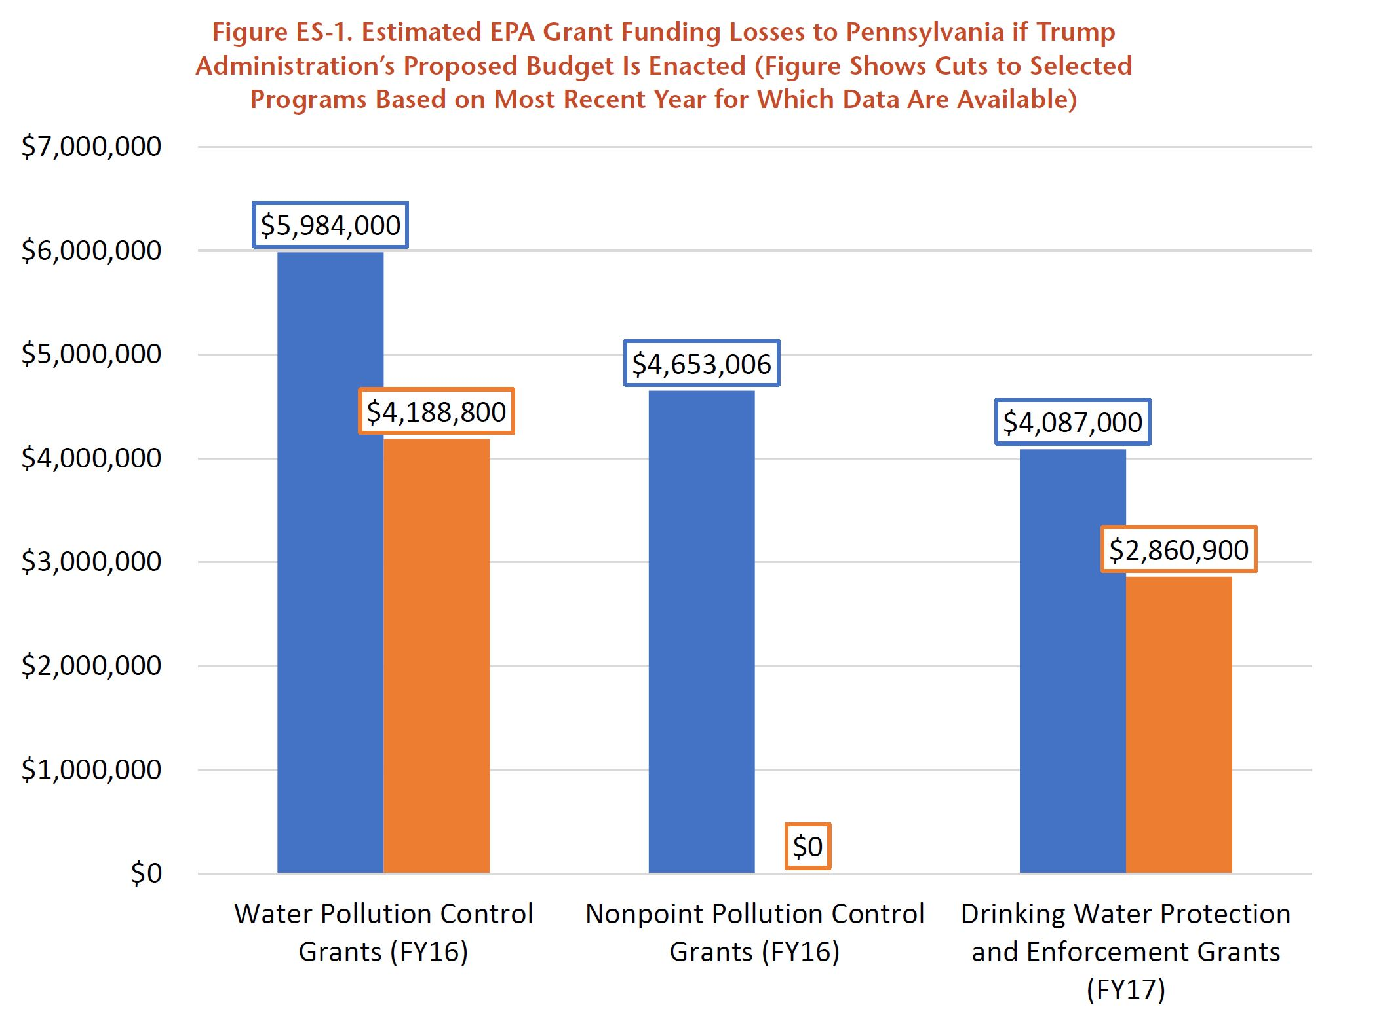
State Level Budget Impacts

Slide 3
The EPA Makes the Susquehanna River Basin Cleaner By: | The EPA Continues to Protect Clean Water By:
Funded local association’s efforts to clean up acid mine drainage in the Miller Run watershed | Supporting local partnerships that restore the health of the Susquehanna River Basin’s
Funded the restoration of Pierceville Run and the South Branch of Codorus Creek from agricultural runoff in York County | Funding restoration of streams and creeks across the region
Set limits on nutrient and sediment pollution to Chesapeake Bay from its tributaries | Enforcing pollution limits and encouraging best management practices in the Susquehanna River Basin
Funded development of tool that protected drinking water in New Oxford, Adams County from contamination during chemical spill | Funding projects to prevent pollution and supervise public water systems.
Ordered a Lancaster County farm to stop discharging manure and wastewater into a tributary of Chiques Creek | Ensuring compliance with pollution standards to limit releases of nitrogen, phosphorus and pathogens to waterways
Reduced discharges of raw sewage into the Susquehanna River from municipal treatment plants | Ensuring compliance with planned infrastructure upgrades to limit releases of raw sewage
Supported research to understand potential impacts of resource extraction in Susquehanna County and three other counties on drinking water and newborns health | Supporting research into new pollution control methods and the effects of water pollution on human health

Slide 4
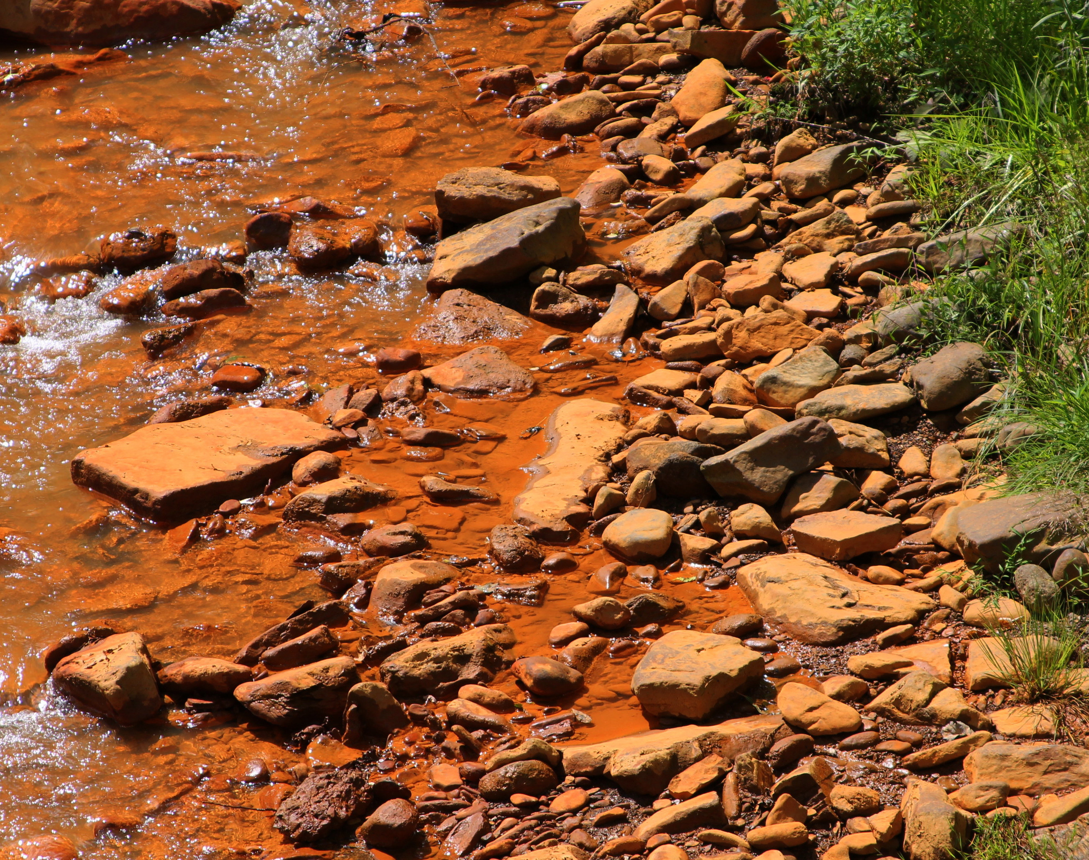
Cleaning up Acid Mine Drainage: Miller Run & Shoup’s Run
Coal mines operating in region predated limits on environmental protection
Mine abandonment led to highly acidic, metal-heavy pollution into Miller Run
$500,000 in grant funding helped restore creek by decreasing acidity of runoff and help heavy metals settle out of water naturally
Recent testing shows stream meets standards for aquatic life, eventually reviving natural brook trout population and leading to more recreation

Slide 5
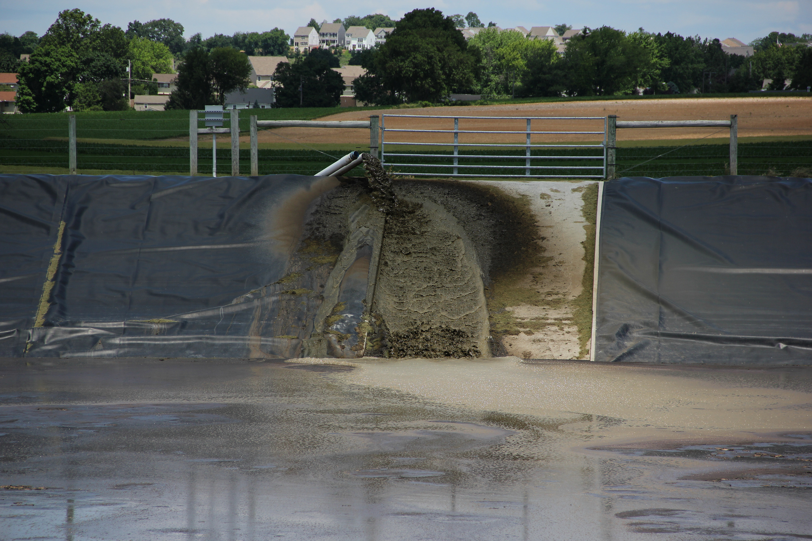
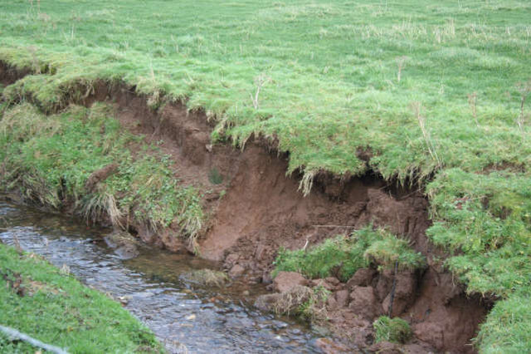
Cleaning up Agricultural Pollution: Codorus Creek & Chiques Creek
Pierceville Run provides critical spawning habitat for the wild trout—but cropland and pastures were high sediment and nutrient pollution.
EPA grant to the Izaak Walton League of America for $500,000 helped assess the damage and restore the creek leading to an “impaired” listing in 2002 and restoration plan in 2007.
Egg-laying and dairy farm in Lancaster County had been discharging manure and washwater into a tributary without a Clean Water Act permit.
Enforcement action stopped pollution, fine on company.
Agricultural pollution is responsible for 60% of Chiques watershed being too polluted for recreational use or aquatic life.

Slide 6
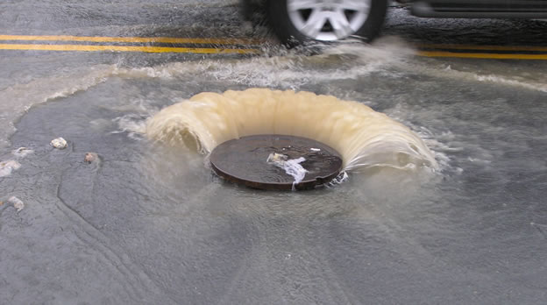
Cleaning up Sewage Overflows: Harrisburg and other cities
From 2007-2015 the City of Harrisburg dumped 8.3 million gallons of raw sewage into the Susquehanna River Basin.
EPA and PA DEP inspected stormwater management and sewage system in 2010 & 2012.
Harrisburg and Capital Region Water ill invest $82 million to improve operations and infrastructure in complaint settlement.
Nitrogen pollution decreased by 90% and suspended solids by nearly half.

Slide 7
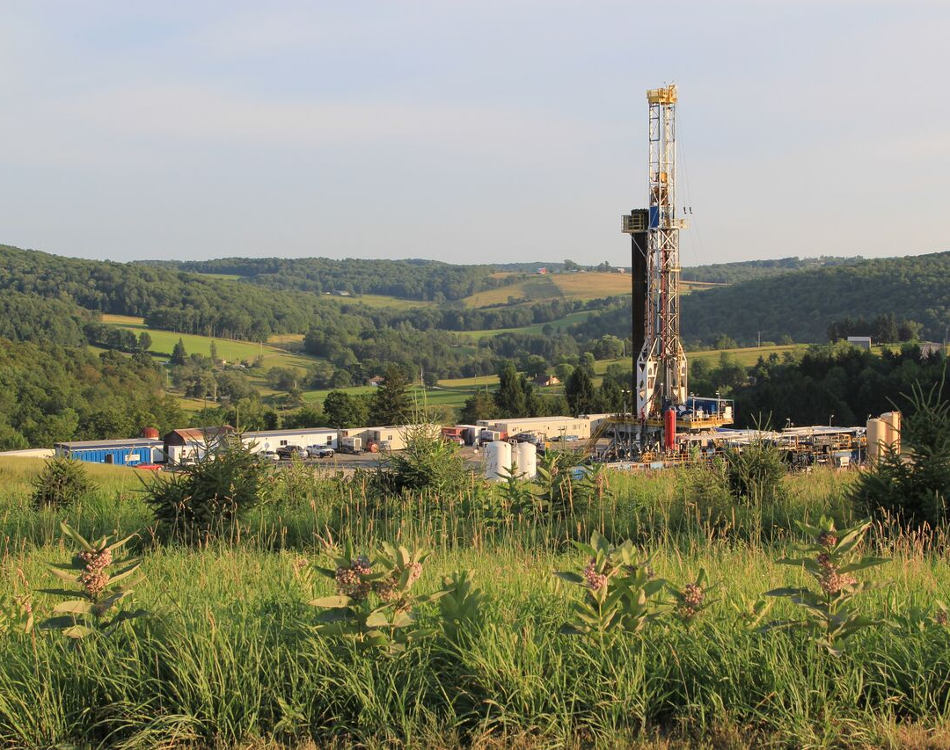
Researching and Education on Environmental Threats & Solutions
EPA-funded research on rapid expansion of fracking in the Susquehanna River Basin has helped identify public health threats.
EPA grant to Yale connected potential water contamination with preterm births and adverse birth outcomes.

Slide 8
Questions?
CONTACT INFORMATION
Adam Garber, PennEnvironment Research & Policy Center
(215) 732-5897
agarber@pennenvironment.org

