Slide 1
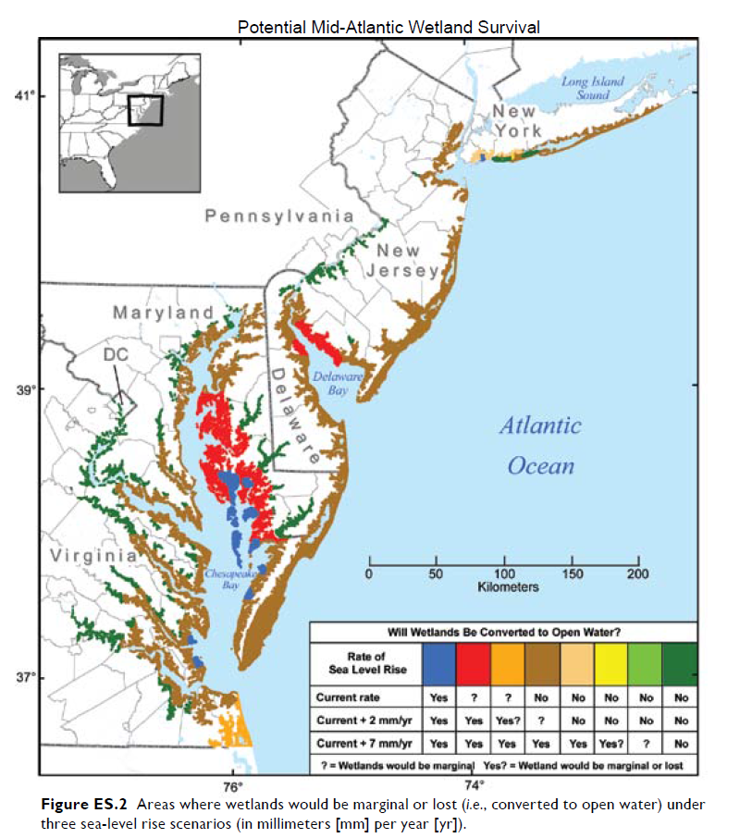
U.S. Climate Change Science Program. 2009. Coastal Sensitivity to Sea-Level Rise: A Focus on the Mid-
Atlantic Region. A report by the U.S. Climate Change Program and the Subcommittee on
Global Change Research. J. G. Titus (Coordinating Lead Author), E. K. Anderson, D.
Cahoon, S. K. Gill, R. E. Thieler, J. S. Williams (Lead Authors).
http://www.climatescience.gov/Library/sap/sap4-1/default.php. Washington, DC: U.S.
Environmental Protection Agency.

