Slide 1
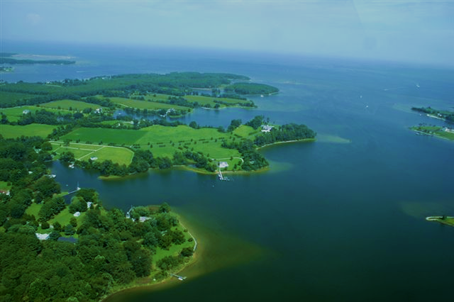




Climate Change & the Chesapeake
TS3 workgroup chapter
Thomas M. Arnold¹, Richard C. Zimmerman², Katharina A. M. Engelhardt³, and J. Court Stevenson⁴
¹ Departments of Biology and Environmental Studies, Dickinson College, Carlisle, PA 17013 ² Department of Ocean, Earth and Atmospheric Sciences, Old Dominion University Norfolk, VA 23529 ³ Appalachian Laboratory, University of Maryland Center for Environmental Science, Frostburg, MD 21532 ⁴ Horn Point Laboratory, University of Maryland Center for Environmental Science, Cambridge, MD 21613
European
MedSeA

Slide 2
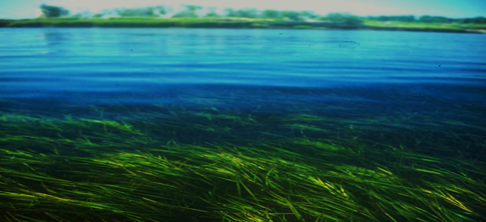
21st CENTURY CLIMATE CHANGE AND SUBMERGED AQUATIC VEGETATION IN THE CHESAPEAKE BAY
The 20th century story: nutrient pollution, eutrophication, water clarity, dead zones, and disease.
The Chesapeake Bay was once renowned for expansive meadows of marine and freshwater SAV.
Historically, these species covered an estimated 250,000 ha in the bay, or about 20% of the bottom area. Today, only 10% of the original Chesapeake Bay SAV meadows survive, covering about 2% of the bay floor at depths < 2 m.
For nearly half a century, coalitions of federal, state, and local agencies have sought to restore Chesapeake Bay SAV to “reflect 1930s abundance” (e.g., 2000 Bay goal) or, more recently, to restore 185,000 acres (75,000 ha) of SAV by 2010.
However, SAV currently cover less than 100,000 acres (40,500 ha) in the Chesapeake, falling well short of these goals.

Slide 3
VALUATION OF BAY SAV
The value of SAV can be quantified in terms of ecosystem services, estimated at approximately $1.9 trillion per year, globally.
Waycott et al (2009) estimated at the value of healthy seagrass communities at as much as $28,916 ha⁻¹ yr⁻¹ (Costanza et al. 2014).
By this simplistic measure, the estimated value of Chesapeake Bay SAV beds would exceed $2.9 billion yr⁻¹.
Recently, an additional service of seagrass meadows has emerged: the capture and long-term storage of “blue carbon”. Globally, underwater meadows are powerful carbon sinks which sequester approximately 10% of oceanic organic carbon, an estimated 27.4 Tg carbon yr⁻¹. In total they may store as much as 19.9 Pg of this “blue carbon” in the form of anaerobic, organic-rich loams for thousands of years.

Slide 4
The challenges of modern coastal ecosystems
Jackson et al.

Slide 5
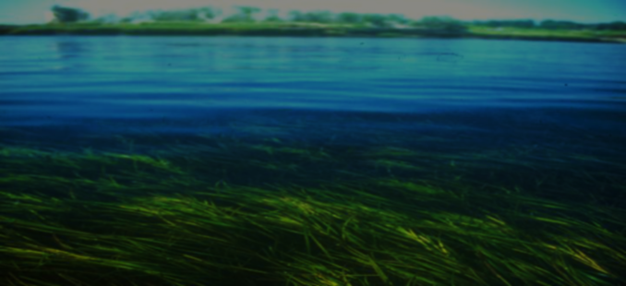
21st CENTURY SAV THE CHESAPEAKE BAY
Any attempt to predict the future of SAV in the Chesapeake Bay must consider the impacts of accelerating climate change. By the end of the century the Chesapeake region will be subject to:
    a mean temperature increase of 2 to 6°C
    a 50-160% increase in CO₂ concentrations
    0.7-1.6m of sea-level rise
If the current trajectory of climate change continues the Chesapeake Bay could develop some characteristics of a subtropical estuary by the next century.

Slide 6

Warming, etc.
The Chesapeake will transition from a temperate to a subtropical estuary during the 21st century.* The most devastating temperature effects may result from an increased in the frequency, duration, and amplitude of periodic summer heat waves.
Eelgrass at Risk
High temperatures of 25-30°C inhibit photosynthesis and growth. Above 30°C plants decline rapidly. Short-term exposures to summer temperatures 4-5°C above normal will “result in widespread diebacks that may lead to Z. marina extirpation from historically vegetated areas, with the potential replacement by other species” and “severely reduce or eliminate” Zostera marina from the Chesapeake Bay (Moore et al. 2012, 2014). Carr et al (2012) concluded that “an increase in the frequency of days when summer water temperature exceeds 30°C will cause more frequent summer die-offs” and is likely to trigger a phase change from which “recovery is not possible”.
* We debated this. See carefully-worded “conclusions”.

Slide 7
Warming, etc.
Warming tolerant species
Widgeongrass. Ruppia maritina tolerates temperatures of 7 to 40°C. Ideal growth conditions are 20-25°C. Ruppia’s superior temperature tolerance may make it a “winner” in a warmer climate, replacing eelgrass in much of the lower Bay.
Freshwater species. Most exhibit optimal growth between 10° and 20°C, and do not survive temperatures above 45°C. However, the response of freshwater aquatic plants is usually species-specific, and may vary even for locally-adapted “biotypes” of a single species. We lack data to forecast the impacts of climate warming on freshwater plants in the Chesapeake Bay.

Slide 8
Warming: complicating factors
Grazers, fouling organisms, and pathogens, eutrophication and light penetration, epiphytes, the wasting disease and other pathogens, sediment sulfide levels, anoxia.
These interacting forces are likely to trigger episodic events, pass ecological thresholds, trigger tipping points, and induce phase changes, making it unlikely that changes in these communities will occur at a uniform pace, or in a predictable manner. Wood et al (2002) surmised that “While it is likely that a prolonged warming will lead to a shift in the ecosystem favoring subtropical species over temperature species, physical or ecological factors other than temperature may preclude a smooth transition to a balanced <subtropical> ecosystem.”

Slide 9

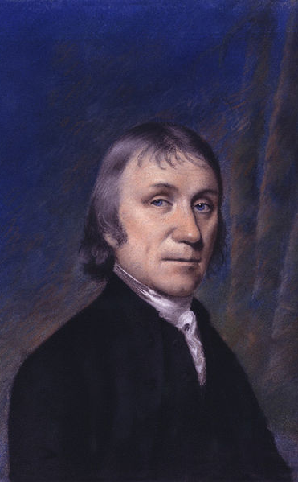
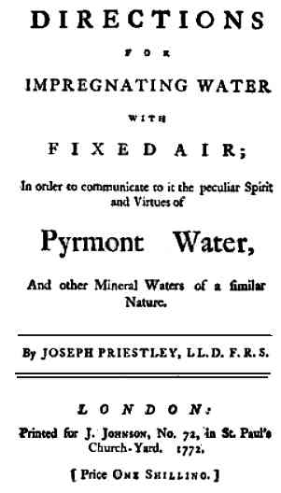
OCEAN ACIDIFICATION
Atmospheric carbon dioxide levels now exceed 400 ppm, on average.
One-third of the CO₂ has been absorbed by the oceans.
Average ocean pH has dropped from 8.21 to 8.10. It will fall another 0.3 to 0.4 units by 2100.
This represents a 150% increase in hydrogen ions and a 50% decrease in levels of carbonate ions (CO₃²⁻).
Notes:
On 17 April 1774, Lindsey held the first Unitarian service in Britain.
Priestley was considered for the position of astronomer on James Cook's second voyage to the South Seas, but was not chosen. Still, he contributed in a small way to the voyage: he provided the crew with a method for making soda water, which he erroneously speculated might be a cure for scurvy. He then published a pamphlet with (1772).^{[65]} Priestley did not exploit the commercial potential of soda water, but others such as J. J. Schweppe made fortunes from it.^{[66]} In 1773, the Royal Society recognized Priestley's achievements in natural philosophy by awarding him the Copley Medal.^{[67]}
The attack on Priestley's home, Fairhill, Sparkbrook, Birmingham
The animus that had been building against Dissenters and supporters of the American and French Revolutions exploded in July 1791. Priestley and several other Dissenters had arranged to have a celebratory dinner on the anniversary of the storming of the Bastille, a provocative action in a country where many disapproved of the French Revolution and feared that it might spread to Britain. Amid fears of violence, Priestley was convinced by his friends not to attend. Rioters gathered outside the hotel during the banquet and attacked the attendees as they left. The rioters moved on to the New Meeting and Old Meeting churches—and burned both to the ground. Priestley and his wife fled from their home; although their son William and others stayed behind to protect their property, the mob overcame them and torched Priestley's house "Fairhill" at Sparkbrook, destroying his valuable laboratory and all of the family's belongings. Other Dissenters' homes were burned in the three-day riot. Priestley spent several days hiding with friends until he was able to travel safely to London. The carefully executed attacks of the "mob" and the farcical trials of only a handful of the "leaders" convinced many at the time—and modern historians later—that the attacks were planned and condoned by local Birmingham magistrates. When George III was eventually forced to send troops to the area, he said: "I cannot but feel better pleased that Priestley is the sufferer for the doctrines he and his party have instilled, and that the people see them in their true light."¹³⁰ Also, since 1952 Dickinson College has presented the Priestley Award to a scientist who makes "discoveries which contribute to the welfare of mankind".^{[169]}

Slide 10

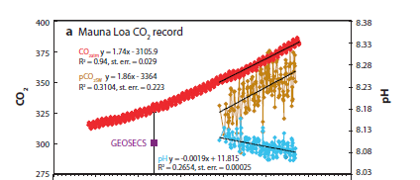

Evidence from six decades of open-ocean monitoring
CO₂ air
CO₂ sea
pH
~25% decrease in carbonate ions

Slide 11
What about the coasts?
NOx
“classic” OA
Terrestrial input
Ocean input & gassing
Organic carbon & nutrient run-off
Marsh plumes
Eutrophication
Benthic respiration
Decomposition
“Biological” acidification

Slide 12
What about the coasts?
NOx
Eutrophication is a common cause of acidification in estuaries: nutrient enrichment stimulates the production of algal DOC, which sinks and fuels microbial respiration in anoxic bottom waters, generating high levels of CO₂.
“classic” OA
Terrestrial input
Ocean input & gassing
Coastal acidification is likely to intensify with “increasing rates of sediment runoff and [OC] transport towards the oceans”
Organic carbon & nutrient run-off
Marsh plumes
Eutrophication
Benthic respiration
Decomposition
“Biological” acidification

Slide 13


What about the coasts?
Ocean acidification
Coastal zone acidification
Precise and stable
High variability
Sunda and Cai (2012) surmised that “we should expect that eutrophication of Chesapeake Bay, and the subsequent release of CO₂ by the decomposition of algal blooms, will generate acidified conditions in bottom waters”.

Slide 14
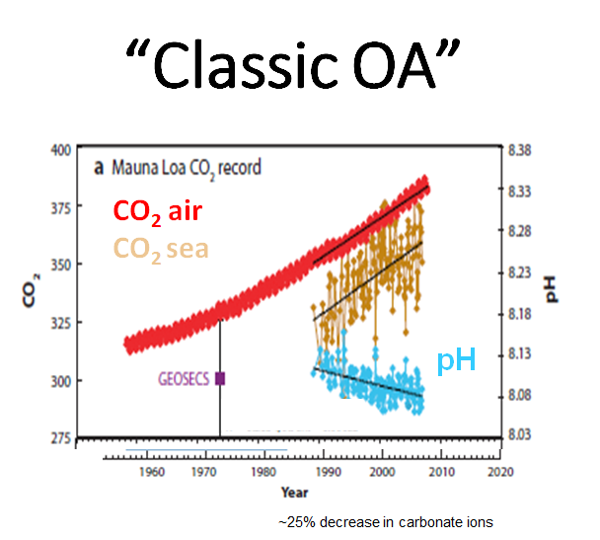
What about the coasts?

Slide 15
What about the coasts?

Slide 16
What about the coasts?

Slide 17
What about the coasts?

Slide 18
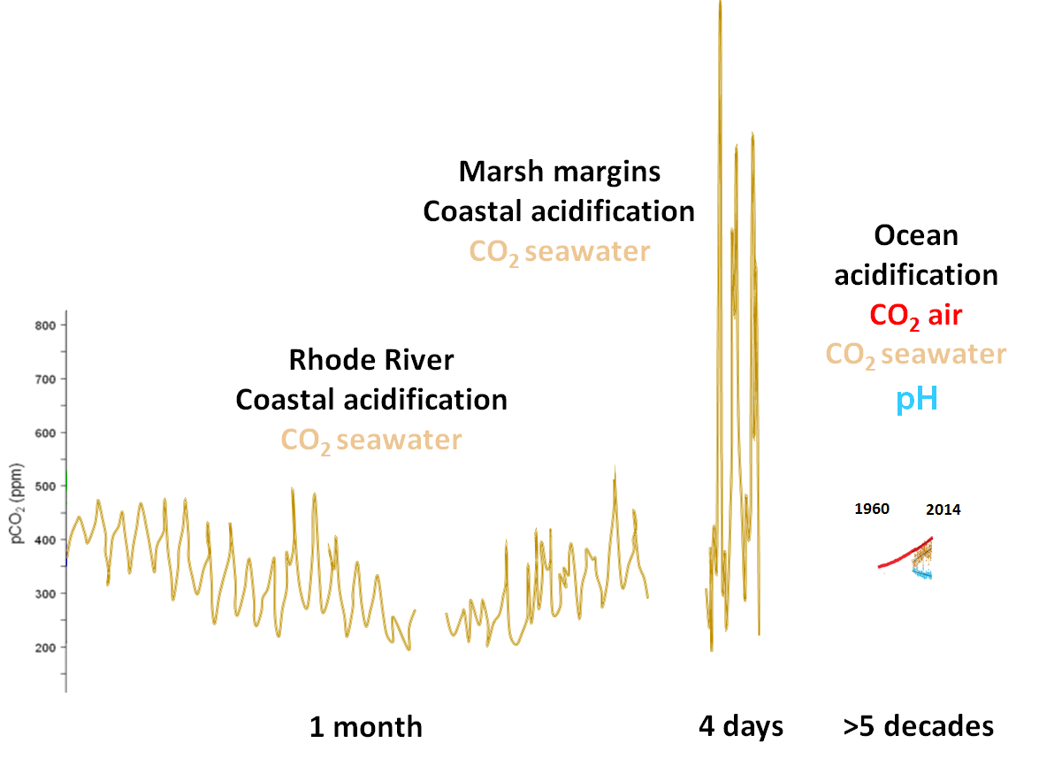
What about the coasts?
High variability
Precise and stable
Whitman Miller, SERC

Slide 19
What about the coasts?
High variability
Precise and stable
with Whitman Miller, SERC

Slide 20
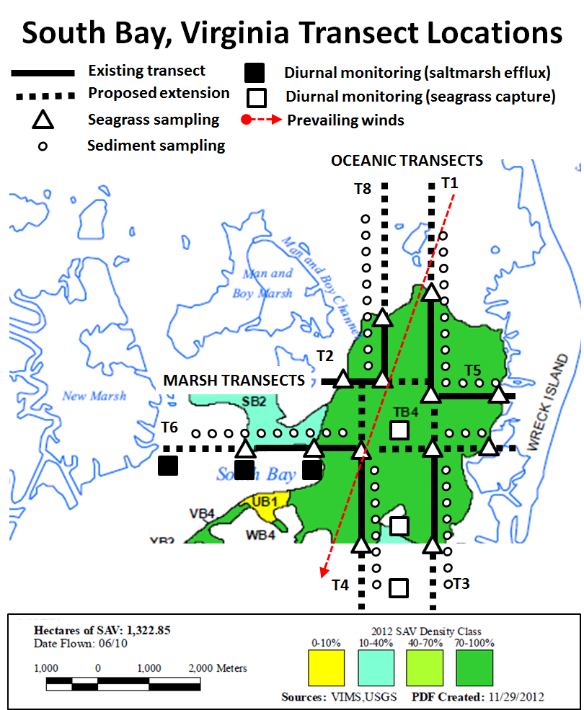
What about the coasts?

Slide 21
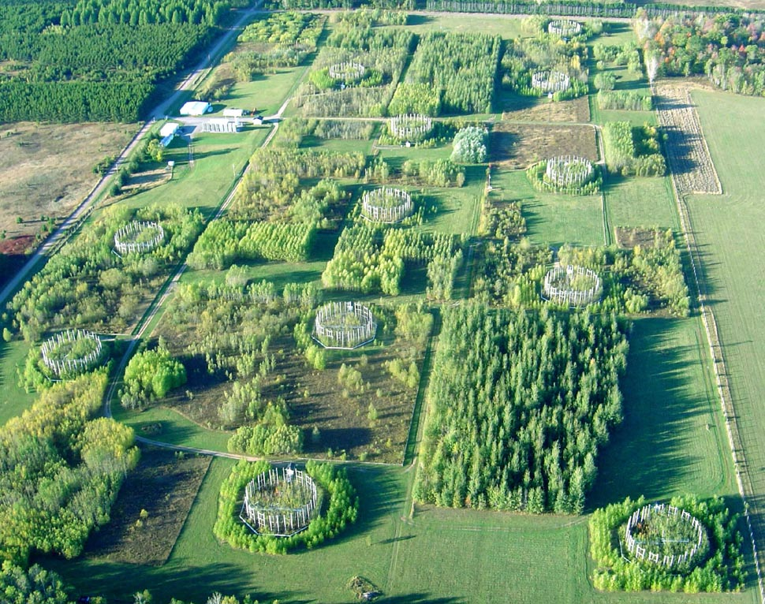
Impacts of high CO₂?

Slide 22
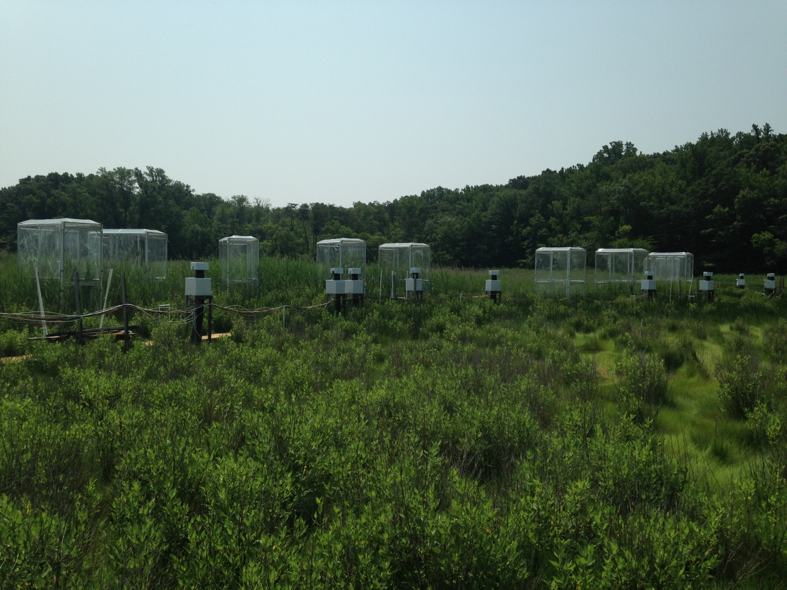
Impacts of high CO₂?

Slide 23
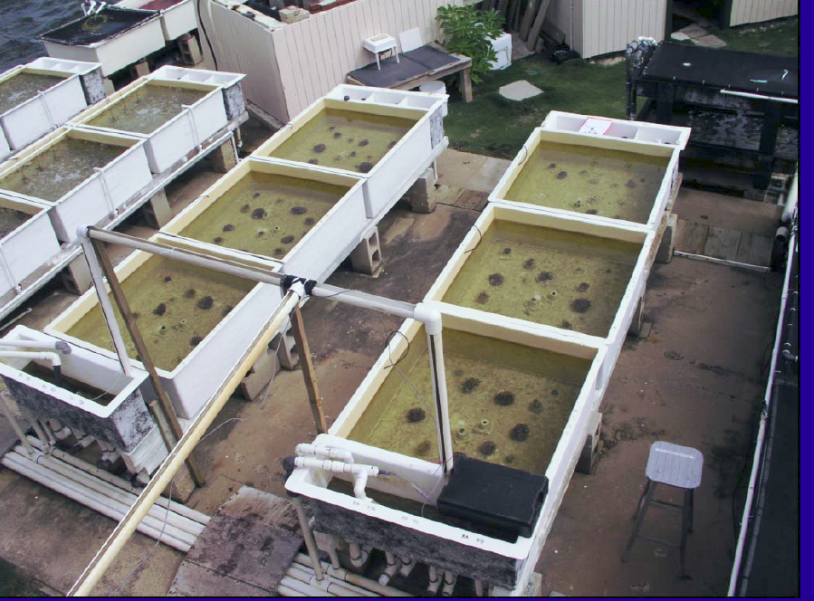
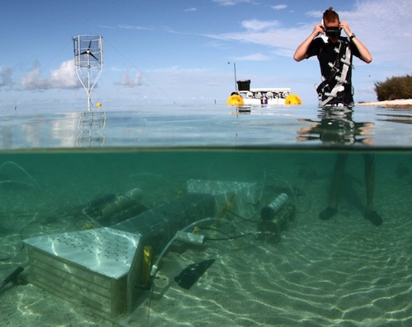
Studying CA
Lab studies | Precise | Less realistic
Mesocosms | Outside | But not natural
Free-ocean-carbon-enrichment | In situ | But replication is a challenge
High CO₂ vents | Natural communities | Rare, artifacts?
Acid springs | Natural communities | Rare, artifacts?

Slide 24
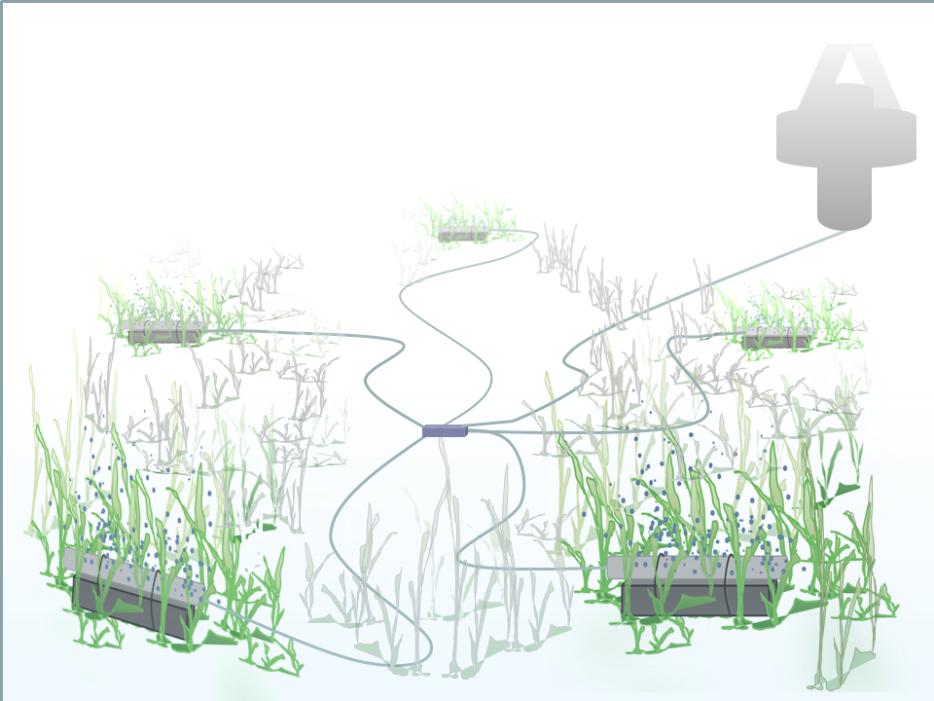
Studying CA

Slide 25
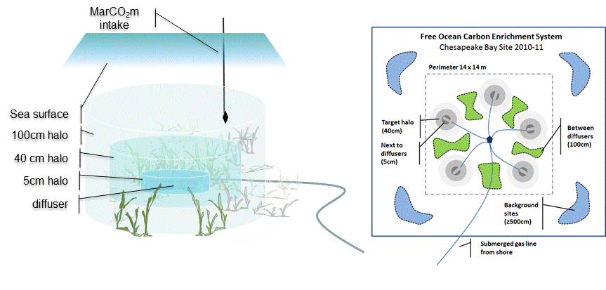
Studying CA
Open-benthos FOCE system and MarCO₂m
real-time pCO₂ monitors

Slide 26
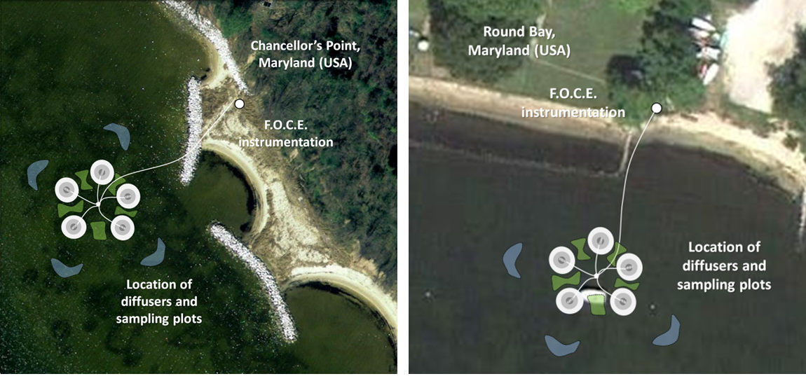
Studying CA

Slide 27
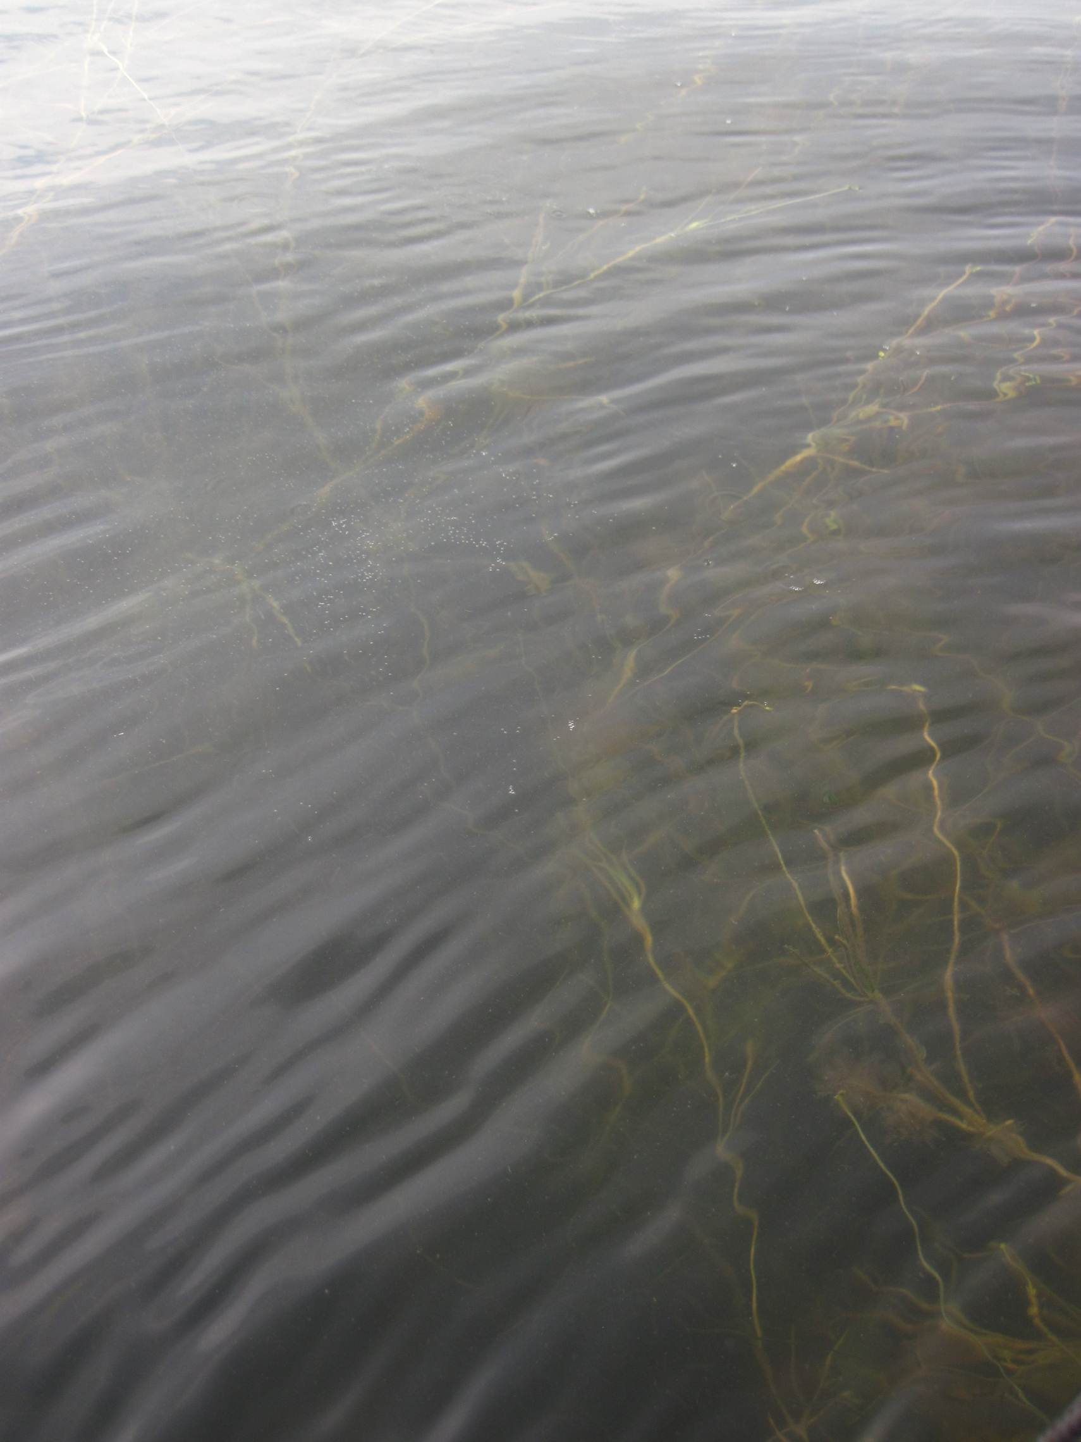

Slide 28
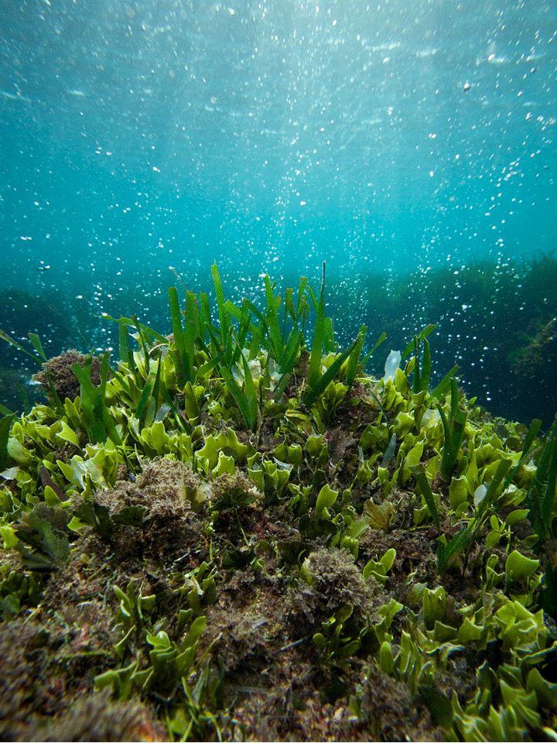

Slide 29
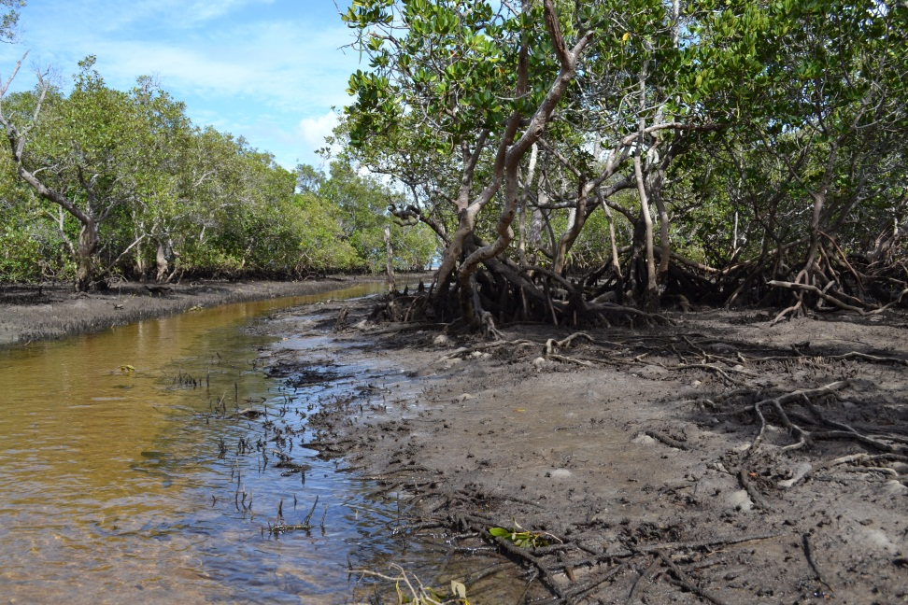

Slide 30
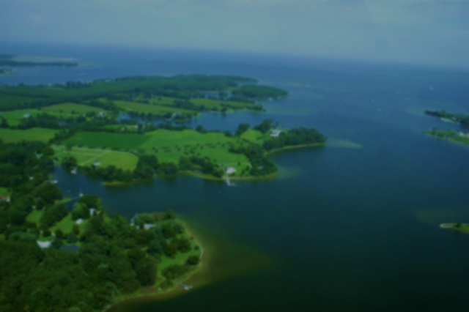
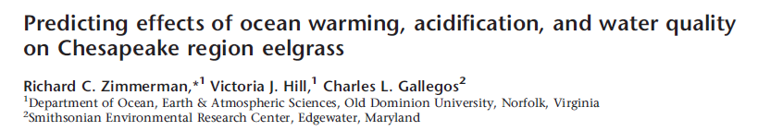
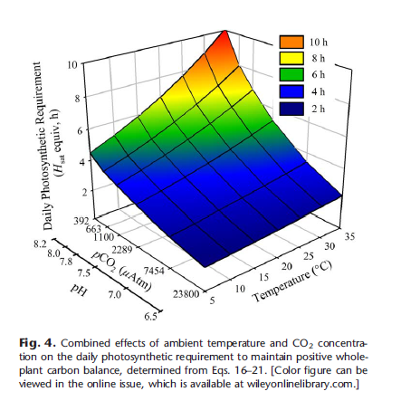
Impacts of high CO₂?
High CO₂ conditions may benefit SAV photosynthesis, which is often CO₂-limited.
The “CO₂ fertilization effect” is often beneficial for eelgrass, and other photosynthetic organisms.
Acidification should stimulate eelgrass photosynthesis sufficiently to offset the deleterious effects of thermal-stress, “facilitating the survival of eelgrass in Chesapeake Bay despite a warmer climate”.
“bad”
“good”

Slide 31
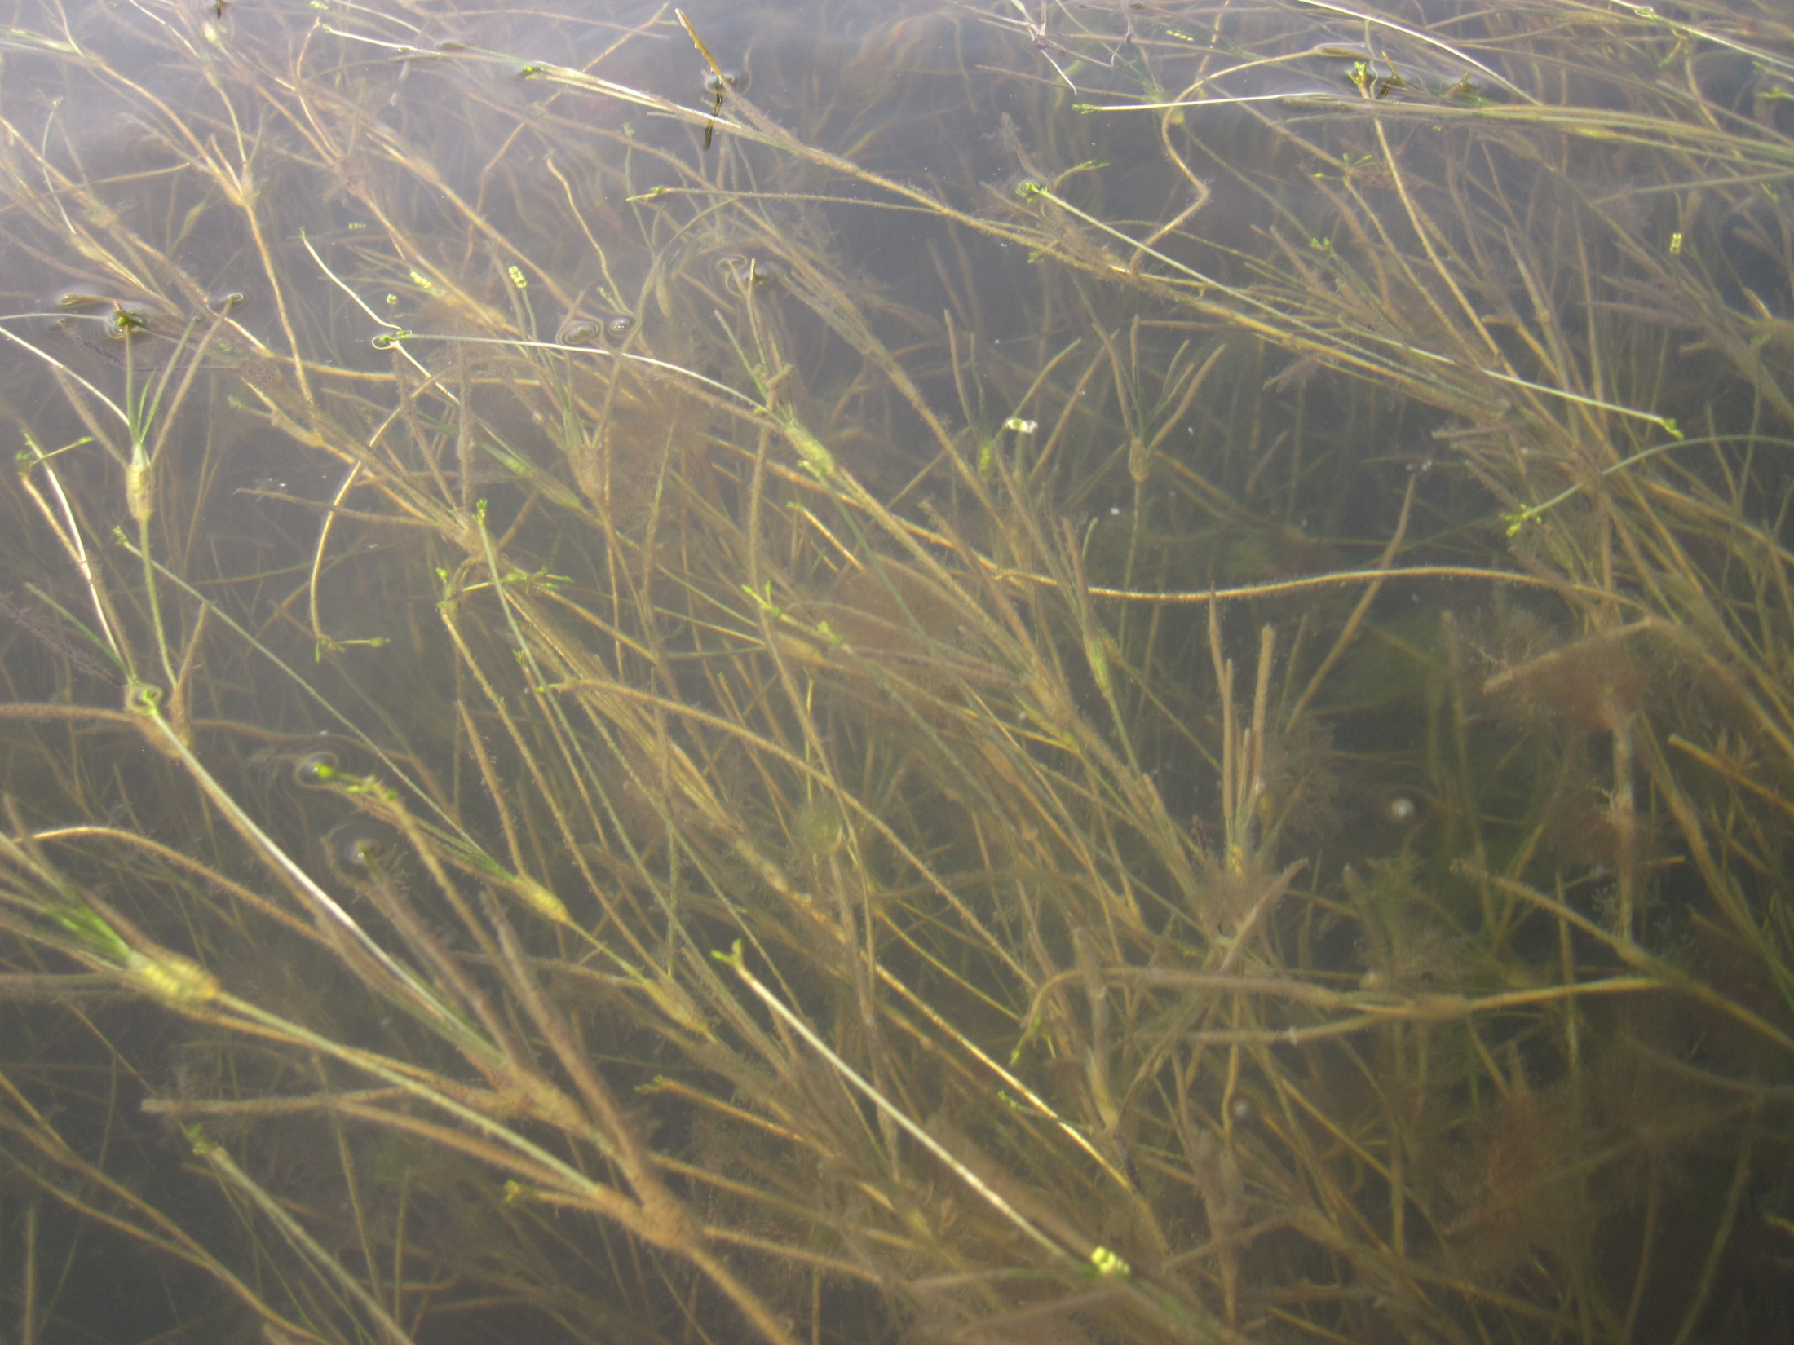
Impacts of high CO₂?

Slide 32
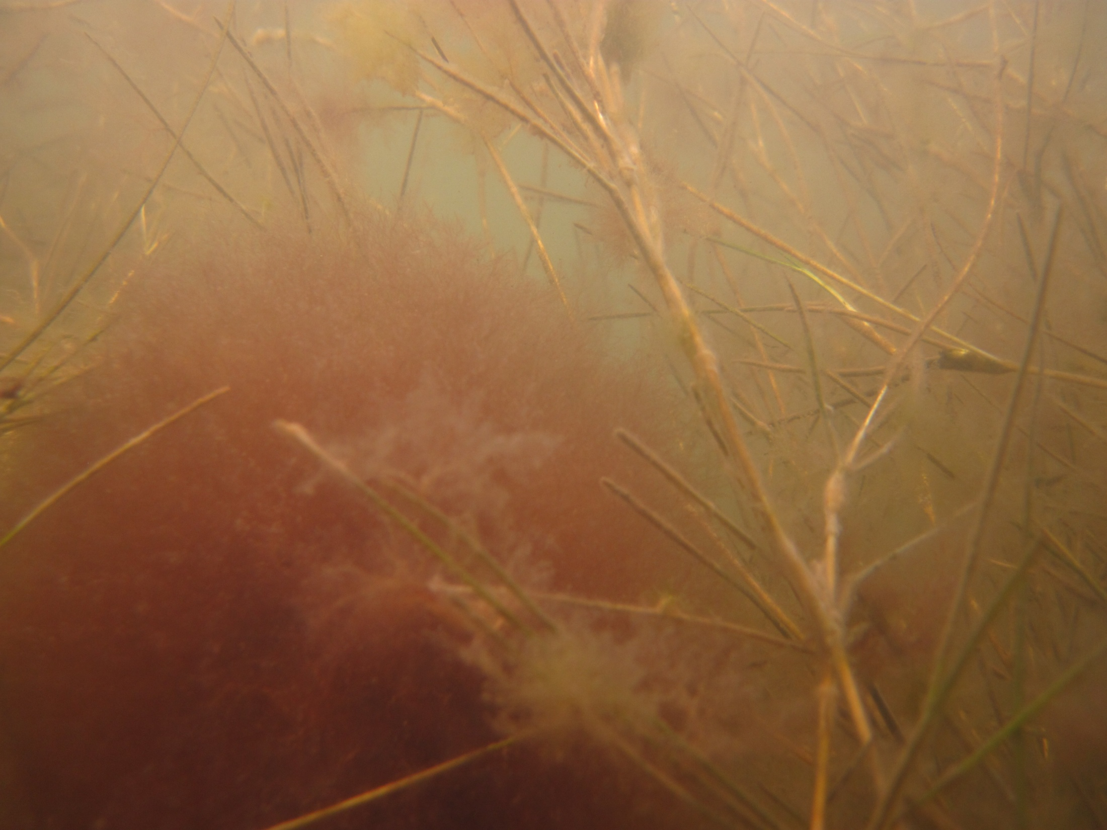
Impacts of high CO₂?

Slide 33
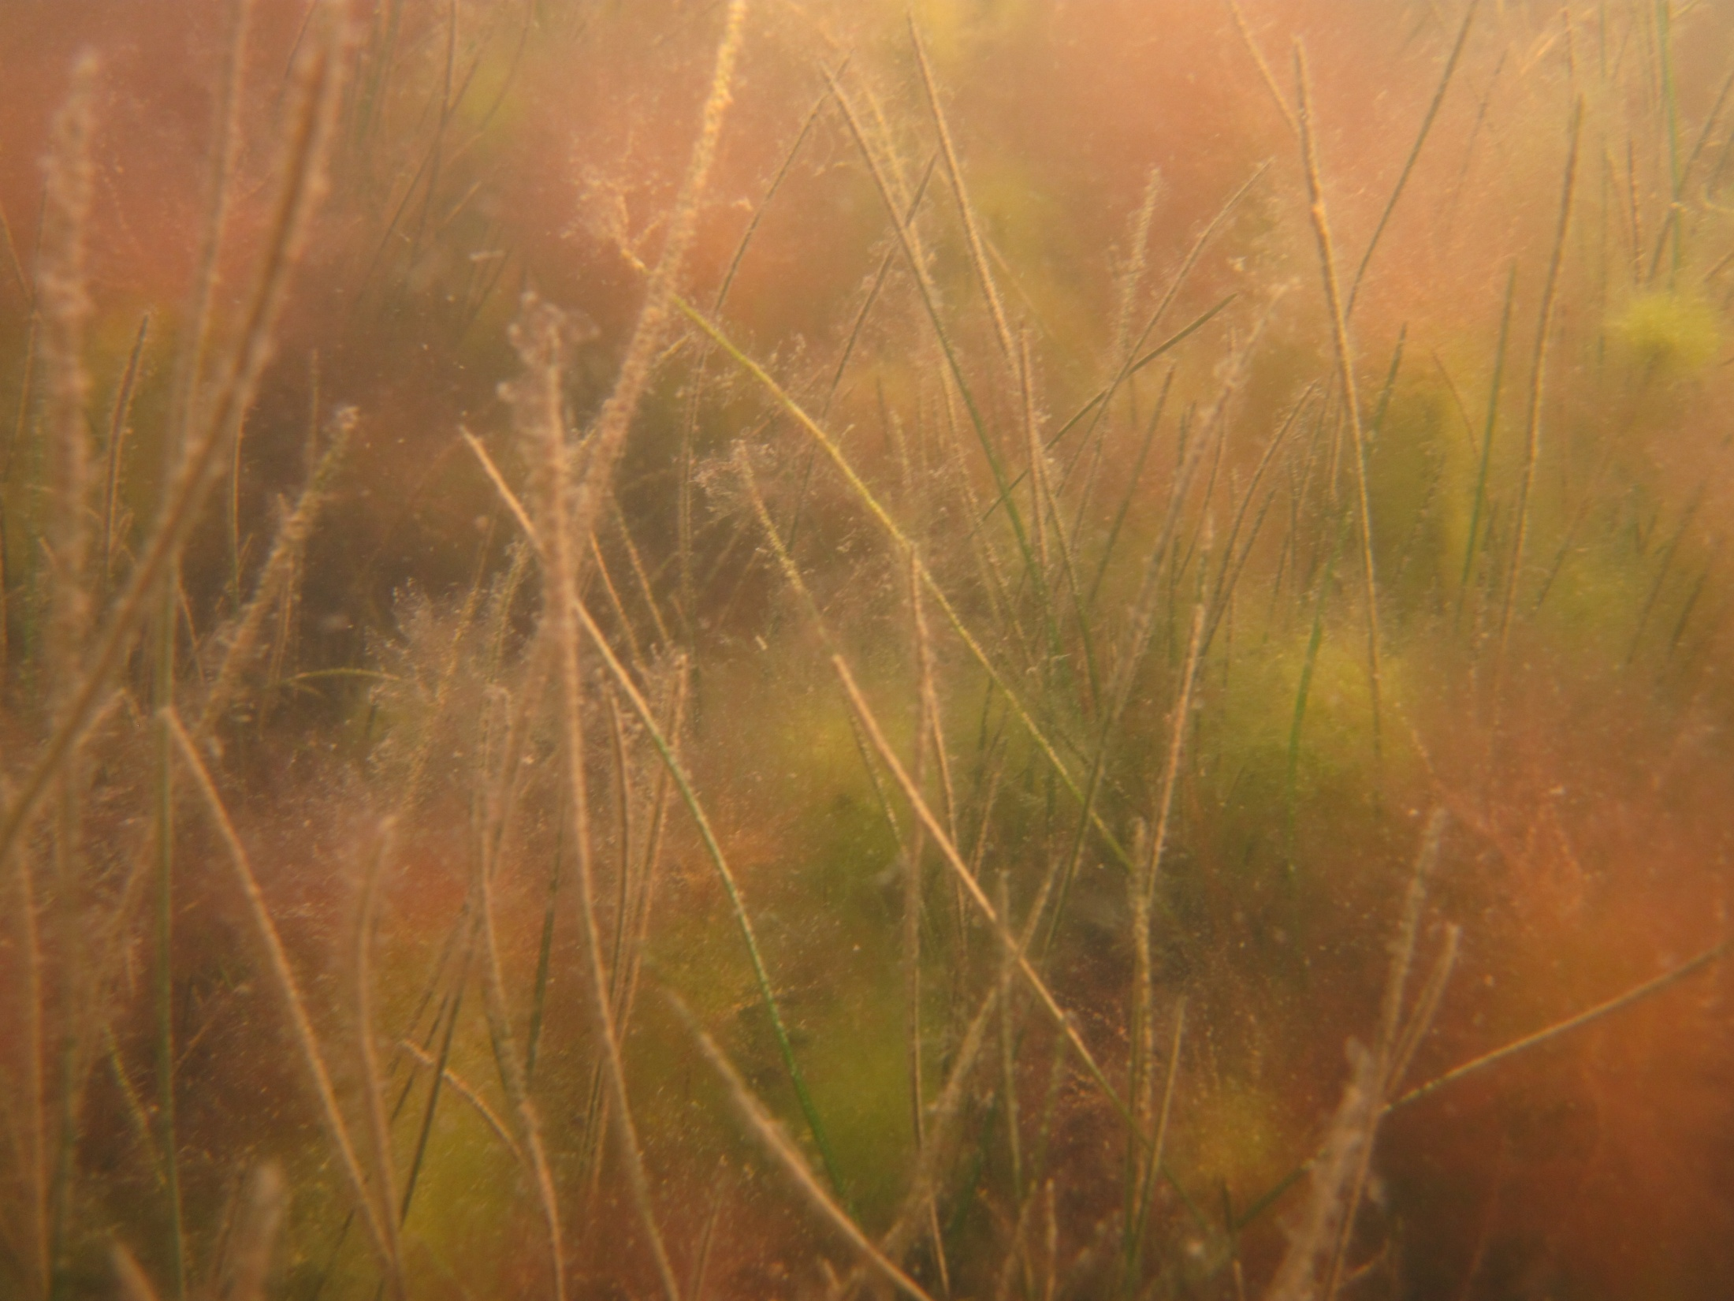
Impacts of high CO₂?

Slide 34
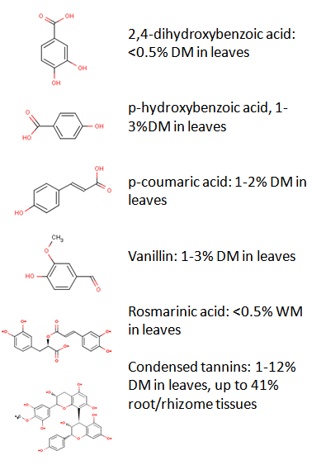
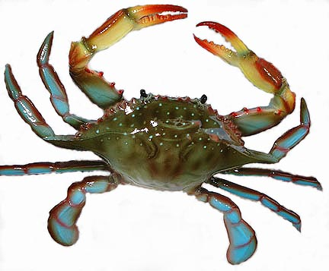
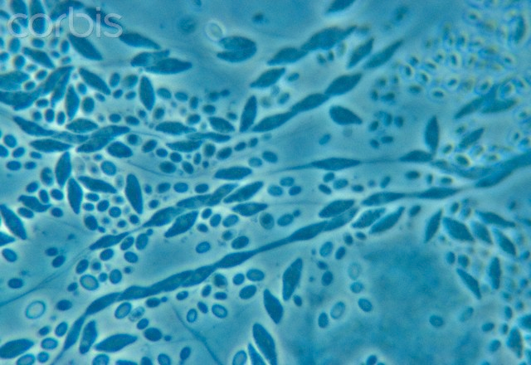
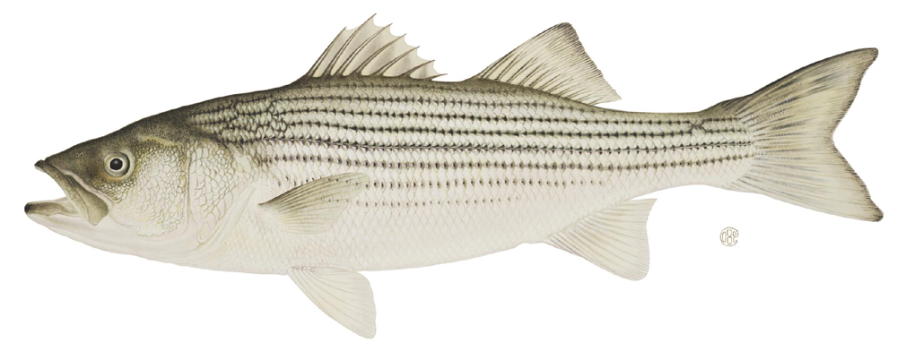
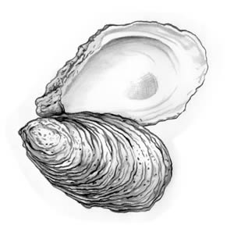
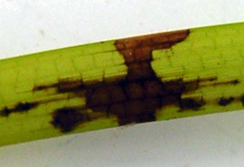
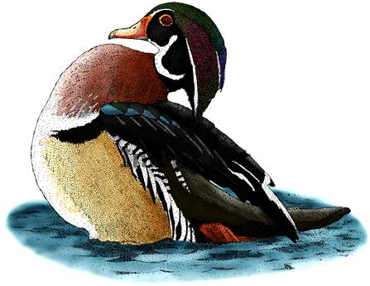
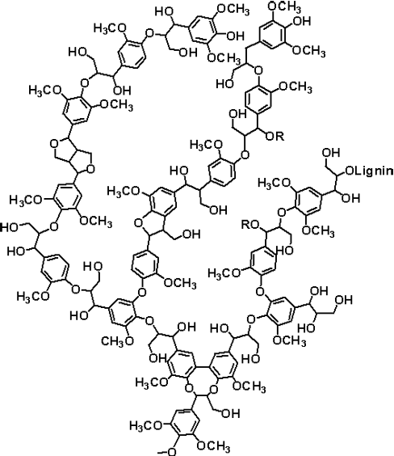
Community-level impacts
Lignins: ~2% DM

Slide 35
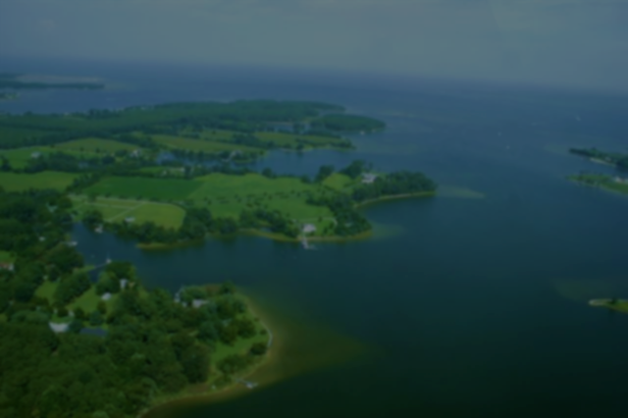
“Our predictions are limited, however, by our poor understanding of the indirect effects of climate change on community members, including fouling organisms, grazers, and microbes associated with seagrass die-offs. These indirect effects are likely to trigger abrupt, unforeseen changes in these communities.” – TS3 report

Slide 36
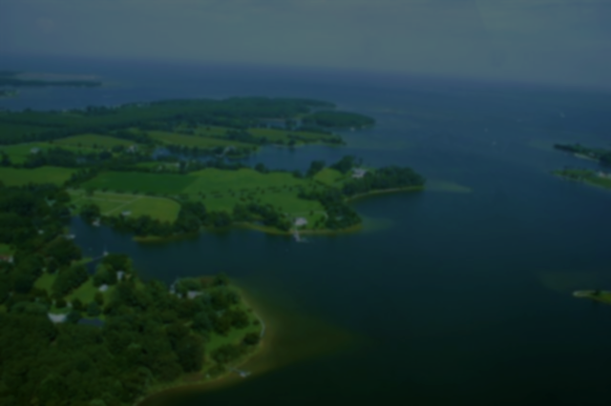
TS3 CONCLUSIONS
If the current trajectory of climate change continues the Chesapeake Bay could develop some characteristics of a subtropical estuary by the next century.
  Climate warming has already been implicated in die-offs of submerged vegetation, especially eelgrass (Z. marina). Continued warming has been predicted to reduce or eliminate eelgrass from the Chesapeake Bay.
  The “CO₂ fertilization effect” of coastal acidification has the potential to stimulate photosynthesis and growth in submerged vegetation. High CO₂ / low pH conditions may facilitate the survival of eelgrass in the Chesapeake Bay.
  Sea level rise will reshape our shorelines. Where they are permitted to migrate landward, suitable SAV habitat may persist. However, where shorelines are hardened suitable SAV habitat is likely to be lost.

Slide 37

Address 20th century challenges, 21st century climate change, maintain diversity to buy time. “Present-day efforts to improve the health and species diversity of the Chesapeake will be important in determining how the ecosystem responds to climate change. It is clear that the ability of ecological communities to resist and/or adapt to climate change is linked to their species and genetic diversity.”
Learn to accept uncertainty and risk. “These interacting forces are likely to trigger episodic events, pass ecological thresholds, trigger tipping points, and induce phase changes, making it unlikely that changes in these communities will occur at a uniform pace, or in a predictable manner. These events are likely to preclude a smooth transition to a balanced subtropical ecosystem.”
Recommendations

