Slide 1


Slide 2
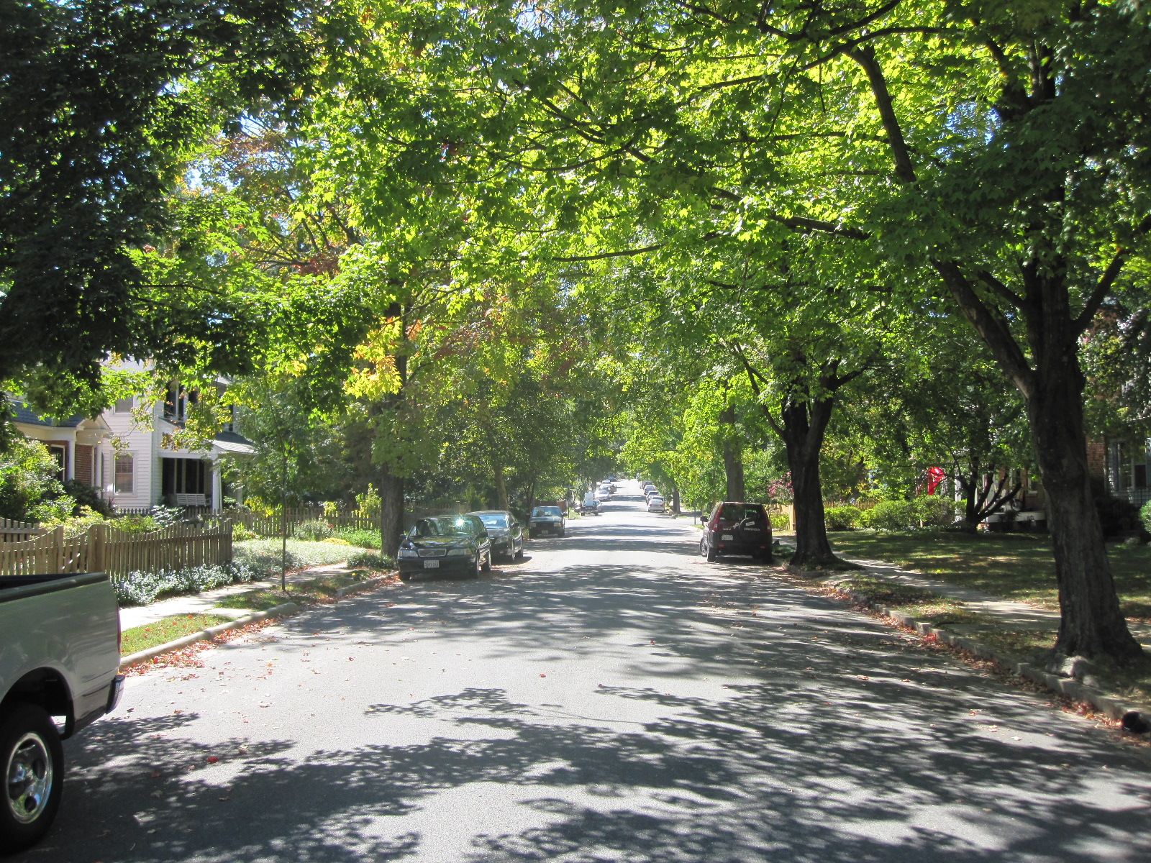
Notes:
Moved to Fredericksburg – College Terrace –wanted to live on Tree lined stree

Slide 3
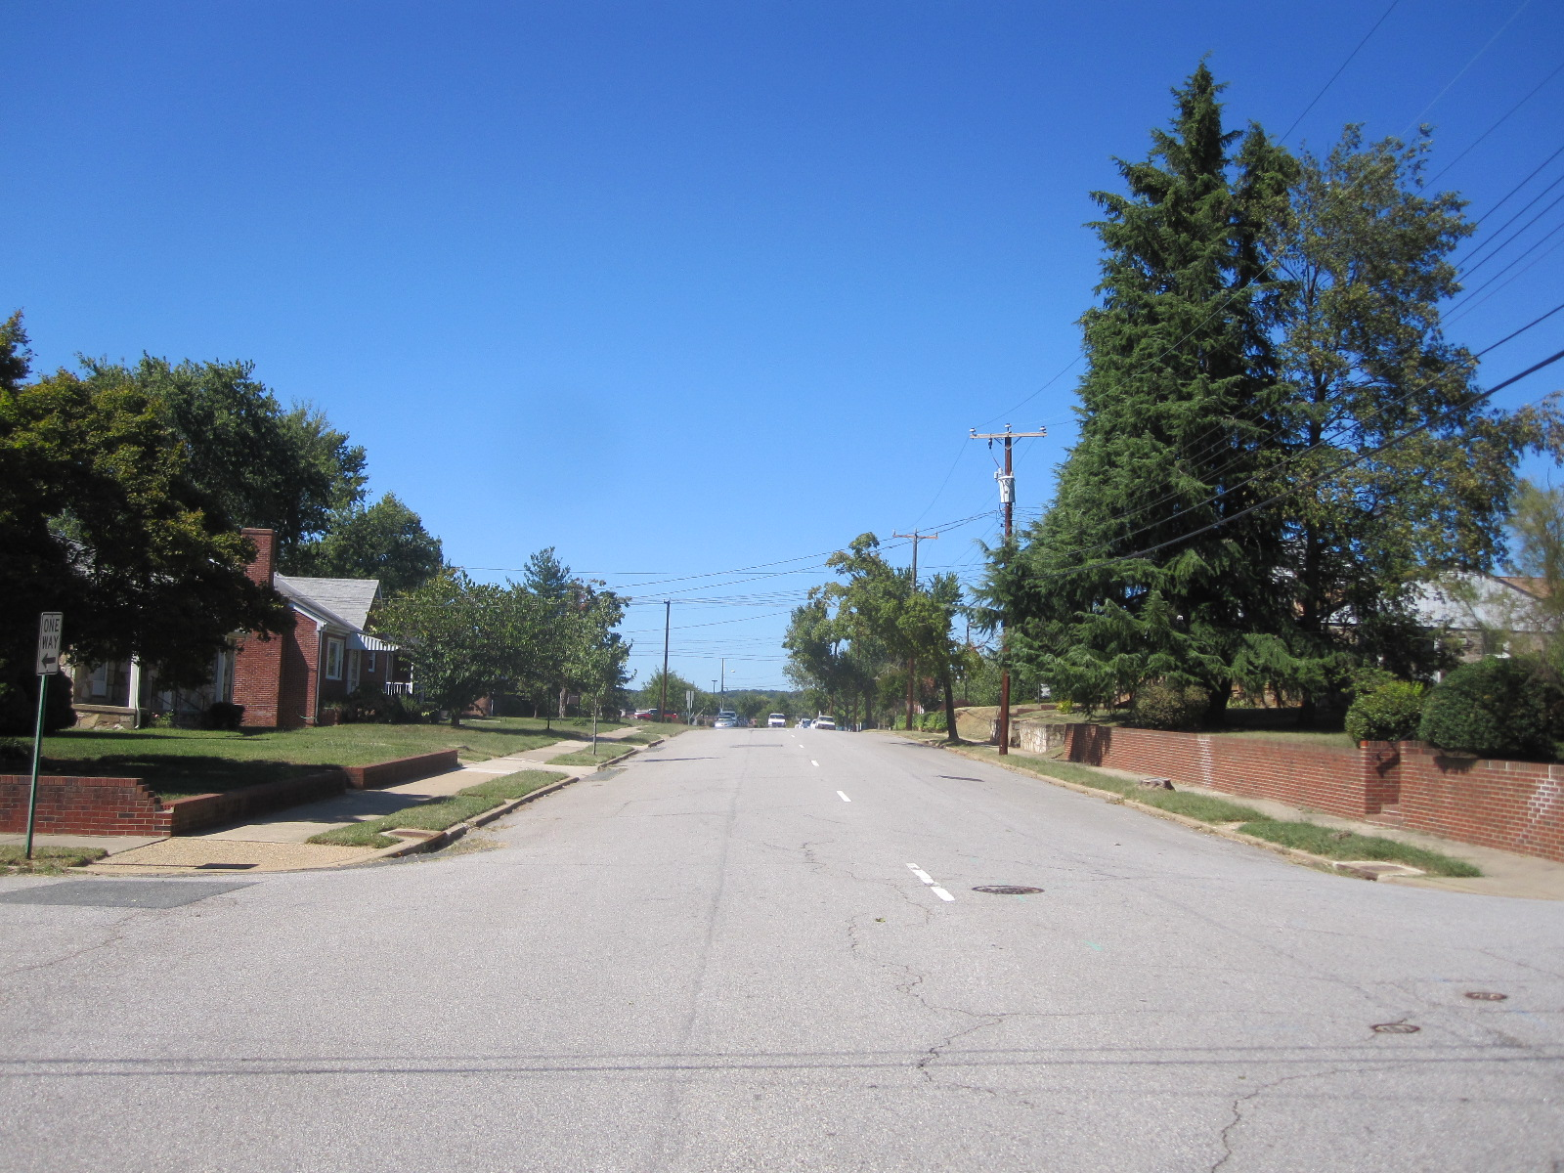
Notes:
2005 tree plan

Slide 4
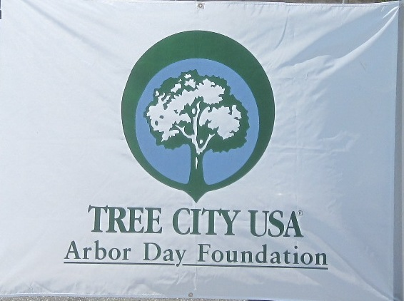
Tree City USA – 29 Years

Slide 6
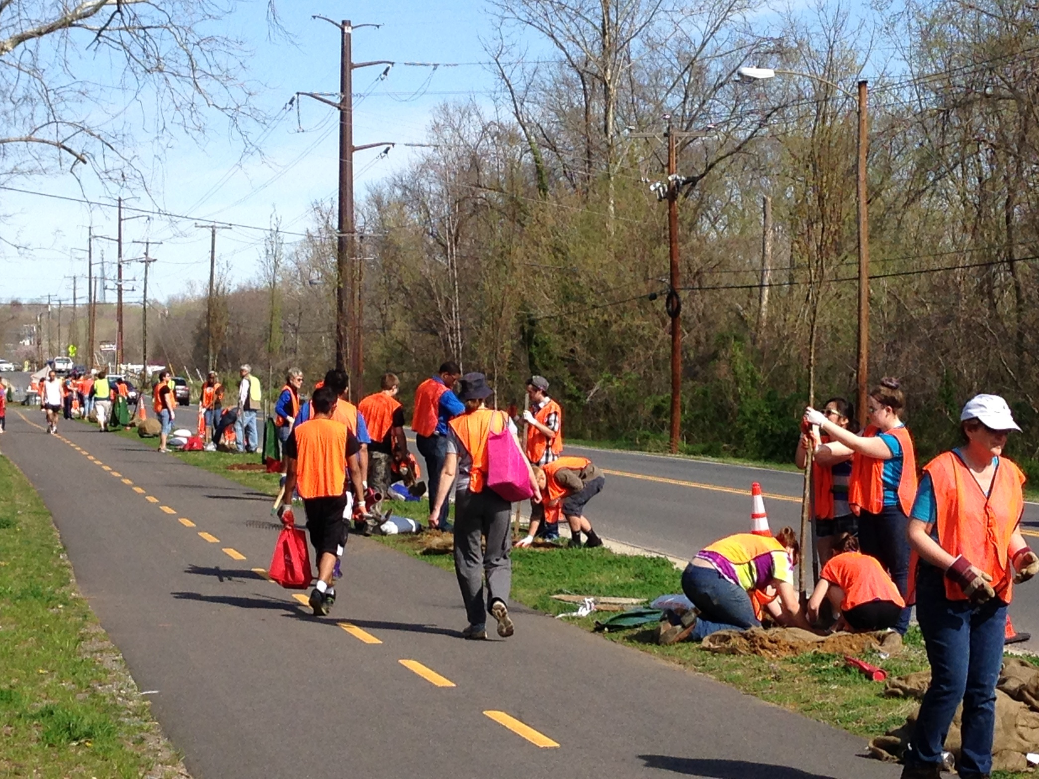

Slide 7
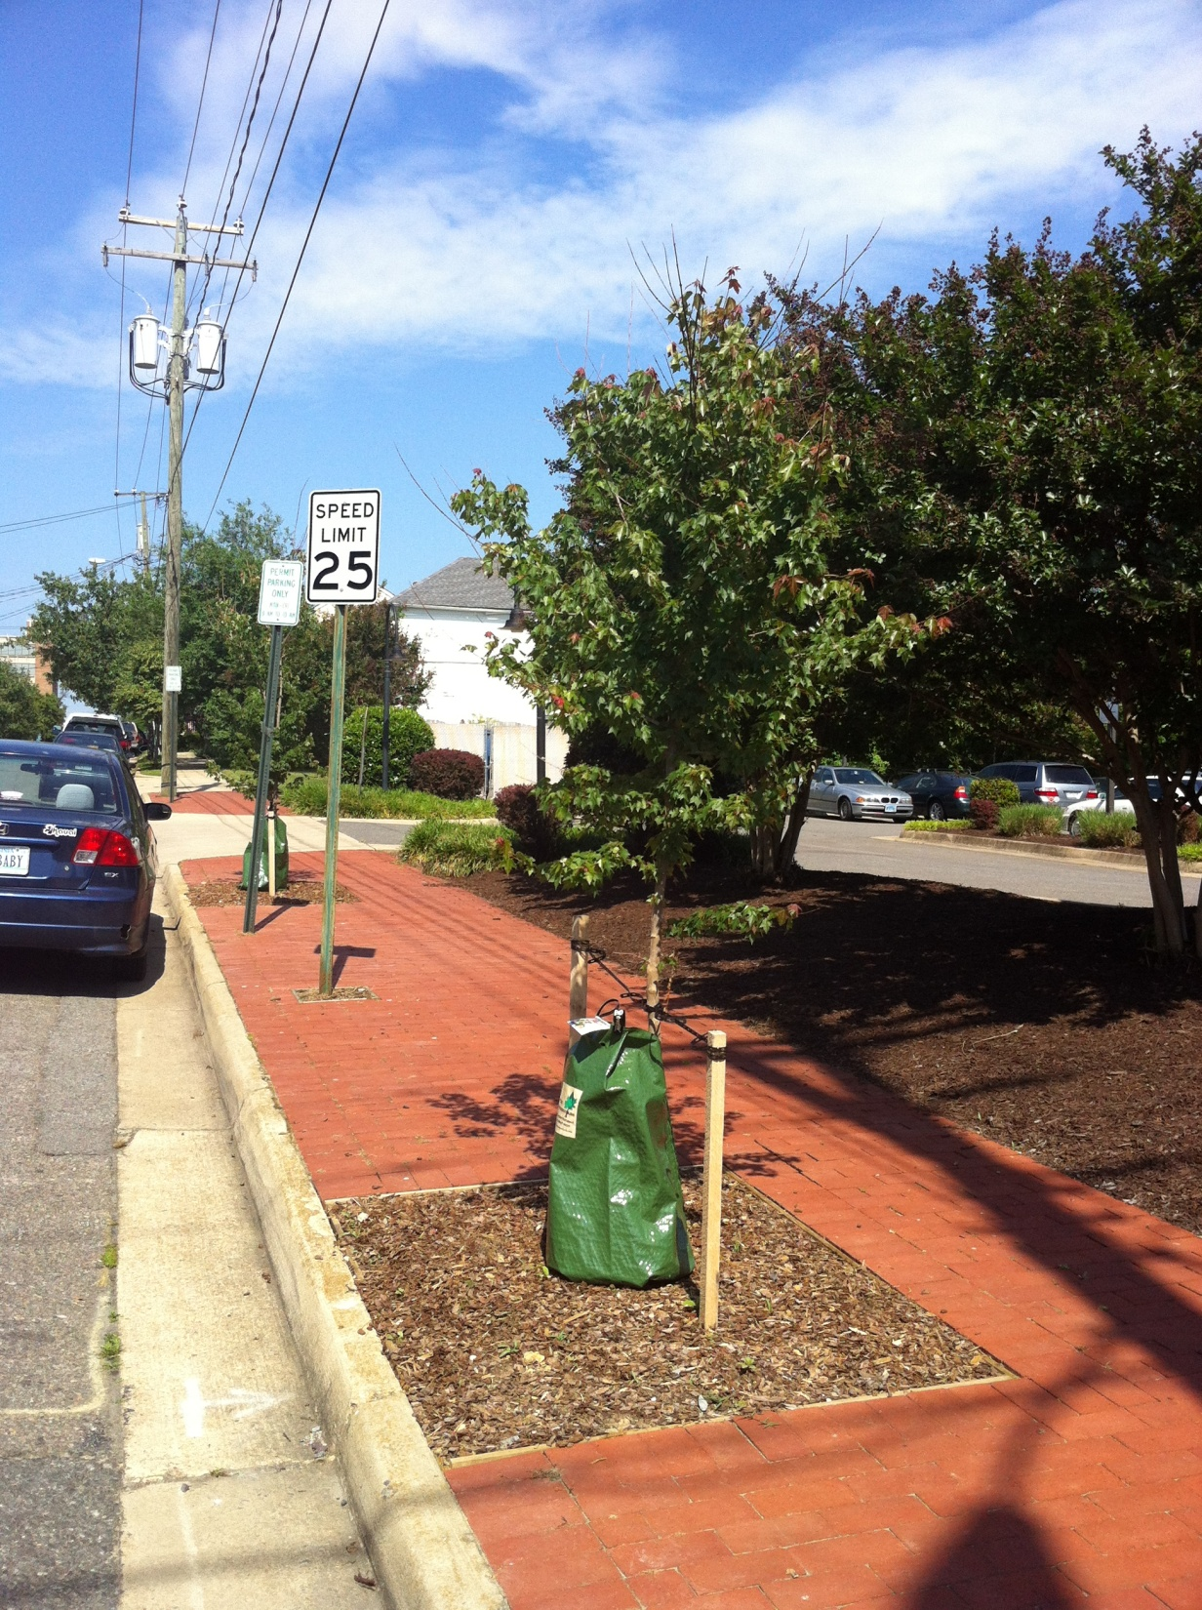
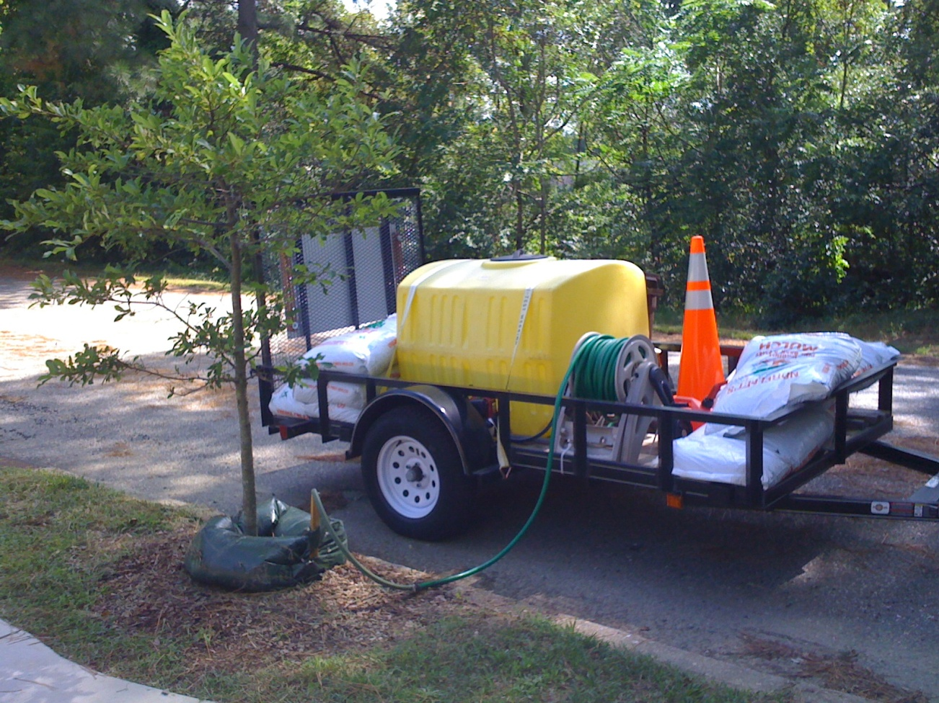

Slide 8
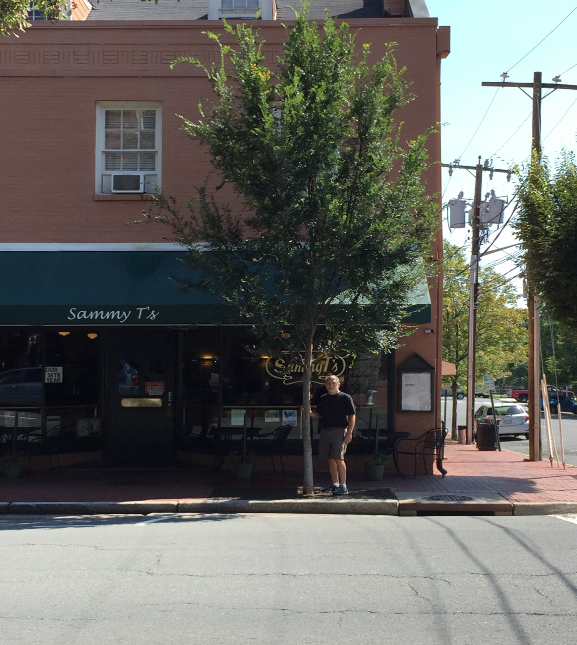
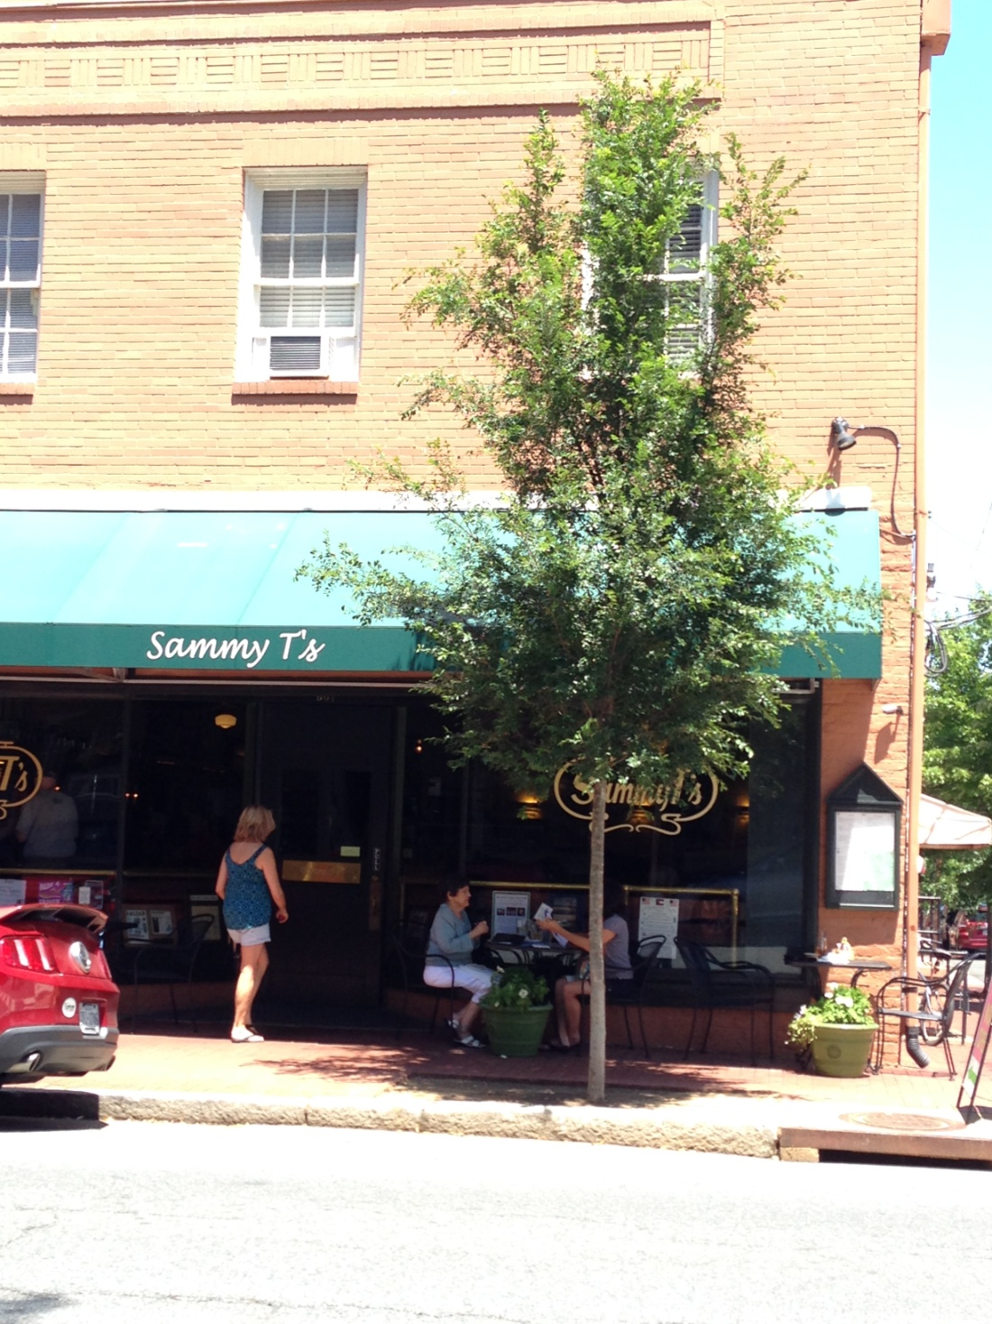

Slide 9
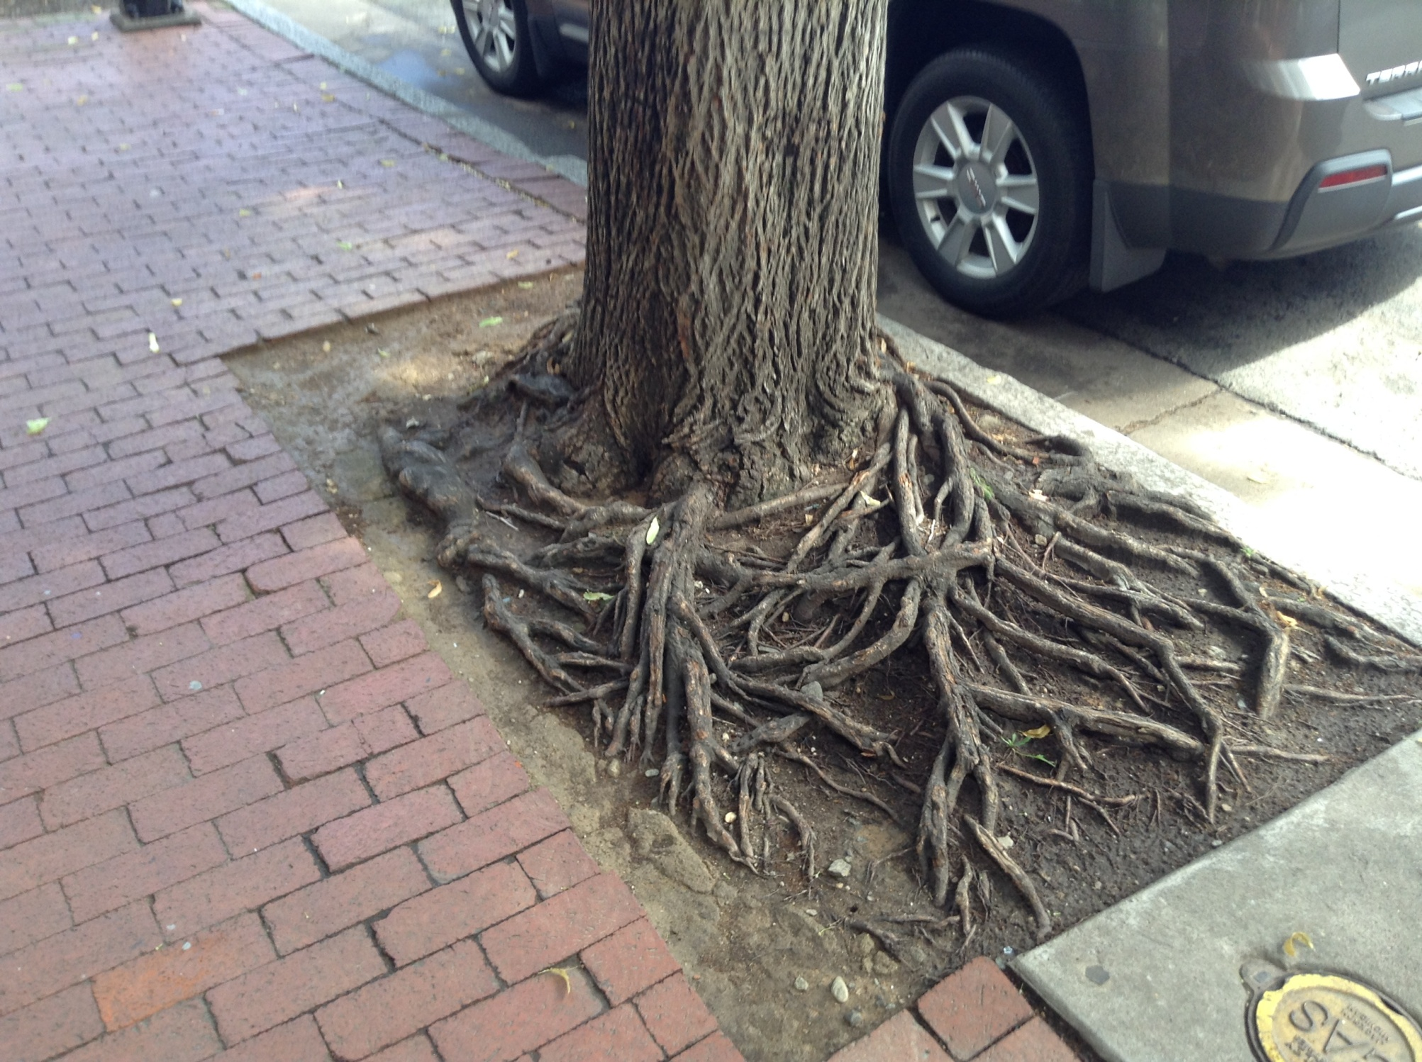

Slide 10
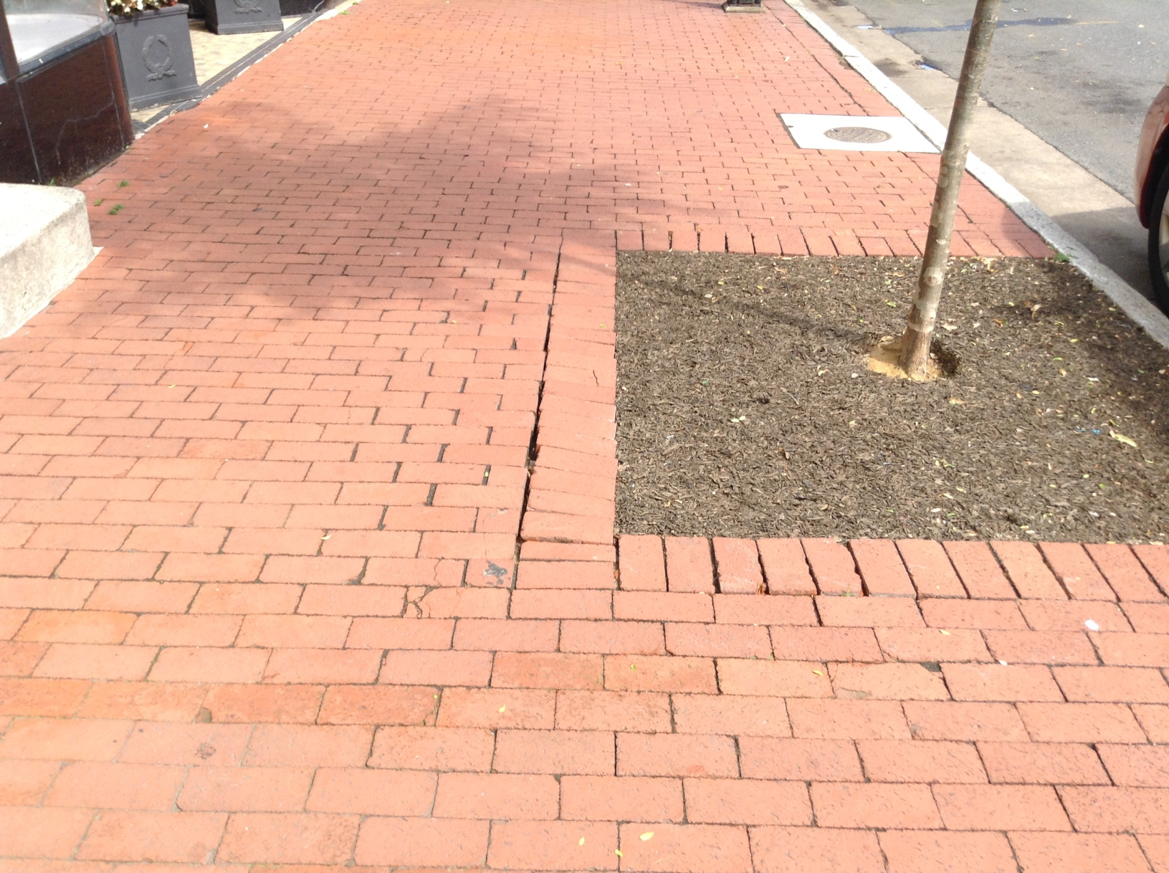

Slide 11
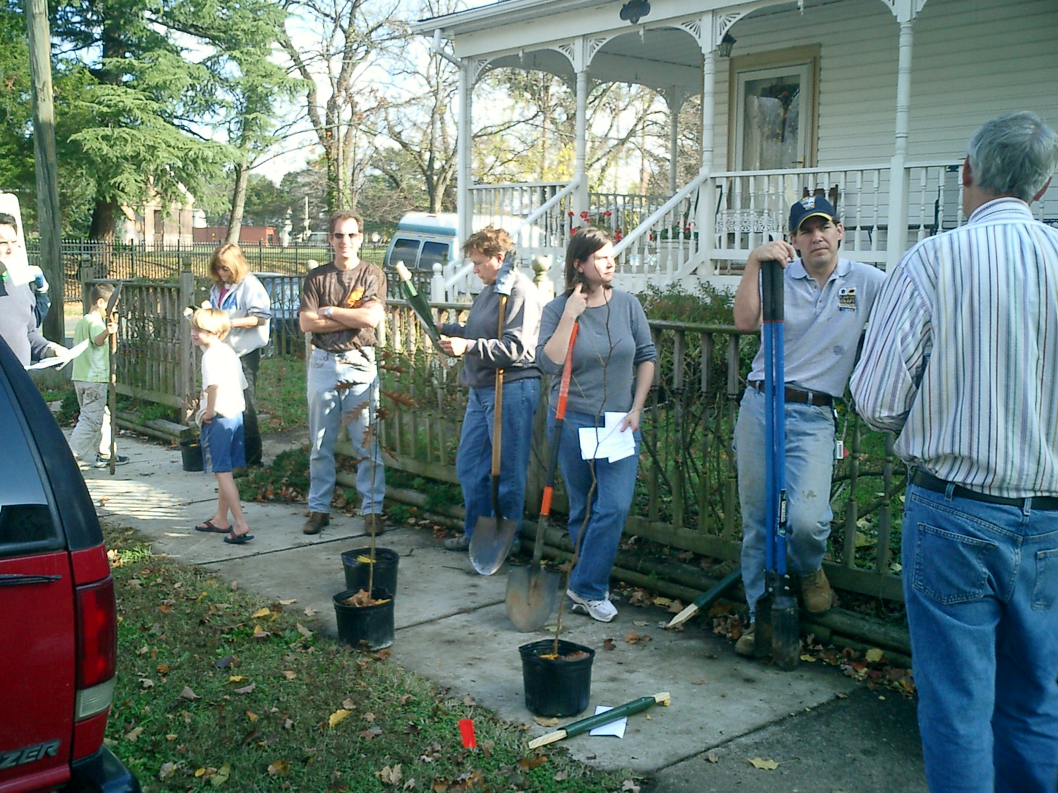
Notes:
Fall 2008 – 47 - 3 gallon trees

Slide 12
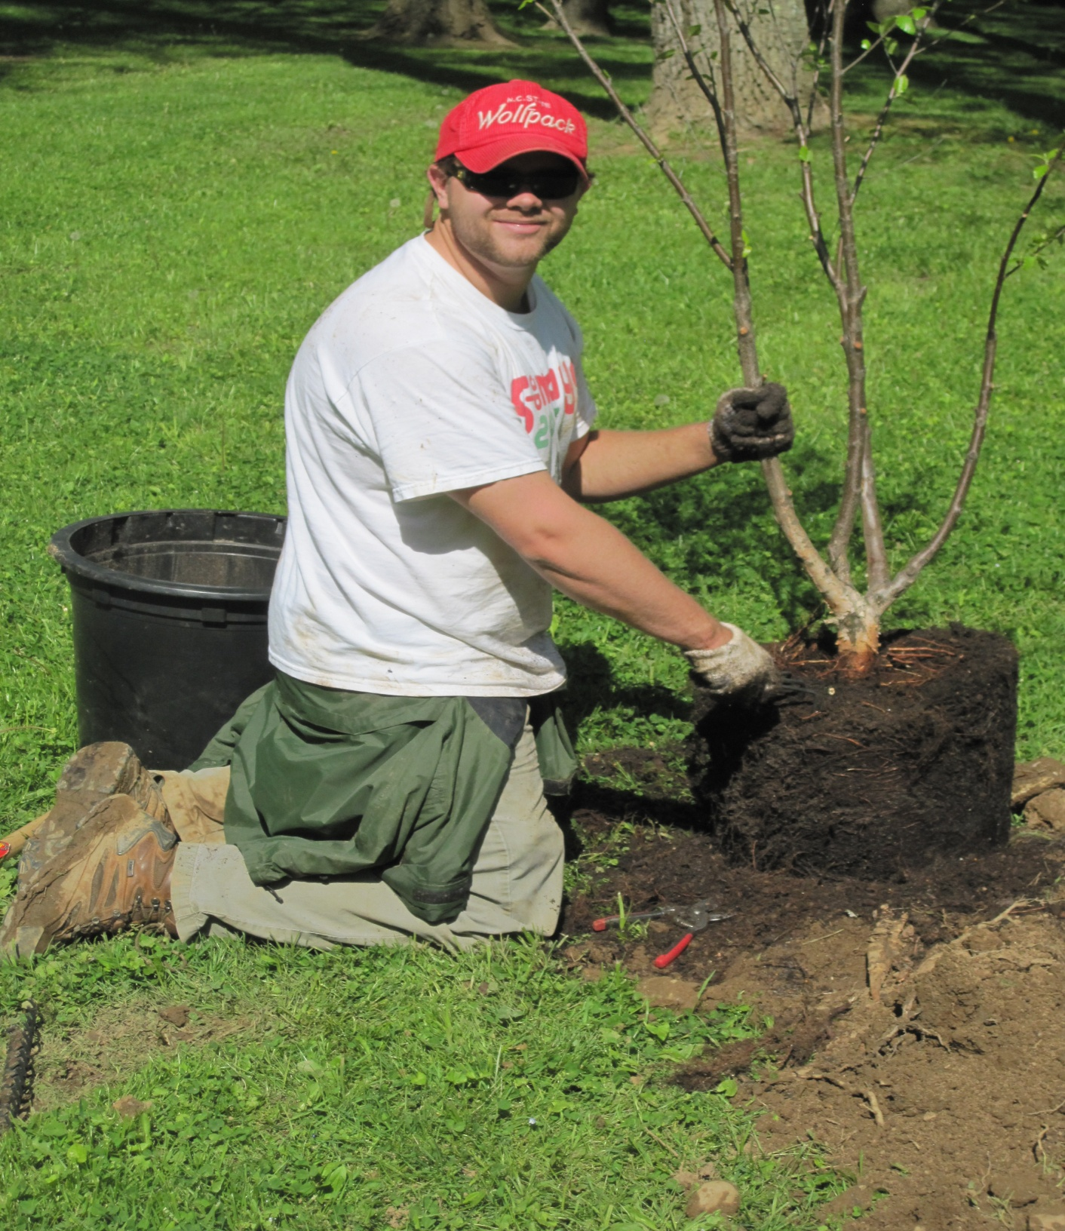
Notes:
2010 start using 15 gallon pots

Slide 13
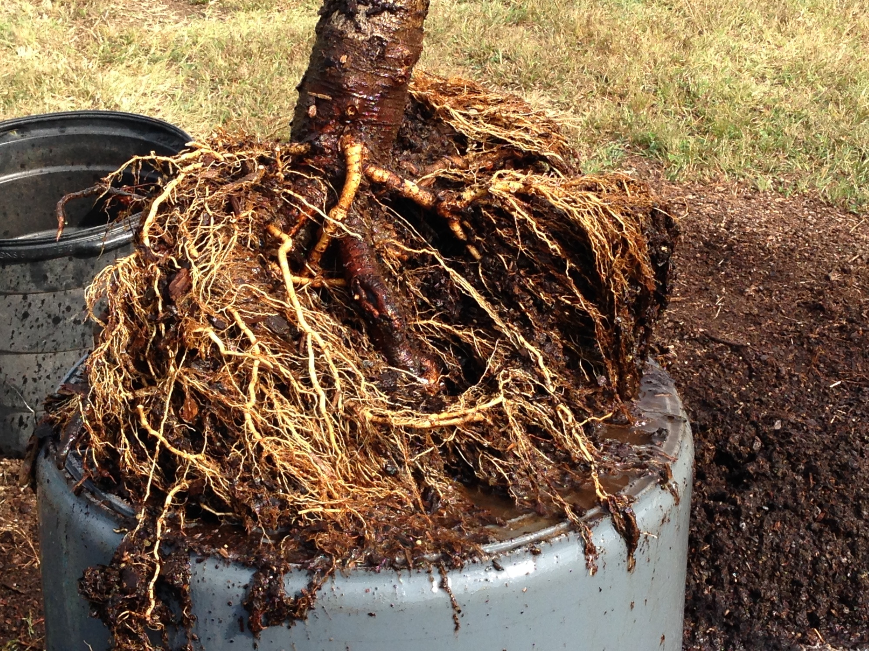

Slide 14
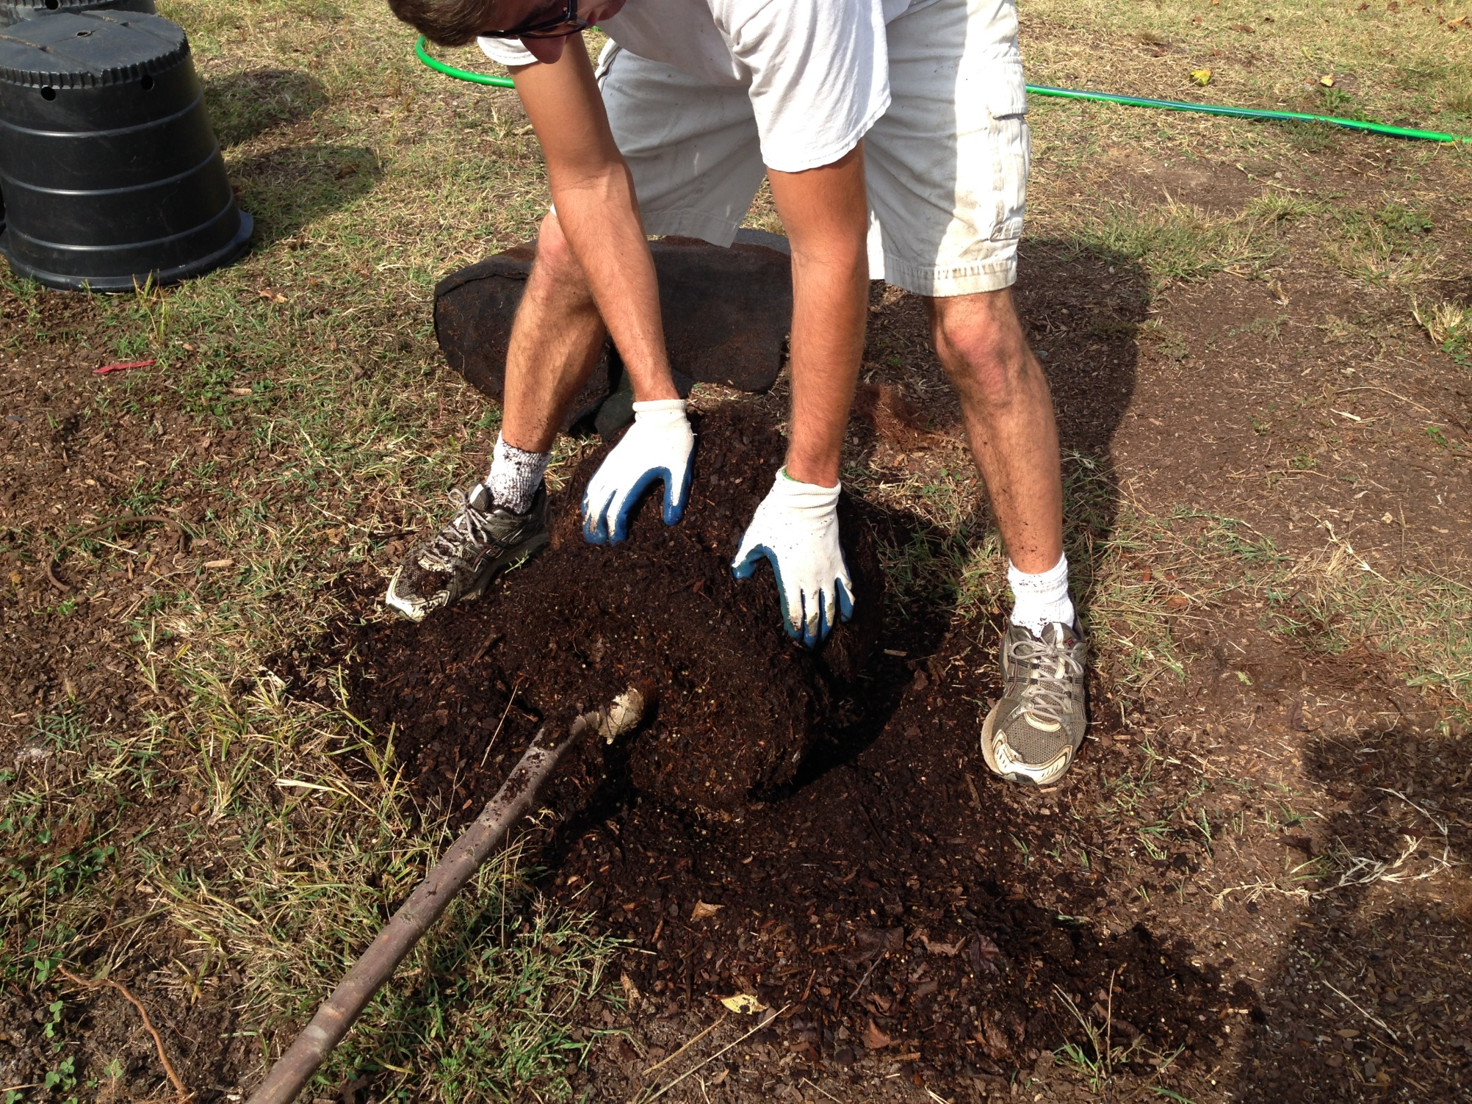

Slide 15
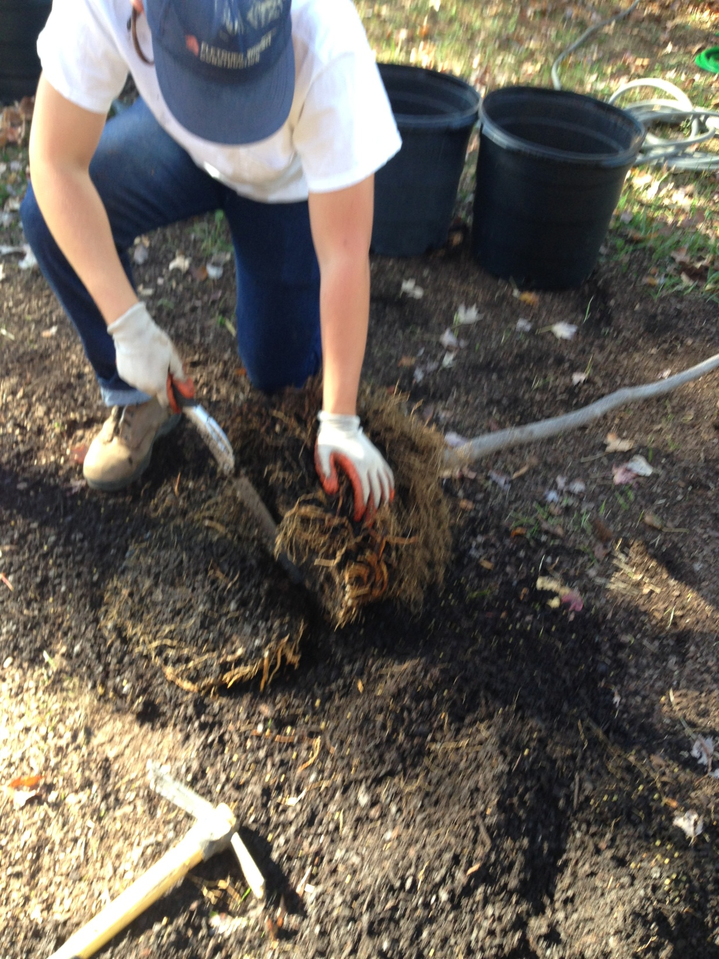

Slide 16
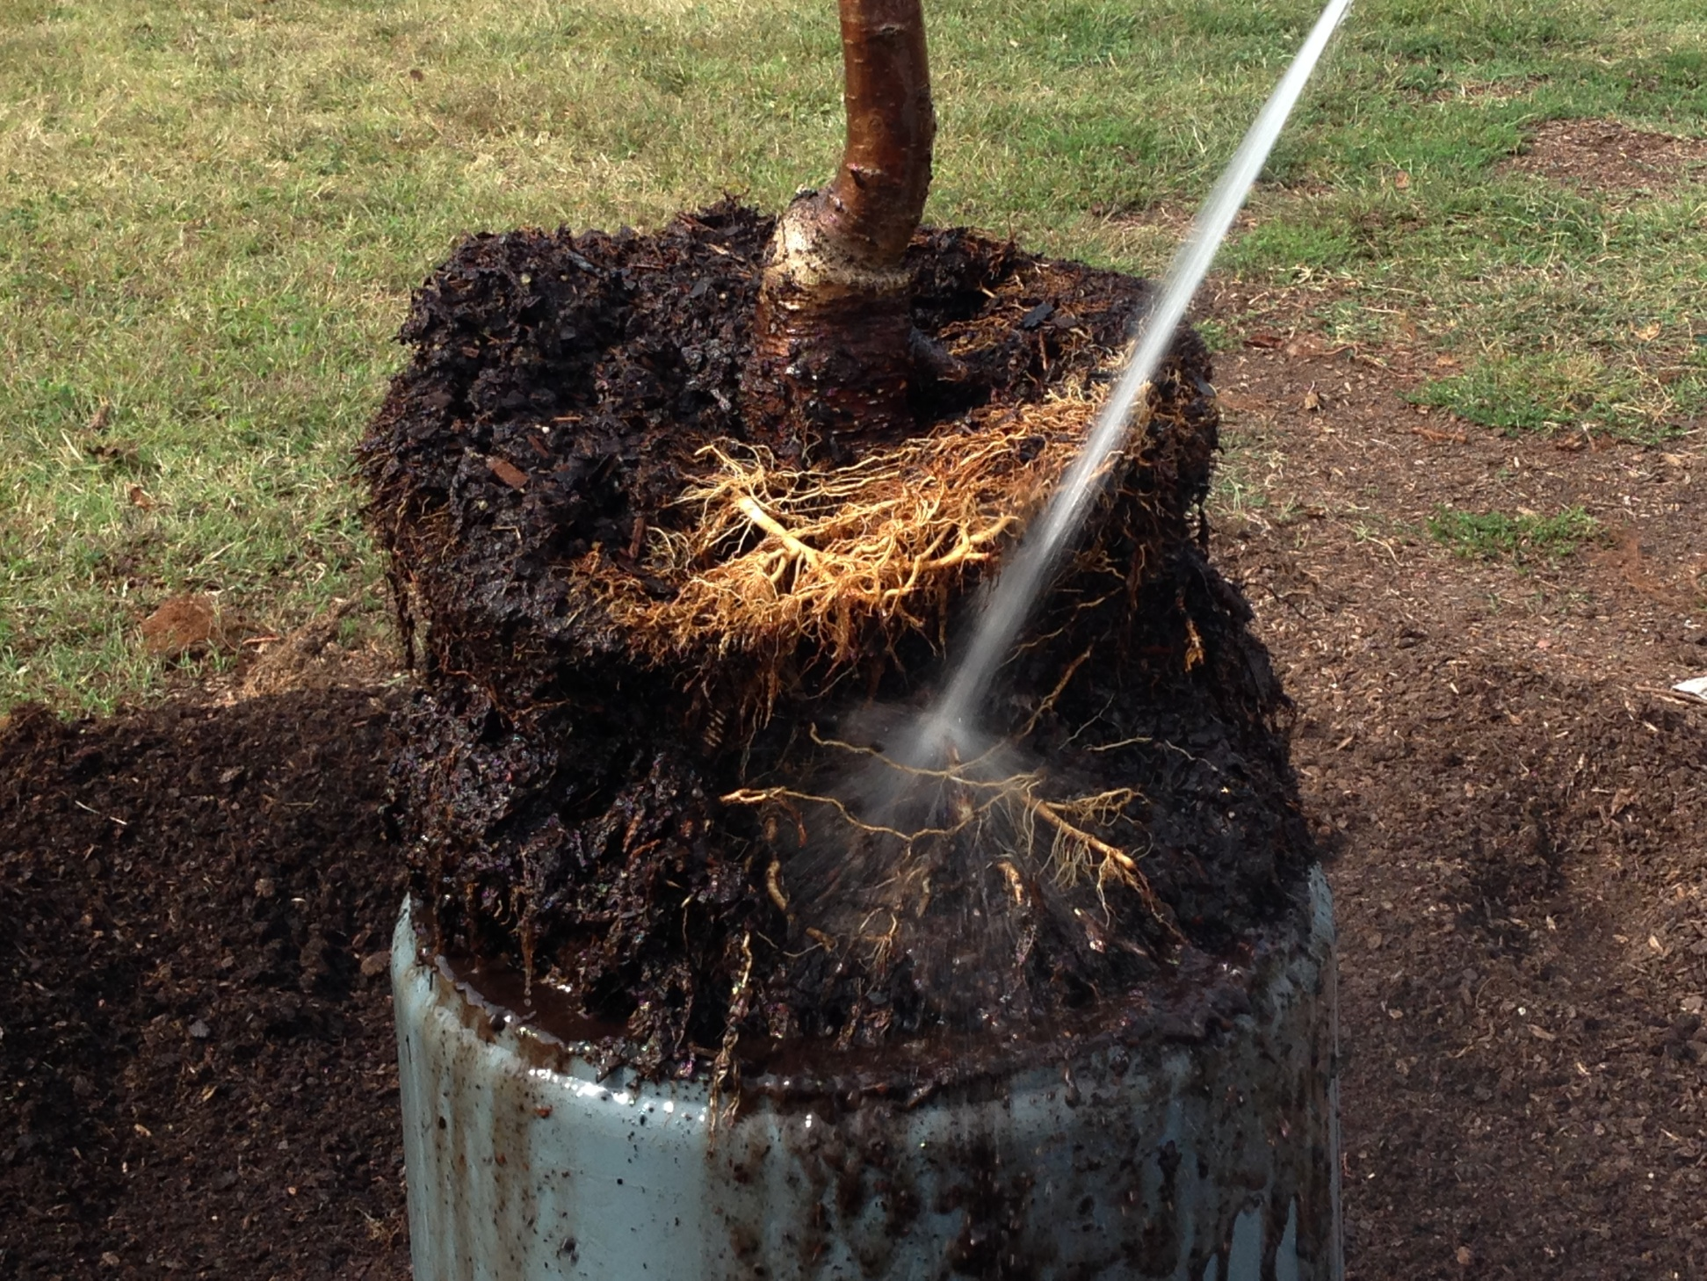

Slide 17
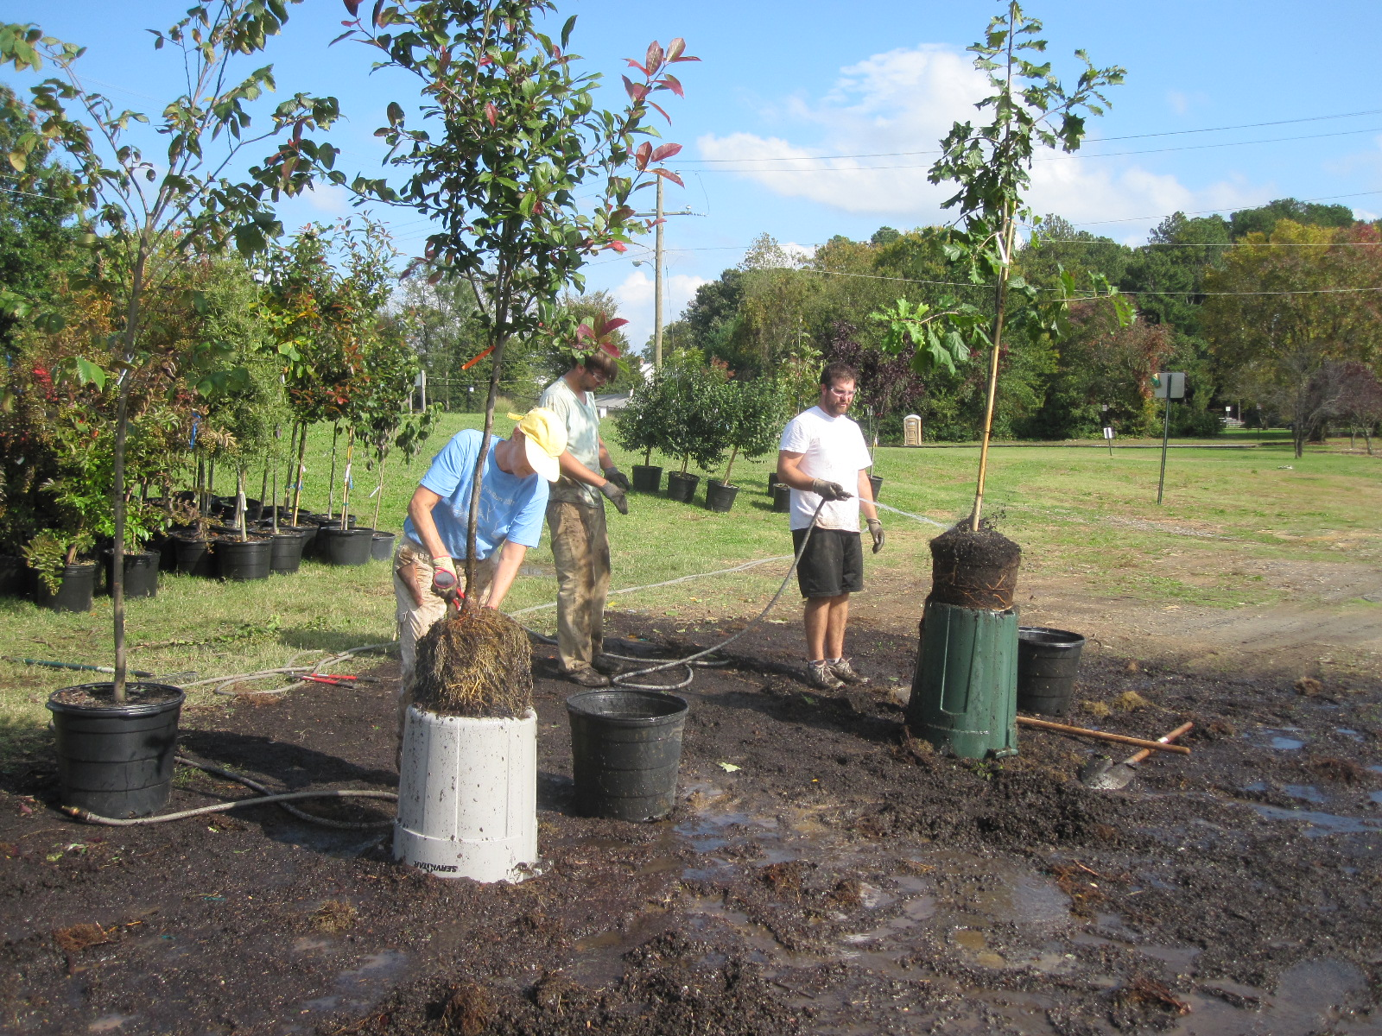

Slide 18
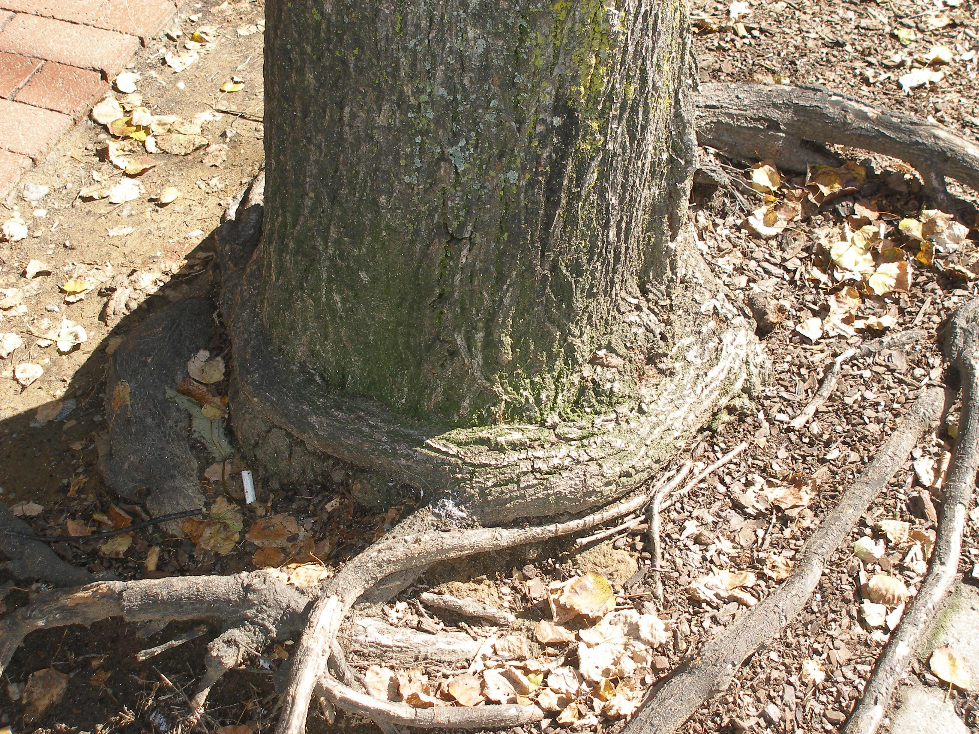

Slide 19
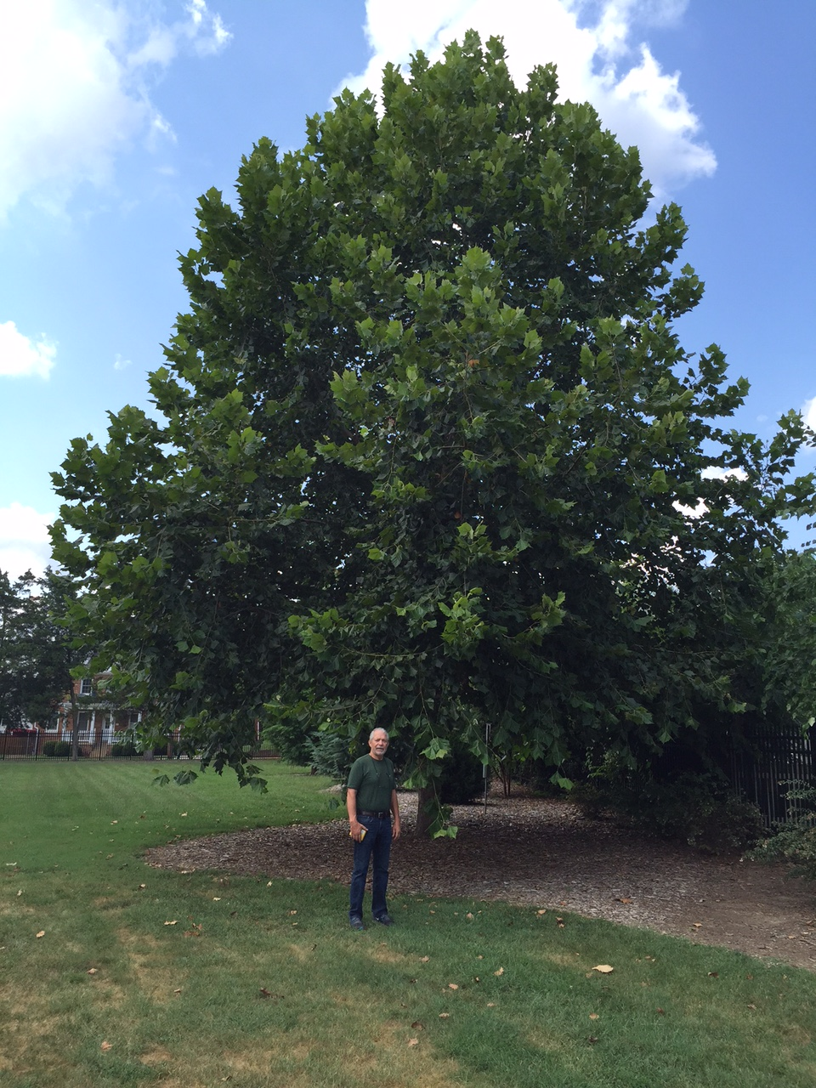
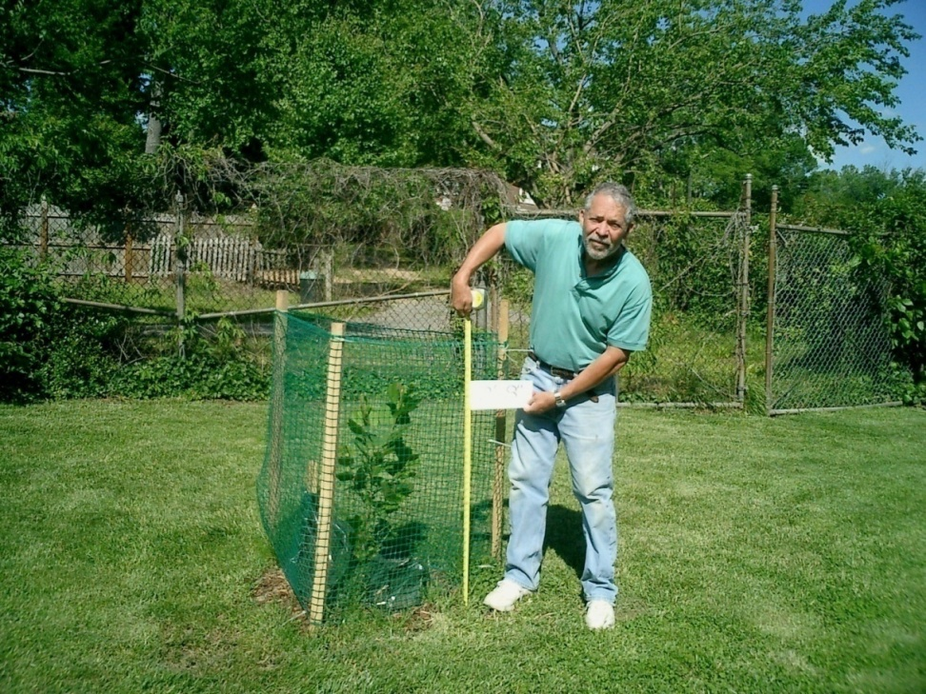
2008-2015
7 years old
45 ft high!

Slide 20
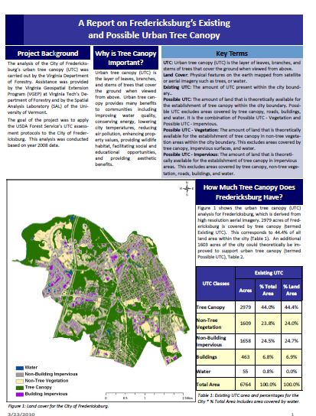

Slide 21
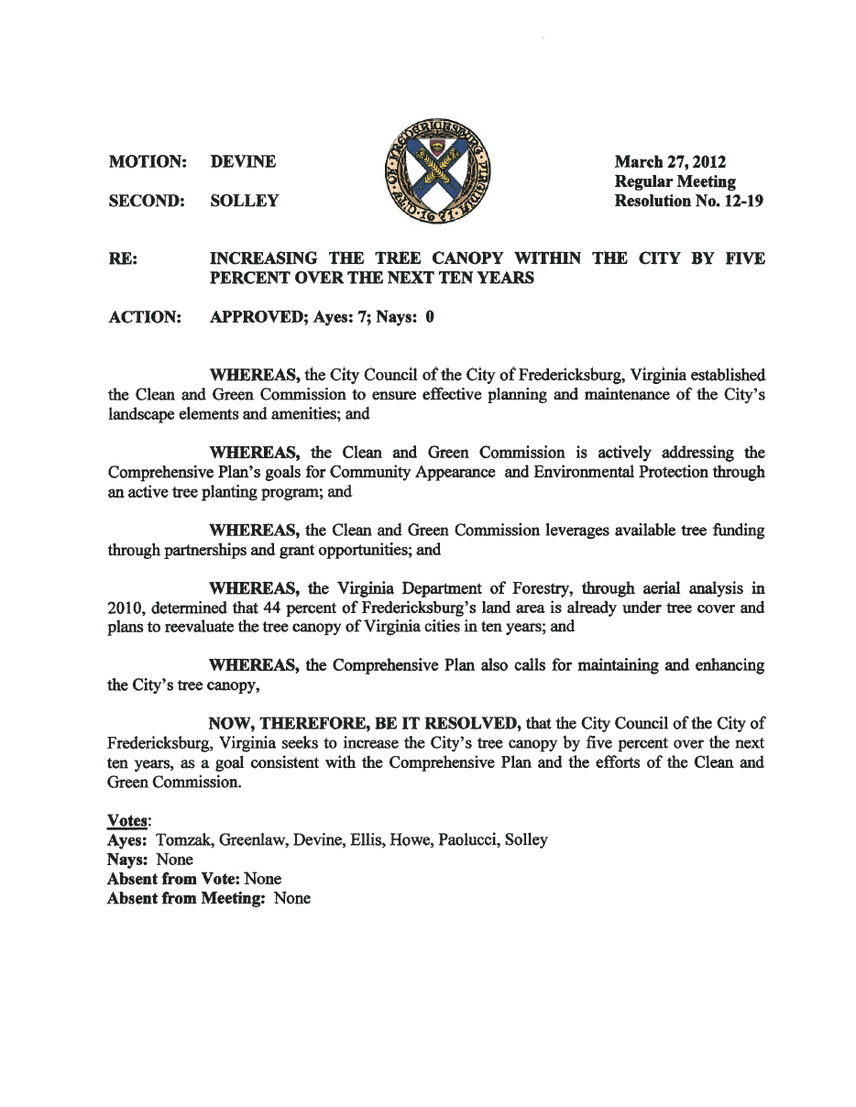

Slide 22
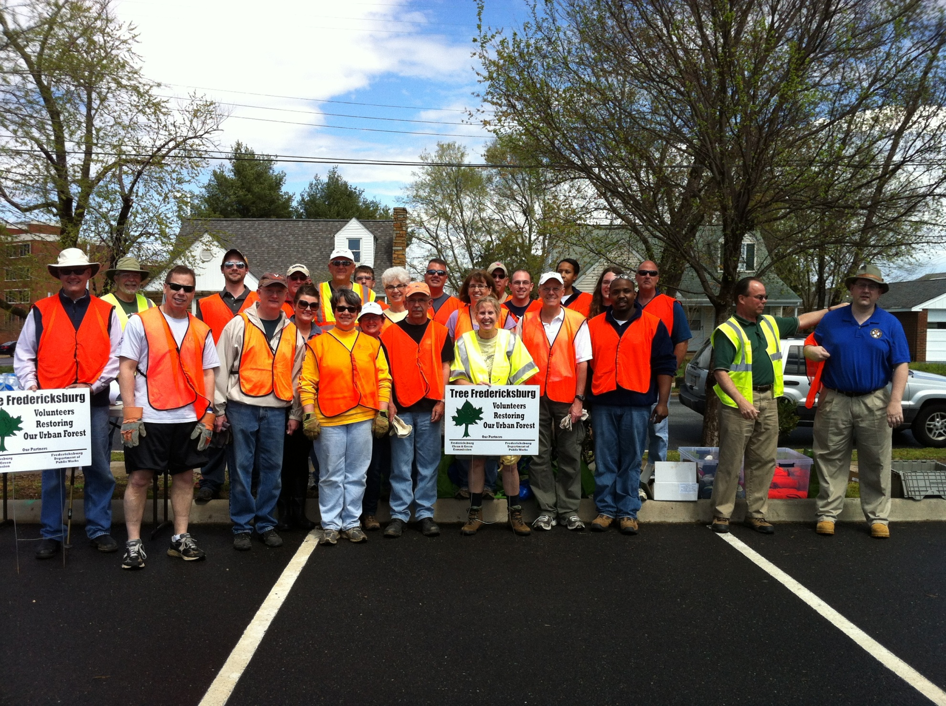

Slide 23
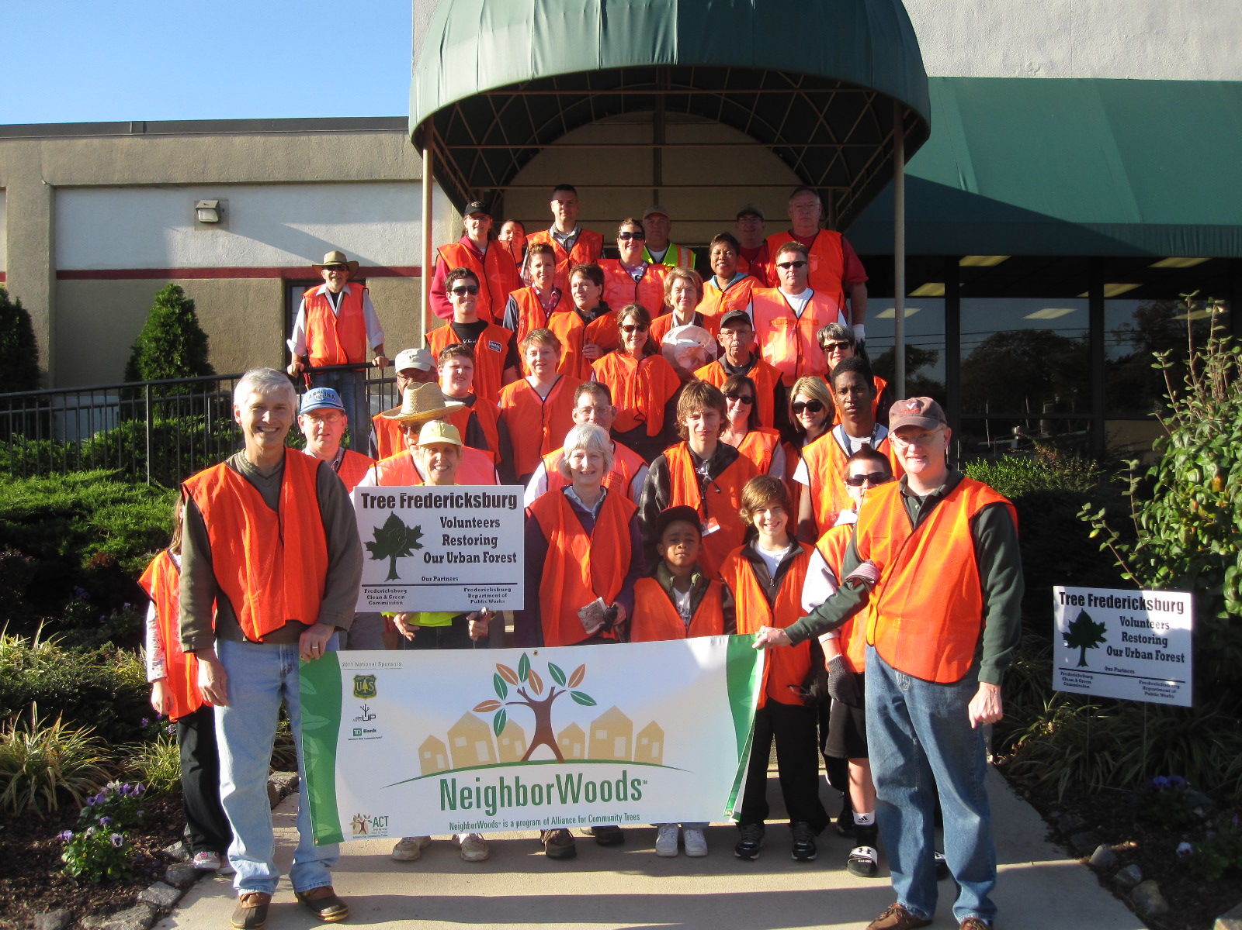
Notes:
2013 – asked city manager and city council to help plant trees and raise our profile

Slide 24
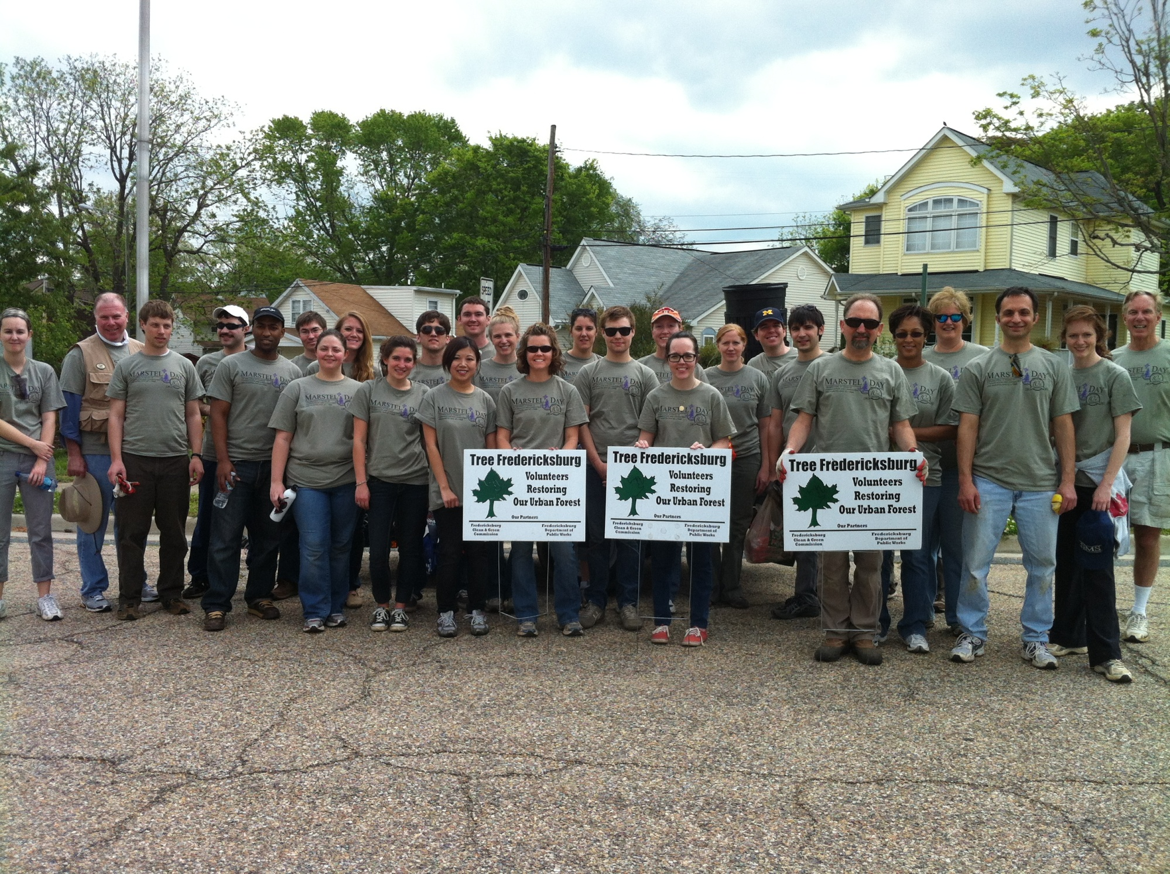

Slide 25
Green Committee Members
City Arborist; Asst Director, Public Works Dept - Dave King
Certified Landscape Designer, B.S. Horticulture, VA Tech - Carolyn Helfrich
Director of Landscape & Grounds, UMW - Joni Wilson
Director of Gardens & Landscapes, George Washington Foundation, - Phoebe Wessinger
Landscape Architect - Anne Gearon
Senior City Planner- Erik Nelson
Head Gardener Parks & Recreation Dept - Robin Saunders & James Bell (Retired)
Park Maintenance Supervisor, Parks & Recreation Dept - Aaron Simmons
Field Supervisor of Street Maintenance- Gary Johnson
Bartlett Tree Experts- Jason Coiner, Rob Allen (former member)
Arborist Dominion VA Power - Hunter Woods, Matt Boltz (former member)
Design Consultant Green Springs Farm -David Dorsey
Forester, Virginia Department of Forestry -Tom Snoddy
Tree Fredericksburg – Carl Little, Anne Little
Friends of the Rappahannock - Bryan Hofmann
2005 Tree Committee, Chair - Frank Widic
Soil Specialist - Morgan Kash
Stormwater Administrator, Planning Dept – Kevin Utt

Slide 26
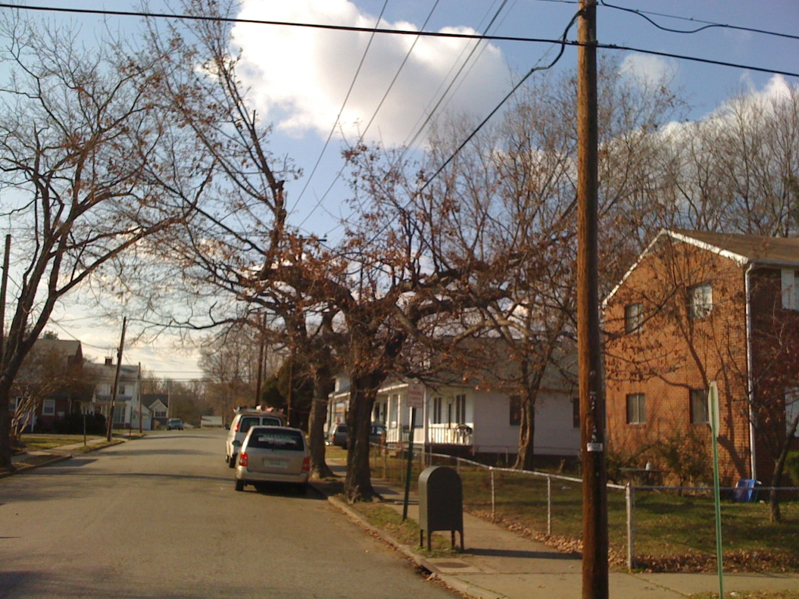
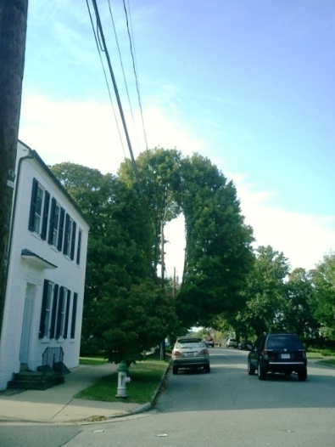
Wrong Tree Wrong Place
Notes:
Overhead wires and large trees are incompatible, causing horrors like these.

Slide 27
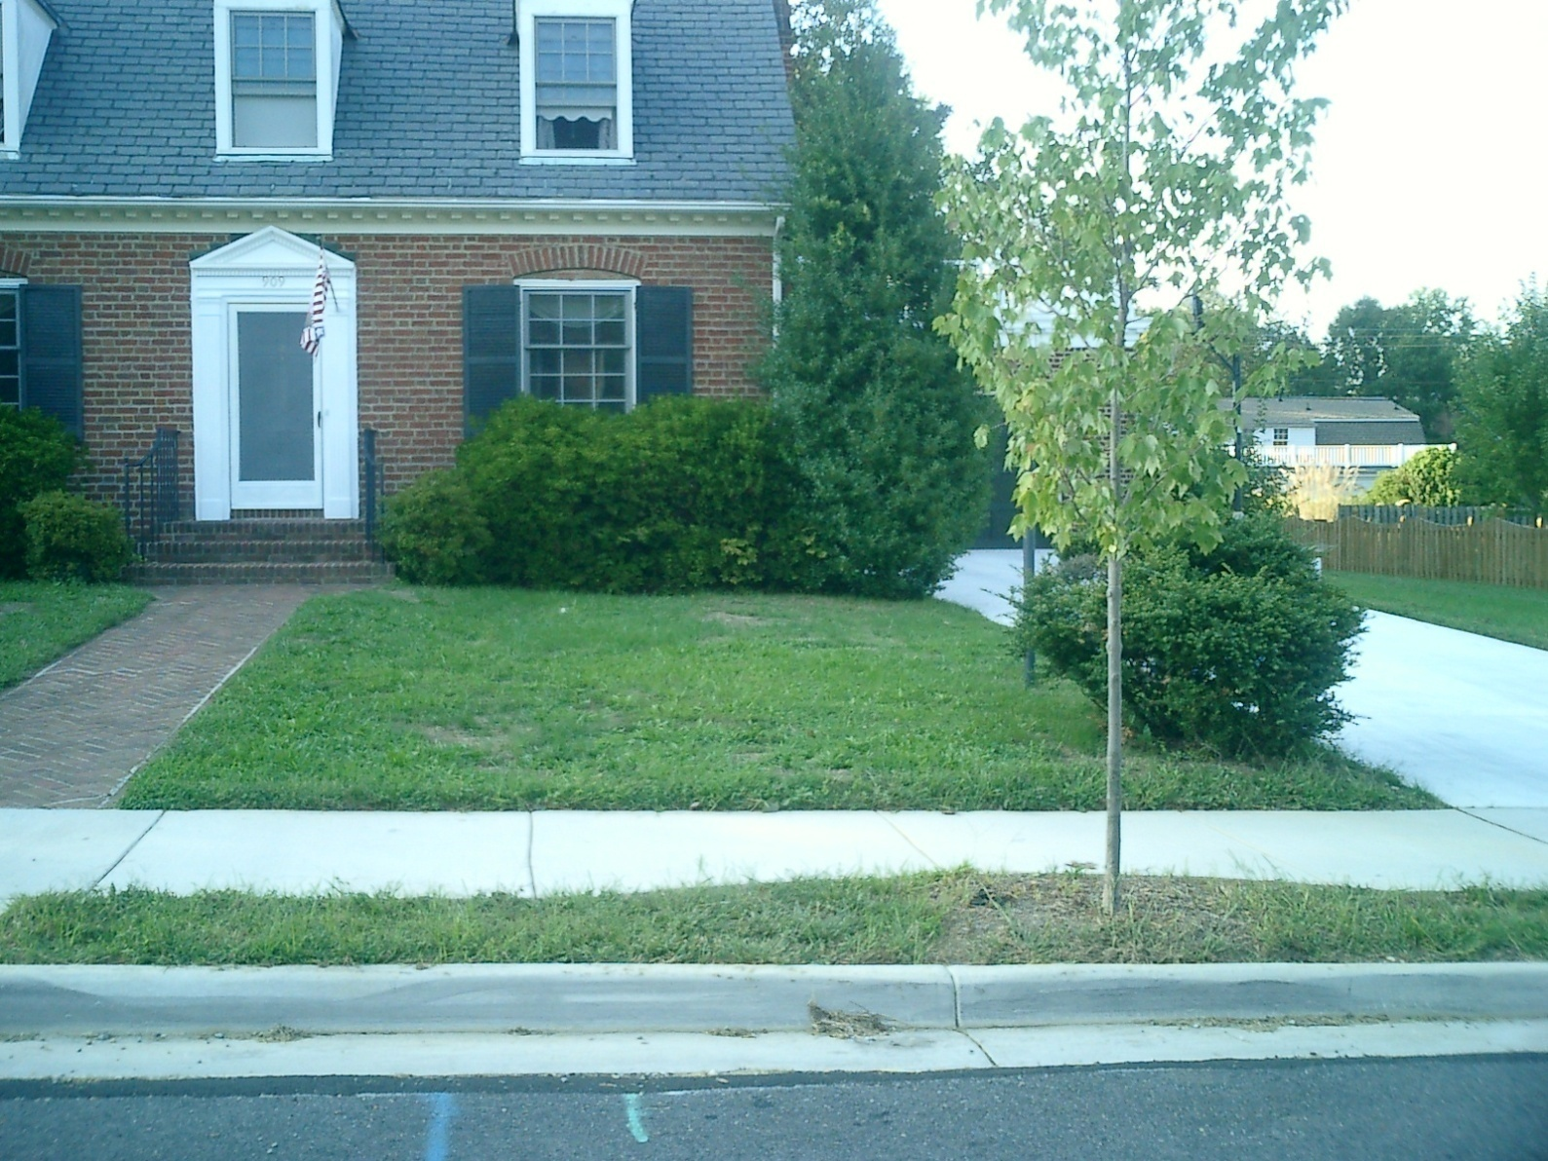

Slide 28
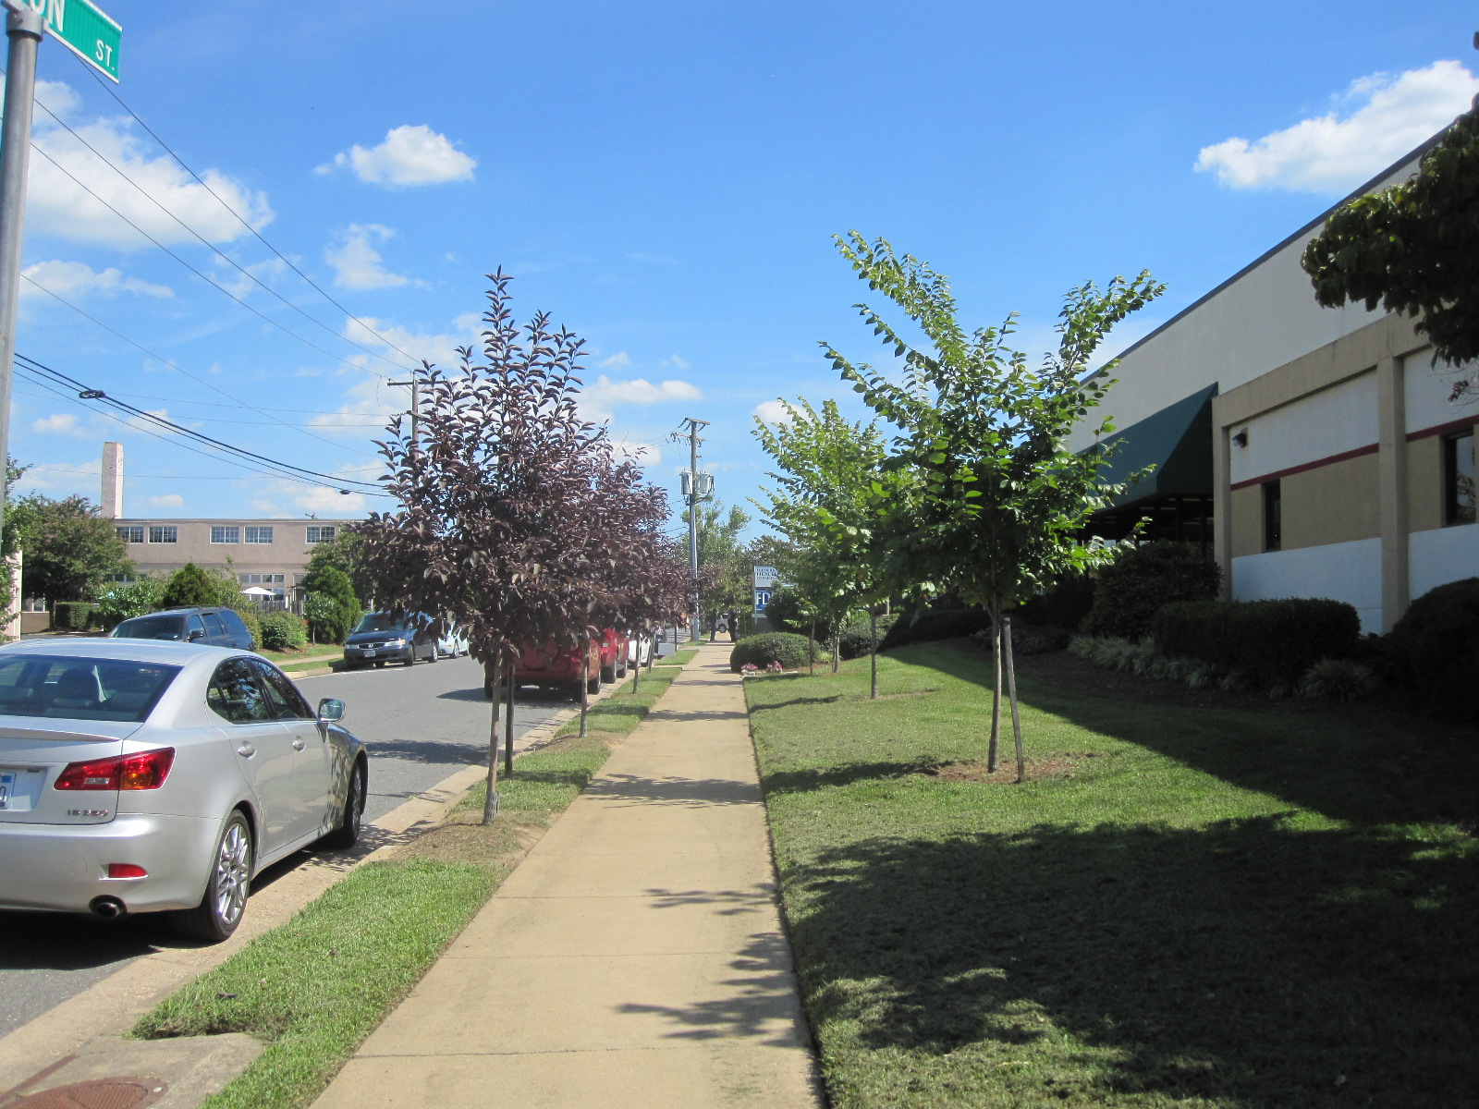

Slide 29
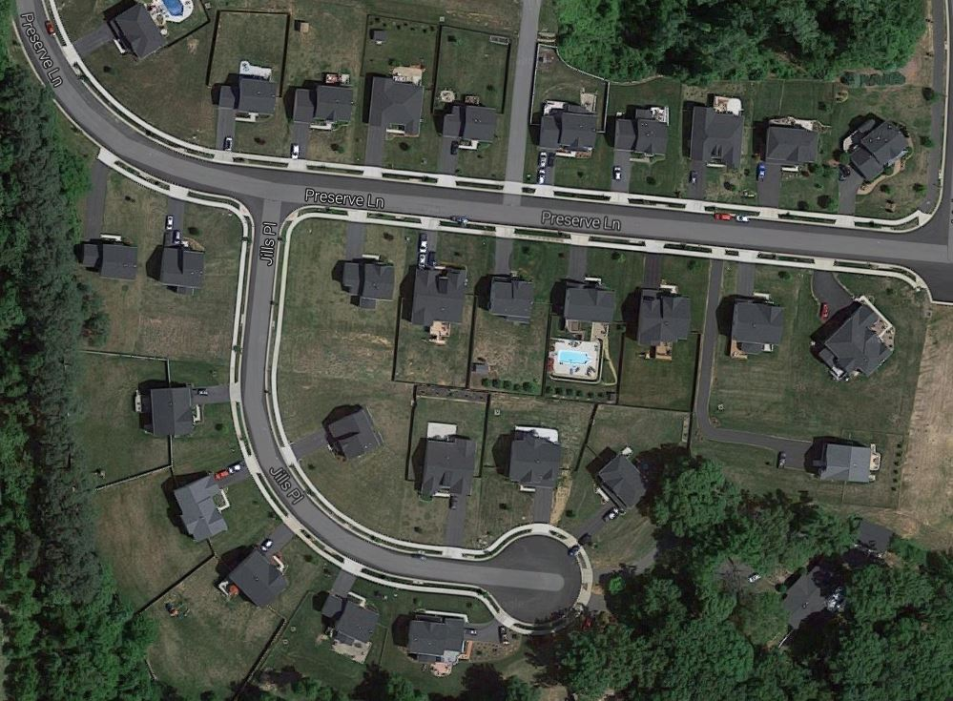

Slide 30
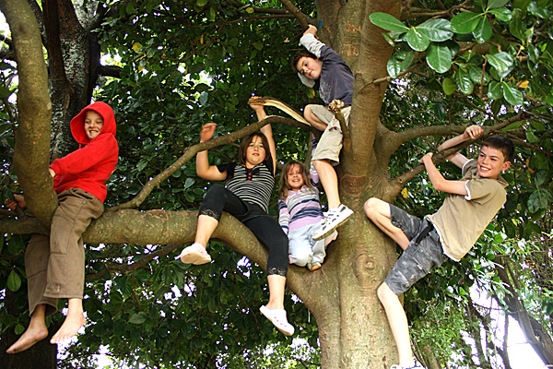

Slide 31
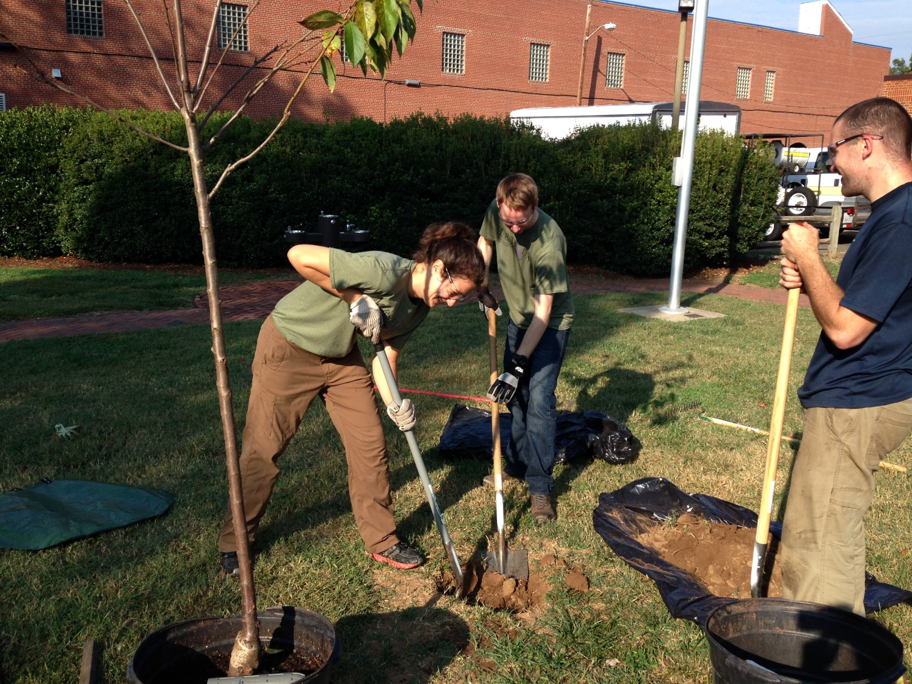

Slide 32
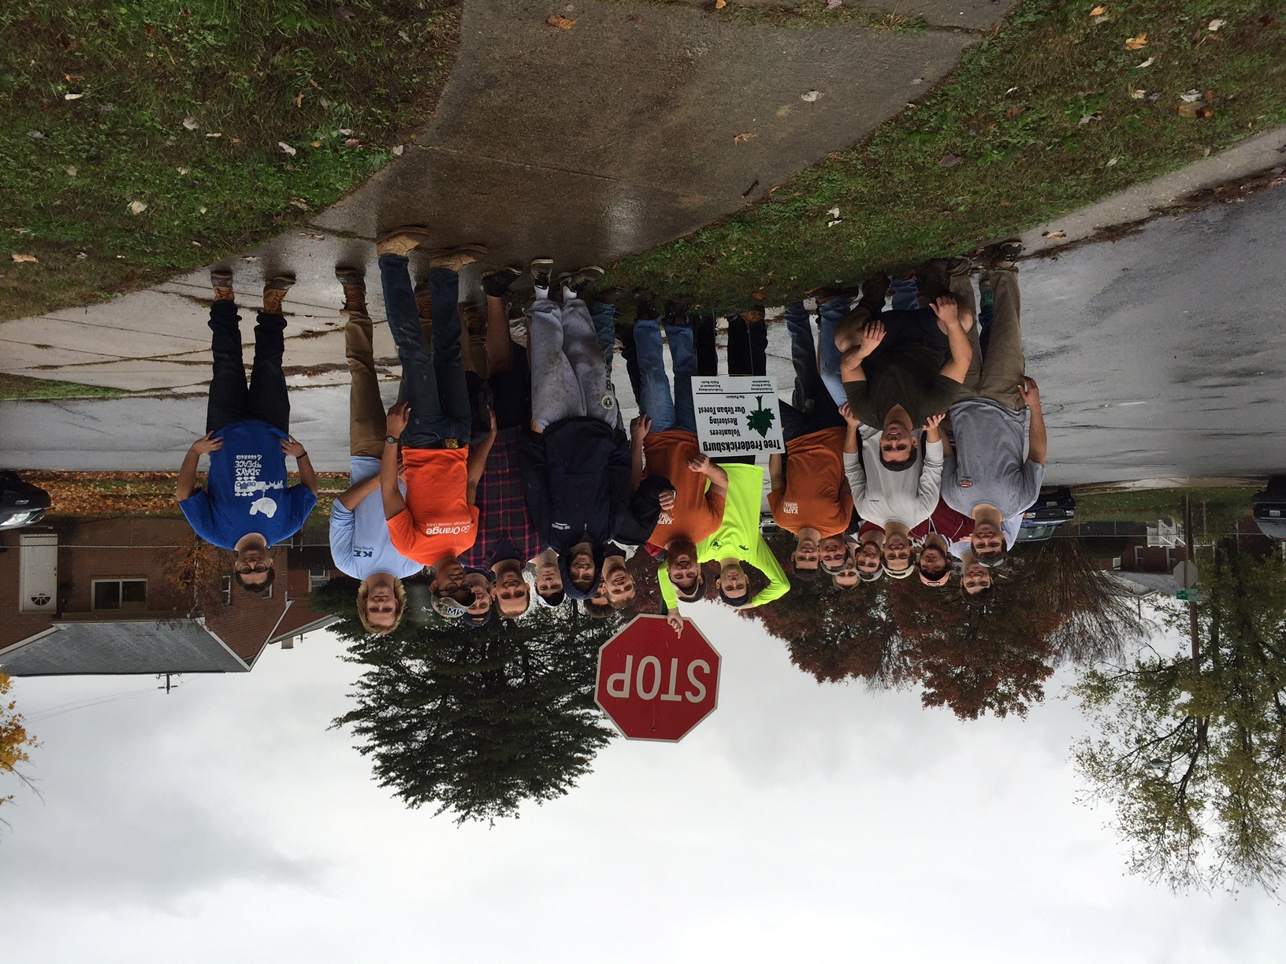

Slide 33
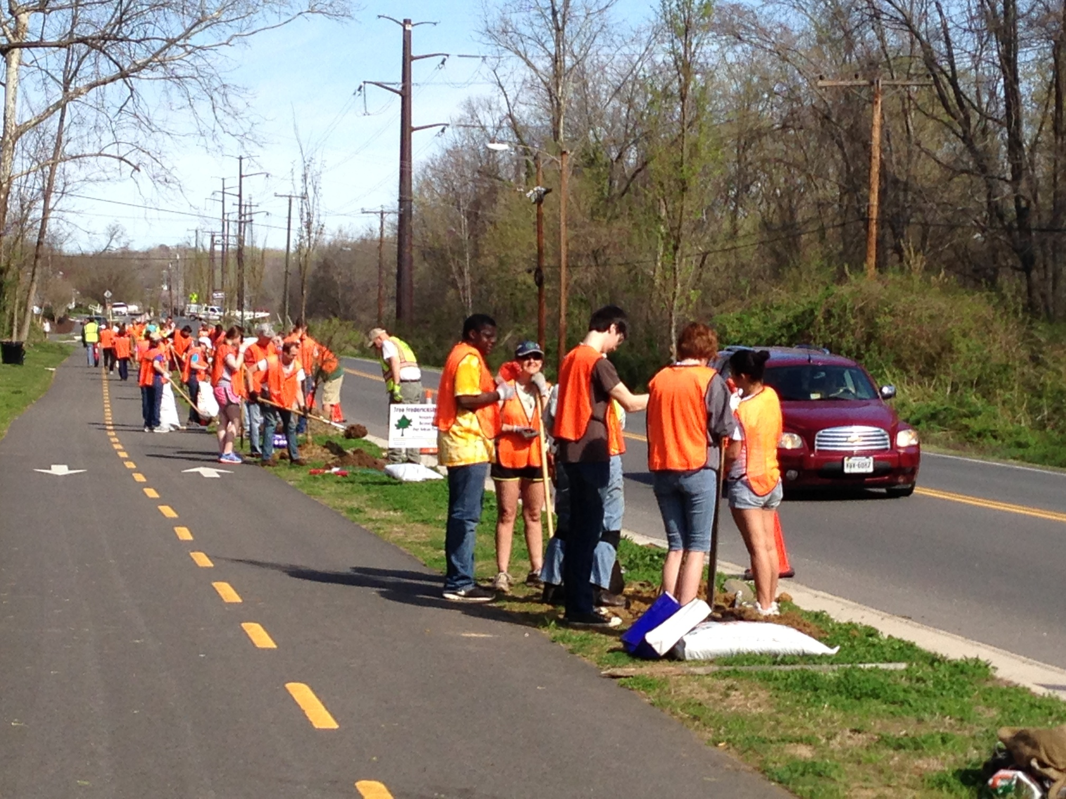

Slide 34
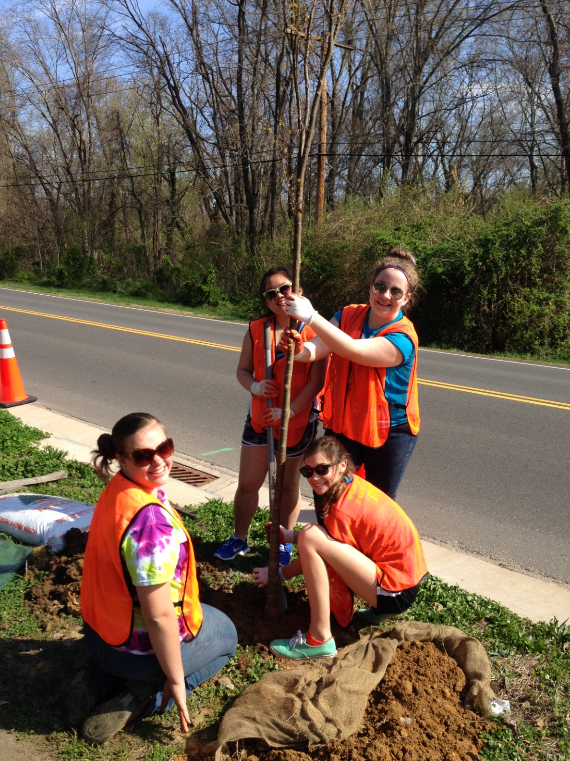

Slide 35
TreeFred@cox.net
TreeFredericksburg.org
540.207.4298

