Slide 1
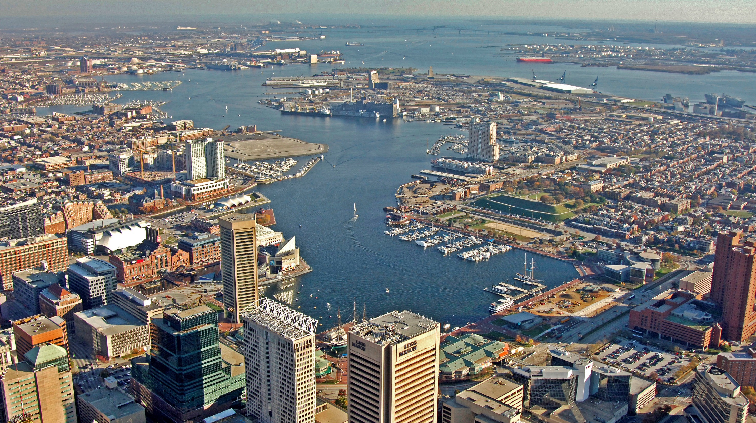
Ecological Changes Across an Urban Gradient - Patapsco Case Study
Ryan Woodland, Lora Harris, Eric Schott, Andrew Heyes, Alexandra Fireman, Erin Reilly*
University of Maryland Center for Environmental Science (CBL/IMET)
*James River Foundation
Photo credit: Marinas.com

Slide 2
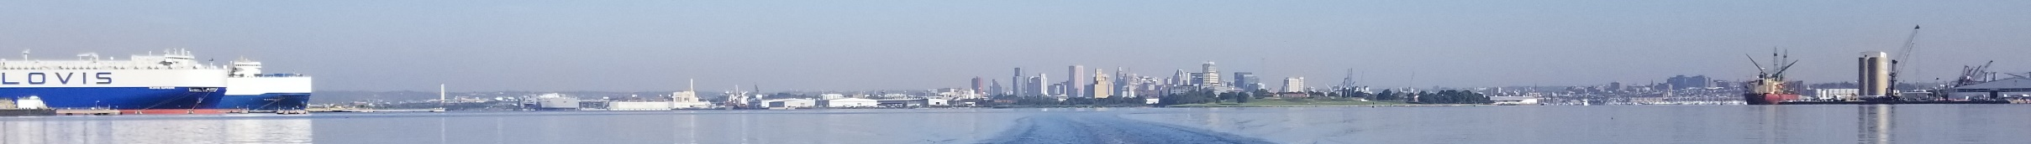


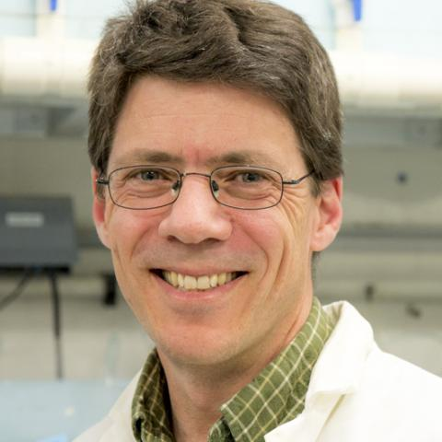


Notes:
6 creeks/areas nested within an urban gradient
Creeks representative of broadly different landuses
4 sampling periods – late summer 2018, spring, mid-summer, late-summer 2019
Sampling areas designated at mid-creek stations
Stations co-located with long-term water quality sampling stations for regional NGO (Blue Water Baltimore)
Mixed Forest- dominated by trees >5 meters tall, > 20% of total vegetation cover. Neither deciduous nor evergreen species >75% of total tree cover.
Developed, Low Intensity- mixture of constructed materials and vegetation. Impervious surfaces ~ 20% to 49% percent of total cover. Commonly include single-family housing units.
Developed, Medium Intensity -mixture of constructed materials and vegetation. Impervious surfaces ~ 50% to 79% of total cover. Commonly include single-family housing units.
Developed High Intensity-highly developed areas, include apartments, row houses and commercial/industrial. Impervious surfaces ~ 80% to 100% of total cover.

Slide 3
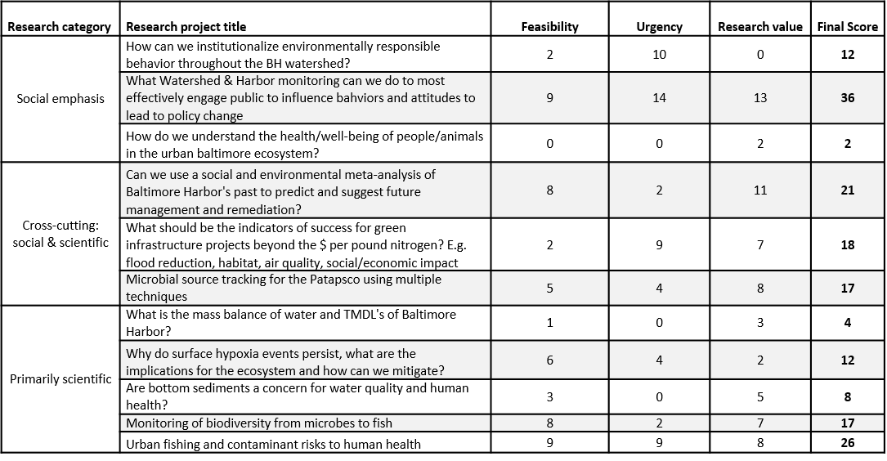
Notes:
6 creeks/areas nested within an urban gradient
Creeks representative of broadly different landuses
4 sampling periods – late summer 2018, spring, mid-summer, late-summer 2019
Sampling areas designated at mid-creek stations
Stations co-located with long-term water quality sampling stations for regional NGO (Blue Water Baltimore)
Mixed Forest- dominated by trees >5 meters tall, > 20% of total vegetation cover. Neither deciduous nor evergreen species >75% of total tree cover.
Developed, Low Intensity- mixture of constructed materials and vegetation. Impervious surfaces ~ 20% to 49% percent of total cover. Commonly include single-family housing units.
Developed, Medium Intensity -mixture of constructed materials and vegetation. Impervious surfaces ~ 50% to 79% of total cover. Commonly include single-family housing units.
Developed High Intensity-highly developed areas, include apartments, row houses and commercial/industrial. Impervious surfaces ~ 80% to 100% of total cover.

Slide 4
Notes:
6 creeks/areas nested within an urban gradient
Creeks representative of broadly different landuses
4 sampling periods – late summer 2018, spring, mid-summer, late-summer 2019
Sampling areas designated at mid-creek stations
Stations co-located with long-term water quality sampling stations for regional NGO (Blue Water Baltimore)
Mixed Forest- dominated by trees >5 meters tall, > 20% of total vegetation cover. Neither deciduous nor evergreen species >75% of total tree cover.
Developed, Low Intensity- mixture of constructed materials and vegetation. Impervious surfaces ~ 20% to 49% percent of total cover. Commonly include single-family housing units.
Developed, Medium Intensity -mixture of constructed materials and vegetation. Impervious surfaces ~ 50% to 79% of total cover. Commonly include single-family housing units.
Developed High Intensity-highly developed areas, include apartments, row houses and commercial/industrial. Impervious surfaces ~ 80% to 100% of total cover.

Slide 5
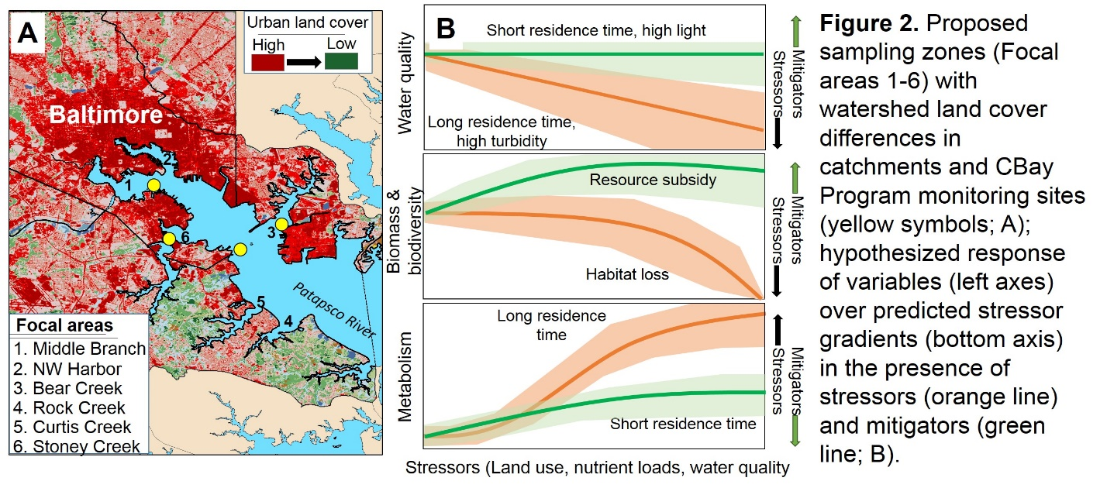
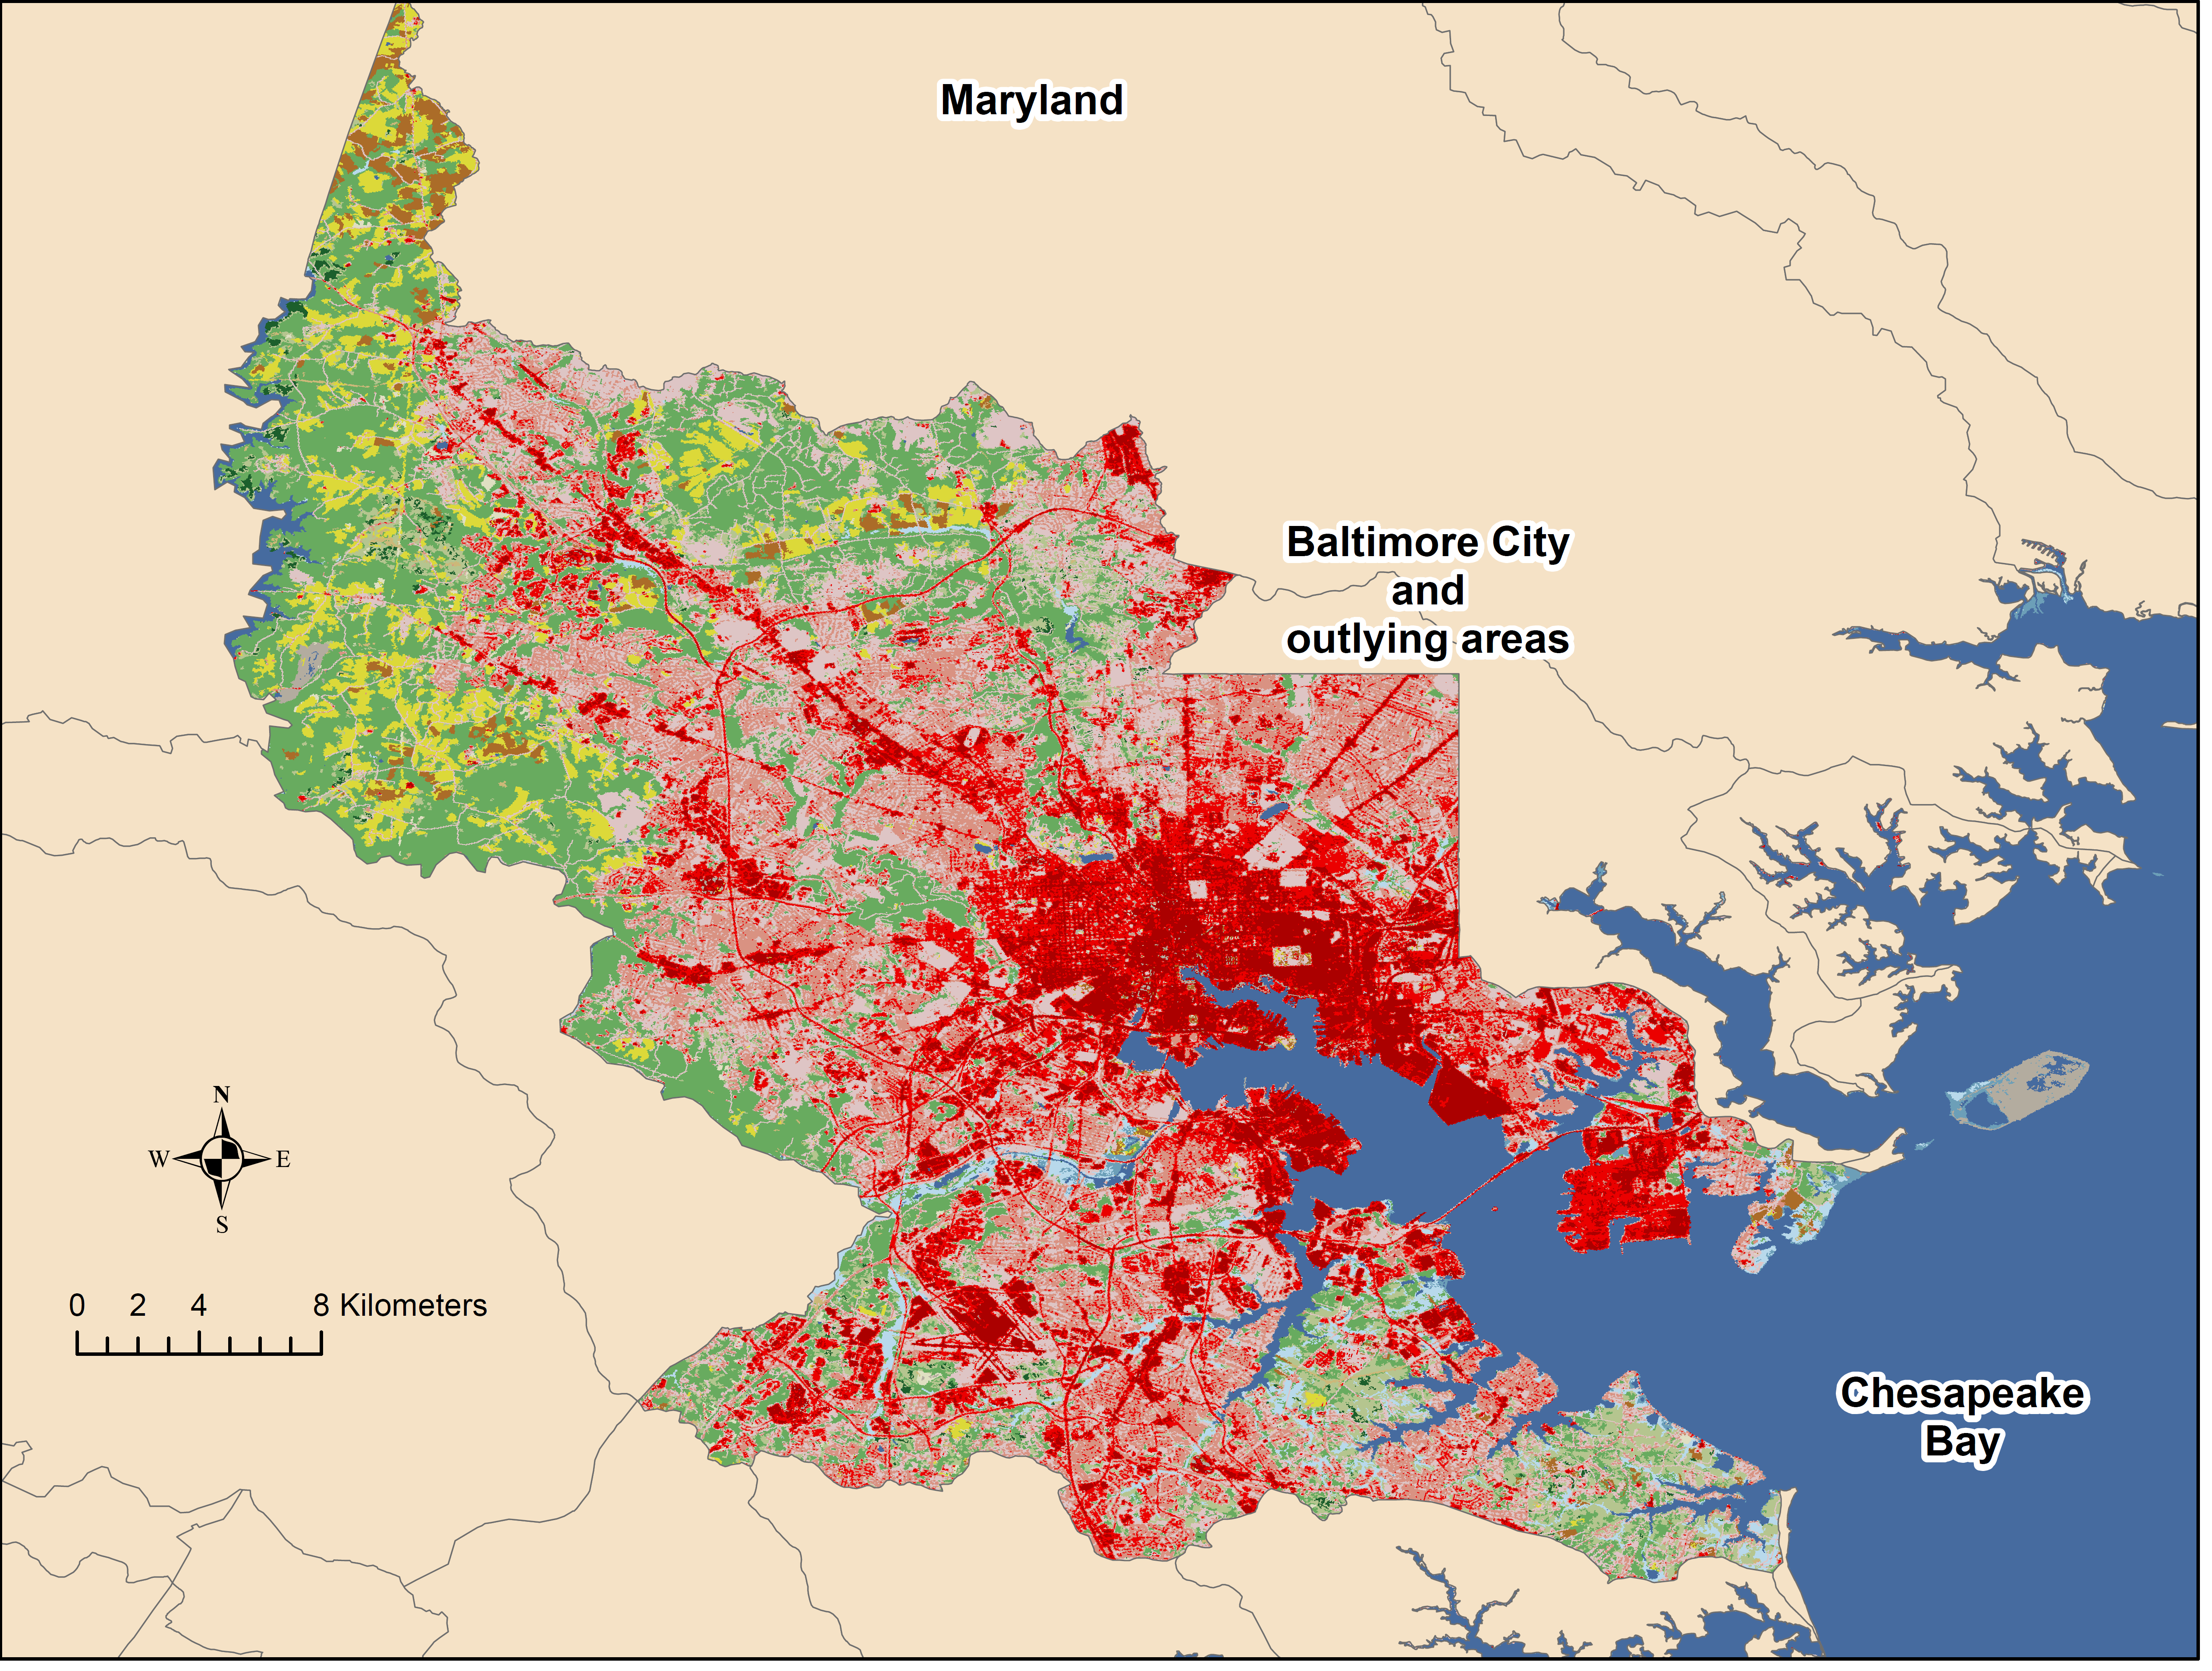
Patapsco River Estuary
Urbanization gradient
Tributary
Bear Creek
Curtis Creek
Stony Creek
Impervious surface
(20 to 100%)
Middle Branch
Rock Creek
Inner Harbor
IH
MB
BC
CC
SC
RC
Shallow water habitat gradient
Patapsco River
Proportion shallow (depth < 3 m)
IH
MB
BC
CC
SC
RC
Notes:
6 creeks/areas nested within an urban gradient
Creeks representative of broadly different landuses
4 sampling periods – late summer 2018, spring, mid-summer, late-summer 2019
Sampling areas designated at mid-creek stations
Stations co-located with long-term water quality sampling stations for regional NGO (Blue Water Baltimore)
Mixed Forest- dominated by trees >5 meters tall, > 20% of total vegetation cover. Neither deciduous nor evergreen species >75% of total tree cover.
Developed, Low Intensity- mixture of constructed materials and vegetation. Impervious surfaces ~ 20% to 49% percent of total cover. Commonly include single-family housing units.
Developed, Medium Intensity -mixture of constructed materials and vegetation. Impervious surfaces ~ 50% to 79% of total cover. Commonly include single-family housing units.
Developed High Intensity-highly developed areas, include apartments, row houses and commercial/industrial. Impervious surfaces ~ 80% to 100% of total cover.

Slide 6
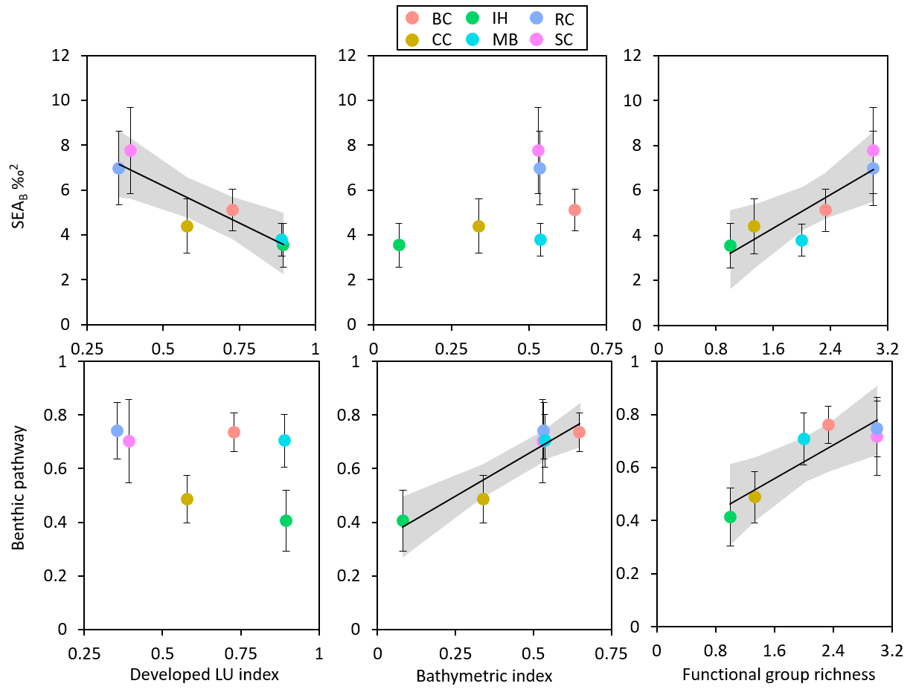
Niche area declined as land use intensity increased
46% decline
Benthic pathway contribution increased as shallow habitat increased
55% increase
White perch trophic ecology linked to functional diversity of benthic forage base
Urbanization gradient
Shallow habitat gradient
Benthic functional richness
Notes:
Trophic pathway contributions
Mixing model framework (MixSIAR)
Proportional contribution of sources to consumer
Variables: season, creek, body length (TL)
Stable isotope niche area
Ellipse area in d13C and d15N space
Proxy for trophic niche

Slide 7
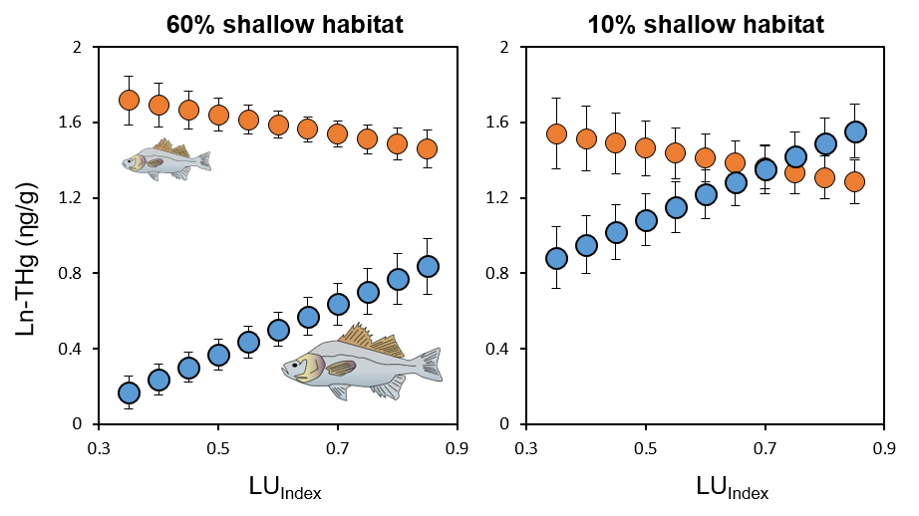
Increased total mercury in adult white perch with:
Increased urbanization
Decreased shallow water habitat
Preliminary evidence that human health risks may minor ecosystem health risks
Urbanization gradient
Urbanization gradient
Notes:
Trophic pathway contributions
Mixing model framework (MixSIAR)
Proportional contribution of sources to consumer
Variables: season, creek, body length (TL)
Stable isotope niche area
Ellipse area in d13C and d15N space
Proxy for trophic niche

Slide 8
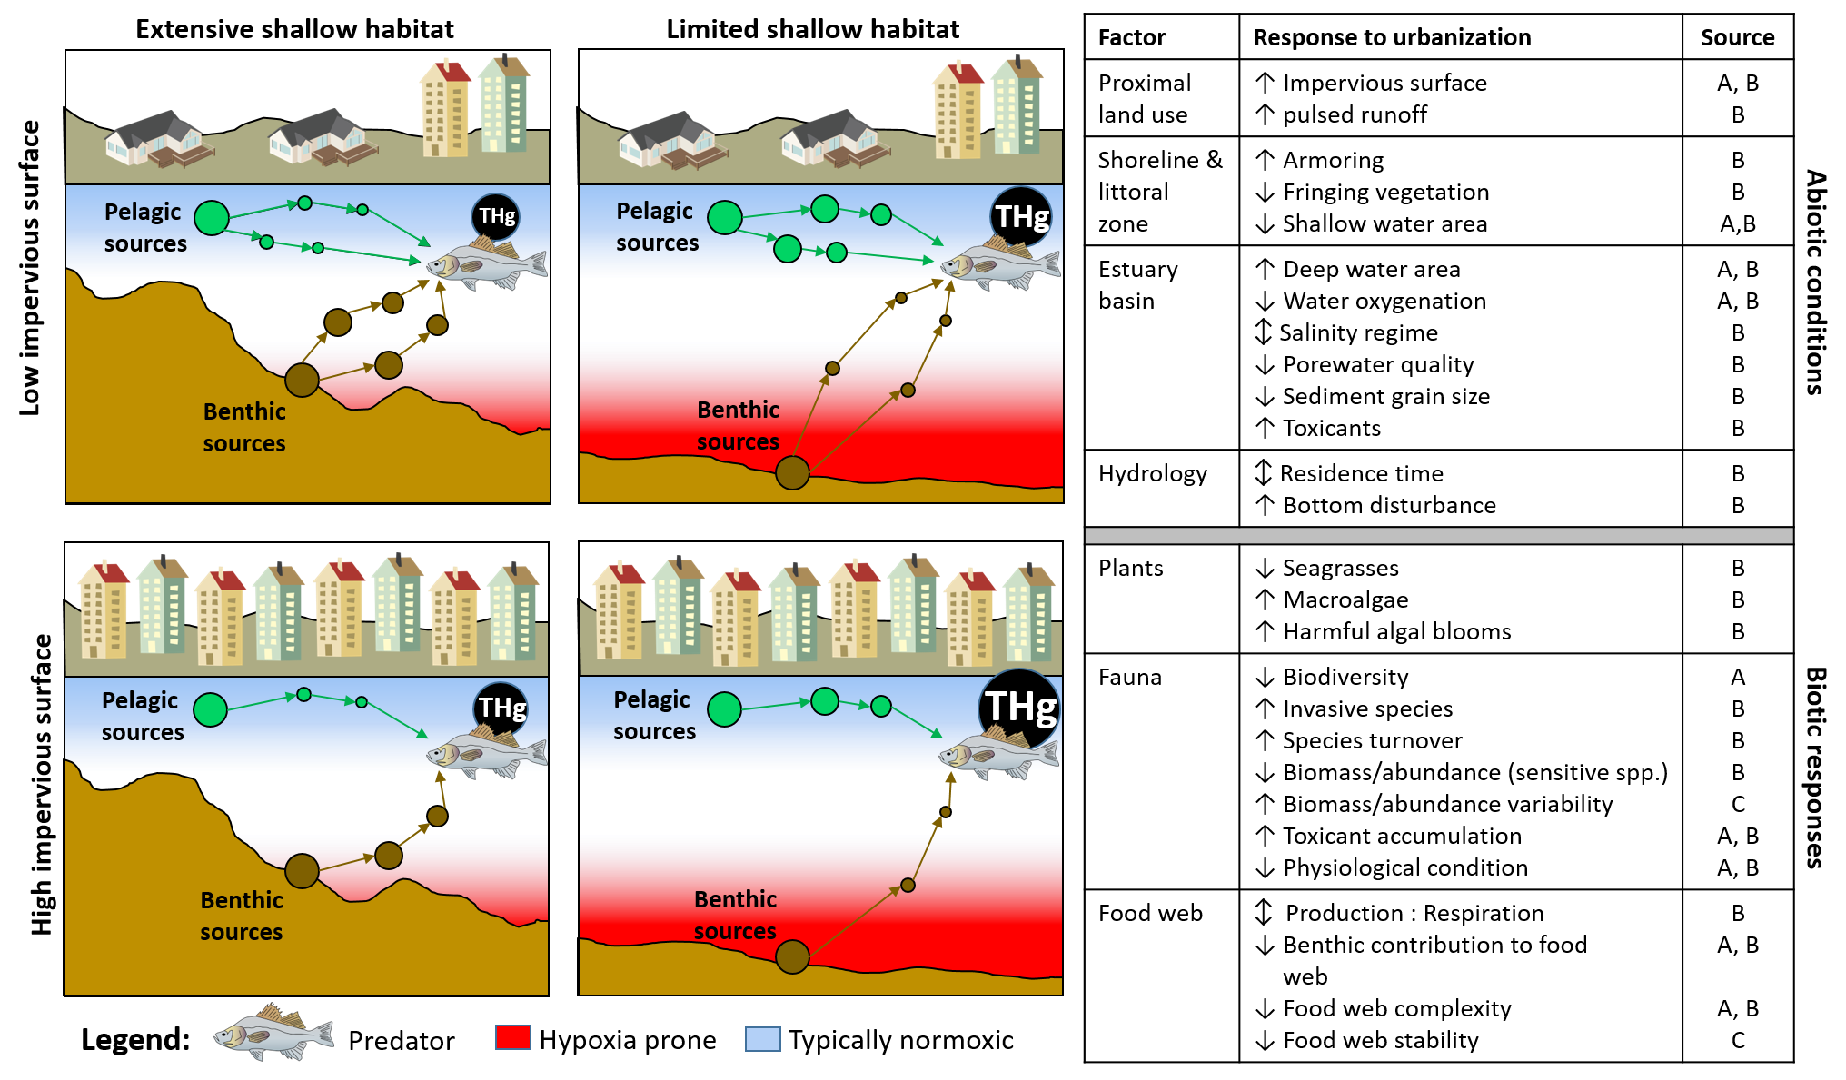
Notes:
Findings suggest competing ecological pressures operating within urban landscape (land use
Similar functional changes in trophic structure arising in dissimilar environment (increased importance of pelagic production)
Strongly suburban systems with extensive greenspace
Deeply channelized and dredged systems (harbors)
Shallow water as habitat and WQ buffer
↓ impervious surface = ↑ food web complexity
Ecological rates in pelagic systems > benthic systems
More variable community composition
Less stable trophic dynamics
Shallow water as habitat and buffer against poor water quality
Maintenance of benthic productivity & availability in this system
Future work: Expand analysis to include additional species and additional metrics (presence-absence, abundance-when-present, growth)

Slide 9
Acknowledgements
Funding
France-Merrick Foundation
Field & Laboratory assistance
Amanda Moore
Melinda Forsyth
Isabel Sanchez
Matt Spitznagel
Curtis Szewczyk
Isabel Sanchez-Viruet
Zachary Gotthardt
Olivia Lopez
Blue Water Baltimore
Workshop assistance
Molly Pickel
Charmaine Dahlenberg
Photo credit: Marinas.com

Slide 11
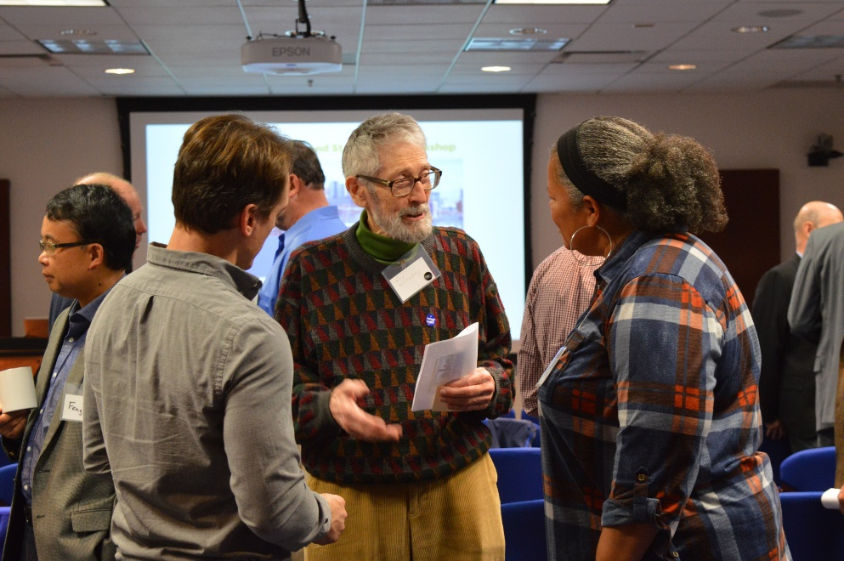
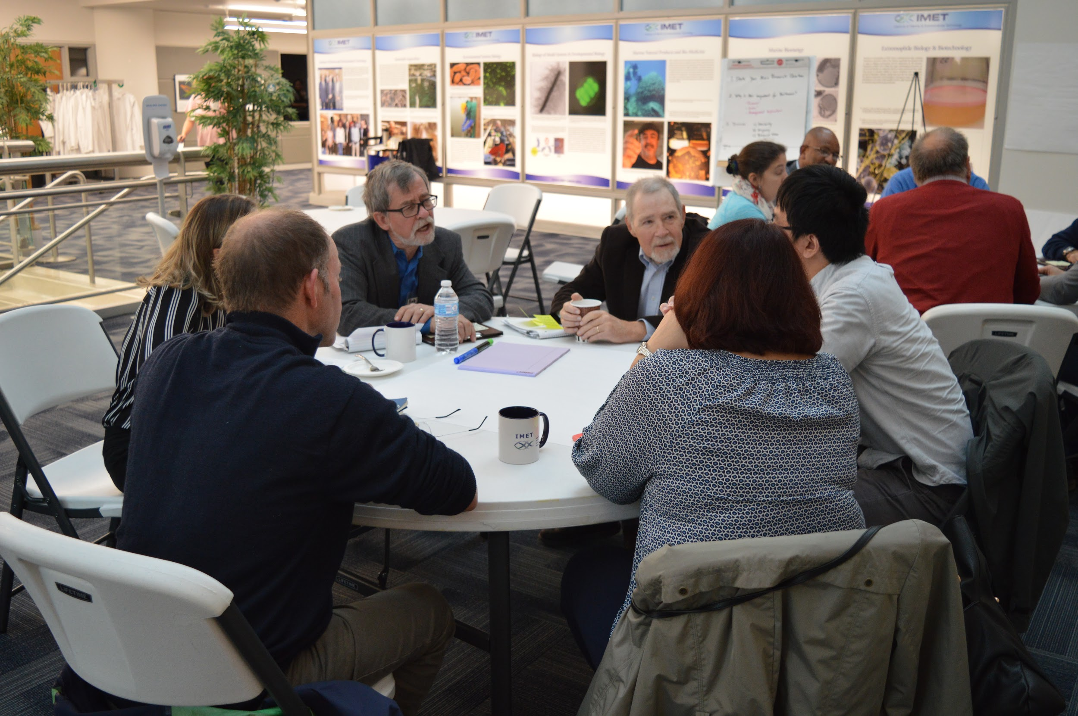
Individual Ideas
Round-robin Brainstorming with ground rules
Pitched Themes
Individual “Dot” voting
Propose a research question for Baltimore Harbor and the Patapsco
Why is it important to you, to the region?
Discuss Feasibility & Urgency
Notes:
6 creeks/areas nested within an urban gradient
Creeks representative of broadly different landuses
4 sampling periods – late summer 2018, spring, mid-summer, late-summer 2019
Sampling areas designated at mid-creek stations
Stations co-located with long-term water quality sampling stations for regional NGO (Blue Water Baltimore)
Mixed Forest- dominated by trees >5 meters tall, > 20% of total vegetation cover. Neither deciduous nor evergreen species >75% of total tree cover.
Developed, Low Intensity- mixture of constructed materials and vegetation. Impervious surfaces ~ 20% to 49% percent of total cover. Commonly include single-family housing units.
Developed, Medium Intensity -mixture of constructed materials and vegetation. Impervious surfaces ~ 50% to 79% of total cover. Commonly include single-family housing units.
Developed High Intensity-highly developed areas, include apartments, row houses and commercial/industrial. Impervious surfaces ~ 80% to 100% of total cover.

Slide 12
Middle Branch
Inner Harbor
Bear Creek
Curtis Creek
Stony Creek
Rock Creek

Slide 13
Dissolved oxygen saturation (%)
Depth (m)
Shallow water index
Notes:
Findings suggest competing ecological pressures operating within urban landscape (land use
Similar functional changes in trophic structure arising in dissimilar environment (increased importance of pelagic production)
Strongly suburban systems with extensive greenspace
Deeply channelized and dredged systems (harbors)
Shallow water as habitat and WQ buffer
↓ impervious surface = ↑ food web complexity
Ecological rates in pelagic systems > benthic systems
More variable community composition
Less stable trophic dynamics
Shallow water as habitat and buffer against poor water quality
Maintenance of benthic productivity & availability in this system
Future work: Expand analysis to include additional species and additional metrics (presence-absence, abundance-when-present, growth)

Slide 14
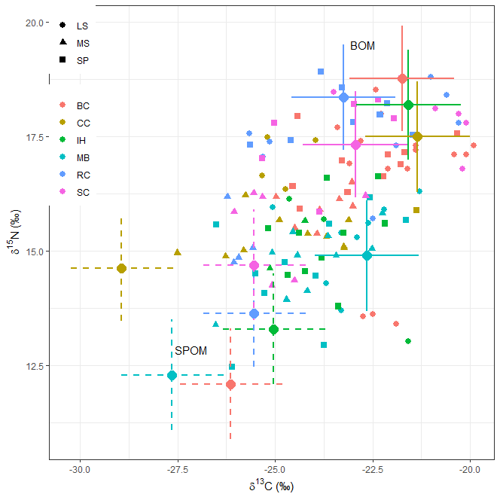
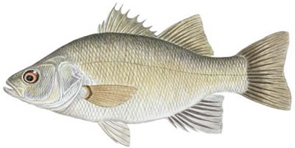
Stable isotope approaches
White perch image: Identifyfish.blogspot.com
Benthic (BOM)
δ¹³C & δ¹⁵N: endmembers, consumer
Pelagic
(SPOM)
Jackson et al. 2011, Stock and Semmens 2016
Notes:
Trophic pathway contributions
Mixing model framework (MixSIAR)
Proportional contribution of sources to consumer
Variables: season, creek, body length (TL)
Stable isotope niche area
Ellipse area in d13C and d15N space
Proxy for trophic niche

Slide 15
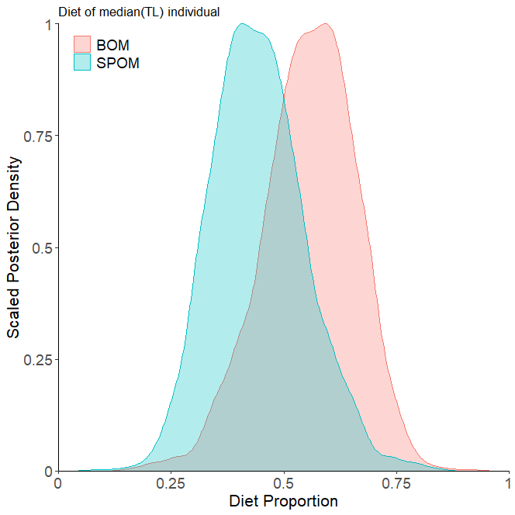
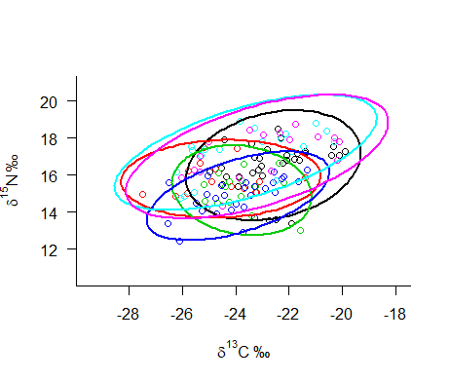
Stable isotope approaches
White perch image: Identifyfish.blogspot.com
1
δ¹³C & δ¹⁵N: endmembers, consumer
Trophic pathway contributions
Mixing model → benthic/pelagic contributions
Stable isotope niche area (consumer)
Ellipse area in δ¹³C and δ¹⁵N space
Pelagic
0.5
Posterior density
Benthic
0
0
0.5
1
Diet proportion
Jackson et al. 2011, Stock and Semmens 2016
Notes:
Trophic pathway contributions
Mixing model framework (MixSIAR)
Proportional contribution of sources to consumer
Variables: season, creek, body length (TL)
Stable isotope niche area
Ellipse area in d13C and d15N space
Proxy for trophic niche

Slide 16
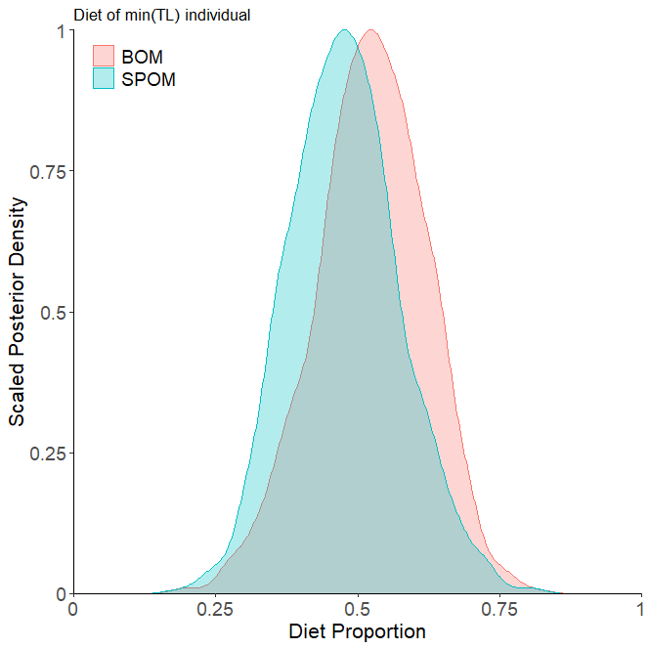
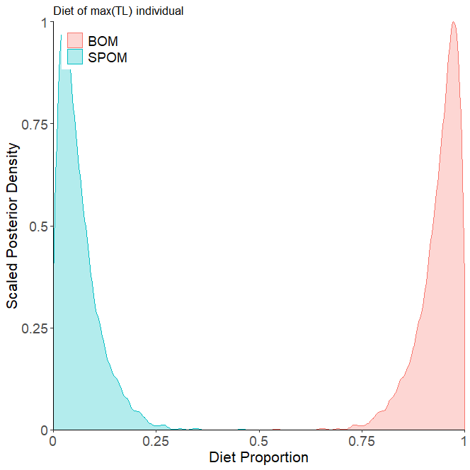
Trophic pathways: ontogenetic shift
White perch image: Identifyfish.blogspot.com
Notes:
HSI – negative length effect for all models

