Slide 1


2025 Chesapeake Bay Climate Change Load Projections
Mark Bennett, U.S. Geological Survey
CBP Climate Resiliency Workgroup Co-Chair
Chesapeake Bay Program Principals’ Staff Committee
March 2, 2018
Notes:
I would remove the Chesapeake Bay image altogether since you already a header image depicting the bay. I would move the logo to the left side of the text ”Chesapeake Bay Program Principals’ Staff Committee, December 19, 2017” since this is where our name is located. Also, widen the text box so that Decisions isn’t on a line by itself. This also gives a bit more breathing room between the title and the sub-text.

Slide 2
Today’s Requested Policy Decisions
Approve the proposed next steps and overall schedule for addressing uncertainty in our understanding of climate change impacts on Chesapeake Bay water quality.
Agree to use the nutrient and sediment load reductions presented in December 2017 as the starting point for proceeding forward the with proposed Partnership multi-year schedule for factoring changing climate conditions into the jurisdictions’ Phase III Watershed Implementation Plans.

Slide 3
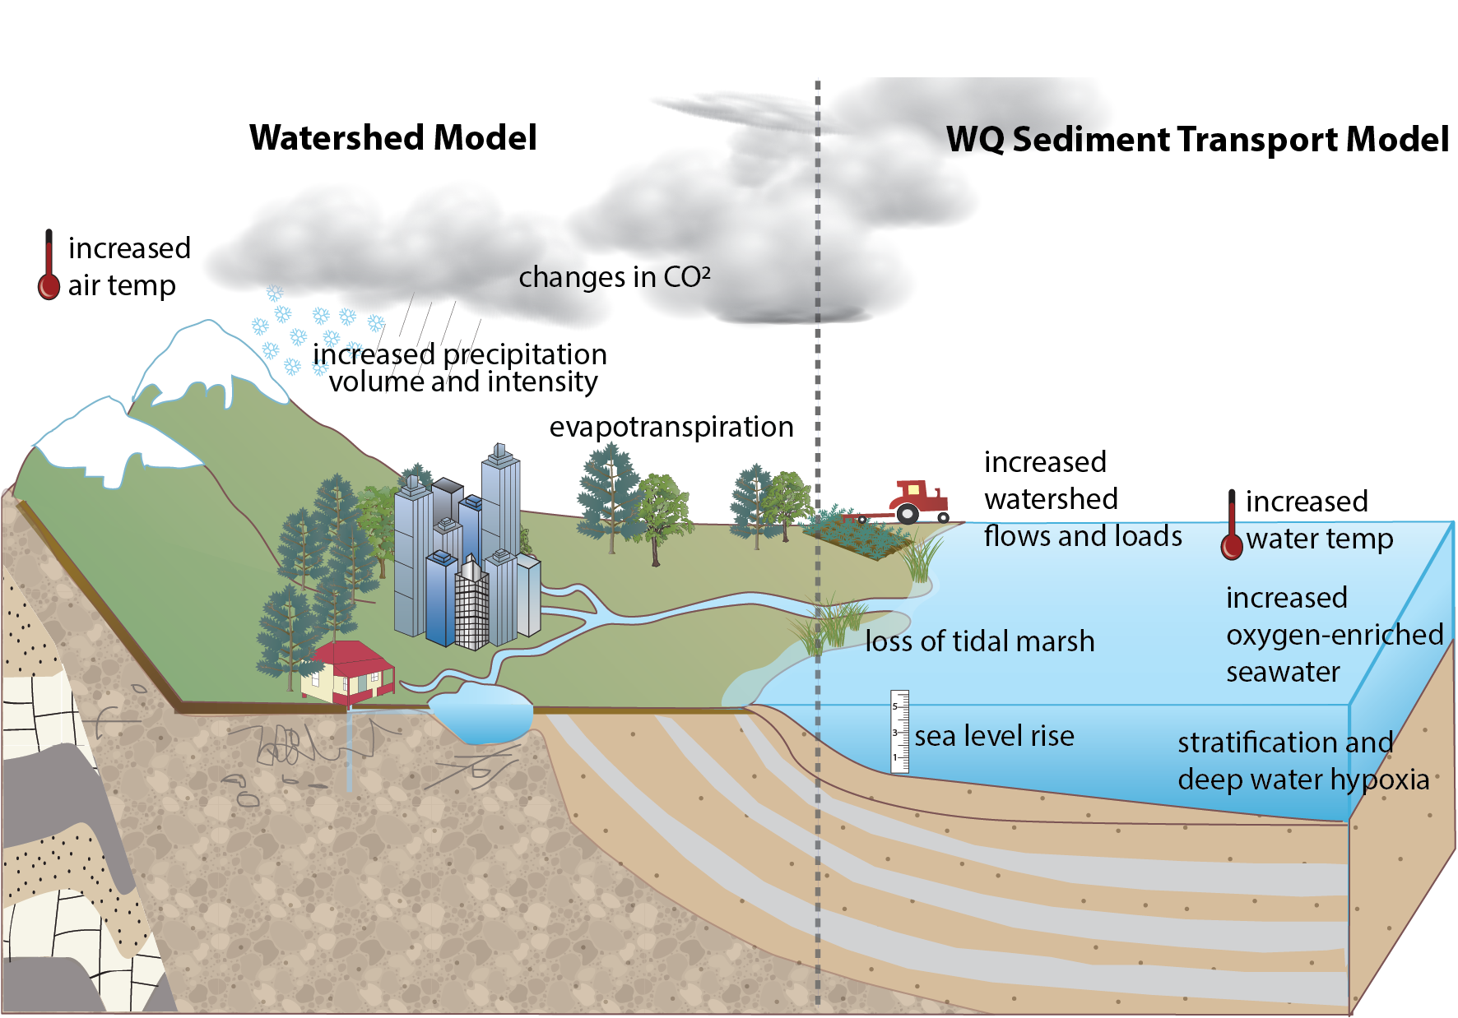
Accounting for Changing Conditions

Slide 4
To Limit Uncertainty
The Partnership used STAC recommended projections for 2025 that have a high level of confidence¹
Selection of projections for sea level rise and precipitation change were based on past records of observed climatic and resultant river flow conditions
Downscaled temperature projections for 2025 are closely aligned with observed trends
CBP Scientific and Technical Advisory Committee. 2016. The Development of Climate Projections for Use in Chesapeake Bay Program Assessments. March 2016 Workshop.

Slide 5
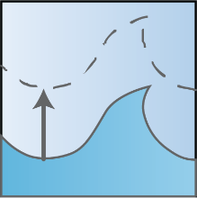


Major Climate Variables: 2025 Projections
Extrapolation of NOAA observed sea level trends (Swells Point, VA)
17 centimeters
Relative Sea Level Rise
Downscaled climate projections (RCP 4.5)
1.98° F / 1.1° C Increase
Temperature Increase
Observed trends in 88-years of annual PRISM^{[1]} data
3.1% Increase
Precipitation Change

Slide 6
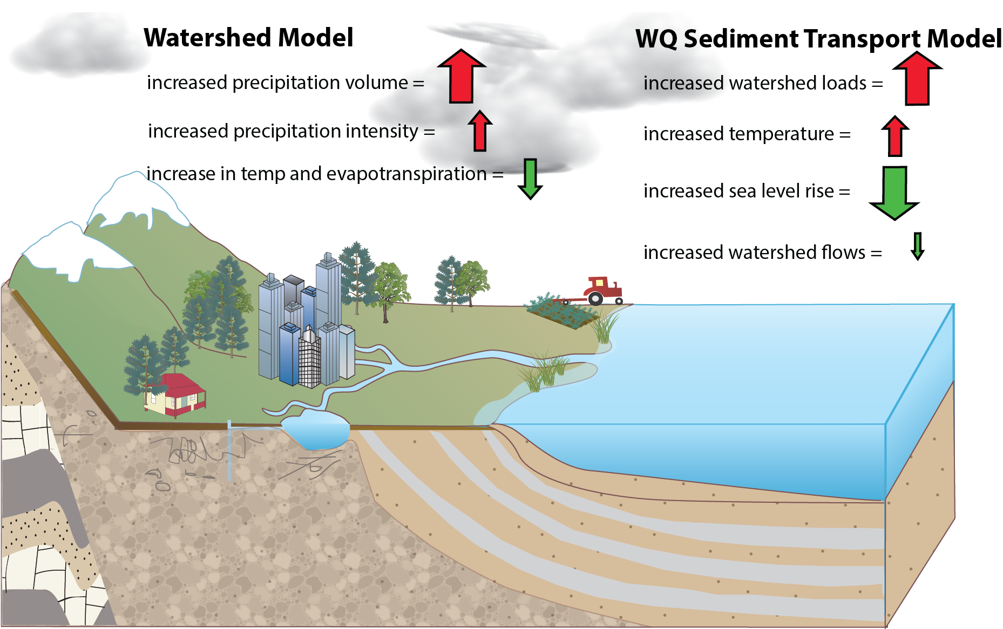
Accounting for Changing Conditions
Cumulative Assessment of Bay Low Dissolved Oxygen Impacts

Slide 7
In the Summer of 2017 Our Message was Climate Change Effects by 2025 were Projected to be Minimal as the Different Effects were Largely Counteracting Each Other

Slide 8

Summer 2017 Assessment:
Deep Water Dissolved Oxygen in Balance
Watershed Loads
Increase
Sea Level Rise
Increases
Water Temperature
in Bay Increases
Decreased Oxygen In Deep Waters of the Bay
Increased Oxygen In Deep Waters of the Bay

Slide 9
So What Changed Between the Summer 2017 Assessment of Projected Climate Change Impacts and what was Presented to the PSC at the December 19-20 Meeting?

Slide 10
Estimated Sea Level Rise Decreased
Partnership originally used a predicted sea level rise of 30 centimeters (1 foot) between the 1990s and 2025
Better scientific understanding brought forth by Partners
  NOAA released new sea level rise projections for the Chesapeake Bay
  VIMS also provided updated sea level rise projections
Based on new science, the CBP Climate Resiliency Workgroup recommended using a projection of 17 centimeters
  Consistent with long term trends at the Sewells Point, VA tide gauge at Bay mouth
Result: less influx of colder, oxygen-rich ocean water causing less ventilation of low dissolved oxygen waters in the deepest portions of the Bay
Notes:
MSL in 2000 = MSL in 1992 + .092957 ft (based on averages of monthly data)

Slide 11
Climate Change Effects on Loading of Different
Types of Nutrients Better Understood
Total nitrogen and phosphorus are expected to stay about the same
Dissolved nitrate and phosphate have a strong effect on dissolved oxygen and increase with climate change
Ammonia decreased as a percentage, but the absolute amount is small
Organic nutrients decrease, but they have a weak effect on dissolved oxygen

Slide 12

December 2017 Assessment:
Deep Water Dissolved Oxygen Not in Balance
Watershed Loads
Increase
Sea Level Rise
Increases
Water Temperature
in Bay Increases
Decreased Oxygen In Deep Waters of the Bay
Increased Oxygen In Deep Waters of the Bay

Slide 13
Nutrient Load Reductions Needed to Account for Reduced Oxygen Due to Climate Change
We can choose to reduce nitrogen, phosphorus, or both
Since most BMPs apply to both nutrients, a balanced approach is more efficient than just focusing on one or the other
Analysis performed in December of 2017 indicated that raising the level of effort for all jurisdictions using the approved planning target method resulted in an estimate of 9.1 million pounds of nitrogen and 490,000 pounds of phosphorus basin-wide

Slide 14
Climate Change Loads: Nitrogen
Jurisdiction | 1985 Baseline | 2013 Progress | Climate Change | Phase III Planning Target
NY | 18.71 | 15.44 | 0.400 (3.8%) | 11.59
PA | 122.41 | 99.28 | 4.135 (5.7%) | 73.18
MD | 83.56 | 55.89 | 2.194 (4.8%) | 45.30
WV | 8.73 | 8.06 | 0.236 (3.7%) | 8.35
DC | 6.48 | 1.75 | 0.006 (0.3%) | 2.43
DE | 6.97 | 6.59 | 0.397 (8.5%) | 4.59
VA | 84.29 | 61.53 | 1.722 (3.1%) | 55.82
Basinwide | 331.15 | 248.54 | 9.09 (4.6%) | 201.25
*Units: millions of pounds

Slide 15
Climate Change Loads: Phosphorus
Jurisdiction | 1985 Baseline | 2013 Progress | Climate Change | Phase III Planning Target
NY | 1.198 | 0.710 | 0.014 (2.9%) | 0.606
PA | 6.282 | 3.749 | 0.141 (4.7%) | 3.073
MD | 7.495 | 3.942 | 0.114 (3.2%) | 3.604
WV | 0.902 | 0.617 | 0.019 (3.9%) | 0.456
DC | 0.090 | 0.062 | 0.001 (0.8%) | 0.130
DE | 0.225 | 0.116 | 0.006 (5.1%) | 0.120
VA | 14.244 | 6.751 | 0.193 (3.0%) | 6.186
Basinwide | 30.44 | 15.95 | 0.489 (3.4%) | 14.173
*Units: millions of pounds

Slide 16
December 19-20 PSC Policy Decisions
1. Incorporate Climate Change in the Phase III WIPs
Include a narrative strategy in the Phase III WIPs that describes the jurisdictions current action plans and strategies to address climate change, as well as the jurisdiction-specific nutrient and sediment pollution loadings due to 2025 climate change conditions, while incorporating local priorities and actions to address climate change impacts.
2. Understand the Science
Address the uncertainty by documenting the current understanding of the science and identifying research gaps and needs.
3. Incorporate into Milestones
Starting with the 2022-2023 milestones, determine how climate change will impact the BMPs included in the WIPs and address these vulnerabilities in the two-year milestones.

Slide 17
Understanding the Science:
Proposed Next Steps
2018
STAC Workshop to examine current results, assess lessons-learned and recommend next steps.
2019
Following the direction of the PSC, the Modeling and Climate Resiliency Workgroups, working with other key Chesapeake Bay Program groups, will develop and implement a complete and fully operational climate change modeling and assessment system in 2019.
2020
In 2020, the CBP partners will complete a technical review and process for approval of the new refined climate change modeling and assessment system as well as the scientific and technical findings from its management applications.
2021
In 2021, the policy implications for including targets adjusted for the influence of climate change into the 2022-2023 milestones will be considered by the Partnership.
Climate Resiliency Workgroup will incorporate actions in its 2018-2020 workplan to develop a better understanding of BMP responses, including new or other emerging BMPs, to climate change conditions.
By the close of 2021, the refined findings on climate change will be implemented into the jurisdictions’ 2022-2023 milestones.

Slide 18
Today’s Requested Policy Decisions
First: Approval of the proposed next steps and overall schedule for addressing uncertainty by documenting the current understanding of the science and identifying research gaps and needs.

Slide 19
Today’s Requested Policy Decisions
Second: Agreement to use the nutrient and sediment load reductions presented in December 2017 needed to address projected climate change impacts on Bay water quality by 2025 as the starting point for proceeding forward the with proposed Partnership multi-year schedule for factoring changing climate conditions into the jurisdictions’ Phase III Watershed Implementation Plans.

Slide 20
Today’s Requested Policy Decisions
Third: Agreement on New York’s proposed revised “Factoring Climate Change Considerations into the Phase III Watershed Implementation Plans” language:
1. Incorporate Climate Change in the Phase III WIPs
Include a narrative strategy in the Phase III WIPs that describes the state and local jurisdictions’ current action plans and strategies to address climate change and commit to adopting climate change allocations by 2021, employing the climate change model and other relevant local information.

Slide 21
Today’s Requested Policy Decisions
2. Understand the Science
Continue to sharpen the understanding of the science, impacts of climate change, and identify research gaps and needs.
Develop an estimate of pollutant load changes (nitrogen, phosphorus, and sediment) due to 2025 climate change conditions.
Develop a better understanding of BMP responses, including new, enhanced and resilient BMPs, to better address climate change conditions such as increased storm intensity.
In 2021, the Partnership will consider results of updated methods, techniques, and studies and determine estimated loads due to climate change for each jurisdiction.
In 2021 jurisdictions will account for additional nutrient and sediment pollutant loads due to 2025 climate change conditions in a Phase III WIP addendum and/or 2-year milestones beginning in 2022.

Slide 22
Today’s Requested Policy Decisions
3. Incorporate into Milestones
Starting with the 2022-2023 milestones, the Partnership will determine how climate change will impact the BMPs included in the WIPs and address these vulnerabilities in the two-year milestones.

