Slide 1
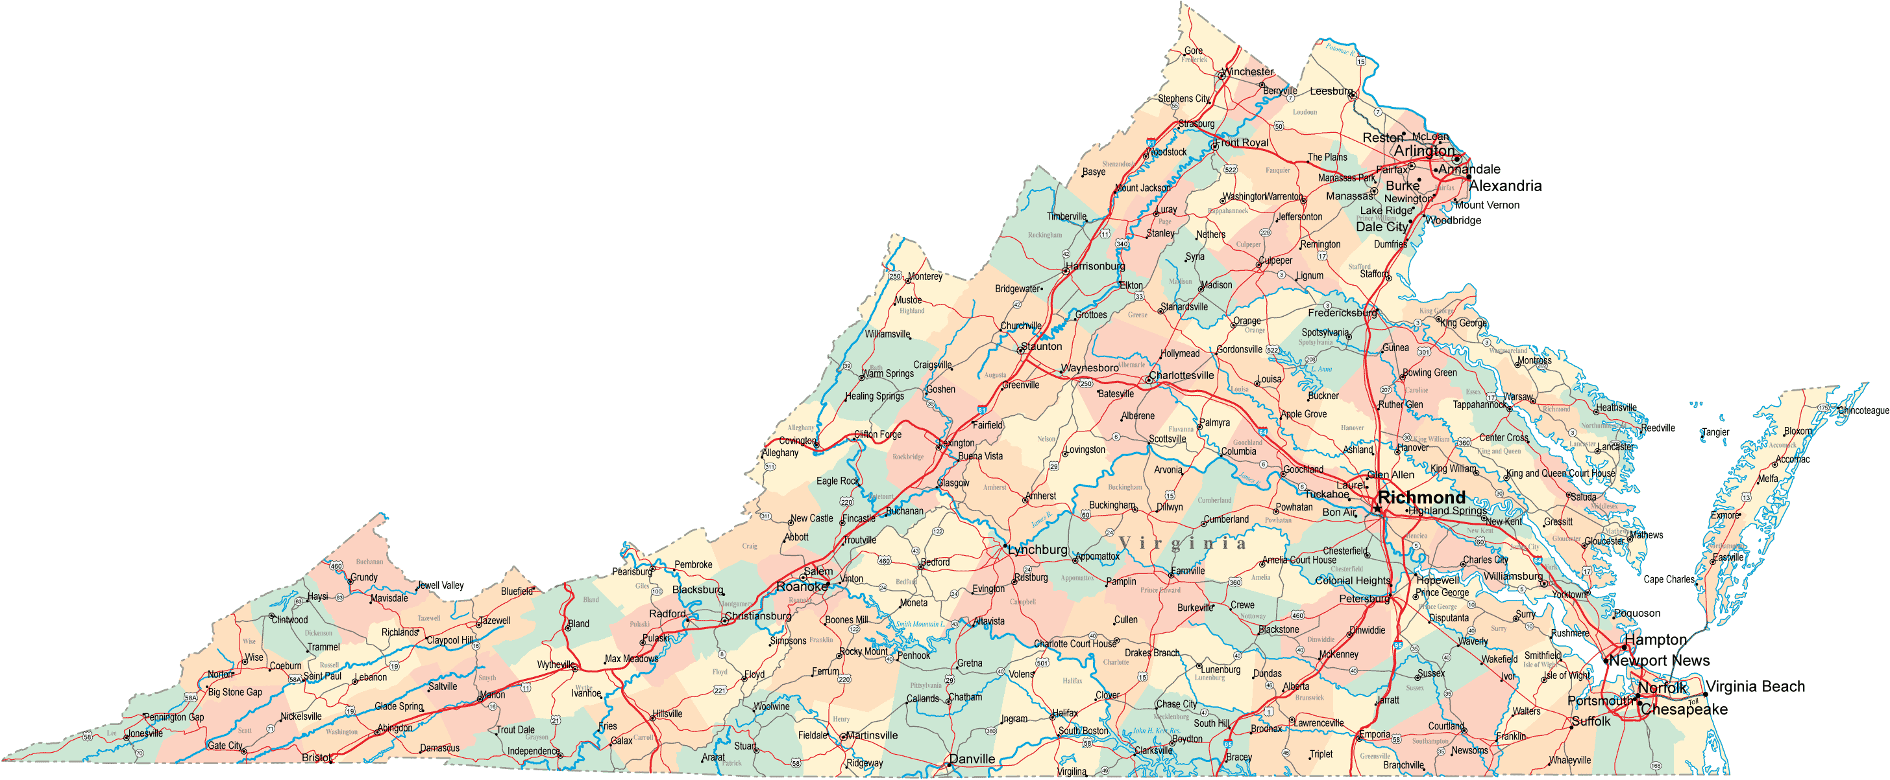





Where are we: Environmental literacy?

Slide 2
Accomplishments
Diploma Seal
Board of Education’s Seal for Excellence in Science and the Environment
Students who earn either a Standard or Advanced Studies Diploma, and
(i) complete 3 laboratory science courses & 1 advanced laboratory science, each with a grade of “B” or higher;
(ii) complete lab or field-science research and a presentation in a formal, juried setting;
(iii) complete 50+ hours of community service or extracurricular activities such as environmental monitoring, protection, management, or restoration.
Notes:
Diploma Seal
Board of Education’s Seal for Excellence in Science and the Environment will be awarded to students who earn either a Standard Diploma or Advanced Studies Diploma, and (i) complete at least three different first-level board-approved laboratory science courses and at least one rigorous advanced- or postsecondary-level laboratory science, each with a grade of “B” or higher; (ii) complete laboratory or field-science research and present that research in a formal, juried setting; and (iii) complete at least 50 hours of voluntary participation in community service or extracurricular activities that involve the application of science such as environmental monitoring, protection, management, or restoration.

Slide 3
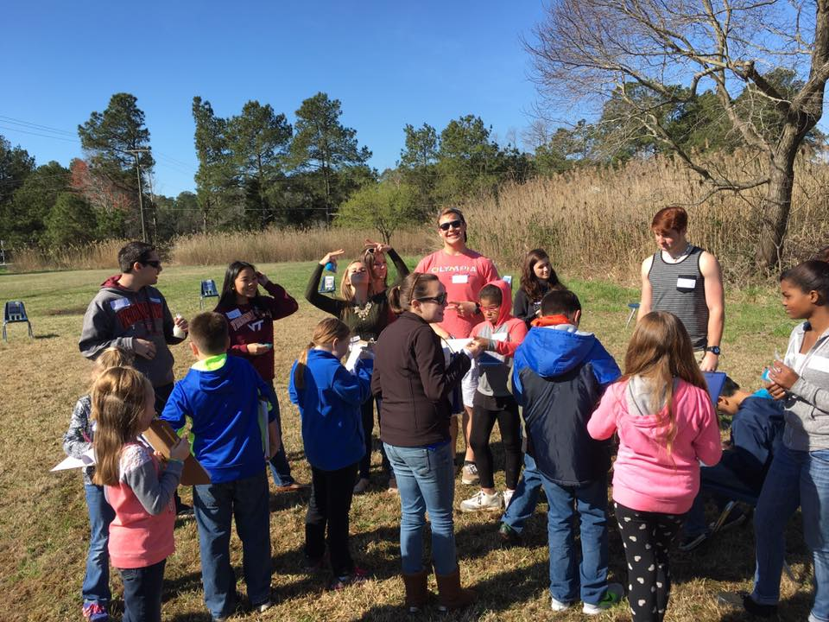
Accomplishments
Executive Order 42-Conservation Classroom Challenge
~EO challenges teachers and administrators to improve environmental literacy
1st year: 55 teachers
Notes:
Governor McAuliffe demonstrated his administrative support by issuing Executive Order #42.

Slide 4
Accomplishments
Creation of Virginia Association of Environmental Education
35 newly certified Watershed Educators (NOAA BWET project to train non-formal educators) bringing the total to more than 100
Completion of Mountains to the Bay Academies

Slide 5
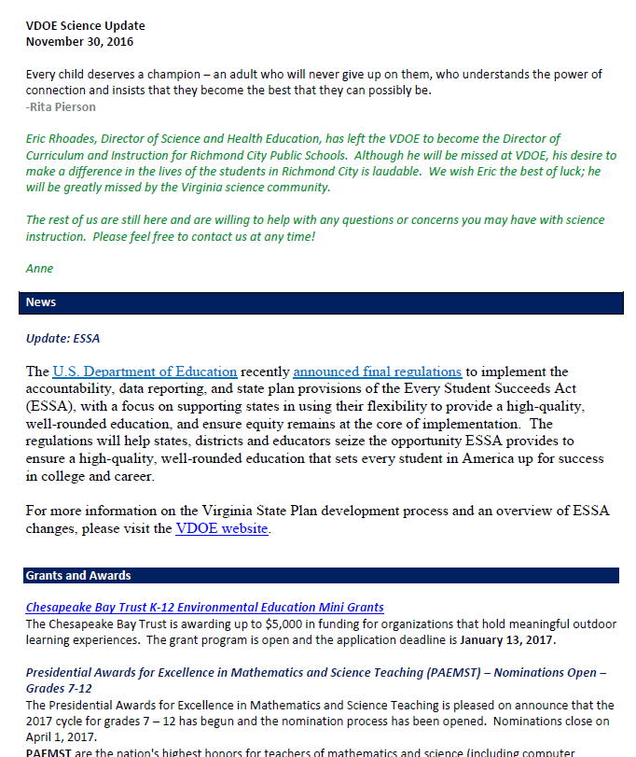
Successful Approaches

Slide 6

Successful Approaches
Professional Development
TOTE: Teachers on the Estuary (4th and 6th grade teachers)

Slide 7
Successful Approaches: Building Skills and Content
Environmental Literacy
2.5 habitats change over time due to many influences
2.8 Plants produce O₂ & food and are a source of useful products
K.11 Reuse, Recycle , & Conserve (materials, water & energy)
1.8 Natural Resource s are limited
Factors that affect air and water quality
3.11 Different sources of energy
3.6 Ecosystems support a diversity of plants and animals that share limited resources. The human role in conserving resources
4.5 Influences of humans on natural resources including watershed and water resources
4.9 VA Natural Resources
5.6 Ecological characteristics of the ocean environment
5.7 Human impact on the Earth’s Surface
6.9 Public policy and the environment
6.5 The importance of protecting & maintaining water resources
6.2 Renewable and nonrenewable energy resources
LS.10 Ecosystems change over time including climate change
LS.11 Environmental issues
PS.5 Conservation of matter and energy

Slide 8
Successful Approaches: Building Skills and Concepts
Biology | Chemistry | Earth Science | Physics
Bio.8 The effects of natural events and human activities on ecosystems | CH.6 Organic chemical uses in pharmaceuticals and genetics, petrochemicals, plastics, & food. | ES.6 Renewable and nonrenewable resources ES.8 Freshwater resources are impacted by geologic process and human activities ES.10 Economic & policy issues concerning oceans and the Chesapeake Bay | PH.7 Energy and useful work: Emphasis on nuclear energy

Slide 9
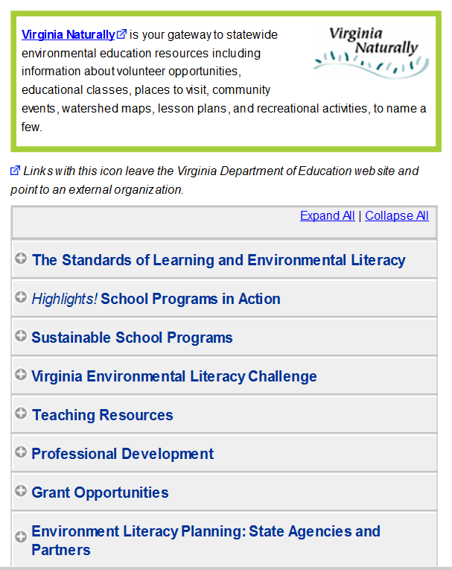
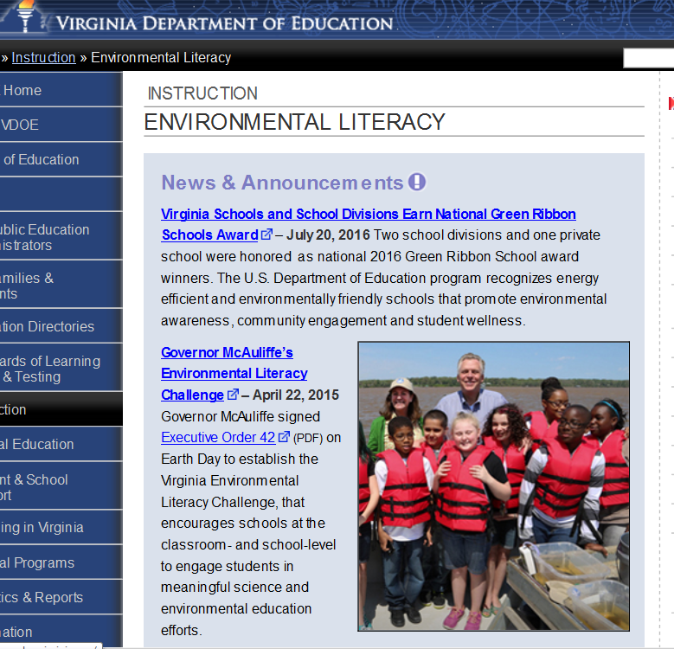
Successful Approaches: Web Presence

Slide 10

Challenges
Equitable funding
Between school districts- 43 school districts not eligible for competitive grant funding (185,000 students) because outside of the CB watershed.
Between organizations (formal and non-formal natural resource education)

Slide 11
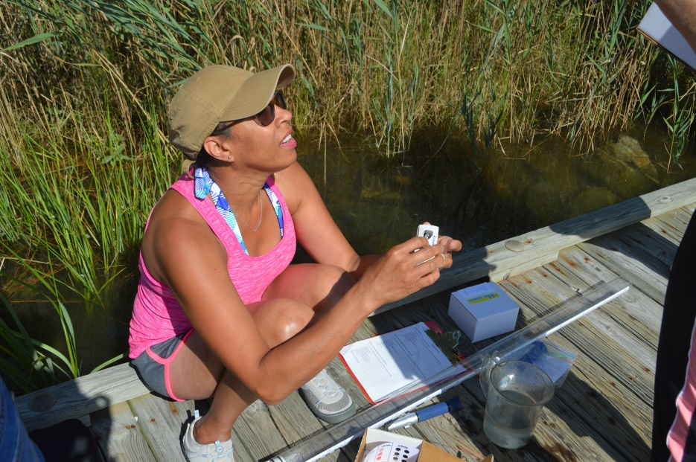
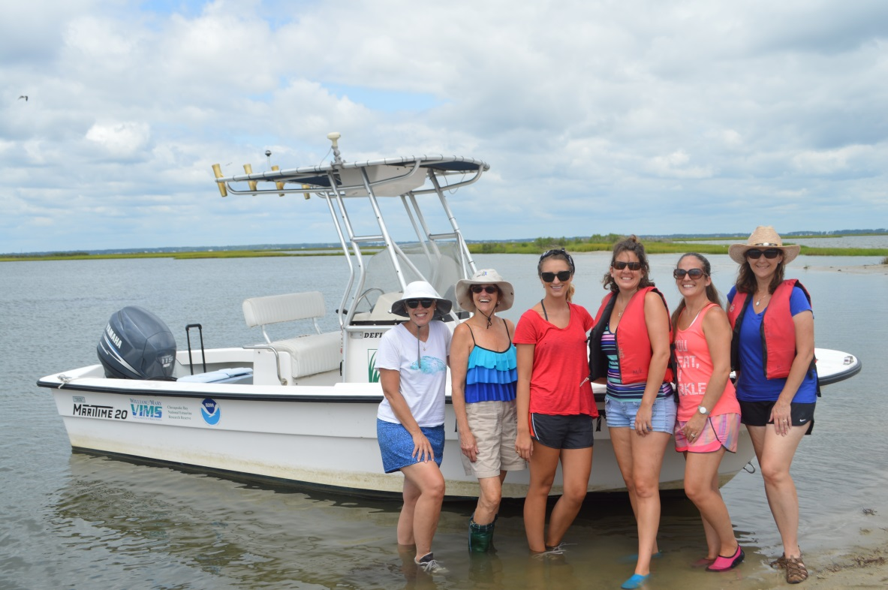
Opportunities to Collaborate
Roles of state interagency groups and EE organizations

