Slide 1
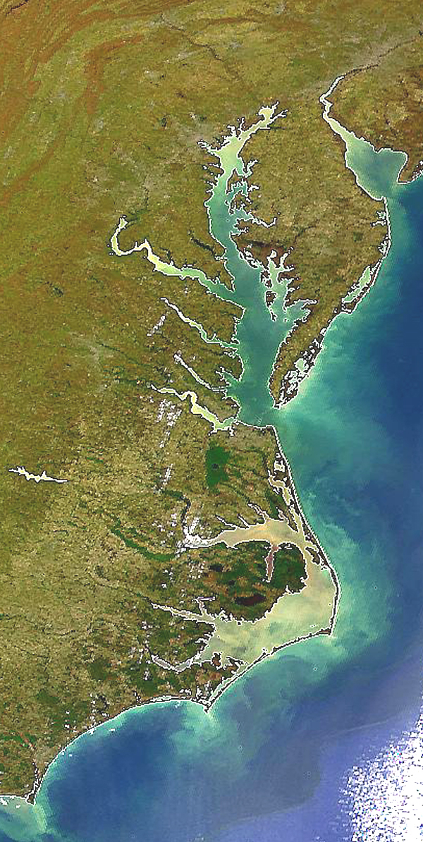

State Profile
Virginia

Slide 2
VA Draft Phase III WIP Planning Targets + Reference Loads
Nitrogen Load
 | No-Action (M lbs) | E3 (M lbs) | 2013 Progress (M lbs) | Phase II WIP (reference) (M lbs) | Draft Phase III WIP Planning Target (M lbs)
VA Eastern Shore | 2.97 | 0.96 | 2.29 | 1.55 | 1.42
VA James | 51.00 | 15.12 | 26.86 | 22.07 | 26.01
VA Potomac | 36.83 | 10.77 | 17.57 | 15.38 | 15.98
VA Rappahannock | 11.55 | 4.83 | 8.37 | 6.84 | 6.86
VA York | 9.02 | 3.78 | 6.43 | 5.63 | 5.54
VA Total | 111.37 | 35.40 | 61.53 | 51.44 | 55.82
Phosphorus Load
 | No-Action (M lbs) | E3 (M lbs) | 2013 Progress (M lbs) | Phase II WIP (reference) (M lbs) | Draft Phase III WIP Planning Target (M lbs)
VA Eastern Shore | 0.27 | 0.12 | 0.18 | 0.16 | 0.16
VA James | 9.82 | 1.36 | 2.67 | 2.19 | 2.76
VA Potomac | 5.86 | 1.04 | 1.98 | 1.62 | 1.87
VA Rappahannock | 1.47 | 0.57 | 0.93 | 0.80 | 0.84
VA York | 1.13 | 0.37 | 0.59 | 0.56 | 0.56
VA Total | 18.55 | 3.46 | 6.35 | 5.33 | 6.19

Slide 3
VA Nitrogen Loads-Goals, Phase 5.3.2

Slide 4
VA Nitrogen Loads-Goals, Phase 6

Slide 5
VA Nitrogen Change in Level of Effort

Slide 6
VA Phosphorus Loads-Goals, Phase 5.3.2

Slide 7
VA Phosphorus Loads-Goals, Phase 6

Slide 8
VA Phosphorus Change in Level of Effort

Slide 9
VA Nitrogen – Phase 6 Level Of Effort
(NoAction:E3 Reference)

Slide 10
VA Phosphorus – Phase 6 Level Of Effort
(NoAction:E3 Reference)

Slide 11
VA Nitrogen – Phase 6 Loads and Target
Where did the
reductions come from?
1985
2013
Draft Phase III WIP
Planning Target

Slide 12
VA Phosphorus – Phase 6 Loads and Target
Where did the
reductions come from?
1985
2013
Draft Phase III WIP
Planning Target

Slide 13
VA Nitrogen – Phase 6 Scenario Loads and Draft Target

Slide 14
VA Phosphorus – Phase 6 Scenario Loads and Draft Target

Slide 15
Nitrogen – Phase 6 Relative Effectiveness
Effect of Nitrogen Load Reduction on WQ Standard Attainment
A = Above Fall Line B = Below Fall Line

Slide 16
Phosphorus – Phase 6 Relative Effectiveness
Effect of Phosphorus Load Reduction on WQ Standard Attainment
A = Above Fall Line B = Below Fall Line

Slide 17
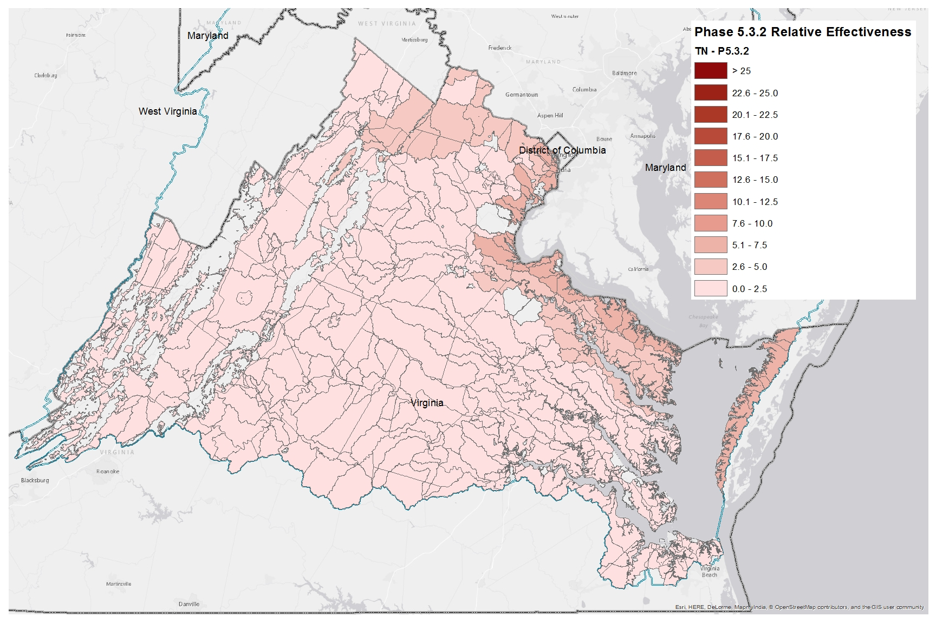
Nitrogen Relative Effectiveness
Phase 5.3.2

Slide 18
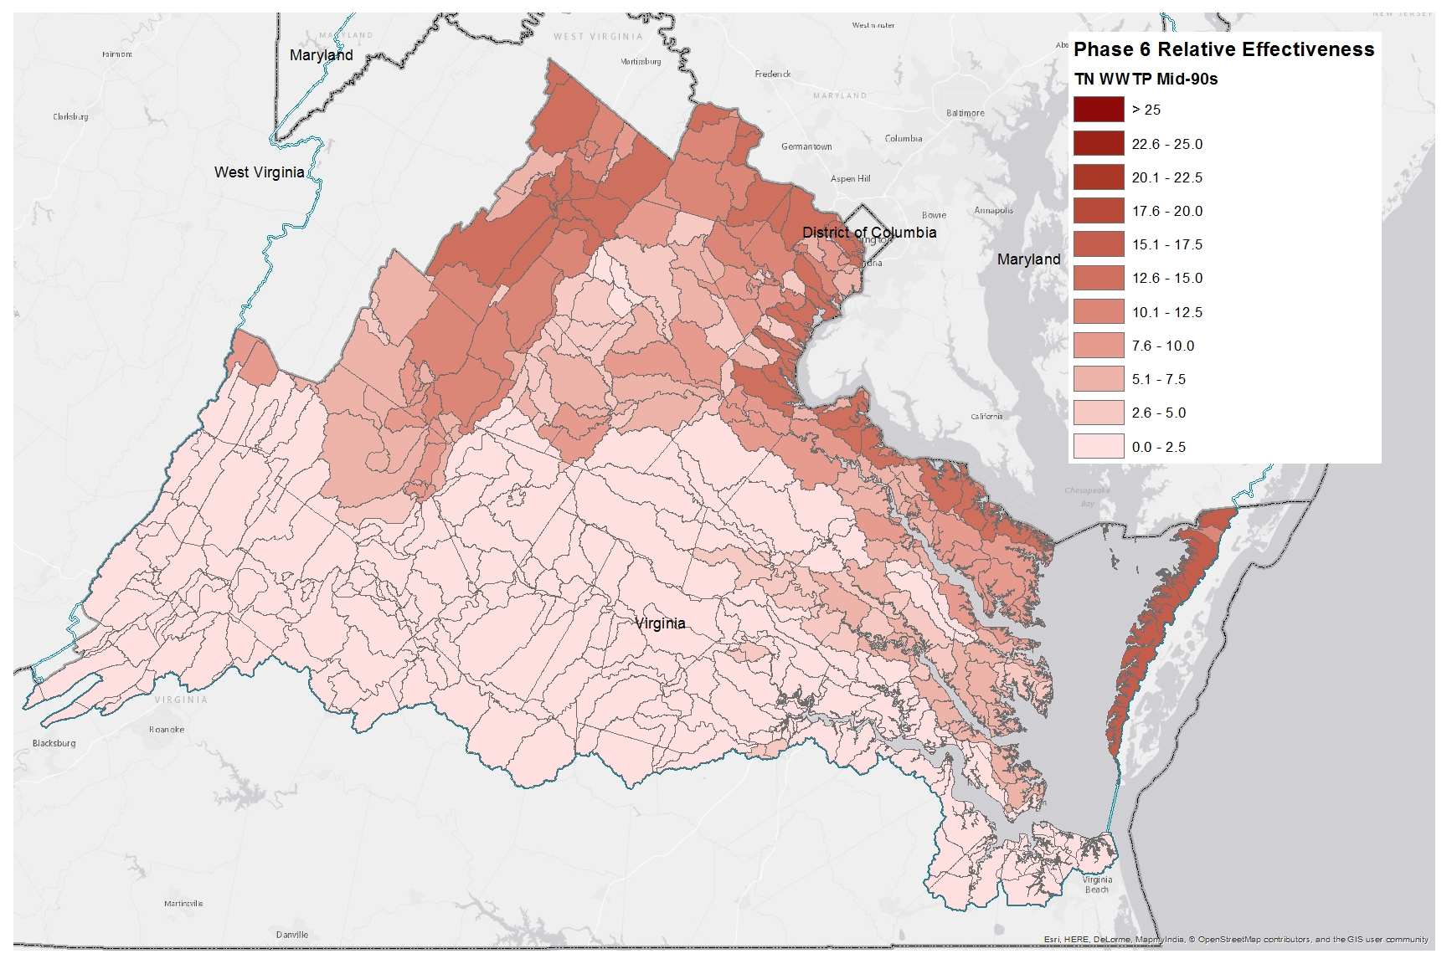
Nitrogen Relative Effectiveness
Phase 6, WWTP, Mid-90s

Slide 19
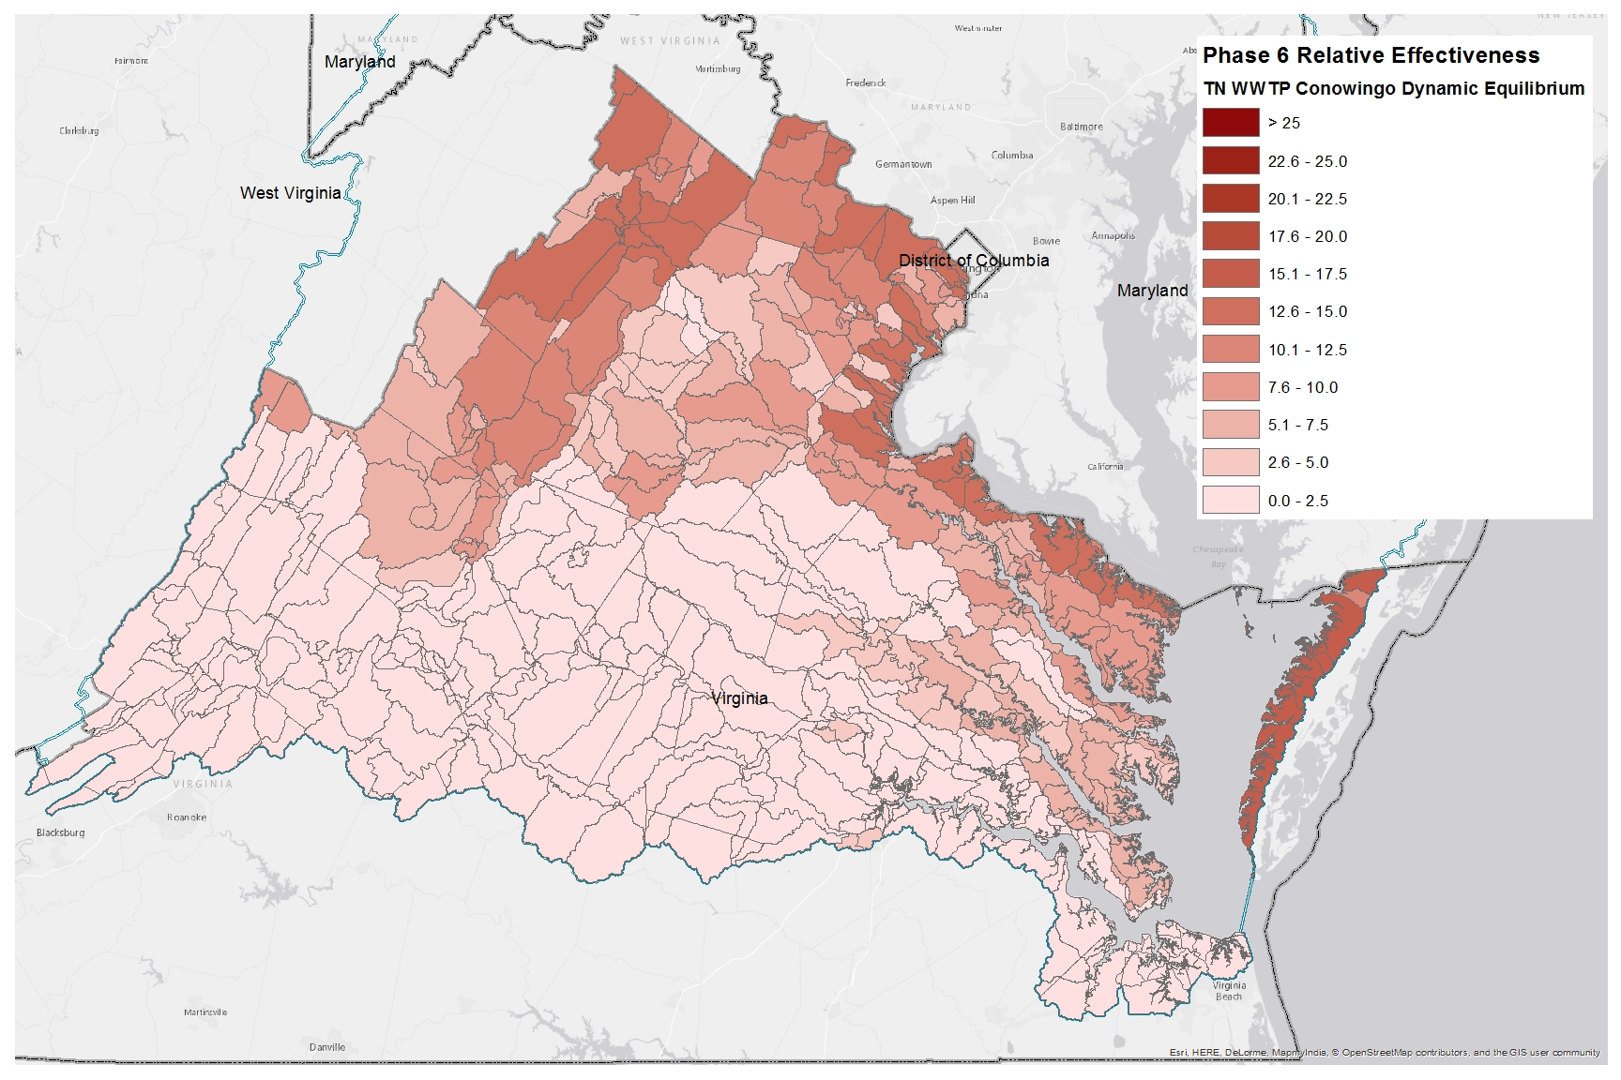
Nitrogen Relative Effectiveness
Phase 6, WWTP, Conowingo Dynamic Equilibrium

Slide 20
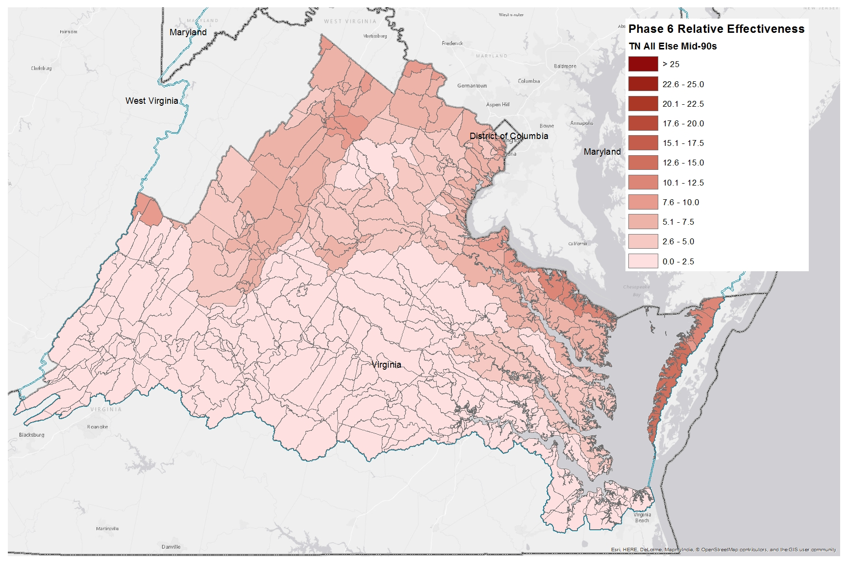
Nitrogen Relative Effectiveness
Phase 6, All Else, Mid-90s

Slide 21
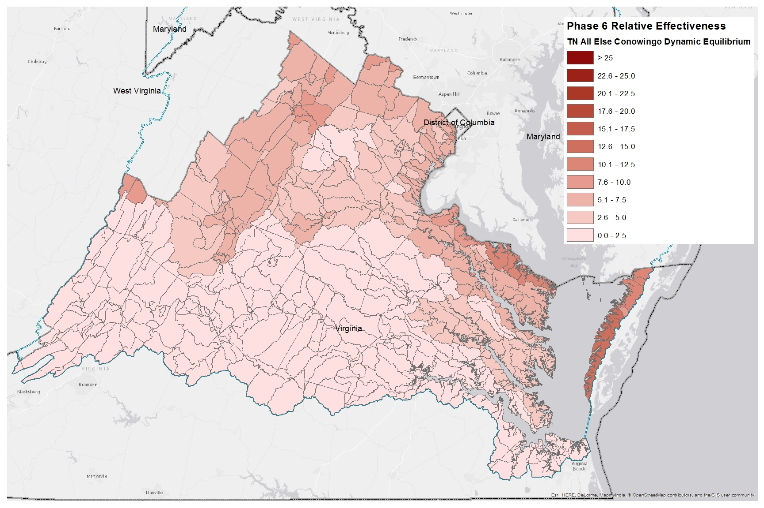
Nitrogen Relative Effectiveness
Phase 6, All Else, Conowingo Dynamic Equilibrium

Slide 22
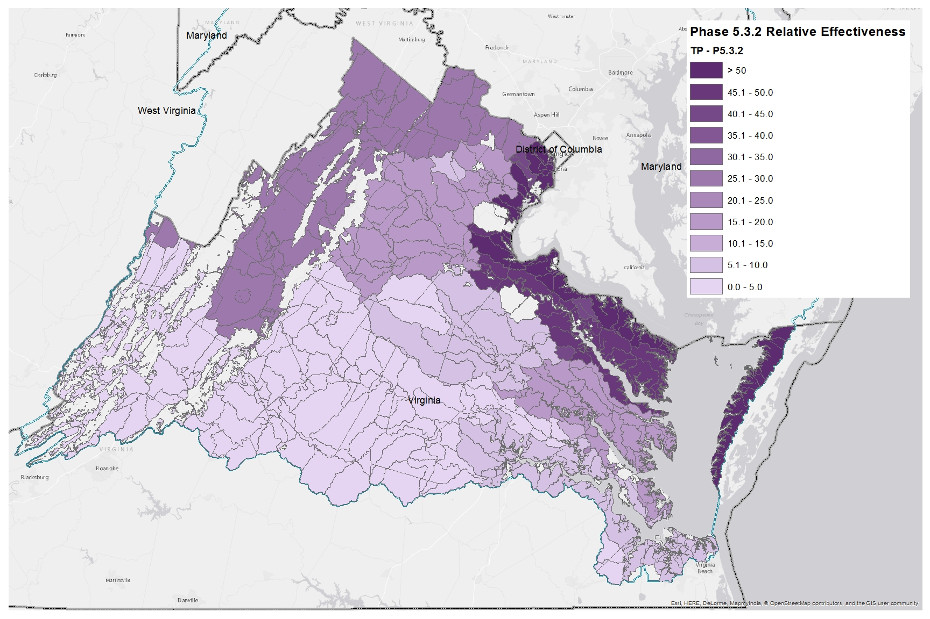
Phosphorus Relative Effectiveness
Phase 5.3.2

Slide 23
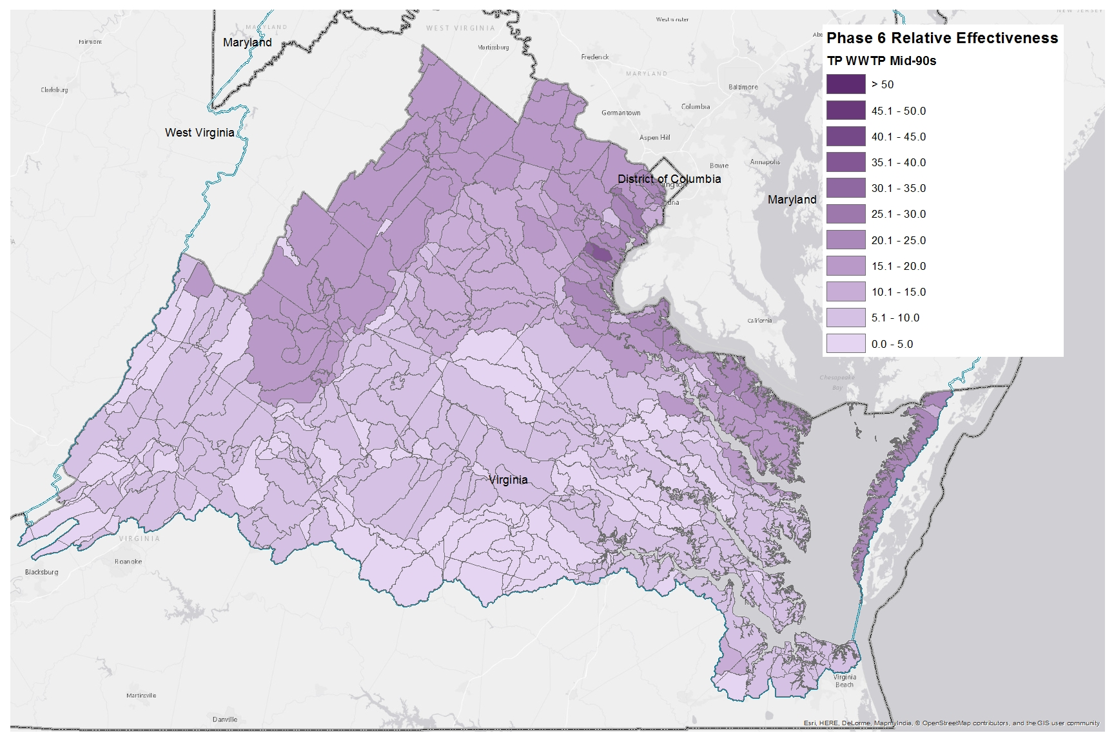
Phosphorus Relative Effectiveness
Phase 6, WWTP, Mid-90s

Slide 24
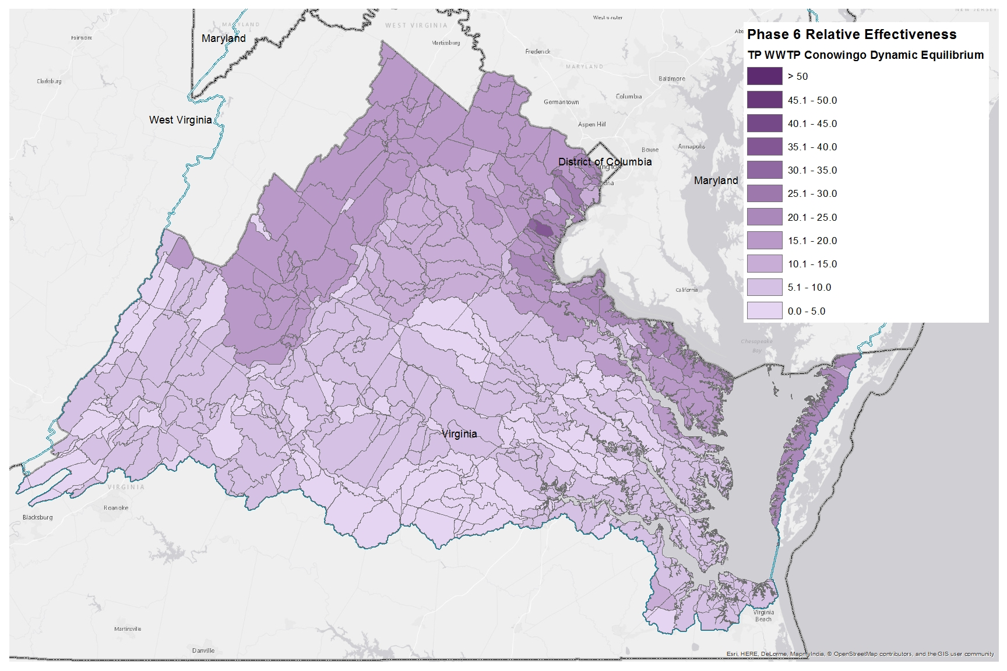
Phosphorus Relative Effectiveness
Phase 6, WWTP, Conowingo Dynamic Equilibrium

Slide 25
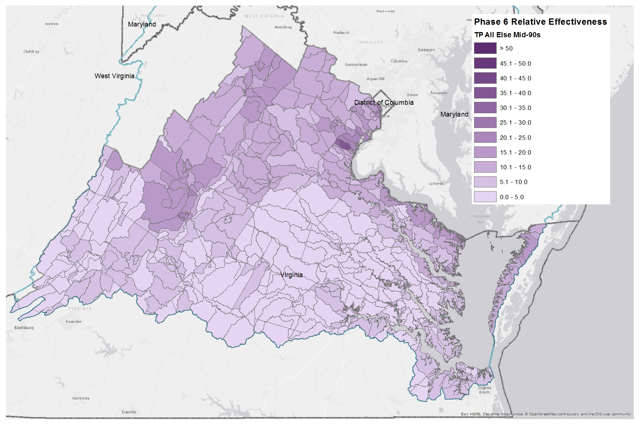
Phosphorus Relative Effectiveness
Phase 6, All Else, Mid-90s

Slide 26

Phosphorus Relative Effectiveness
Phase 6, All Else, Conowingo Dynamic Equilibrium

