Slide 1
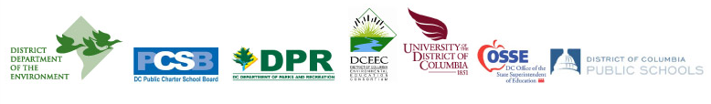
DC Environmental Literacy Plan: Integrating Environmental Education into the K-12 Curriculum
Grace Manubay District Department of the Environment

Slide 2
Healthy Schools Act of 2010
Seeks to improve the health and wellness of all District students.
Addresses nutrition, health education, physical education and physical activity, Farm-to-School programs, and school gardens.
Acknowledges that creating and sustaining an environmentally-friendly school environment and integrating environmental education into the schools’ curriculum are essential to the health and wellness of students, as well as the health of the local environment and community.

Slide 3
Healthy Schools Act of 2010
Incorporates provisions that incorporate environmental stewardship behaviors into building practices.
Meet LEED Gold Level certification when renovating or constructing new schools.
Assist schools in receiving U.S. Green Ribbon Schools recognition.
Develop an Environmental Literacy Plan for District schools.

Slide 4
HSA Amendment Act – July 2011
Section 502 is amended as follows:
(b) The Environmental Literacy Plan shall, at minimum, describe the following:
(1) Relevant teaching and learning standards adopted by the State Board of Education;
(2) Professional development opportunities for teachers; (3) How to measure environmental literacy;
(4) Governmental and nongovernmental entities that can assist schools; and (5) Implementation of the Plan.
(c) The District Department of the Environment shall transmit the Environmental Literacy Plan to the Mayor and the Council by June 30, 2012.

Slide 5
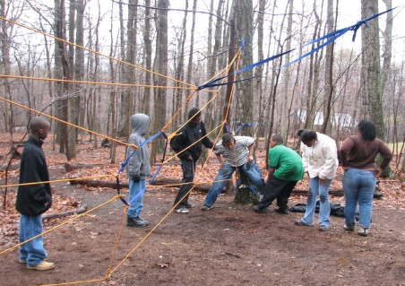
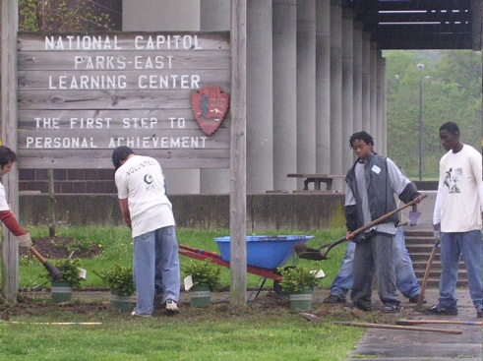
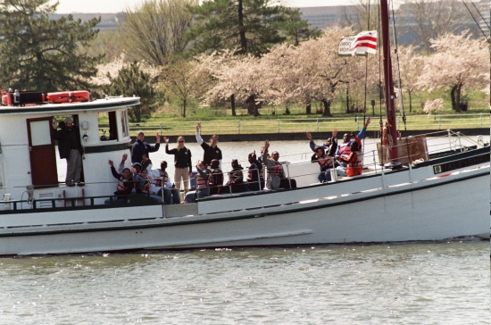
Workgroup Structure
DC ELP Workgroup
Consists of 2 representatives from each agency named in the Healthy Schools Act
Responsible for developing sections of the ELP and overseeing the task forces
Year-long commitment to create draft by June 29, 2012

Slide 6
DCELP Workgroup Task Forces
Content Standards and Professional Development | Graduation Requirements and Evaluation | Implementation and Funding
DCPS | SBoE | OSSE
OSSE | OSSE | SBoE
DCEEC | DCEEC | DCEEC
DDOE | DDOE | DDOE
Non-profits | Non-profits | Non-profits

Slide 7
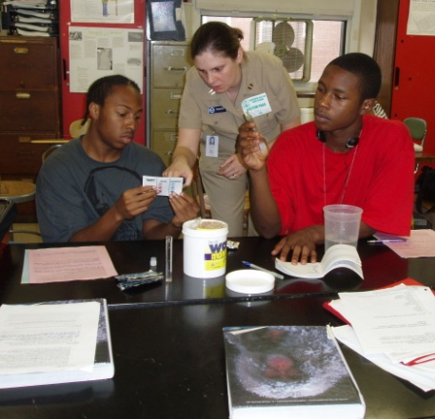
What is Environmental Literacy?
Environmental literacy is the development of knowledge, attitudes, and skills necessary to make informed decisions concerning the relationships among natural and urban systems.
Notes:
Quote from Environmental Literacy Council
Environmental Literacy Definitions:
Maryland: “Environmentally literate students possess the knowledge, intellectual skills, attitudes, experiences and motivation to make and act upon responsible environmental decisions as individuals and as members of their community. Environmentally literate students understand environmental and physical processes and systems, including human systems. They are able to analyze global, social, cultural, political, physical, economic and environmental relationships, and weigh various sides of environmental issues to make responsible decisions as individuals and as members of their community and citizens of the world.”
Definition logic: understanding of systems ->analysis of holistic issue-> responsible decision making.
New Jersey: “Environmentally literate persons understand:
• The systems of the natural world and the relationships and interactions between the living and nonliving environment;
• That choices they make as humans and as consumers affect the environment;
• How these choices can either help or harm the environment and the earth’s ability to sustain human and other life;
• How to deal sensibly with problems that involve scientific evidence, uncertainty, and economic, aesthetic and ethical considerations; and
• What they need to do – individually or as part of a community – to keep the environment healthy and sustain its resources so that people can create and enjoy a good quality of life for themselves and their children.”
Definition logic: understanding of systems -> choices -> consequences-> possible solutions -> actions

Slide 8
What is Environmental Literacy?
An environmentally literate person:
discusses and describes ecological and environmental systems and human impacts on these systems;
engages in hands-on, outdoor learning experiences that involve discovery, inquiry, and problem solving;
questions and analyzes information pertaining to his or her surrounding environment; and
understands how to take actions that respect, restore, protect, and sustain the health and well-being of human communities and environmental systems.
Notes:
Quote from Environmental Literacy Council
Environmental Literacy Definitions:
Maryland: “Environmentally literate students possess the knowledge, intellectual skills, attitudes, experiences and motivation to make and act upon responsible environmental decisions as individuals and as members of their community. Environmentally literate students understand environmental and physical processes and systems, including human systems. They are able to analyze global, social, cultural, political, physical, economic and environmental relationships, and weigh various sides of environmental issues to make responsible decisions as individuals and as members of their community and citizens of the world.”
Definition logic: understanding of systems ->analysis of holistic issue-> responsible decision making.
New Jersey: “Environmentally literate persons understand:
• The systems of the natural world and the relationships and interactions between the living and nonliving environment;
• That choices they make as humans and as consumers affect the environment;
• How these choices can either help or harm the environment and the earth’s ability to sustain human and other life;
• How to deal sensibly with problems that involve scientific evidence, uncertainty, and economic, aesthetic and ethical considerations; and
• What they need to do – individually or as part of a community – to keep the environment healthy and sustain its resources so that people can create and enjoy a good quality of life for themselves and their children.”
Definition logic: understanding of systems -> choices -> consequences-> possible solutions -> actions

Slide 9
The Environmental Literacy Plan will…
Create opportunities for current District standards to be taught using the environment as a context for learning.
Identify local resources to support teachers who want to integrate environmental education into their teaching practices.
Provide professional development for teachers (at all levels) and educators.
Help determine whether environmental literacy efforts have any impact on student achievement.

Slide 10
The Environmental Literacy Plan will…
Encourage all District high schools to offer an environmental science course.
Increase participation in environmental service-learning to fulfill the community service graduation requirements.
Find ways to build upon existing efforts in environmental education.
Lay the groundwork for systemic implementation of environmental efforts that foster environmental literacy.

Slide 11
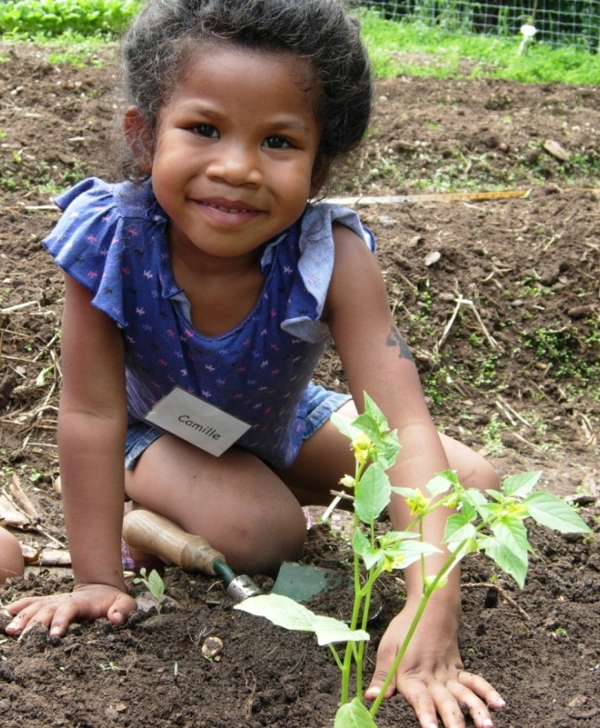
Other Local Efforts
Sustainable DC Initiative
DCPS STEM Vision
DPR’s “Move. Grow. Be Green.”
Healthy Schools Act requirements
Meaningful Watershed Educational Experiences
Others…

Slide 12
Components of the ELP
Background rationale: research
Current context: where we are
Objectives and action items: what we will accomplish over the next 5 years
Status: progress made
Implementation recommendations: framework to get to our desired outcomes
Next steps: actions agencies can take to move forward

Slide 13
Table of Contents
Content Standards
Professional Development
High School Graduation Requirements
Student Assessment (Evaluation)
School Facilities
Implementation

Slide 14
Table of Contents
Appendices
About the Workgroup
District’s Education Landscape
Status of Environmental Literacy
Existing Science and High School Social Studies Standards that Support Environmental Literacy
Organizations with Environmental Literacy Resources for Schools
Case Studies of Environmental Literacy in Schools

Slide 15
Future Timeline
Draft available on DDOE’s website
http://ddoe.dc.gov/education
Public comment period until May 31, 2012
Draft due to Council on June 29, 2012
Mayor is “willing and ready to work with Ward 3 Councilmember Mary Cheh to ensure that the plan, once completed, is implemented.”
Moving forward with action items.

