Slide 1

“Phase 6 Septic vs Local/State Data”
Peter Claggett,
USGS, CBP Land Use Workgroup Coordinator
June 5, 2018
Wastewater Treatment Workgroup

Slide 2
August 2017
P6 Calibration
data locked down
1985 - 2013
Nov/Dec 2017
Scenario-relevant data solicited and provided in response to review of draft
“Current Zoning” scenario
Future population data for MD and WV updated
VA provides 2016 septic count data
WV provides data on annual septic growth
CBLCM spatial simulations used to estimate future septic systems
Jan/Feb 2018
“Current Zoning” and “Conservation Plus” scenarios
finalized
Land use output from CBLCM
verified
VA septics projected to increase 66,000 from 2013 -2025
March 2018
Land Use scenarios entered in CAST
Land use output from CAST verified
April 2018
VA septics projected to increase 264,000 from 2013 – 2025
Reason: 2013 conditions in CAST reflect Aug 2017 data but 2013 conditions in CBLCM reflect Nov/Dec updates

Slide 3
Why did the estimates of new septics change form 66,000 to 264,000?
Because:
Virginia Department of Health Data show ~20% more septics in the watershed compared to CBLCM (which relies on Census Bureau and mapped sewer service area data); and
2013 values in CAST were fixed in August 2017, therefore the entire 20% difference is reflected in the change from 2013 to 2025.
Why are Virginia Department of Health’s data so different from CBLCM?

Slide 4
Comparison of Septic System Estimates for Two Local Jurisdictions in Virginia
Notes:
Fairfax County provided point data on alternative and conventional systems.
Loudoun County provided point data on septic drain fields (https://data-loudoungis.opendata.arcgis.com/datasets/).
In_SSA = points falling within locally mapped sewer service areas.
Out_SSA = points falling outside locally mapped sewer service areas.
VDH = Virginia Department of Health
2010 Census = Total housing units in Census Blocks with centroid falling outside mapped sewer service areas.
CBLCM = Single-detached housing units in Census Blocks with centroid falling outside mapped sewer service areas.

Slide 5
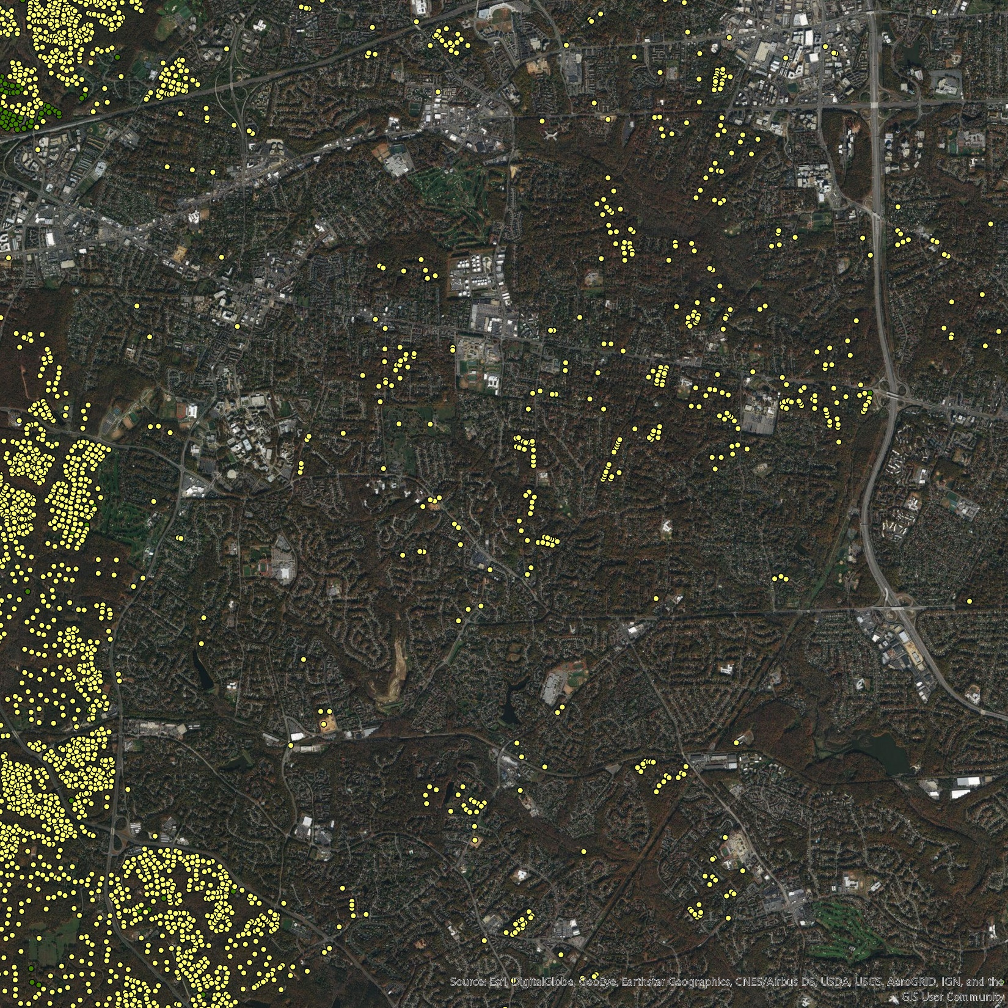
“Out_SSA” Systems in Fairfax County, Virginia

Slide 6
Comparison of 2013 Septic System Estimates in the Bay Watershed by Jurisdiction

Slide 7
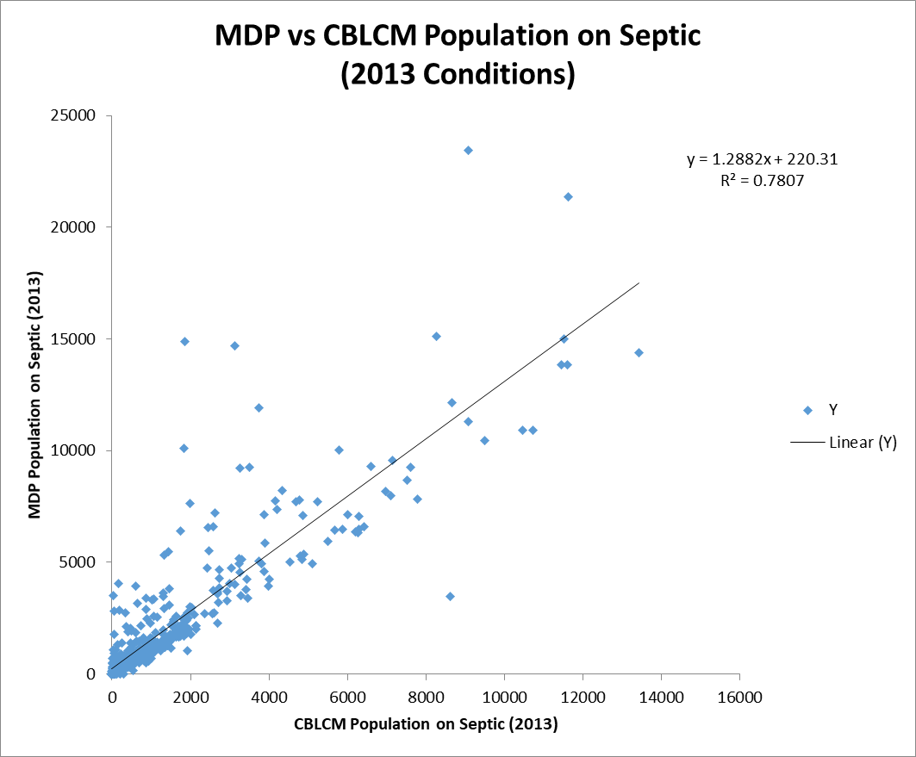
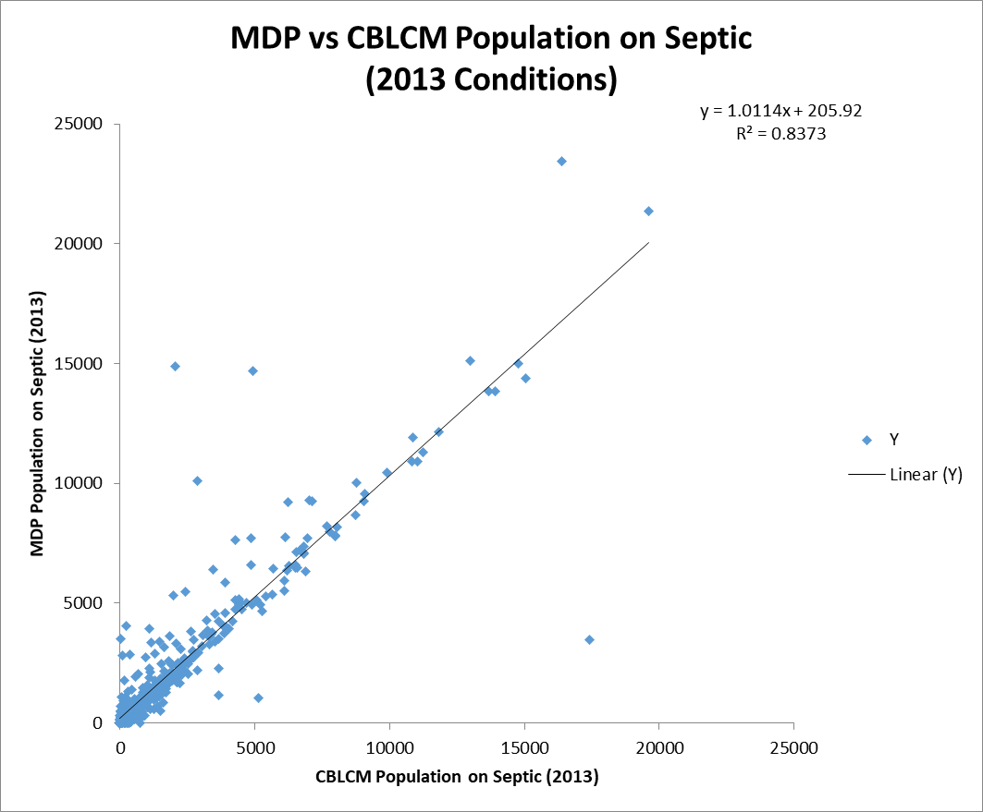
Population on Septic based on
Single-Detached Housing Units outside sewered areas
Population on Septic based on
Total Housing Units outside sewered areas

Slide 8
Observations:
Differences between CBLCM septic system estimates and local/state data are potentially explained by the use of single-detached (vs total) housing units outside sewer service areas and by the omission of septic systems within mapped sewer service areas. The exclusion of commercial systems may only explain a small portion of the differences.
Additional investigations are needed to understand the efficiencies of community septic systems serving apartments, condominiums, and townhouses which are included in “Total Housing Units”.
Additional state and local septic data and analyses are needed to determine if the CBLCM is systematically underestimating the number of septic systems in all jurisdictions.
Septic systems comprise 3.3% of the Total Nitrogen, Edge-of-Tide Load (2017 Progress). If the CBLCM is systematically underestimating the number of septic systems, it is possible that the total septic load in the watershed is being underestimated by 24% or ~2 million lbs. (0.8% of total nitrogen load).
Recommendations:
Defer use of the Virginia Department of Health data received post-calibration for use in the future land use scenarios.
Eliminate septics in the District of Columbia as per DC’s recommendation
Solicit additional state and local septic data to evaluate the accuracy of CBLCM septic estimates in each state (or for select counties in each state).

