Slide 1

Water Quality Trading: A Virginia Primer
Jenny McGarvey
Chesapeake Forests Program Manager
Alliance for the Chesapeake Bay
jmcgarvey@allianceforthebay.org
Citizens Advisory Committee Meeting
Wednesday, November 9th, 2017
National Arboretum, Washington, D.C.
Notes:
Virginia Non-point source nutrient trading program has existed since 2007.
Draft regulations still in review for certification of non-point source nutrient credits.

Slide 2
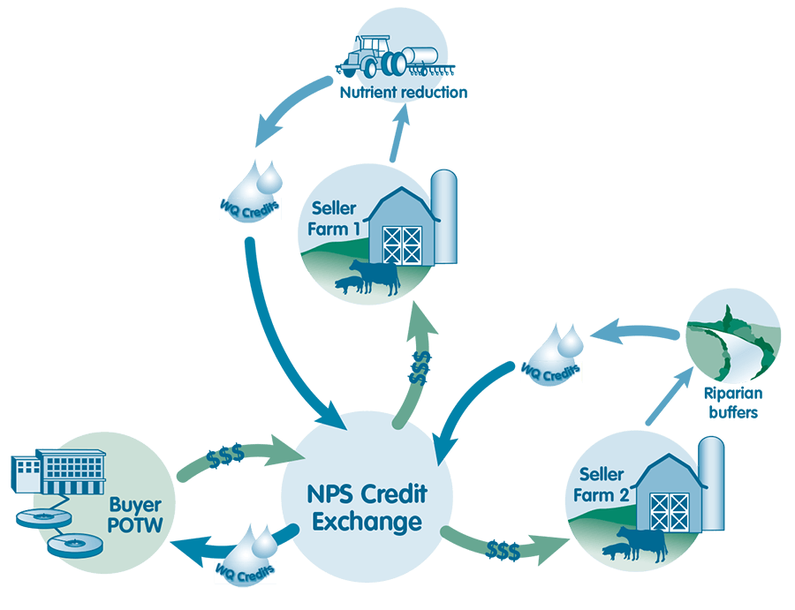
Nutrient Trading: The Fundamentals
Credit: Ecosystem Enterprise Partnership
Notes:
- Best management practices reduce nutrient loads to nearby streams, improving water quality as well as often providing co-benefits.
Once a farmer meets a certain threshold, or baseline, and continues to reduce the amount of nutrient runoff, the farmer may generate credits.
These credits may be purchased by eligible producers (non-point source or point source), offsetting their load reduction goals and improving local water quality

Slide 3
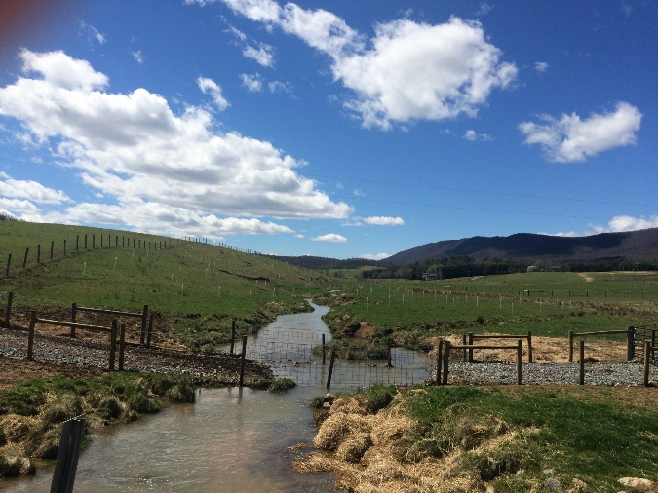
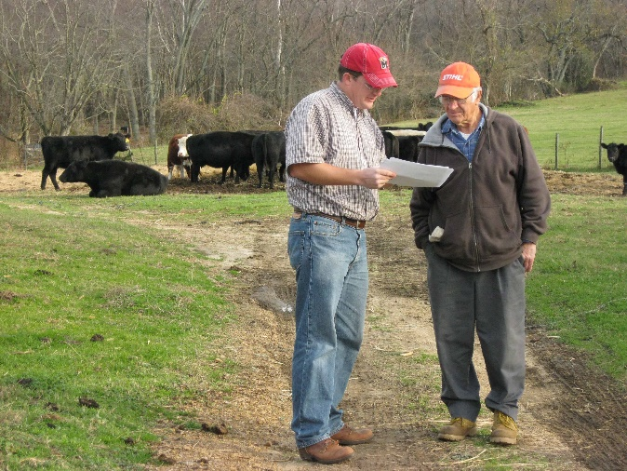
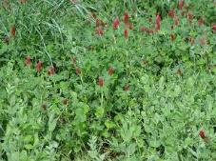
Nutrient Trading: The Fundamentals
Maryland Department of Agriculture
Step 1: Meet Baseline Requirements
USDA NRCS
Credit: Ecosystem Enterprise Partnership
Notes:
- Best management practices reduce nutrient loads to nearby streams, improving water quality as well as often providing co-benefits.
Once a farmer meets a certain threshold, or baseline, and continues to reduce the amount of nutrient runoff, the farmer may generate credits.
These credits may be purchased by eligible producers (non-point source or point source), offsetting their load reduction goals and improving local water quality
In Maryland, baseline determined by

Slide 4
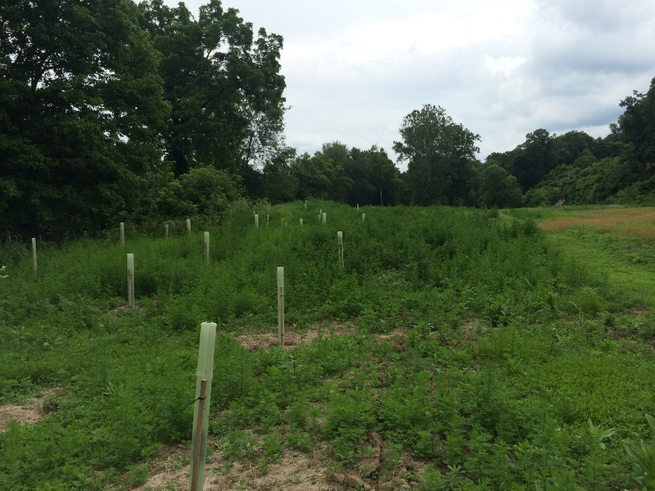
Nutrient Trading: The Fundamentals
Step 2: Implement BMP enhancement practice.
Credit: Ecosystem Enterprise Partnership
Notes:
- Best management practices reduce nutrient loads to nearby streams, improving water quality as well as often providing co-benefits.
Once a farmer meets a certain threshold, or baseline, and continues to reduce the amount of nutrient runoff, the farmer may generate credits.
These credits may be purchased by eligible producers (non-point source or point source), offsetting their load reduction goals and improving local water quality

Slide 5
Nutrient Trading: The Fundamentals
Credits based on removal efficiencies assigned by the Chesapeake Bay Program.
Step 3: Nutrient credits are generated and posted on the non-point source credit exchange.
Credit: Ecosystem Enterprise Partnership
Notes:
- Best management practices reduce nutrient loads to nearby streams, improving water quality as well as often providing co-benefits.
Once a farmer meets a certain threshold, or baseline, and continues to reduce the amount of nutrient runoff, the farmer may generate credits.
These credits may be purchased by eligible producers (non-point source or point source), offsetting their load reduction goals and improving local water quality

Slide 6
Nutrient Trading: The Fundamentals
Point source: 1:2 Credit Ratio
Non-Point Source: 1:1 Credit Ratio
Same HUC 12
Same HUC 10
Same HUC 8
Adjacent HUC 8 within same tributary
Same tributary
Step 5: Point and non-point source seek to purchase offset credits.
Credit: Ecosystem Enterprise Partnership
Notes:
For areas with water impaired for dissolved oxygen, benthics, or nutrients but with no local approved TMDL, the exchange limited to the hierarchy
For areas within the Chesapeake Bay Watershed the exchange of credits within an area subject to an approved local TMDL more stringent than the Chesapeake Bay TMDL shall be limited to credits generated upstream of where the discharge reaches impaired waters and within the approved local TMDL watershed.

Slide 7
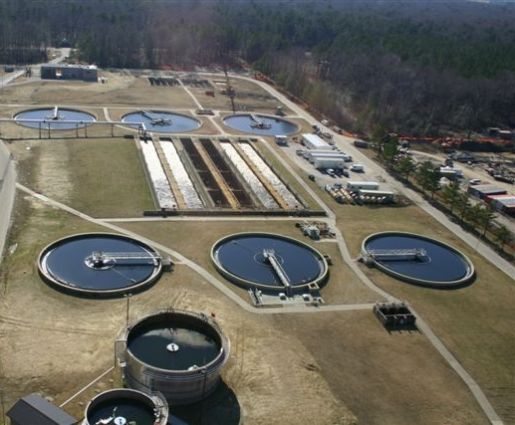
Who is eligible to purchase nutrient credits?
Virginia Storm Water Management Program Permittees (VSMP) for Discharge associated with Construction Activities
MS4 Permittees
Point sources (e.g., waste water treatment facilities).
Virginia Pollutant Discharge Elimination System (VPDES) Permittees for Discharges of Storm Water Associated with Industrial Activity
Bottom line: point sources need the most credits, but typically trade amongst themselves.
Notes:
Picture of York Waste Water Treatment Facility. Source: Hampton Roads Sanitation District (HRSD)

Slide 8
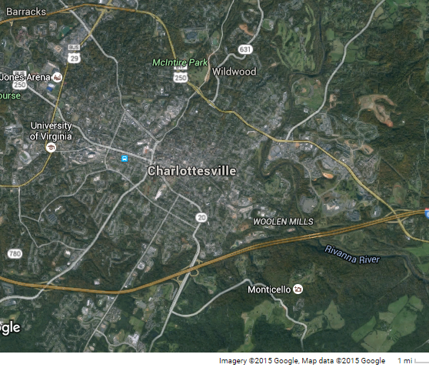
Who is eligible to purchase nutrient credits?
Virginia Storm Water Management Program Permittees (VSMP) for Discharge associated with Construction Activities
Small Municipal Separate Storm Water Systems (MS4s) are required to meet nutrient load reductions dictated by the Chesapeake Bay TMDL.
Virginia Pollutant Discharge Elimination System (VPDES) Permittees for Discharges of Storm Water Associated with Industrial Activity
MS4 Permittees
Reductions can be met incrementally with five year permit cycles. Current cycle requires only 5% implementation.
Bottom line: More MS4 permittees will purchase credits starting next year for the 2nd permit cycle.
Notes:
City of Charlottesville, Source google maps. Permit cycle 1: 2013-2018, 5% implementation; Permit cycle 2: 2018-2023, 35% implementation; Permit cycle 3: 2023-2028, 60% implementation.

Slide 9
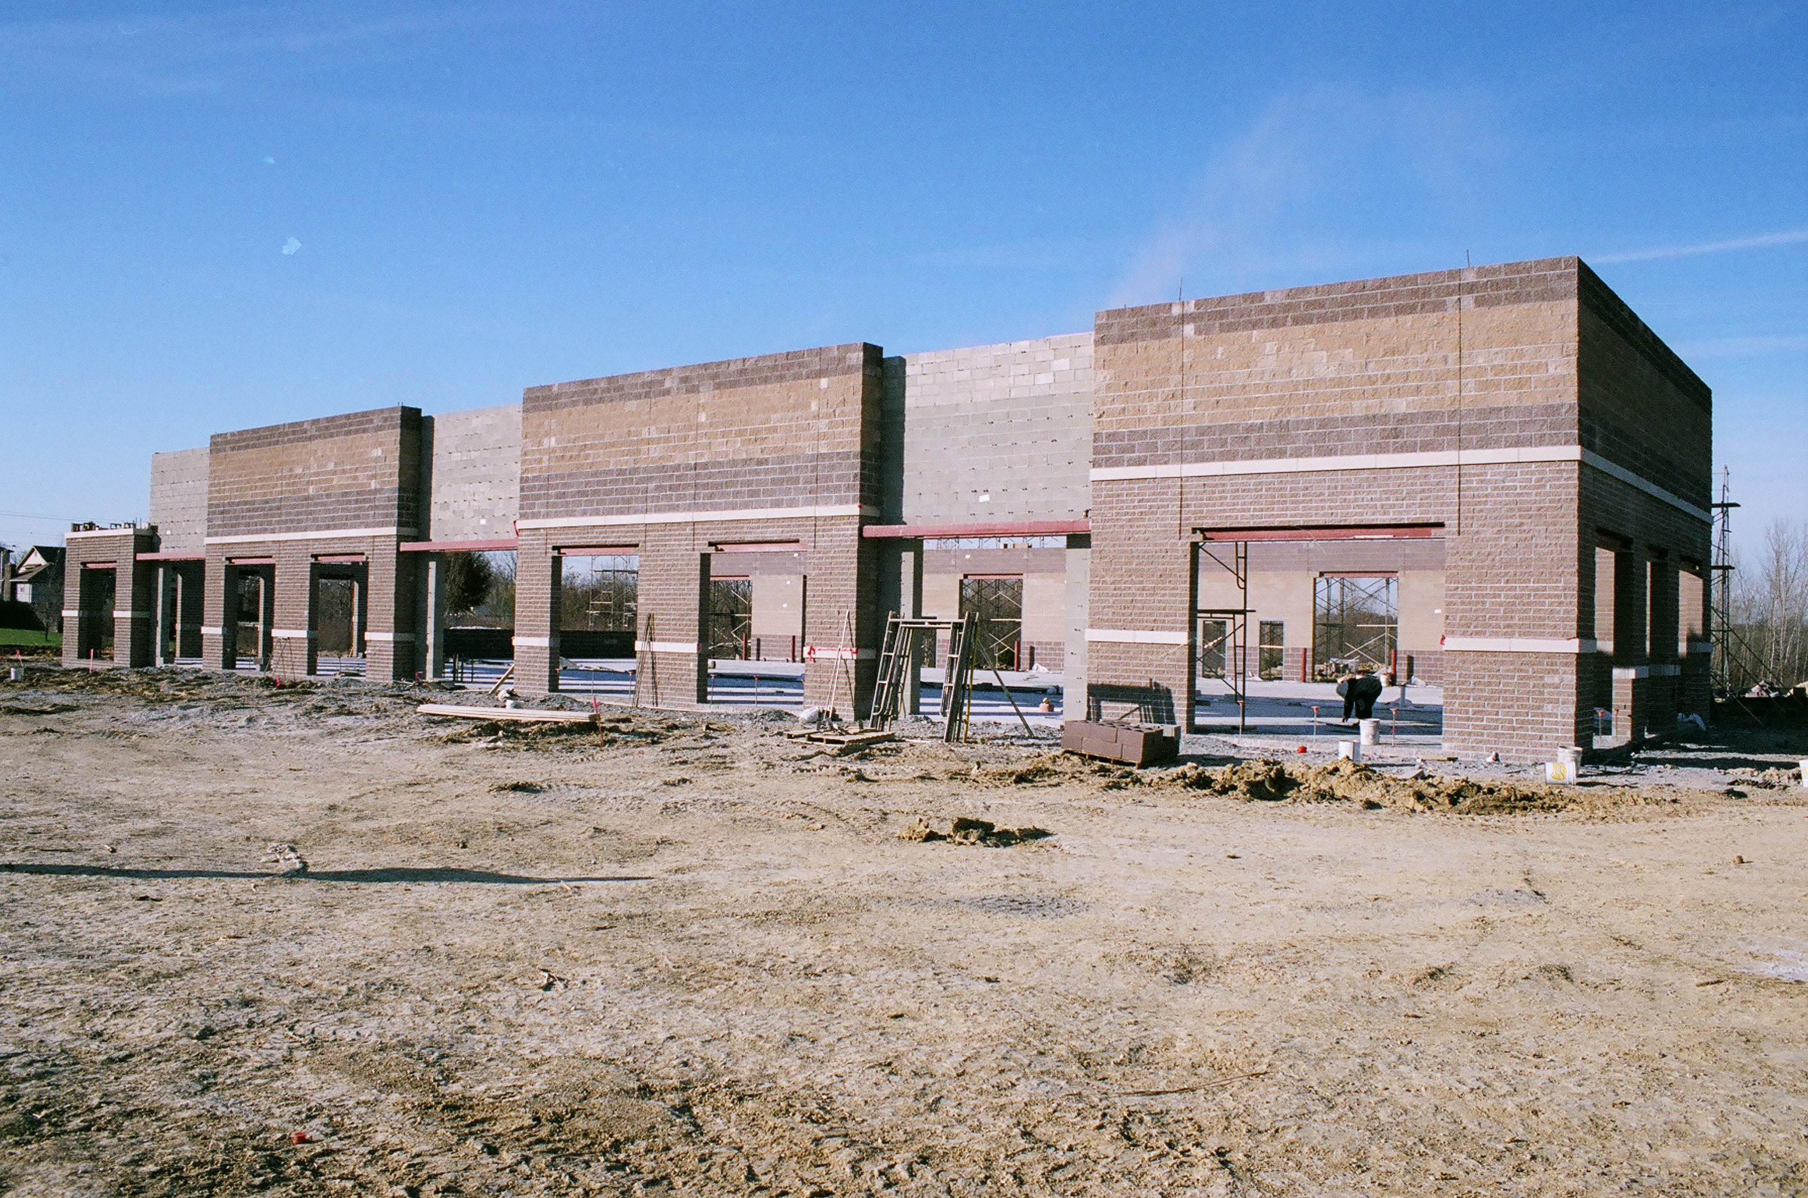
Who is eligible to purchase nutrient credits?
MS4 Permittees
Construction activities resulting in land disturbance ≥ 2,500 sq ft. must have a site-specific storm water pollution prevention plan. This includes single family homes!
Virginia Storm Water Management Program (VSMP) Permittees for Discharge associated with Construction Activities
Virginia Pollutant Discharge Elimination System (VPDES) Permittees for Discharges of Storm Water Associated with Industrial Activity
Bottom line: As part of VSMP, general construction permittees present biggest demand for nutrient credits and the majority of sales.
Notes:
Reasons- when the storm water program technical criteria (developed by VA DCR) transferred to DEQ and was implemented on July 1, 2014, there were changes to the criteria as part of the effort to meet the states WIP goals. Specifically, before these updates, water quality was monitored for only the first ½ inch of rain fall on impervious surfaces and now it is measured for first inch of rainfall over the entire drainage area. That doubles the measuring period for water quality. In addition, the threshold for P loading was for new development was reduced from 0.45 to 0.41 pounds per acre per year. In combination, these new criteria increased the need for BMPs, however post development management of BMPs are difficult for developments, especially as an environmental site design is not yet the model used by many developers. Therefore, developers are interested in permanent credits purchased offsite where they do not have to maintain the BMP in the future. Current credits are only for permanent practices (land use conversions).

Slide 10
Nutrient Trading: The Fundamentals
Step 6: Verification and Inspection
Annual report to DEQ by the owner of the nutrient credit generating-entity with confirmation of continued implementation and maintenance of practices.
- Recent photos of structural BMPs required.
Credit: Ecosystem Enterprise Partnership
Notes:
- Best management practices reduce nutrient loads to nearby streams, improving water quality as well as often providing co-benefits.
Once a farmer meets a certain threshold, or baseline, and continues to reduce the amount of nutrient runoff, the farmer may generate credits.
These credits may be purchased by eligible producers (non-point source or point source), offsetting their load reduction goals and improving local water quality

Slide 11
Chesapeake Forests programs improve the health of existing trees and forests, create new forests in places important to water quality and to watershed residents and promote the benefits of forests to the public and decision-makers – “help forests help us”

Slide 12
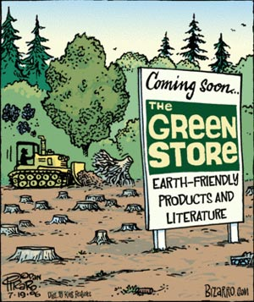
Forestland Base is Decreasing
500,000+ acres since 1977
2/3 due to development
Most from family-owned forestlands
Notes:
OVER HALF MILLION ACRES CONVERTED IN LAST 40 YEARS.
16,000 – 44 – 2
RATE OF CONVERSION IN THE WATERSHED IS ABOUT 70 ACRES PER DAY, OR ABOUT 26,000 ANNUALLY
2/3 CAN BE ATTRIBUTED TO RESIDENTIAL AND COMMERCIAL DEVELOPMENT
MOST FROM FAMILY-OWNED FORESTLAND.
THIS DECLINE PROJECTED TO CONTINUE IN VIRGINIA – LOSE ANOTHER ½ MILLION ACRES BY 2040.

Slide 13
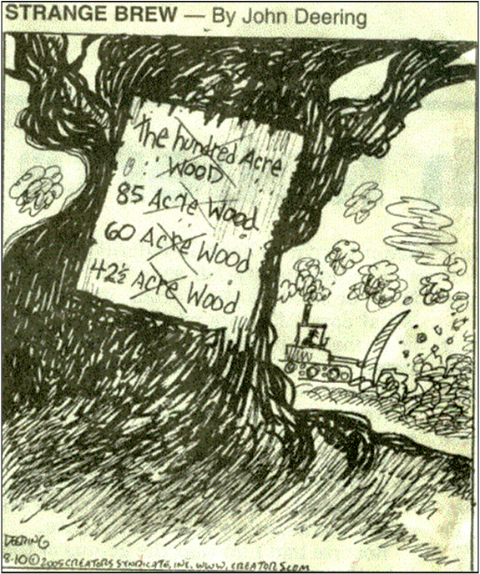
Family Forests Becoming More Fragmented
LESS THAN 100 ACRES:
  95% of ownerships
  47% of acreage
Average size:
  Parcel: 27 acres
  Ownership: <75 acres
Source: National Woodland Owner Survey
Notes:
REMAINING FAMILY FORESTLANDS ARE HIGHLY PARCELIZED AND FREAGMENTED - GETTING MORE SO WITH EACH PASSING GENERATION.
95% OF FFO OWNERSHIPS ARE LESS THAN 100A ACRES, WHICH ACCOUNTS FOR NEARLY HALF THE FOREST LAND BASE.
IN THE WHOLE WATERSHED, 70% OF ALL FFOs HOLD LESS THAN 10 ACRES OF LAND.
ON THE EDGE OF ECOLOGICAL AND ECONOMIC FUNCTIONALITY

Slide 14

Aged 65 and older
  27% of owners
  41% of land
Aged 55 and older
  59% of owners
  71% of land
Unprecedented future intergenerational transfer
Source: National Woodland Owner Survey
Notes:
IN VIRGINIA 59% OF FFOs ARE 55 OR OLDER. THAT FIGURE IS 70% IN THE ENTIRE WATERSHED.
IN THE NEXT 20 to 30 years, 7 MM ACRES IS POISED TO CHANGE HANDS – SAME CAN BE SAID OF THE ENTIRE WATERSHED.
THIS IS THREE-QUARTERS OF PRIVATELY OWNED FORESTLAND IN OUR STATE.
THE SHAPE THIS TRANSFER TAKES WILL GO A LONG WAY TO DETERMINE THE FUTURE OF VA’s FORESTS.
WHY IS THIS IMPORTANT? TWO BIGGEST DRIVERS:
ESTATE DISPOSAL – WELL DOCUMENTED CORRELATION BETWEEN INTERGENERATIONAL TRANSFER AND FRAGMENTATION. FRAGMENTATINO INCREASES EXPONENTIALLY WITH EACH PASSING GENERATION.
INCREASING PROPERTY TAXES – FIXED INCOME; LANDOWNER HAS TO SELL ALL OR A PIECE OF LAND TO COVER INCREASING PROPERTY TAXES.
FFOs WHO UNDERSTAND THE LONG-TERM EFFECTS OF THIS ARE MORE WILLING TO MAKE PLANS TO KEEP THE FAMILY FORESTLAND INTACT.

Slide 15
What FFOs Want
  Their land to stay in forest
  Their land to stay in the family
  Keep the family land intact
  Have no intention of selling
  Are concerned with property taxes
Source: National Woodland Owner Survey
Notes:
CONCERNS OF TODAY’S FFOs.
THEY WANT THEIR LAND TO STAY IN FOREST, INTACT and IN THE FAMILY.
THEY EXPRESS CONCERN REGARDING THE TWO BIGGEST DRIVERS OF FFO FRAGMENTATION.

Slide 16
Creates and conserves forest land.
Makes Conservation pay.
Promotes whole farm sustainability and best management practices.

Slide 17
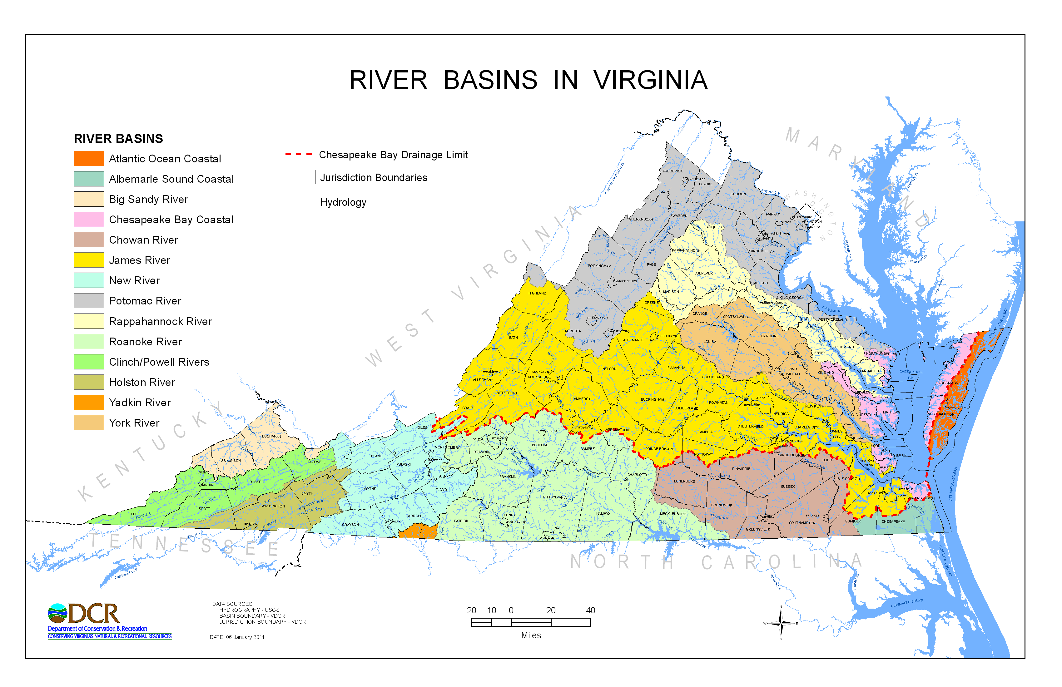
How much are credits selling for?
Potomac/Shenandoah:
$25,000 per pound of phosphorus (credit).
Rappahannock:
$15,000 per credit. 4 banks.
York:
$15,000 per credit. 5 banks.
Eastern Shore:
No banks.
James:
$8,000-15,000 per credit.
Notes:
Dashed red line on the map is the boundary for the Chesapeake bay watershed. Current market represents demand for phosphorus, not nitrogen, however nitrogen credits are retired with the purchase of phosphorus credits. The variability in credit value across basins reflects the loading reductions for each practice by basin (e.g., a greater reduction in phosphorus per acre of land converted to forest) and the market demand and saturation of banks. In the James there are a lot of banks (17 banks)! The rates are approximate and subject to change. York = 5 banks; Potomac/Shenandoah = 16 banks.

Slide 18
OK. But I’ve heard the nutrient market is stagnant. How many credits are really being traded?
From August 2008 to July 2014 (when new criteria for post-development water quality & quantity were implemented), approximately 300 lbs of P were traded through nonpoint source nutrient banks.
In 2015, approximately 100 lbs of P were traded per quarter, and 200 lbs of P in the last quarter, totaling approximately 500 lbs of P in 2015.
These numbers are huge for nonpoint sources!

Slide 19
Perceived Landowner Barriers to Entry
High upfront costs to establish nutrient credits.
Lack of reliable and easy-to-understand resources on the non-point source nutrient trading program.
Insufficient number of services providers in the region available to guide interested landowners through the process.
Risk of no economic return.

Slide 20
Perceived Landowner Barriers to Entry
High upfront costs to establish nutrient credits.
Lack of reliable and easy-to-understand resources on the non-point source nutrient trading program.
Insufficient number of services providers in the region available to guide interested landowners through the process.
Risk of no economic return.

Slide 21
Perceived Landowner Barriers to Entry
High upfront costs to establish nutrient credits.
Lack of reliable and easy-to-understand resources on the non-point source nutrient trading program.
Insufficient number of services providers in the region available to guide interested landowners through the process.
Risk of no economic return.
Notes:
Alliance for the Chesapeake Bay the only non-profit currently shepherding landowners through the credit generation process in Virginia. There are well qualified brokerage services in the state, however, even they are limited in their capacity to support landowners, especially in watersheds where they have competing banks in place.

Slide 22
Perceived Landowner Barriers to Entry
High upfront costs to establish nutrient credits.
Lack of reliable and easy-to-understand resources on the non-point source nutrient trading program.
Insufficient number of services providers in the region available to guide interested landowners through the process.
Risk of no economic return.
Notes:
Reasons for this risk-
1. Process of identifying a project

Slide 23
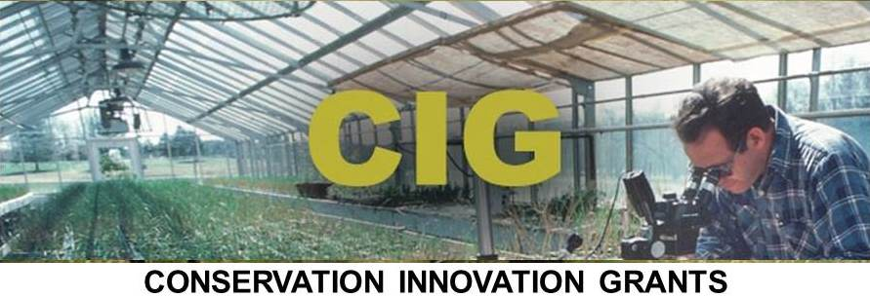

Sustainable Conservation Investment Fund:
An impact investment Approach for Chesapeake Farms and Forests

Slide 24
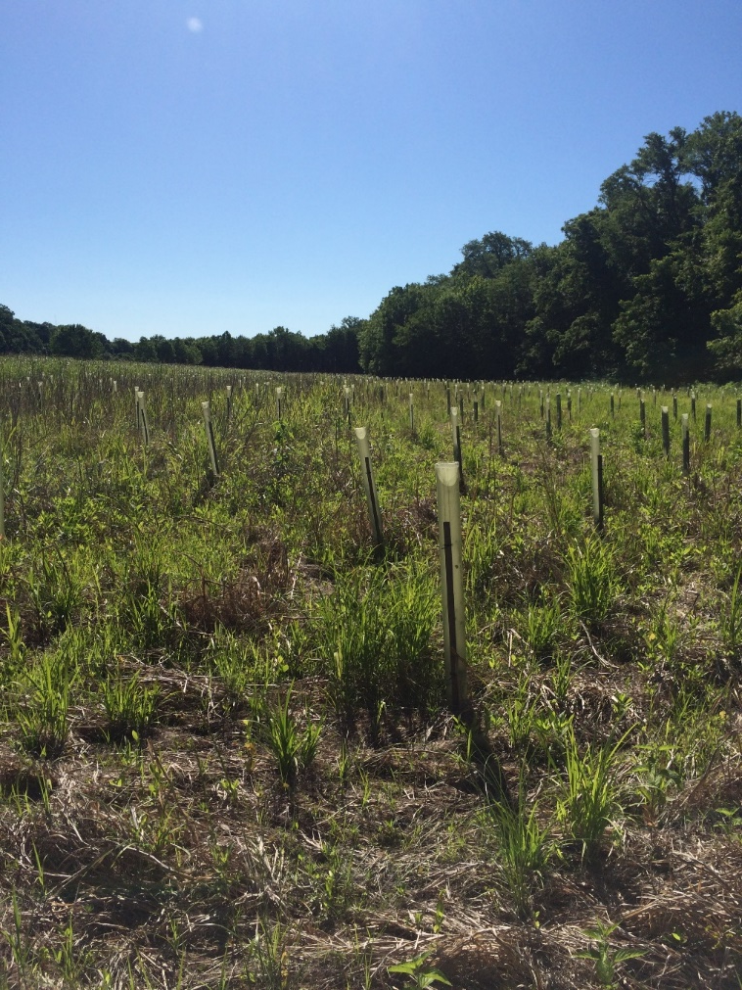
Beardog LLC Nutrient Bank
Property is a total of 2,070 acres.
Land use is a mix of abandoned pastures, cropland and mixed hardwoods as various successional stages.
967 acres of bottomland cropland along the James River.

Slide 25
Maryland Nutrient Trading Program
Everything still in draft form.
Schedule- proposed regulations are out for comment (early fall)
November 30th- public hearings
12/13/17- comment period ends
December 29th, 2017- can adopt the regulations
1/29/18- effect date of regulation

