Slide 1
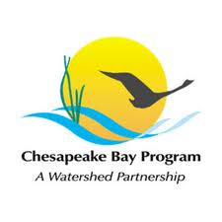
MID Atlantic
Education Workgroup
June 6, 2012 Full Workgroup Session

Slide 2
The Vision
We believe that citizen stewardship is the key to long-term success of protection and restoration efforts and that building a foundation for environmental literacy must begin in childhood.
To that end, the Education Workgroup works to ensure that elementary and secondary students in the Mid-Atlantic Region graduate environmentally literate with the tools they need to make informed choices to protect and restore local environments and the Chesapeake Bay.

Slide 3
Workgroup Purpose
Cross-jurisdictional coordination and support on all aspects of environmental education with an emphasis on:
Increasing Meaningful Watershed Educational Experiences (MWEE) and other place-based, outdoor education
Supporting training for teachers and environmental education professionals in content, pedagogy, and outdoor-learning techniques related to environmental topics
Encouraging green infrastructure and operations on school grounds
Supporting federal, state, and regional environmental literacy planning, including providing an ongoing forum to collaborate on the goals and objectives of the federal Executive Order and the nonprofit community Regional Roundtable.

Slide 4
What We’ve Accomplished Together
Shared definition of “meaningful” that created foundation for program development and funding
Consistent (and substantial!) funding –
NOAA B-WET, CBT
Environmental Literacy Plans – federal, state, affiliate
Biennial summits that engage high level audiences and raise the bar for EE
Online clearinghouse of resources – Bay Backpack
National reputation for excellence

Slide 5
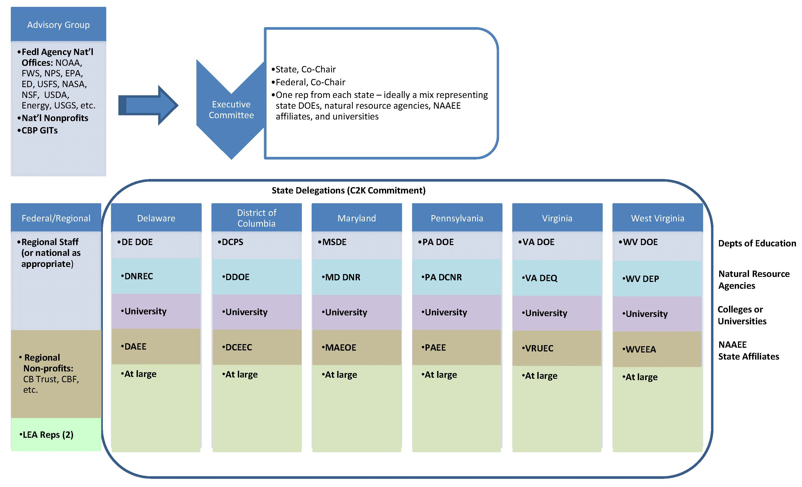
Membership

Slide 6
Now let’s hear from you!
Name, Organization, Position
Why are you here?
What do you hope that this regional workgroup can accomplish together?

Slide 7
Meeting Objectives
Introduce new Workgroup members
Discuss federal, state, and NAAEE affiliate environmental literacy efforts
Complete a draft of the Education Workgroup 2012-2013 Action Plan

