Slide 1
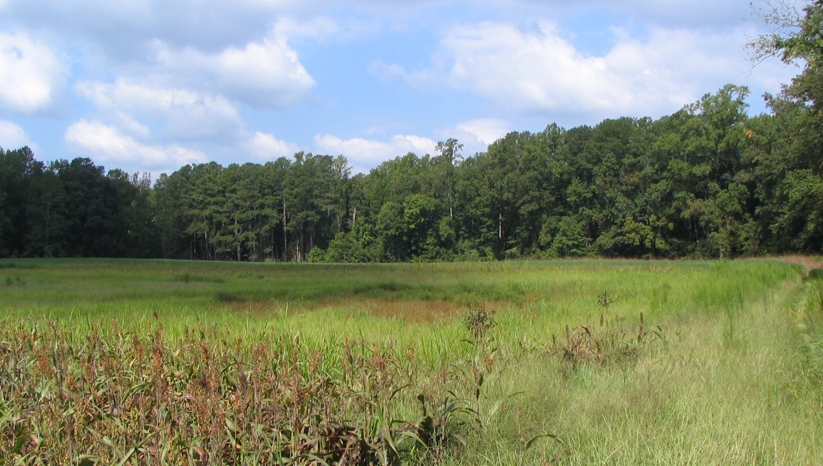
Wetland Expert Panel recommendations for Phase 6 Watershed Model
Pam Mason, Panel Chair, VIMS
Kathy Boomer, Panelist, TNC
Jeremy Hanson, Panel Coordinator, Virginia Tech
Photo courtesy of UMD-Extension

Slide 2
Overview
Recap and current status
What’s a “preliminary report?”
Crash course: Phase 5 Wetland Restoration BMP definition and methods
Overview of preliminary recommendations for calibration
Description of panel’s framework and reasoning for Phase 6 Wetland Restoration
Next steps and timeline
Questions and discussion

Slide 3
Recap and status
Fall 2014: Wetland expert panel convened, CWP coordinating
Spring 2015: Virginia Tech begins coordinating panel
Fall 2015: Partnership approves two nontidal wetland land uses for Phase 6 watershed model: Floodplain and Other
Today: Presenting “preliminary report”
September 30, 2016: Deadline for new partnership decisions/inputs for calibration of 4th-beta version of Phase 6 Watershed Model

Slide 4
What’s a “preliminary report?”
Agriculture Workgroup is using this same approach for some of its Phase 6 BMPs.
It takes 3+ months for a BMP panel report to go through sector workgroup, Watershed Technical Workgroup, and WQGIT. Phase 6 calibration schedule needs to stay on track.
Sector workgroup approves “preliminary report” to allow modelers to incorporate BMP efficiencies that will more closely resemble the final partnership-approved version of the BMPs.

Slide 5
Why do we need a preliminary report?
Current panel has developed definitions for the four wetland BMP categories it was asked to consider for Phase 6 (Restoration, Creation, Enhancement, Rehabilitation).
Re-establishment, establishment, and enhancement are confusingly lumped into Phase 5 “Wetland Restoration” practice for annual progress reporting.
We were only able to develop effectiveness estimates for one of the categories: Wetland Restoration (re-establishment). A new panel will need to provide effectiveness estimates for Creation, Enhancement and Rehabilitation.
The “preliminary report” proposes how to use the current Phase 5 efficiencies and assumptions as placeholder for acres of these 3 categories. The alternative is to “turn off” these categories for the calibration.

Slide 6
Summary: Request to the Wetland Workgroup
Consider the preliminary report and today’s presentation/discussion.
We welcome your questions and feedback.
You’ll be asked if you have any objections to the approach proposed in the preliminary report.

Slide 7
Phase 5 Wetland Restoration BMP
The Chesapeake Bay Program currently defines the agricultural wetland restoration best management practice (BMP) as:
Reestablishment (restore)—Manipulation of the physical, chemical, or biological characteristics of a site with the goal of returning natural/historic functions to a former wetland. Results in a gain in wetland acres.
Establishment (create)—Manipulation of the physical, chemical, or biological characteristics present to develop a wetland that did not previously exists on an upland or deepwater site.
Results in a gain in wetland acres.
The literature search for this practice focuses only the water quality benefits that wetlands provide and literature on the wildlife, mitigation wetlands, and natural wetlands are not considered.
A more broad-based definition is provided by the CBPO when wetland area or drainage area is unreported:
“Agricultural wetland restoration activities reestablish the natural hydraulic condition in a field that existed before the installation of subsurface or surface drainage. Projects can include restoration, creation and enhancement acreage. Restored wetlands can be any wetland classification including forested, scrub-shrub or emergent marsh.”

Slide 8
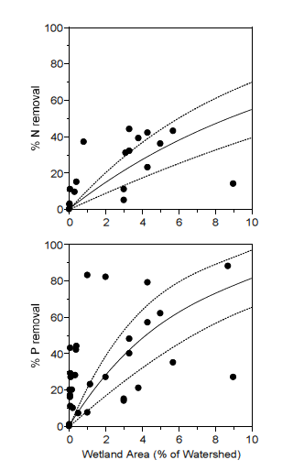
Phase 5 Wetland Restoration BMP
Geomorphic Province | TN Removal Efficiency | TP Removal Efficiency | TSS Removal Efficiency
Appalachian | 7% | 12% | 4%
Piedmont and Valley | 14% | 26% | 8%
Coastal Plain | 25% | 50% | 15%
Default, if HGM unknown | 16.75% | 32.18% | 9.82%
Reduction efficiencies based on kinetic equation for TN and TP; fit to literature data. Uniform 15% sediment rate set for sediment.
1%, 2% and 4% wetland area is assumed for each respective HGMR
Figure 2. Literature review data points for wetland nutrient removal efficiency based on the wetland area as a proportion of the watershed. (STAC 2008).

Slide 9
Overview of preliminary report

Slide 10
Basic bottom-line summary of proposal
Use panel’s definitions and categories for Phase 6 to replace Phase 5 “Wetland Restoration” BMP
For Phase 6 Wetland Restoration: Land use change plus apply panel’s new efficiency to new upland acre ratios. Update if changes made as result from review/approval process of full report.
For Phase 6 Wetland Creation: Land use change plus apply Phase 5 efficiencies using Phase 5 upland acre ratio (1:1 acres). Update based on future panel.
For Phase 6 Wetland Enhancement: Apply Phase 5 efficiencies using Phase 5 upland acre ratio (1:1). No land use change since it is a gain in function. Update based on future panel.
For Phase 6 Wetland Rehabilitation: Apply Phase 5 efficiencies using Phase 5 upland acre ratio (1:1). No land use change since it is a gain in function. Update based on future panel.

Slide 11
Wetland BMP category definitions
Proposed BMP Category | Proposed CBP Definition (for Phase 6 CBWM) | CBP will count the BMP acres as... | Practice and Project Examples (Disclaimer: Some of these practices may fit in more than one place, and this table will never be comprehensive. Wetland Workgroup feedback is welcome to improve usefulness of this table)
Restoration | Re-establish The manipulation of the physical, chemical, or biological characteristics of a site with the goal of returning natural/historic functions to a former wetland. | Acreage gain (toward Watershed Agreement outcome of 85,000 acre wetland gain and in Phase 6 annual progress runs) | Restore hydrology to prior-converted agricultural land (cropland or pasture); re-establishing needed vegetation on cropland with wetland hydrology; native wetland meadow planting; elevate subsided marsh and re-vegetate; ditch plugging on cropland; Legacy Sediment Removal NRCS Practice 657
Creation | Establish (or Create) The manipulation of the physical, chemical, or biological characteristics present to develop a wetland that did not previously exist at a site. | Acreage gain (toward Watershed Agreement outcome of 85,000 acre wetland gain and in Phase 6 progress runs) | Modifications to shallow waters or uplands to create new wetlands. Placement of fill material or excavation of upland to establish proper elevations for tidal wetland; Hydrologic measures such as impoundment, water diversion and/or excavation of upland to establish nontidal wetlands NRCS Practice 658

Slide 12
Wetland BMP category definitions
Enhancement | Enhance The manipulation of the physical, chemical, or biological characteristics of a wetland to heighten, intensify, or improve a specific function(s). | Function gain (toward 150,000 acre outcome and Phase 6 annual progress runs) | Flood seasonal wetland for waterfowl benefit; regulate flow velocity for increased nutrient uptake; invasive species removal NRCS Practice 659
Rehabilitation | Rehabilitate The manipulation of the physical, chemical, or biological characteristics of a site with the goal of repairing natural/historic functions to a degraded wetland. | Function gain (toward 150,000 acre outcome and Phase 6 annual progress runs) | Restore tidal flow to degraded wetland; ditch plugging in a forested wetland area; moist soil management*; invasive species removal, floodplain reconnection May include some NRCS Code 657 practices . *Moist soil management should only be counted if there are predominantly native wetland plants; and site can sustain itself as wetland without active management, meaning whether water control structure is operated or not.

Slide 13
How do reported practices in Phase 5 match with Phase 6? Table 3 is starting point.
BMP in current Phase 5 NEIEN appendix | Associated FSA or NRCS practice code, if applicable | Suggested wetland BMP using Phase 6 BMP definitions
CREP Wetland Restoration | CP23, 327, 657 | Wetland Restoration
Wetland and Buffer Restoration, Wetland Restoration |  | N/A
Wetland Buffer |  | N/A
Wetland Creation | 658 | Wetland Creation
Wetland Functional Gains - Enhanced | 659 | Wetland Enhancement
Wetland [Acreage] Gains - Established | 658 | Wetland Creation
Wetland [Acreage] Gains - Reestablished | 657 | Wetland Restoration
Wetland Restoration | 657 | Wetland Restoration
N/A |  | Wetland Rehabilitation

Slide 14
Placeholder functional gain wetland BMPs for Phase 6
For Functional Gain practices (Wetland Enhancement and Wetland Rehabilitation)
Type of reduction: Treatment of upland acres (1 acre treated per 1 acre enhanced or rehabilitated).
Frequency: Cumulative
Credit duration: 15 years (?)
Eligible P6 land use(s): Nontidal wetland – Floodplain; Nontidal wetland – Other
 | TN removal (%) | TP removal (%) | TSS removal (%) | Upland acres treated
Restoration* | 42 | 40 | 31 | See Table 4
Creation** | 16.75 | 32.18 | 9.82 | 1
Enhancement** | 16.75 | 32.18 | 9.82 | 1
Rehabilitation** | 16.75 | 32.18 | 9.82 | 1

Slide 15
Placeholder for Wetland Creation in Phase 6
Wetland Creation.
Type of reduction: This practice is a gain in acreage, so it is a land use change plus treatment of upland acres. Creation will treat 1 upland acre per acre of created wetland, using the current Phase 5 efficiencies as placeholder.
Frequency: Cumulative.
Credit duration: 15 years (current credit duration for Phase 5 Wetland Restoration)
Eligible land uses: All agricultural land uses and land use groups.
 | TN removal (%) | TP removal (%) | TSS removal (%) | Upland acres treated
Restoration* | 42 | 40 | 31 | See Table 4
Creation** | 16.75 | 32.18 | 9.82 | 1
Enhancement** | 16.75 | 32.18 | 9.82 | 1
Rehabilitation** | 16.75 | 32.18 | 9.82 | 1

Slide 16
Wetland Restoration for tidal areas: use existing Shoreline Management BMP
Tidal restoration practices will be credited in estuarine model, not the Watershed Model. Tidal re-establishment TN, TP and TSS reductions will be reported as Shoreline Management using protocols 2, 3 and 4:
 |  | TN (lbs/ac) | TP (lbs/ac) | TSS (lbs/ac)
Protocol 2 – Denitrification | Acres of re-vegetation | 85 | NA | NA
Protocol 3 - Sedimentation | Acres of re-vegetation | NA | 5.289 | 6,959
Protocol 4 – Marsh Redfield Ratio | Acres of re-vegetation | 6.83 | 0.3 | NA
Sum of protocols 2-4 | Acres | 91.83 | 5.589 | 6,959

Slide 17
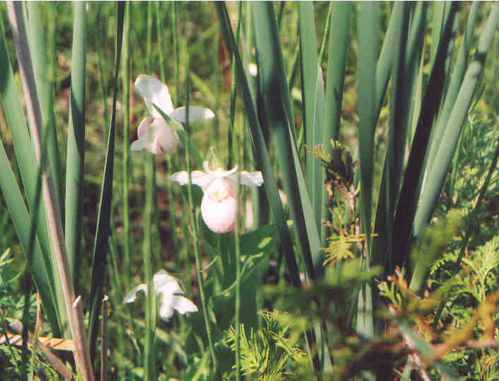
Proposed Summary of Wetland BMP Function across the Chesapeake Bay Watershed
Kathy Boomer, Judy Denver, Steve Strano, Ken Staver

Slide 18
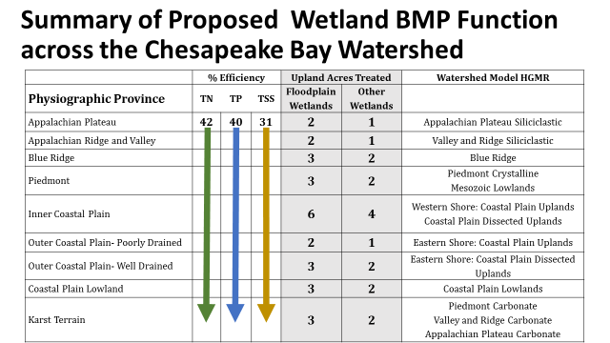
Summary of Proposed Wetland BMP Function across the Chesapeake Bay Watershed
Review Evolution of Panel’s Approach
Summary of Current, Paradigms Related to Wetland WQ Function
Logic Framework behind Proposed Wetland BMP Efficiencies

Slide 19
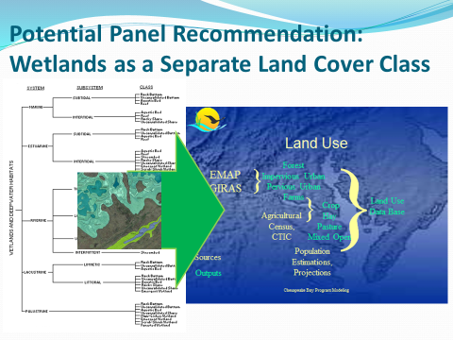
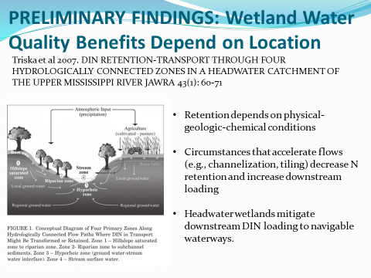
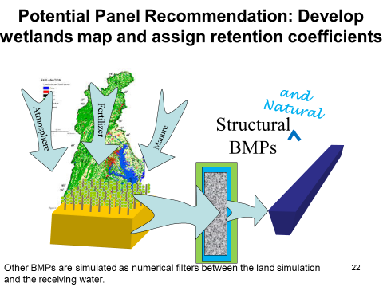
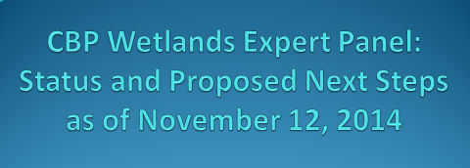
Modeling Wetland BMP Function across the Chesapeake Bay Watershed

Slide 20
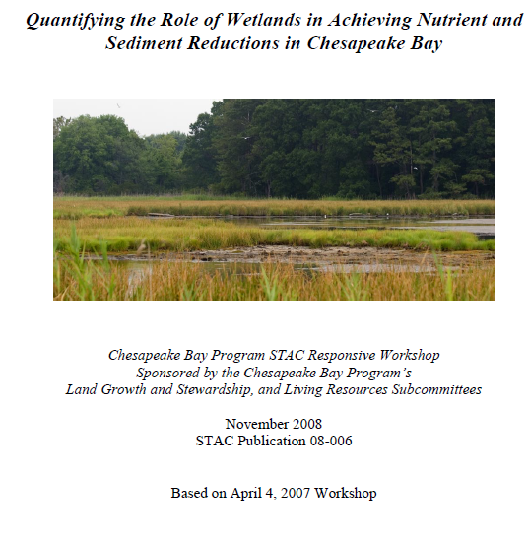
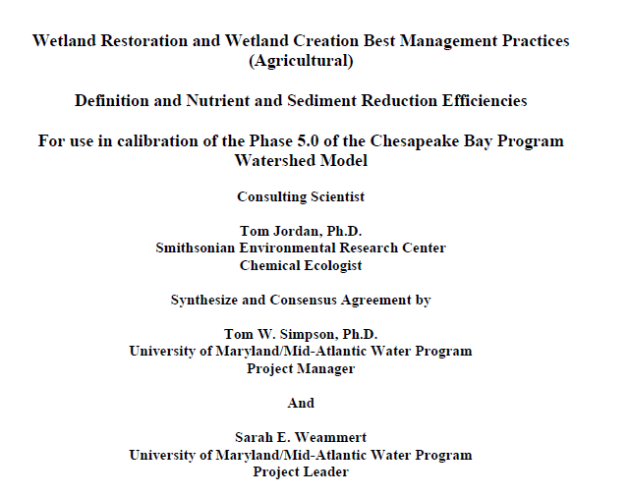
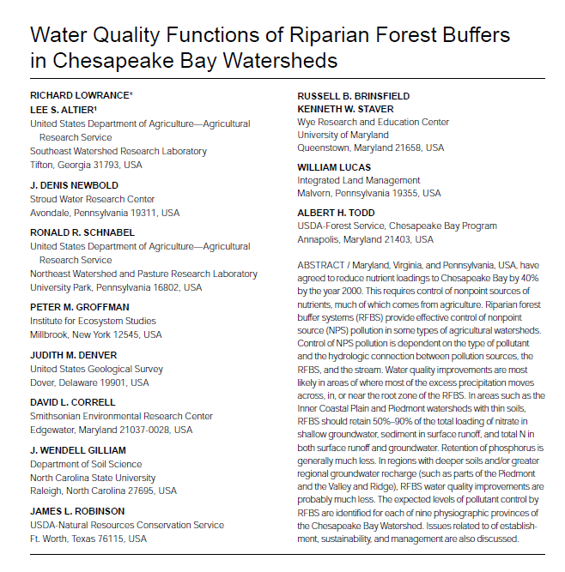
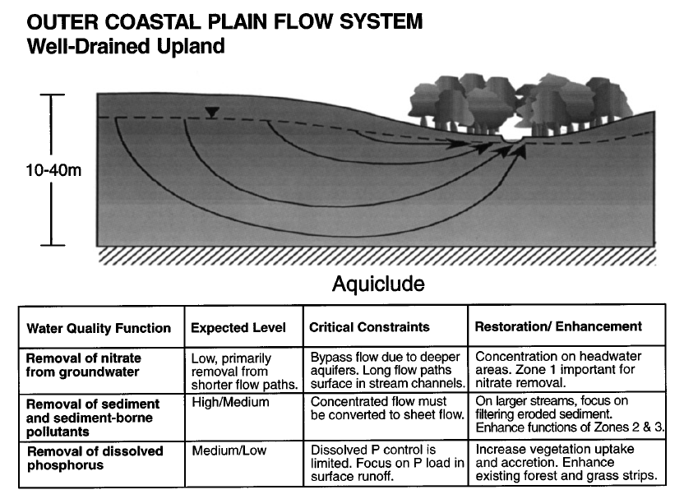
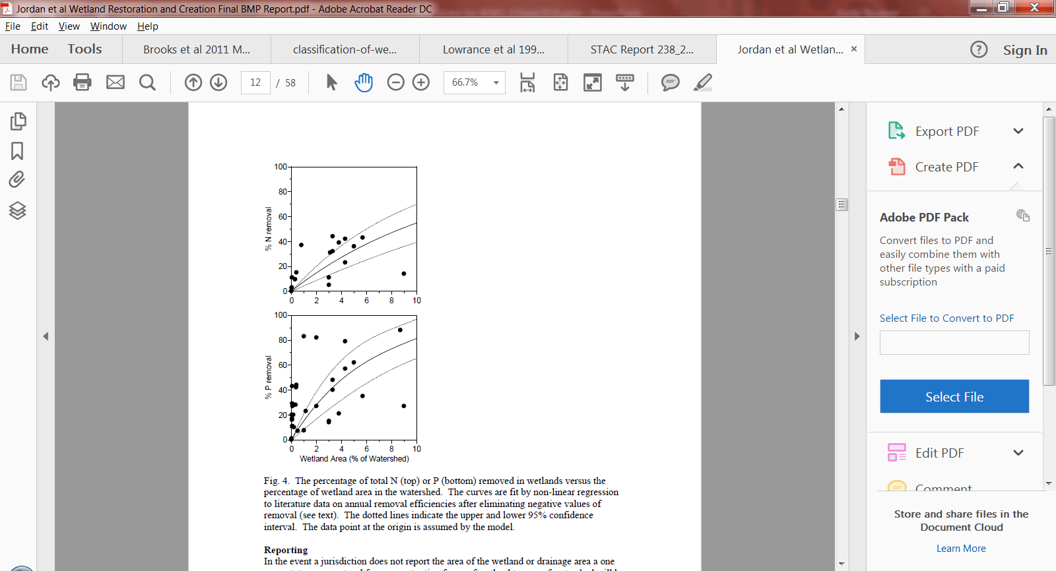
Modeling Wetland Function across the Chesapeake Bay Watershed: Current Paradigms
Geomorphic Province | TN Removal Efficiency | TP Removal Efficiency
Appalachian | 7% | 12%
Piedmont | 14% | 26%
Coastal Plain | 25% | 50%

Slide 21
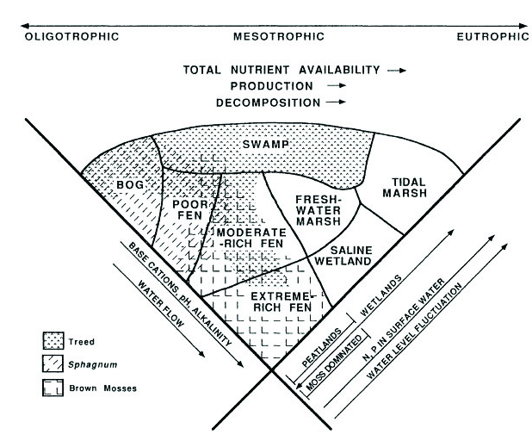
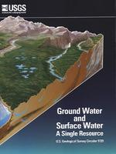
Modeling Wetland Function across the Chesapeake Bay Watershed: Current Paradigms
Zoltai and Vitt 1995
Brinson 1993
Winter 1998

Slide 22
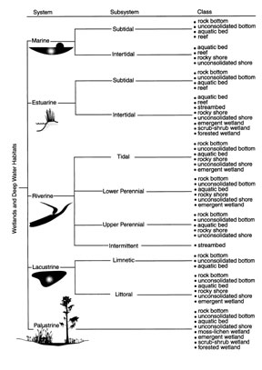
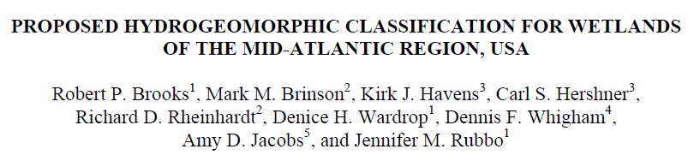
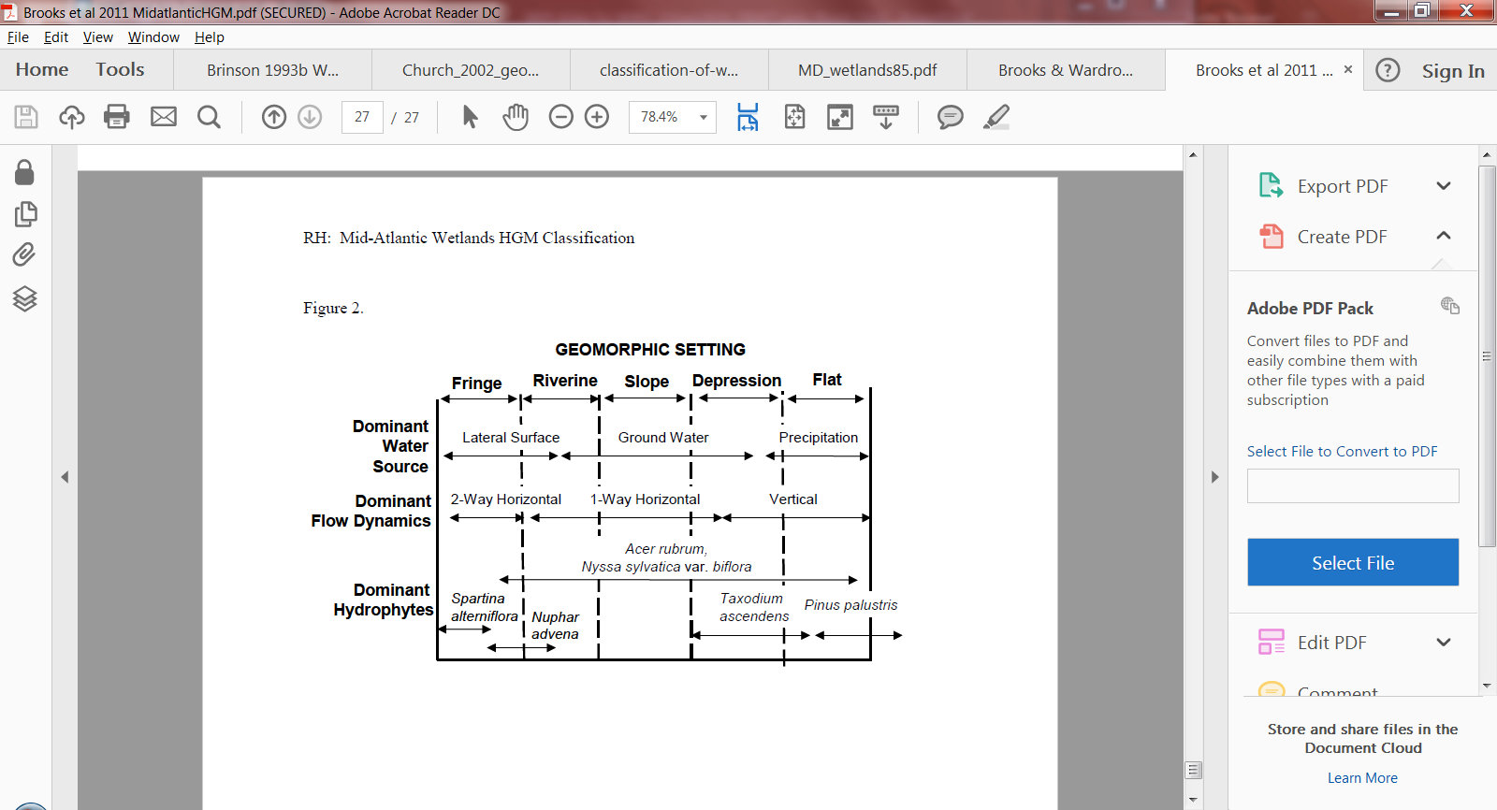
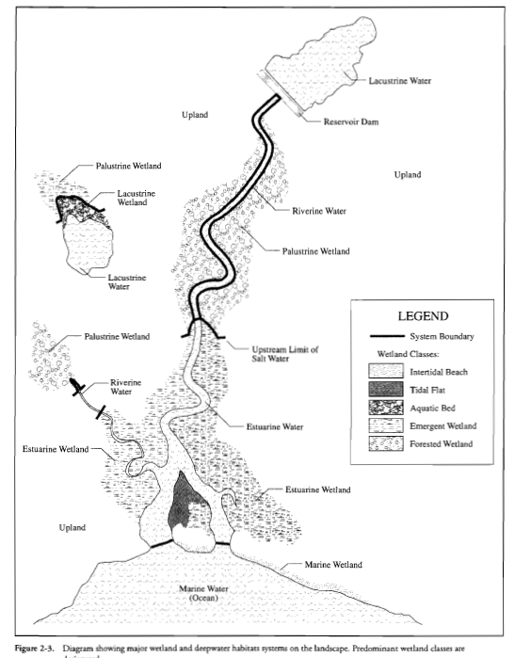
Modeling Wetland Function across the Chesapeake Bay Watershed: Current Paradigms
2011
Cowardin et al 1979

Slide 23
Logic Framework behind Proposed Wetland BMP Efficiencies
‘Other’ Wetlands
Floodplain Wetlands

Slide 24
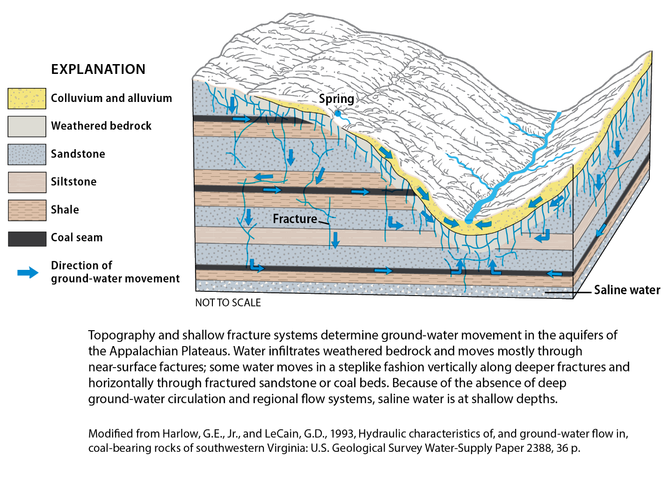
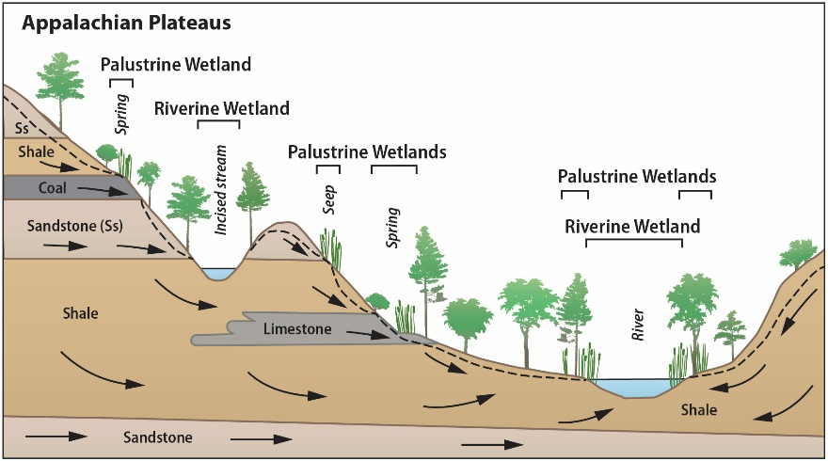
Appalachian Plateau
Sloping
Sloping riparia
Sloping
Floodplain

Slide 25
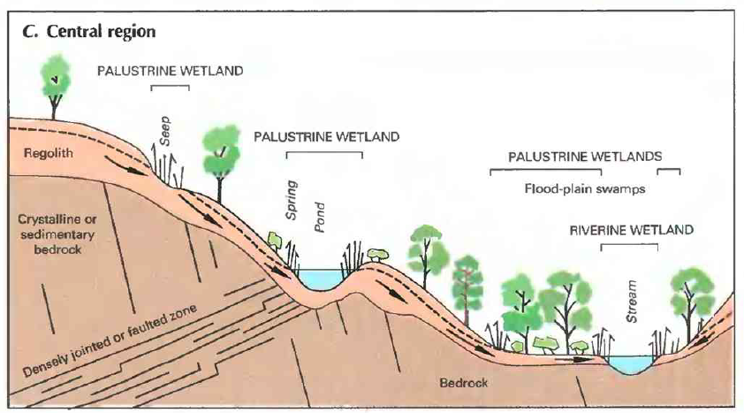
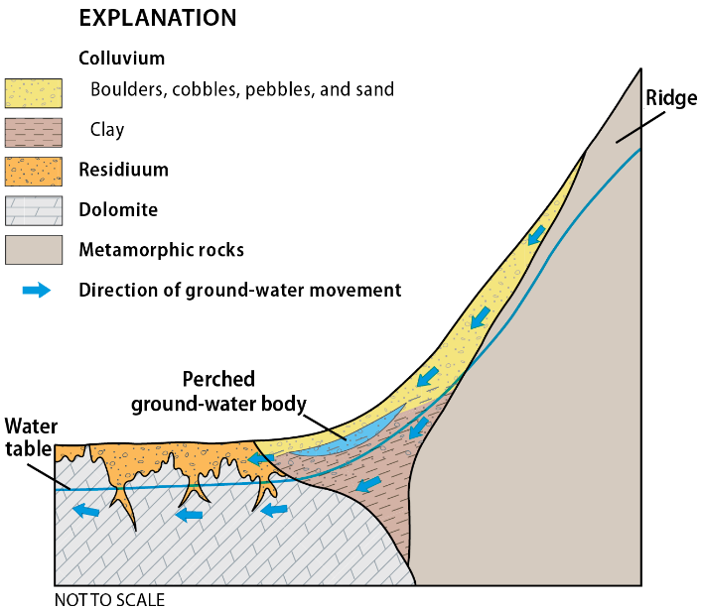
Ridge and Valley
Modified from Nutter, L.J., 1974a, Hydrogeology of Antietam Creek Basin: U.S. Geological Survey Journal of Research, v. 2, p. †249-252.
Modified from Fretwell et al 1996. National Water Summary on Wetland Resources. USGS Water-Supply Paper 2425.

Slide 26
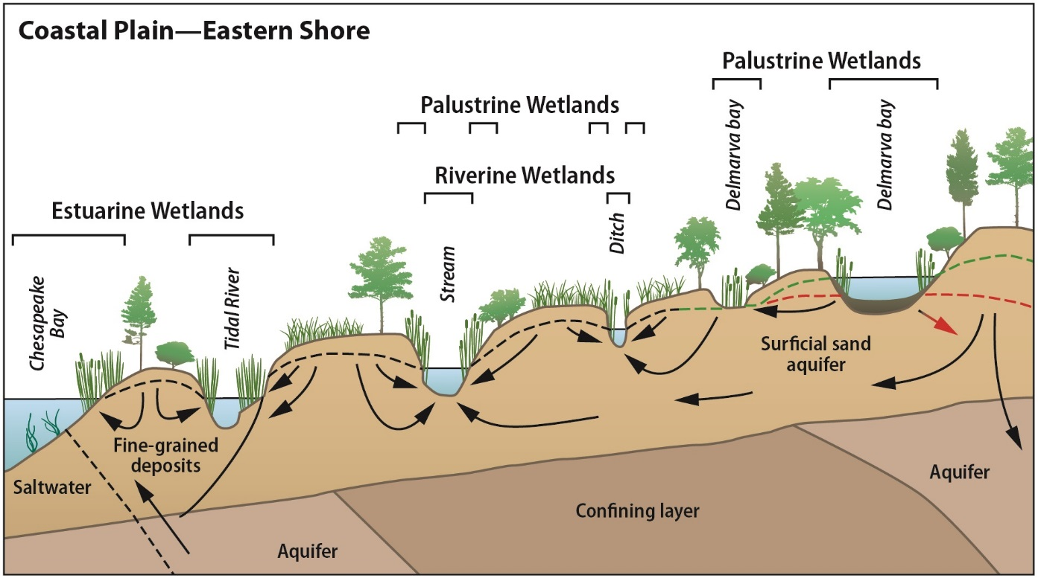
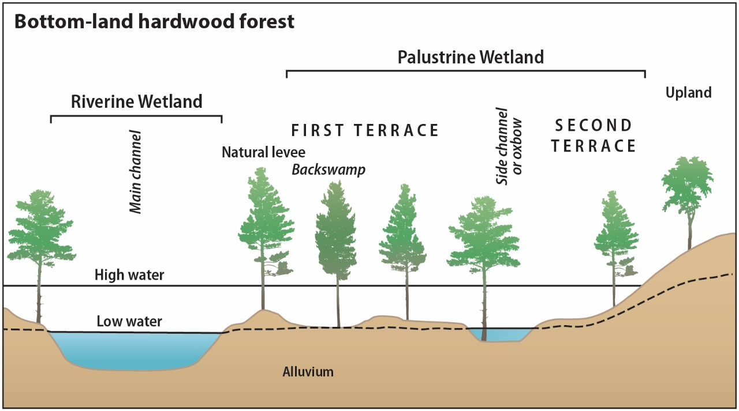
Coastal Plain

Slide 27
Logic Framework: Wetland Forms and Distributions across the Chesapeake Bay Watershed
Physiographic Province | Other Wetlands |  |  | Floodplain Wetlands
 | Flats | Depressional Wetlands | Sloping Wetlands
Appalachian Plateau |  | -moraine depressions | Aquifer outcrops Small tributary riparia | -valley floors, above bedrock outcrops
Appalachian Ridge & Valley |  | Aquifer outcrops Fractured rock springs | Small tributary riparia Slope breaks | - Medium to large waterways
Blue Ridge |  | Ridgetops | Fractured bedrock outcrops Riparia | Tributary confluences - Medium to large waterways
Piedmont |  |  | Fractured bedrock outcrops riparia | Eroded stream/river terraces
Inner Coastal Plain |  |  | - Small streams, floodplain edges | Small to large waterways
Outer Coastal Plain - Poorly drained uplands | Watershed divides | Watershed divides | - Small (natural and artificial) tributary riparia | Small to large waterways
Outer Coastal Plain - - Well drained uplands |  |  | - Small tributary riparia | Small to large waterways
Coastal Plain Lowlands | Watershed divides |  | - Small (natural and artificial) tributary riparia | Bottom lands
Karst terrain Appalachian Plateau Appalachian Ridge & Valley Piedmont |  | Tubular springs | Outcrops, slope breaks, springs

Slide 28
Logic Framework: Wetland WQ Function Decomposition f(initial concentration, reaction rate)
Retention Efficiency Factors:
Amount/rate of contamination in inflow (surface- and ground-waters)
portion of contaminated water that actually intersects carbon-rich substrate rather than by-passing wetland system
soil carbon availability
water chemistry, temperature
Initial concentration
Decomposition
Rate (Efficiency)

Slide 29
Wetland WQ Function: Reaction Rate ~ BMP Efficiency
TN removal (%) | TP removal (%) | TSS removal (%)
42 | 40 | 31
Mean reduction efficiency from literature (excluding constructed wetlands). Average of 36 values for TN; 64 for TP, and 15 for sediment.

Slide 30
Wetland WQ Function: Initial Concentration ~ f(impacted acres and wetland hydrologic connectivity)
Physiographic Province | Other Wetlands |  |  | Floodplain Wetlands
 | Flats | Depressional Wetlands | Sloping Wetlands
Appalachian Plateau |  | L – variability in hydrologic settings & predominant forest cover | L – confined aquifer discharge not likely contaminated | L - predominant forest cover and greater likelihood of hyporheic exchange rather than wetland discharge
Appalachian Ridge & Valley |  | L – small contributing area; predominant forest cover | L – confined aquifer discharge not likely contaminated; predominant forest cover | L - predominant forest cover and greater likelihood of hyporheic exchange rather than wetland discharge
Blue Ridge |  | L – small contributing area; predominant forest cover | H - Surficial aquifer and heavy human impacts | M – Incised, more infrequent events; potential deep aquifer by-pass
Piedmont |  |  | M - Surficial aquifer and heavy human impacts | M – Incised, more infrequent events; potential deep aquifer by-pass
Inner Coastal Plain |  |  | H - Surficial aquifer and heavy human impacts | H – well connected, more frequently flooded
Outer Coastal Plain - Poorly drained uplands | L – small contributing area; flat hydraulic gradient predominant forest cover | L – small contributing area; flat hydraulic gradient predominant forest cover | M – Small contributing area, but surficial aquifer important and heavily influenced by human impacts | M – well connected, frequently flooded but potentially limited exchange due to flat hydraulic gradients
Outer Coastal Plain - - Well drained uplands |  |  | L – Deep aquifers with strong potential to bypass contaminated waters | H – well connected, more frequently flooded
Coastal Plain Lowlands | L – small contributing area; flat hydraulic gradient predominant forest cover |  | H – well connected, more frequently flooded | M – well connected, frequently flooded but potentially limited exchange due to flat hydraulic gradients
Karst terrain* Appalachian Plateau Appalachian Ridge & Valley Blue Ridge & Valley |  | H – Strong potential for contaminated discharge. | M – Strong potential for contaminated discharge, but potential for rapid flow-through & short contact time | L/M – see floodplain descriptions above, respectively

Slide 31
Wetland WQ Function: Initial Concentration ~ f(impacted acres and wetland hydrologic connectivity)
Physiographic Province | Other Wetlands | Floodplain Wetlands
Appalachian Plateau | 1 | 2
Appalachian Ridge & Valley | 1 | 2
Blue Ridge | 2 | 3
Piedmont | 2 | 3
Inner Coastal Plain | 4 | 6
Outer Coastal Plain - Poorly drained uplands | 1 | 2
Outer Coastal Plain - - Well drained uplands | 2 | 3
Coastal Plain Lowlands | 2 | 3
Karst terrain* Appalachian Plateau Appalachian Ridge & Valley Blue Ridge & Valley | 2 | 3

Slide 32
Wetland WQ Function: Initial Concentration ~ f(impacted acres and wetland hydrologic connectivity)
Physiographic Province | Other Wetlands | Floodplain Wetlands | Lowrance et al 1997 TN, TP, TSS
Appalachian Plateau | 1 | 2
Appalachian Ridge & Valley | 1 | 2 | Sandstone/shale: M/H, H/M, M/L Valleys: MH, H/M, M/L
Blue Ridge | 2 | 3
Piedmont | 2 | 3 | Thin Soils, Shales: H, H/M, M/L Schist/Gneiss: M, H/M, M/L
Inner Coastal Plain | 4 | 6 | H,H/M, M/L
Outer Coastal Plain - Poorly drained uplands | 1 | 2 | M/H, H/M, M/L
Outer Coastal Plain - - Well drained uplands | 2 | 3 | L, H/M, M/L
Coastal Plain Lowlands | 2 | 3 | L/M, H/M, M/L
Karst terrain* Appalachian Plateau Appalachian Ridge & Valley Blue Ridge & Valley | 2 | 3 | L, H/M, M/L

Slide 33
Wetland WQ Function: Initial Concentration ~ f(impacted acres and wetland hydrologic connectivity)
Physiographic Province | Other Wetlands | Floodplain Wetlands | Lowrance et al 1997 TN, TP, TSS
Appalachian Plateau | 1 | 2
Appalachian Ridge & Valley | 1 | 2 | Sandstone/shale: M/H, H/M, M/L Valleys: MH, H/M, M/L
Blue Ridge | 2 | 3
Piedmont | 2 | 3 | Thin Soils, Shales: H, H/M, M/L Schist/Gneiss: M, H/M, M/L
Inner Coastal Plain | 4 | 6 | H,H/M, M/L
Outer Coastal Plain - Poorly drained uplands | 1 | 2 | M/H, H/M, M/L
Outer Coastal Plain - - Well drained uplands | 2 | 3 | L, H/M, M/L
Coastal Plain Lowlands | 2 | 3 | L/M, H/M, M/L
Karst terrain* Appalachian Plateau Appalachian Ridge & Valley Blue Ridge & Valley | 2 | 3 | L, H/M, M/L
Other wetlands with low treatment potential due to small contributing area predominanted by forest and/or strong potential for contaminated water to by-pass the wetlands: 1 ACRE
Other wetlands with high treatment potential, located in heavily impacted watersheds and having strong likelihood for hydrologic contact: 4 ACRES
All other wetlands: 2 ACRES
Floodplain wetlands with additional overbank delivery: 150% of Other

Slide 34
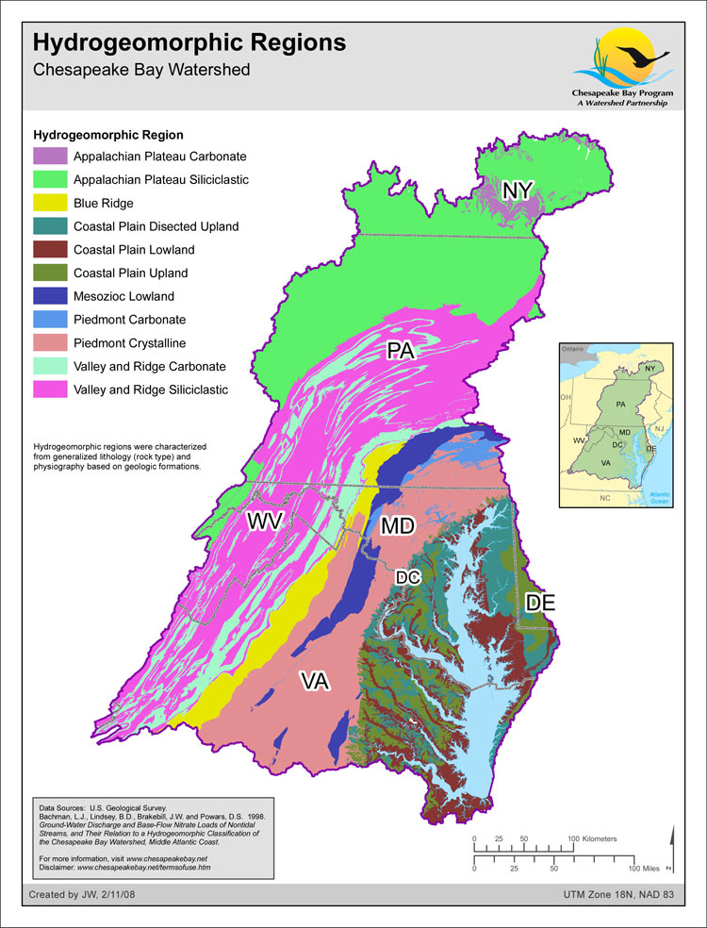
Physiographic subregions for non-tidal wetland restoration
Physiographic Subregion described by panel | Watershed Model HGMR(s)
Appalachian Plateau | Appalachian Plateau Siliciclastic
Appalachian Ridge and Valley | Valley and Ridge Siliciclastic
Blue Ridge | Blue Ridge
Piedmont | Piedmont Crystalline Mesozoic Lowlands
Inner Coastal Plain | Western Shore: Coastal Plain Uplands Coastal Plain Dissected Uplands
Outer Coastal Plain- Poorly Drained | Eastern Shore: Coastal Plain Uplands
Outer Coastal Plain- Well Drained | Eastern Shore: Coastal Plain Dissected Uplands
Coastal Plain Lowland | Coastal Plain Lowlands
Karst Terrain | Piedmont Carbonate Valley and Ridge Carbonate Appalachian Plateau Carbonate

Slide 35
Summary of Proposed Wetland BMP Function across the Chesapeake Bay Watershed
 | % Efficiency |  |  | Upland Acres Treated |  | Watershed Model HGMR
Physiographic Province | TN | TP | TSS | Floodplain Wetlands | Other Wetlands
Appalachian Plateau | 42 | 40 | 31 | 2 | 1 | Appalachian Plateau Siliciclastic
Appalachian Ridge and Valley |  |  |  | 2 | 1 | Valley and Ridge Siliciclastic
Blue Ridge |  |  |  | 3 | 2 | Blue Ridge
Piedmont |  |  |  | 3 | 2 | Piedmont Crystalline Mesozoic Lowlands
Inner Coastal Plain |  |  |  | 6 | 4 | Western Shore: Coastal Plain Uplands Coastal Plain Dissected Uplands
Outer Coastal Plain- Poorly Drained |  |  |  | 2 | 1 | Eastern Shore: Coastal Plain Uplands
Outer Coastal Plain- Well Drained |  |  |  | 3 | 2 | Eastern Shore: Coastal Plain Dissected Uplands
Coastal Plain Lowland |  |  |  | 3 | 2 | Coastal Plain Lowlands
Karst Terrain |  |  |  | 3 | 2 | Piedmont Carbonate Valley and Ridge Carbonate Appalachian Plateau Carbonate

Slide 36
Wetland Type | Vegetation Type | TN % Reduction Mean Range Median (#) | TP % Reduction | TSS % Reduction
Headwater/ Depressional | ALL | 33% -8-97 34% (9) | 25% -15-94 10% (13) | 28% -30-75% 37% (6)
Floodplain | ALL | 44% -8-94 38% (24) | 37% -41-100 29% (24) | 32% -15-95 14% (7)
All except constructed | Forest, mixed and unknown | 47% -8-97 59% (16) | 45% -47-100 43% (44) | 37% -15-95 32% (8)
All except constructed | Emergent | 39% -8-89 36% (20) | 31% -15-100 30% (20) | 25% -30-75 27% (7)
All except constructed | ALL | 42% -8-97 39% (36) | 40% -47-100 41% (64) | 31% -30-95 27% (15)

Slide 37
Other components that will be provided in full report (forthcoming)
Land use recommendations
Accountability: Tracking, reporting and verification
Potential unintended consequences and qualifying conditions
Future research and management needs

Slide 38
Next steps
Discuss suggested placeholder framework
Reach workgroup agreement on placeholder framework prior to September 30 deadline
Full report will be released soon; will have full 30-day comment period and webinars

Slide 39
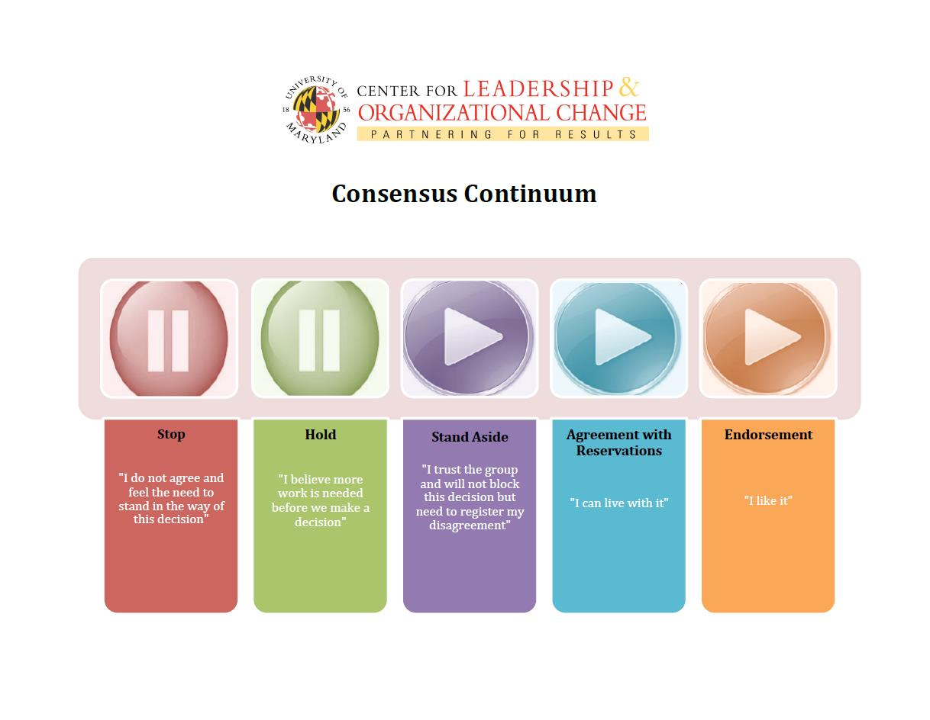

Slide 40
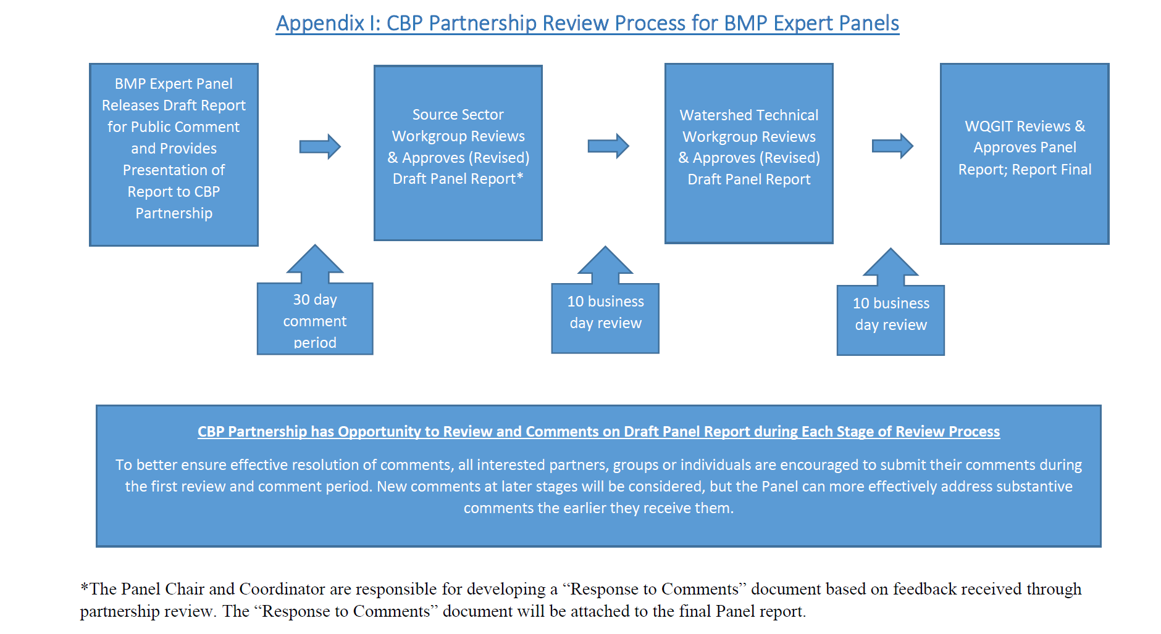

Slide 41
Timeline (tentative and subject to change)
September 15: Discuss preliminary recommendations and seek approval before September 30 deadline
Mid-September: Full report available for review and comment
October: Host webinar with Wetland Workgroup for detailed discussion of recommendations
Mid- to late-October: Begin initial 30-day comment period; host open webinar
Late November: 30-day comment period ends
Mid-December: Seek Wetland Workgroup approval
January: Brief AgWG and seek WTWG approval
February: Seek WQGIT approval

Slide 42
Thank you!
Contact Jeremy with any questions or comments
jchanson@vt.edu
410-267-5753

