Slide 1
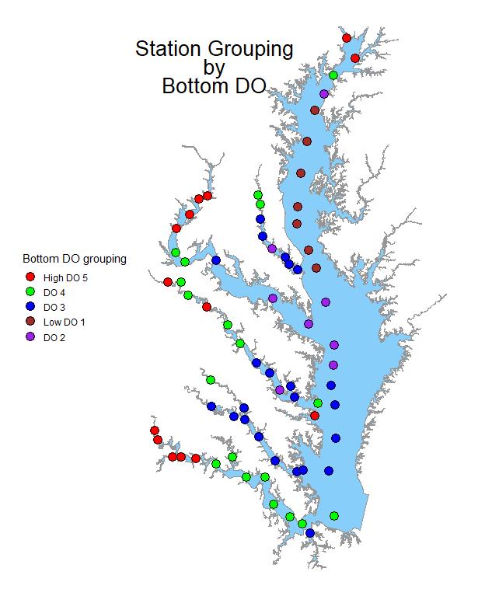
Western Tributary—Cluster analysis of GAM2 results
Integrated Trends and Analysis Team
September 29, 2021
Elgin Perry
w/ support from Tetra Tech

Slide 2
Western Tributary—Cluster analysis of GAM2 results
Purpose
  Compare temporal trends across tributaries to identify meaningful spatial patterns to inform tributary summaries
Methodology
  GAM2 (baytrends): 75 stations | 1994-2018 | All Seasons
    Using baytrends, GAM2 fits a non-linear smooth spline function to the long-term data over time. There is no flow-adjustment with this model.
  Parameters: Bottom DO | SAP Chla/TN/TP | Secchi
  Cluster analysis of full GAM2 time series for each parameter
    This approach is in lieu of applying cluster analysis to single point estimates of baseline or current means
Results
  Preliminary observations
Discussion
  Reflection on preliminary observations
  Next Steps
    Refined methodology
    Opportunities for further engagement

Slide 3
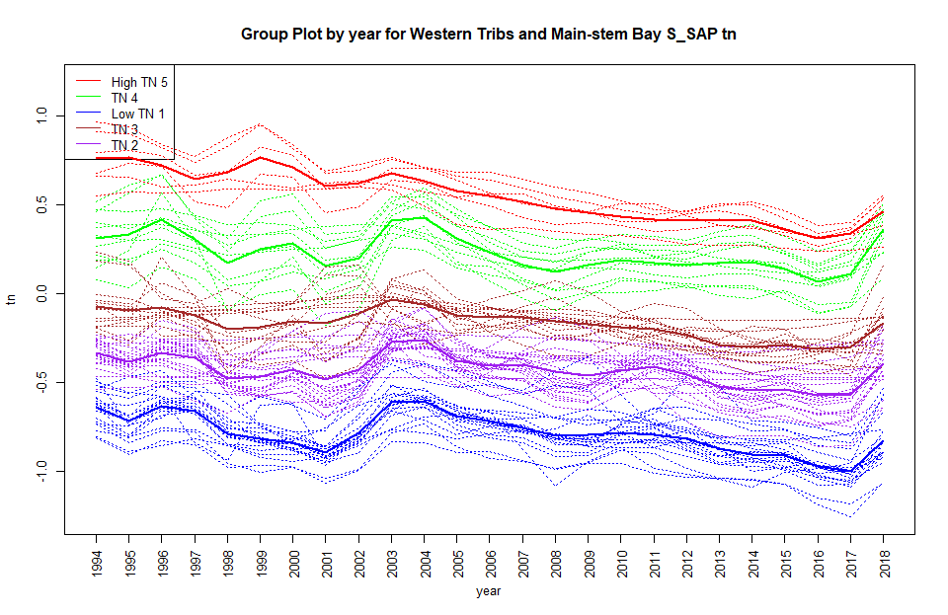
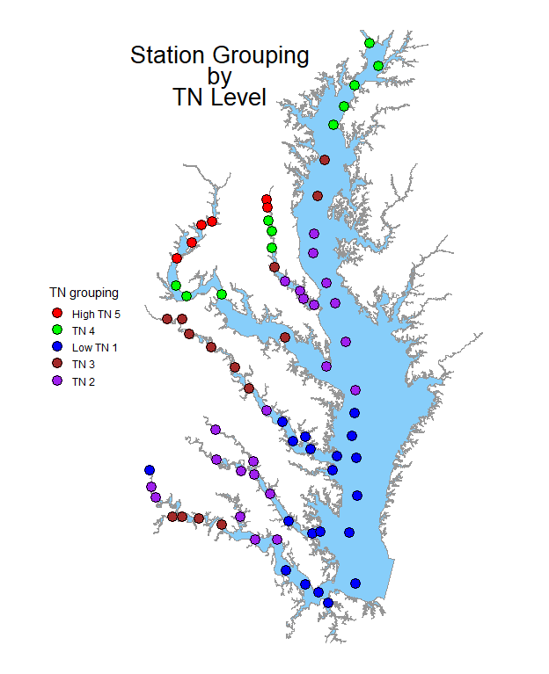
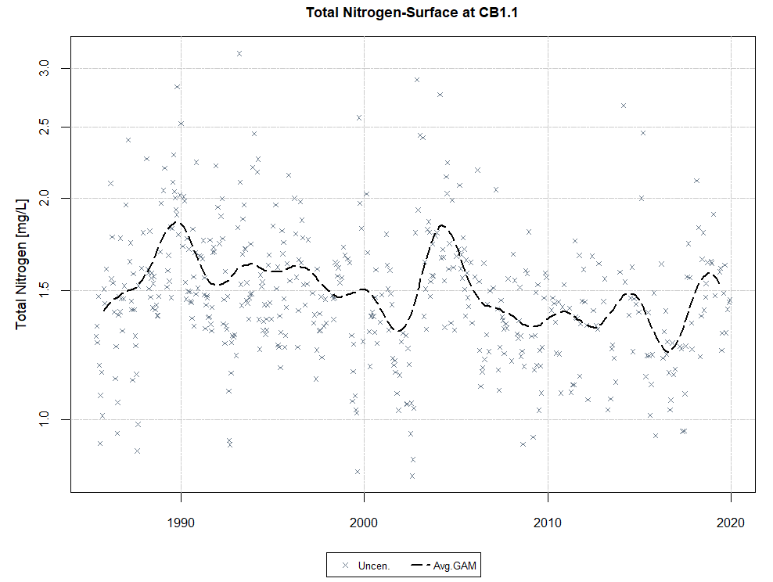
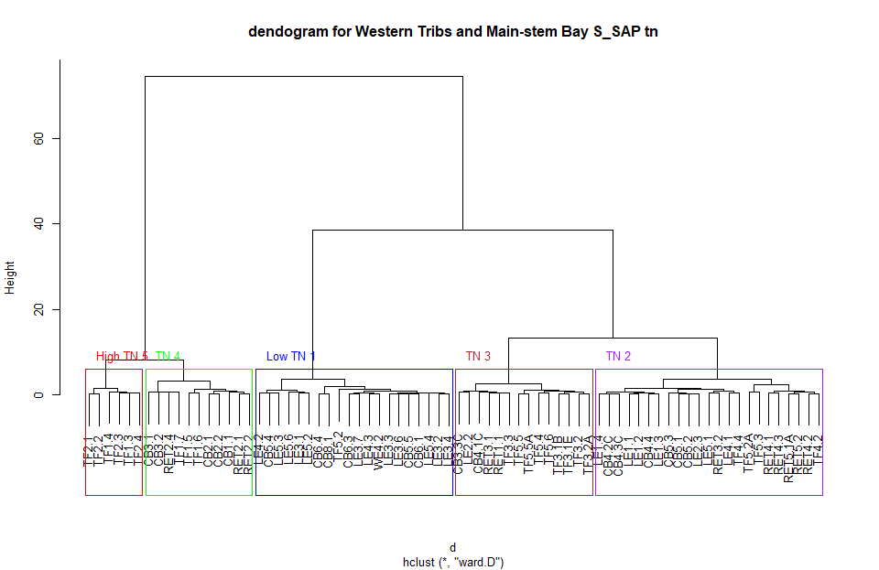
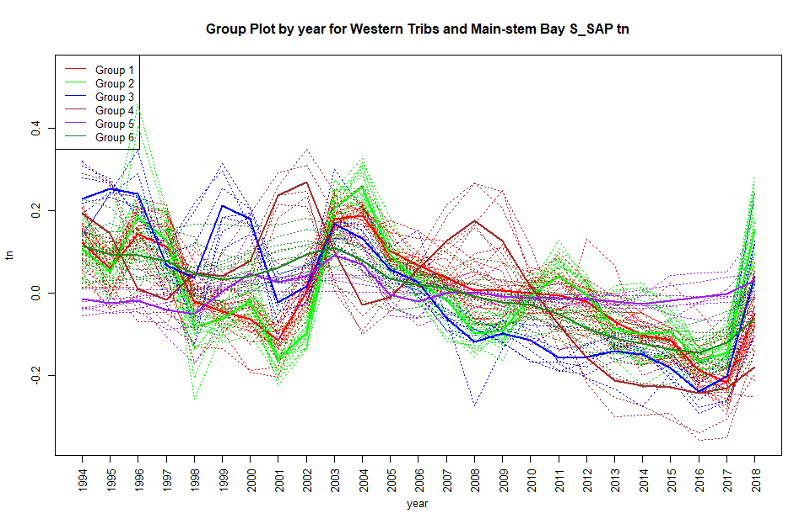
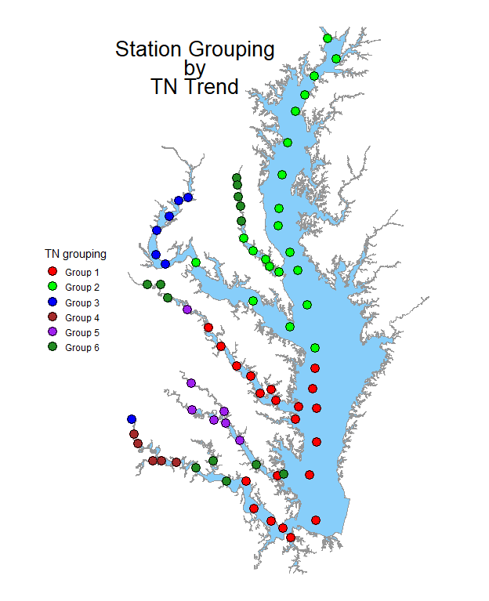
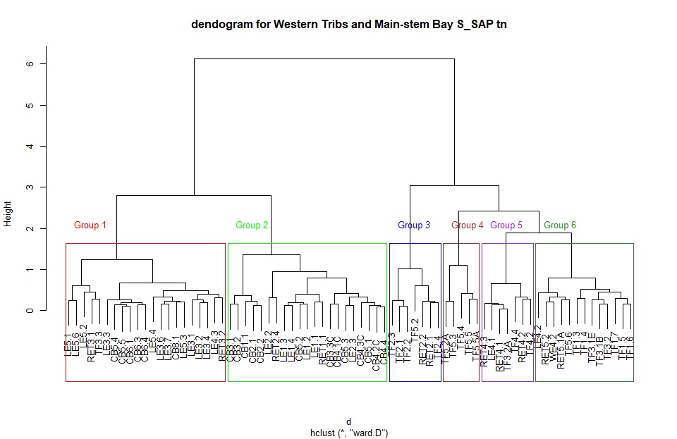
Methodology
B) Cluster Analysis
w/ obs. data
C) Observed Data
A) GAM2 results
Panel Depiction
A GAM2 model was developed for each target parameter and station
Cluster analysis was applied to the observed GAM2 for all stations and given parameter
  Dendrograms were inspected and station groups selected
Station groups were plotted for interpretation
D&E) Same as B&C except cluster analysis was applied to “zero-mean” adjusted GAM2
E) Mean Adjusted
D) Cluster Analysis
w/ mean adj.

Slide 4
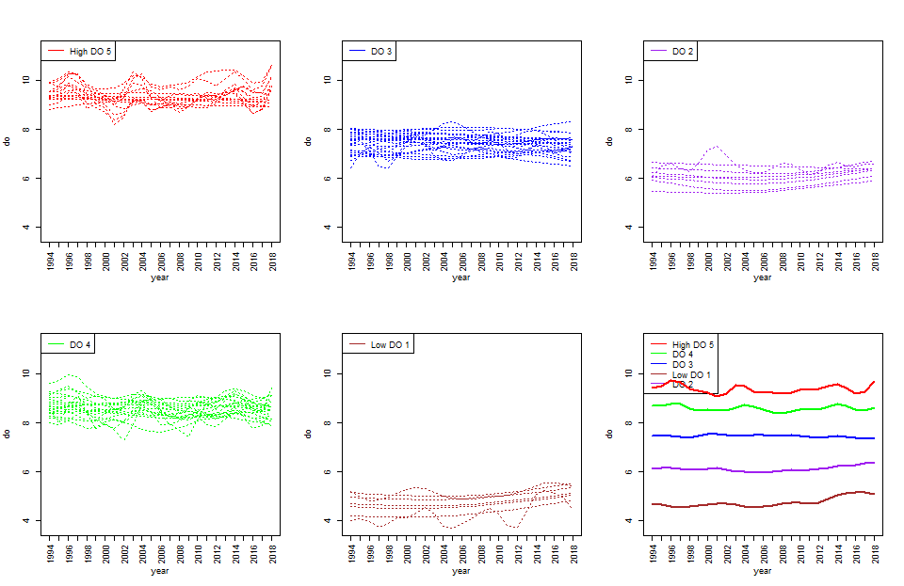
1. Cluster analysis grouping items defined by station using patterns over year for B do observed in the WesternTribs (pg 4-9)
Observed
Data
Grouping structure is primarily based on the mean DO level.
  High DO stations (red) are generally in the tidal fresh except for LE3.7 which is a relatively shallow station in the mouth of the Piankatank River.
  Low DO stations (brown) are in the deep trench portion of the mainstem bay.
  The James is remarkable for maintaining relatively high DO throughout the estuary. (Note that LE5.6 is in the Elizabeth River. )
  The Patuxent, Potomac, and Rappahannock all have regions of low DO in the lower estuary. The lowest DO (brown) appears in the deep trench region of the Main Stem Bay.
Lowest DO levels (brown and purple) are showing some improvement in the recent decade.
Reactive to flow
  Groups with highest DO (red) appears to increase in the high flow years of 1996 and 2003-2004.
  Lowest DO groups (brown and purple), there are stations that show increased DO in dry years (1997-2002, 2014-2016).

Slide 5
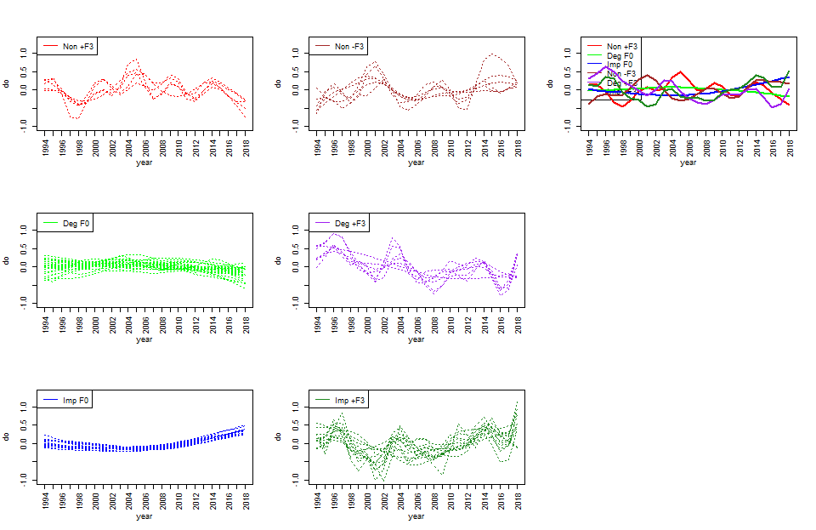
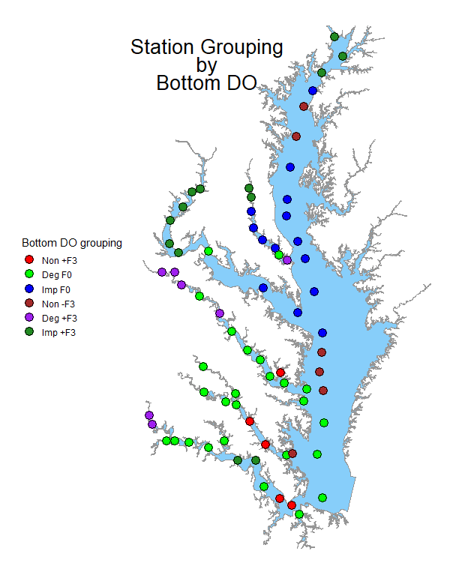
2. Cluster analysis grouping items defined by station using patterns over year for B do observed in the WesternTribs. (p 10-16)
Mean Adjusted Data
Deep trench of the main-stem bay (blue) has little response to flow and has signs of improvement in recent years.
  Roughly same location as the low DO zone in the previous cluster but slightly seaward.
The trench is flanked by stations (brown) that show a negative response to flow and little or slightly improving trend.
  A negative response to flow seems consistent with a bottom up model where we conjecture the increase flow results in increased nutrient delivery, which leads to increases in phytoplankton abundance, which leads to increased BOD.
A positive response to flow possibly indicates increased mixing with higher flow or a hydraulic translocation within the estuary. It is curious that the positive responses to flow (red) tend to mix with the very smooth green trend lines in the lower estuary. Positive responses to flow in the upper estuary (purple and dark green) would seem to be a more logical location for a positive mixing response.
Non: No trend
Imp: Improving
Deg: degrading
F0: No flow response
+F3: Strong Pos. Response
-F3: Strong Neg. Response
<3 lesser response

Slide 6
1. Cluster analysis grouping items defined by station using patterns over year for B do observed in the WesternTribs (pg 4-9)
2. Cluster analysis grouping items defined by station using patterns over year for B do observed in the WesternTribs. (p 10-16)
Observed
Data
Mean Adjusted Data
Non: No trend
Imp: Improving
Deg: degrading
F0: No flow response
+F3: Strong Pos. Response
-F3: Strong Neg. Response
<3 lesser response

Slide 7
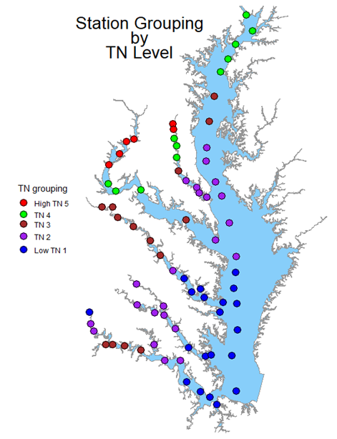
1. Cluster analysis grouping items defined by station using patterns over year for S_SAP tn observed in the Western Tribs and Main-stem Bay (4-9)
Observed
Data
Grouping structure is primarily based on the mean TN level and are fairly distinct
  High TN stations (red) are generally in the upper tidal fresh stations.
  The longitudinal trend in each sub-estuary is generally higher in the tidal fresh and then decreases downstream
  Group 5 (purple) is equally “close” to both group 3 (blue) and group 4 (brown)
TF - TN concentration by tributary in decreasing order is:
  Potomac, Patuxent, Bay ,Rappahannock, York, James
The lowermost estuary tend to be in the same group as the main stem Bay station

Slide 8
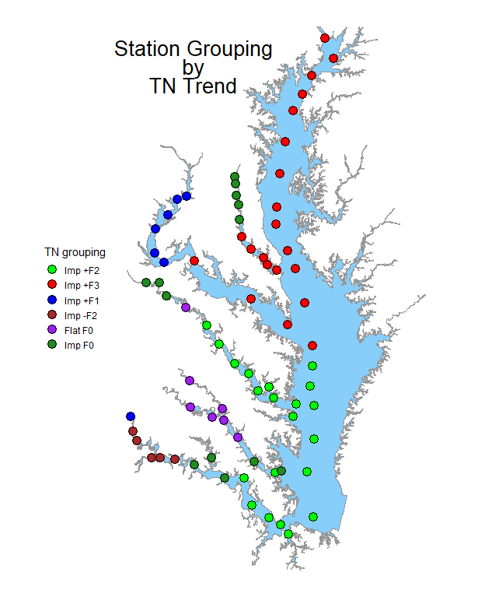
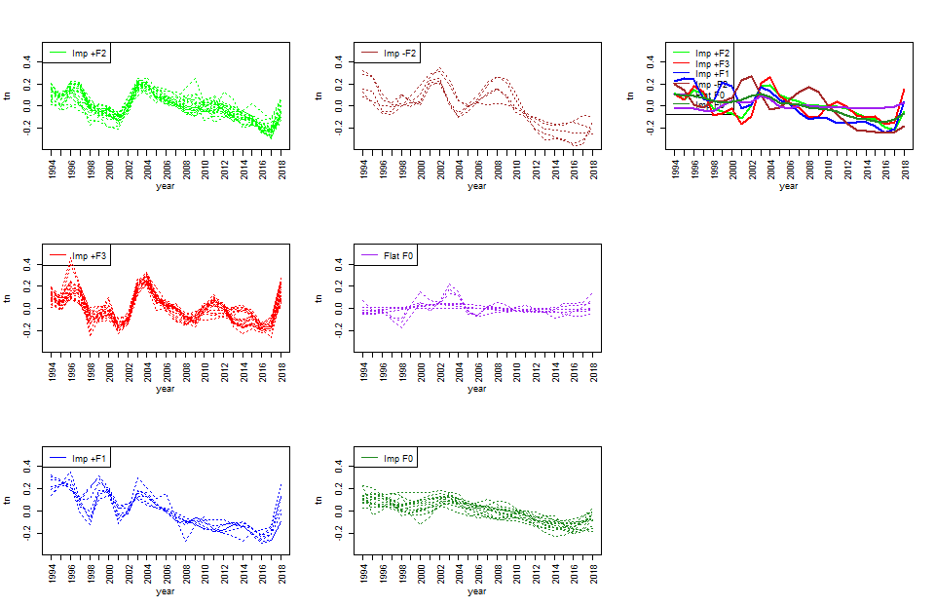
1.Cluster analysis grouping items defined by station using patterns over year for S_SAP tn observed in the Western Tribs and Main-stem Bay. (10-16)
Mean Adjusted Data
The purple group which shows no improvement is confined to the upper York and one Rappahannock station.
The dark green group shows improvement and little response to flow; a pattern that occurs in the tidal fresh of the Rappahannock and Patuxent.
The green and red groups show similar responses to flow with the green being somewhat attenuated as compared to the red. The red appears in the upper bay and the mesohaline of upper bay tributaries while the green appears in the lower bay and mesohaline of lower bay tributaries.
The response to flow tends to attenuate moving seaward.
The blue pattern is mostly the tidal fresh Potomac and the uppermost tidal fresh James.
Recall that the blue cluster shows high TN around 1999 that does not occur for red and green.
It would be interesting to check if the western Bay watershed experience a precipitation event in 1999 that missed the more eastern rivers and the Susquehanna.
The brown pattern is confined to the TF James. It is a pattern with we associate with dilution in that high flow years tend to have lower TN. This would suggest that TN in the James is primarily controlled by point sources and ground water which are diluted in high flow events.

Slide 9
1. Cluster analysis grouping items defined by station using patterns over year for S_SAP tn observed in the Western Tribs and Main-stem Bay (4-9)
2. Cluster analysis grouping items defined by station using patterns over year for S_SAP tn observed in the Western Tribs and Main-stem Bay. (10-16)
Observed
Data
Mean Adjusted Data

Slide 10
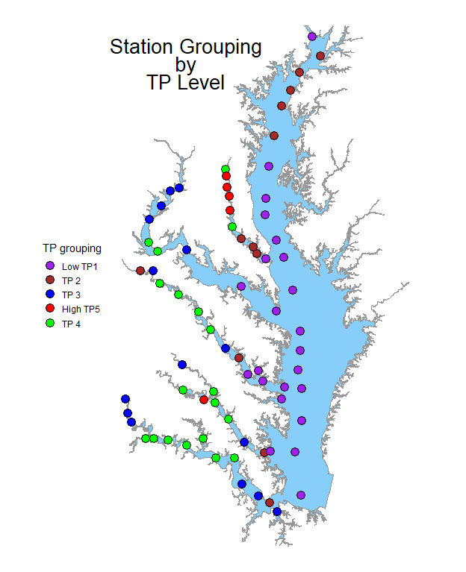
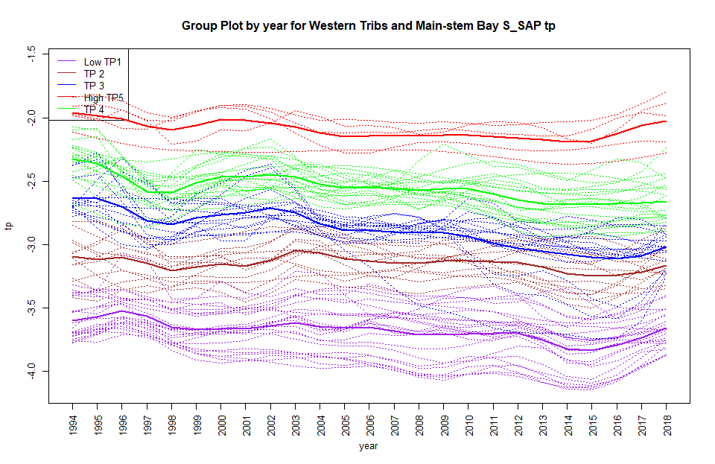
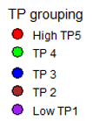
1. Cluster analysis grouping items defined by station using patterns over year for S_SAP tp observed in the Western Tribs and Main-stem Bay. (4-8)
Observed
Data
Highest TP (red or green) in the RET zone of each tributary.
Patuxent has the highest TP in the tidal fresh below Western Branch (TF1.4-TF1.7). From TF1.7 seaward, TP steps down through green, brown, to purple.
York system has one location in the red group in the Pamukey branch and otherwise reaches its highest concentration in the green group in the RET and then decreases going seaward.
Potomac and the Rappahannock have same pattern of highest concentrations in the RET and lower concentrations up stream and much lower concentrations downstream.
James River follows a similar pattern of blue in the upper tidal fresh, increasing to green in the middle estuary, and back down to blue and eventually brown in the lower estuary.
  Note, station LE5.6 in the James system is in the Elizabeth river.
Main-stem bay follows a similar pattern but is comparatively subdued and much lower in TP as compared to the tributaries. The main-stem begins in group purple at the uppermost bay station (CB1.1) and increases slightly to the brown group for stations CB2.1 to CB3.3c, and then decreases again to red for lower bay stations (CB4.1C to CB8.1).

Slide 11
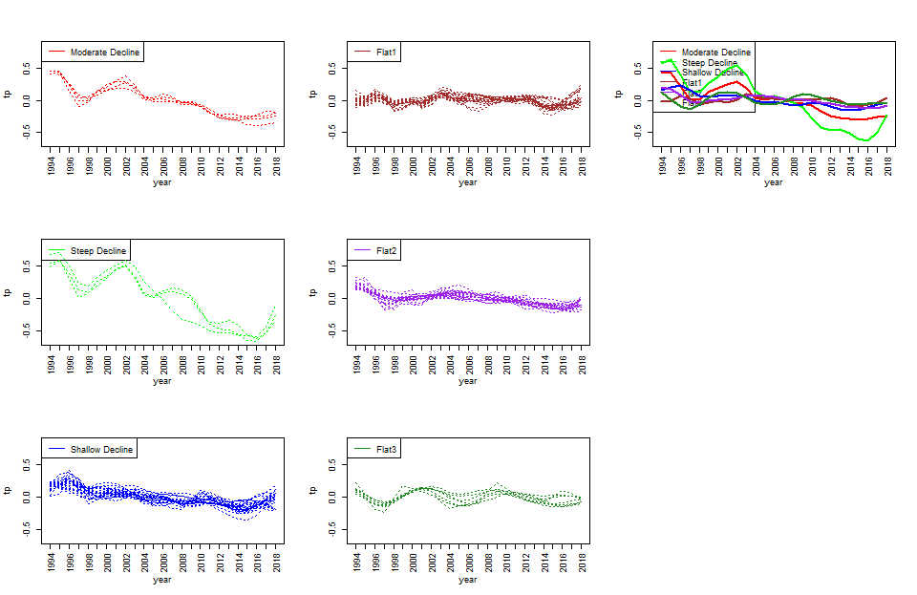
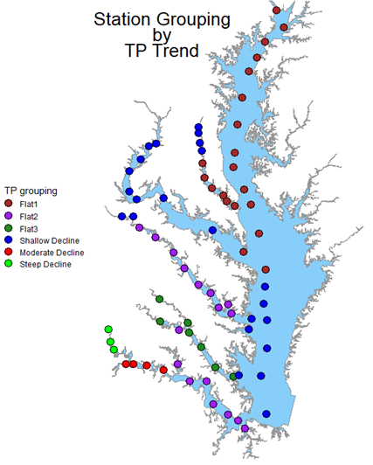
2. Cluster analysis grouping items defined by station using patterns over year for S_SAP tp observed in the Western Tribs and Main-stem Bay. (9-15)
Mean Adjusted Data
  Groups are formed from mean adjusted long term trend
    The red and green groups (Moderate & Steep decline) have large departures from the other groups, the other groups tend to overlap
    The red and green groups (Moderate & Steep) show the most improvement, the blue and purple (Shallow & Flat 2)groups show similar overall improvement but through different paths. The Brown and Dark green groups (Flat1 & Flat3) show very little improvement
  In the lower estuary zones the James and Rappahannock show most stations in purple (Flat2) indicating some improvement.
  The lower estuary of the Patuxent and York are brown and dark green (Flat1 & Flat3) indicating little improvement.
  The Upper part of the main stem bay is brown (FLat1) shows little improvement while the lower bay is mainly blue (Shallow Decline) indicating modest improvement

Slide 12
1. Cluster analysis grouping items defined by station using patterns over year for S_SAP tp observed in the Western Tribs and Main-stem Bay. (4-8)
2. Cluster analysis grouping items defined by station using patterns over year for S_SAP tp observed in the Western Tribs and Main-stem Bay. (9-15)
Observed
Data
Mean Adjusted Data
Observed
Data

Slide 13
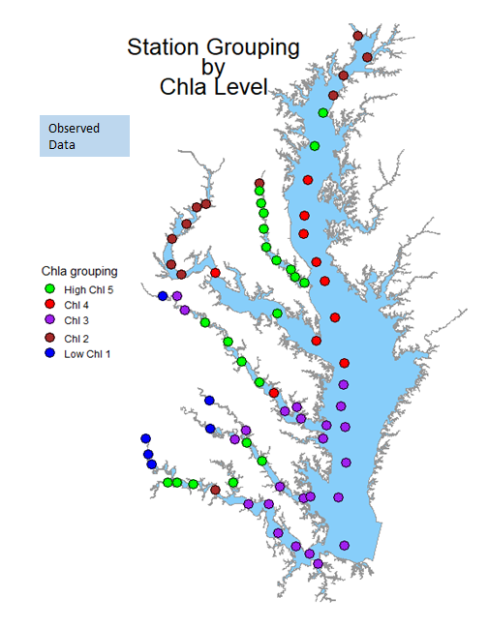
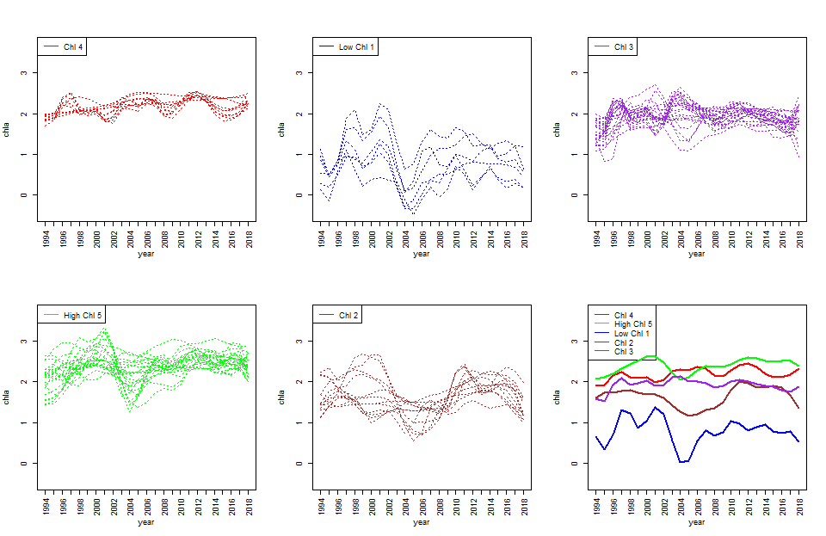
1. Cluster analysis grouping items defined by station using patterns over year for S_SAP chla observed in the BayPaxPotRapYrkJam. (4-10)
Grouping structure is primarily based on the mean CHLA level
  Generally group 5 (green) is the highest with the exception of 2003-2004 where group 5 dipped below groups 4 and 3 ( red and purple)
  Group 1 (blue) is the only group with a clearly improving trend
  Group 3 (purple) may be improving in the most recent decade
  Group 4 (red) has an increase over time
  Group 2 has no discernable trend
The highest level of ChlA (green) seems to be in the middle of most estuaries (lower tidal fresh to RET) except for the Patuxent, which extends from the tidal fresh down to the mesohaline, and the Potomac which reaches it’s zenith at the mesohaline.
The lowest levels (blue) seem to be in the upper tidal fresh of the York, Rappahannock and James

Slide 14
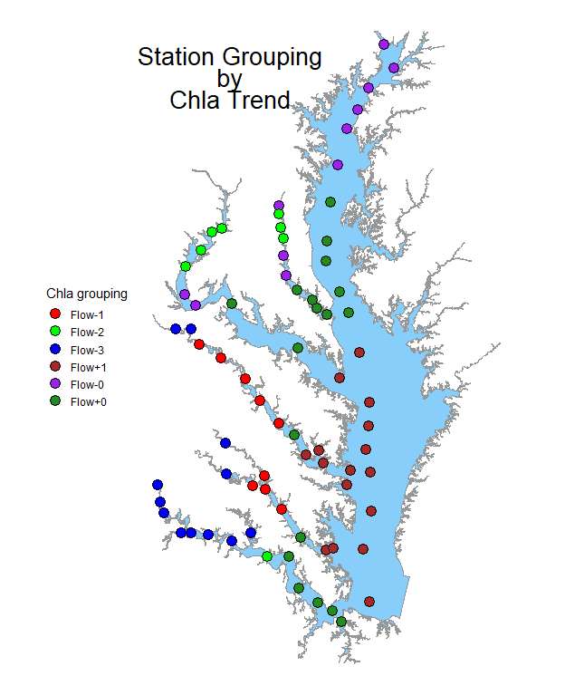
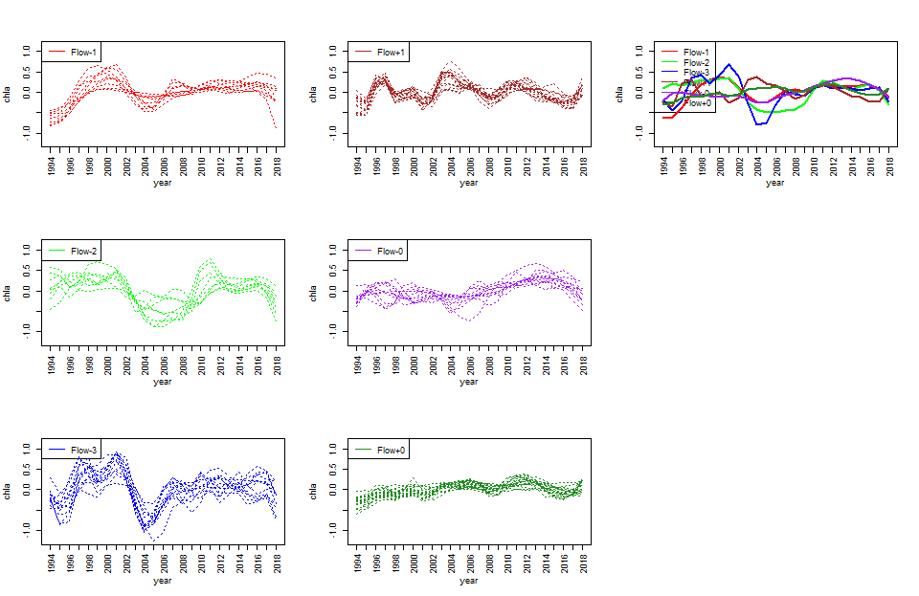
1. Cluster analysis grouping items defined by station using patterns over year for S_SAP chla observed in the BayPaxPotRapYrkJam.(11-18)
Mean Adjusted Data
  Groups are sorted based on the long-term trend profile adjusted for the mean
  The trends over time are largely characterized by different responses to flow
    The brown group (Flow+1) shows a positive response to high flow (2003-2004) and a negative response to low flow (2000-2001)
    The blue, green, and red groups (Flow-3,Flow-2,Flow-1) show a negative response to low flow.
    Green’s (Flow-2) negative response to flow goes beyond peak flows in 2003-2004).
    Red and blue (Flow-1 & Flow-3) show decreased ChlA in recent decade (vs 1997-2001) but this may be due to the low flow of 1997-2001.
    Purple and dark green (Flow-0, Flow+0) both seem unresponsive to flow but show a gradual increase in ChlA
  Recently blue, red, and green (flow-3,flow-1,flow-2) exhibit increasing ChlA while brown (Flow+1) is decreasing. Brown’s trend may reverse after the high flows of 2003-2004)

Slide 15
1. Cluster analysis grouping items defined by station using patterns over year for S_SAP chla observed in the BayPaxPotRapYrkJam. (4-10)
2. Cluster analysis grouping items defined by station using patterns over year for S_SAP chla observed in the BayPaxPotRapYrkJam.(11-18)
Mean Adjusted Data

Slide 16
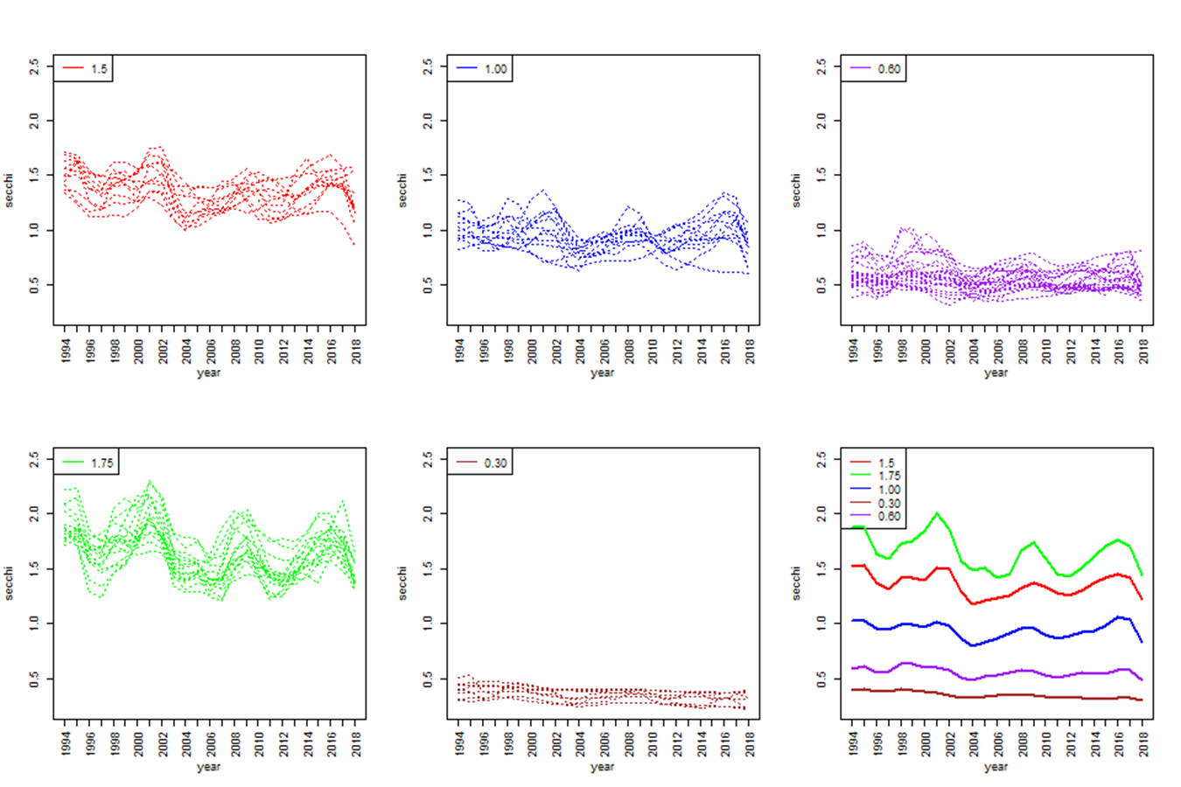
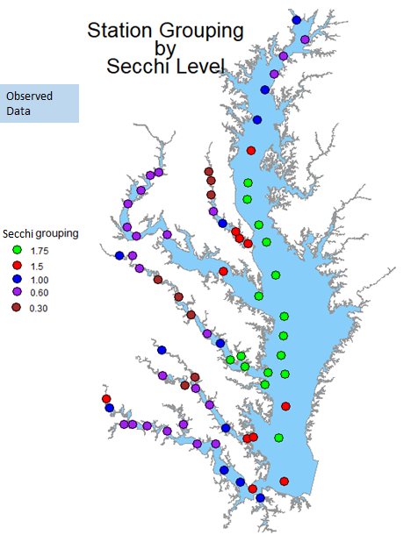
1. Cluster analysis grouping items defined by station using patterns over year for S secchi observed in the WesternTribs. (4-10)
    Groups are formed from Secchi Disk level
      Generally low secchi like brown and purple (.030 & .060) are less reactive to flow
      As clarity increases there is a tendency for secchi depth to increase in low flow years (2000-2002, 2008-2010, 2014-2016) and decrease in high flow years (1996,2003,2011,2018)
    The lowest values (Brown) occur in the middle estuary stations of the Rappahannock, York, and the tidal fresh area of the Patuxent. The middle estuary stations are flanked by the second lowest purple group (0.60)
    The lowest group Brown, (0.30) does not appear in the Potomac or James
    Water clarity improves in the lower estuaries and tends to match the clarity of neighboring stations in the Chesapeake Bay
    The uppermost TF stations in the James, Mattaponi, Rappahannock and Main Bay have better clarity than downstream TF stations

Slide 17
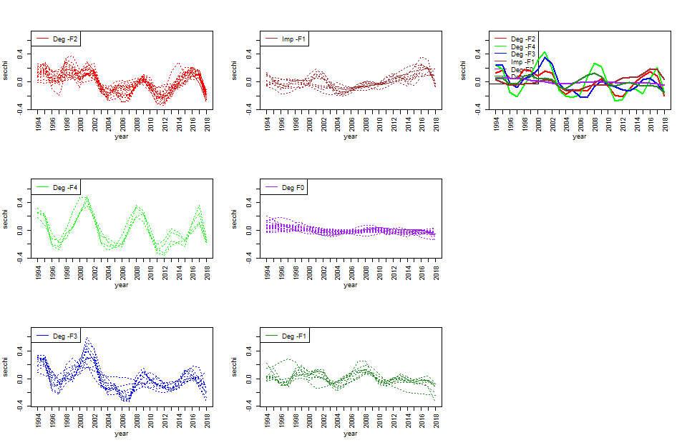
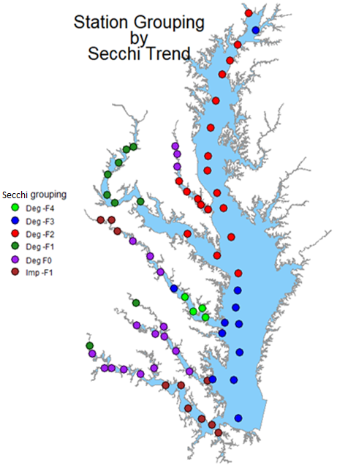
2. Cluster analysis grouping items defined by station using patterns over year for S secchi observed in the WesternTribs. Profiles have been mean adjusted. (11-18)
Mean Adjusted Data
    Groups are formed from Secchi disk level over time. The primary differentiator between groups is the degree to which clarity reacts flow.
      The labels reflect whether a trend is improving (Imp) or degrading (Deg)
      The purple group (Deg F0) seems to be the least reactive to flow
      The green group (Deg –F4) seems to be the most reactive to flow
      Only the brown group (Imp –F1) shows an improving trend, which is mostly in the recent decade
      The red group (Deg F2) does not have degraded clarity in 1996 unlike Green and blue groups (Deg F4 & Deg F3)
    Less reactive stations (Purple) occur in the tidal fresh to middle estuary of the Patuxent, Rappahannock, York, and James.
    The Potomac has a unique profile (Dark Green) in the tidal fresh to middle estuary that responds more to flow than other tributaries do.
    Curiously, the lower James and upper Rappahannock group together (Brown) while the lower Rappahannock has the only very flow reactive sites (Green Deg F4).
    It is strange that Red stations (Deg F2) does now show degraded clarity response in the high flow year of 1996, this does not appear to be a timing issue.
Deg means degrading trend
Imp means improving trend

Slide 18
1. Cluster analysis grouping items defined by station using patterns over year for S secchi observed in the WesternTribs. (4-10)
2. Cluster analysis grouping items defined by station using patterns over year for S secchi observed in the WesternTribs. Profiles have been mean adjusted. (11-18)
Mean Adjusted Data
Deg means degrading trend
Imp means improving trend

Slide 19
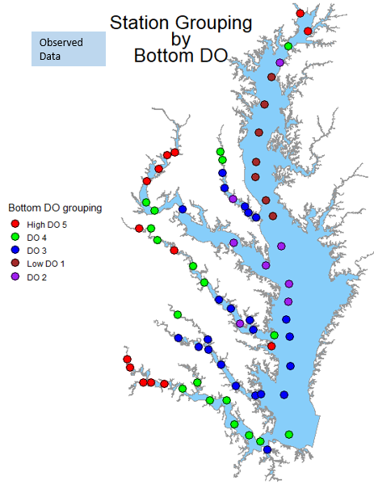
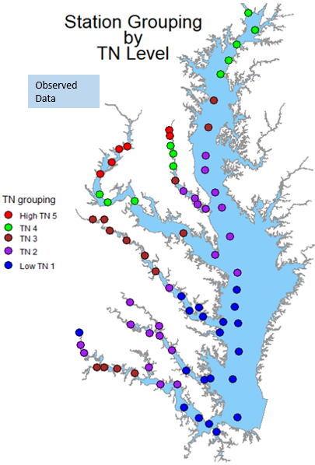
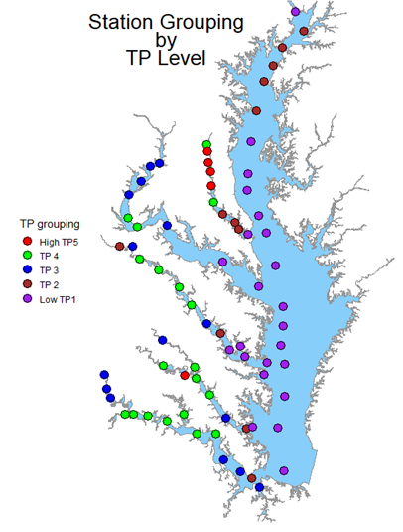
Observed
Data
Observed
Data

Slide 20
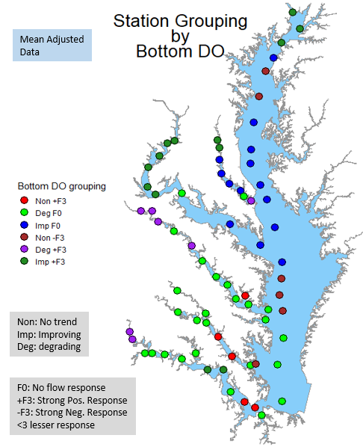
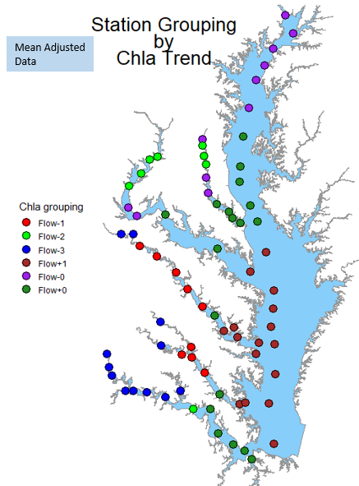
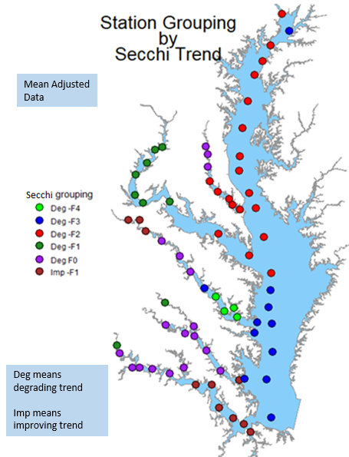
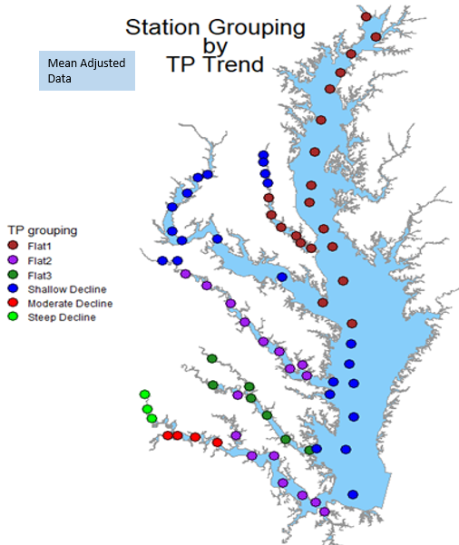
Mean Adjusted Data
Mean
Adjusted

Slide 21
Western Tributary—Cluster analysis of GAM2 results
Potential Next Steps
  Compile questions raised by the clustering analysis and/or list of stories that could be told
  Adjust color-scheme for easier understanding
  Conduct similar grouping analysis with smaller tributary data
  Expand analysis to 2020 and use flow-adjusted results as well

