Slide 1
Wetland Workgroup
Amy Jacobs, Co-Chair, TNC
Erin McLaughlin, Co-Chair, MD DNR
Presented to Habitat GIT
October 14, 2015

Slide 2
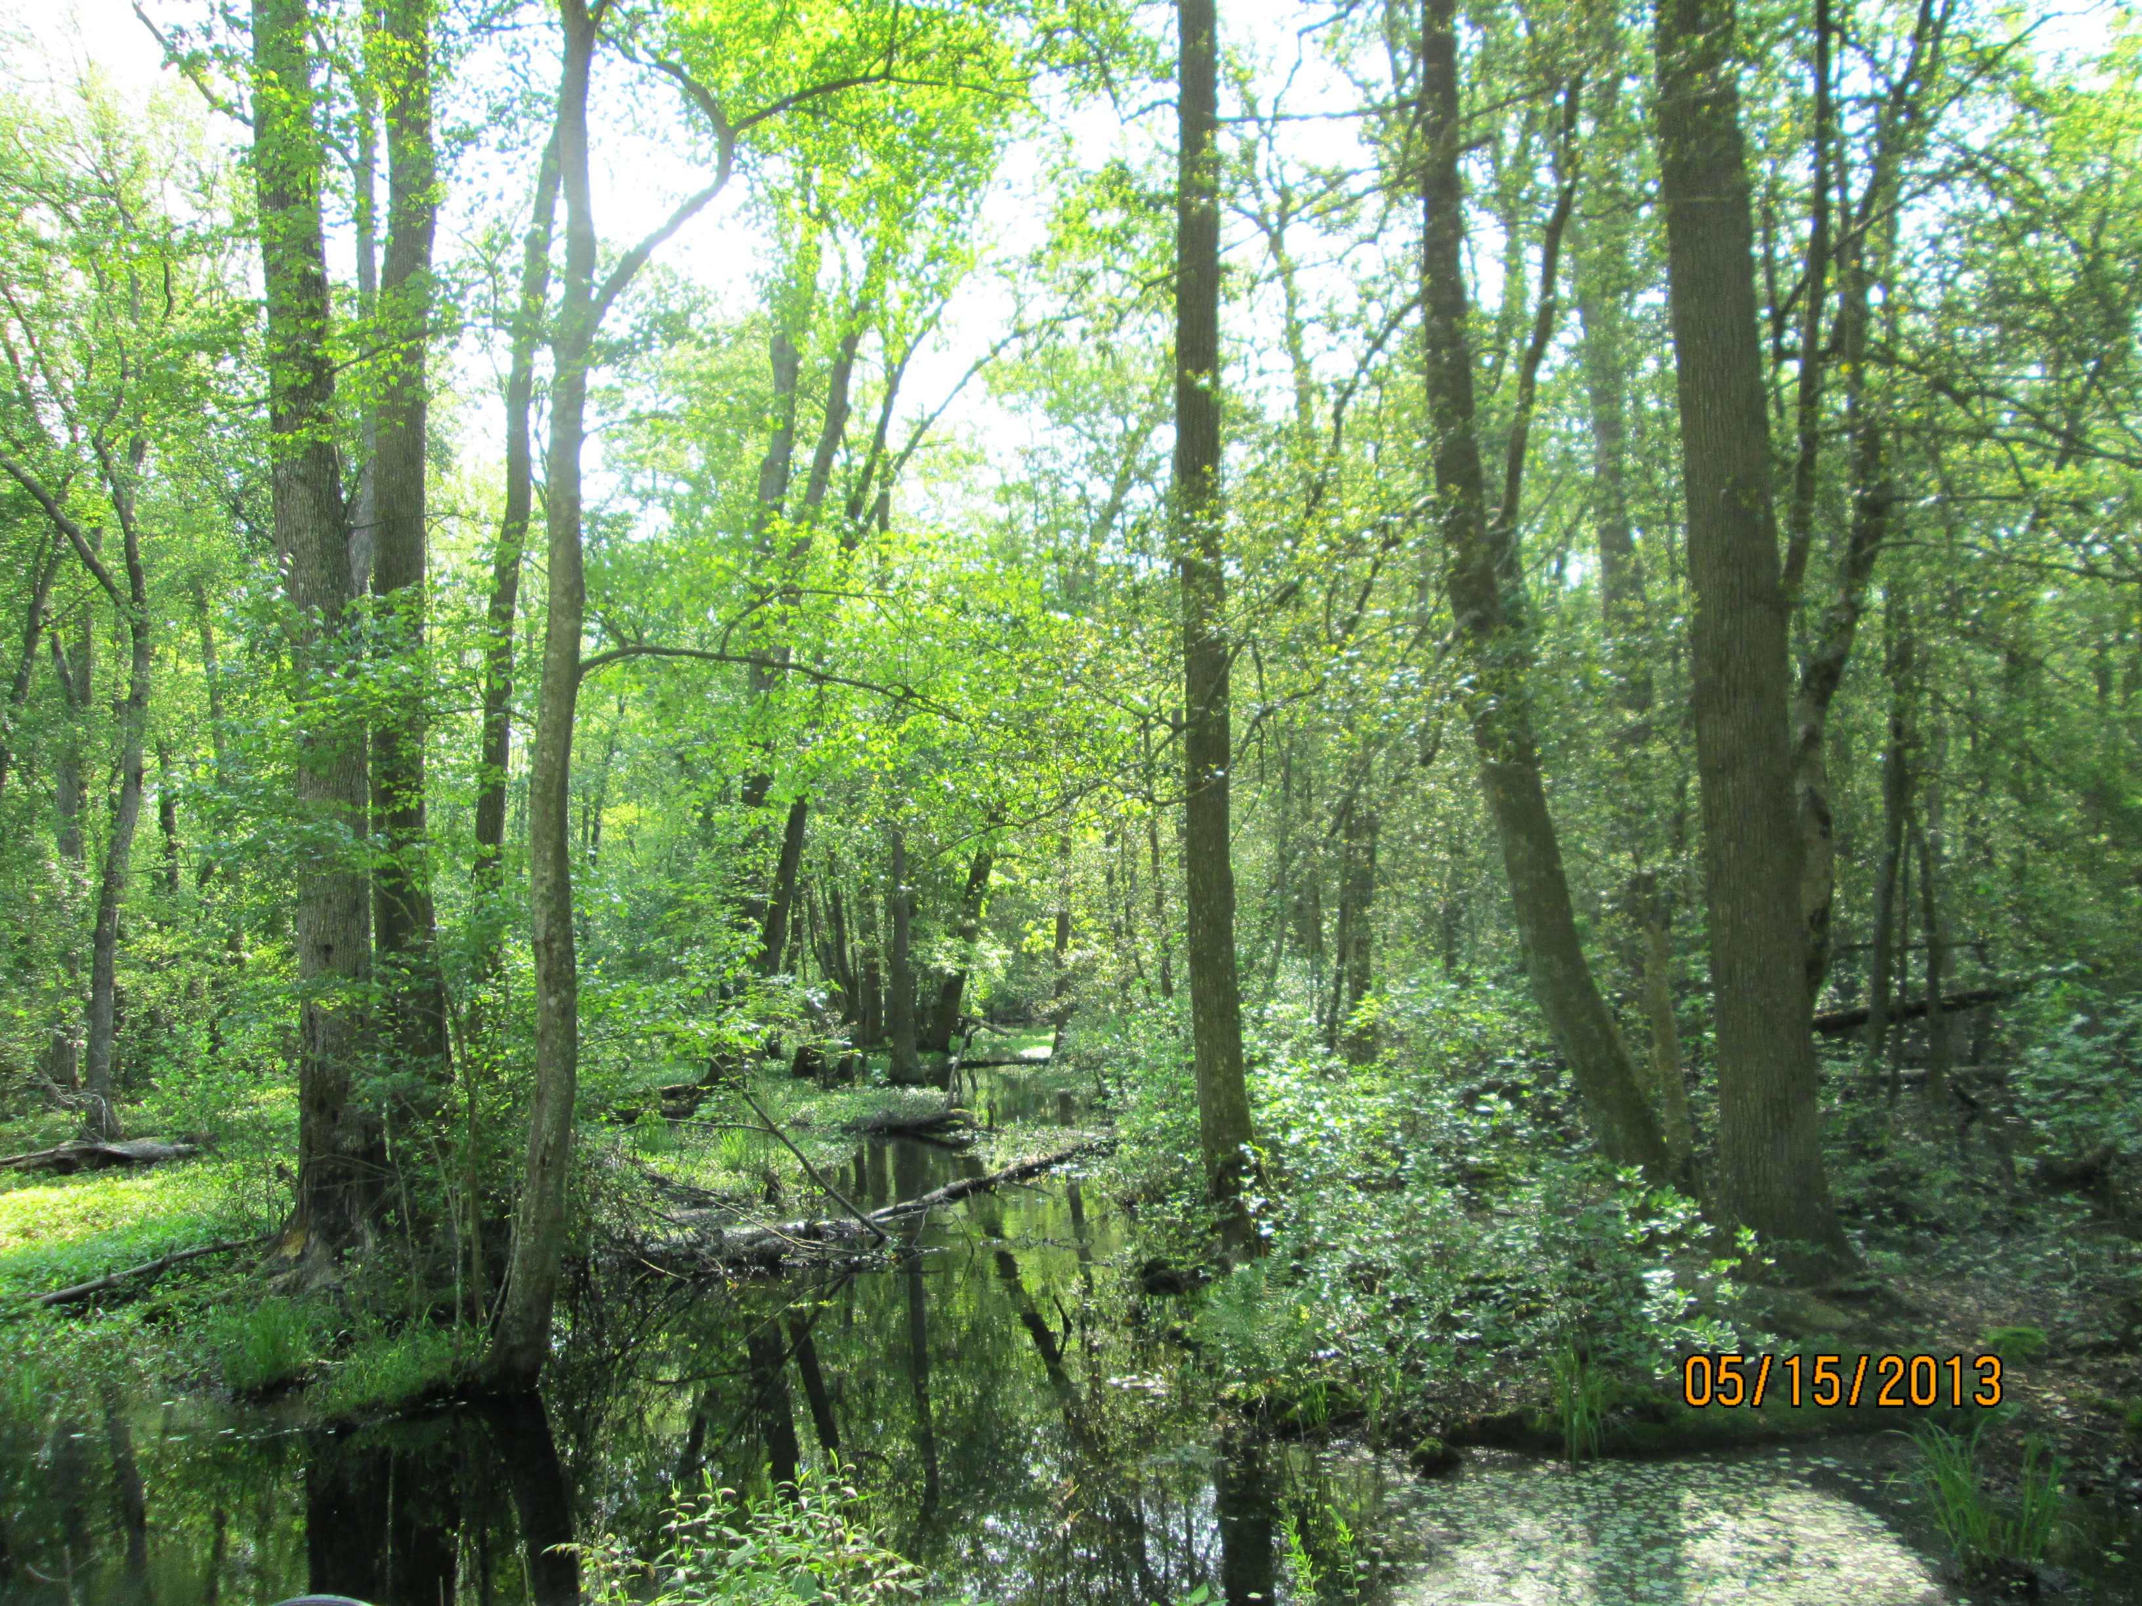
Overview
Wetland Expert Panel Recommendations
  Panel charge
  Land use recommendations
  Discussions
Wetland Mapping
  Updating NWI
Two-year Workplan

Slide 3
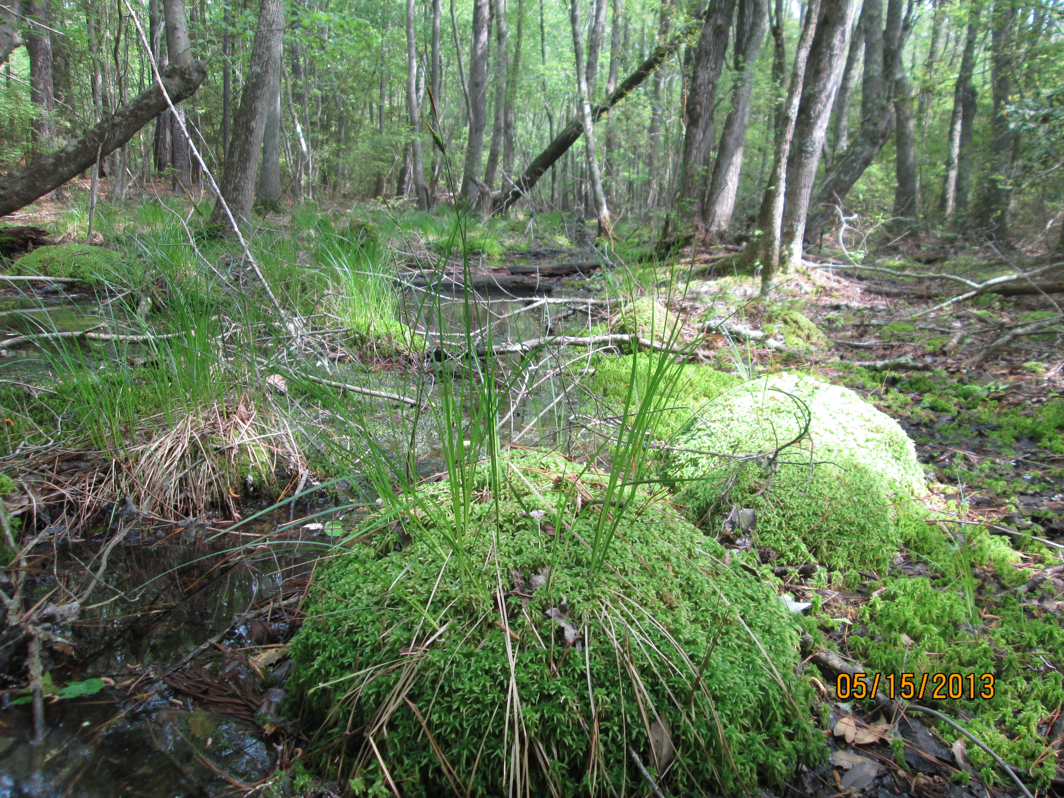
Panel Charge
  Assessment and recommendation of wetland land use(s) for the Phase 6 Watershed Model
  Wetland land use efficiencies
  Wetland restoration and enhancement sediment and nutrient load reduction efficiencies (BMPs)

Slide 4
Panel Recommendations
The Expert Panel recommended two nontidal wetland land use classes:
  Floodplain wetlands (surface water dominated systems)
  Other wetlands (ground water dominated systems)
The loading rate from the wetland acres is equal to the TN, TP and TSS rates for Forest
  Wetland land use efficiencies and wetland BMPs are still under consideration by the panel and will be presented for partnership review/approval for a later calibration
Tidal wetlands will NOT be a land use in the Phase 6 Watershed Model. They will be simulated in the Estuarine Water Quality and Sediment Transport Model
  These wetlands interact with the tidal water column so the Modeling Workgroup is working to simulate their effects in the estuarine model

Slide 5
Summary of recommendations
Table 1. Recommended land use classes and relative loading rates for nontidal wetlands in the Phase 6 Watershed Model
Proposed wetland land uses for Phase 6 Watershed Model | Relative Loading Rate (TN) | Relative Loading Rate (TP) | Relative Loading Rate (Sediment)
Floodplain | 100% Forest | 100% Forest | 100% Forest
Other | 100% Forest | 100% Forest | 100% Forest

Slide 6
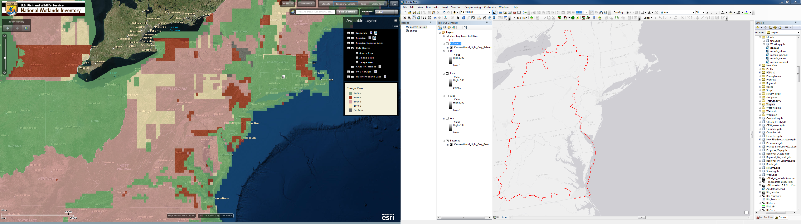
Wetland Mapping

Slide 7
Discussions
Pennsylvania and Virginia voiced concerns about outdated, inaccurate, and inconsistent NWI data
Expert Panel and Wetland Workgroup are discussing options for updating the NWI data (for PA and parts of VA)
  Potential options:
    National LULC, NHD, LiDAR, and hydric soils
    Penn State data
    Virginia will have new leaf-off imagery flown in early 2016
  “Healthy” discussion is planned for next week’s MAWWG meeting

Slide 8
Biennial Work Plan
Outcome: Wetlands
Goal: Restore 15,762 acres; Enhance 30,000 acres over the next two years
Outcome: By 2025, Restore 85,000 acres; Enhance 150,000 acres
Long term Target: X by 2025
2 year Target: Y by 2018
Management Approach 1: Improve wetland mapping, and the wetland restoration reporting and tracking process.
Key Action** Description of work/project. Define each major action step on its own row. Identify specific program that will be used to achieve action. | Performance Target(s) Identify incremental steps to achieve Key Action. | Participating Entity Identify responsible partner for each step. | Geographic Location | Timeline Identify completion date (month & year) for each step) | Estimated Project Cost Best estimate of total project cost (needed) | Available funding by Partner | Factors Influencing and/or Gap Identify related factor or gap in Management Strategy
1. Collaborate with Wetland Expert Panel and Modeling Team to improve wetland mapping for Chesapeake Bay Watershed | Identify a methodology | Wetland Workgroup | mainly PA and VA | ASAP | TBD
 | Secure funding | Wetland Expert Panel
 | Complete mapping updates | Modeling Team
2. Streamline NEIEN data collection for each State. |  | Wetland Workgroup |  | Completed for NY, PA, MD, DE, and WV | $0
 |  | NEIEN Contacts for each State | all States in Watershed
 |  |  |  | VA to be completed by December 2015 | $0
3. Confirm the accuracy of information reported. |  | NEIEN Contacts for each State | all States in Watershed | Ongoing |  |  | Are states willing to develop a QA/QC plan?
4. Improve mapping of tidal wetlands to document loss due to sea level rise and other factors | Identify a methodology | Wetland Workgroup | Tidal waters of MD and VA | September 2017 | $50,000 |  | requires funding
 | Secure funding | Outside contractor |  |  |  |  | may not be a priority for all states
 | Complete mapping and compare to previous data for status and trends analysis | Climate Change Workgroup
Total |  |  |  |  |  | $50,000

Slide 9
Biennial Work Plan
Management Approach 2: Identify barriers to wetland restoration and develop solutions to address them.
Key Action** Description of work/project. Define each major action step on its own row. Identify specific program that will be used to achieve action. | Performance Target(s) Identify incremental steps to achieve Key Action. | Participating Entity Identify responsible partner for each step. | Geographic Location | Timeline Identify completion date (month & year) for each step) | Estimated Project Cost Best estimate of total project cost (needed) | Available funding by Partner | Factors Influencing and/or Gap Identify related factor or gap in Management Strategy
1. Identify barriers to wetland restoration for practitioners. | completed | The Nature Conservancy | Pennsylvania | Completed June 2015 | Covered by NFWF grant
 |  | Ducks Unlimited | Maryland
 |  |  | Delaware
2. Identify to barriers to landowner willingness for agricultural landowners. | OpinionWorks and UMD Report | Wetland Workgroup | Pennsylvania | December 2015 | Funded by 2015 CBP GIT funding
 |  | OpinionWorks and UMD | Maryland
 |  | CBT
3. Workshop at Delaware Wetland Conference to refine marketing and outreach strategies | More refined marketing and outreach recommendations to engage landowners | Wetland Workgroup | CB Watershed | March 2016 | TBD
4. Develop solutions to address barriers and improve outreach. | Identify priority areas and implement outreach | Wetland Workgroup and practitioners | All states | September 2017 | TBD
Total |  |  |  |  |  | TBD

Slide 10
Biennial Work Plan
Management Approach 3: Increase our technical understanding of the factors influencing restoration success.
Key Action** Description of work/project. Define each major action step on its own row. Identify specific program that will be used to achieve action. | Performance Target(s) Identify incremental steps to achieve Key Action. | Participating Entity Identify responsible partner for each step. | Geographic Location | Timeline Identify completion date (month & year) for each step) | Estimated Project Cost Best estimate of total project cost (needed) | Available funding by Partner | Factors Influencing and/or Gap Identify related factor or gap in Management Strategy
1. Continue to include technical presentations at Wetland Workgroup meetings | Information exchange | Wetland Workgroup | CB Watershed | Ongoing | $0
 | Shared lessons learned | Other Partners
 | Total |  |  |  |  | $0
Management Approach 4: Prioritize areas for wetland restoration.
Key Action** Description of work/project. Define each major action step on its own row. Identify specific program that will be used to achieve action. | Performance Target(s) Identify incremental steps to achieve Key Action. | Participating Entity Identify responsible partner for each step. | Geographic Location | Timeline Identify completion date (month & year) for each step) | Estimated Project Cost Best estimate of total project cost (needed) | Available funding by Partner | Factors Influencing and/or Gap Identify related factor or gap in Management Strategy
1. Coordinate with Black Duck Workgroup | Incorporate priority areas for black ducks from Black Duck Workgroup | Wetland Workgroup | tidal MD and VA | June 2016 | $0
 |  | Black Duck Workgroup
2. Identify areas where wetland restoration would greatly benefit water quality and habitat | Develop prioritization criteria | Wetland Workgroup | CB Watershed | 2 years; completed by September 2017 | $75,000
 | Identify areas for each state and/or priority watershed | Outside consultant
3. Identify opportunities to restore large wetland acreages. | Areas identified for each state and/or priority watersheds | Wetland Workgroup | CB Watershed | completed in concert with water quality analysis | $75,000
 |  | Outside consultant
 | Total |  |  |  |  | $150,000

Slide 11
Biennial Work Plan
Management Approach 5: Expand the involvement of local stakeholders.
Key Action** Description of work/project. Define each major action step on its own row. Identify specific program that will be used to achieve action. | Performance Target(s) Identify incremental steps to achieve Key Action. | Participating Entity Identify responsible partner for each step. | Geographic Location | Timeline Identify completion date (month & year) for each step) | Estimated Project Cost Best estimate of total project cost (needed) | Available funding by Partner | Factors Influencing and/or Gap Identify related factor or gap in Management Strategy
1. STAC Workshop - "Enhancing Capacity" | framework for enhancing capacity | Wetland Workgroup | CB Watershed | TBD | TBD
 |  | Other Partners
 | Total |  |  |  |  | TBD

