Slide 1
Wetland Workgroup What, When, Where?
May 7, 2020
Pamela Mason, Chair. Center for Coastal Resources Management, VIMS

Slide 2
Wetlands Outcome:
Continually increase the capacity of wetlands to provide water quality and habitat benefits throughout the Chesapeake Bay watershed.
Create or reestablish 85,000 acres of tidal and non-tidal wetlands
83,000 of these restored acres should take place on agricultural lands
Enhance the function of an additional 150,000 acres of degraded wetlands
These activities may occur in any land use (including urban), but should primarily occur in agricultural or natural landscapes.

Slide 3
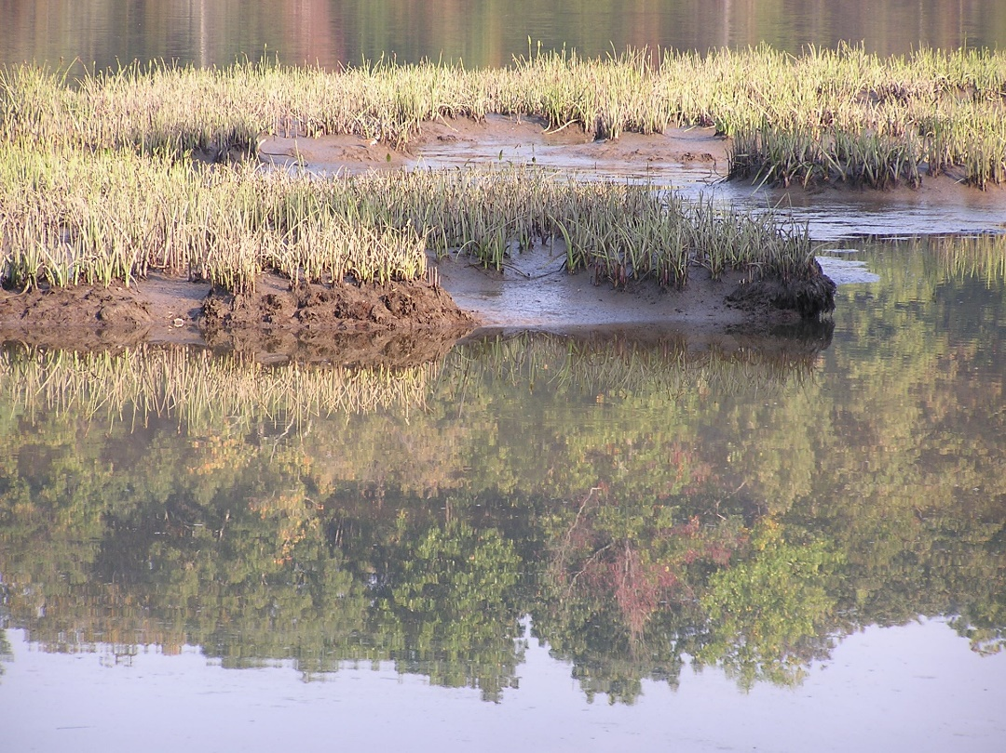
Wetlands Outcome Tracking
Regulatory Programs designed to meet No Net Loss
Some jurisdictions report incremental net gain. Is this counted?
Creation/ Reestablishment (restoration) comes from Voluntary Actions
Jurisdictions struggle with voluntary action accounting
Certain funding programs limit access to location-based information
Accounting systems are generally separate - often in different agencies

Slide 4
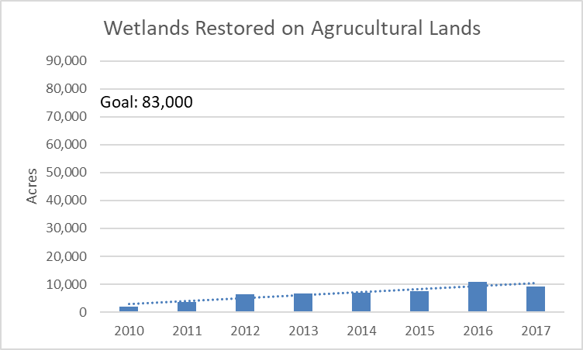
Wetlands Restored on Agricultural Lands
Progress
Percent of Goal Reached: 11%

Slide 5
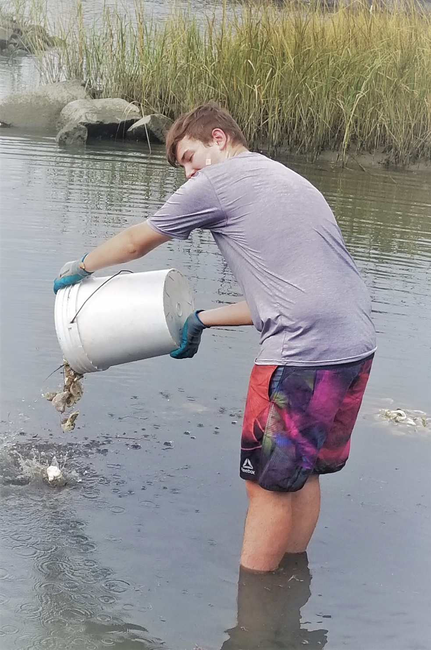
Wetlands TMDL Benefits
Driver for wetland restoration/ creation
Driver for preservation?
Incentive for multiple partnerships
Financial
Design
Implementation
Trade-offs/ unintended consequences

Slide 6
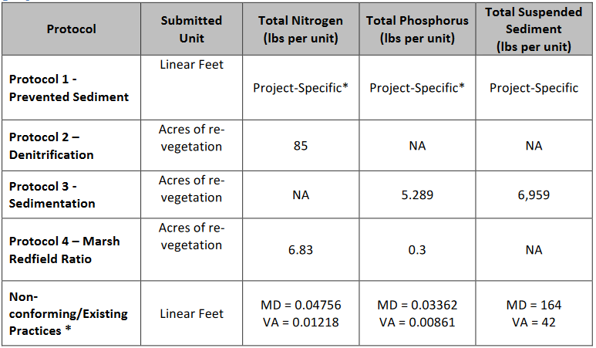
Tidal Shoreline BMPs
Basic qualifying conditions for BMPs/sites
4 general protocols to define load reductions associated with specific BMPs
10-year BMP life, renewable upon field verification
Protocol 1: Prevented Sediment: Annual mass sediment reduction credit for practices that prevent tidal shoreline erosion. The pollutant loads are reduced for sand content and bank instability (based on the state’s assessment).
Protocol 2: Credit for Denitrification: Annual mass nitrogen reduction credit for vegetative practices (Living shoreline w Marsh).
Protocol 3: Credit for Sedimentation: Annual mass sediment and phosphorus reduction credit for vegetative practices (Living shoreline w Marsh)
Protocol 4: Credit for Marsh Redfield Ratio: One time nutrient reduction credit for vegetative practices (Living shoreline w Marsh)
Default Rate: This protocol provides an annual mass sediment and nutrient reduction credit for qualifying shoreline management practices
Notes:
Basic qualifying conditions for BMPs/sites. For example, Living Shoreline – a) nonstructural; b) hybrid system including a sill; and c) hybrid system including a breakwater. The site is currently experiencing shoreline erosion or is replacing existing armor. The site was graded, vegetated, and excess sediment was removed or used. and When a marsh fringe habitat or beach/dune habitat is created, enhanced, or maintained. 4 general protocols to define load reductions associated with specific BMPs. 1 protocol is for prevented sediment from the BMPs. The other 3 protocols are for sediment and nutrient reductions from planted marsh grasses associated with certain BMPs. 5-year BMP life, renewable upon field verification

Slide 7
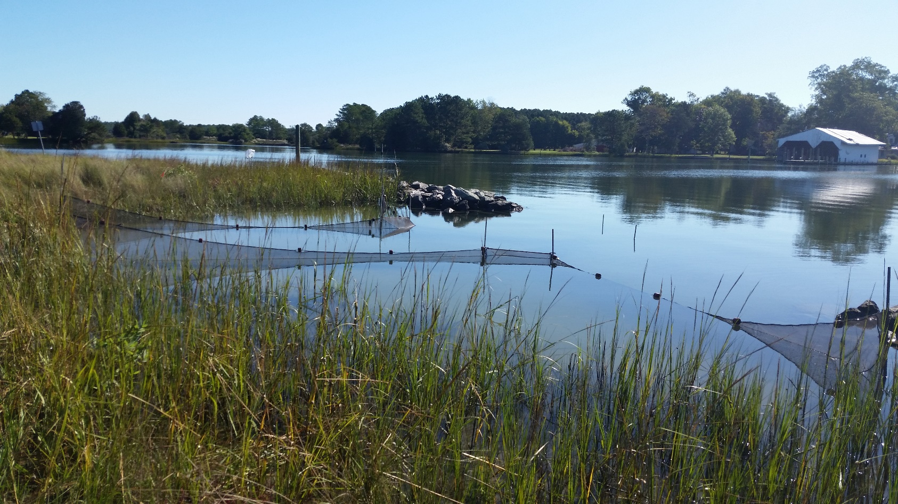
Concerns for Tidal Marsh BMP Incentive
Review Processes for Qualifying Criteria: How and Who verifies
Erosion as a natural process: Sand and sediment necessary for marsh and beach persistence. Significant credits from Protocol 1 : Non-vegetated approach
Promoting shoreline management in locations with little or no risk. May promote unwarranted shoreline management and modification to natural processes

Slide 8
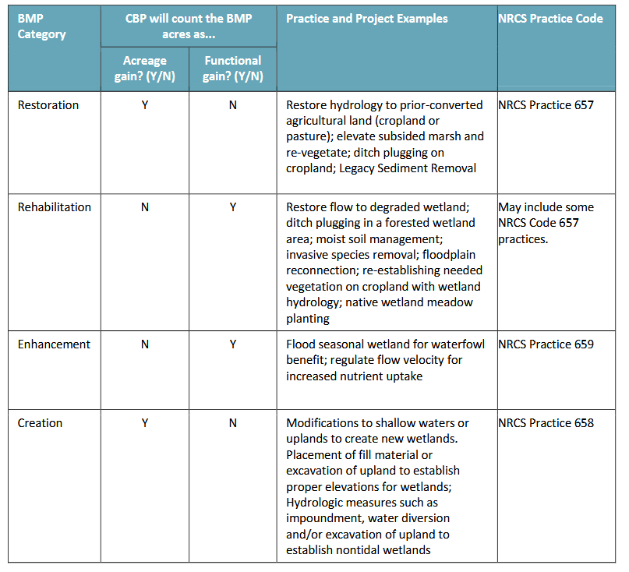
Restoration-The manipulation of the physical, chemical, or biological characteristics of a site with the goal of returning natural/historic functions to a former wetland.
Rehabilitation-The manipulation of the physical, chemical, or biological characteristics of a site with the goal of repairing natural/historic functions to a degraded wetland.
Enhancement -The manipulation of the physical, chemical, or biological characteristics of a wetland to heighten, intensify, or improve a specific function(s).
Creation -The manipulation of the physical, chemical, or biological characteristics present to develop a wetland that did not previously exist at a site

Slide 9
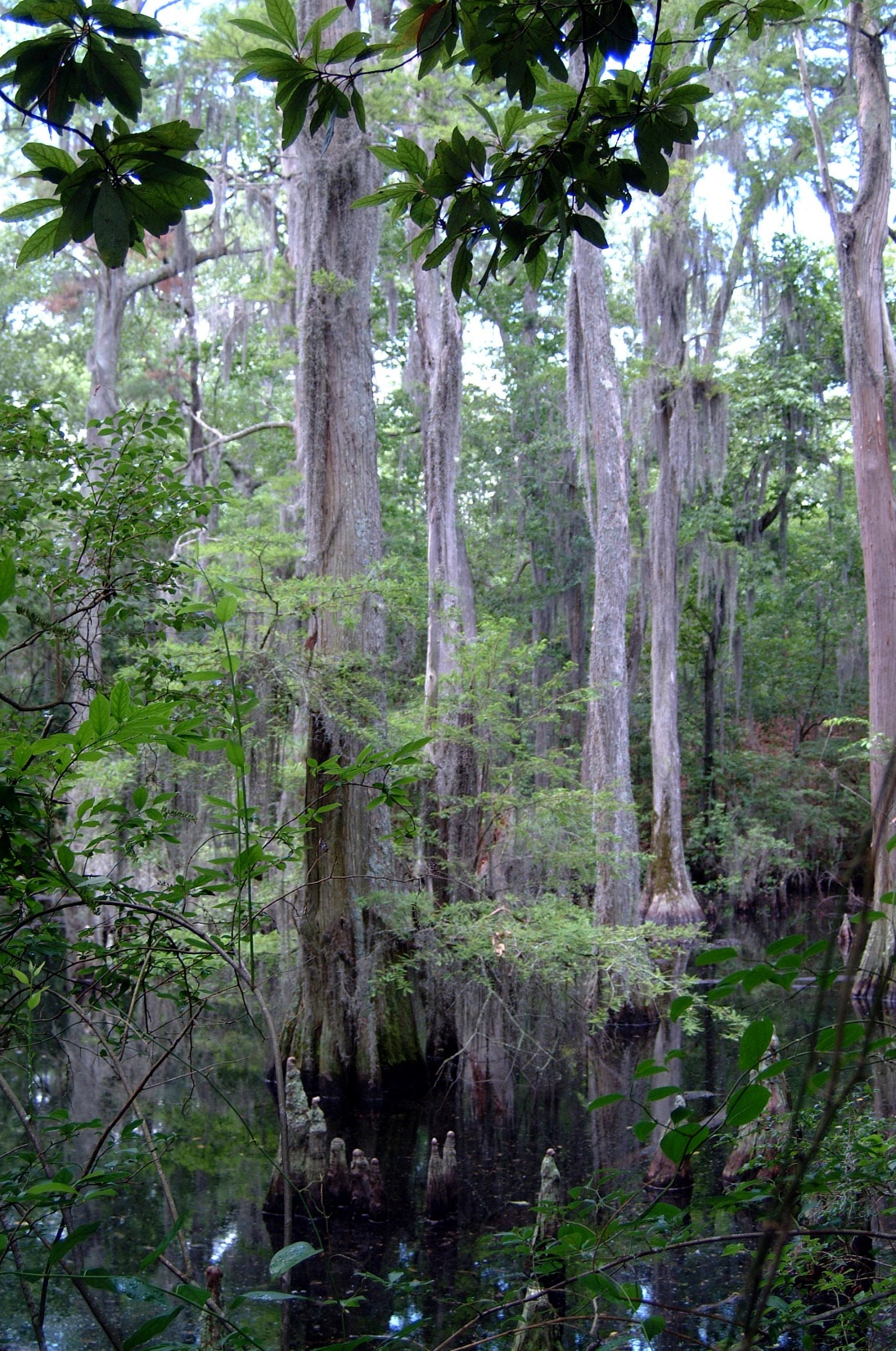
Non-tidal Wetland Restoration
Stacking Benefits: Counts Twice
1. Restoration (returning function to former wetland) or Creation (construction of new wetlands from upland) changes loading from previous landcover (Ag/ Urban impervious, turf…)to wetland landcover Ag or Urban
Non-tidal Wetlands are modeled with the same Load as forest
PLUS
2. Load Reduction Efficiencies (BMP)

Slide 10
Non-tidal Wetland Load Reduction BMPs
Wetland BMP Type | TN (%) | TP (%) | TSS (%)
Restoration | 42 | 40 | 31
Creation | 30 | 33 | 27
Rehabilitation | 16 | 22 | 19
Enhancement | Not Recommended

Slide 11
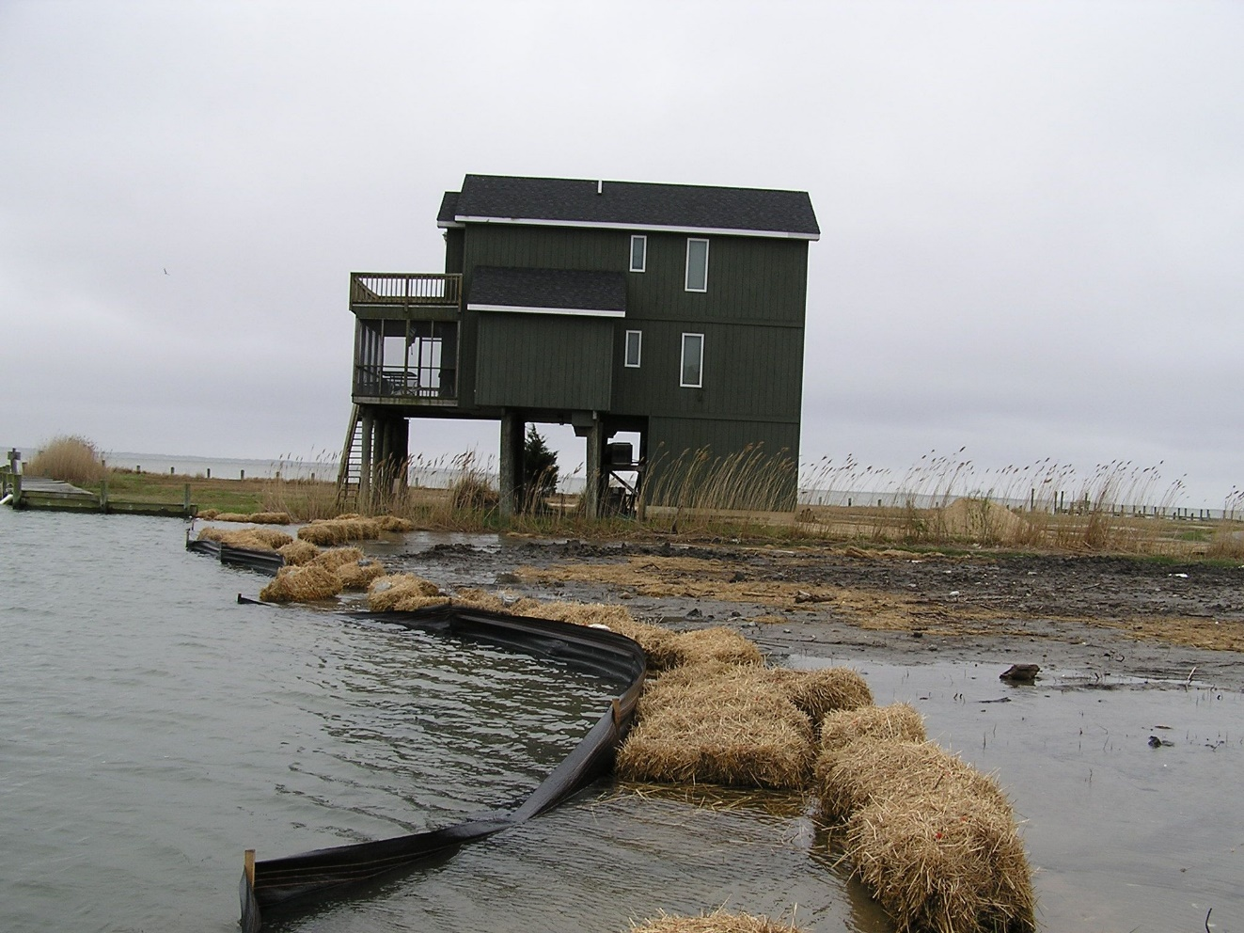
Wetlands Outcome: Climate Effects
Wetland loss and degradation due to:
Development
Climate
Both in synergy
Need
Data on Development extent and trends
Hydrology data and models
Robust projections on wetland areal extent and distribution
Tidal wetlands
Drowning: Sediment supply and accumulation. Organic material production
Migration Corridors: Limited by Development and Topography
Non-tidal wetland effects from precipitation, surface, and groundwater withdrawal/ recharge

Slide 12
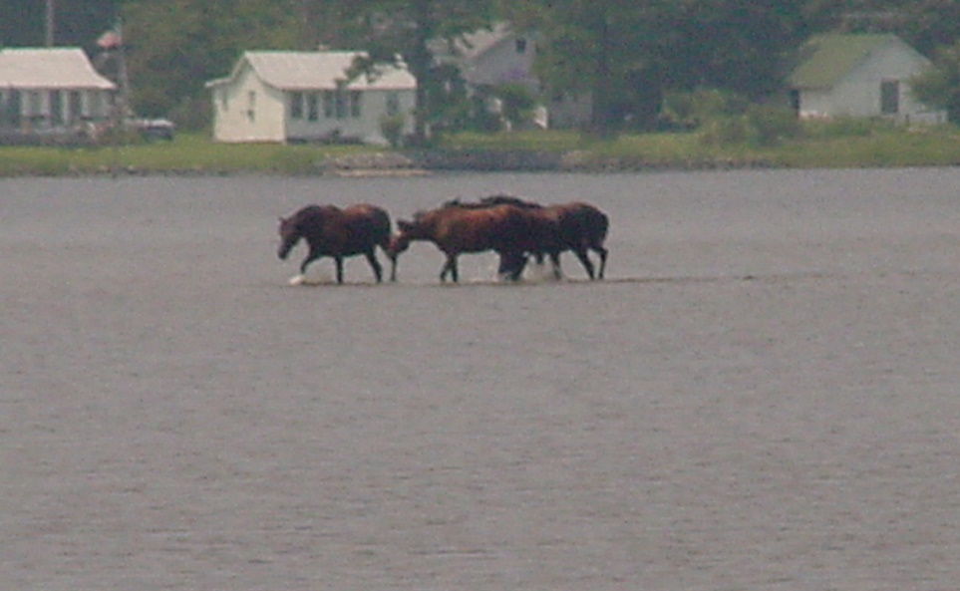
Logic and Action Plan
FACTORS
Funding and Incentives
Communication
Landowners
Decision-makers
Practitioners
Data and Reporting
Leadership and Commitment

Slide 13
Existing Actions
Communications:
Wetland Works. Website focused on Nontidal Wetland on Agricultural land. WetlandWorks.org
Develop Fact Sheet: Compile report of program, plans, and incentives for Wetlands Projects. Started with Virginia
Include expert presentations in WWG agendas
TNC Wetland Restoration Project. Kick off 2020
Restoration Coordinators
Landowner engagement

Slide 14
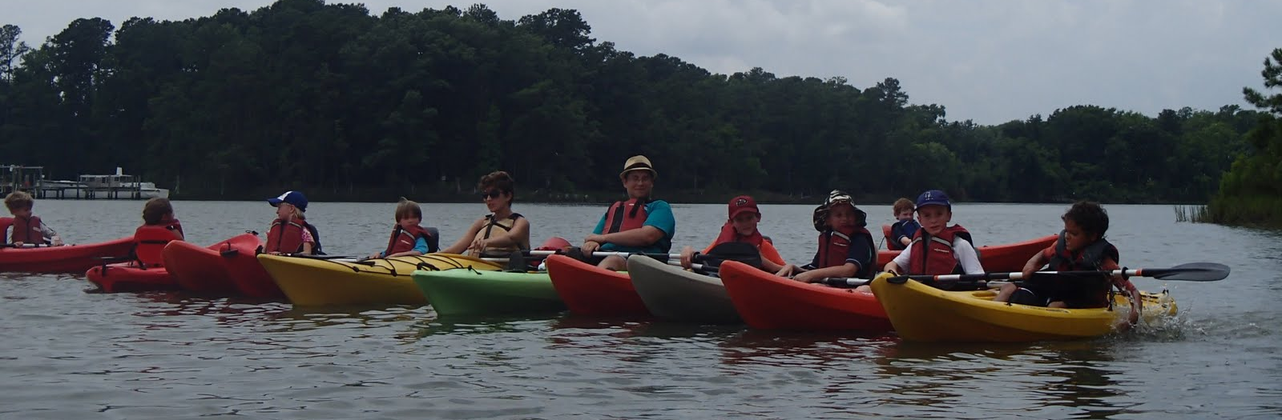
Proposed Actions
Funding & Incentives
Collaboration with Comms Team on Wetland Funding Factsheets
Communications
Wetland Works
Market site
Expand inventory of funding programs to include tidal and non-agricultural
Expand to include information about tidal wetlands, non-agricultural lands
Next Steps for Living Shoreline GIT project: Collaborate and Support
Hold a Panel at Marsh Resilience Summit to present Action Plan

Slide 15
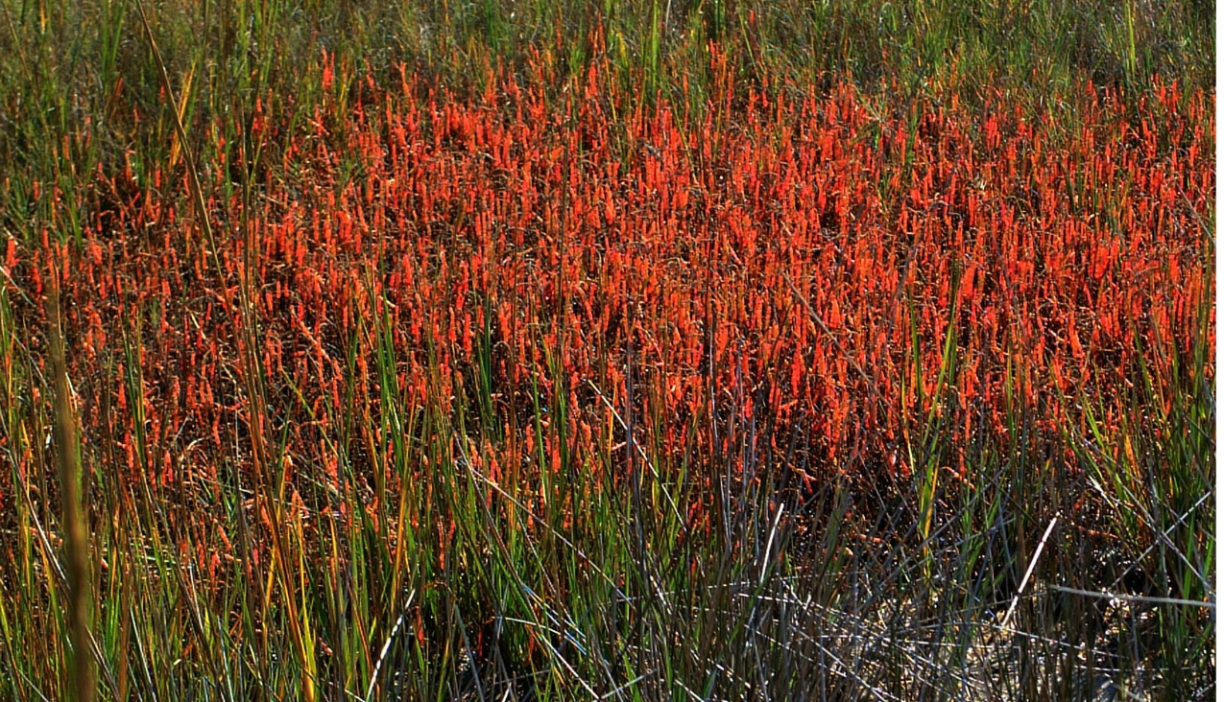
Proposed Actions
Data & Reporting
Work to improve the process for collecting, inputting and validating wetland data: NEIEN
Support improved and updated wetland mapping and classification: GIS/ Modeling
Lead and collaborate on STAC workshop proposal to develop a systems approach to BMP accounting
Assess risks to coastal wetlands: Wetland Migration Corridors
Improve Wetland Restoration Targeting
Co-benefits of habitat and water quality

Slide 16
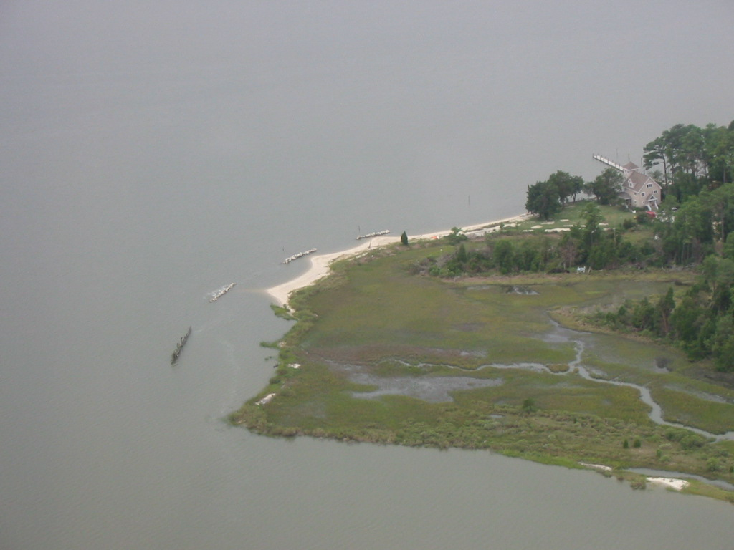
Proposed Actions
Leadership & Commitment
Update Co-Benefit Factsheet. Collaborate with Comms
Identify Legal/ Regulatory Barriers. Develop strategies to address
Engage Leadership from City of Norfolk on Wetlands Mowing Factsheet

Slide 17
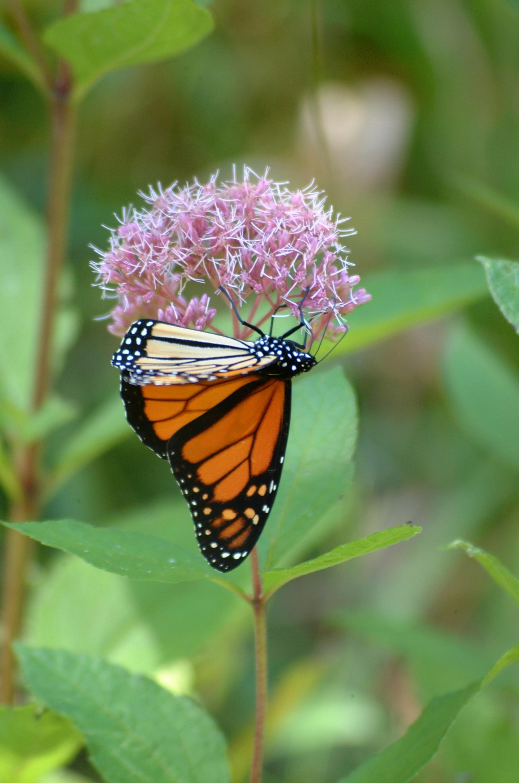
Moving Forward on Wetland Goal
WWG has dual responsibility of data tracking and program/ project development and implementation.
Workgroup focus on data collection takes significant commitment limiting capacity to work on Actions in Strategy and Work Plan.
Rectifying Wetland Status and Trends with Restoration Data
High rates of Bay watershed development and sea level rise mean wetlands are at great risk
Low restoration numbers raise concern that we are not only way behind on the goal, but that the baseline is also changing.

