Slide 1
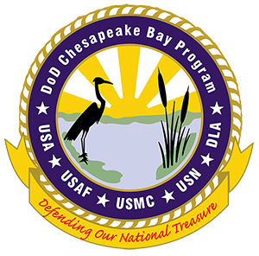
Wetland Workgroup Action Plan Item 5.4 Update
June 16, 2020
Kevin Du Bois, PWS, PWD, CFM - DoD Chesapeake Bay Program

Slide 2
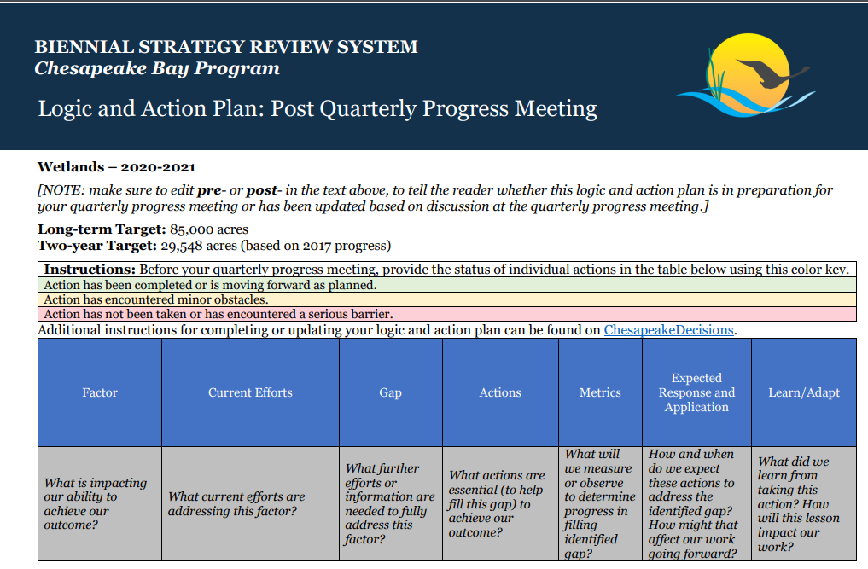
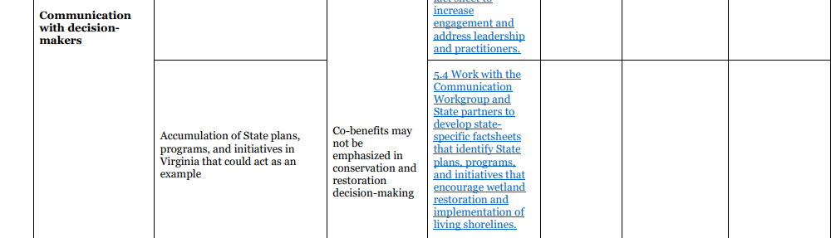
Wetlands Workgroup: Action Plan Item 5.4 Update

Slide 3
Logic table
Factor: What is impacting our ability to achieve our outcome?
Communication with decision-makers
Current Efforts: What current efforts are addressing this factor?
Accumulations of State plans and initiatives in Virginia that could act as an example
Gap: What further efforts or information are needed to fully address this factor?
Co-benefits may not be emphasized in conservation and restoration decision-making
Actions: What actions are essential to help fill this gap to achieve your outcome?
Work with the Communication Workgroup and State partners to develop state-specific factsheets that identify State plans, programs, and initiatives that encourage wetland restoration and implementation of living shorelines.
Wetlands Workgroup: Action Plan Item 5.4 Update

Slide 4
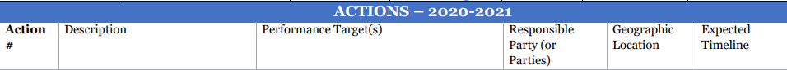
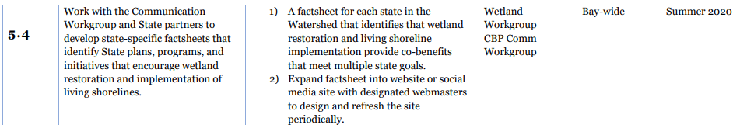
Wetlands Workgroup: Action Plan Item 5.4 Update

Slide 5
Phase III WIP
Executive Summary: SWCDs and PDCs responded to the challenge of identifying best management practices (BMPs) and programmatic actions that are necessary to restore the Chesapeake Bay. From over 500 ideas and suggestions, the common themes among the programmatic actions for the urban/developed sector include: ...Enhance promotion of living shoreline techniques to address shoreline erosion.
Pg. 24: Capitalize on co-benefits – Maximize BMP selection to increase climate or coastal resilience, soil health, flood attenuation, habitat restoration, carbon sequestration, or socioeconomic and quality of life benefits
Wetland restoration and Shoreline Management are credited in the TMDL
Wildlife Action Plan
The Virginia wildlife action plan unites natural resource agencies and citizens through a common vision and concept for the conservation of the Commonwealth’s wildlife and the habitats in which they live.
Page 11-19. Conservation Strategies: Maintain and Restore Wetland Habitats. Promote Living shorelines where possible and minimize hardened shorelines. Enhance vegetative buffers. Control invasive species.
Page 11-27. Additional wetlands climate-related conservation actions include: restoring and enhancing vegetation within the wetlands to support changing conditions (e.g. using vegetation species that can withstand a broader array of conditions like more frequent inundation and higher salinity levels), restoration of wetlands to increase their elevation along the coast where feasible or needed and enhancement of wetland migration by targeted restoration or acquisition in areas where wetlands may migrate (both inland and upstream).
Wetlands Workgroup: Action Plan Item 5.4 Update

Slide 6
Using VA as an example, the value of wetlands and the need to protect, restore, and enhance wetlands was referenced in the following:
Phase III WIP
State Wildlife Action Plan
Virginia's Strategy for Safeguarding Species of Greatest Conservation Need from the Effects of Climate Change (2009)
VMRC Tidal Wetland Regulations: Chapter 13 of Title 28.2, Code of VA
State Outreach/Education Goals
Virginia Natural Heritage Program
Virginia Executive Order 24: Coastal Resilience Master
Constitution of Virginia
VA Outdoors Plan 2018
Virginia Living Shorelines Act
Virginia State Wetlands Program Plan
State Outreach/Education Goals
VA Chesapeake Bay Preservation Act
Plan
Virginia Scenic River Program
VA Dam Safety and Floodplains Program
Virginia Coastal Zone Management Program
Now we are expanding the same methodology to other Jurisdictions in the Partnership
Wetlands Workgroup: Action Plan Item 5.4 Update

