Slide 1
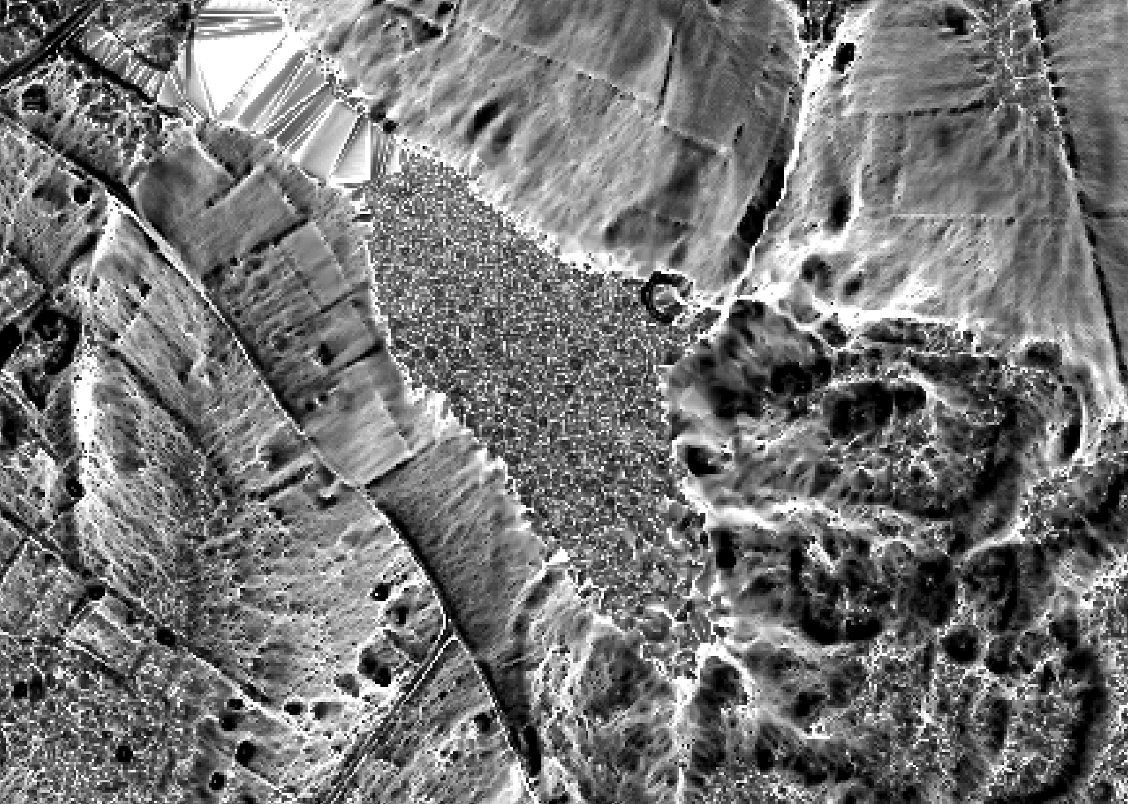


Chesapeake Bay Watershed Wetlands Mapping
Part 2- Object-based Image Analysis
Jarlath O’Neil-Dunne, Patrick Raney*, and Sean MacFaden
University of Vermont Spatial Analysis Laboratory
*Upper Susquehanna Coalition

Slide 2
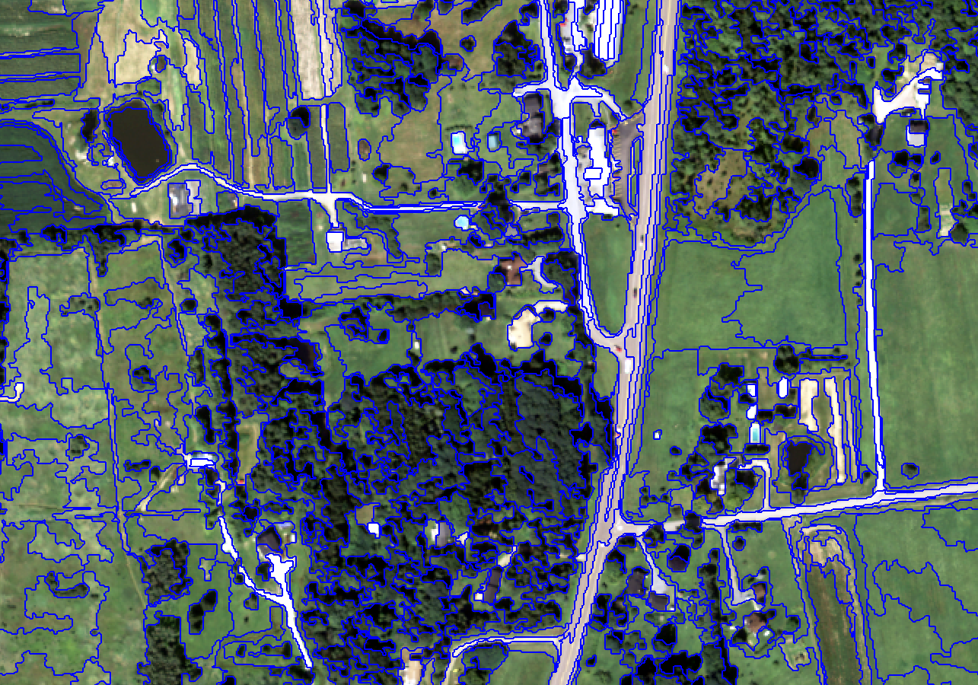
Object-based Image Analysis
Objects Rather Than Pixels
Better Approximates Landscape Objects
Contextual Analysis
Data Fusion
Enterprise Processing - eCognition

Slide 3
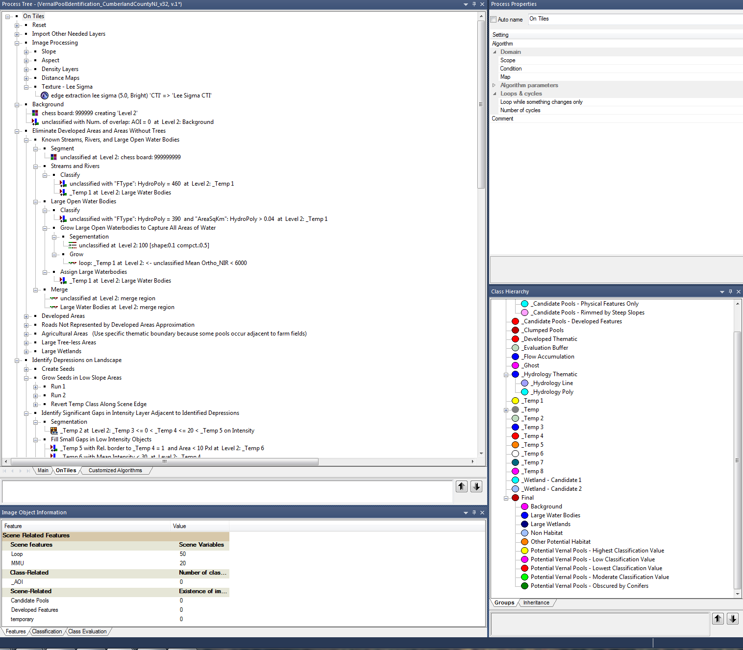

Slide 4
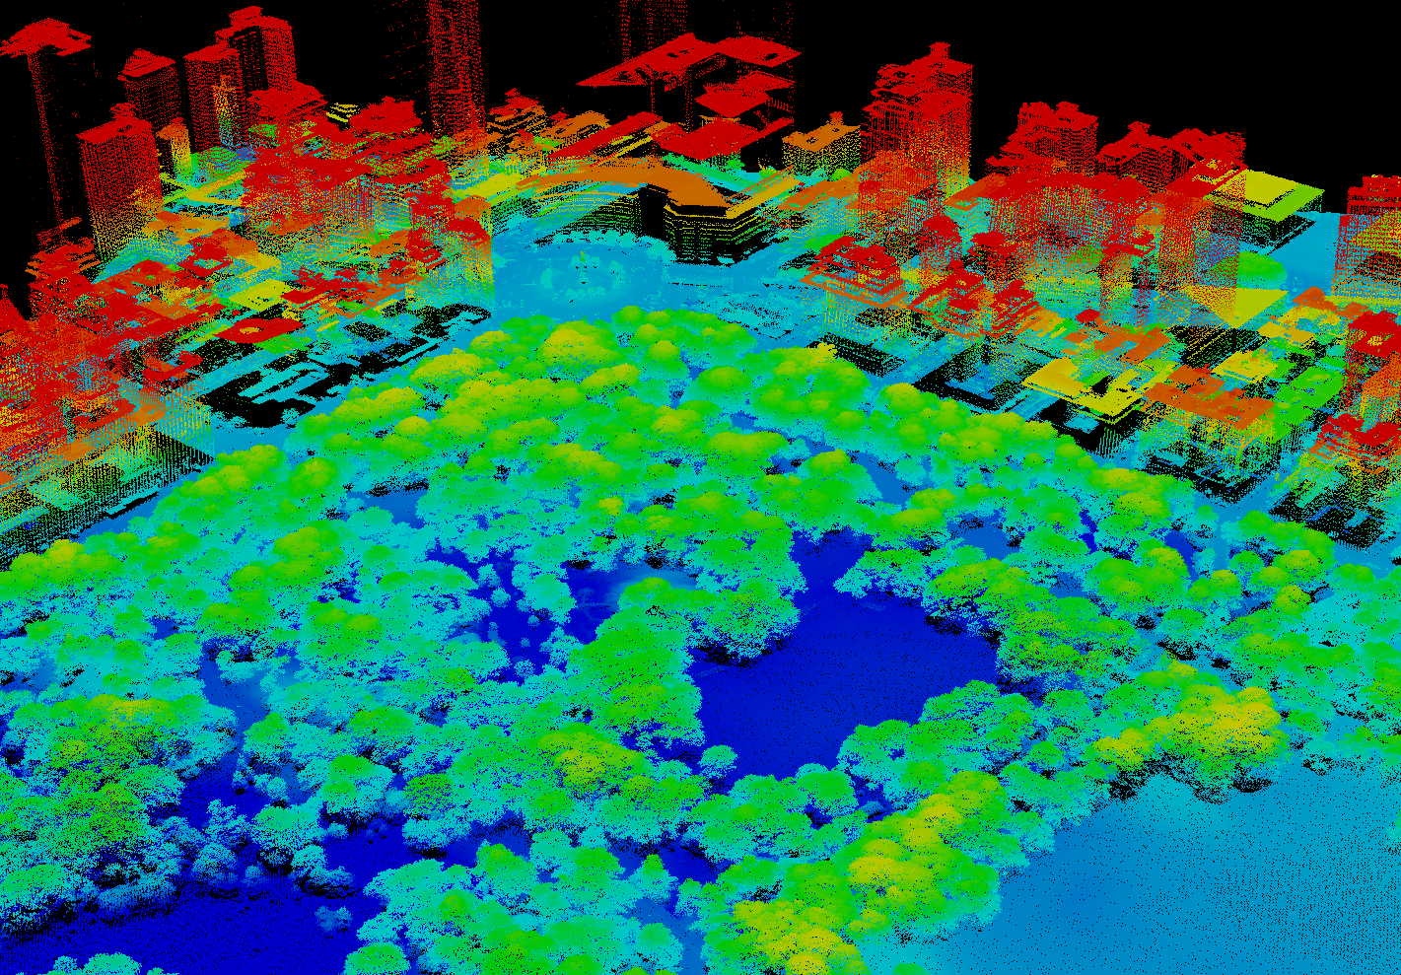

Slide 5
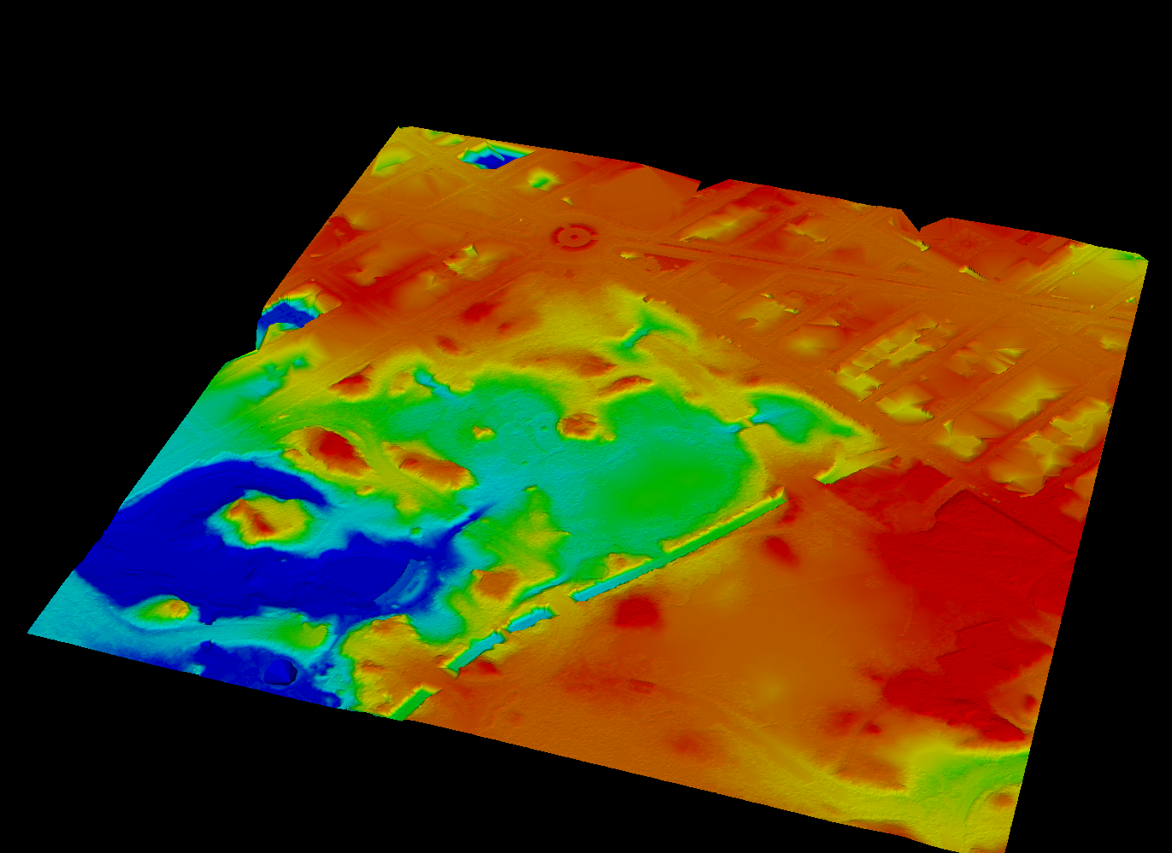
Digital Elevation Model (DEM)

Slide 6
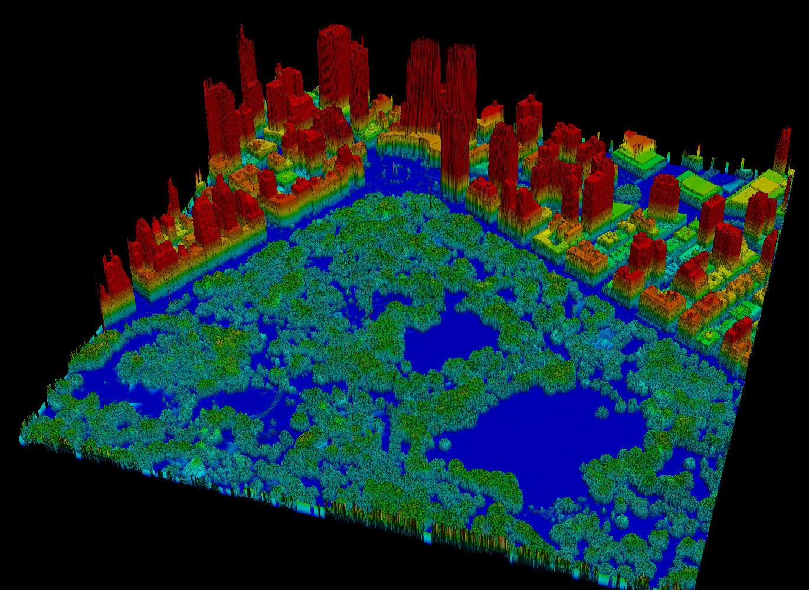
Normalized Digital Surface Model (nDSM)

Slide 7
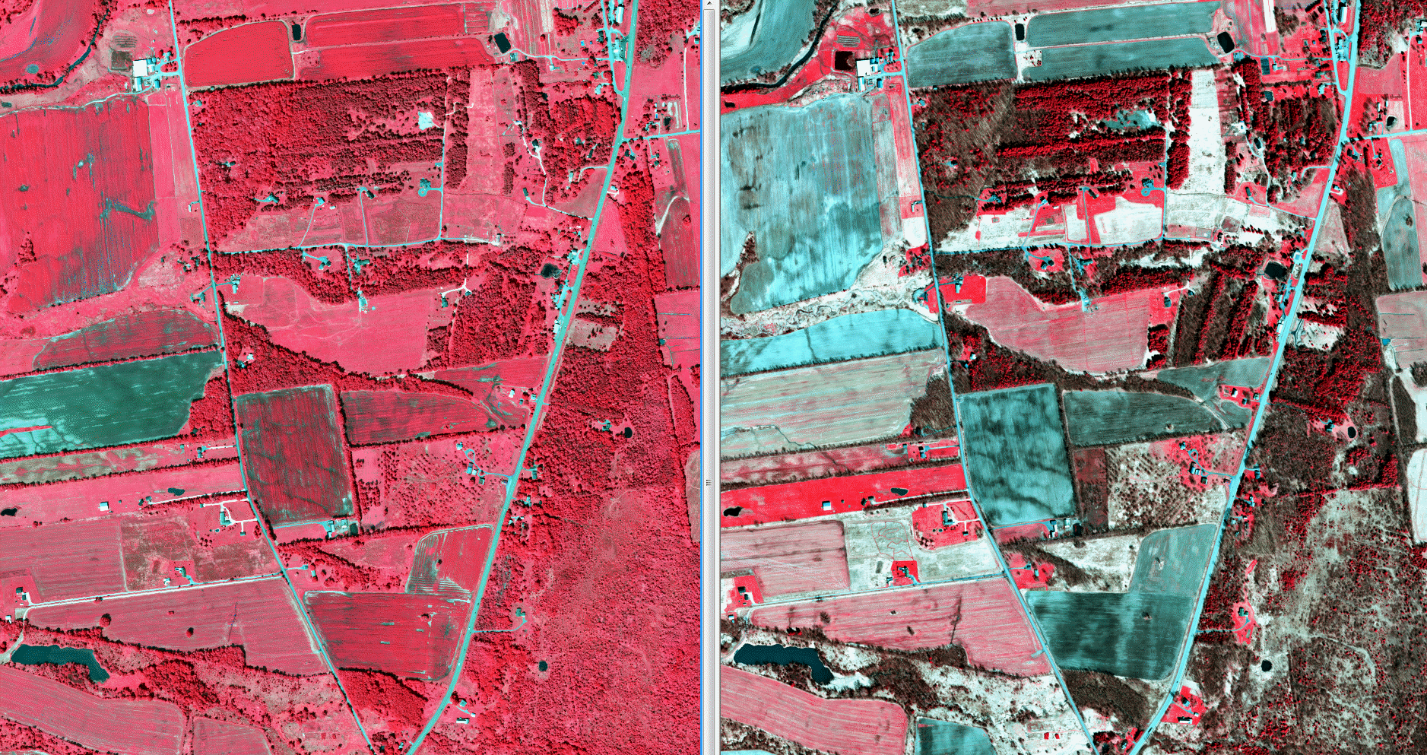
Leaf-on Orthoimagery
Leaf-off Orthoimagery

Slide 8
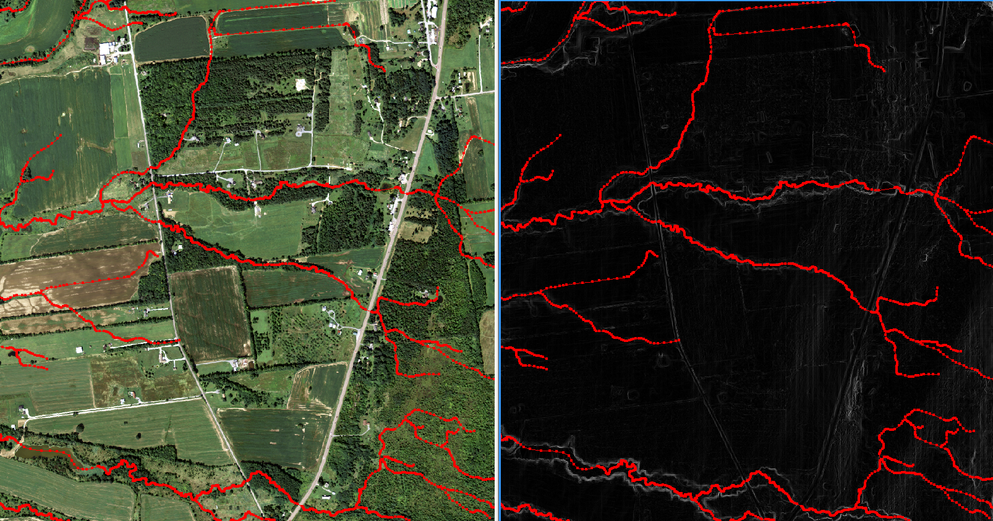
NHD Hydrology

Slide 9
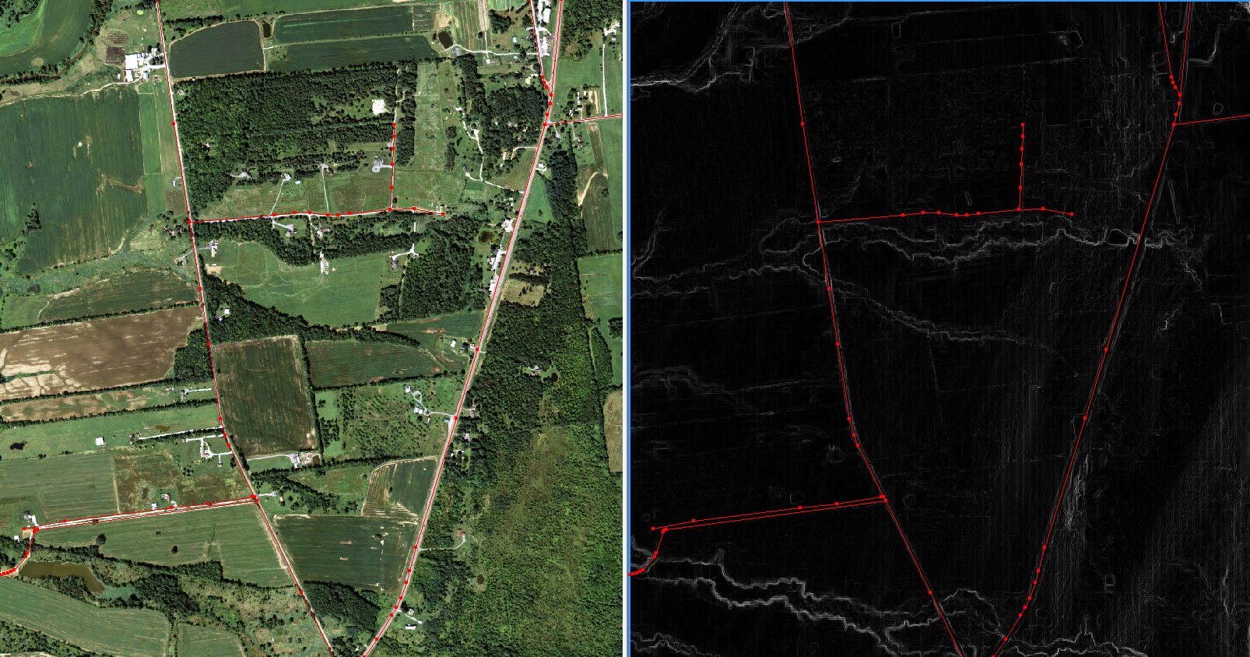
Road Centerlines

Slide 10
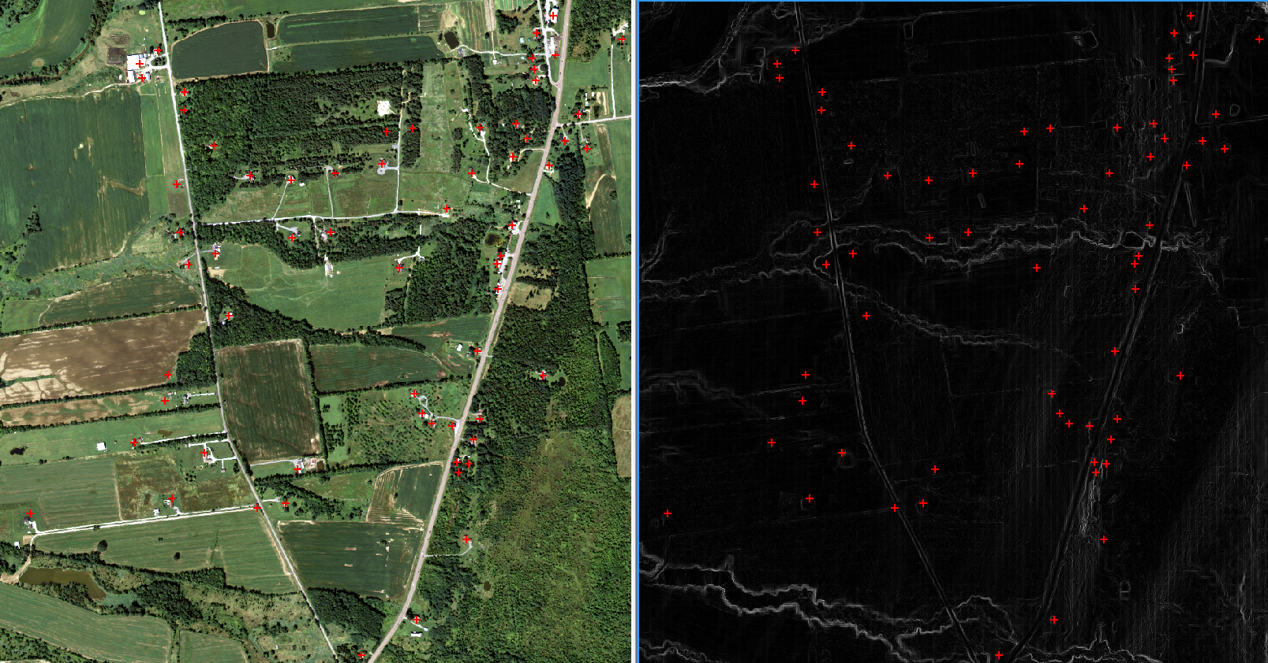
Building Locations

Slide 11
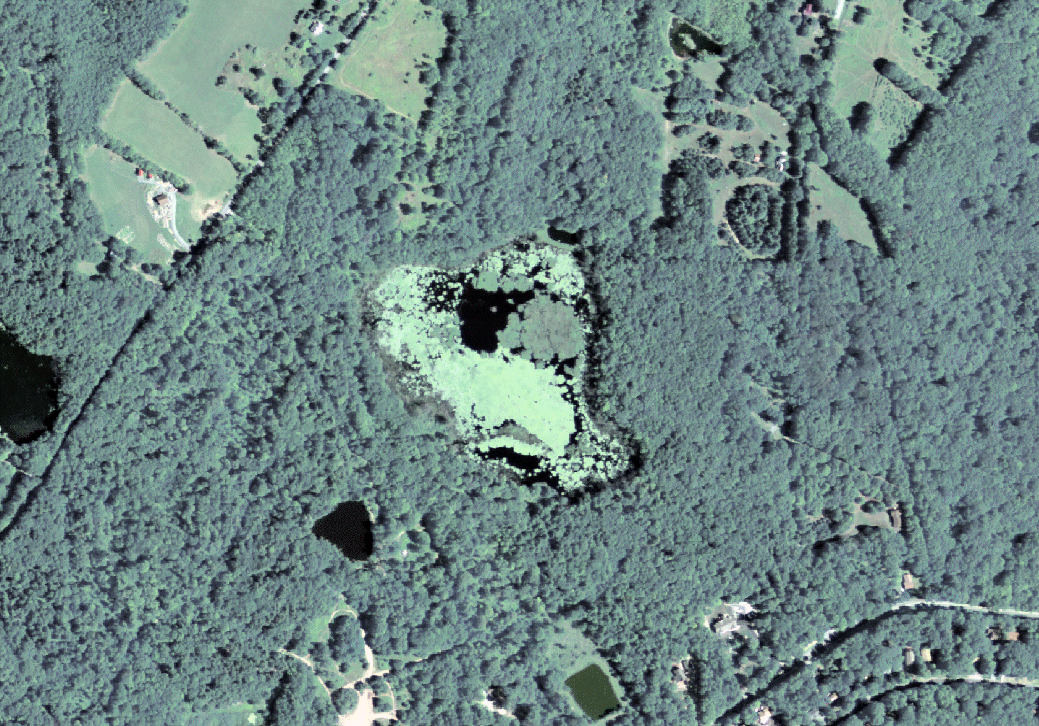
Land-Cover Mapping

Slide 12
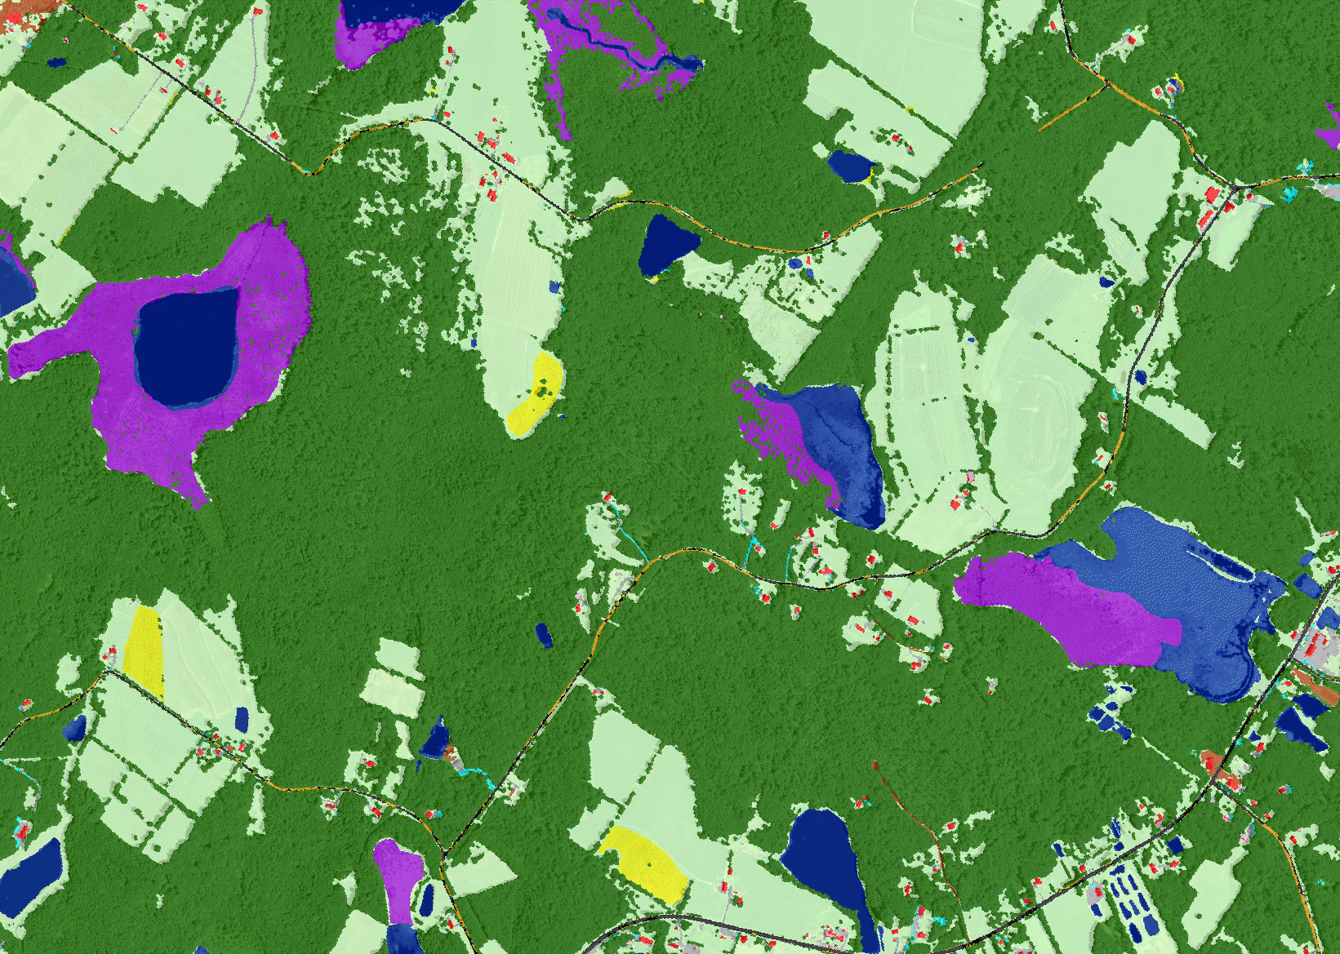
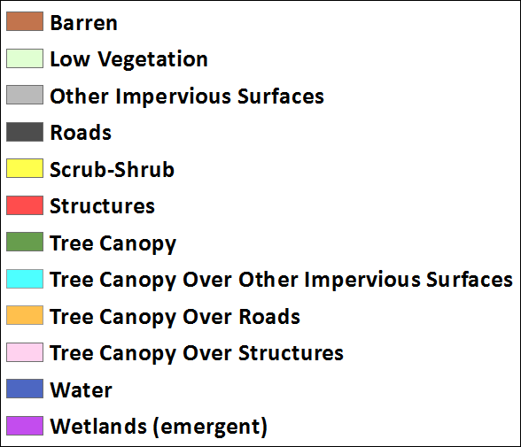

Slide 13
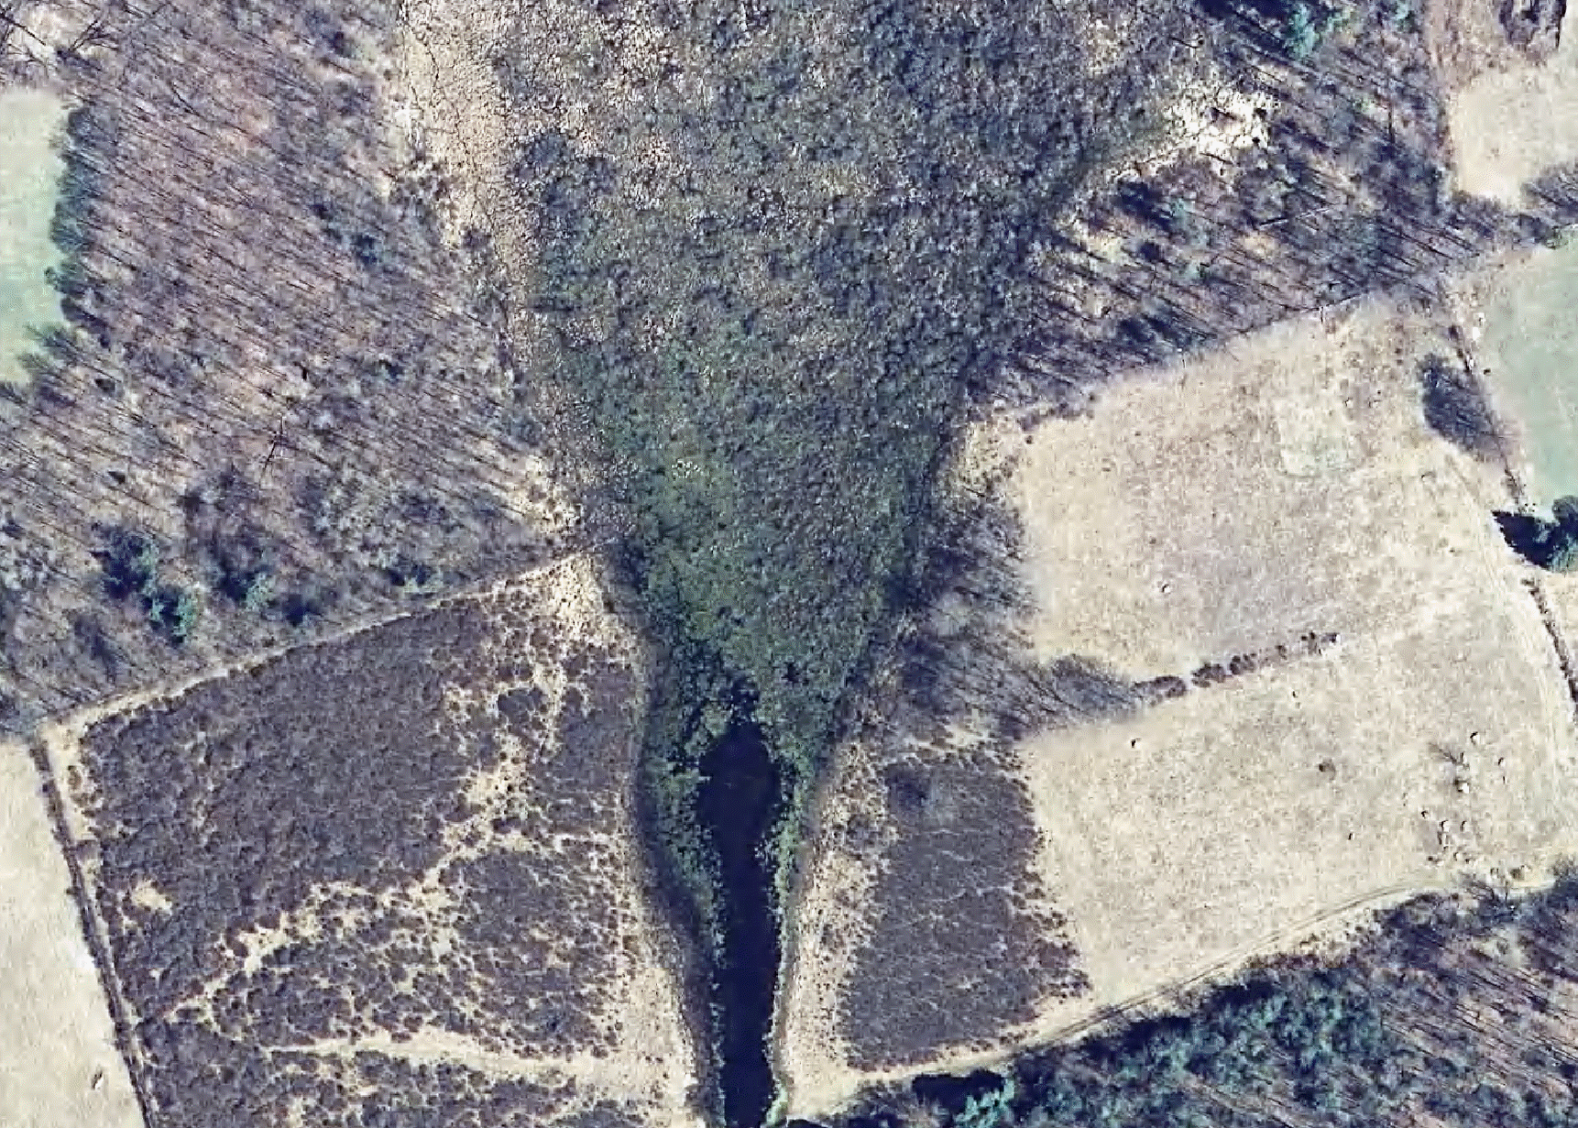
High-Resolution Wetlands Mapping

Slide 14
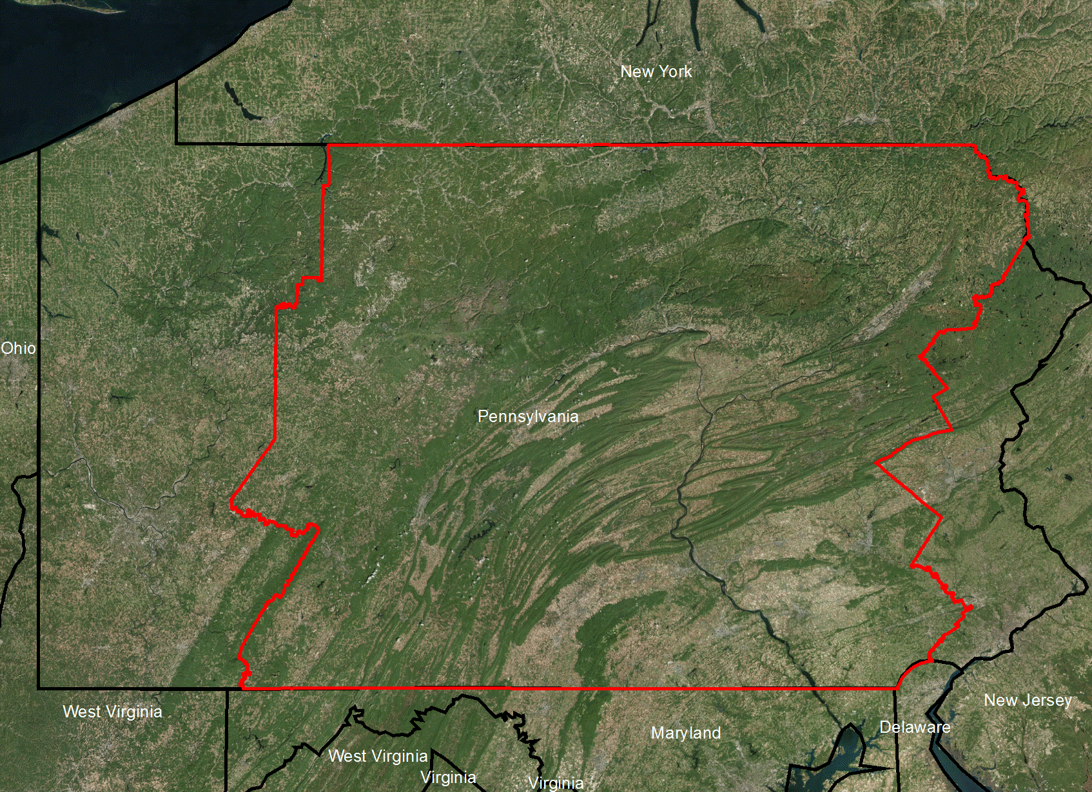
ArcGIS Online

Slide 15
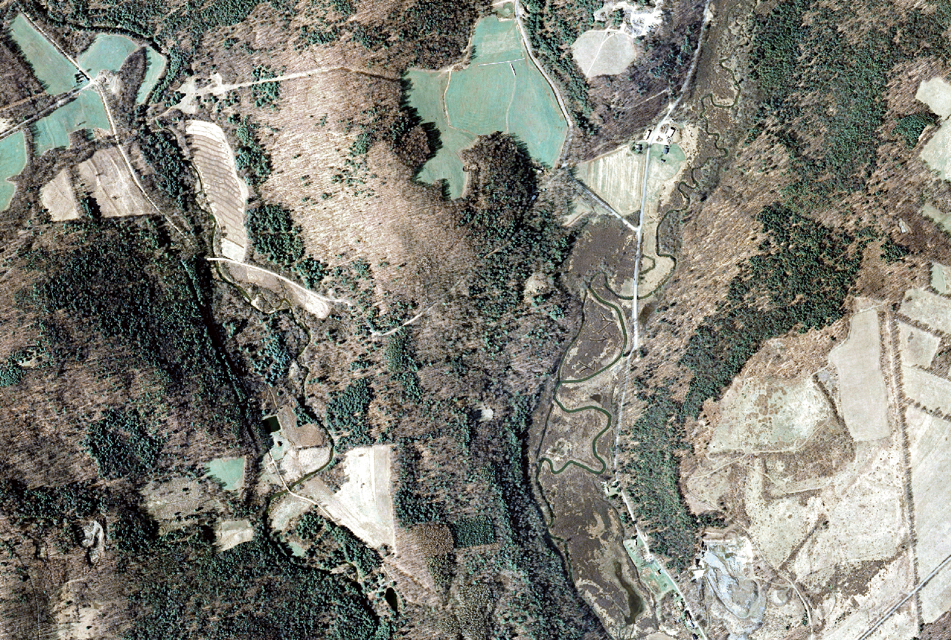

Slide 16
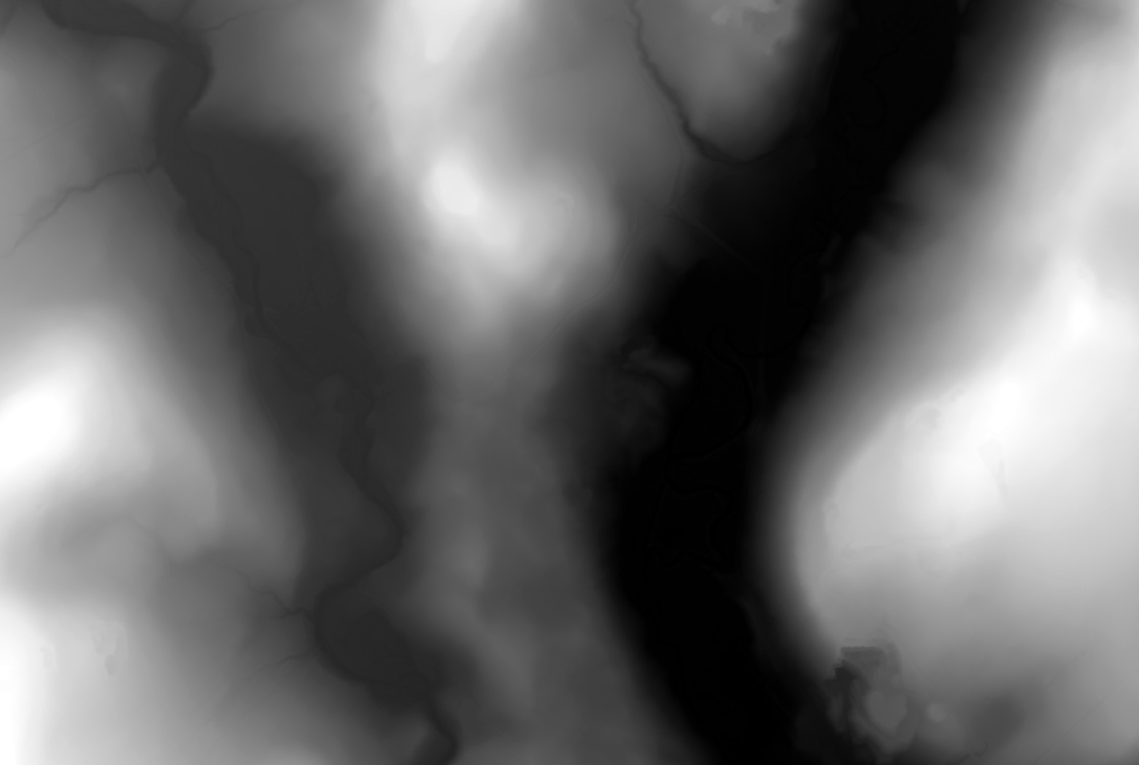
LiDAR-derived Digital Elevation Model

Slide 17
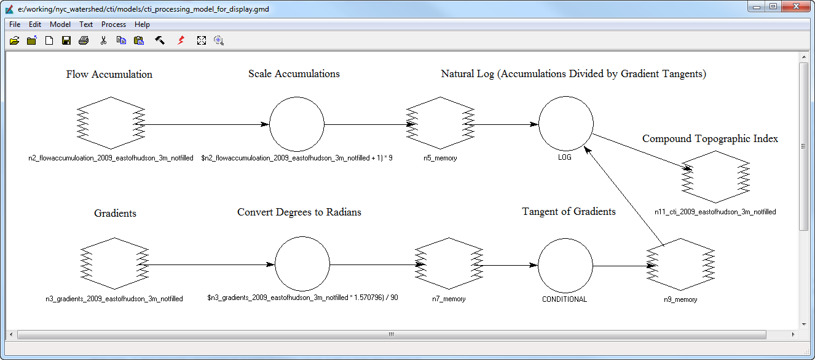
Compound Topographic Index
Bevan and Kirby (1979), as described by Rampi et al. (2014)

Slide 18
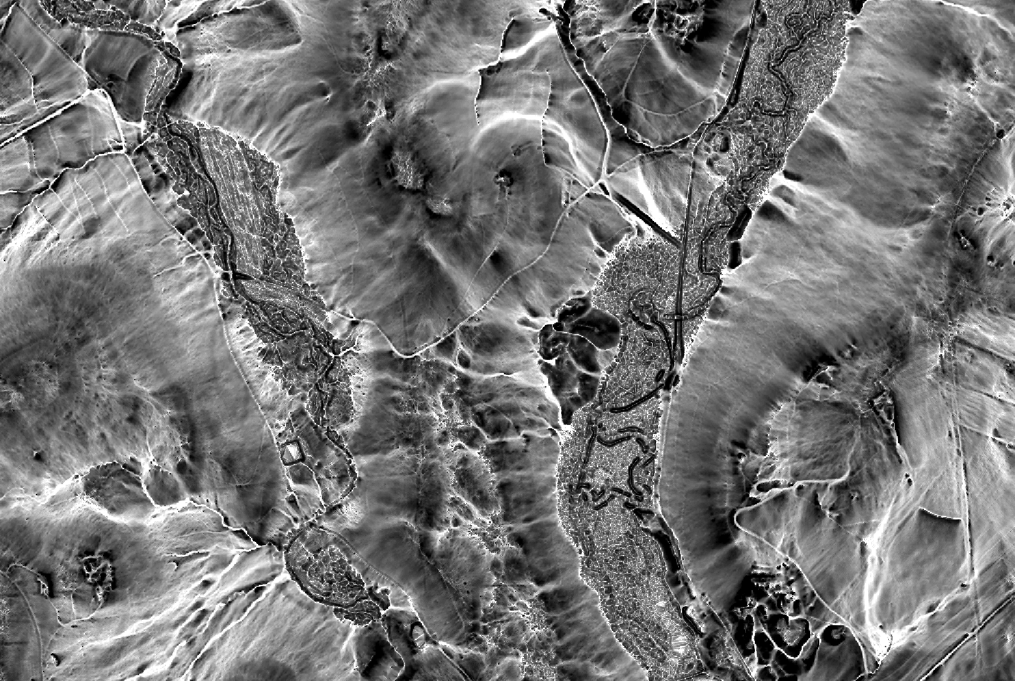

Slide 19
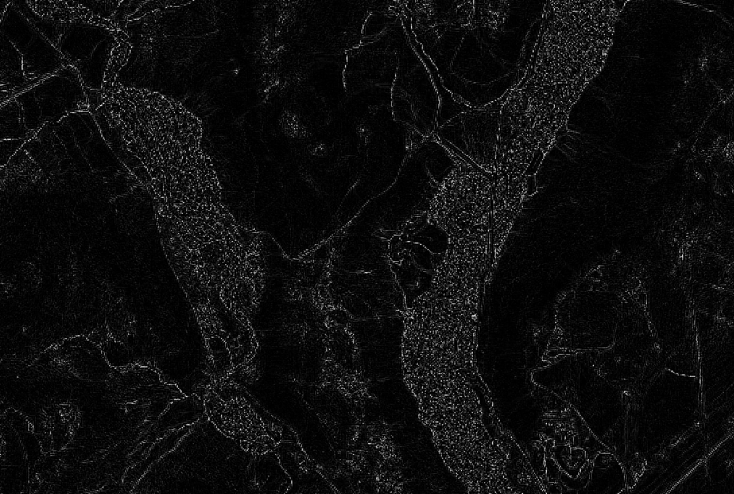
Edge Extraction Lee Sigma (Bright)

Slide 20
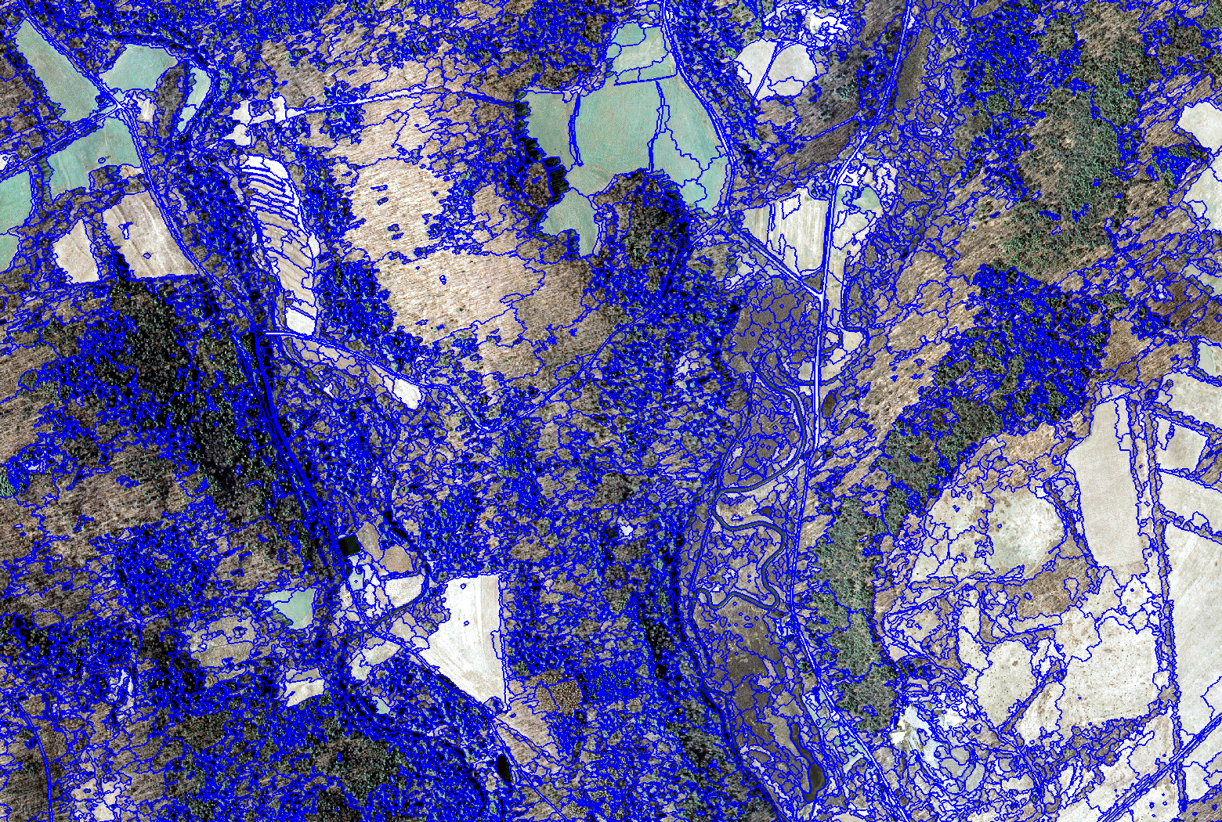

Slide 21
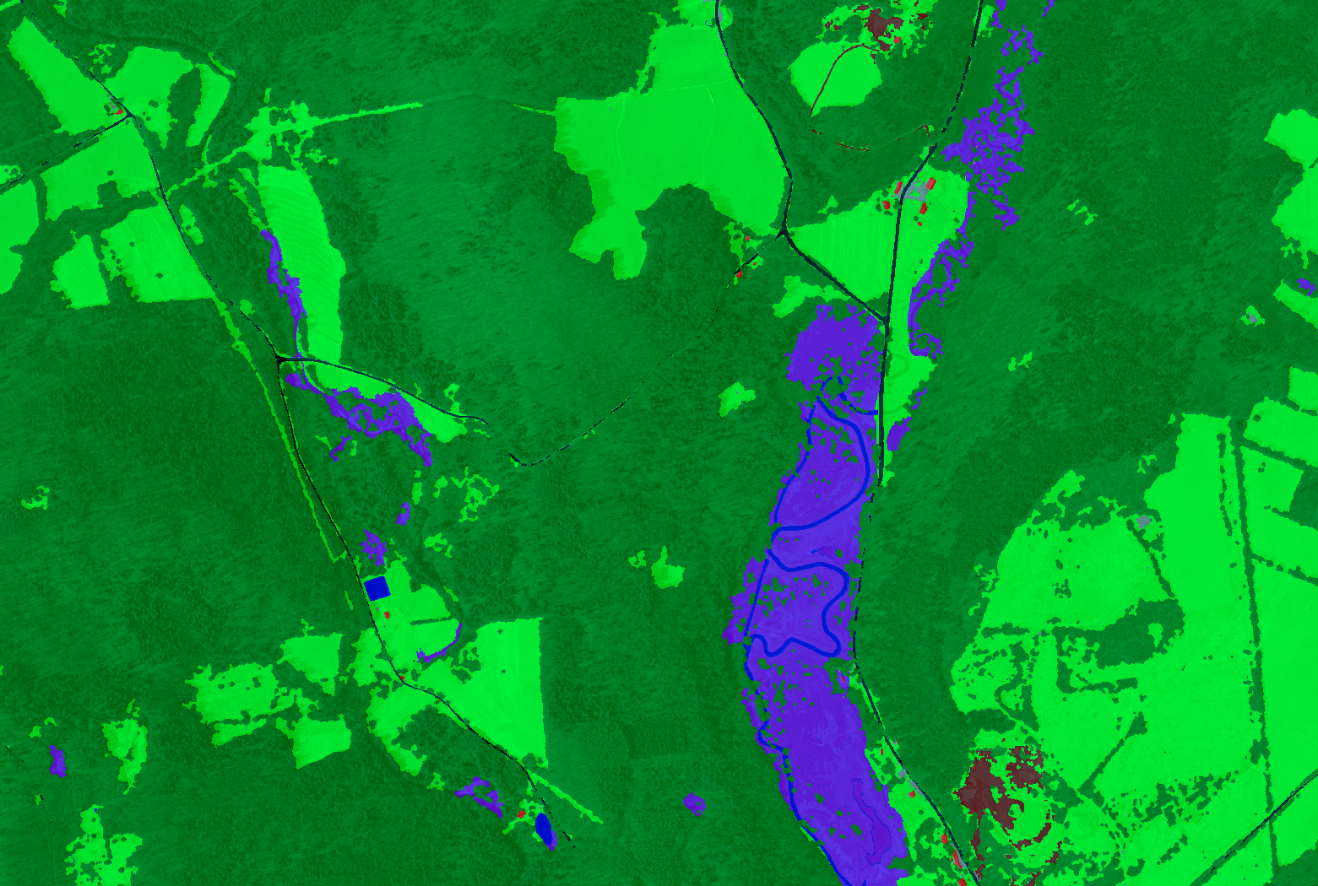

Slide 22
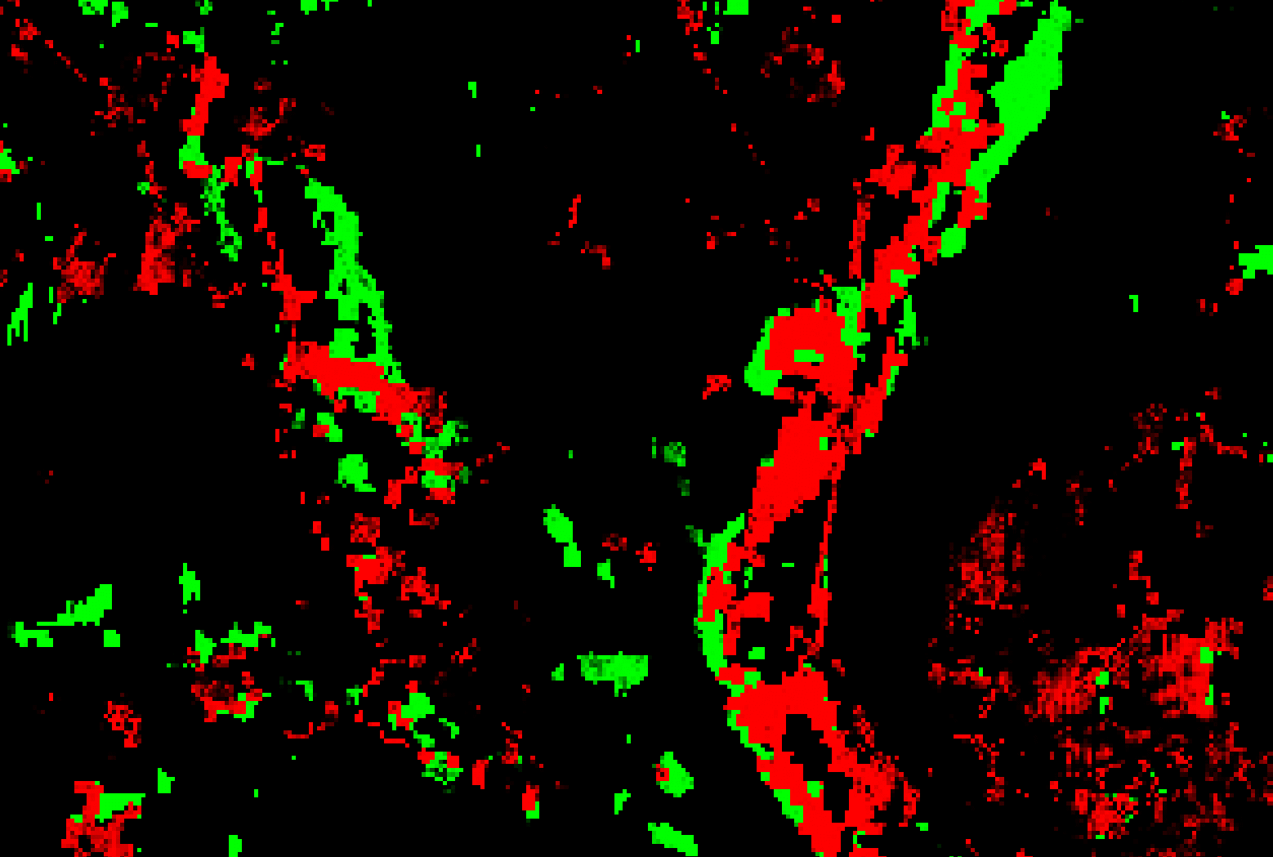
10-m Statistical Models Incorporating Topography and Climate
Patrick Raney, Upper Susquehanna Coalition

Slide 23
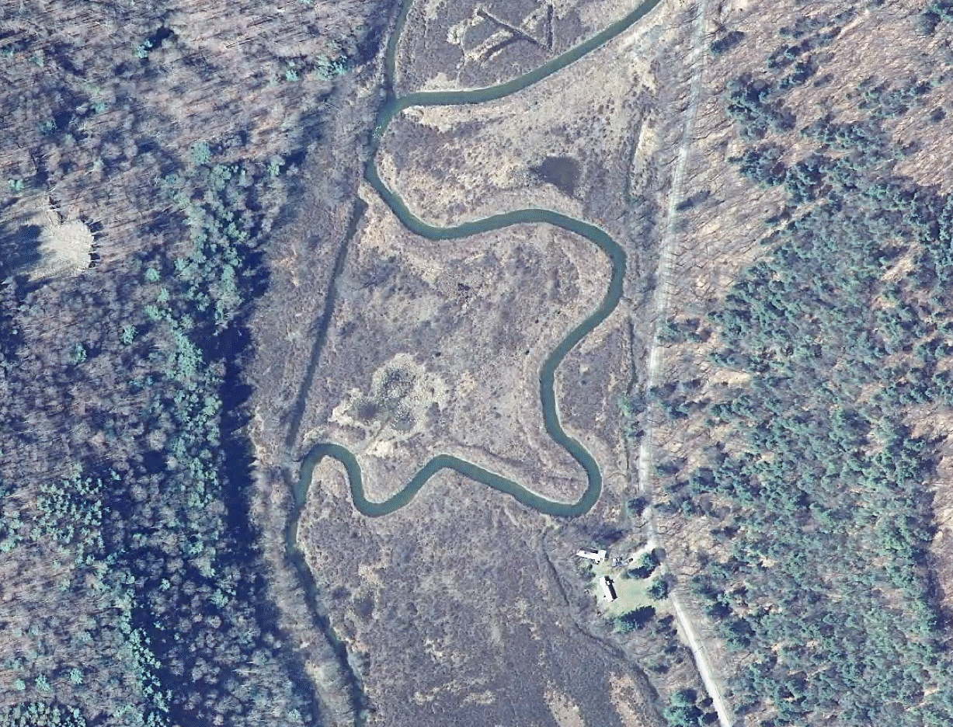
Emergent (PEM)

Slide 24
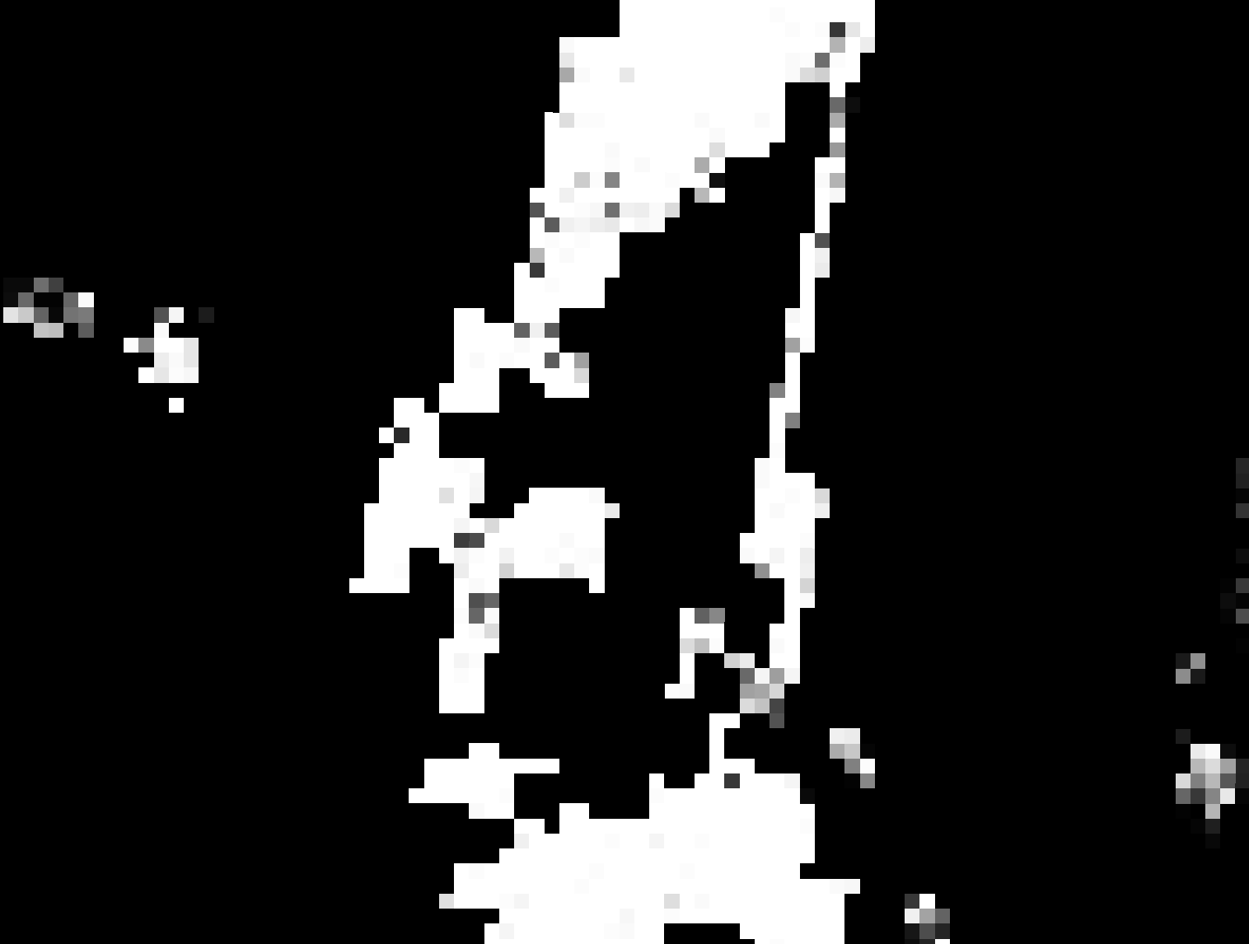
10-m PEM

Slide 25
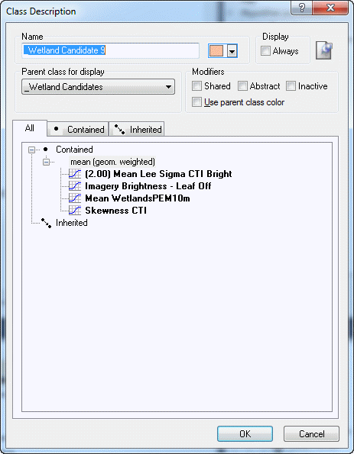
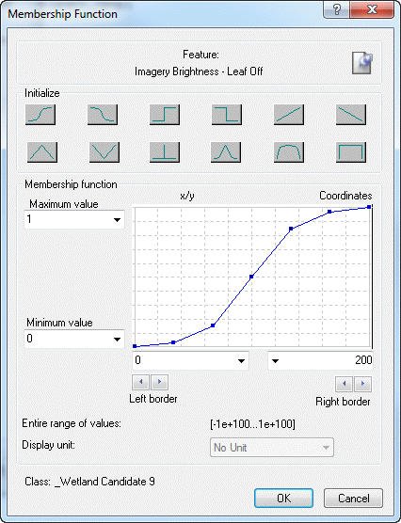

Slide 26
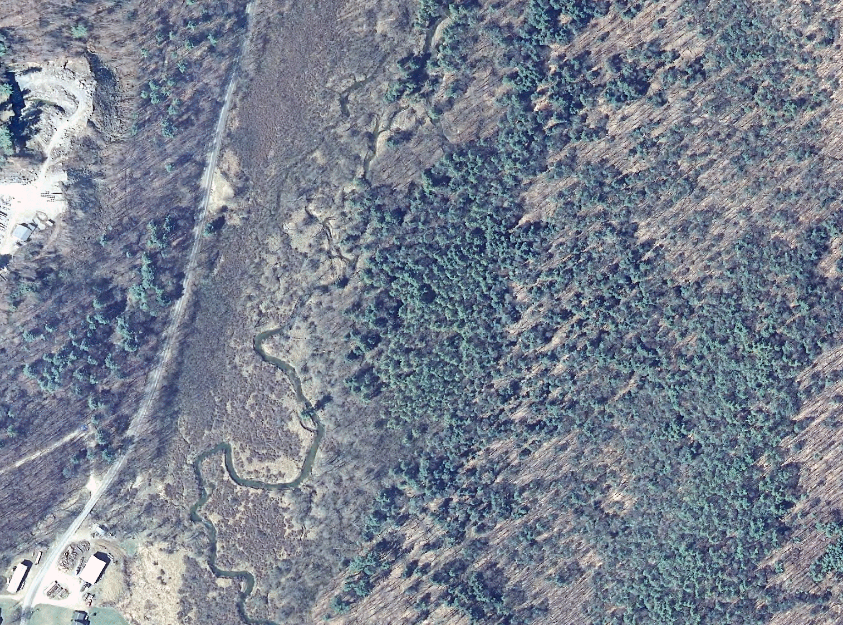
Scrub\Shrub and Forested (PSS\PFO)

Slide 27
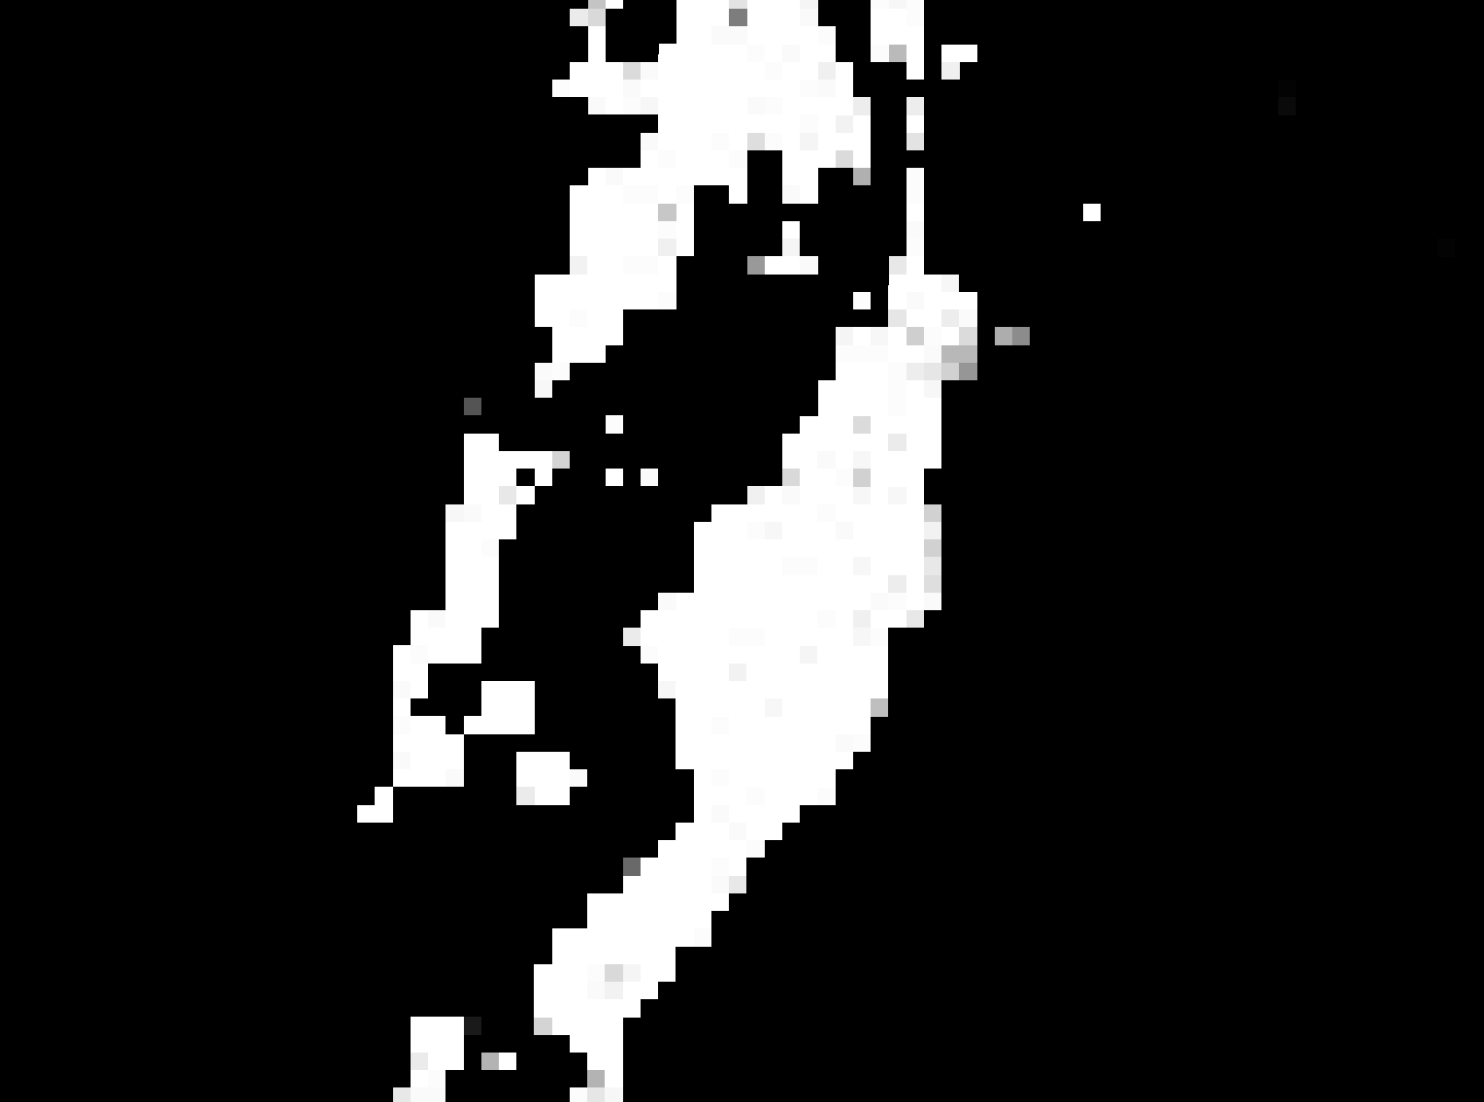
10-m PSS\PFO

Slide 28
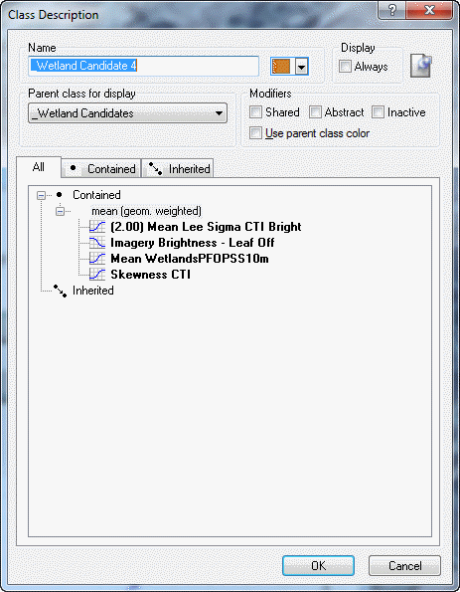
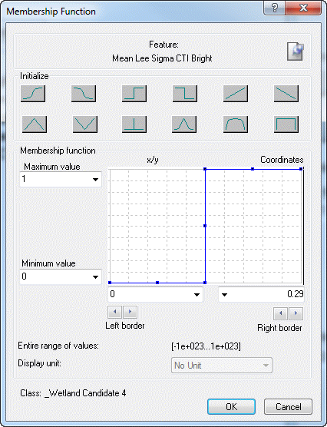

Slide 29
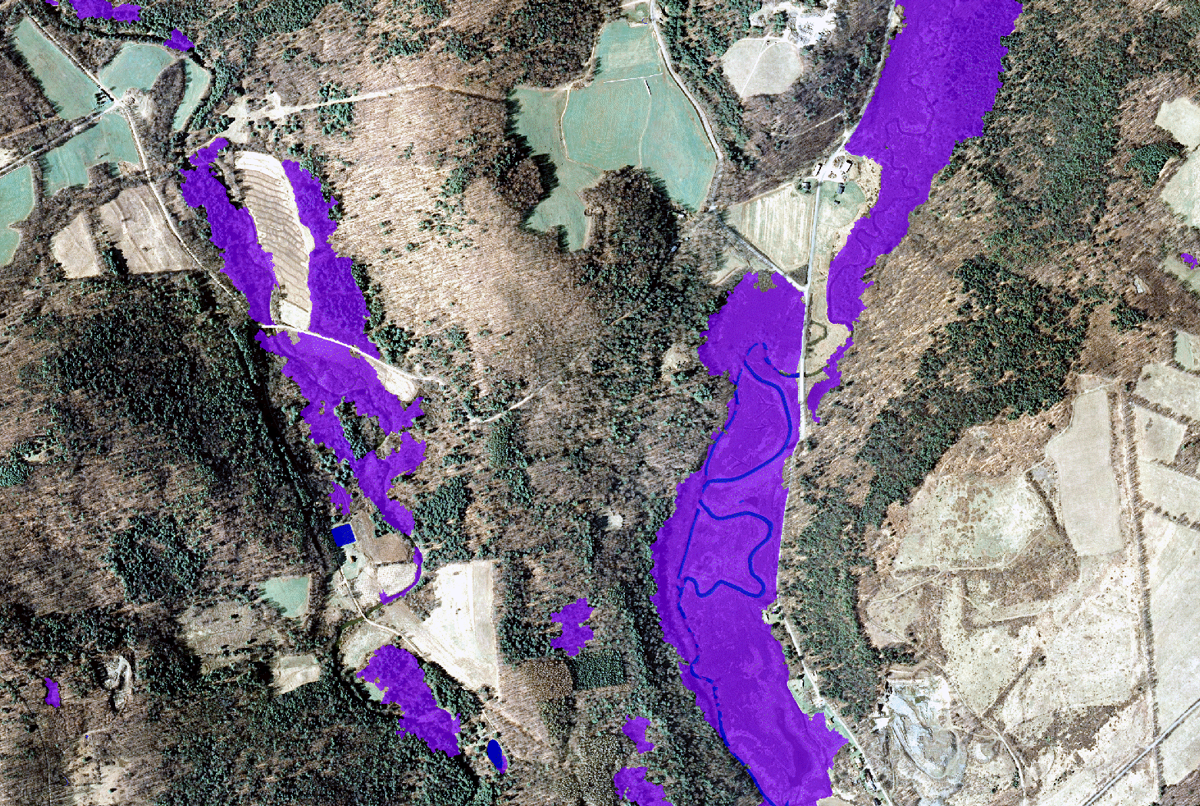

Slide 30
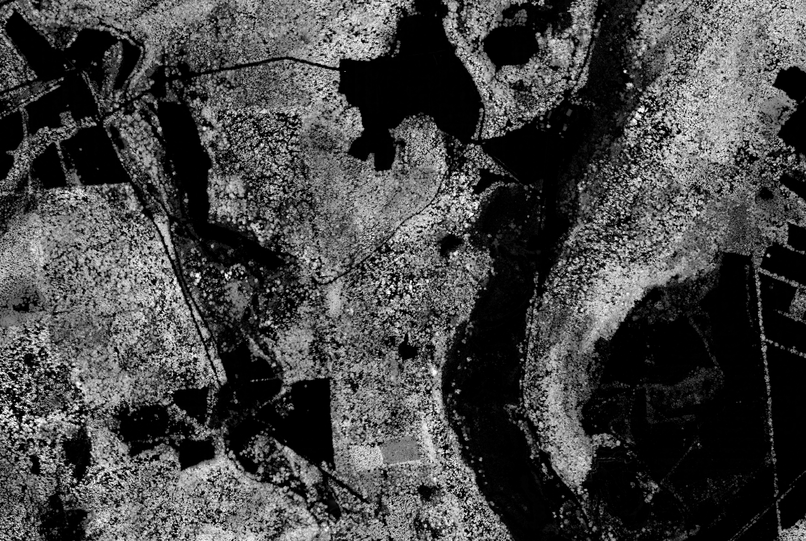

Slide 31
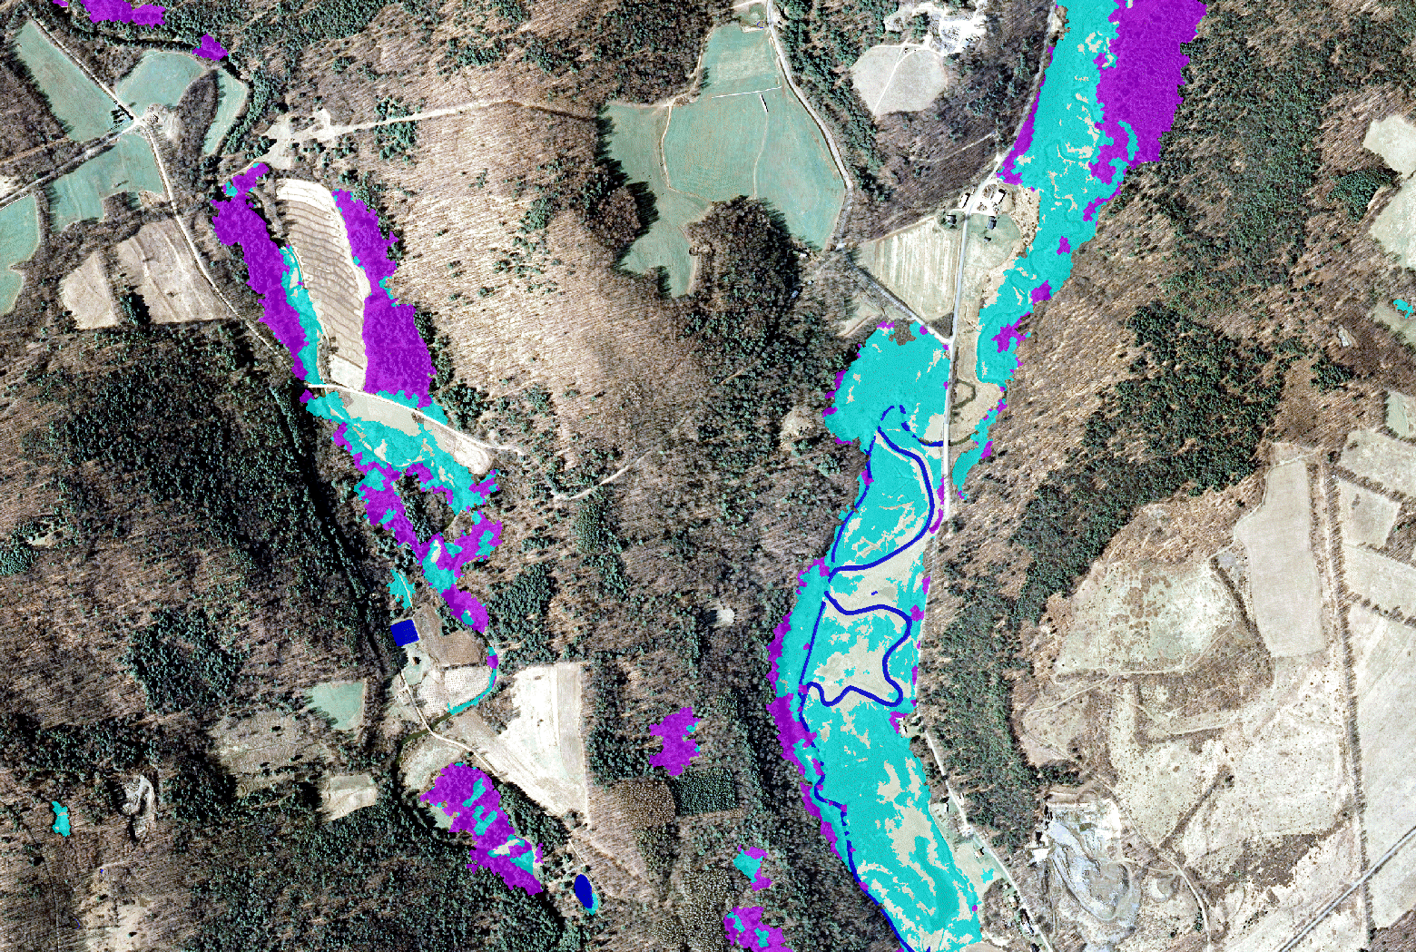
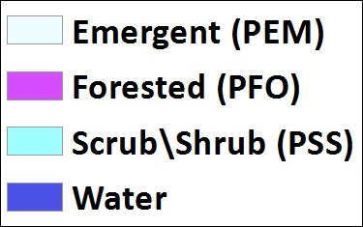

Emergent (PEM)
Forested (PFO)
Scrub\Shrub (PSS)

Slide 32
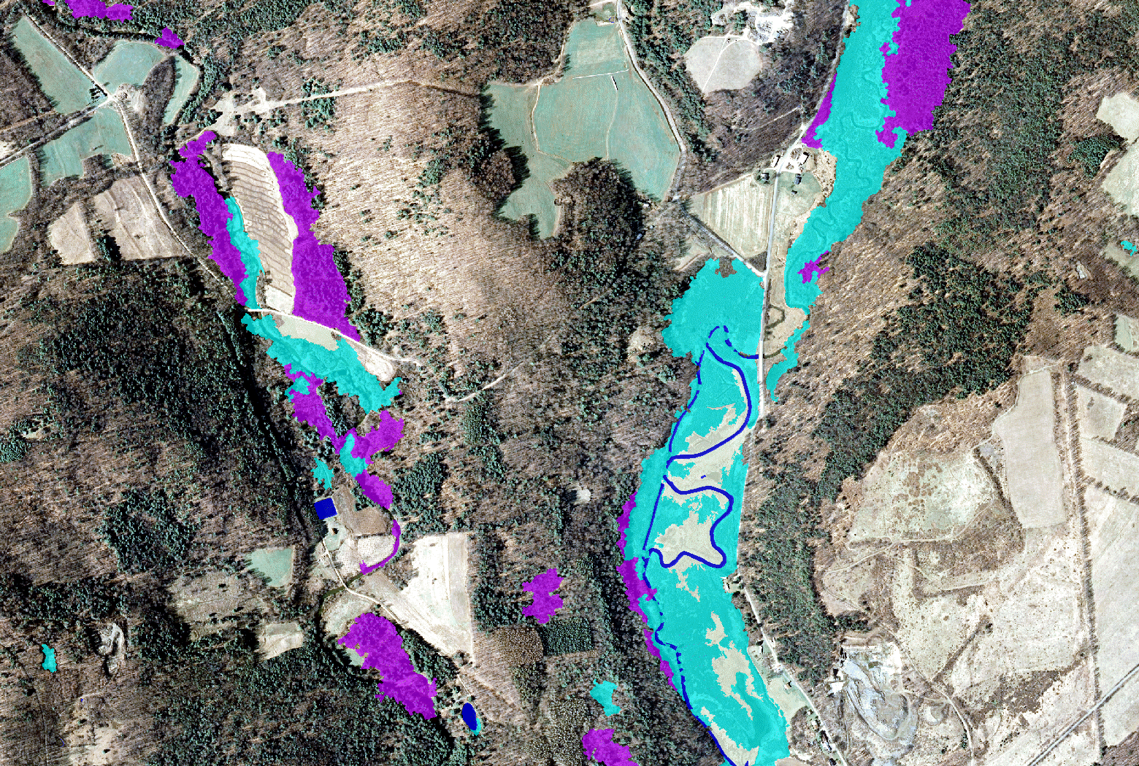
Emergent (PEM)
Forested (PFO)
Scrub\Shrub (PSS)

Slide 33
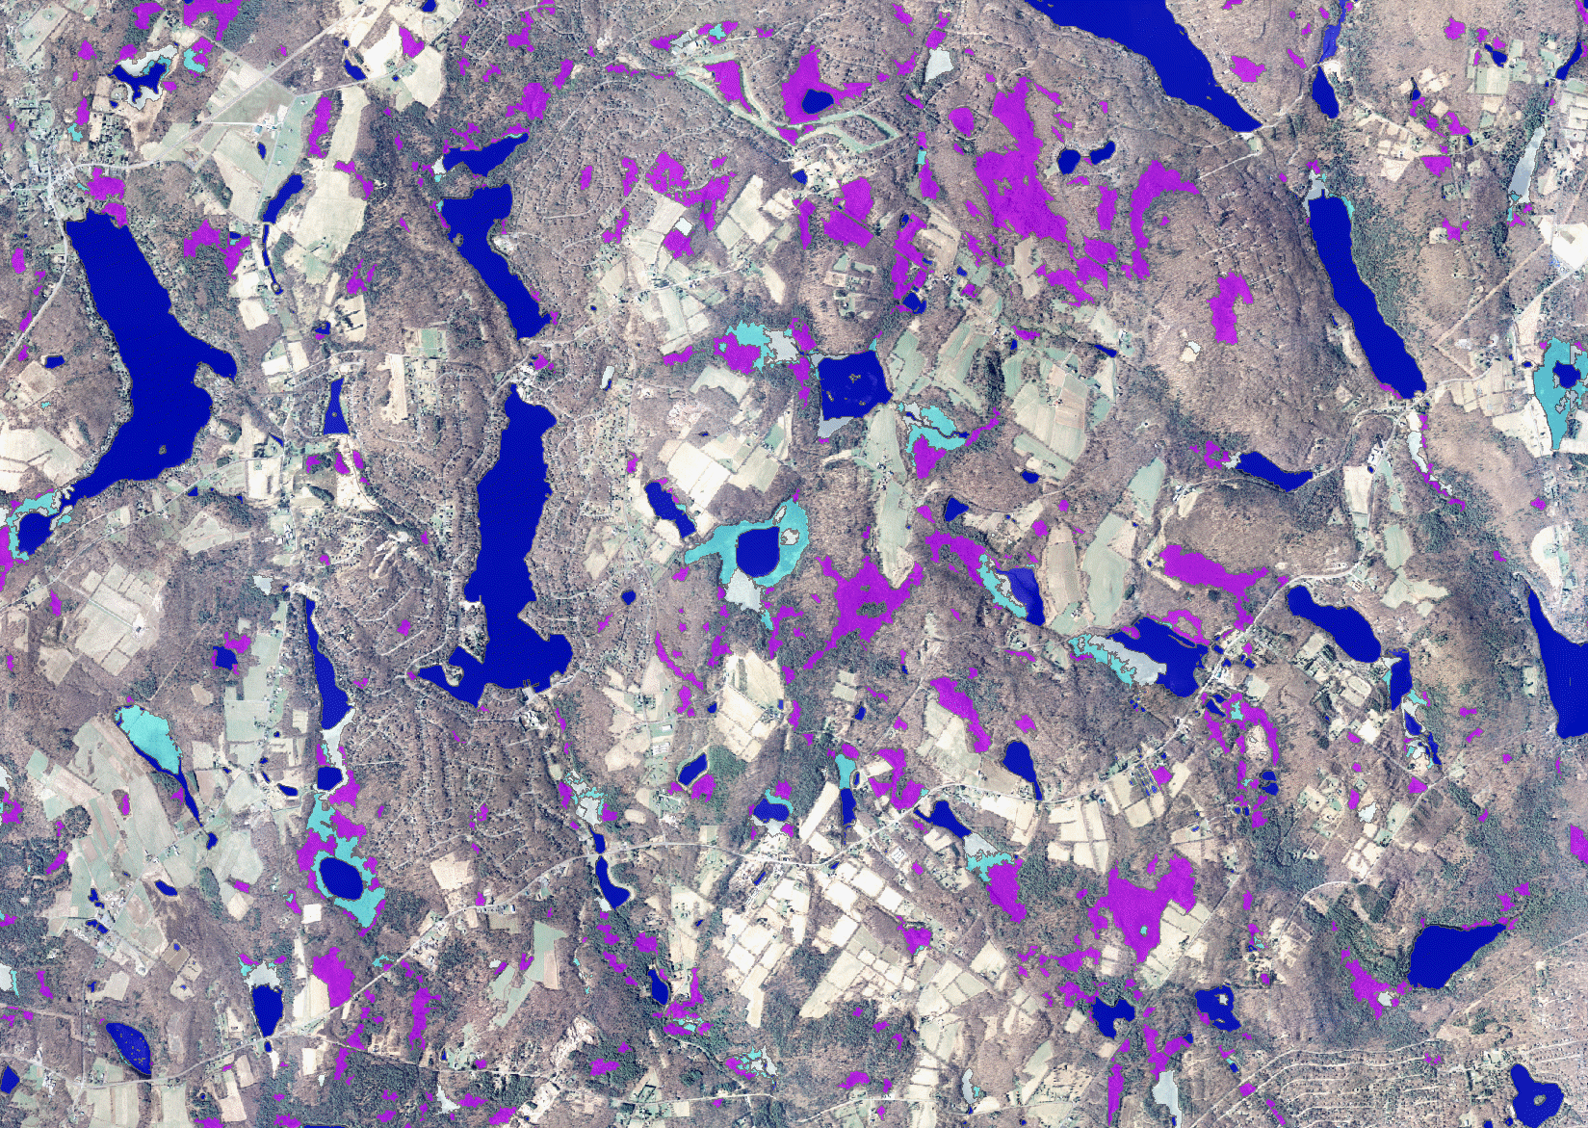
Emergent (PEM)
Forested (PFO)
Scrub\Shrub (PSS)
Notes:
Final output: 1-m resolution map with primary wetlands classes

Slide 34
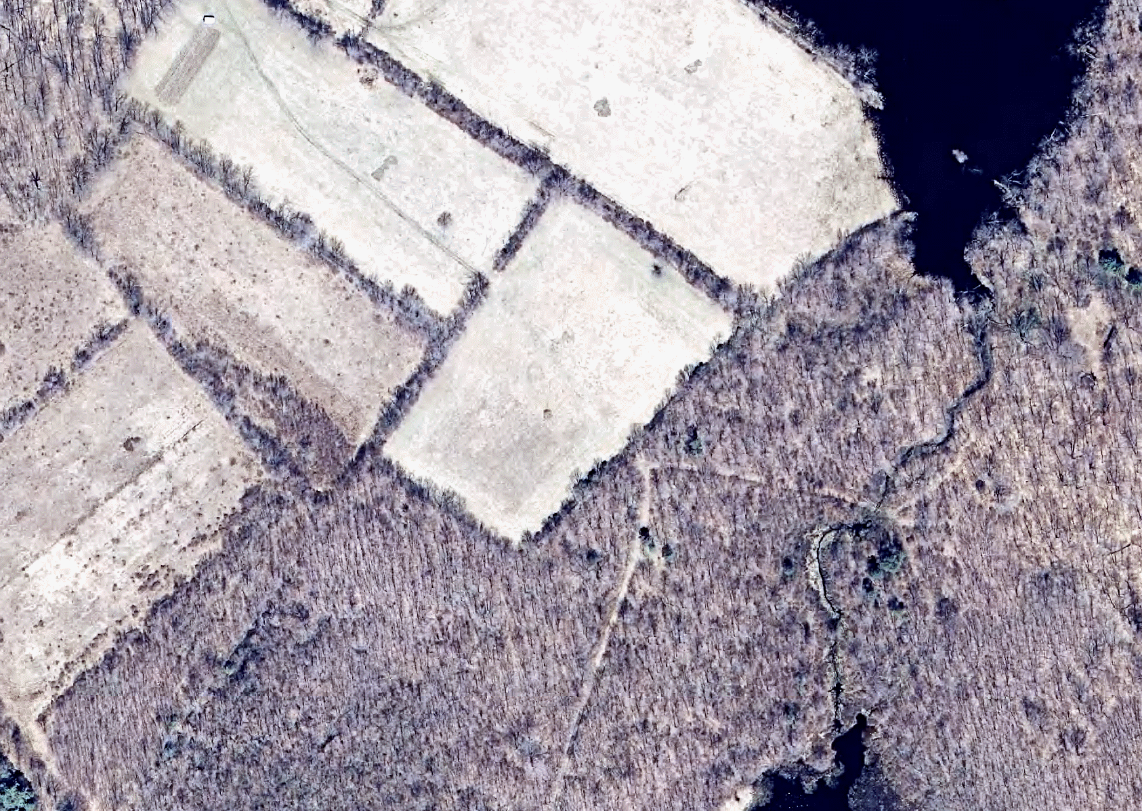

Slide 35
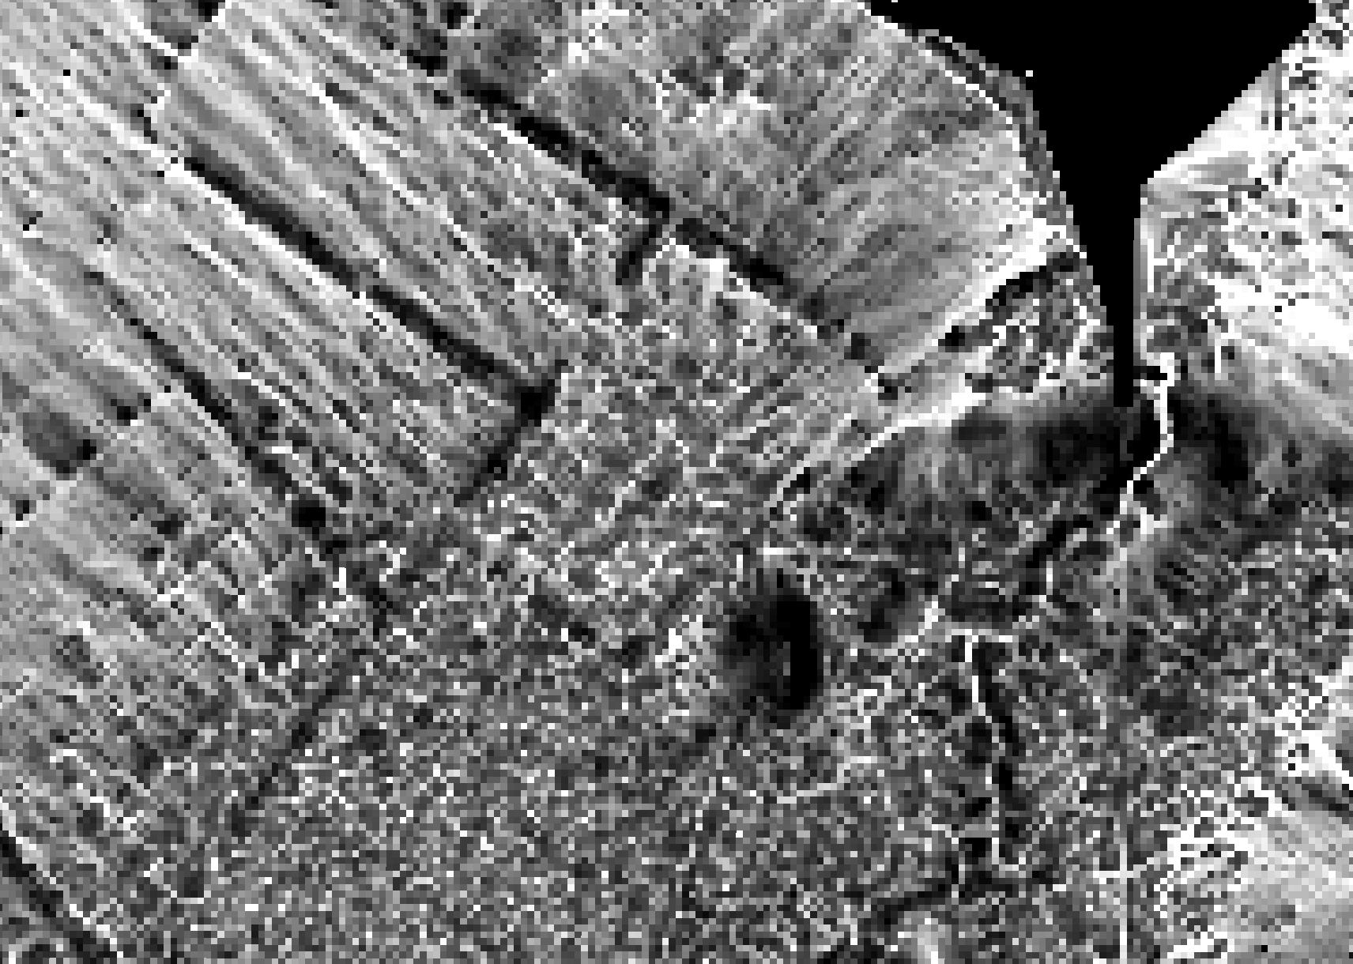

Slide 36
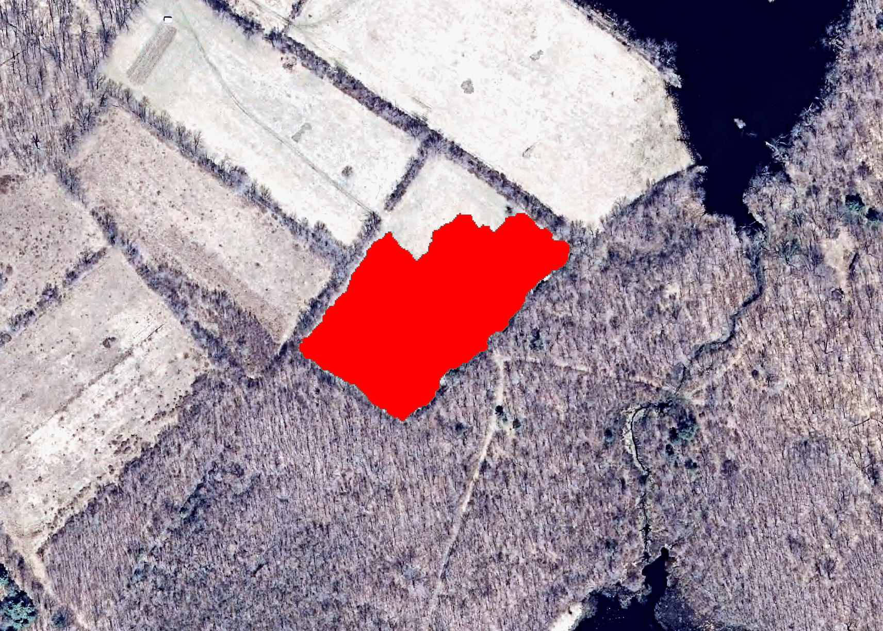

Slide 37
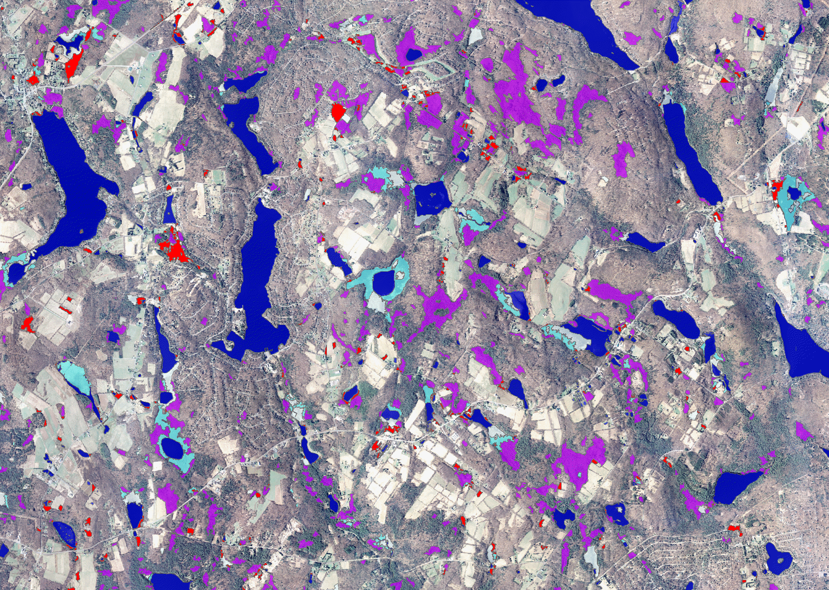
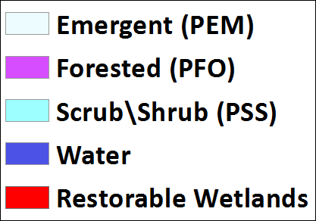
Emergent (PEM)
Forested (PFO)
Scrub\Shrub (PSS)

Slide 38
Chesapeake Bay Watershed Wetlands Mapping
Sean MacFaden, 802-656-3007, Sean.MacFaden@uvm.edu

