Slide 1
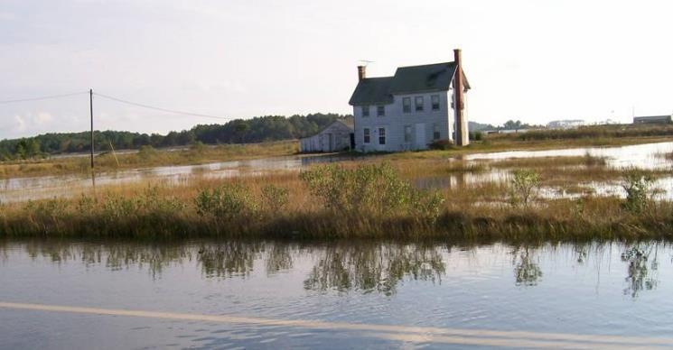
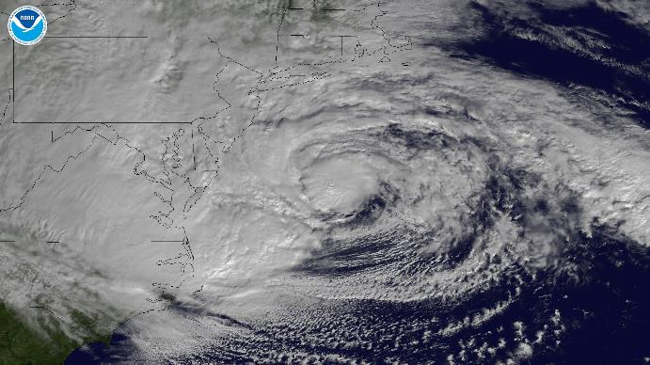
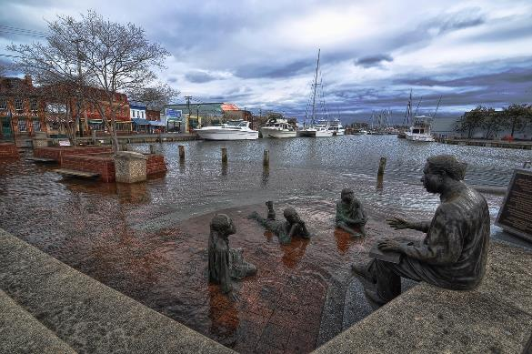



Coastal Planning Tools: Mapping Natural Solutions for Resilient Maryland Communities Nicole Carlozo, Chesapeake & Coastal Service, Maryland Department of Natural Resources
Wetland Workgroup January 26, 2017
Notes:
Share how DNR is addressing coastal resiliency through planning and tool development. We released a new spatial planning tool in 2016 in collaboration with The Nature Conservancy. Provide background on tool development and how spatial data is being integrated into decision-making, and what our next steps are to make this data more robust.

Slide 2
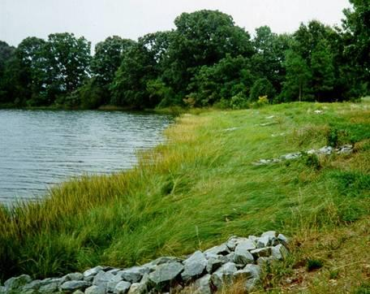
Building Resilience to Climate Change Policy - 2010
“It is the policy of the Maryland Department of Natural Resources to make sound investments in land and facilities and to manage its assets and natural resources so as to better understand, mitigate and adapt to climate change.”
Notes:
Maryland’s Coastal Resiliency Planning builds off of both state and regional policies. In 2010, DNR recognized that climate change will impact the state’s natural resources, and the Department adopted a policy on Building Resilience to Climate Change. In adherence to this policy, DNR considers climate impacts within land investment, infrastructure siting & design, and habitat restoration decisions. A few years after this policy, Hurricane Sandy made landfall on the East Coast and there was renewed interest in identifying conservation and restoration projects that would provide coastal protection benefits for communities.

Slide 3
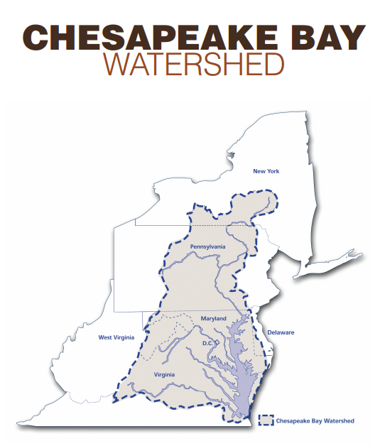
2014 Climate Resilience Watershed Goal
Goal: Increase the resiliency of the Chesapeake Bay watershed, including its living resources, habitats, public infrastructure and communities, to withstand adverse impacts from changing environmental and climate conditions.
Adaptation Outcome: Continually pursue, design, and construct restoration and protection projects to enhance the resiliency of bay and aquatic ecosystems from the impacts of coastal erosion, coastal flooding, more intense and more frequent storms and sea level rise.
Notes:
Then, in 2014, the Chesapeake Bay Watershed Agreement was re-signed with a new Climate Resilience Goal. This goal calls on jurisdictions to increase the resiliency of the Chesapeake Bay watershed, including its living resources, habitats, public infrastructure and communities. One means of meeting this goal is through the pursuit, design and implementation of restoration and protection projects to enhance ecological and community resiliency.

Slide 4
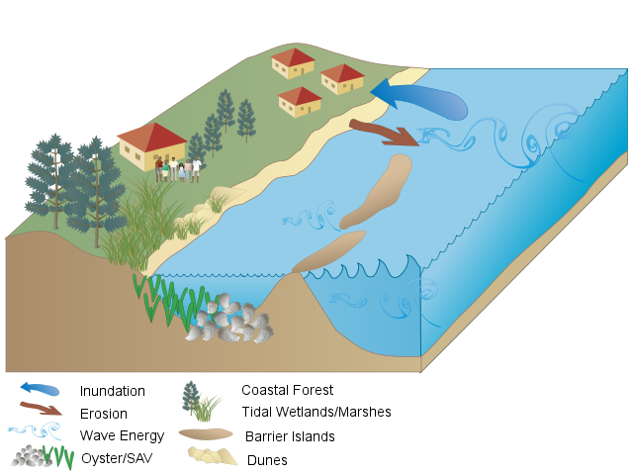
Coastal Resiliency Assessment Goal
Evaluate the risk reduction benefits of existing natural features and establish priorities for conservation and restoration to enhance resiliency of communities impacted by coastal hazards.
Notes:
To build off of these state and regional efforts, and to address the state’s data gaps, DNR pursued a Coastal Resiliency Assessment. The overall goal of this Assessment is to proactively identify, protect, and enhance coastal habitats that provide coastal protection benefits to residents. Through the Assessment, we 1) evaluated the risk-reduction benefits of the state’s existing natural features, and 2) established priorities for conservation/restoration that will enhance resiliency of coastal communities. We took a comprehensive look at Maryland’s shorelines, as well as marsh complexes.

Slide 5
Natural Features / Infrastructure
US Army Corps 2015, Use of NNBF for Coastal Resilience
Notes:
When we use the term “natural features” we are referring to coastal habitats that enhance coastal community resiliency through wave attenuation, shoreline stabilization, and infiltration. For this assessment, we considered tidal wetlands and marshes, coastal forests, oyster reefs, submerged aquatic vegetation, and dunes.

Slide 6
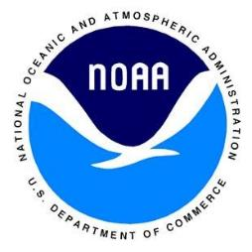
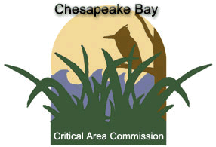
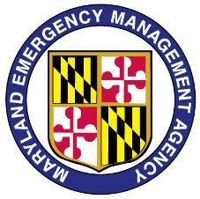
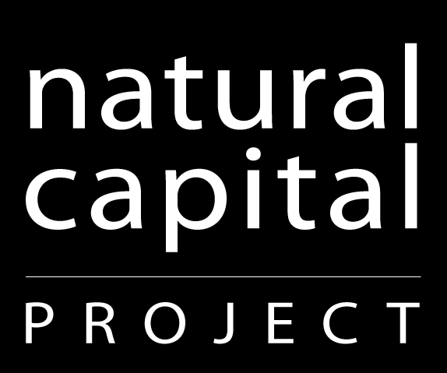


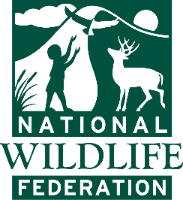






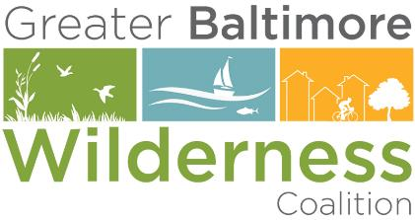

Coastal Resiliency Partnerships
Notes:
To meet the goals of the Assessment, DNR worked very closely with The Nature Conservancy and many state, federal, and non-profit partners (listed here) to develop the Assessment methodologies and products. We drew on previously developed methodologies from The Nature Conservancy, the Natural Capital Project, and the Army Corps of Engineers to develop an analysis appropriate for us at the state scale. We engaged a widely-represented Steering Committee to ensure that the products were useable by as many partners as possible.

Slide 7

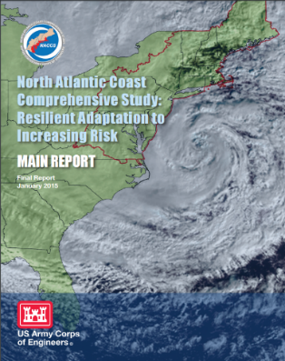
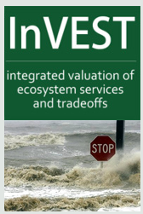
Coastal Resiliency Evaluation Terms & Definitions
Resiliency – The ability of a community to prepare for, respond to, and recover from a coastal hazard event.
Where are the people?
Are there demographic/social metrics or community characteristics that limit community resiliency?
Where are the hazards?
Identify physical parameters that contribute to erosion and inundation risk.
Where are the habitats?
Identify natural features that provide risk- reduction benefits.
Notes:
The Steering Committee defined resiliency as “the ability of a community to prepare for, respond to, and bounce back from a coastal hazard event.” To evaluate resiliency, we asked ourselves 3 questions. First, where are the people, and are there demographic or social metrics that indicate reduced community resilience? Second, Where are the hazards, or coastal areas at higher risk to erosion and flood impacts? And third, where are the habitats, of coastal features that provide risk-reduction benefits to nearby communities? To answer these questions, we downscaled a regional Army Corps analysis (NACCS) and modified a model developed by the Natural Capital Project called the InVEST Coastal Vulnerability model.

Slide 8
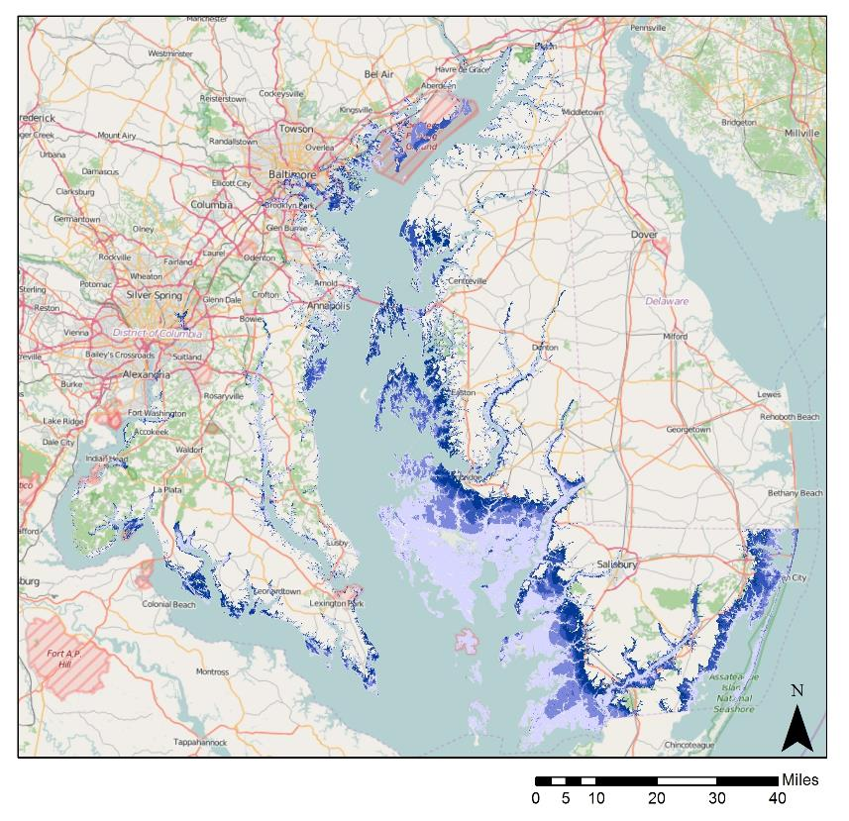
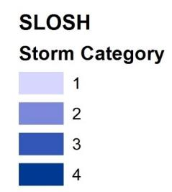
Study Area
Furthest extent of flood hazard event: Hurricane Events Category 1-4
Sea, Level, and Overland Surges from Hurricanes Model
Landscape Scale - Coast
Notes:
The study area for the Assessment includes tidal areas of Maryland’s coastal zone. We defined this area as the furthest extent of a flood hazard event as identified by the SLOSH model Category 4 storm surge extent. This narrows our focus to natural features that reduce flooding and erosion impacts from coastal storms. Riverine and upland flooding were beyond the scope of this study and were not considered within this analysis.

Slide 9
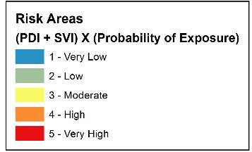
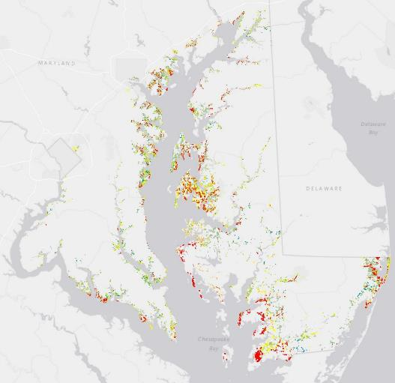
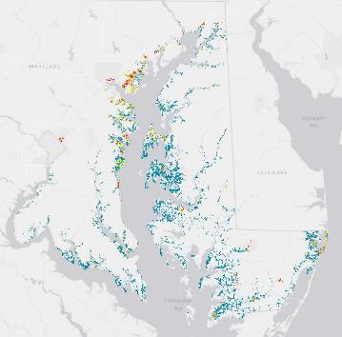
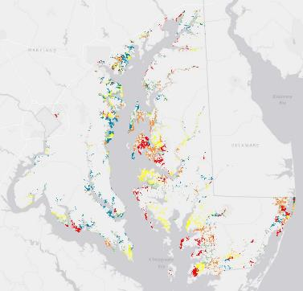
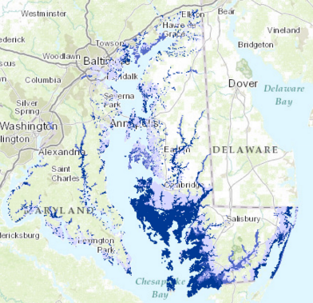
Community Flood Risk Areas
Residential areas less equipped to prepare for, respond to, or recover from coastal hazard events.
Population Density (Residential Focus)
Social Vulnerability (Age, Income, Language Proficiency)
Probability of Exposure (Floodplain – 10, 50, 100, 500yr)
Population Density
Social Vulnerability
Exposure Probability
Notes:
Through the Assessment, we produced many data products that can be used in decision-making. We first identified “community flood risk areas” (last panel). We identified residential areas and ranked them from low to high risk based on 3 factors – population density (1st panel), social vulnerability (2nd panel), and probability of exposure (3rd panel). Population Density was calculated for residential areas using land use and census data. Social vulnerability was ranked from low to high based on the metrics of Age, Income, and Language proficiency. We selected social metrics that we believed represented the ability of a community to prepare for, respond to, or recover from a coastal hazard event. These metric relate to considerations like mobility, communication, and resource availability. Lastly, Probability of Exposure was determined based on floodplain data from MES. We combined these factors to rank residential areas from low to high risk (blue = low and red = high).

Slide 10
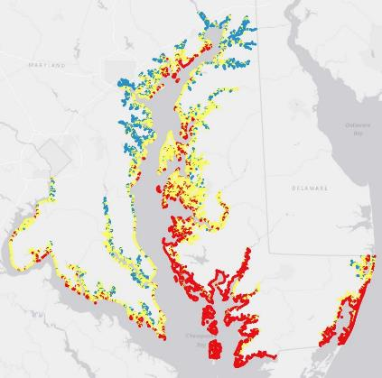
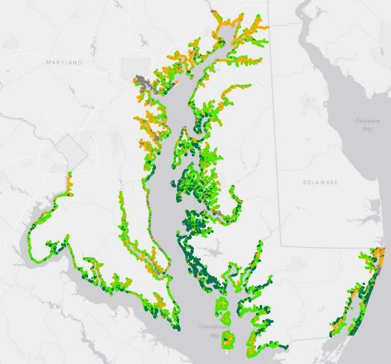
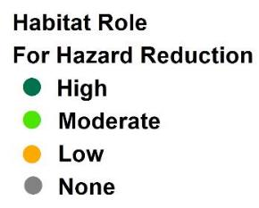
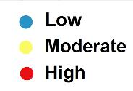
Coastal Exposure and Habitat Role
Where do Habitats Reduce Exposure to Coastal Hazards? [250 meter scale]
Identify High, Moderate, Low Hazard Shorelines based on physical characteristics.
Evaluate Habitat Role in Reducing Exposure based on habitat presence/protectiveness.
Shoreline Type
Elevation
Sea Level Rise
Wave Power
Storm Surge Height
Historic Erosion
Coastal Forest
Tidal Wetlands / Marshes
Underwater Grasses
Oyster Reefs
Dunes
Notes:
Along with evaluating community risk, we also evaluated coastal exposure and the role of habitats in reducing that exposure. The InVEST model was run at a 250m scale and produced two data layers. First, the Shoreline Hazard Index ranks relative exposure along MD’s shoreline based on physical parameters and shoreline characteristics. Low hazard shorelines are in blue, moderate hazard shorelines in yellow, and high hazard shorelines in red. The factors considered when developing this index include shoreline type, elevation, relative SLR, wave power, and storm surge height, and historic erosion rates (1st panel).
We also evaluated the relative role habitats play in reducing coastal exposure by acting as a buffer against coastal flooding and erosion. That role will depend on the types of habitat present, with forests and wetlands providing higher protective benefits than SAV or oyster reefs. The model also considers that multiple habitat types will provide more protection than any single habitat alone. This layer identifies shoreline where habitats have a high role in reducing exposure (dark green), moderate role (light green), little role (orange), and no role (grey) where habitats are not present.

Slide 11
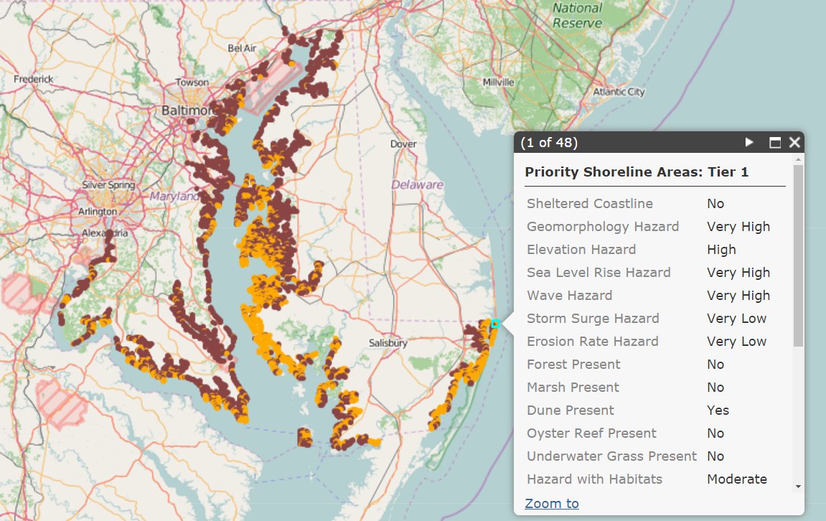
Resiliency Master Plan: Priority Areas
Tier 1 Shorelines
High Habitat Role
Within 2km of Risk Area
22% of shoreline
Conserve/Maintain/Enhance
Tier 2 Shorelines
Moderate Habitat Role
Within 2km of Risk Area
40% of shoreline
Restore
Notes:
All of these data layers were compared to identify Priority Shoreline Areas where conservation or restoration will enhance coastal resiliency. Tier 1 areas (in orange) indicate shorelines where habitat has a high role in risk-reduction and consist of about ~22% of the shoreline. These areas are prioritized for conservation and management to enhance and maintain risk-reduction benefits. Tier 2 areas (in brown) indicate shorelines where habitat has a moderate role in risk-reduction and consist of about ~40% of the shoreline. These areas are prioritized for restoration to enhance risk-reduction benefits. All priority shorelines must fall within 2km of a community flood risk area.
Each ranked portion of the shoreline has data associated with it that helps planners think about relative exposure and conditions. Click on a shoreline point to view shoreline conditions, such as the types of coastal hazards and habitat present/expected. This data layer represents the start of DNR’s Resiliency Master Plan, which seeks to identify and implement conservation and restoration projects that will provide ecological value and protect communities from climate change impacts.

Slide 12
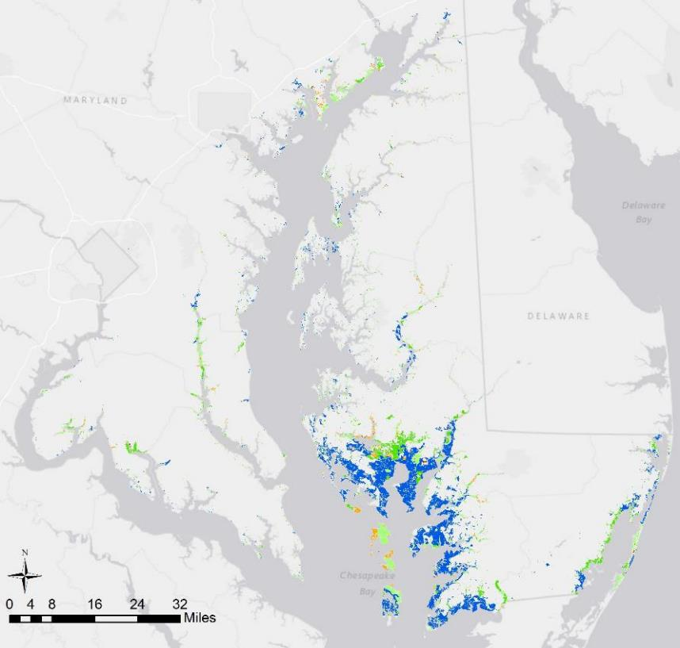
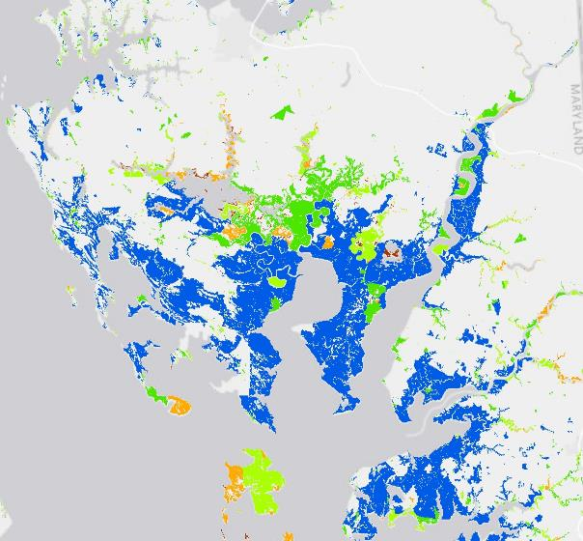
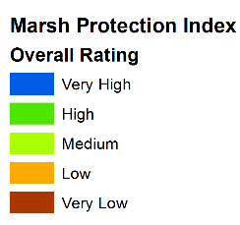
Marsh Protection Potential Index
Marsh Size (Area)
Proximity to Hazards (High, Moderate, Low, or Floodplain)
Proximity to people (Residential Areas – High density / social vuln.)
Persistence (SLR and Migration)
Proximity to Other Protective Habitats
The Index ranks marshes based on their ability to protect people from coastal hazards.
The Index will be updated as we increase our knowledge of marsh role in coastal protection.
Notes:
One limitation of the shoreline analysis is that it only provides data at the land/water interface. However, we recognize that communities exist further inland that are still at risk to flooding, and many of our coastal habitats also extend inland and provide protection benefits. Because Maryland marshes are one of the most protective and extensive habitats, we developed a Marsh Protection Index to supplement the shoreline data. This Index ranks marshes based on their ability to protect people from coastal hazards. It considers five characteristics when identifying marshes with low to high protection potential. Each Marsh Complex in the Index has a score from 1 to 25. These scores were used to rank marshes from low to high protection potential (red to blue). This information can be used to supplement the shoreline data to prioritize conservation and management actions. It tells a story about which marshes are providing the most resiliency benefits now, and how those benefits may be at risk due to climate change.

Slide 13
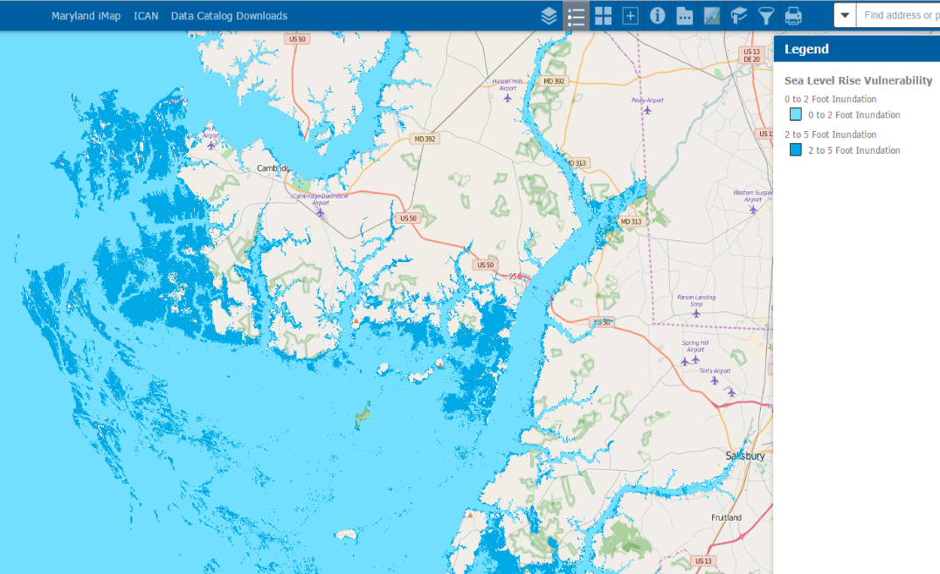
Maryland’s Coastal Atlas
dnr.maryland.gov/ccs/coastalatlas/
Climate Change Data Layers:
Sea Level Rise Vulnerability
Storm Surge Areas
Wetland Adaptation Areas
Shoreline Inventory
Historical Shorelines/Shoreline Rates of Change
100 & 500 Year Floodplains
Coastal Resiliency Data Layers:
Priority Shoreline Areas
Shoreline Hazard Index
Hazard Reduction by Habitat
Marsh Protection Potential Index
Community Flood Risk Areas
Notes:
All data products are now available on DNR’s Coastal Atlas (URL at top of slide), which is the state’s online data viewing platform for coastal data. This tool is used by coastal planners during project review. Other spatial data layers are also available on the Atlas, such as SLR vulnerability (at 2, 5, and 10 foot intervals), storm surge areas (for Category 1-4 hurricanes), historical shorelines, and others. Many of these datasets were considered throughout development of the resiliency data and you can turn these layers on and off alongside the resiliency data for a better understanding of the final rankings and priorities. A Query tool is also available on the Atlas to select for shorelines based on individual program priorities and shoreline conditions.

Slide 14
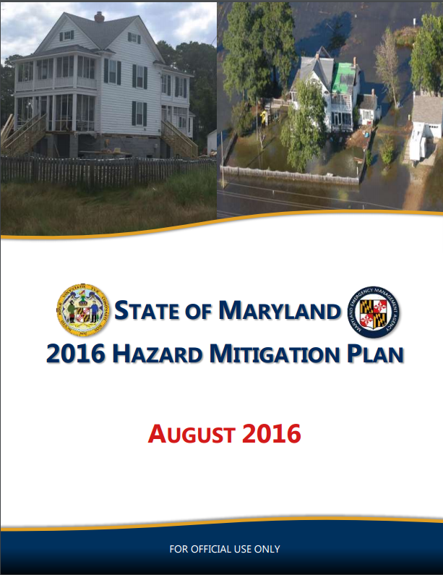
Data-to-Decision Making
DNR Land Acquisition Program
GreenPrint Ecological Scorecard
Conservation Targeting
Resilience Easements
2016 State Hazard Mitigation Plan
Coastal Hazards Risk Assessment
High Priority Mitigation Implementation Strategy: Coastal Restoration to Mitigate Hazards for Vulnerable Communities
Notes:
DNR is currently working to integrate the Assessment Results into our land acquisition targeting. We are updating the GreenPrint Ecological scorecard, which scores parcels for acquisition based primarily on ecological criteria. By updating the scorecard, we can increase the score of parcels falling along our priority shoreline and marsh areas.
We also integrated the results into the 2016 update to the State Hazard Mitigation Plan. This Plan assesses state hazards, evaluates risk to infrastructure and populations, and identifies mitigation strategies for reducing risk. Coastal restoration within our priority areas has been identified as a High Priority strategy for hazard mitigation and funding may be available through MEMA for restoration projects in these areas.
Next steps include utilizing the results to target restoration projects and expanding the analysis to look at riverine systems and upland areas impacted by precipitation-induced flooding.

Slide 15
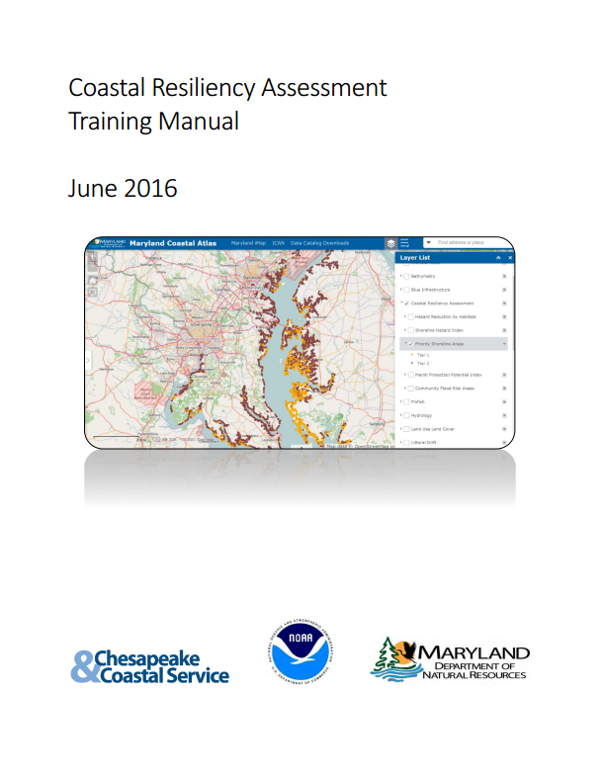
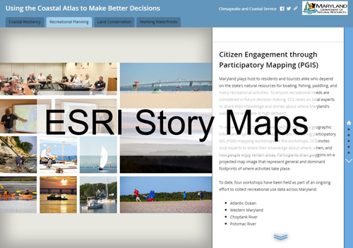
Want to Learn More?
For more information, visit: http://dnr.maryland.gov/ccs/coastalatlas/Pages/CoastalResiliencyAssessment.aspx Or email nicole.carlozo@maryland.gov
Notes:
If you’re interested in learning more, please visit our website for access to a Training Manual that fully describes the resiliency products and how to filter, query and download data. We also have an ESRI Story Map available to briefly explain this effort.
In addition, DNR will be planning 2 additional trainings later this year.

Slide 16
Next Steps for Marsh Index
Maryland Marsh Health: Evaluating marsh integrity to inform site management near vulnerable coastal communities [PROPOSAL to NOAA by DNR]
Rapid Assessment Development – Year 1
Enhance understanding of marsh integrity and ground-truth Maryland’s Marsh Protection Potential Index by evaluating marsh health at representative sites across the state.
Data Integration – Year 2
Integrate site-level scientific data into coastal resiliency targeting to enhance the robustness of Maryland’s spatial planning tools.
Stakeholder Engagement – Year 2
Identify and recommend management strategies to preserve or elevate the protective benefits of marsh complexes and communicate findings to coastal stakeholders.
Notes:
We are currently planning for updates to the Marsh Index over the next 2 years, pending funding. We recently submitted a proposal to NOAA to work with the CBNERR to develop a Rapid Assessment for Marsh Health that will allow us to ground truth the Marsh Index, integrate site level data into these resiliency planning tools, and discuss restoration options for less resilient sites with the potential to provide risk-reduction benefits.
Ideally would like to work with a graduate student and university for Rapid Assessment development.

Slide 17
Next Steps for Marsh Index
Utilizing NASA Earth Observations to Monitor Marsh Health in the Chesapeake Bay [PROPOSAL to NASA by TNC]
Proposal to NASA DEVELOP National Program for a Summer Intern
Evaluate and forecast marsh health in the Chesapeake Bay using NASA Earth observations (satellite remote sensing).
Classify marsh type, health, and extent over several decades
Landsat and Aqua/Terra satellite data
TerrSet Earth Trends Modeler to analyze image time series data
Inform updates to Marsh Index and/or site selection for Rapid Assessment development, as well as data-integration discussions.
Notes:
The Nature Conservancy is also submitting a proposal to the NASA Develop program to hire an intern to explore how NASA Earth Observations data and remote sensing can provide information on marsh health and vegetation stress, and be integrated into the Marsh Index. If these projects are funded, the results of the NASA internship will be considered for integration into the Index at the same time as the Rapid Assessment results. Similar studies have been completed in regions like coastal Alabama and North Carolina.
https://earthzine.org/2016/08/11/the-dark-side-of-the-marsh-forecasting-marsh-health-in-alabama/

