Slide 1
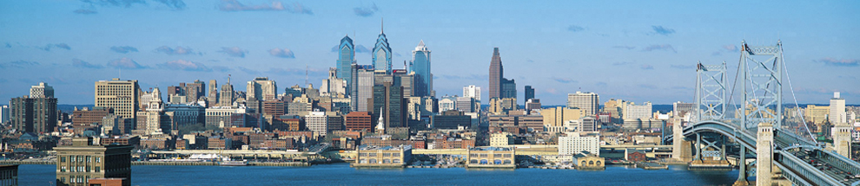
Chesapeake Bay Program Citizens Advisory Committee
Stroud Water Research Center
September 18, 2019
Andrew Johnson
ajohnson@williampennfoundation.org
215-988-1830
Notes:
The William Penn Foundation is a family foundation established in 1945
In 2018, the Foundation’s grantmaking totalled $112MM across its three grant centers focused on education, arts/culture/public spaces, and the environment.

Slide 2
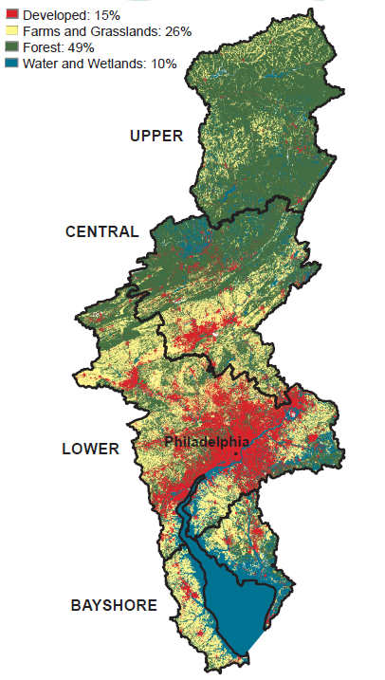
Delaware River Watershed
13,500 Square Miles
Supplies water to more than 13MM people
Sole source of water for Philadelphia, Camden NJ, and Wilmington DE
Source of half of NY City’s water.
Growing threats from NPS Pollution from loss of forests to development, stormwater and agricultural runoff
Notes:
The environmental grantmaking is focused on protecting and restoring clean water in the Delaware River watershed, with an emphasis on three threats.

Slide 3
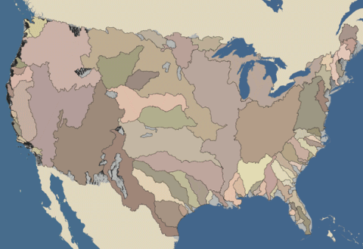
Major Watersheds of the US
Delawarer
River Watershed

Slide 4
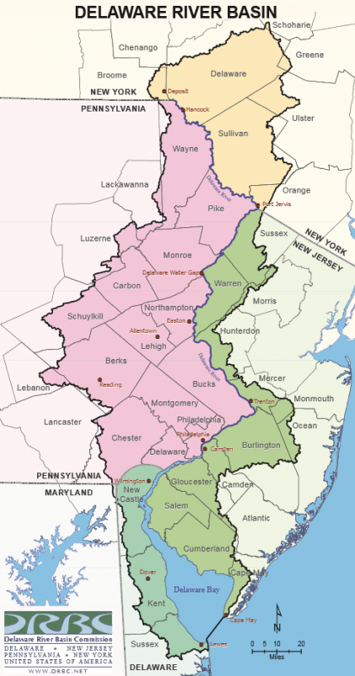
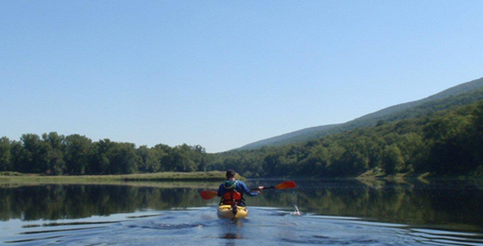
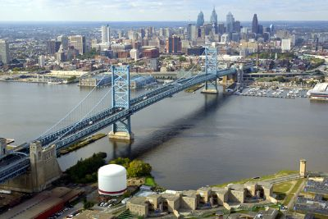
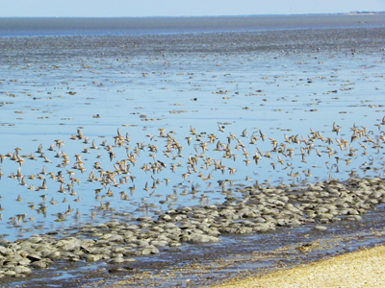
Watershed lies within:
Two EPA Regions
Four States
42 Counties
800+ Munis
Notes:
When we developed our Watershed Protection Program in 2011-2012, we recognized that efforts to protect the watershed as a whole were fragmented and “underfunded”, creating significant barriers to desired ecological outcomes.
For example:
The watershed lies within 2 EPA regions and four states.
There is an excellent river basin commission formed by the states and federal government, but it is severely underfunded
There was no federal watershed program aimed specificially at the Delaware (as there was in the Chesapeake)
Various jurisdictions collected data differently, so consistent basin-wide data on watershed conditions was limited.
Nonprofits had formed advocacy collaborations at the basin scale, but conservation nonprofits doing on the ground land protection and stream restoration focused locally with limited coordinated basin-wide vision.
HOWEVER – a robust effective conservation and environmental protection community existed in the watershed– which had already demonstrated great success, and which represented a significant opportunity for collaborative, strategic conservation.

Slide 5
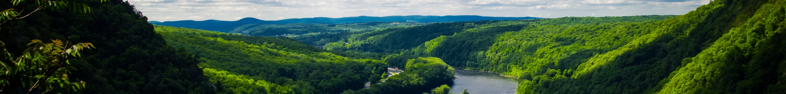
The Watershed Protection Program was designed to address these barriers and opportunities through three grantmaking strategies:
Watershed-Wide:
Inform
Organize
Institutionalize
Constituency Building:
Engage
Educate
Activate
Targeted Sub-Watersheds:
Prioritize
Protect
Restore
Drive science-informed policies and practices aimed at select stressors to protect water quality and supply by supporting civic engagement, research, and advocacy
Increase public access to water and enhance stewardship of Delaware River watershed’s waterways
Align efforts to protect and restore water quality and supply in eight targeted sub-watersheds using scientific decision tools and innovative conservation approaches that address select stressors
ALIGN/
INTEGRATE
FOCUS/
PRIORITIZE
ASSESS IMPACT
Notes:
The Foundation’s Watershed Protection Program was designed to address these barriers and opportunities through three distinct but related grantmaking strategies.
These focus on POLICY, PEOPLE and PLACE
In each strategy, we have developed “frameworks” and align individual grants with each other.

Slide 6
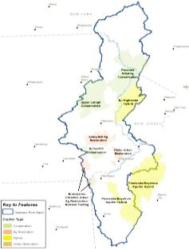
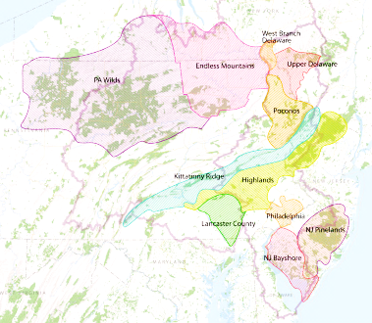
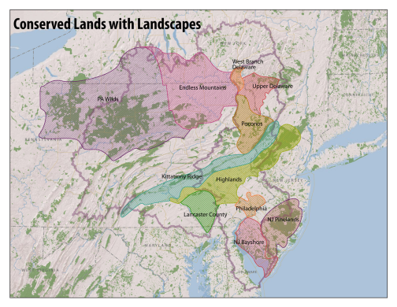
Delaware River Watershed Initiative Site Selection Process
(Under WPF’s Targeted Sub-Watershed Strategy)
Science screen – Led by Academy of Natural Science
Feasibility Screen – Led by Open Space Institute in consultation with ANS and key experts
Science-based focus areas
Ranking of watersheds by conservation / restoration need
Capacity
8 priority regions identified for investment
Impact/investment
Key data:
Physical
Biological
Development trends
Protected lands
Ground water
Organizations
Track Records
Measurability
Urgency
Leverage
Feasibility
Indicators
Monitoring
Measures
Develop scale-appropriate indicators linked to specific strategies
Hypothetical focus areas
Feasibility screen
Notes:
One of the three is the Targeted Sub-Watersheds strategy, which is focused on “on the ground” practice in local places.
In designing this strategy, we deliberately selected smaller sub-watersheds where we could concentrate aligned grants for on-the-ground conservation to address specific threats and measure impact, instead of supporting projects dispersed across the whole basin.
The primary framework for our on-the-ground grantmaking under this strategy is the Delaware River Watershed Initiative.
This slide describes the process we followed to identify places to work.

Slide 7
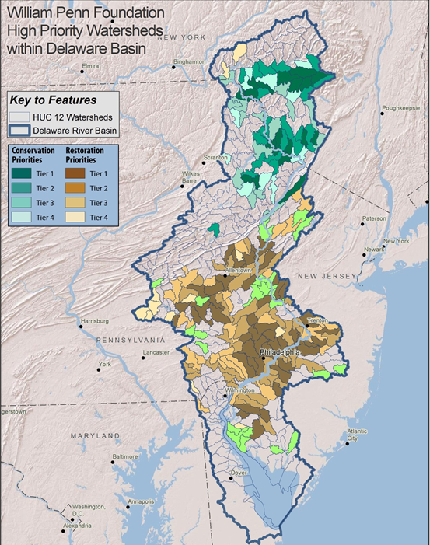
4
Notes:
Science Screen

Slide 8
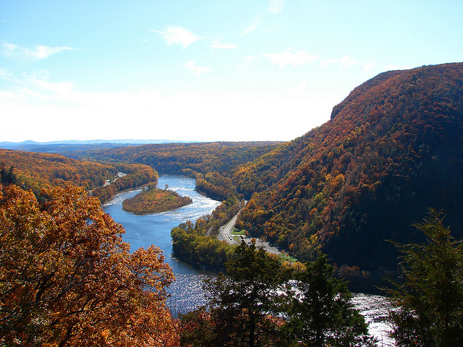
Criteria for Investment in Watersheds
Potential for Significant Impact
Urgency to Act
Organization Capacity
Cost Efficiency
Ability to Measure Impact
Delaware Water Gap National Recreation Area
Notes:
Capacity and threat screen

Slide 9
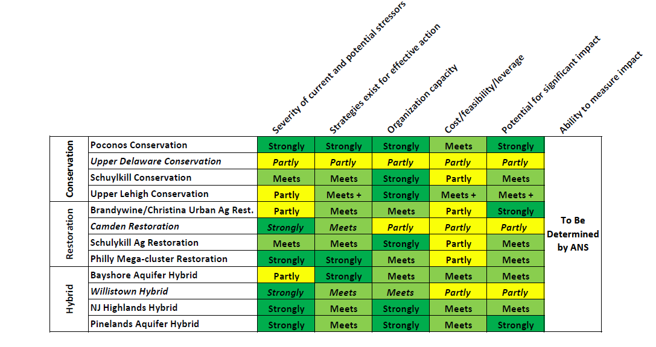
Ranking of Clusters by Key Criteria
Notes:
Captacity and threat screen

Slide 10
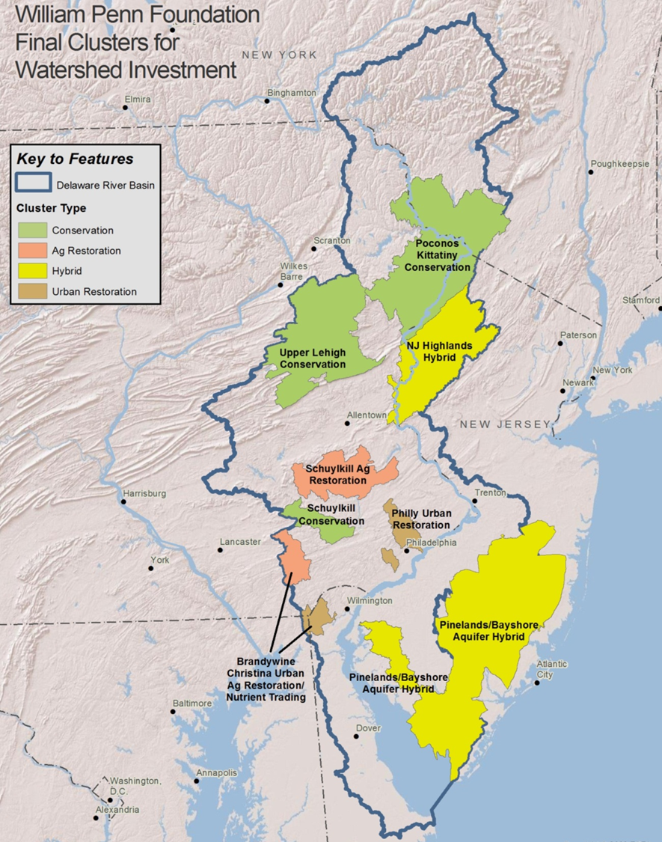
In designing this strategy, we deliberately selected smaller sub-watersheds where we could concentrate aligned grants for on-the-ground conservation to address specific threats and measure impact, instead of supporting projects dispersed across the whole basin.
Notes:
Eight sub-watershed clusters that are the geography for the DRWI

Slide 11
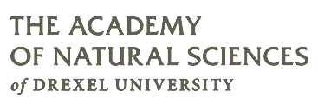
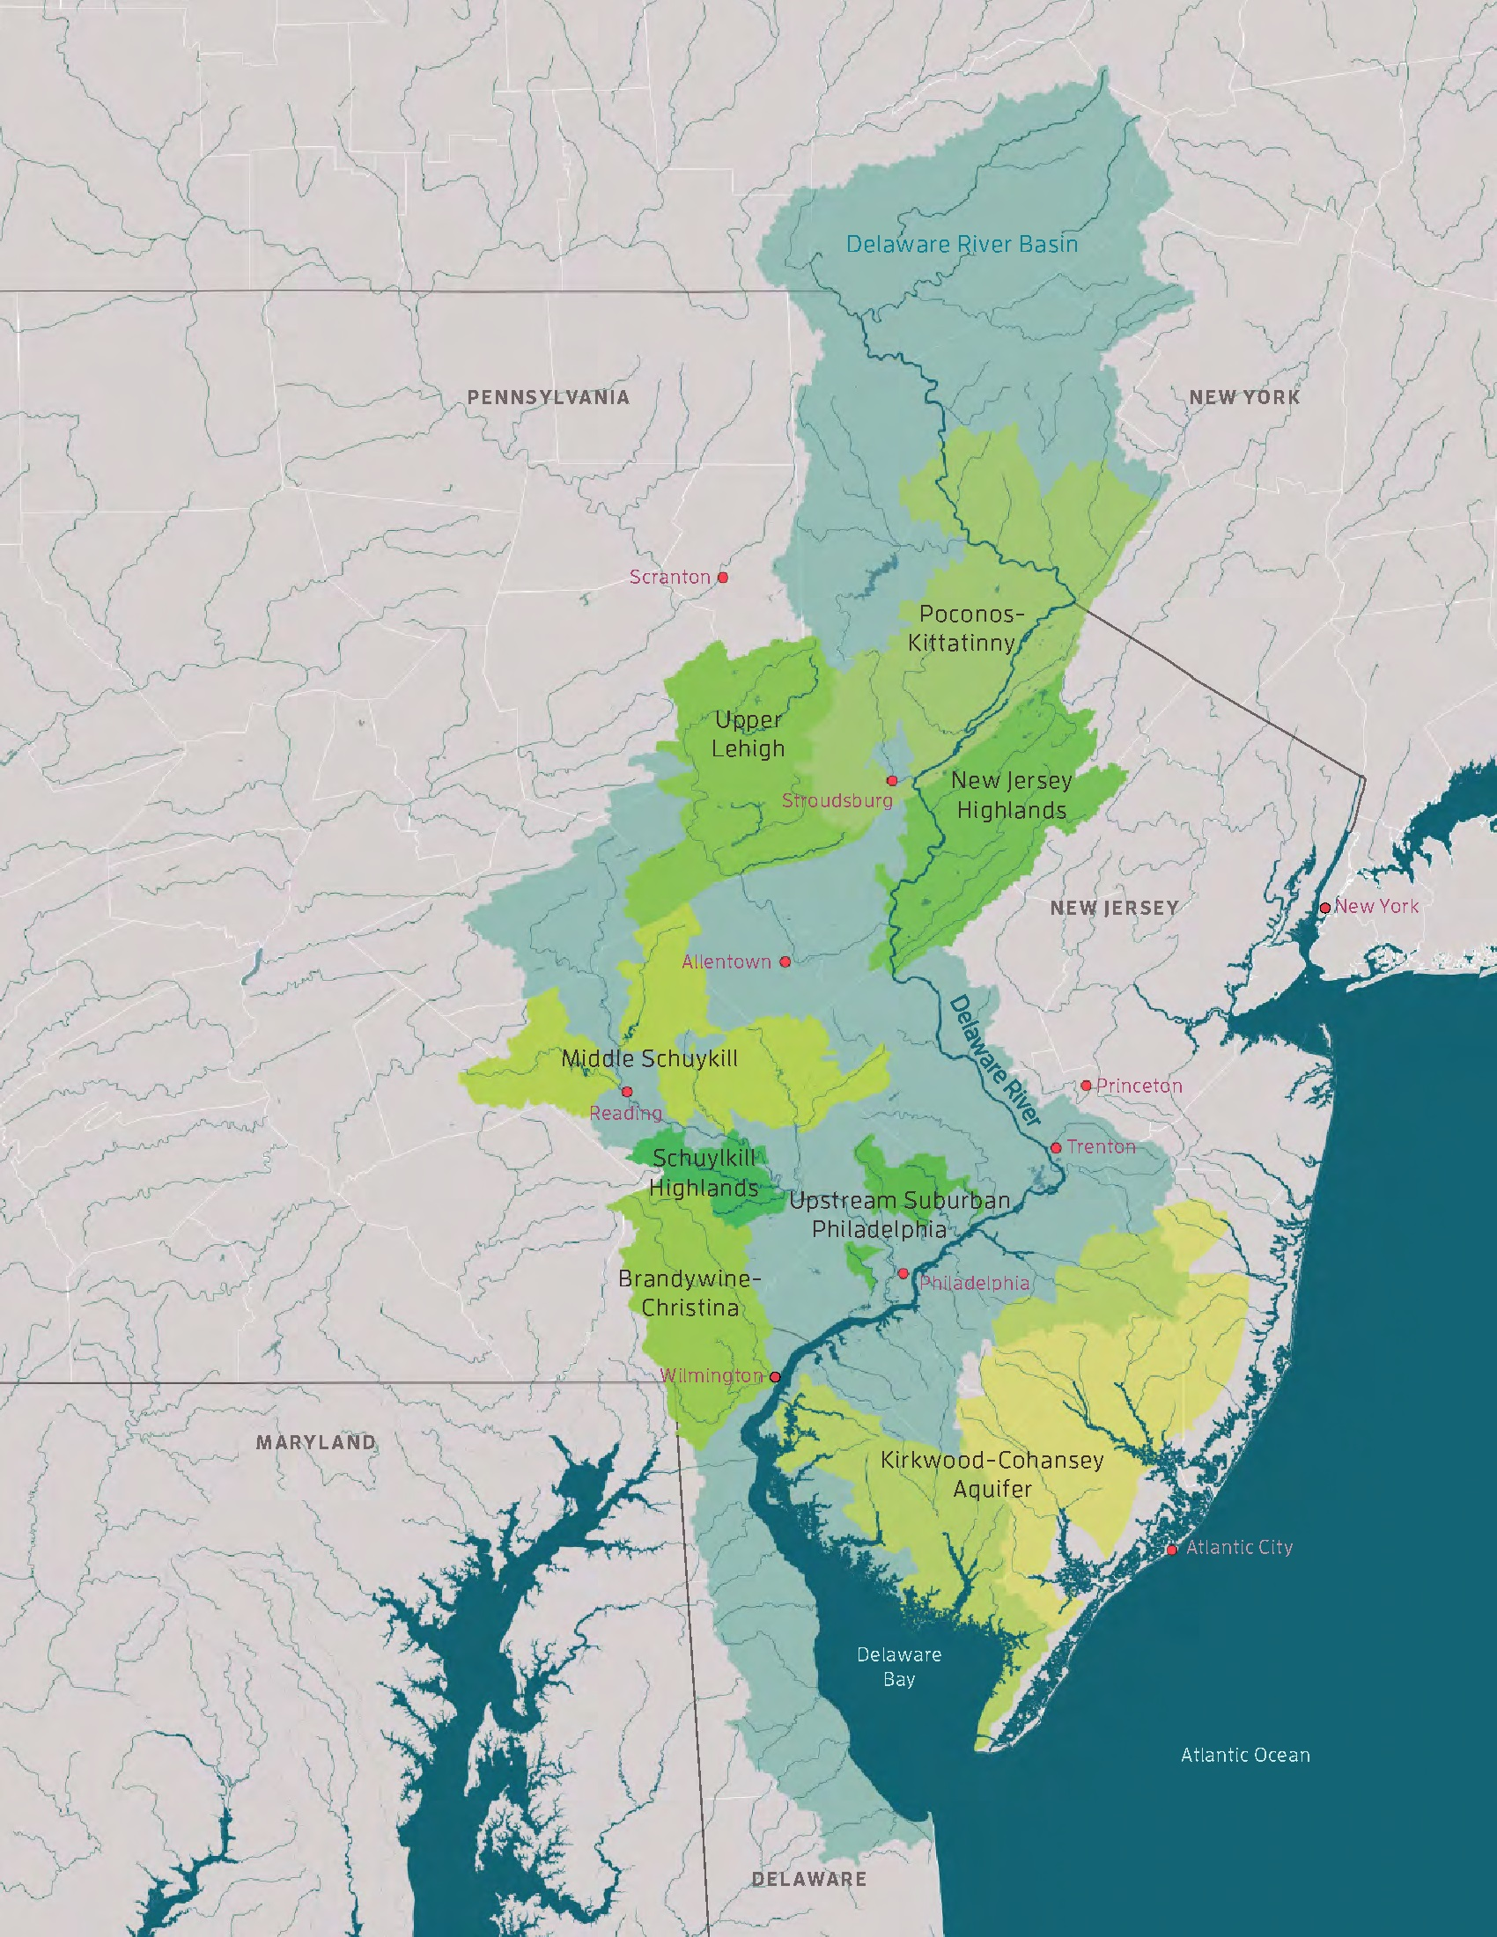
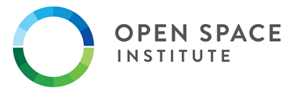
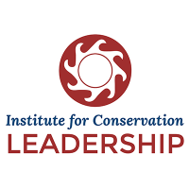


WPF and partners purposefully built the DRWI around science, collaboration, land protection, and stream restoration. WPF funded four expert organizations to provide leadership in each area. These organizations function as a “Coordinating Committee” and work with 45 local conservation organizations to implement on-the-ground projects and track progress.
SCIENCE
PROTECTION
COLLABORATION
RESTORATION
3-11 on-the-ground conservation organizations (45 total) implement shared restoration and/or protection plans in the 8 target geographies (aka “clusters”).
Notes:
Coordinating committee helped us design the program and play critical roles in implementation
ANS is the science lead (Stroud plays a critical role in implementation)
OSI – capital regrant program for protection
NFWF – capital regrant program for restoration
ICL – network building

Slide 12
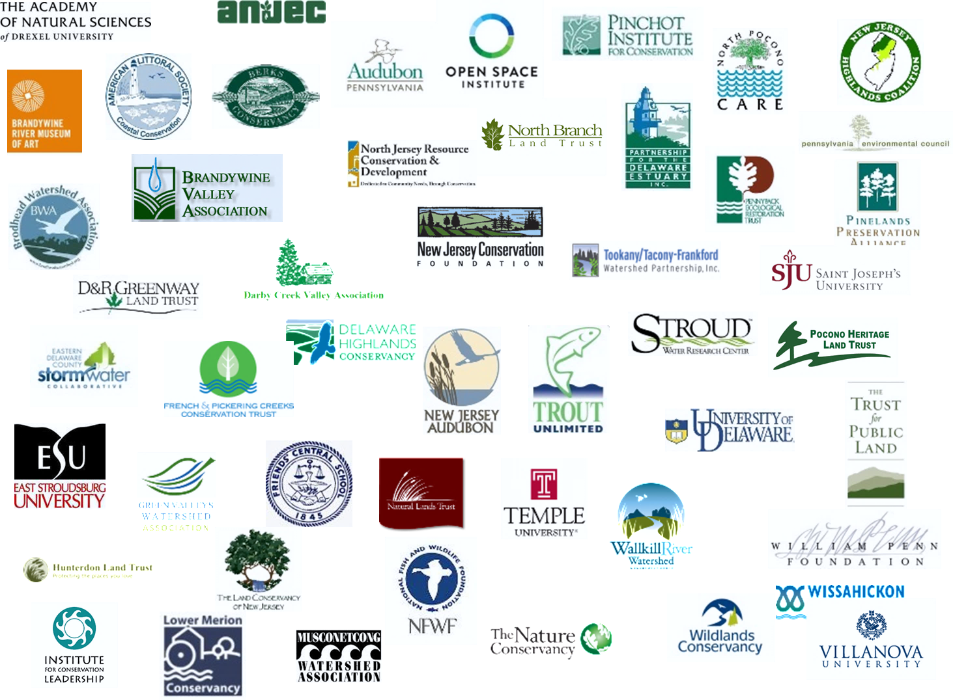
Working in concert with the Coordinating Committee, which provides capital re-grants and technical assistance across all eight sub-watershed clusters, are 45 organizations focused on implementing shared conservation plans with Foundation support.
Poconos and Kittatinny
Pinchot Institute for Conservation
The Nature Conservancy PA
Natural Lands Trust
Trust for Public Land
Pocono Heritage Land Trust
Delaware Highlands Conservancy
East Stroudsburg University
Brodhead Watershed Association
Upper Lehigh
Wildlands Conservancy
Natural Lands Trust
National Audubon Society PA
The Nature Conservancy PA
Pocono Heritage Land Trust
North Pocono CARE
Schuylkill Highlands
Partnership for the Delaware Estuary
Natural Lands Trust
Berks Nature
French and Pickering Creeks Conservation Trust
National Audubon Society PA
Green Valleys Watershed Association
Stroud Water Research Center
Chester County Water Resources Authority
Brandywine and Christina
Brandywine Conservancy
Brandywine Red Clay Alliance
University of Delaware – Water Resources Agency
Natural Lands Trust
The Nature Conservancy DE
Stroud Water Research Center
Middle Schuylkill
Berks Nature
Partnership for the Delaware Estuary
Stroud Water Research Center
Upstream Suburban Philadelphia
Pennsylvania Environmental Council
Temple University
Villanova University
Tookany/Tacony-Frankford Watershed Partnership
Lower Merion Conservancy
Pennypack Ecological Restoration Trust
Wissahickon Valley Watershed Association
Friends of the Poquessing Watershed
Eastern Delaware County Stormwater Collaborative
Pennsylvania Resources Council
Darby Creek Valley Association
New Jersey Highlands
The Nature Conservancy NJ
NJ Conservation Foundation
Land Conservancy of NJ
Hunterdon Land Trust
Musconetcong Watershed Association
NJ Highlands Coalition
Association of NJ Environmental Commissions
New Jersey Audubon Society
North Jersey Resource Conservation and Development Council
Trout Unlimited
Wallkill River Watershed Management Group
Kirkwood-Cohansey Aquifer
New Jersey Conservation Foundation
American Littoral Society
Pinelands Preservation Alliance
The Nature Conservancy NJ
Natural Lands Trust
Trust for Public Land
NJ Audubon Society
Association of NJ Environmental Commissions
Partnership for the Delaware Estuary
Notes:
45 individual organizations are working in teams in the eight clusters

Slide 13
WPF has invested more than $100 million in this work since 2013.
Significant progress on the ground has begun to advance watershed protection with alignment and prioritization across the watershed that did not exist before the Initiative.
Phase 1: $64MM 2013-2018
Phase 2: $42MM committed for 2018-2021

Slide 14
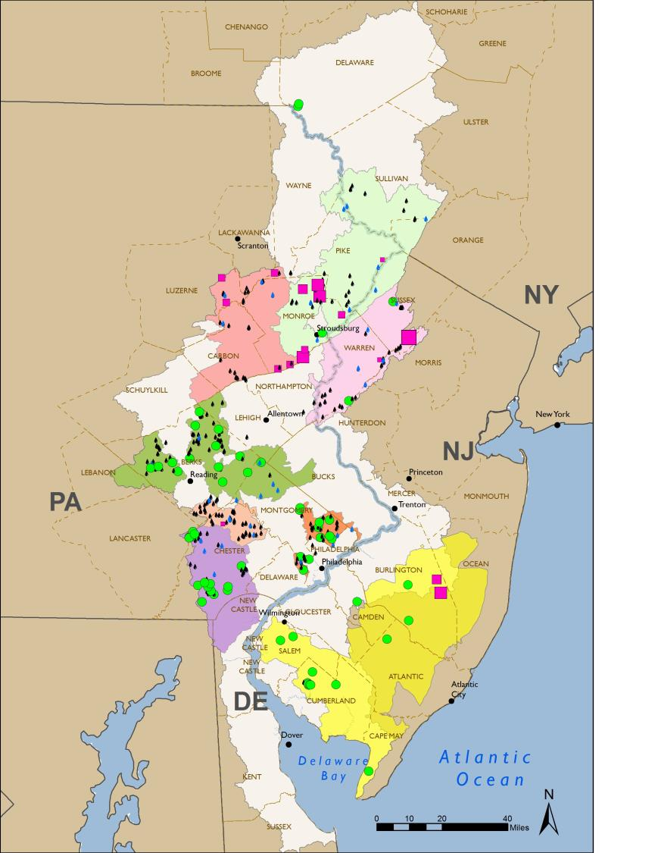
Notes:
Map to give a sense of how protection and restoration projects are concentrated in the clusters, in “focus areas”

Slide 15
DRWI Highlights To Date
Since 2014, the the organizations participating in DRWI have made substantial progress that positions them to continue accelerating the rate of conservation in years to come. These achievements include:
• Using science to prioritize work: Partners determined eight priority places in which to concentrate their conservation efforts, where scientific data showed the highest potential for improved water quality.
• Collaboration: Dozens of conservation organizations collaborated to develop shared work plans for their efforts in those eight places, where they are pooling their resources and concentrating efforts for greater impact.
• Baseline assessment: The Academy of Natural Sciences brought its scientific expertise to analyze stream conditions in the eight priority areas, establishing a critically important baseline against which to measure impact.
• Ongoing monitoring: Water quality is continually measured within these eight areas to detect changes in stream quality and assess impact over time, harnessing the capacity of academics, professionals, and citizen scientists.
• Conservation: Partners collectively protected 19,604 acres of important headwater forests to protect already-clean waterways and restored an additional 8,331 acres to reduce the impacts of pollution from agriculture and stormwater on impaired streams,and are funded to secure similar totals 2018-2021.
• New technology: Expert data scientists developed nationally significant new tools to help practitioners find the best places to further concentrate conservation in the future: WikiWatershed and the Stream Reach Assessment Tool. These tools were used to identify project areas for the newly funded phase of the Initiative. Dashboard developed for reporting of metrics.

