Slide 1

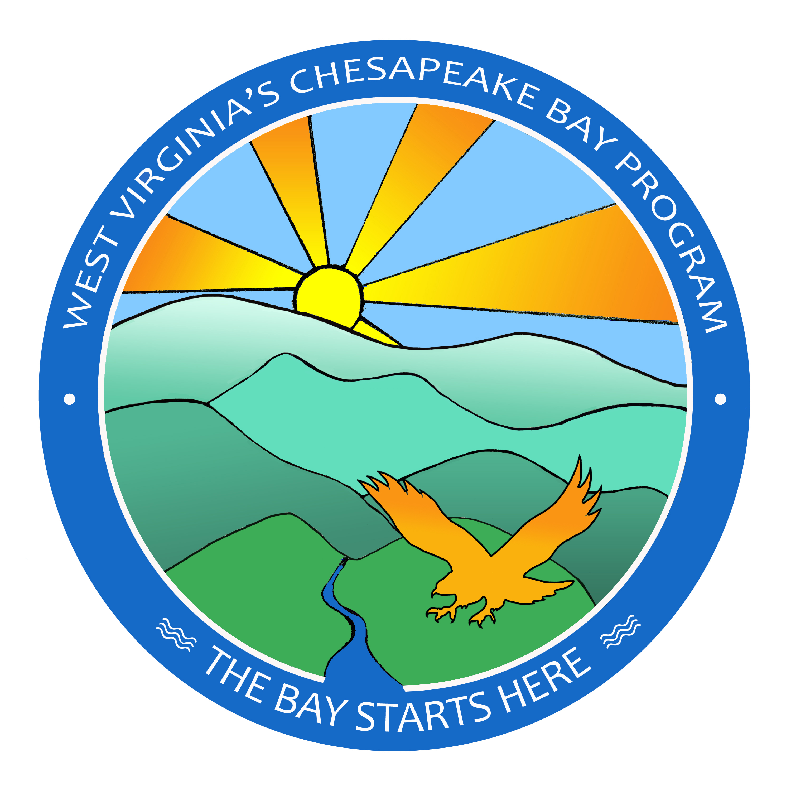


West virginia’s Chesapeake Bay Watershed Implementation Plan
Phase 3
February 20, 2020
Alana Hartman
west Virginia department of environmental protection

Slide 2
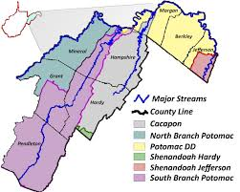
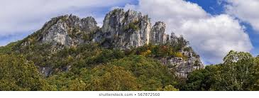

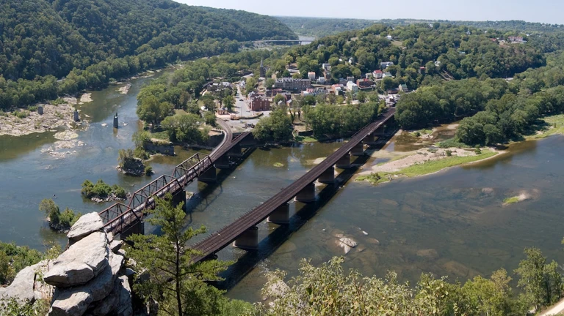

Slide 3

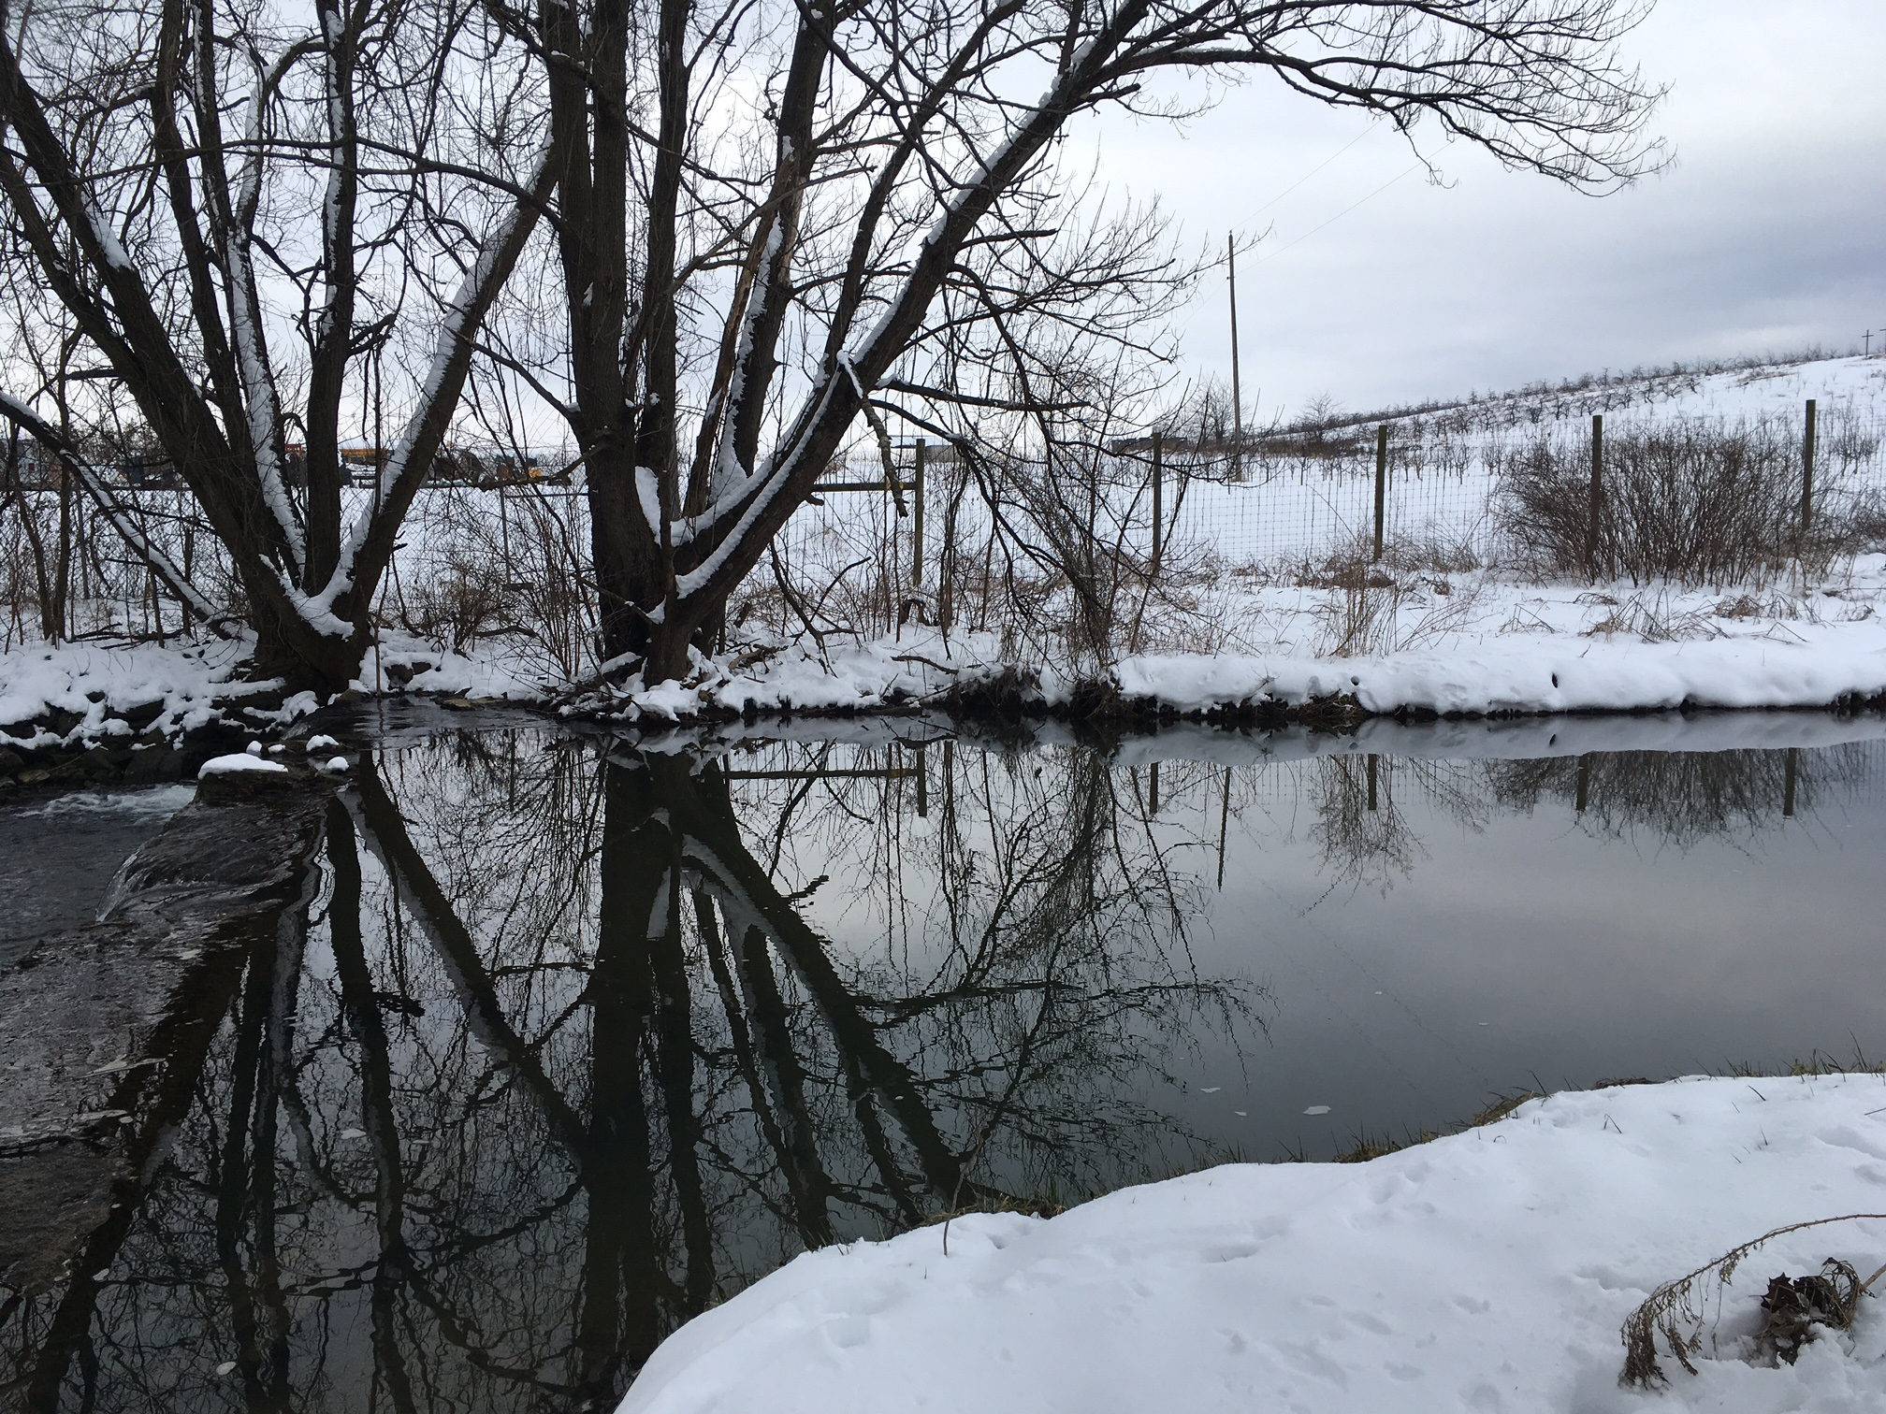
What makes wv’s wip3 unique
Monitoring results good
Load reductions on track
Small area means we could reach out to many stakeholders
Wip3 “input deck” Not reliant on many new stormwater retrofits
Mill Creek, Gerrardstown WV

Slide 4
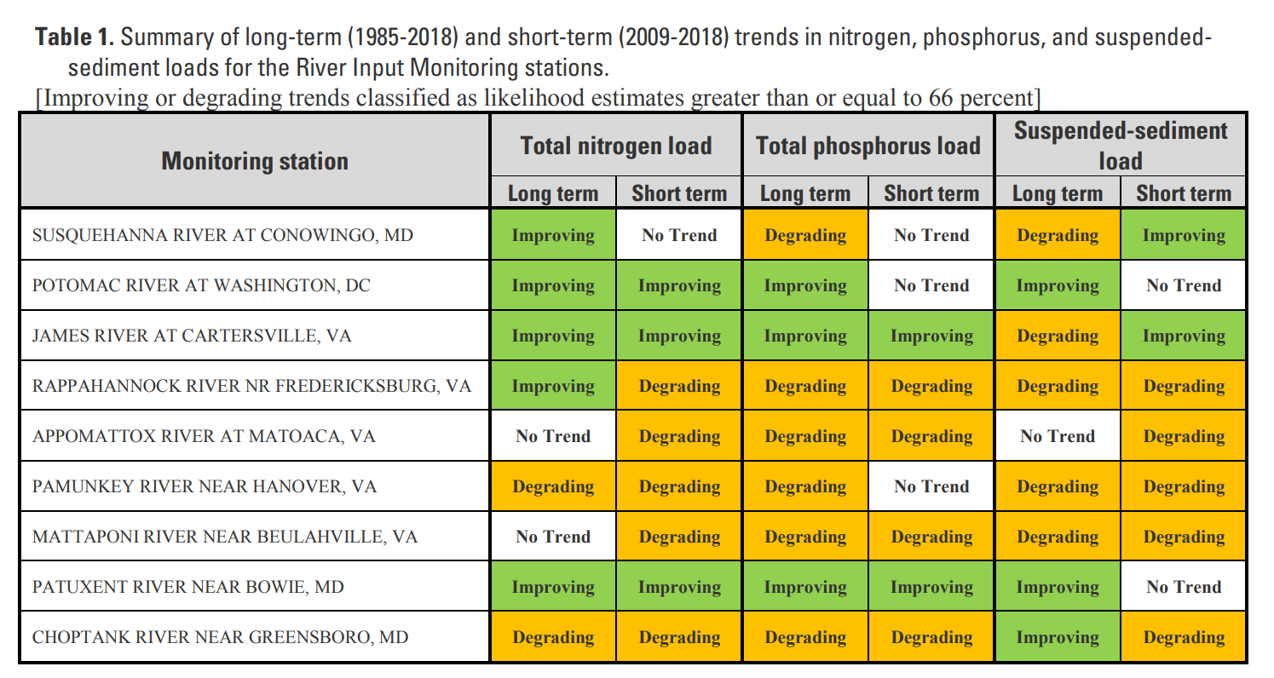
Source: https://cbrim.er.usgs.gov/data/RIM_Load_Trend_Summary_1985-2018_Combined.pdf

Slide 5
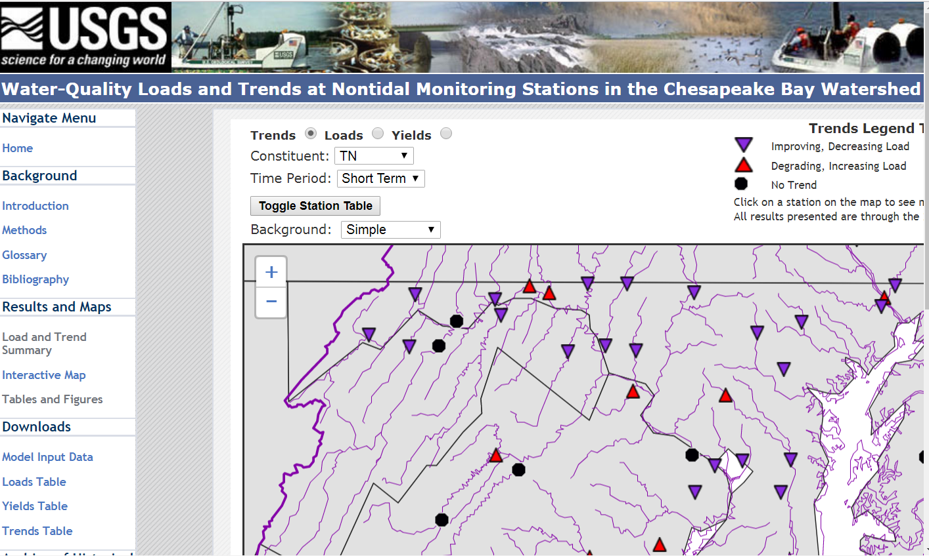
https://cbrim.er.usgs.gov/maps/
Notes:
“Monitoring” which is actually modeled monitoring results. These interactive maps reflect data through 2016.

Slide 6
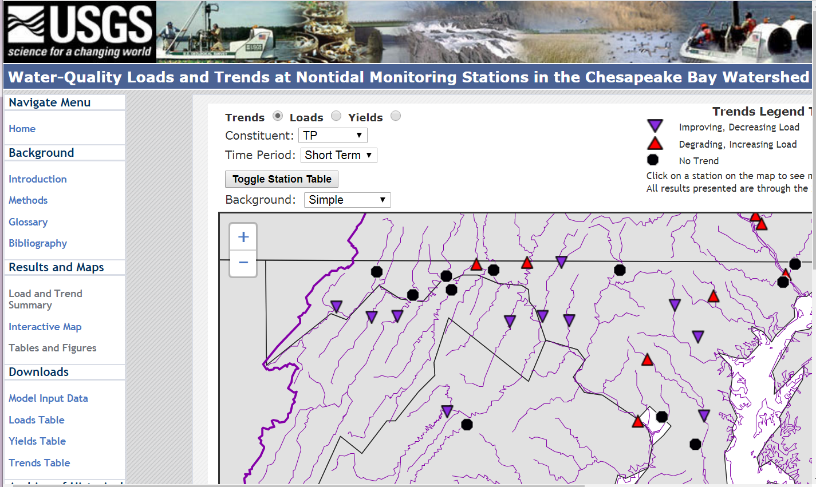
https://cbrim.er.usgs.gov/maps/
Notes:
“Monitoring” which is actually modeled monitoring results. These interactive maps reflect data through 2016.

Slide 7
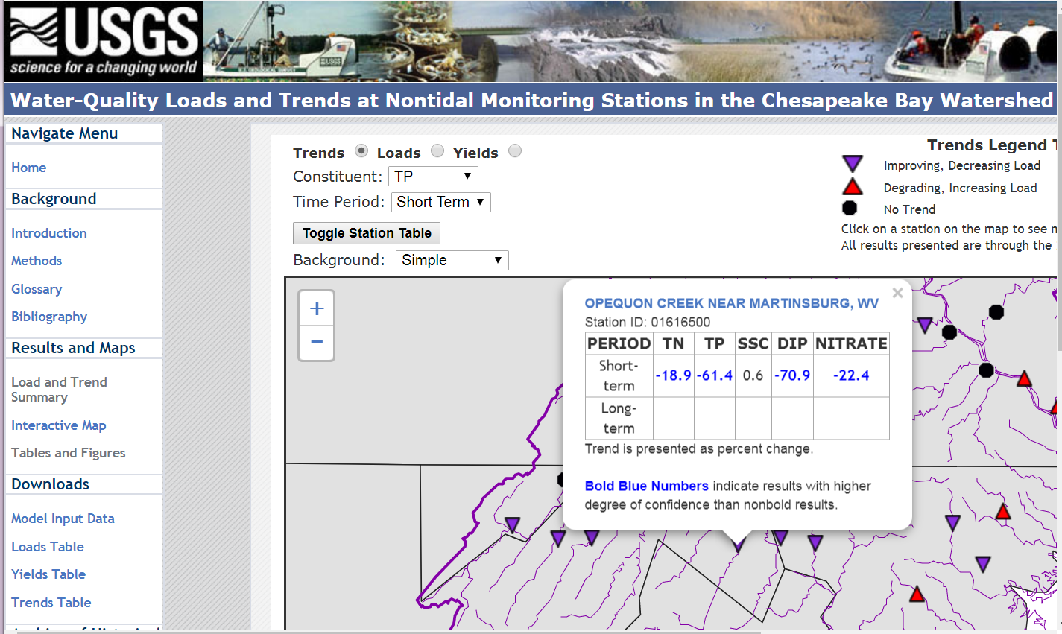
https://cbrim.er.usgs.gov/maps/
Notes:
“Monitoring” which is actually modeled monitoring results. These interactive maps reflect data through 2016.

Slide 8
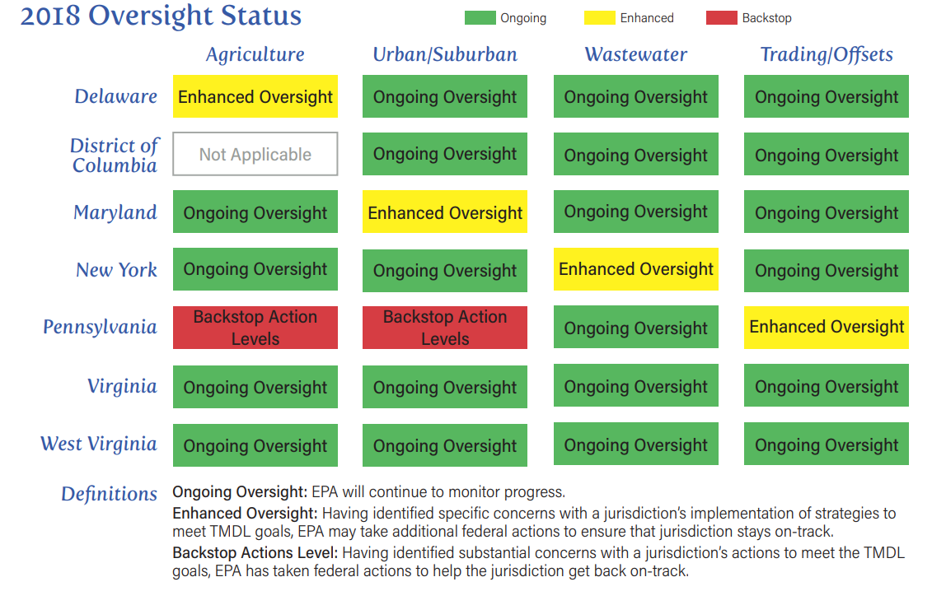
ePA’S midpoint assessment of West Virginia's progress through 2017
This was assessed using the Phase 5.3.2 model, which has now been replaced with an updated model, Phase 6.
Source: https://www.epa.gov/sites/production/files/2018-07/documents/factsheet-epa-midpoint-assessment-chesapeake-bay-tmdl.pdf

Slide 9
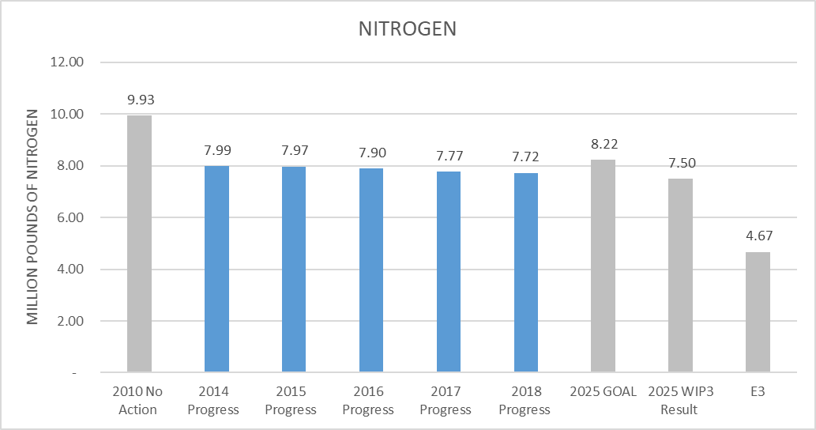
E3 = Everyone, everything, everywhere
Notes:
Load targets assigned to WV were higher than levels we had already achieved. Knowing there are uncertainties in the future, we set these WIP3 goals.

Slide 10
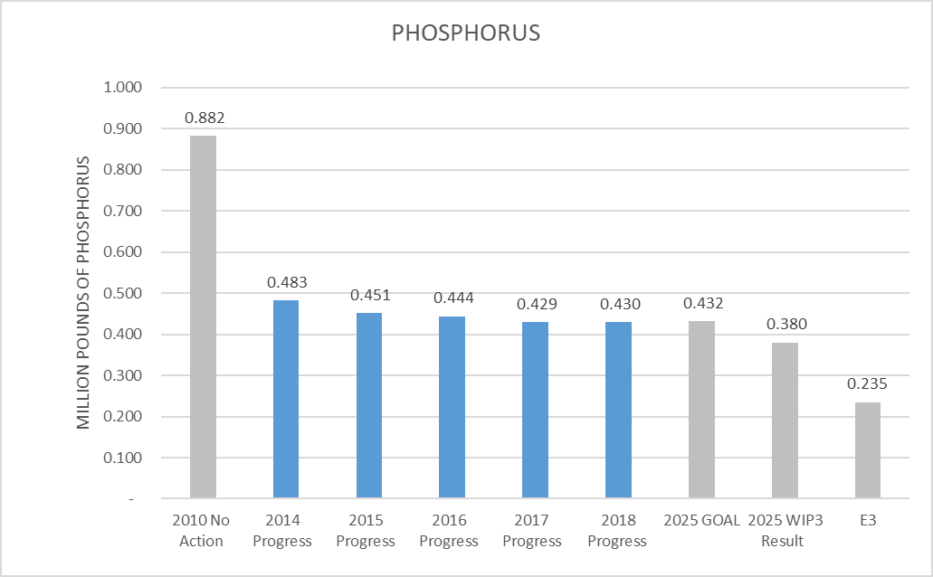
E3 = Everyone, everything, everywhere

Slide 11
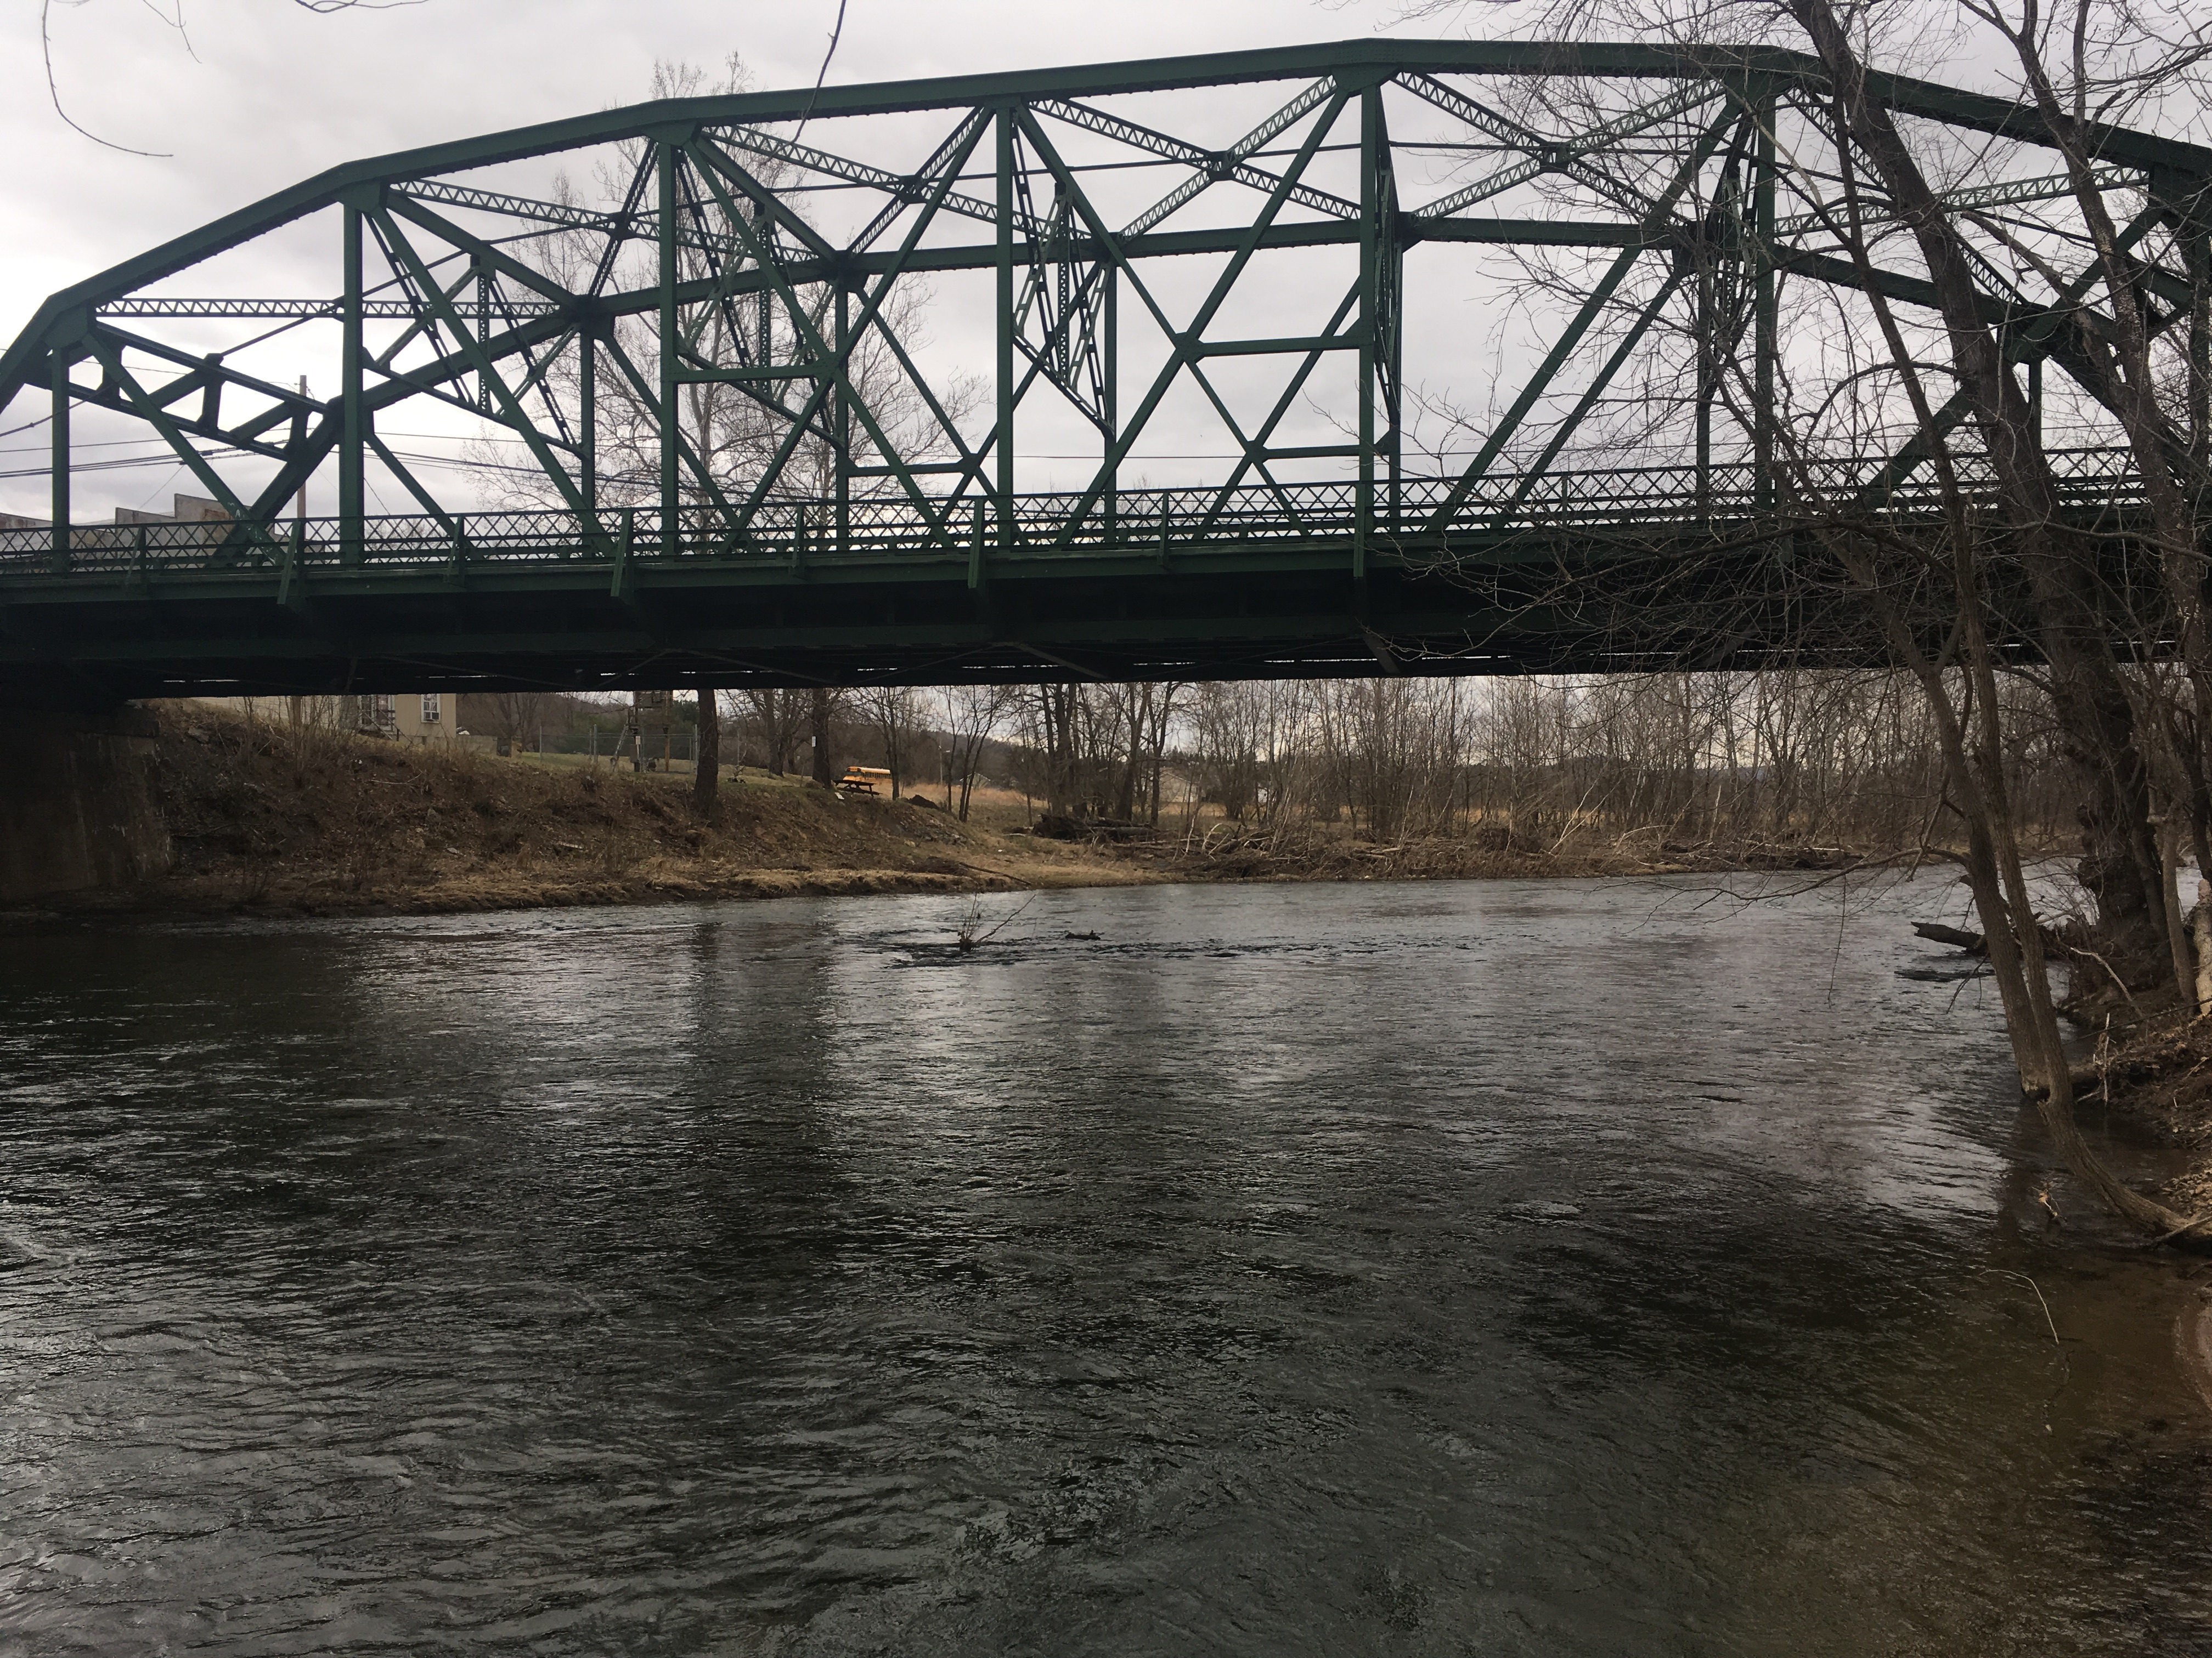
what challenges and opportunities the WIP presents
Uncertainties about Conowingo, climate change, bmp credit, and verification
Opportunity to explore corollary benefits of nutrient-reducing projects & practices (see upcoming slides)
Opportunity to achieve local goals, e.g. reducing nuisance algae in Cacapon river (specific chapter in wip3)
Cacapon River, Capon Bridge WV
Notes:
As shown on previous slides, because of the challenges, we decided to make our WIP goals lower than the assigned targets.

Slide 12
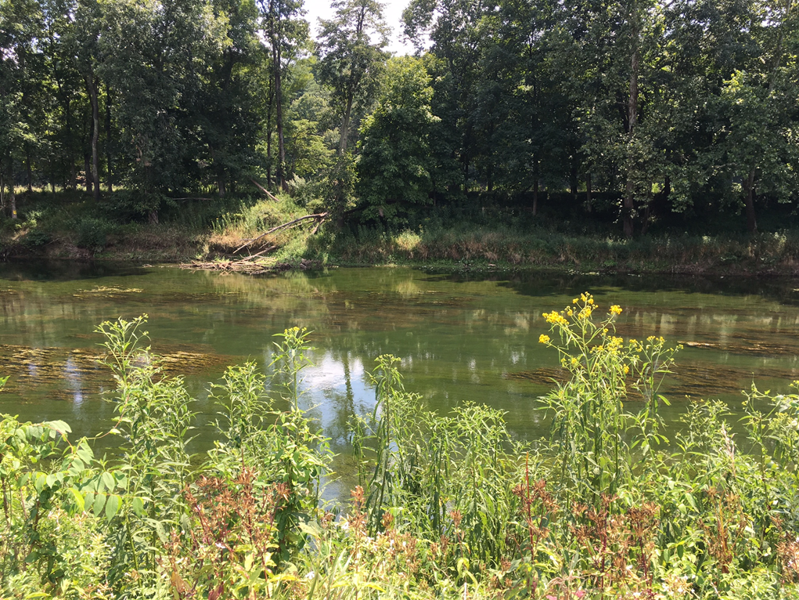

Slide 13
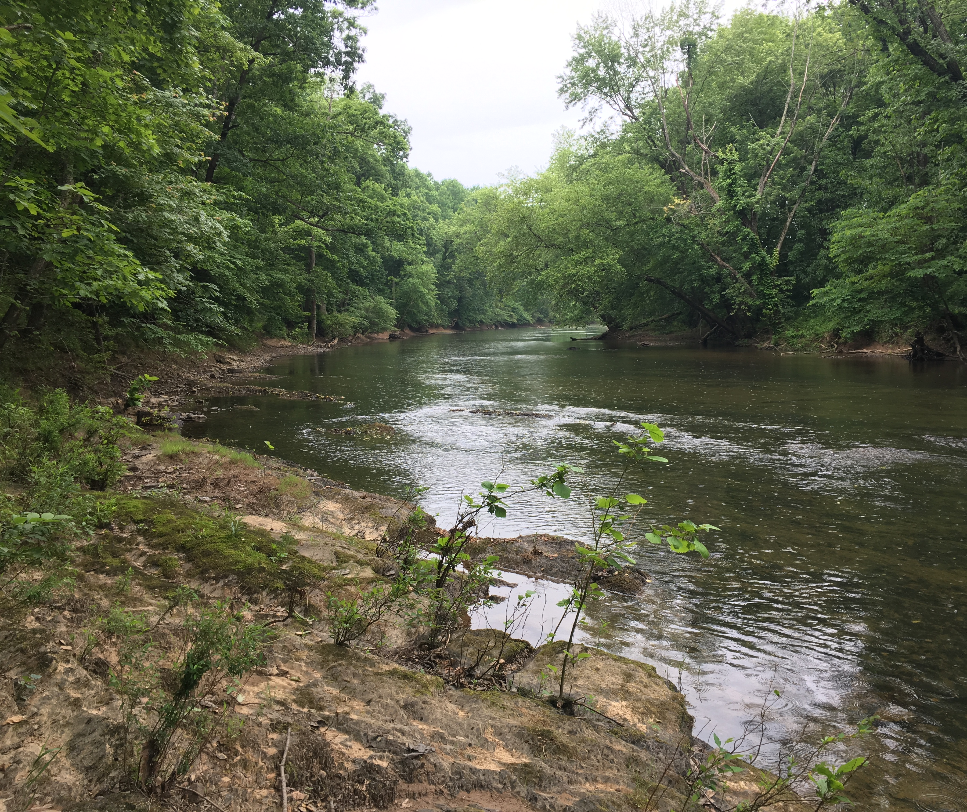
What approaches have proven successful
wastewater Treatment plant upgrades
volunteer tree plantings
County/city stormwater ordinances
  Having Chesapeake bay coordinator at region 9 to work with local governments
enforcement of permitted activities
More on next slide
Back Creek near Hedgesville, WV
Notes:
The main bullet points were shared at WIP3 outreach meetings. The sub-bullets about the staff who helped with these tasks were added as I thought about what I would say today (2/20/20).

Slide 14
What approaches have proven successful
Continued:
Stormwater and Agricultural Best Management Practices
  Having stormwater specialists who can take project ideas through the proposal and implementation process
  Having riparian forester specialists who can work with crep program and non-profits’ tree programs
  Having more nutrient management specialists and program staff to promote and deliver agricultural cost-share incentive programs
streambank Restoration projects (specific chapter in wip3)

Slide 15
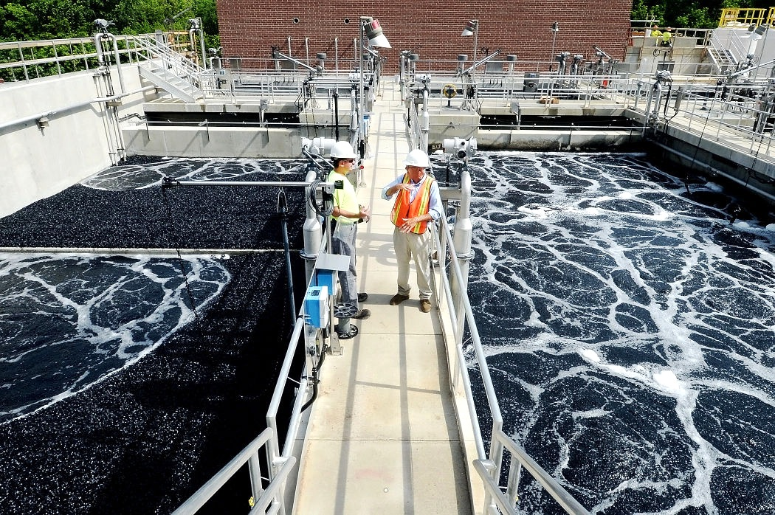
Sector
Wastewater:
12 plants upgraded to Chesapeake Bay nutrient standards
Most used funds provided through state legislature (plus ratepayers and other sources)
Corollary benefits:
increased capacity
Prepared for growth
Updates = less day-to-day maintenance
Notes:
These are slides we showed at WIP3 outreach meetings

Slide 16
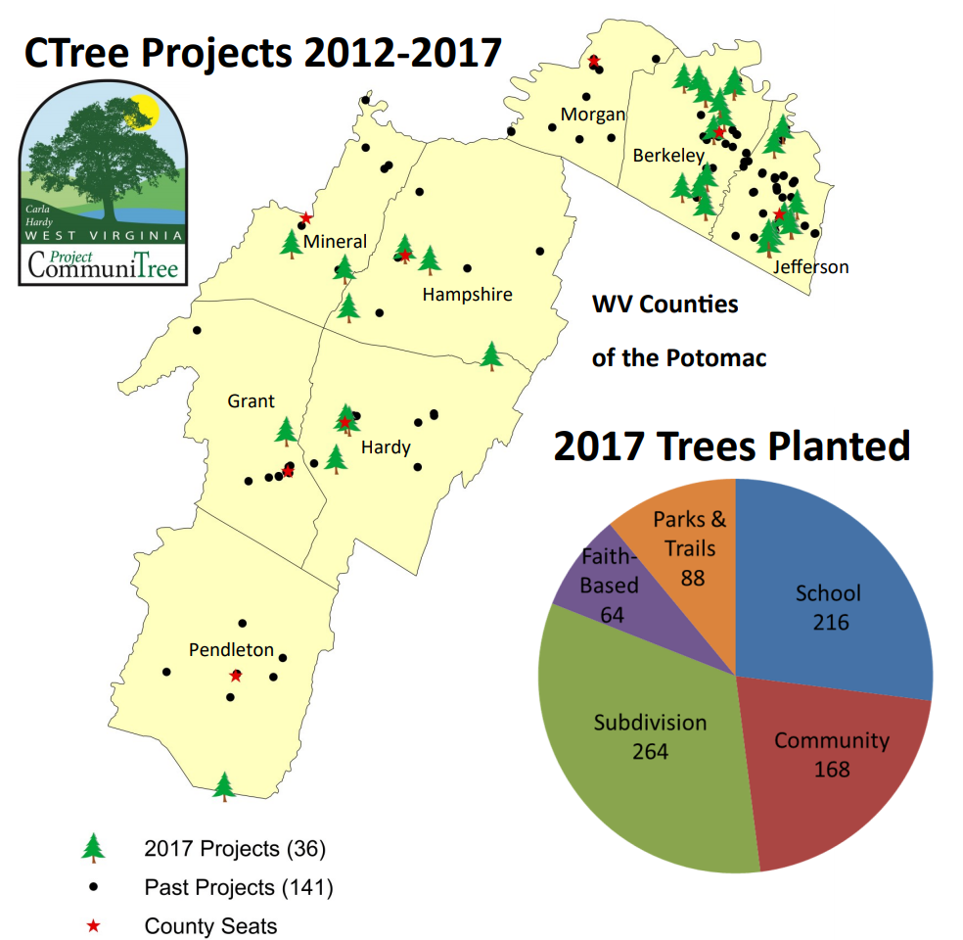
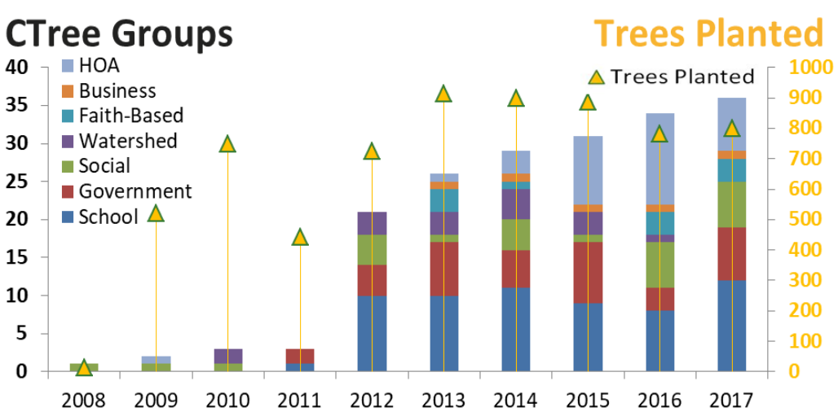
Sector
Developed Lands:
“Carla Hardy WV Project CommuniTree”
Corollary benefits: wildlife habitat, air quality, beautification, Flash flood reduction

Slide 17
Developed Lands:
Applies to new and redevelopment
  4 stormwater ordinances voluntarily enacted
  2 stormwater ordinances required modification
  1 Stormwater Ordinance partially modified
Corollary benefits:
Reduces Flash Flooding Risk,
Improves Water Quality

Slide 18
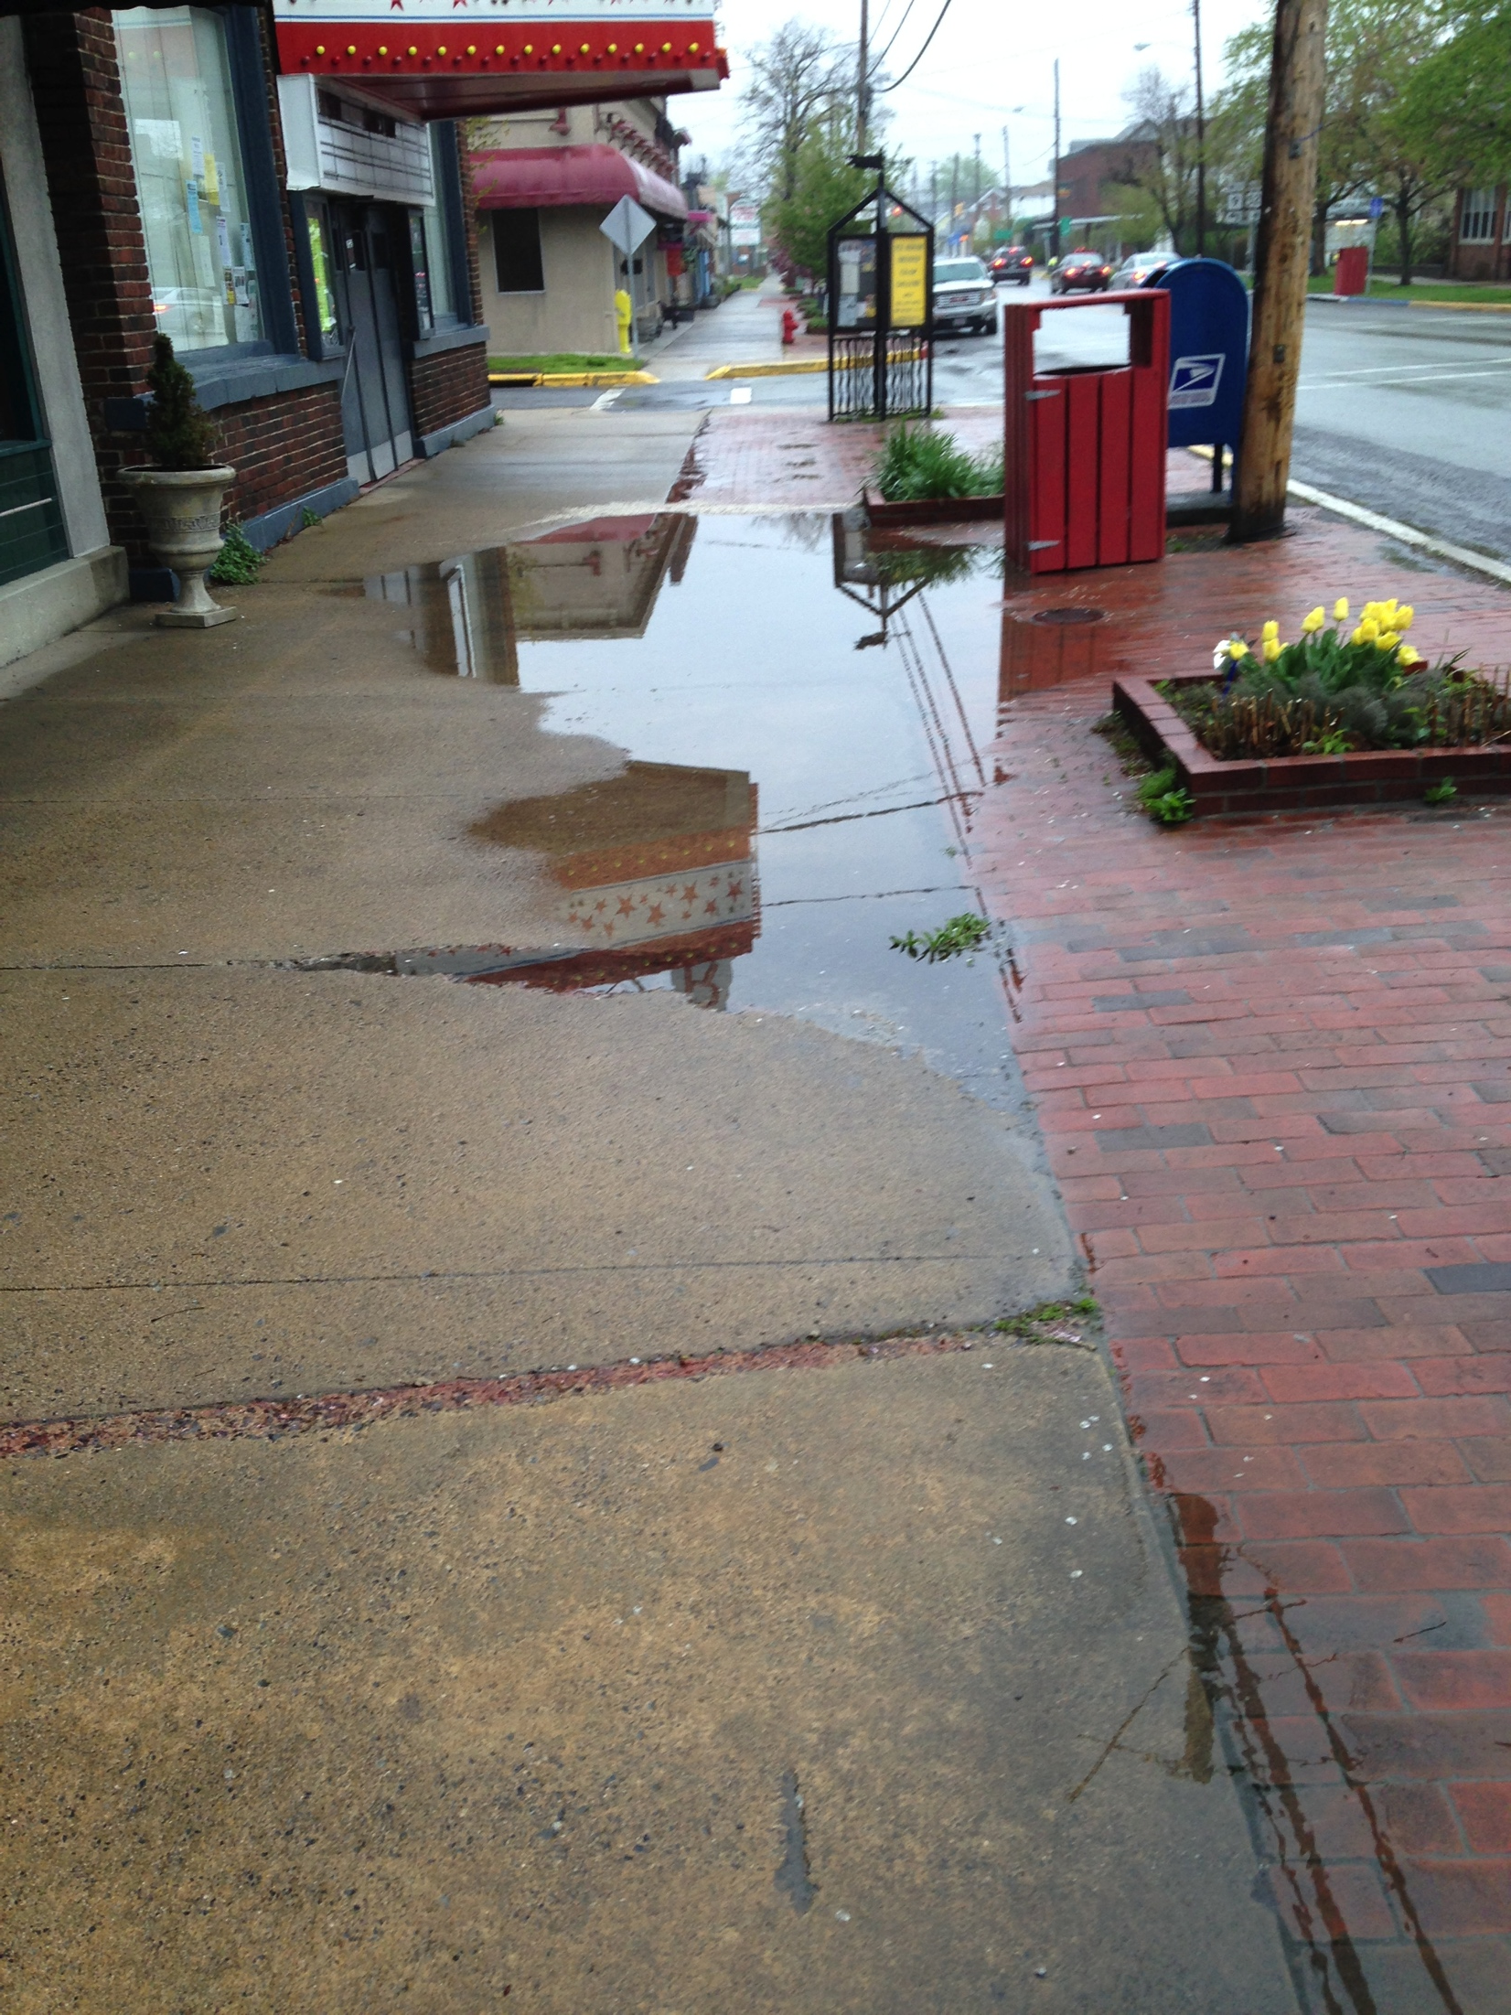
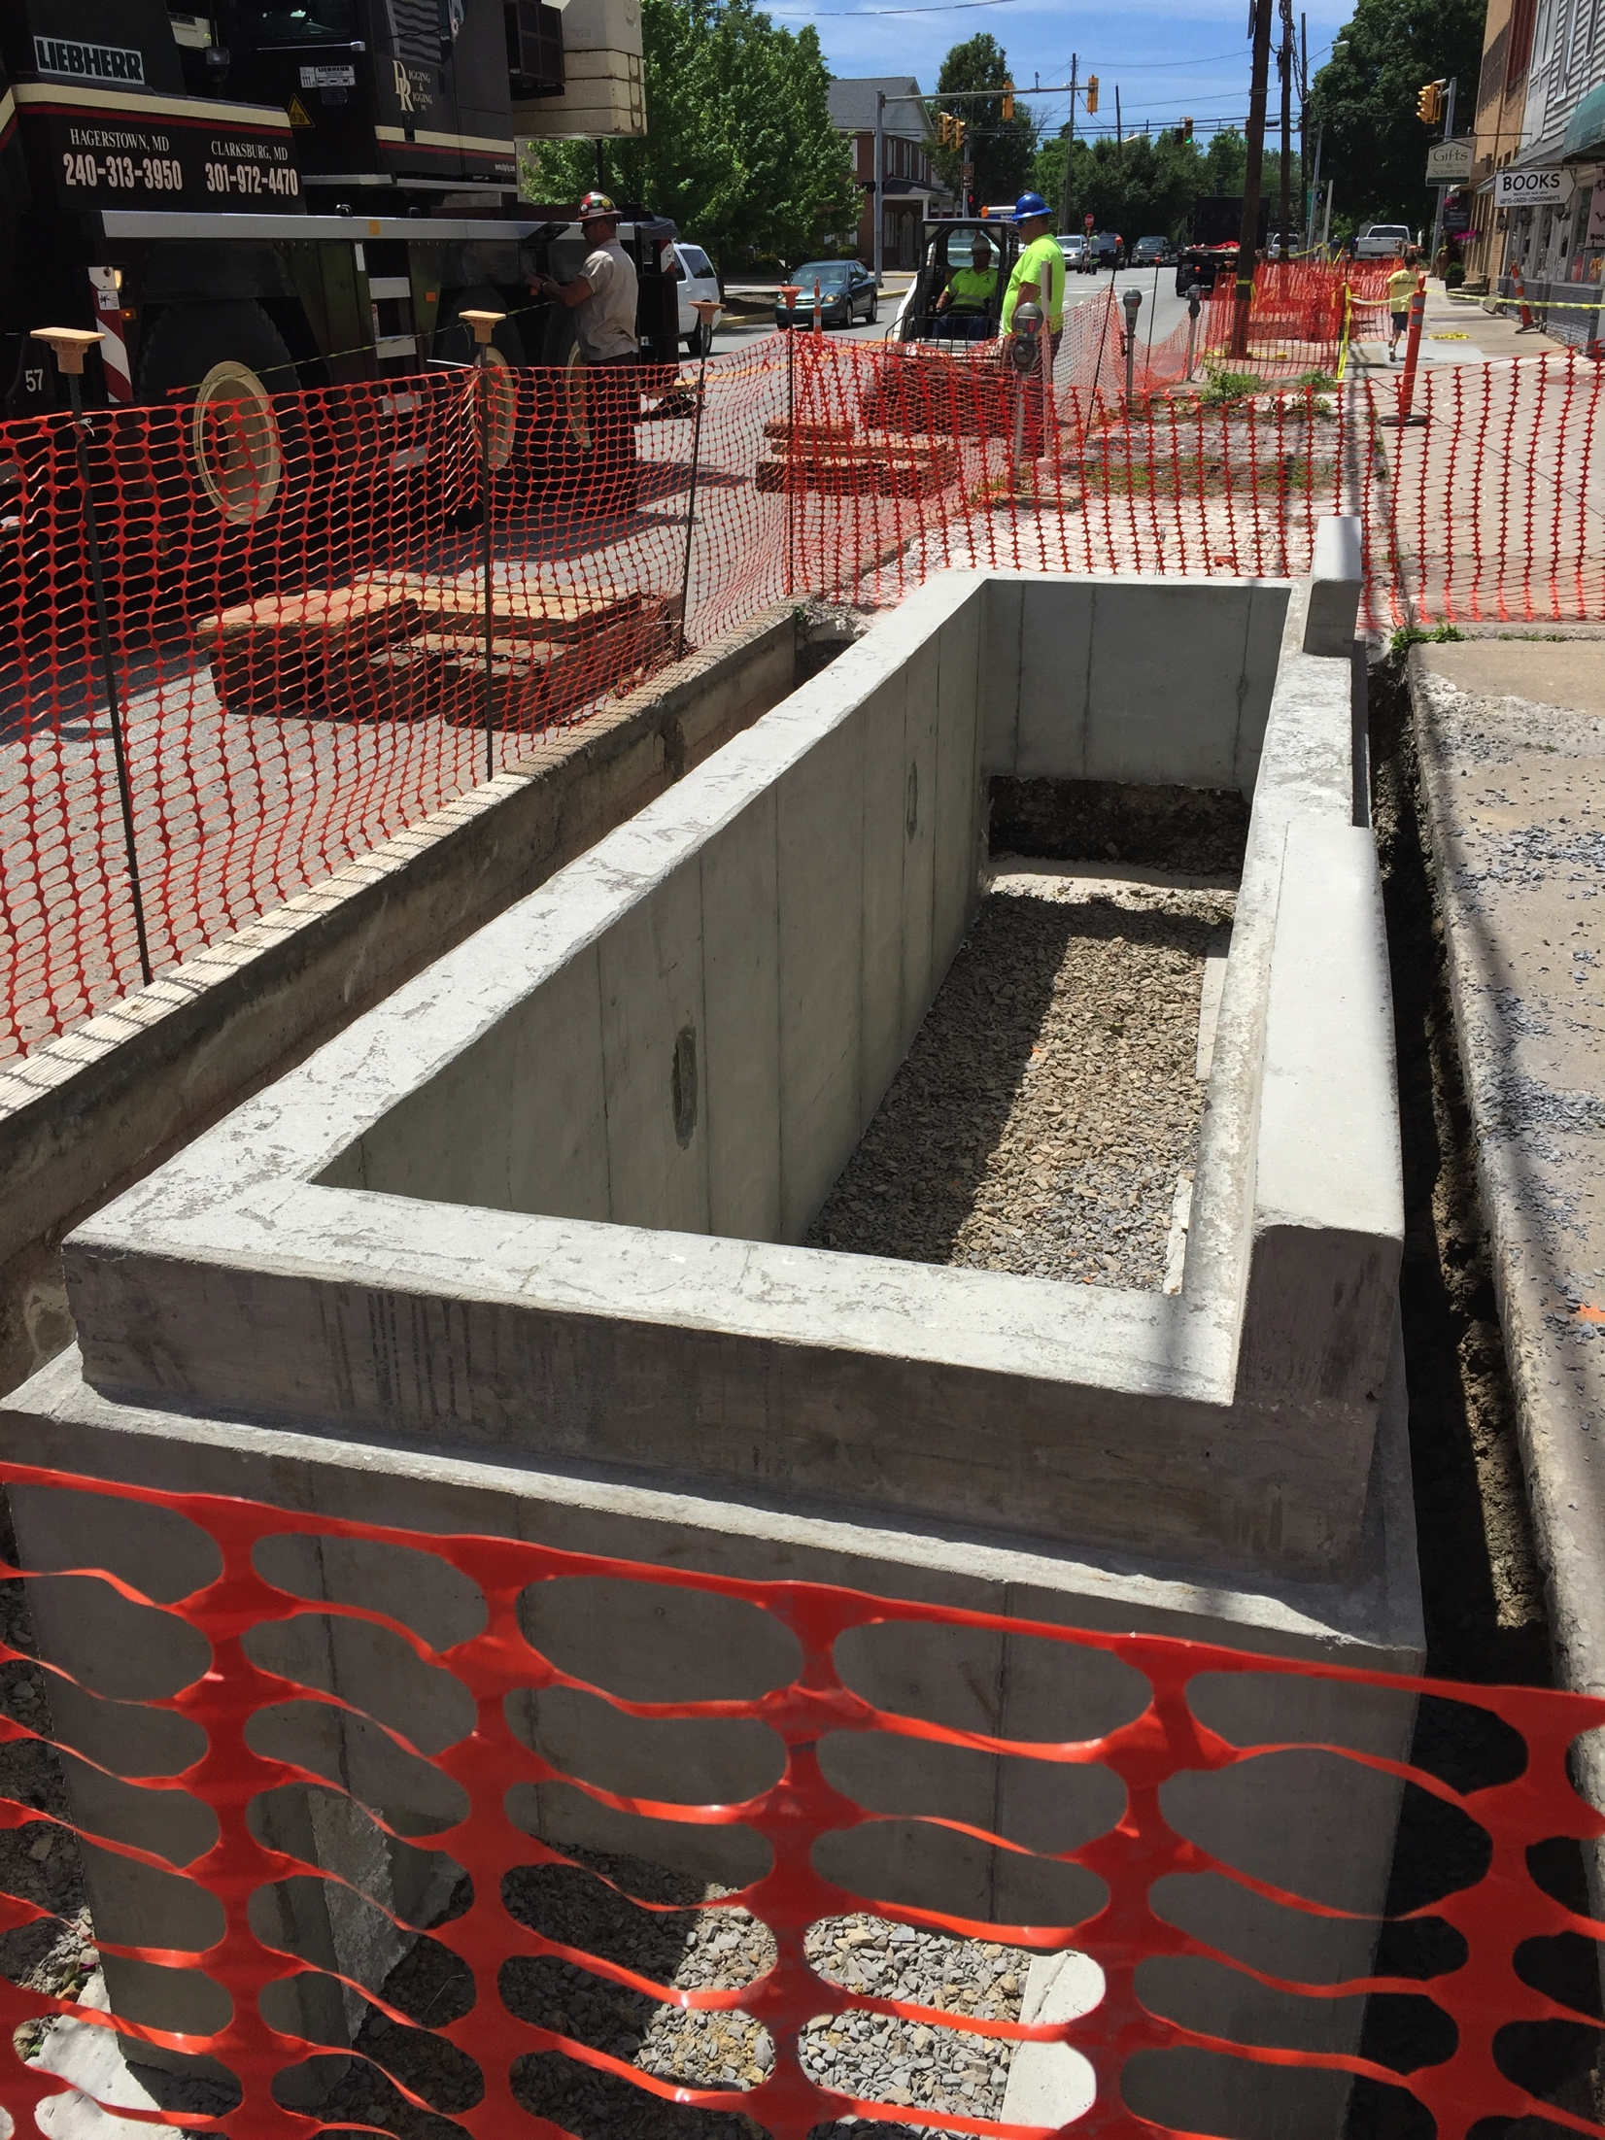
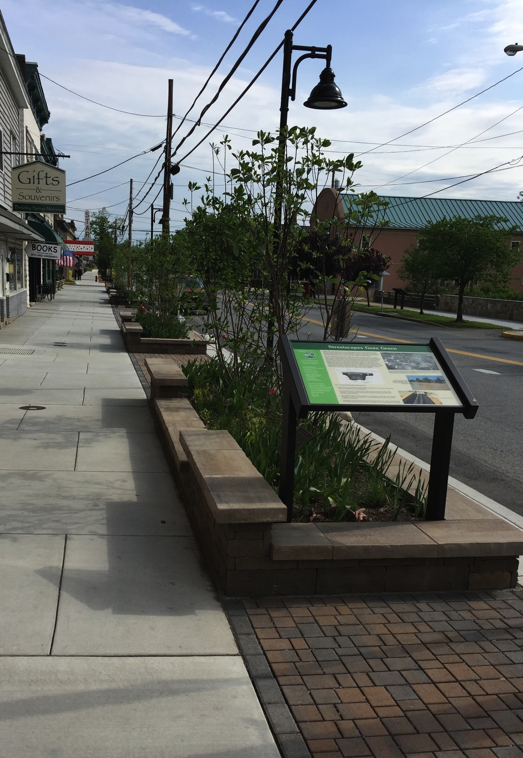
Stormwater
Demonstration Capital improvement Projects
Corollary benefits:
Reduce nuisance flooding
Beautify Downtown cores
Notes:
Right here in Berkeley Springs – has been an inspiration to other local communities

Slide 19
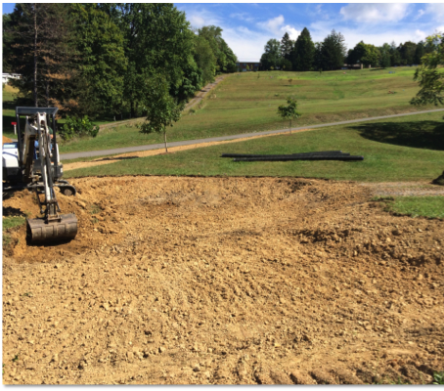
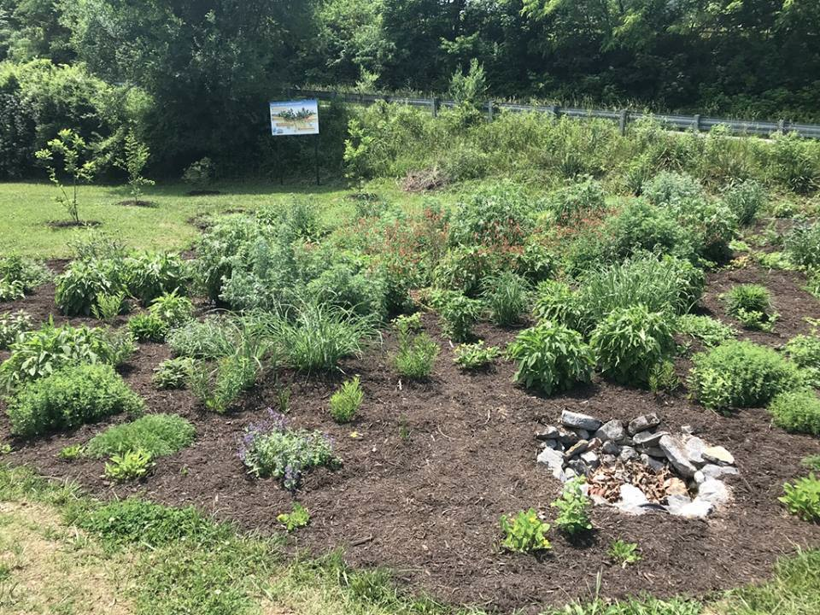
Stormwater
Demonstration Capital improvement Projects
Corollary benefits:
Reduce nuisance Flooding
Beautify Public Spaces
Notes:
Also in Berkeley Springs, good demonstrations of how to treat steep, gravel roads. Also, a local watershed group cares for the rain garden.

Slide 20
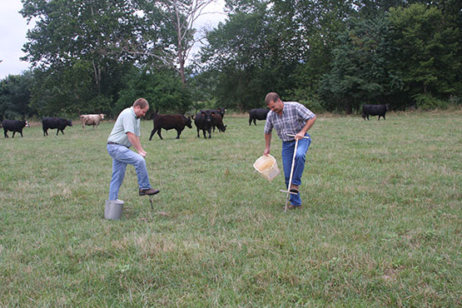
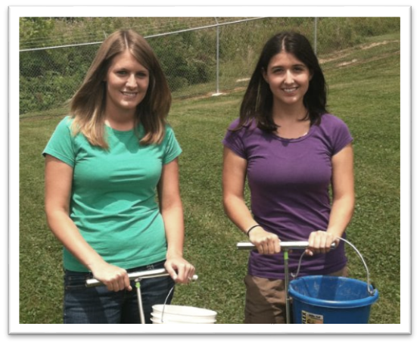
What is a Nutrient Management Plan?
Site-specific plan that utilizes soil test results, manure/litter analysis and producer goals to develop a written document that is designed in a way to minimize potential nutrient loss.

Slide 21
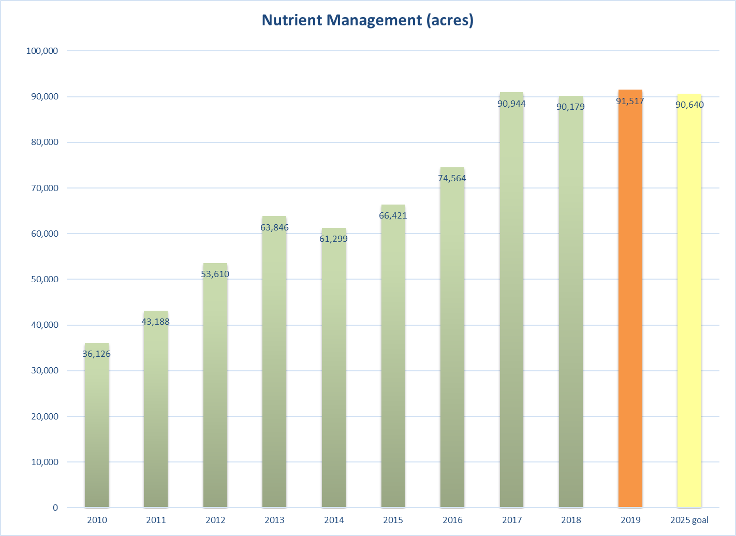

Slide 22
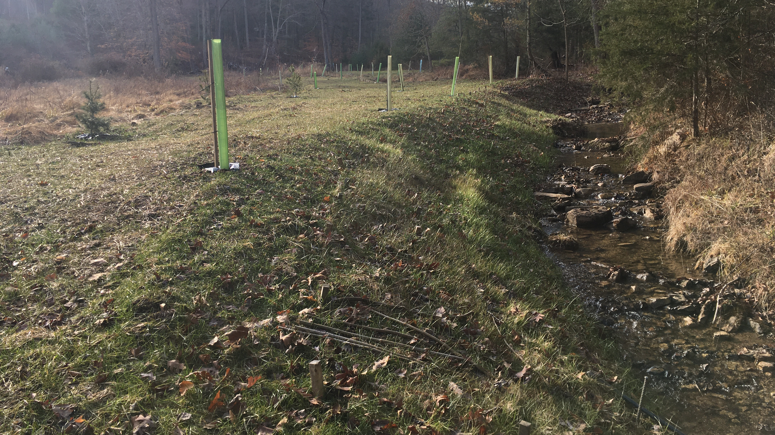
Stream restoration by Trout Unlimited
Lost River watershed near Wardensville, WV

Slide 23
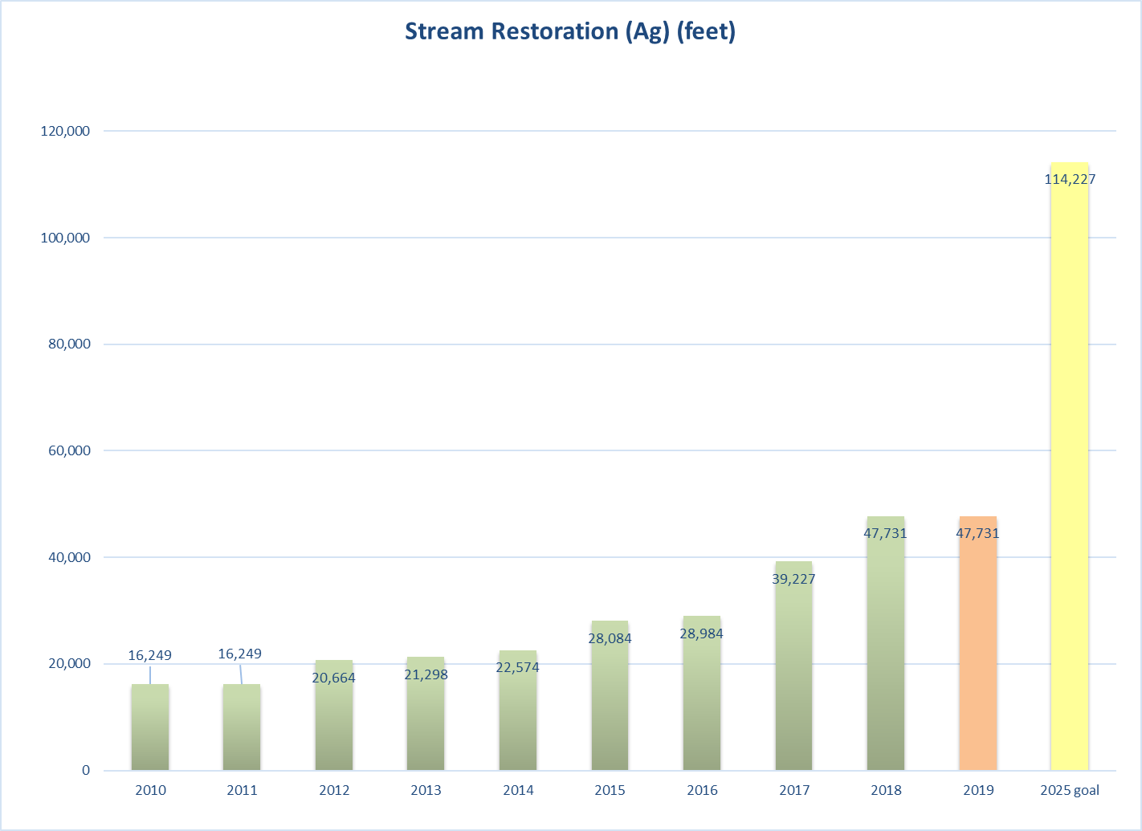

Slide 24
WIP3 Development
Identifying local priorities
Agricultural producers know which strategies work for their operations
Source water protection plans have management measures
Local watershed based plans need to be implemented to improve our streams
Connecting good fish habitats by improving in-between Sections
Floodplain Management and Community rating Systems Green Guide

Slide 25
Concepts based on feedback from local work sessions
  Wastewater
    Sanitary service expansion to areas with failing septic systems
    Asset Management programs
  Stormwater
    Assist with nuisance flooding
    Focus assistance in MS4 communities
    Green Infrastructure development and implementation
  Technical assistance capacity
Notes:
Ecologix report suggests that "local governments are more likely to be interested in Chesapeake Bay activities if they fit into the following three priority areas: 1. Economic development; 2. Infrastructure development; 3. Public health and safety". Which seems to suggest that Local Governments feel co-beneficial strategies help their local constituency.

Slide 26
partners wvdep worked with for outreach and implementation
Tributary team partners
  Wv conservation agency, wv department of agriculture, wv division of forestry
  “region 9” (Eastern panhandle regional planning & development council), west virginia rivers coalition, Cacapon institute
  Tetra tech, inc.
Additional Implementation partners
    Trout unlimited
    Nrcs (natural resources conservation service)
    Fsa (farm service agency)
    Wvu and local community & technical colleges
    Watershed groups

Slide 27
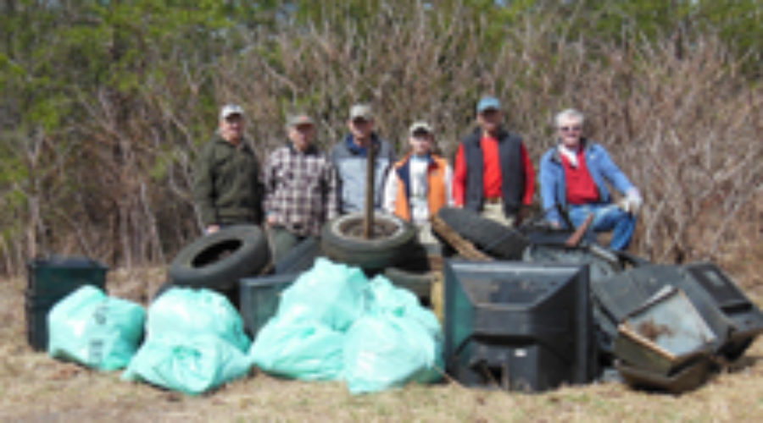
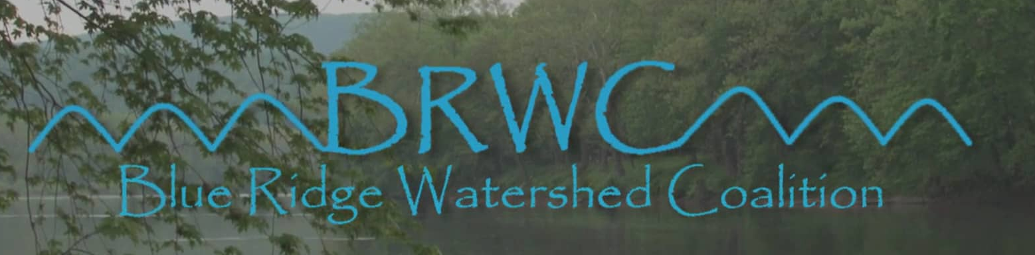
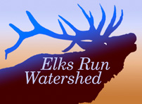
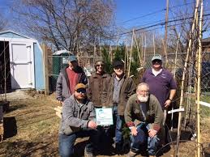

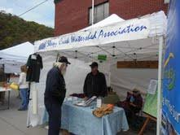
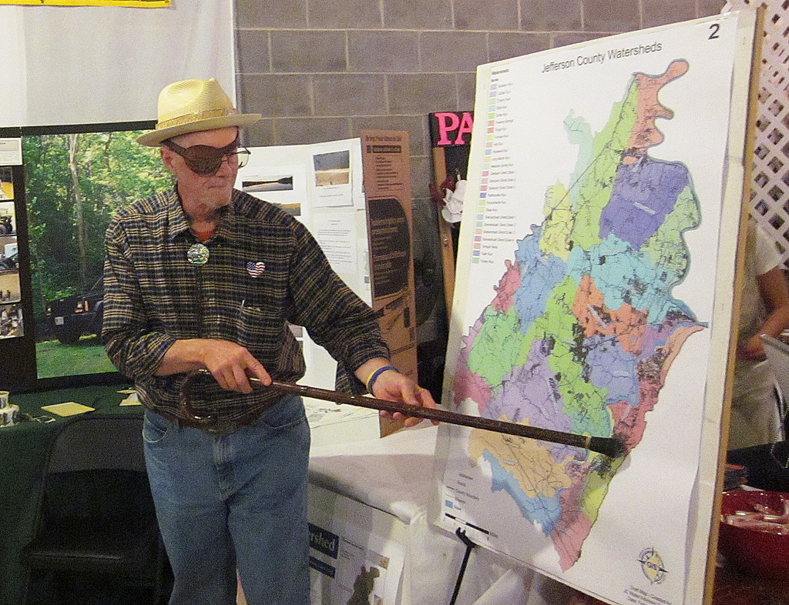

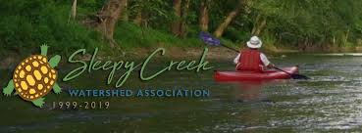

Slide 28
what innovations and state/local funding have resulted in WV's participation in Bay Watershed recovery
Legislation (SB245) that provided funds for wastewater upgrades in 2011
Communitree, trout unlimited and other programs that attract landowners, volunteers and local project leaders for match, and can aggregate tree orders for a bulk rate
Ms4 communities starting down the path of collecting stormwater fees
319 nonpoint source funds applied in watersheds with bacteria and sediment impairments
Region 9 Chesapeake bay coordinator helped communities acquire diverse grants (604b, nfwf, etc.)

Slide 29
how WV is approaching BMP verification
Stormwater:
WVDEP Stormwater specialist visits newly developed sites when their construction permit is officially terminated, then updates a database of post-construction stormwater bmps.
coordinates the future visual inspection of these bmps so they will not be lost in the model due to reaching their lifespan.
Agriculture:
WVDA and WVCA currently developing a new system to verify livestock exclusion fencing with riparian buffers, which is a particularly important BMP for WV
other verification activities are on a voluntary basis as staff interacts with landowners. Challenging to track and report over time since most agriculture bmps are reported as county totals to protect producer privacy.

Slide 30
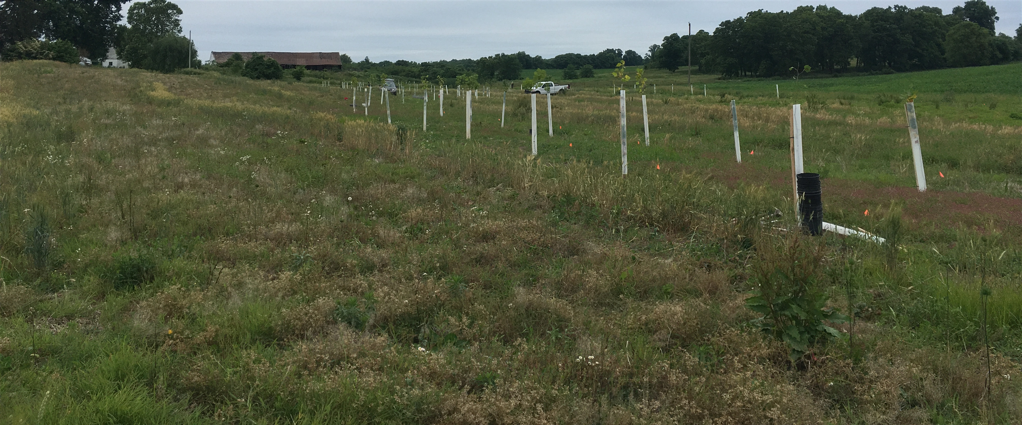
Riparian tree planting along Elks Run, Jefferson County, WV

Slide 31
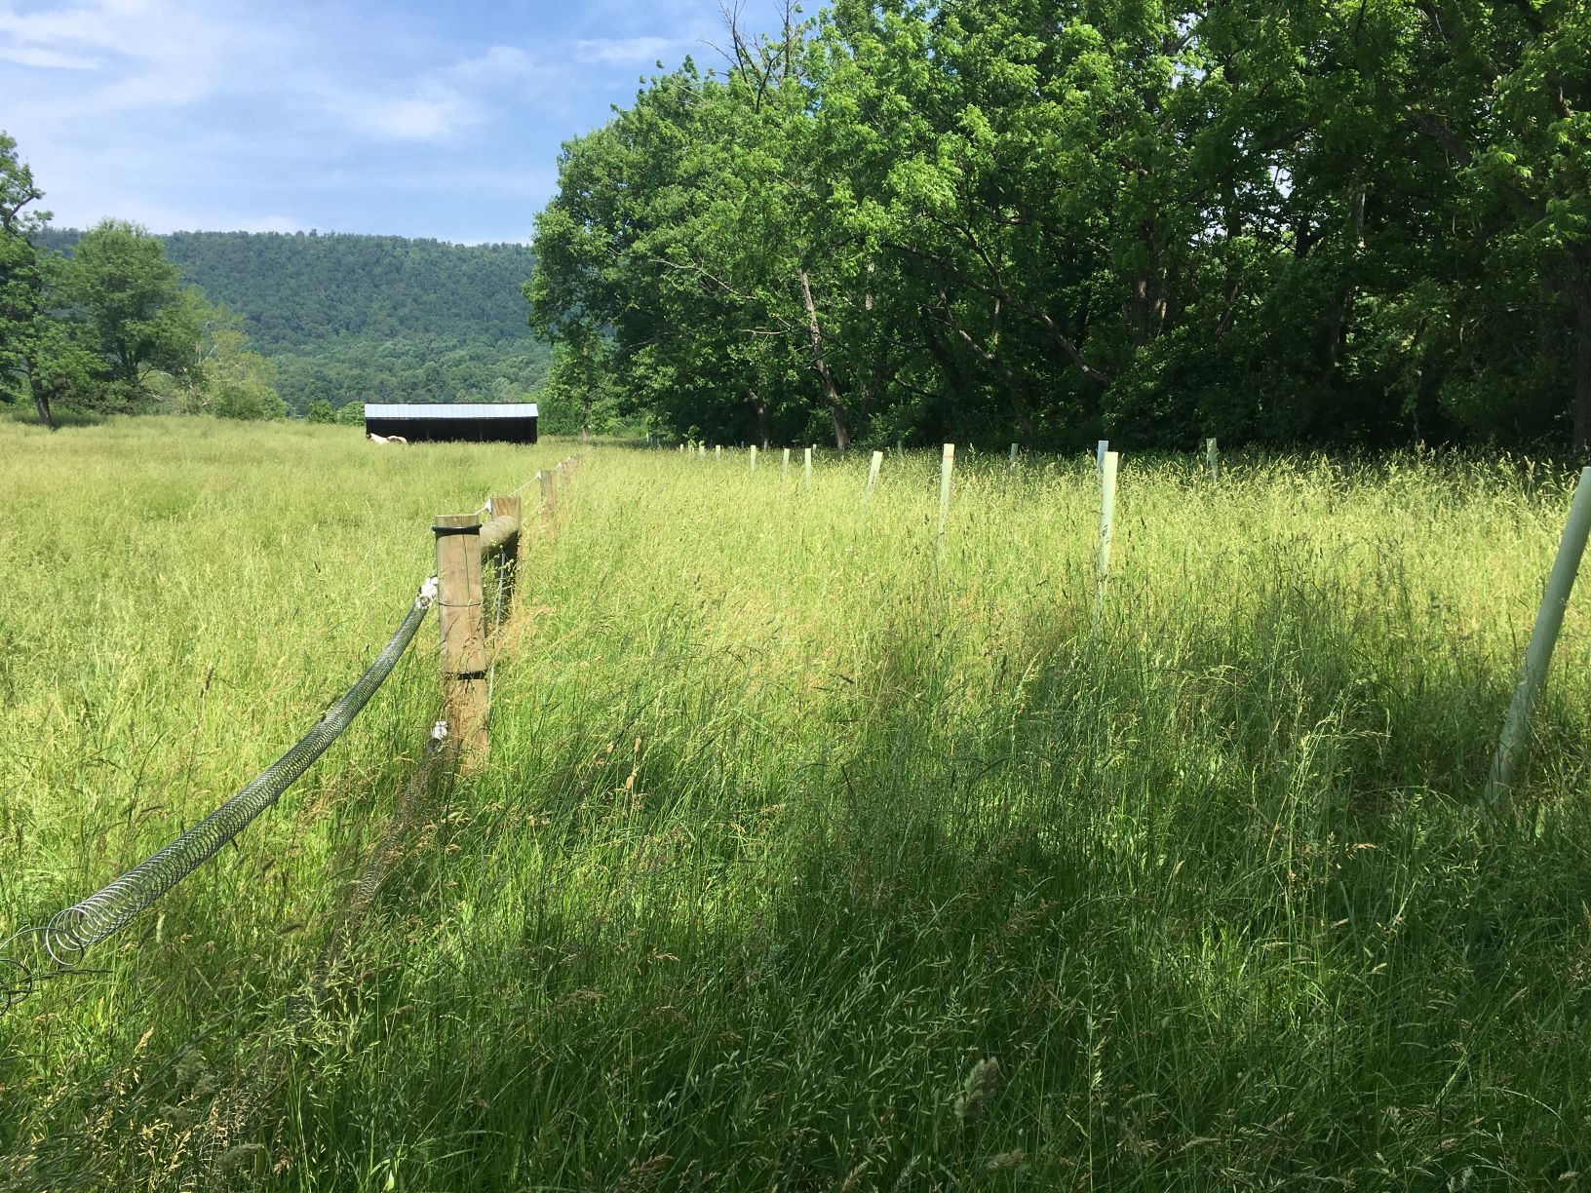
CREP program buffer area and fence, Tuscarora Creek near Martinsburg WV

Slide 32
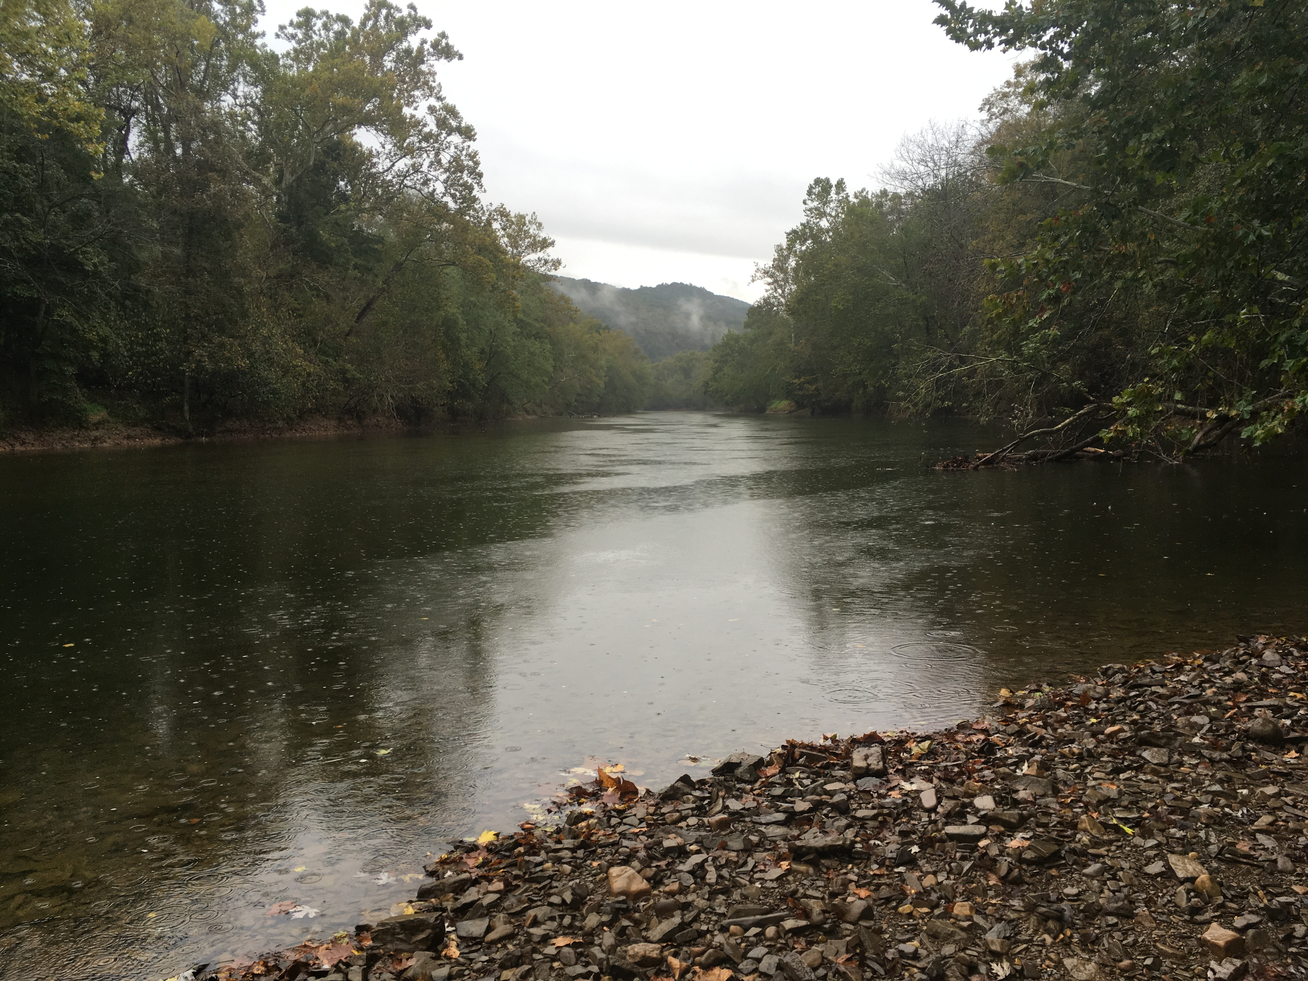
Cacapon River near Great Cacapon WV

