Slide 1

Calculating the Chesapeake Basin’s Percent of Healthy Streams
Claire Buchanan (ICPRB) and Kelly Maloney (USGS)
Stream Health Workgroup, February 21, 2020

Slide 2
Stream Health Outcome
2014 Chesapeake Bay Watershed Agreement
“Continually improve stream health and function throughout the watershed. Improve health and function of ten percent of stream miles above the 2008 baseline for the Chesapeake Bay watershed.”
What is the indicator of “stream health and function?”
What is the “2008 Baseline?”
What qualifies as “10%” improvement?
What is the total number of “stream miles” in the watershed?

Slide 3
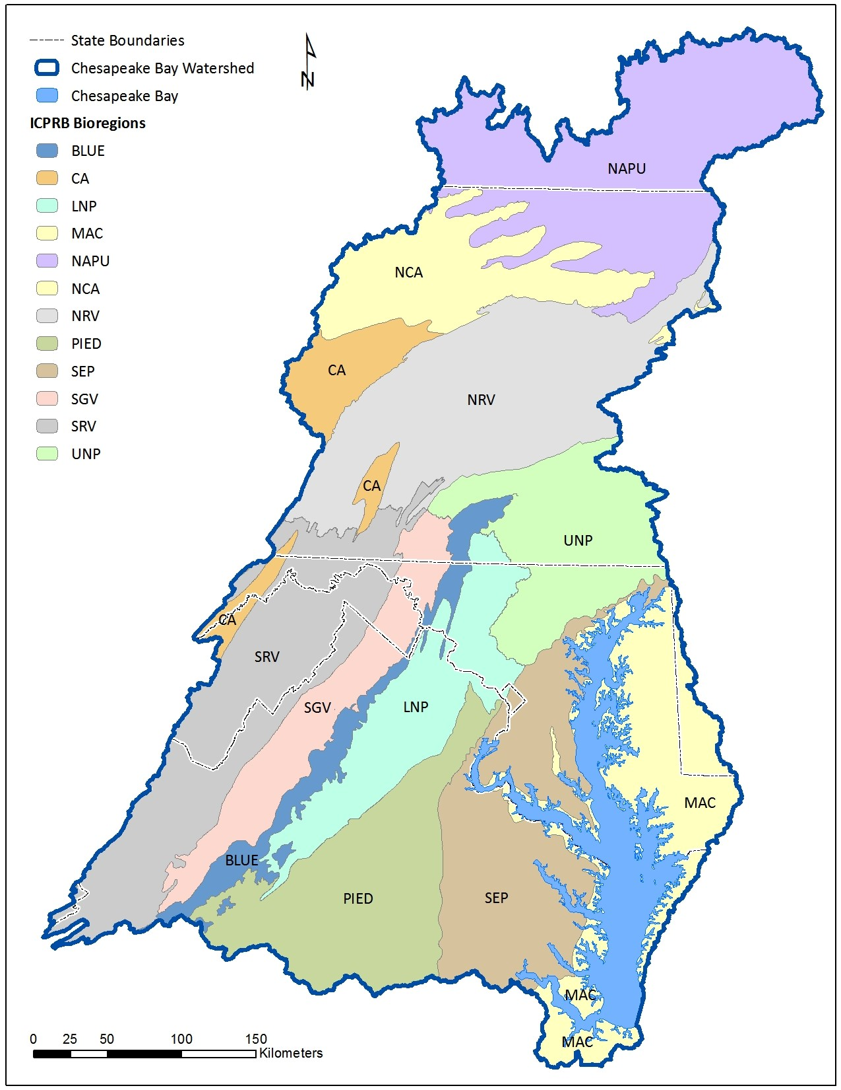
Indicator of “Stream Health & Function?”
Chessie BIBI (2015 Management Strategy decision)
  Multi-metric index of stream macroinvertebrates
  1st – 4th order streams in Chesapeake basin (@ 1:100,000)
  Reference-based
  2017 index refinement (25,067 samples)
  Twelve “bioregion” sub-indices (2017 Workshop decision)
  Five narrative ratings (Excellent, Good, Fair, Poor, Very Poor)
  Sensitive to multiple different stressors
more
˅
Notes:
The most sensitive metrics in each bioregion are used to form bioregion-specific indices.
Common scoring protocols -> bioregion indices are directly comparable.
Narrative ratings are determined by the 50th, 25th, 10th, and ½ of 10th percentiles of index score distributions in Reference.
Sensitive to instream habitat conditions, conductivity, pH, DO, as well as flow alteration, nutrients, climate change, landcover change

Slide 4
Indicator of “Stream Health & Function?”
Issue: there are gaps in spatial coverage of monitoring data
Solution: use Random Forest Model to fill in gaps (2018 Workshop decision)
Maloney et al. (2018) and subsequent model runs are refining the Random Forest approach
Notes:
Maloney et al. (2018) related Chessie BIBI ratings to
Local catchment: number of dams
Upstream catchments: agricultural lands, precipitation, soil type, atmospheric SO4 deposition, elevation, area, % imperviousness, % tree canopy
Model correctly predicted 72% of samples in the training data set (1,449) and 73% of samples in test data set.

Slide 5
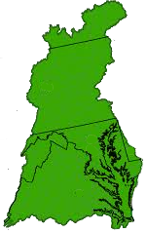
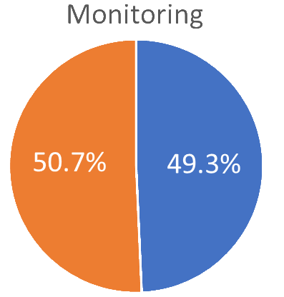
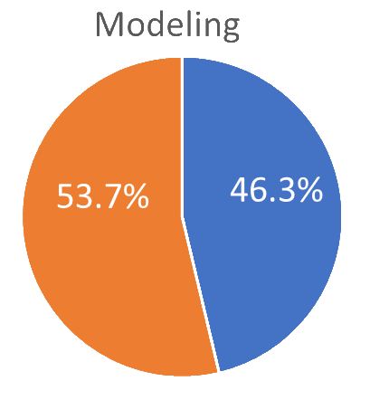
Is the Model Any Good?
Yes!
Monitoring and modeling results do not agree in ~9.1% of 4,888 catchments*
Disagreement is only 3.0% when % Healthy and
% Unhealthy are calculated for the 4,888 catchments
At basin scale, monitoring and modeling results agree well
(weighted by hydrologic unit area)
% Healthy
Monitoring
~ 60.0%
Modeling
~ 61.8%
Only 1.8%
difference
Exact Match | 75.7%
Near Match | 15.2%
Mismatch | 9.1%
(pred3catb)
Poor
Very Poor
Excellent
Good
Fair
All available data used. Unsampled HUC12’s excluded from Monitoring calculations; unmodeled catchments excluded from Modeling calculations.
*4,888 catchments in 2006 – 2011 period have monitoring and modeling ratings
Notes:
4,888 catchments had both monitoring and modeling results
Remember – Random Forest model was developed with monitoring results, so there should be good agreement (!!)
Point out that unsampled (unmonitored) subwatersheds tend to be rural or forested, where higher BIBI scores can be expected.
(Note: monitoring station scores in the same catchment were averaged and the average rated.)

Slide 6
“2008 Baseline?”
Issue: monitoring programs have different sampling schedules (“rounds”)
Solution: multi-year baseline (2018 Workshop decision)
  2006 – 2011 => Baseline period
  2012 – 2017
  2018 – 2023
  2024 – 2029
  2030 – 2035

Slide 7
“10% Improvement?”
Issue: what qualifies as improvement?
Is Very Poor => Poor improvement?
Is Excellent => Good degradation? or just natural variability?
Is a Poor => Good improvement at one site balanced by a Good => Poor degradation at another site?
Temporary Solution: for now, just work with sites classifying as Excellent, Good, or Fair in each interval (2018 Workshop decision)
Notes:
Decision to be made by SHWG

Slide 8
Total “Stream Miles?”
Issue: as resolution improves
total number 1st - 4th order streams increases
total length of streams ID’ed as Strahler order 1st – 4th increases
more
˅

Slide 9
1 : 100,000 Scale
NHD Plus V2
1 : 24,000 Scale
NHD Plus High Resolution
Change
Stream Order | Count | Length (Km)
1 | 44,867 | 78,609
2 | 17,808 | 23,338
3 | 9,425 | 12,579
4 | 5,971 | 7,621
5 | 3,536 | 3,778
6 | 2,177 | 2,057
7 | 540 | 649
Stream Order | Count | Length (Km)
1 | 238,288 | 130,297
2 | 96,584 | 48,268
3 | 49,032 | 25,934
4 | 26,797 | 13,723
5 | 16,047 | 8,302
6 | 6,818 | 3,646
7 | 3,745 | 2,128
8 | 1,371 | 1,449
9 | 3 | 17
Freq | Length
+ 5.3X | + 1.7X
+ 5.4X | + 2.1X
+ 5.2X | + 2.1X
+ 4.5X | + 1.8X
+ 4.5X | + 2.2X
+ 3.1X | + 1.8X
+ 6.9X | + 3.3X
New | New
New | New
Data from John Young, USGS Leetown Science Center

Slide 10
Total “Stream Miles?”
Issue: as resolution improves
total number 1st - 4th order streams increases
streams ID’ed as Strahler order 1st – 4th increases
One option: calculate percent of healthy streams using AREA of a hydrologic unit to weight results (2018 Workshop temporary decision)
as resolution increases, areas of hydrologic units are not expected to change as much as flowlines
Alternate option: calculate percent of healthy streams using NUMBER OF MILES in a hydrologic unit to weight results and recalculate 2008 baseline for each stream layer resolution/version
as resolution increases, the lengths and numbers of flowlines (miles) increase and Strahler order assignment changes
Notes:
The 1:24,000 resolution was a 2018 decision of both the Stream Health Workgroup and the Fish Habitat workshop.
The Brook Trout and Fish Passage workgroups are using 1:24,000 as well.

Slide 11
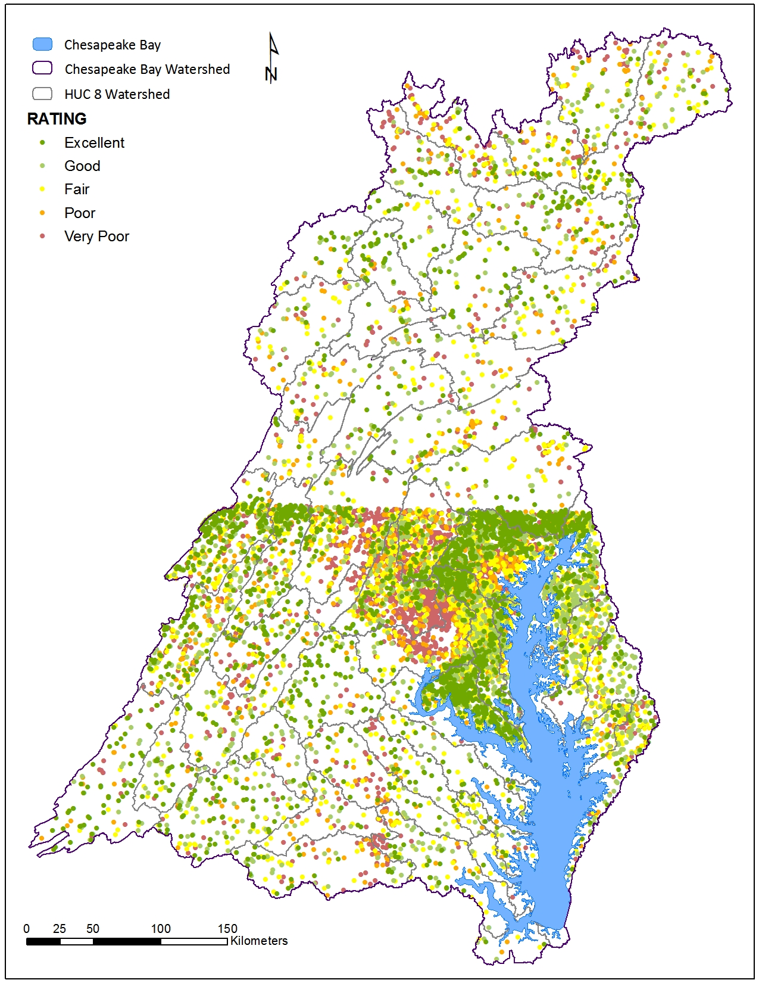
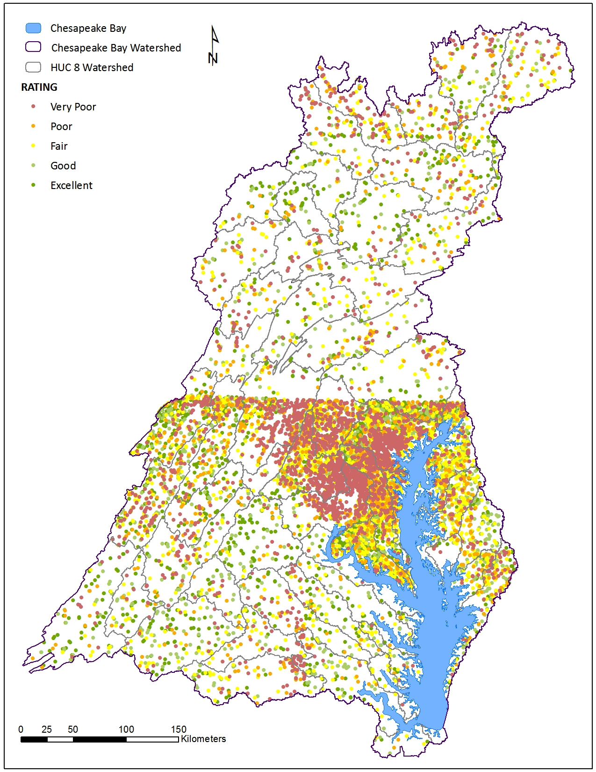
Step 1 for Both Options: Group by Hydrologic Unit
Minimizes bias
% Healthy streams
Simple count method:
50.3%
Area-weighted method:
60.0%
Green dots on top
Red dots on top

Slide 12
Which Size Hydrologic Unit?
1 Chesapeake Watershed ~ 64,000 mi²
58 HUC8 Subwatersheds ~ 1,301.6 mi²
1,971 HUC12 Subwatersheds ~ 34.6 mi²
104,000 SHEDS Catchments ~ 0.6 mi²
HUC12’s
7,300 stations sampled in baseline period
(~ 3.7 per HUC12 or ~ 1 per 8.8 mi²)
Only ~ 2/3rd of HUC12’s have data because station coverage is uneven
One station likely won’t represent an individual HUC12 well when land cover is heterogeneous….
Catchments
Modeled ratings can be assigned to 99% of all 104,000 catchments in basin
Catchments are small (~0.6 mi²), have one local stream segment, and land cover is often homogeneous
Notes:
7,300 stations per 64,000 mi2 averages to 1 station for every 8.8 mi2.
However, stations are clustered in urban areas where counties monitor intensely.

Slide 13
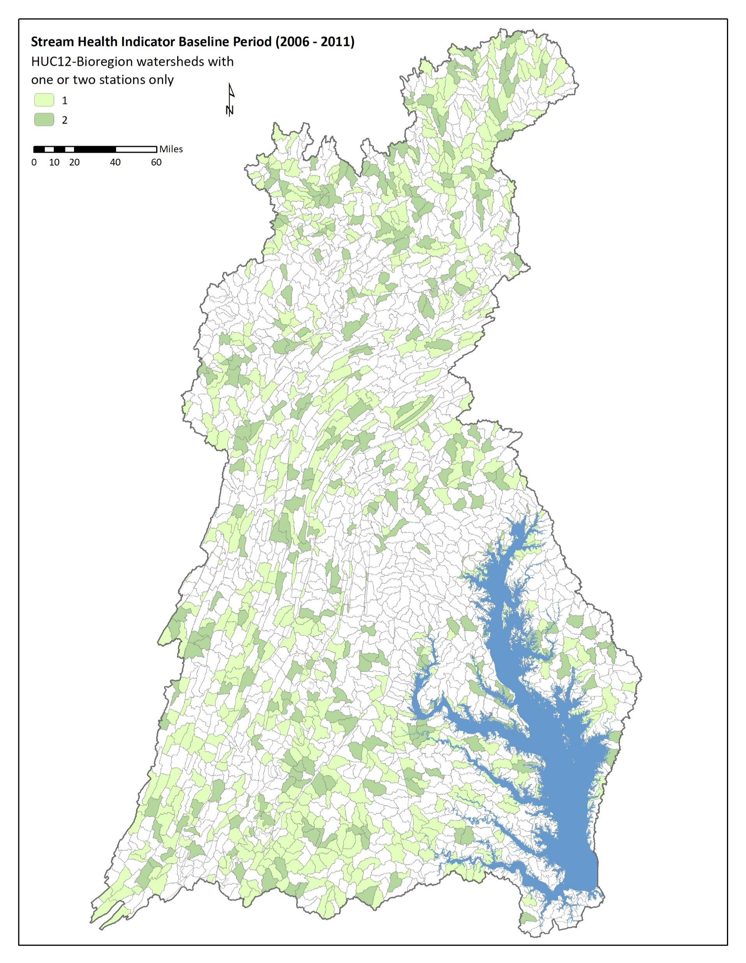
Because many monitoring programs have random-stratified designs…
relatively accurate basin estimates can be obtained from HUC12’s with just 1 – 2 monitoring sites!!
One or two stations may represent a HUC12 well when land cover is homogeneous
Ongoing analysis by Kelly Maloney and John Young may give us answers about how many samples are needed to adequately represent a HUC12 unit, given its landscape’s level of homogeneity
Sub-watersheds with just one or two sampled stations

Slide 14

Merged monitoring and model Chessie BIBI ratings
Step 2: Weight by Area or Miles?
Group the site scores by hydrologic unit
Weight by area of hydrologic unit?
Weight by # miles in hydrologic unit?
Notes:
If by area – baseline will be fairly consistent over time
If by # miles – baseline will need to be recalculated for each GIS layer resolultion

Slide 15
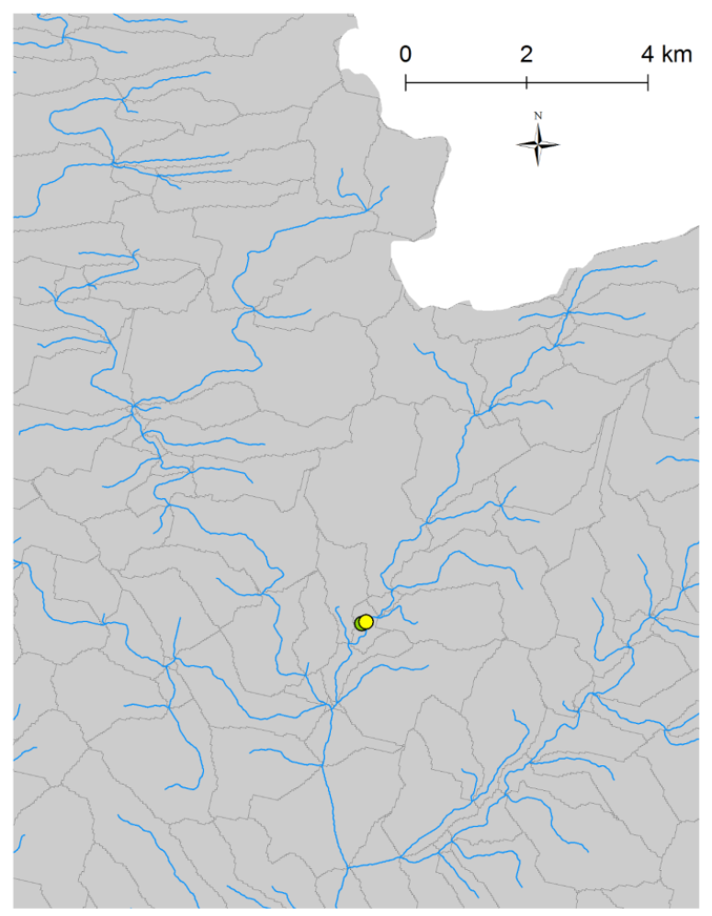
Same Method for Both Options
Group ratings by hydrologic unit
For units with one or more monitoring sites, use monitoring results weighted by equal portions of catchment’s area or # of stream miles
For units with no monitoring data, use model results weighted by catchment’s area or # of stream miles
Sum all unit areas or # of stream miles with Healthy ratings (E, G, F) and divide by Chesapeake watershed’s total area or total stream miles to calculate % Healthy streams
Monitoring Results

Slide 16
Option 1: Use Area-Based Method for Basin Estimates
Areas of catchments & HUC12’s will remain relatively consistent over time
Baseline will not change much, if at all
Most useful when reporting % improvement basin-wide
Option 2: Use Mile-Based Method for Basin Estimates
Total miles per hydrologic unit will change as GIS layer resolution improves
Baseline will need to be recalculated for each resolution
Most useful in local restoration projects
Option 3: Calculate Both
Notes:
If the SHWG selects a stream layer as their official one then baseline should remain constant.
But different GITs/Action Teams are using different versions and others are developing different options (e.g., Peter C's work at 1:2,000) so over time mileage will change.
Adopting a catchment area-based method avoids all this uncertainty and change because catchment boundaries are not likely to change much.

Slide 17
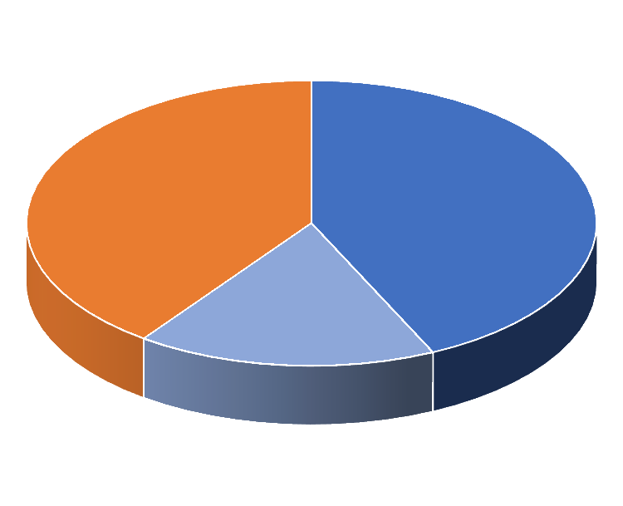
“2008 Baseline” for Stream Health Indicator Calculated with Option 1
40% Poor or
Very Poor
43% Excellent or Good
…But There is Also a Semantics Issue
17% Fair
Technically, this should be read “60% of the Chesapeake Bay watershed supports streams that are in Excellent, Good or Fair condition according to the Chessie BIBI Stream Health Indicator.”
Notes:
Sidebar analysis: in 2020 we want to test the robustness of 1 survey point in HUC12s with heterogeneous landscapes

Slide 18
Outcome Unchanged?
Continually improve stream health and function throughout the watershed. Improve health and function of ten percent of stream miles above the 2008 baseline for the Chesapeake Bay watershed.
Outcome Revised?
Continually improve stream health and function throughout the watershed. Improve health and function of ten percent of streams above the 2008 baseline for the Chesapeake Bay watershed.

Slide 19
Questions?
REFERENCES
Chesapeake Bay Program (CBP). 2015. Stream Health Outcome Management Strategy. CBP Stream Health Workgroup.
Smith, Z. M., C. Buchanan, and A. Nagel. 2017. Refinement of the Basin-Wide Benthic Index of Biotic Integrity for Non-Tidal Streams and Wadeable Rivers in the Chesapeake Bay Watershed. ICPRB Report 17-2, Interstate Commission on the Potomac River Basin, Rockville, MD.
Chesapeake Bay Program (CBP). 2018. Workshop to develop a 2008 baseline for the CBP stream health outcome indicator, Cacapon Resort State Park, WV, 5th – 6th April 2018. Workshop report prepared by Interstate Commission on the Potomac River Basin.
Maloney, K., Z. M. Smith, C. Buchanan, A. Nagel, and J. A. Young. 2018. Predicting Stream Biological Conditions for Small Headwater Streams in the Chesapeake Bay Watershed. Freshwater Science 37(4):795-809. DOI: 10.1086/700701.
Buchanan, C., K. Maloney, Z. Smith, A. Nagel, and J. Young. 2018. Creating a stream health baseline for the Chesapeake basin from monitoring and model data. Report to Stream Health Workgroup prepared by Interstate Commission on the Potomac River Basin.

