Slide 1



Robin Sizemore, WVDE Science Coordinator
Vicki Fenwick-Judy, The Mountain Institute
Frank Rodgers, Cacapon Institute

Slide 2
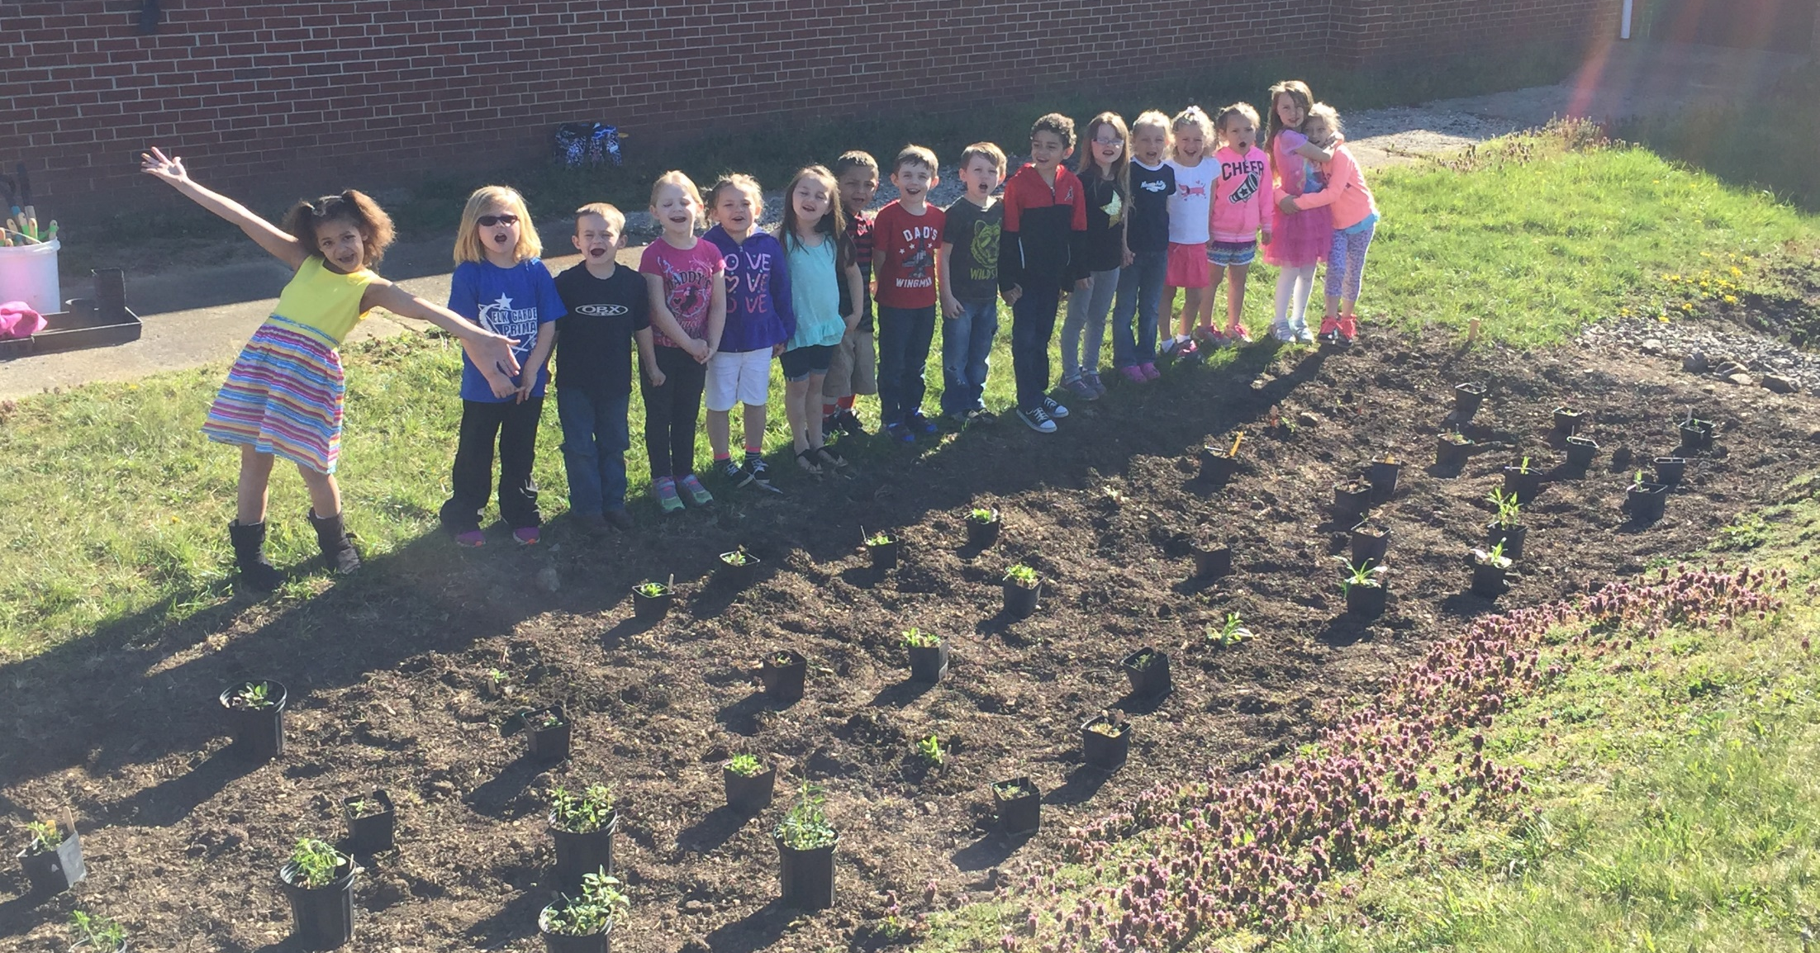
Mid-Atlantic Environmental Literacy
WV Work Plan Commitments
Robin Sizemore, WVDE Science Coordinator
Vicki Fenwick-Judy, The Mountain Institute
Frank Rodgers, Cacapon Institute

Slide 3


WV Work Plan Commitments
Partner Responsible
CI, TMI, and NGO EE providers
Geographic Location
WV Bay Counties
Identify factor or gap in Management Strategy
Dependent on NGO funding. No state commitment.

Slide 4
WV Work Plan Commitments
Review Next Generation Content Standards and Objectives for Science (Policy 2520.3C) for correlation to Bay MWEEs with rigorous science and environmental-related content
Support outreach on NCBO ELIT and related data collection regarding MWEE providers and participation in RESA8 schools
Rejuvenate WV Environmental Education Association and convene EE providers to review WV Sustainable Schools for science, citizenship, and EL opportunities.
Attend CBP EWG and EWG Leadership Committee meetings to represent WV Bay counties.

Slide 5
WV Work Plan Commitments
Review Next Generation Content Standards and Objectives for Science (Policy 2520.3C) for correlation to Bay MWEEs with rigorous science and environmental-related content
Support outreach on NCBO ELIT and related data collection regarding MWEE providers and participation in RESA8 schools
Rejuvenate WV Environmental Education Association and convene EE providers to review WV Sustainable Schools for science, citizenship, and EL opportunities.
Attend CBP EWG and EWG Leadership Committee meetings to represent WV Bay counties.

Slide 6
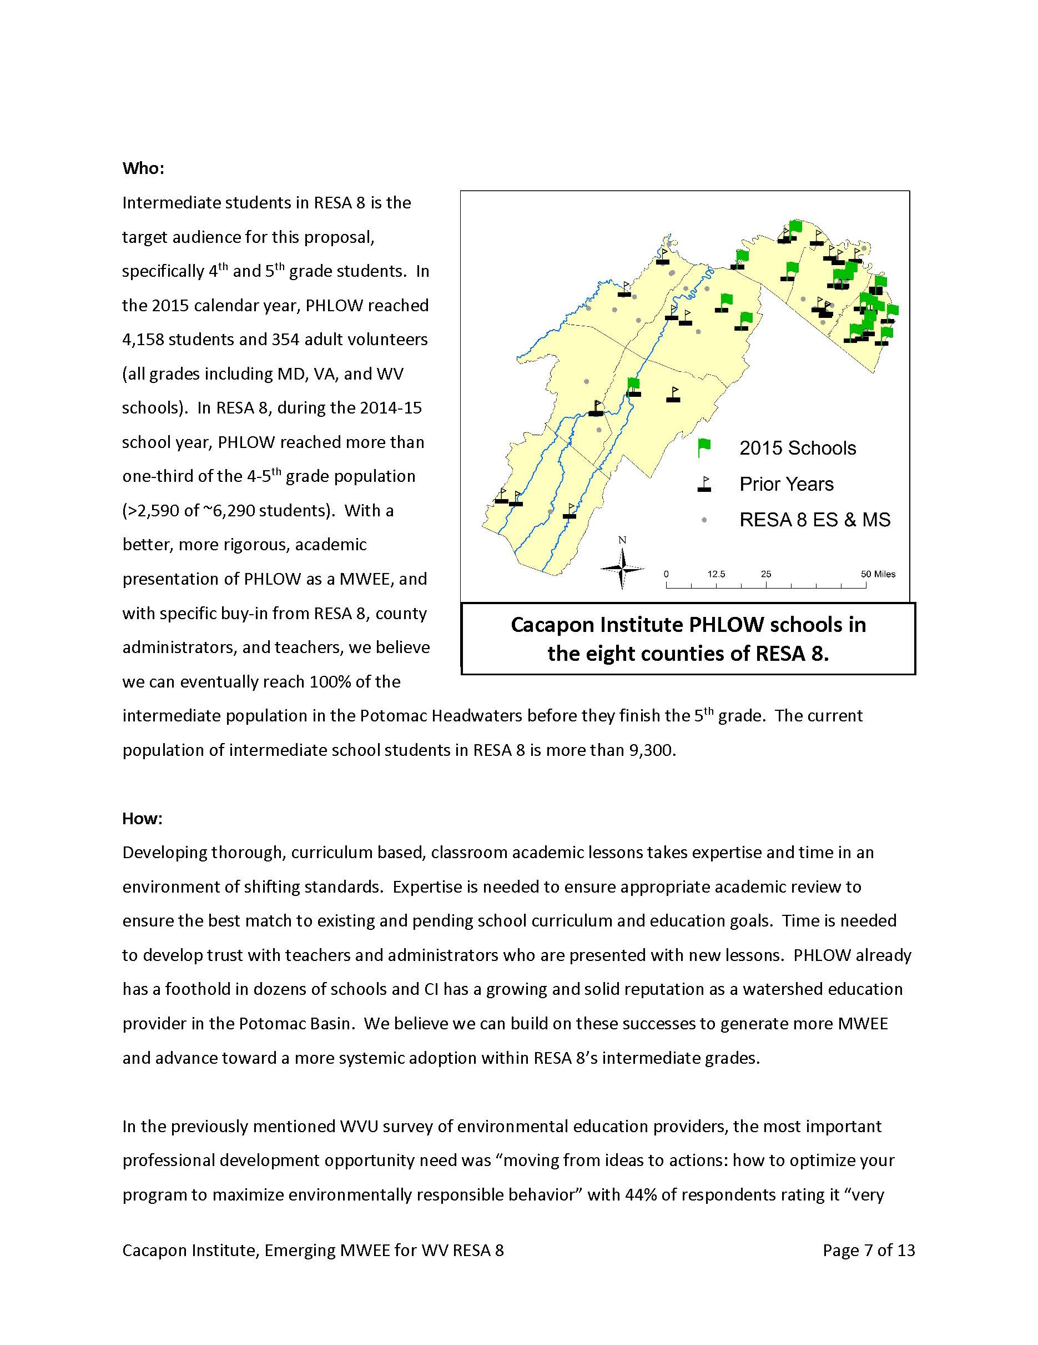
NOAA B-WET
“Emerging MWEE for
RESA 8”

Slide 8
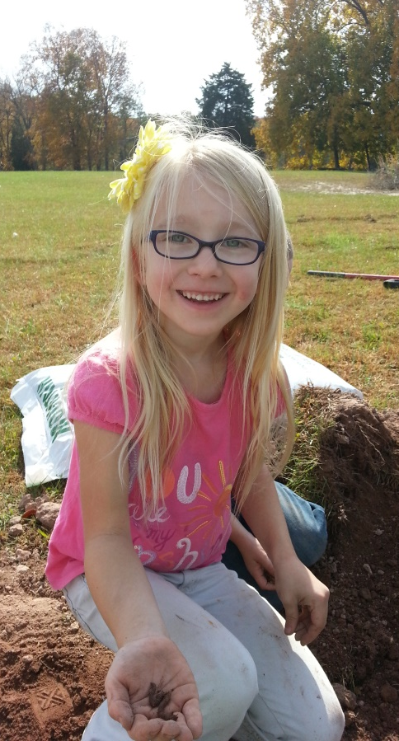
Potomac Headwaters Leaders of Watersheds (PHLOW)
Educating future generations of environmental stewards through classroom education and on the ground conservation practices at schools.
Established in 2008
Since 2011, primary funders include:
  WV DEP Chesapeake Bay Program
  National Fish and Wildlife Foundation
  USDA Forest Service
Three major programs:
  Grow-a-Garden
  Plant-a-Tree
  Growing Native

Slide 9
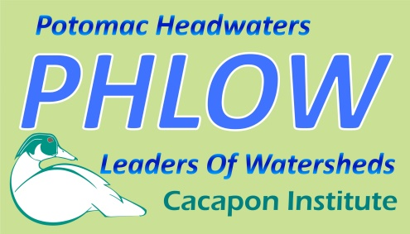



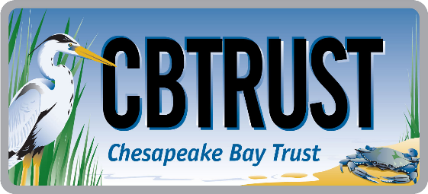
It’s Raining classrooms! Rain gardens for learning

Slide 10
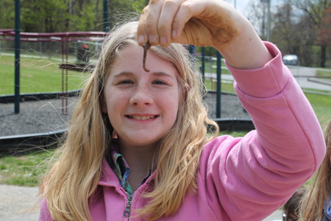
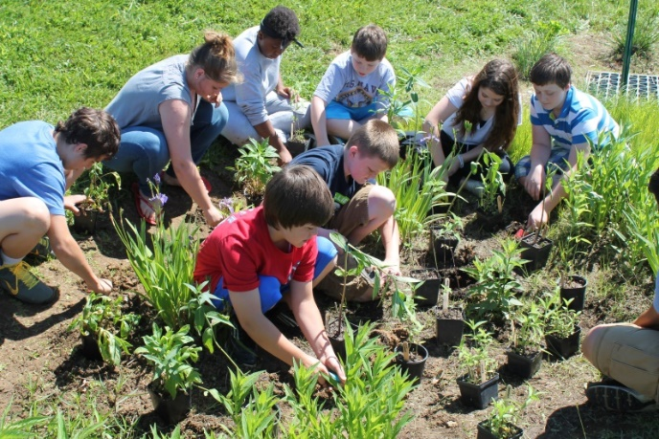
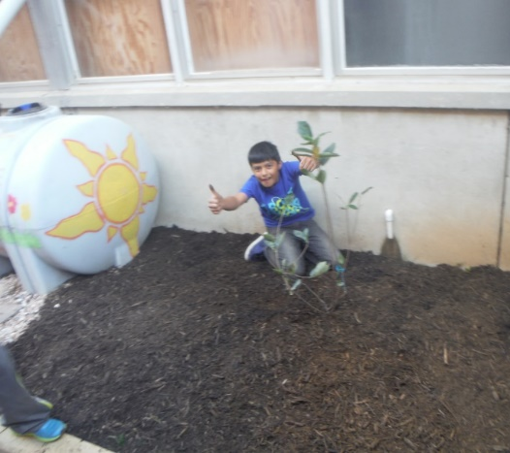
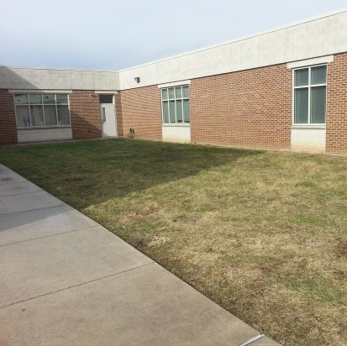
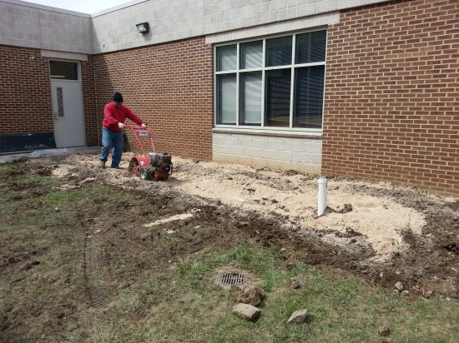
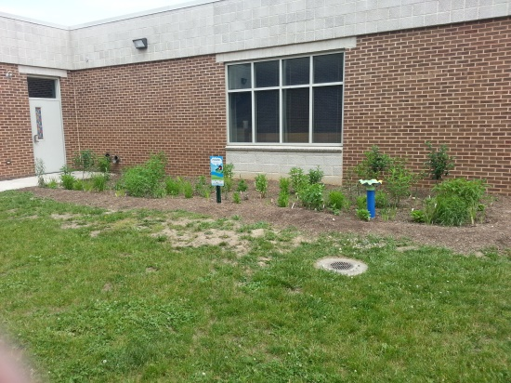
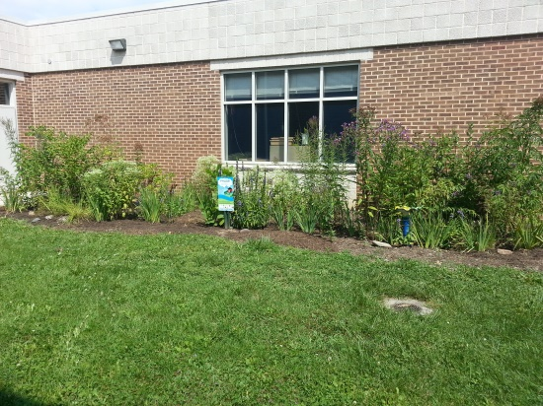
grow-a-garden
Four One-hour Classroom Lessons
Preparation & Rain Garden Design
Installation with Students & Community
Maintenance & Education Resource

Slide 11
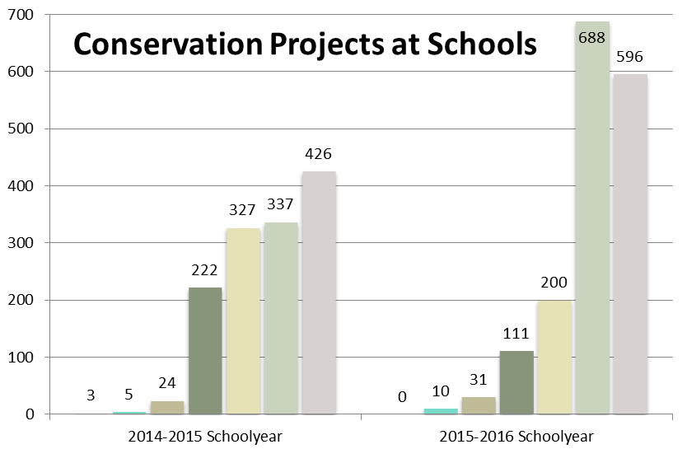
2015-16 Quick Facts
1,376 Square Feet of Rain Gardens
31 School Projects
  West Virginia, Maryland, Virginia
111 Trees Planted
3,443 Volunteers Engaged
11,534 Education Hours
2014-2015 School Year
2015-2016 School Year

Slide 12
Frank F. Rodgers
Executive Director, Cacapon Institute
frodgers@cacaponinstitute.org
304-240-2721
10 Rock Ford Road, Great Cacapon, WV 25422

