Slide 1
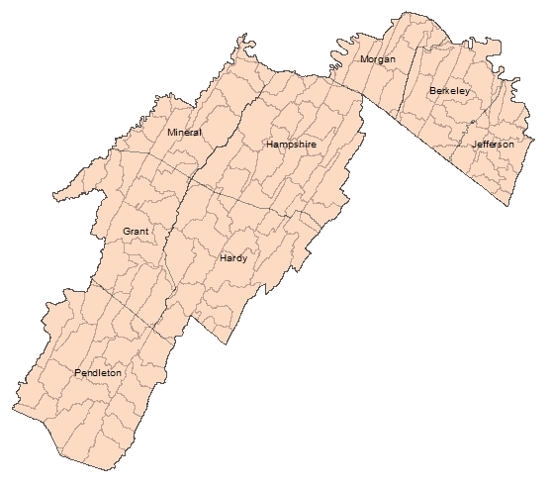
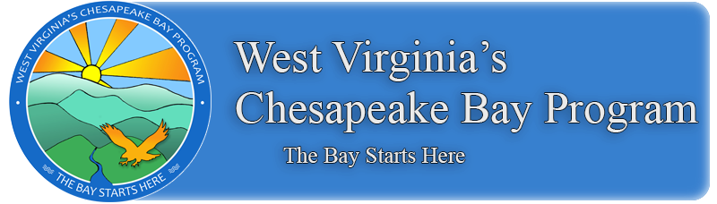
West Virginia’s Agriculture Stakeholders Engagement Strategy
Led by: WVDA and WVCA
In the agriculture sector, “local government” will refer to the Potomac Valley Conservation District (PVCD), Eastern Panhandle Conservation District (EPCD), and Greenbrier Valley Conservation District.
Partnering entities will likely include WVCA, WVDA, Extension, WVPA, WVDOF, USFWS, WVDNR, USDA NRCS, FSA, Farm Bureau, and Non-Profits such as Trout Unlimited
The involvement of these entities is critical in engaging agricultural producers and encouraging farmers to voluntarily adopt certain conservation practices identified by Technical Experts in Conservation Plans.
Avenues for education and outreach may include newsletters, public meetings and one-on-one communication.
Modification of existing programs may be required to achieve new targets.
PVCD will focus more on animal waste storage and poultry litter transfer
EPCD will focus more on tillage practices and cover crops
Tentative Timeline
  Fall 2017: Develop CAST scenarios after targets are assigned
  Winter 2017 to 2018: Host meetings to roll out official targets and scenarios, discuss level of effort we are seeing initially, and accept feedback to modify these scenarios.

Slide 2
West Virginia’s Agriculture Stakeholders Engagement Strategy
Key Messages:
  With a fully developed Verification Program, Farmers and Districts can continue to take credit for practices and programs already in place, both with cost share funds and practices that were implemented with farmers’ own money.
  The Bay Model has improved significantly; reflecting more refined local land use data, a better understanding of lag times, and better calibration to water quality monitoring data.
  Communities benefit economically and environmentally when local waterways are clean.
  Local governments need to identify what resources they need so the Bay Program partnership can help.
  Local governments should be actively involved in Phase III WIPs so they can tie-in their own local priorities and constraints.
  Resources are available to help implementation planning and decision-making processes for BMP funding, targeting, and implementation.

Slide 3
West Virginia’s Agriculture Stakeholders Engagement Strategy
Planned Communication / Engagement
  Attend monthly Conservation District Meetings
  Encourage Conservation Districts to include WIP III goals in their annual plans of work
  Specific engagement conference calls or face-to-face meetings
  NRCS Local Workgroup Meetings
  WV Trib Team Bi-monthly Meetings
  Note: Engagement is also needed in the Greenbrier Valley Conservation District for the small portion of Monroe County that feeds into the James River.

Slide 4
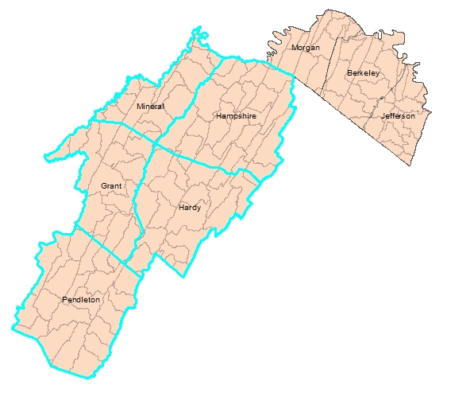
West Virginia’s Potomac Valley Local Governments Engagement Strategy
Led by: WVDEP Staff
Met with each of the 5 County Commissions and Region 8 Planning & Development Council throughout summer 2017
Noted their questions and concerns about the Chesapeake Bay cleanup effort so far and the funding available through CBP grants to the state
Informational brochure (LGEI provided) mailed to each contact person in county government plus mayors of the incorporated towns in September
Follow-up meetings being conducted as interested people are identified
Key contacts will be invited to public meeting early 2018 and a few will become part of a local government WIP III workgroup

Slide 5
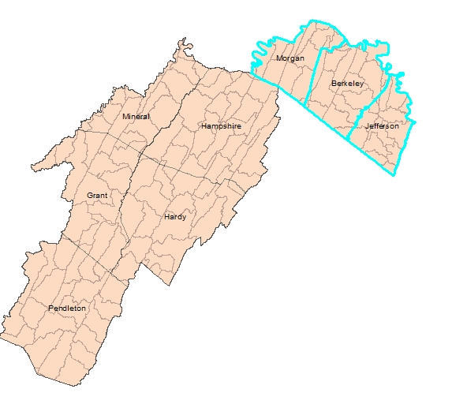
West Virginia’s Eastern Panhandle Local Governments Engagement Strategy
Led by: Region 9 Planning and Development Council

Slide 6
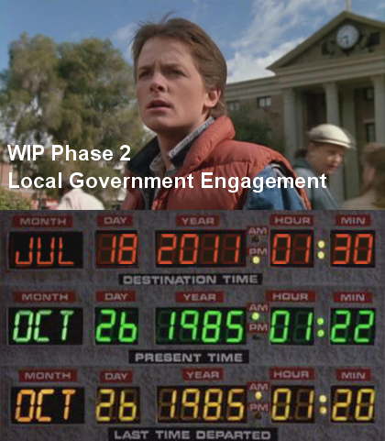
13 total engagement meetings throughout the Spring and Summer of 2011
Three (3) separate meetings for each of the following sectors:
  Agriculture
  Wastewater
  Developed Lands
  Local Leadership
One (1) WV Bay Summit Meeting invited stakeholders from all sectors (August 2011).

Slide 7
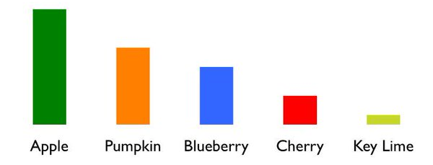
What information do local governments need
DATA
  Current progress in achieving our load reduction goals.
  Economic development and job creation prospects related to restoration economy and clean water dependent industries.
Notes:
1) how much further we need to go, and the progress made in the Phase II Land Development Strategy Matrix.
3) Local leaders should be made aware of what those contaminants of concern are, and how improving their community stream improves the Bay.
5) It would be most helpful if the BMPs co-benefits were quantified based on the localities needs and long-term goals.
6) then present these load reduction results from those scenarios. Additional scenario recommendations may be needed that achieve more reductions to meet goals, dependent upon results of initial feedback
7) and the requirements of these funding sources such as, Income eligibility, preliminary design, match requirements, local contaminant of concern reduction.

Slide 8

Recommendations from previously completed plans and studies on local waterways
Notes:
Content and message delivery will vary with each sector and location within West Virginia. Funding will be used to obtain proper facilitation services, at the meetings mentioned above, based on the demographic and target audience. Examples of these trusted resources and messengers could include, but not limited to, modeling experts, authors of watershed based plans, karst geology experts, agriculturalists, media members, stormwater specialists, and forestry experts.

Slide 9
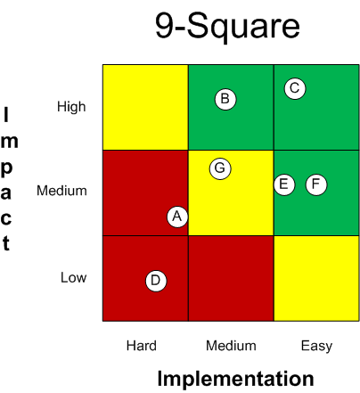
Concise BMP and Policy Feasibility Matrix.
  Relevancy based on demographic and local priorities
  Secure funding sources
  Strategy load reductions and impact
  Ease of Implementation

Slide 10
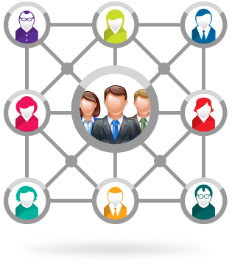
An organizational chart of all partners involved.
How can local governments can support the effort.
How can local governments become active partners.
“Consistent Message” to share with their constituents, fellow elected officials, board members, and the press.

Slide 11

Conceptual CAST scenarios incorporating initial needs, feedback, and practicability

Slide 12

Clear understanding of the EPA consequences, if WV does not achieve our responsibility in meeting TMDL cap loads.

Slide 13
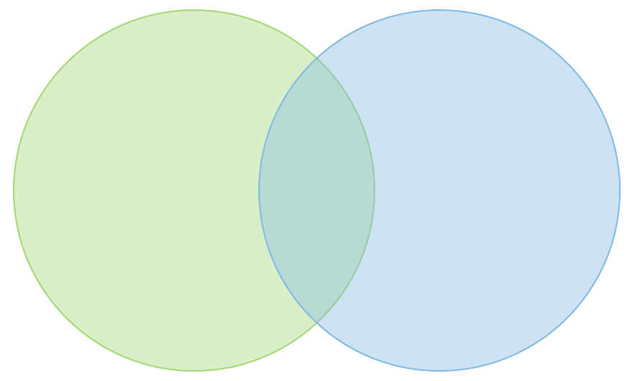
What WIP planners need from local governments
Understand local needs & goals so that mutually beneficial strategies can be identified, funded, and implemented.
Understand local Capital Improvement Plans to determine if integrating nutrient-reducing BMPs into those projects is feasible.

Slide 14

Identify obstacles and help find solutions in which to overcome them.

Slide 15
Proposed Timeline
Informal Meetings Winter 2016 – Fall 2017
Local Work sessions and outreach Fall 2017 – April 2018
Writing of WIP III DRAFT May – September 2018
Public Outreach on DRAFT October - November 2018
Draft WIP to EPA / Official public comment December 2018
Final WIP due to EPA April 2019

Slide 16
Roles, Resources, and Capacity
Preliminary assumptions based on feedback from possible partners
  Wastewater – Sanitary service expansion to areas with failing on-site systems. Asset Management protocols to reduce Inflow/Infiltration and Illicit Discharges.
  Stormwater – Assistance with flooding issues in communities with inadequate infrastructure.
  Source Water Protection – Assist in completing strategies identified with Drinking Water Utility Protection Plans
  Green Infrastructure development and implementation in concert with CIP .
  Economic Development - Job Creation in a restoration based economy and green infrastructure installation and maintenance.
Notes:
Ecologix report suggests that "local governments are more likely to be interested in Chesapeake Bay activities if they fit into the following three priority areas: 1. Economic development; 2. Infrastructure development; 3. Public health and safety". Which seems to suggest that Local Governments feel co-beneficial strategies help their local constituency.

Slide 17
Source sector areas where local engagement is most needed to accelerate WIP implementation
  Stormwater – Focus assistance in MS4 communities
  Wastewater – Focus assistance to service areas within Karst Geology and high capacity/higher nutrient reducing treatment plants.
  Agriculture –Encourage Local Leaders to promote Agricultural BMPs within their community.

Slide 18
Key Messages:
Communities benefit economically with clean local waterways
Local governments must be present during the Phase III WIP development process
Current local government practices and programs could benefit overall state progress.
The Bay Model is improved with refined local land use data
Tools are available for WIP planning and decision-making
Learn feasible, sustainable financing solutions.
  “One time funding is not the solution to ongoing expenses.”
Notes:
2) to integrate their local priorities into the plan, while identifying possible constraints based on local knowledge.
4) processes for BMP funding, targeting, and implementation

