Slide 1
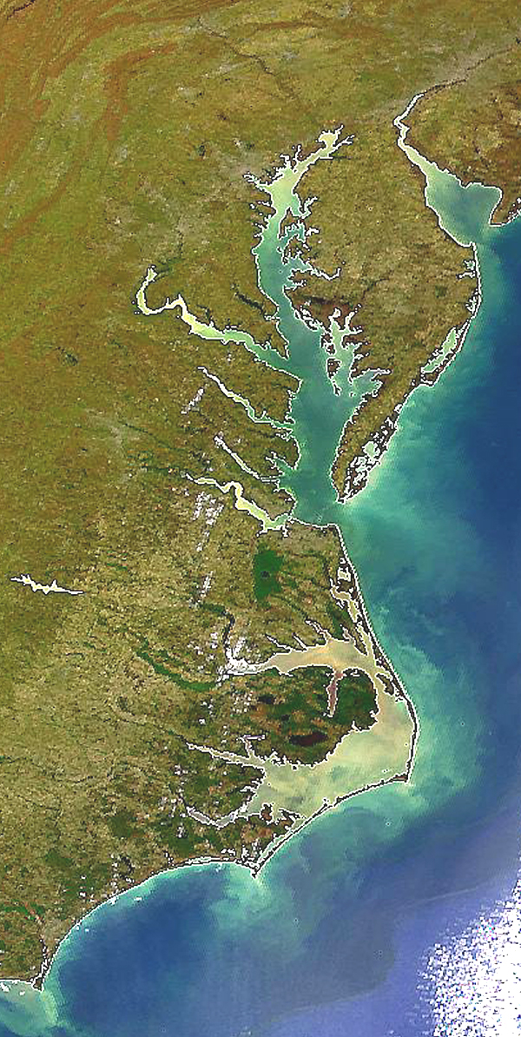

State Profile
West Virginia

Slide 2
WV Draft Phase III WIP Planning Targets + Reference Loads
Nitrogen Load
 | No-Action (M lbs) | E3 (M lbs) | 2013 Progress (M lbs) | Phase II WIP (reference) (M lbs) | Draft Phase III WIP Planning Target (M lbs)
WV James | 0.05 | 0.04 | 0.05 | 0.05 | 0.04
WV Potomac | 9.90 | 4.95 | 8.01 | 7.78 | 6.30
WV Total | 9.95 | 4.98 | 8.06 | 7.82 | 6.35
Phosphorus Load
 | No-Action (M lbs) | E3 (M lbs) | 2013 Progress (M lbs) | Phase II WIP (reference) (M lbs) | Draft Phase III WIP Planning Target (M lbs)
WV James | 0.005 | 0.004 | 0.005 | 0.005 | 0.005
WV Potomac | 0.909 | 0.280 | 0.555 | 0.453 | 0.451
WV Total | 0.915 | 0.285 | 0.560 | 0.458 | 0.456

Slide 3
WV Nitrogen Loads-Goals, Phase 5.3.2

Slide 4
WV Nitrogen Loads-Goals, Phase 6

Slide 5
WV Nitrogen Change in Level of Effort

Slide 6
WV Phosphorus Loads-Goals, Phase 5.3.2

Slide 7
WV Phosphorus Loads-Goals, Phase 6

Slide 8
WV Phosphorus Change in Level of Effort

Slide 9
WV Nitrogen – Phase 6 Level Of Effort
(NoAction:E3 Reference)

Slide 10
WV Phosphorus – Phase 6 Level Of Effort
(NoAction:E3 Reference)

Slide 11
WV Nitrogen – Phase 6 Loads and Target
Where did the
reductions come from?
1985
2013
Draft Phase III WIP
Planning Target

Slide 12
WV Phosphorus – Phase 6 Loads and Target
Where did the
reductions come from?
1985
2013
Draft Phase III WIP
Planning Target

Slide 13
WV Nitrogen – Phase 6 Scenario Loads and Draft Target

Slide 14
WV Phosphorus – Phase 6 Scenario Loads and Draft Target

Slide 15
Nitrogen – Phase 6 Relative Effectiveness
Effect of Nitrogen Load Reduction on WQ Standard Attainment
A = Above Fall Line B = Below Fall Line

Slide 16
Phosphorus – Phase 6 Relative Effectiveness
Effect of Phosphorus Load Reduction on WQ Standard Attainment
A = Above Fall Line B = Below Fall Line

Slide 17
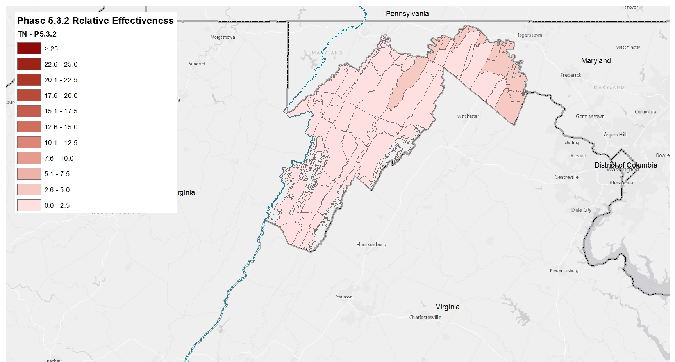
Nitrogen Relative Effectiveness
Phase 5.3.2

Slide 18
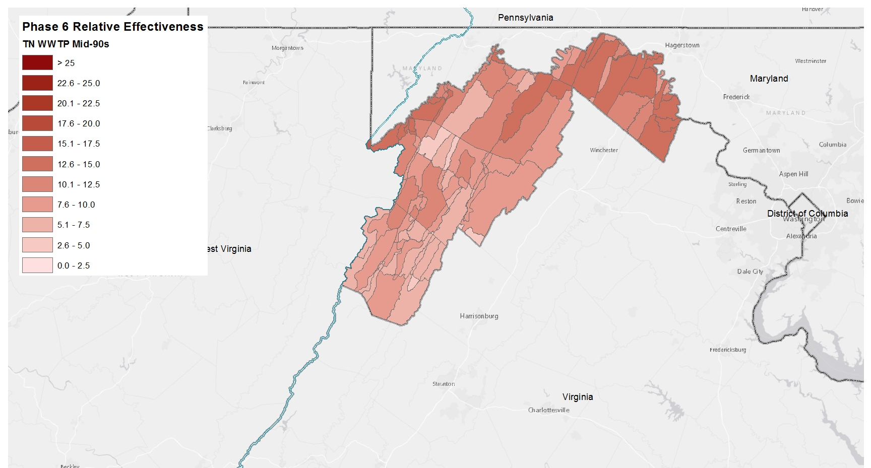
Nitrogen Relative Effectiveness
Phase 6, WWTP, Mid-90s

Slide 19

Nitrogen Relative Effectiveness
Phase 6, WWTP, Conowingo Dynamic Equilibrium

Slide 20
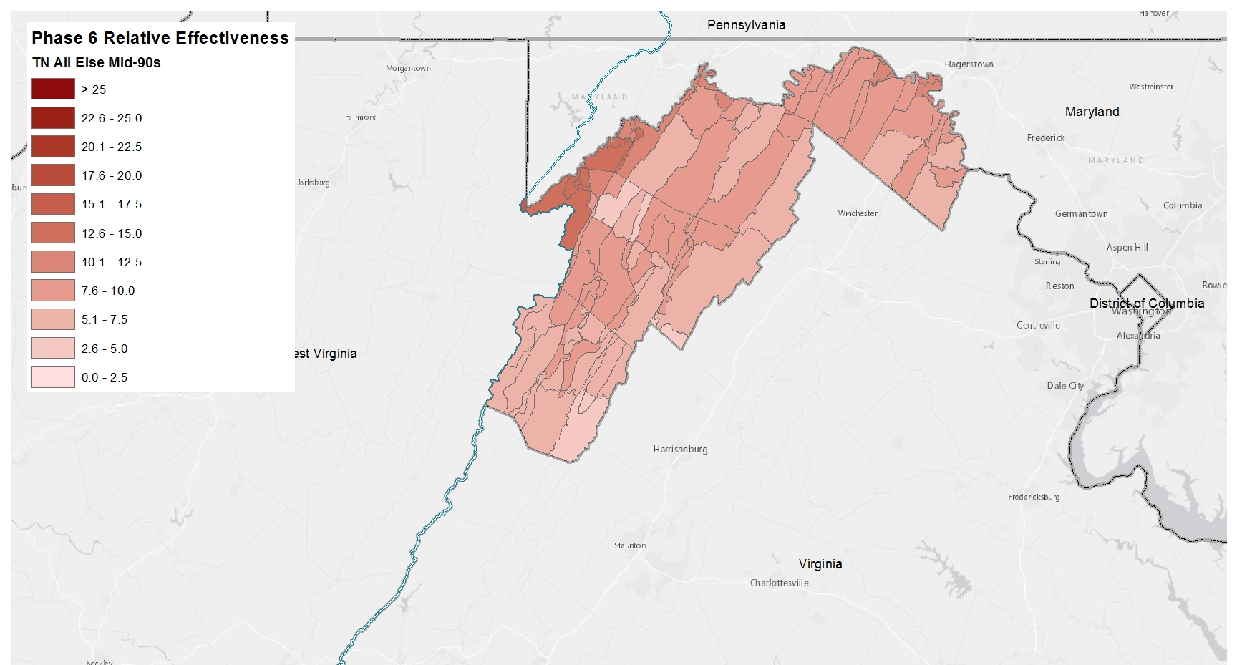
Nitrogen Relative Effectiveness
Phase 6, All Else, Mid-90s

Slide 21
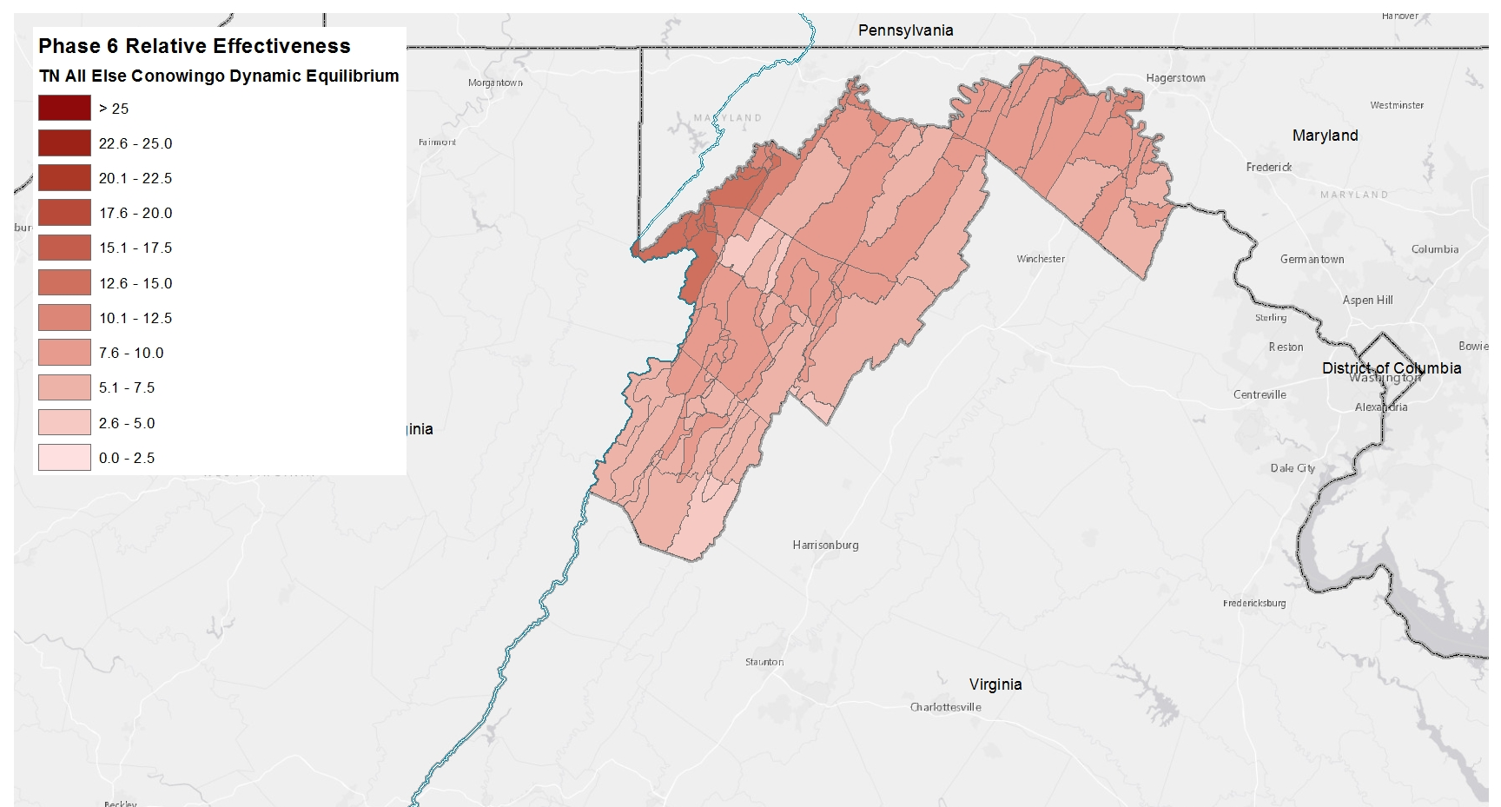
Nitrogen Relative Effectiveness
Phase 6, All Else, Conowingo Dynamic Equilibrium

Slide 22
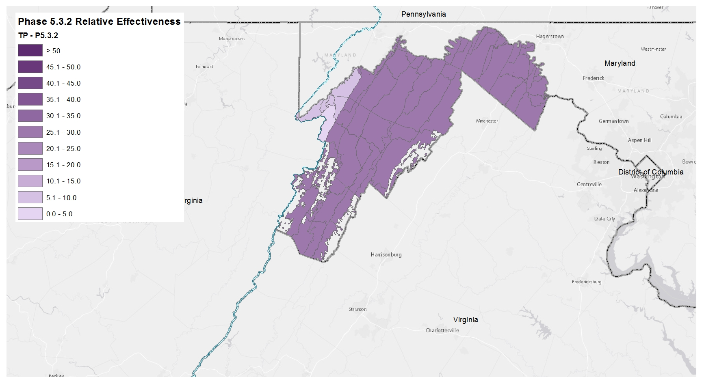
Phosphorus Relative Effectiveness
Phase 5.3.2

Slide 23
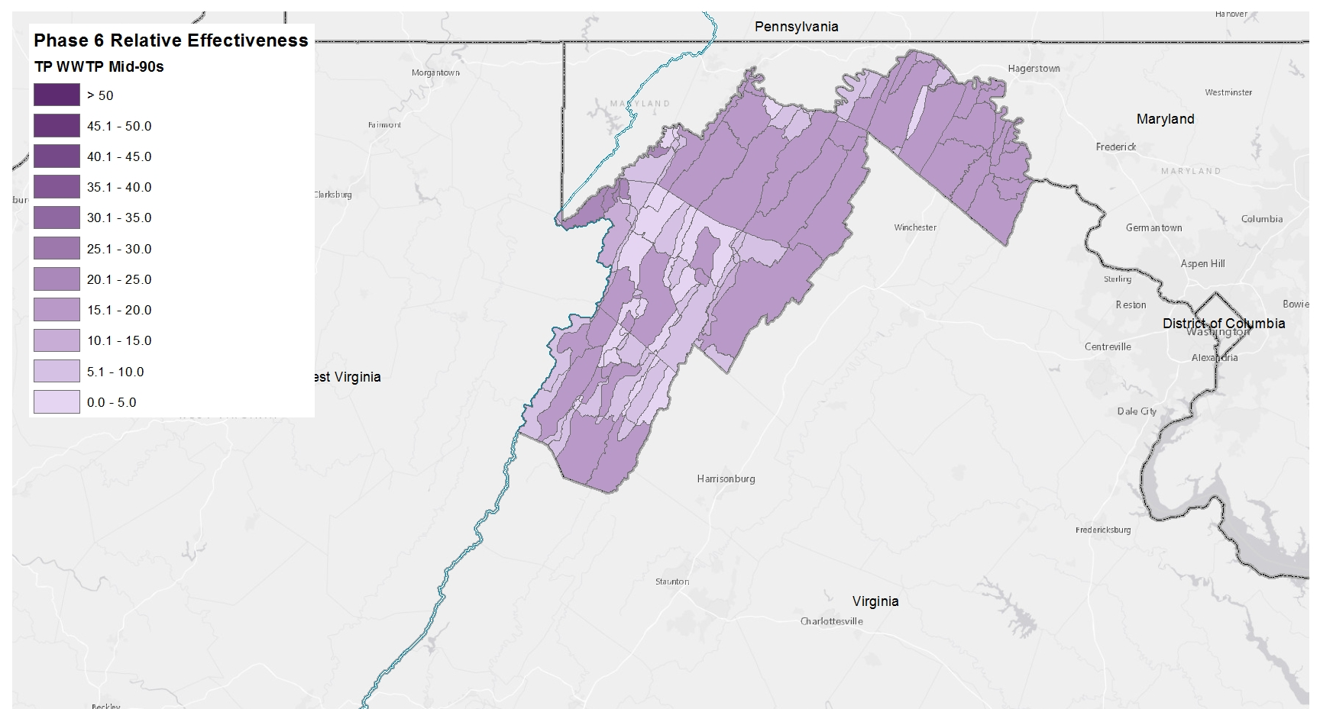
Phosphorus Relative Effectiveness
Phase 6, WWTP, Mid-90s

Slide 24
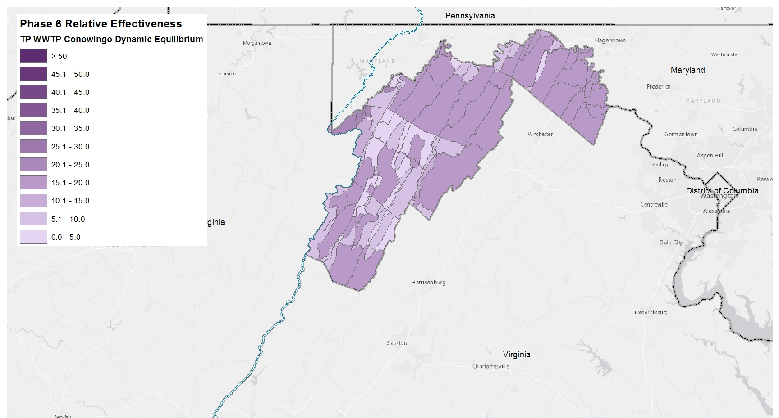
Phosphorus Relative Effectiveness
Phase 6, WWTP, Conowingo Dynamic Equilibrium

Slide 25
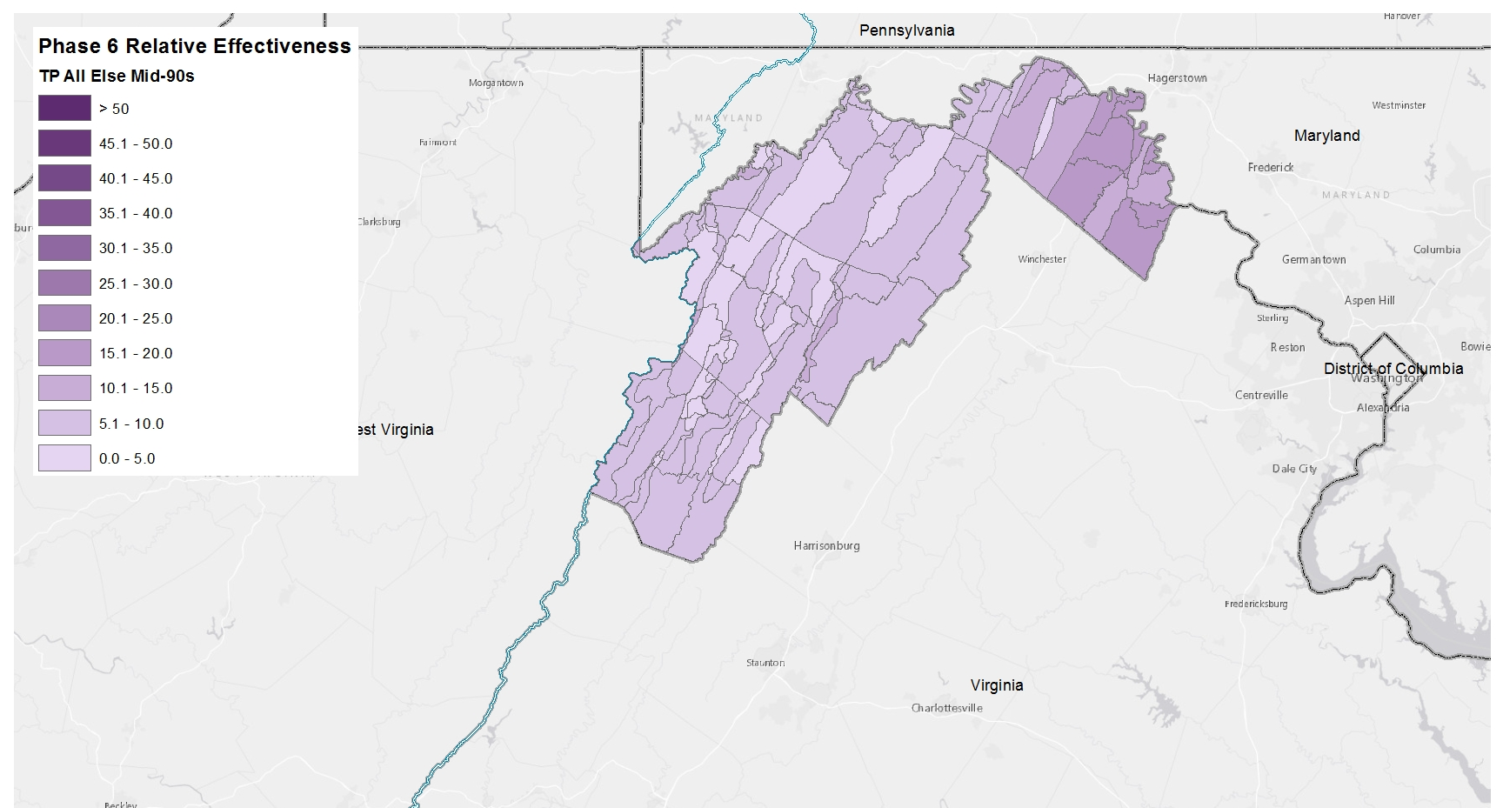
Phosphorus Relative Effectiveness
Phase 6, All Else, Mid-90s

Slide 26

Phosphorus Relative Effectiveness
Phase 6, All Else, Conowingo Dynamic Equilibrium

