Slide 1
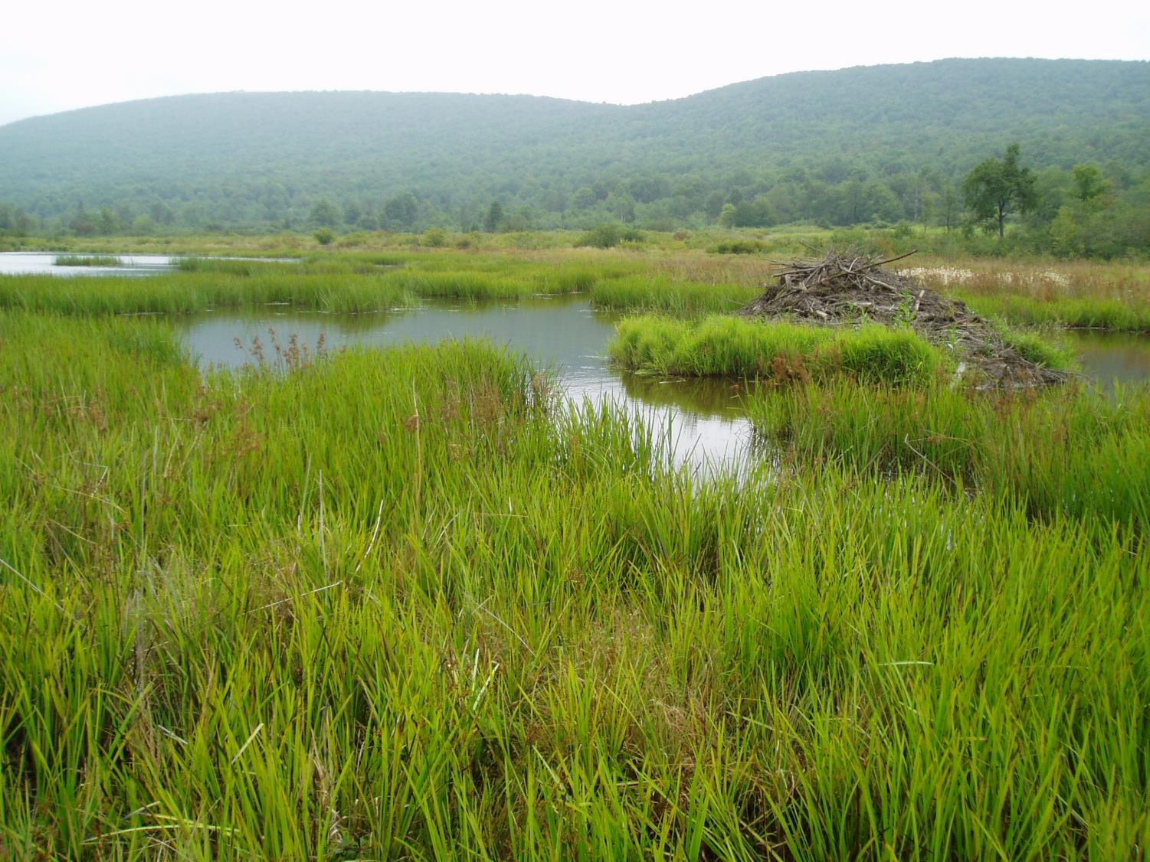

WVWRAM
WV Wetland Rapid Assessment Method
Elizabeth Byers, Senior Wetland Scientist
WVDEP Watershed Assessment Branch
Elizabeth.A.Byers@wv.gov
Notes:
Glade Run, 100+ year old beaver wetland, CVNWR; Introduce WVWRAM to DEP leadership

Slide 2
WVWRAM
WV Wetland Rapid Assessment Method
Background
How it works
Innovations & Refinements
Questions
Notes:
Glade Run, 100+ year old beaver wetland, CVNWR; Introduce WVWRAM to DEP leadership

Slide 3
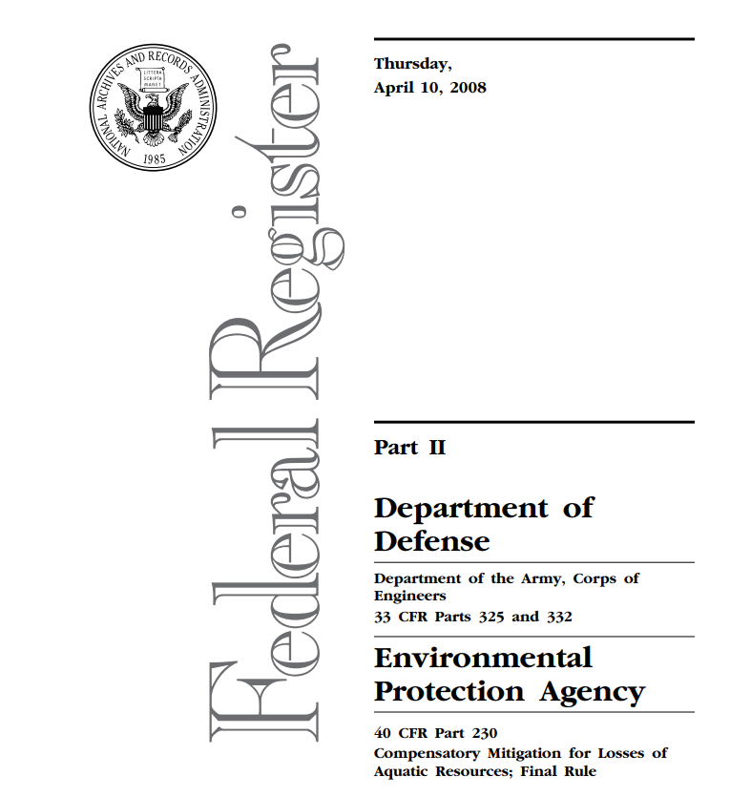
Catalyst for
developing WVWRAM:
2008 Mitigation rule
for aquatic resources
“no net loss of
wetland function”

Slide 4
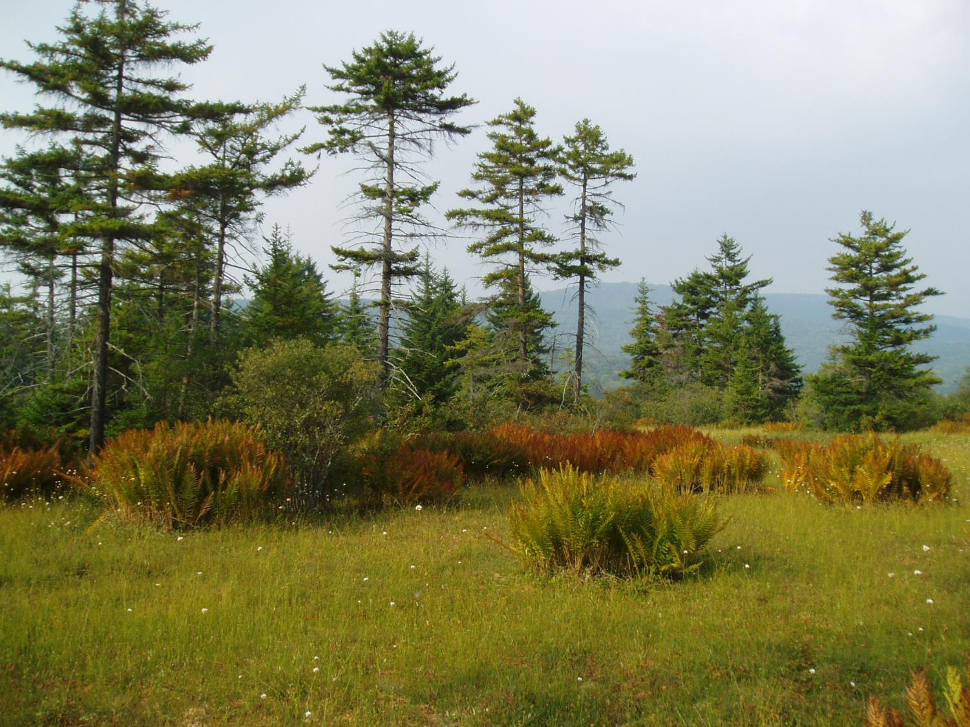
Legal protection of WV wetlands
Clean Water Act 1972
  2008 Mitigation Rule: no net loss of function
WV Water Pollution Control Act 2014
Food Security Act 1985
  Swampbuster
Notes:
NRCS “swampbuster” provision: farmers lose subsidies or do not qualify for federal programs if they destroy wetlands – but they are allowed to continue to farm/drain wetlands that were impacted prior to 1985. Clean Water Act: Corps/EPA Mitigation Rule 2008.

Slide 5
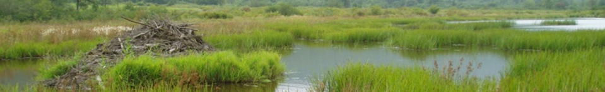

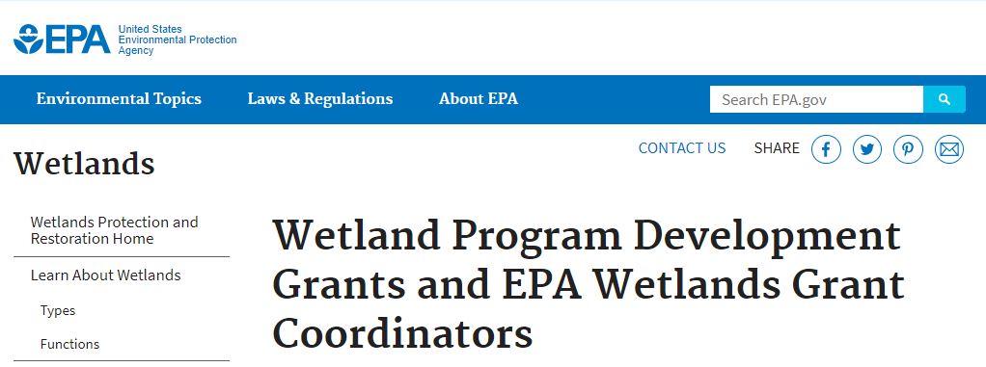
Financial support from:

Slide 6
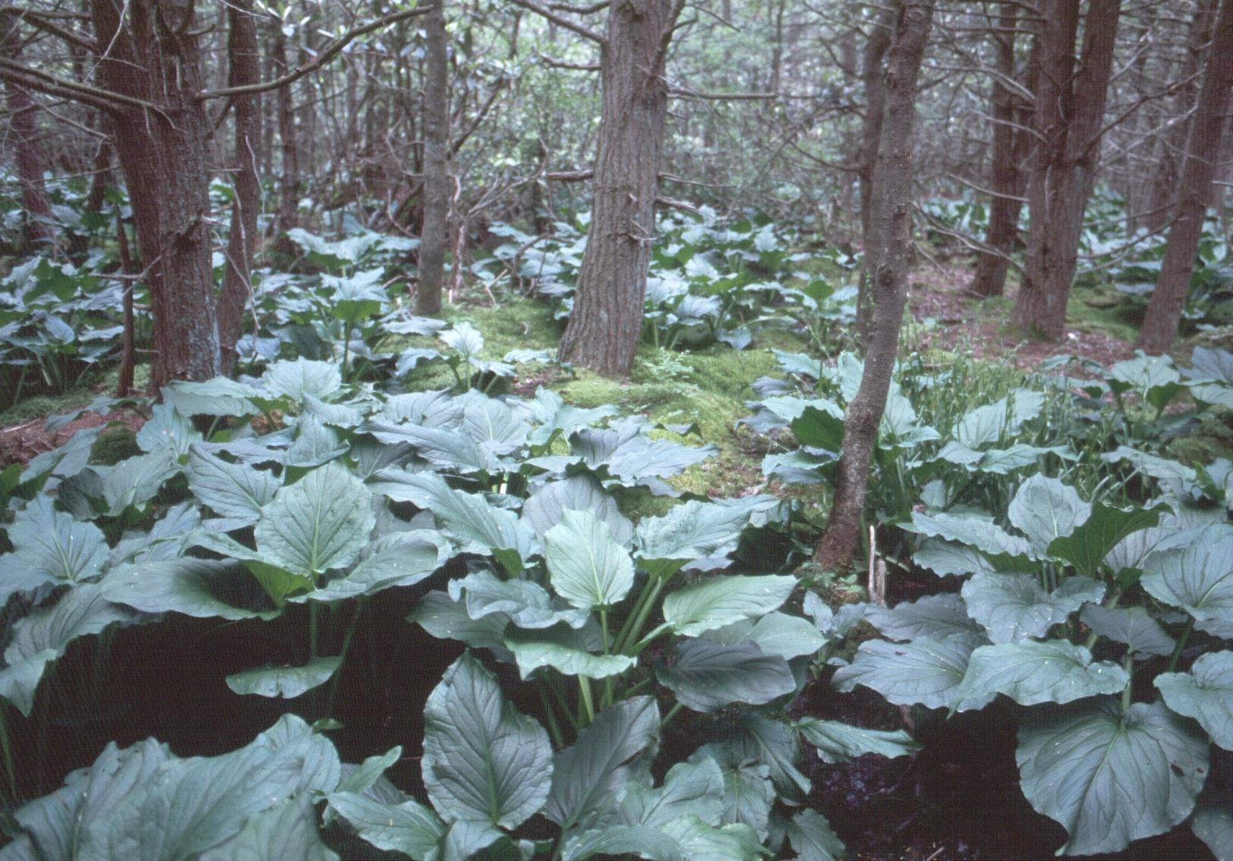
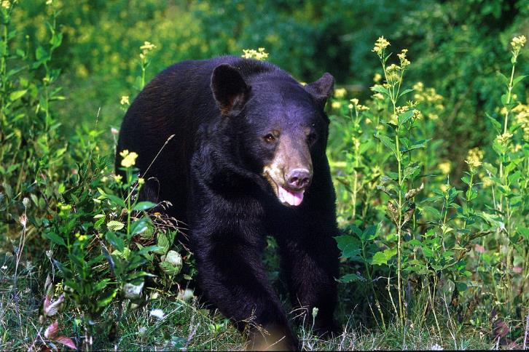
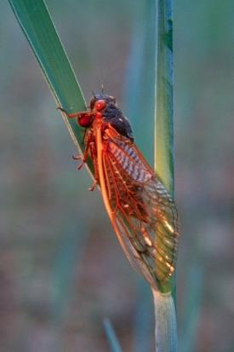
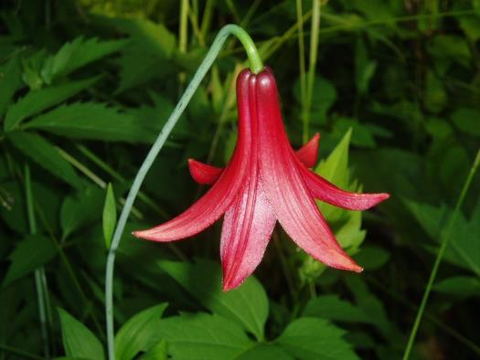
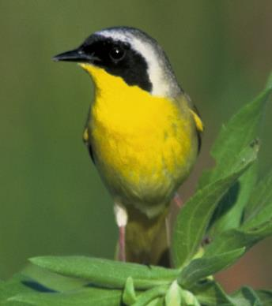
Fish & wildlife, rich biodiversity, productivity
Notes:
…now expanded to include: fish and wildlife, extensive food chain and rich biodiversity
(Cranesville swamp, Black Bear, Insect, Canada Lily, common yellowthroat)

Slide 7
Fish & wildlife, rich biodiversity, productivity
0.6%
23%
44%
Notes:
…now expanded to include: fish and wildlife, extensive food chain and rich biodiversity
(Cranesville swamp, Black Bear, Insect, Canada Lily, common yellowthroat)

Slide 8
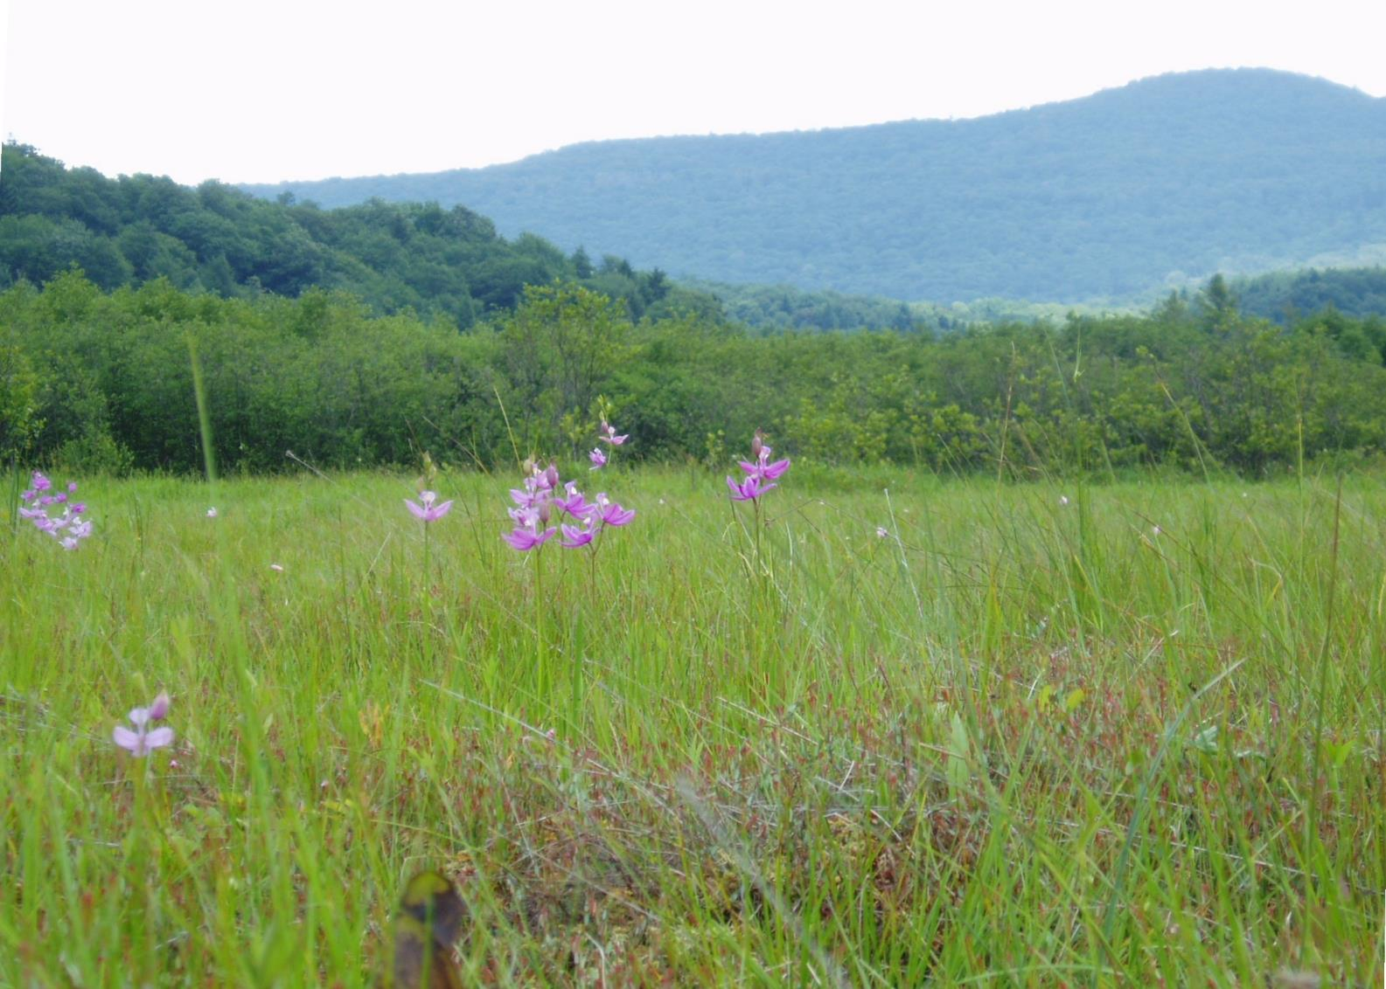
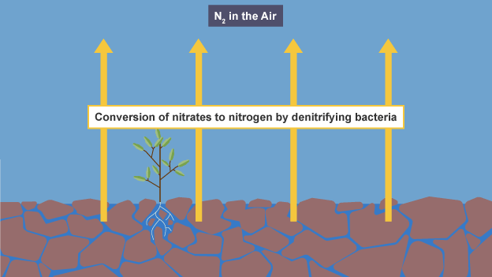
kidneys of the landscape
Notes:
kidneys of the landscape
cleanse polluted waters: receive of water and waste from both natural and human sources
Naturally-occurring bacteria in wetlands convert polluting nitrates into harmless nitrogen gas, filtering and purifying water for areas downstream.

Slide 9
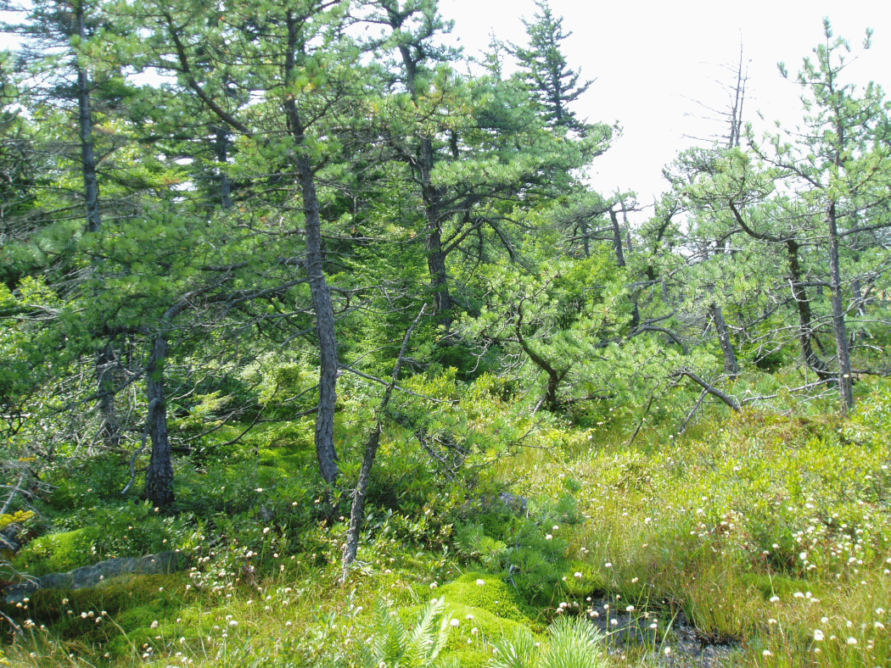

stabilize water supplies
Pinus rigida - Picea rubens / Viburnum nudum var. cassinoides / Sphagnum spp. Woodland (G1G2)
Notes:
stabilize water supplies, thus mitigate both floods and drought, recharge groundwater aquifers
Large headwater wetlands in the Allegheny Mountains and Meadow River provide important flood protection services to the state.
Pitch pine – heath peat woodland S1 / G1G2 : Northern-affiliated Swamps, Allegheny Front and the Catskills of NY.

Slide 10
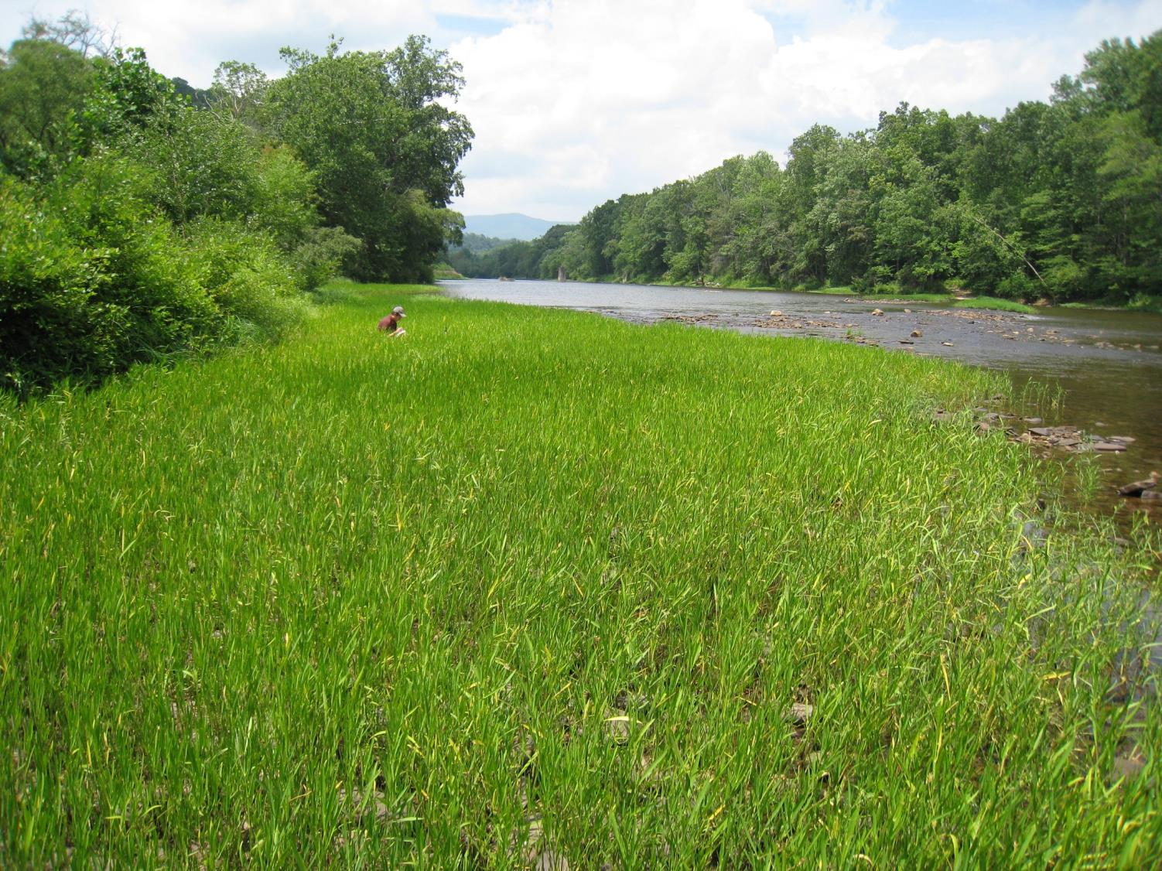
protect shorelines and banks from erosion
Notes:
Justicia meadow, Plot CAPR.4 Denmar, Greenbrier River
(Jim Vanderhorst photo)

Slide 11


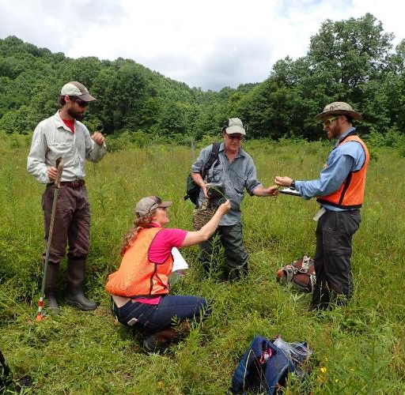
2015-16 Develop tool for functional assessment of wetlands
Notes:
Building on best available science.

Slide 12
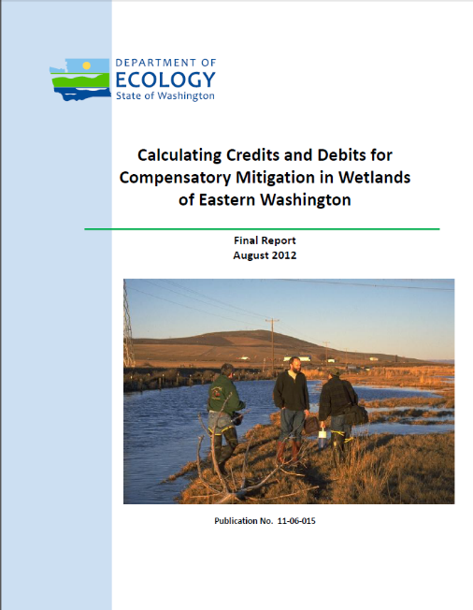
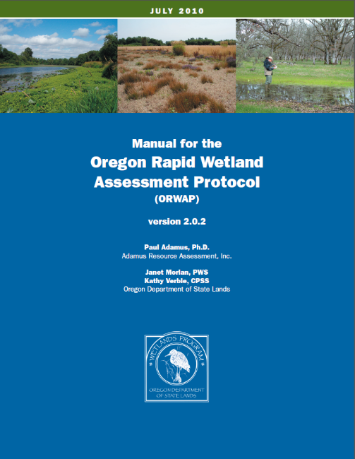
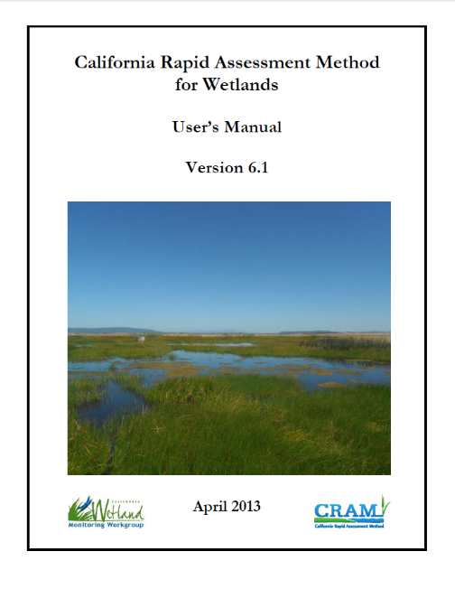
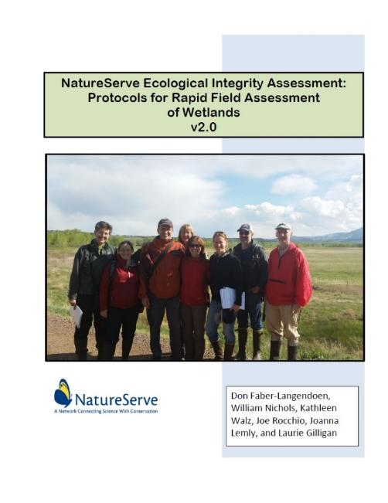
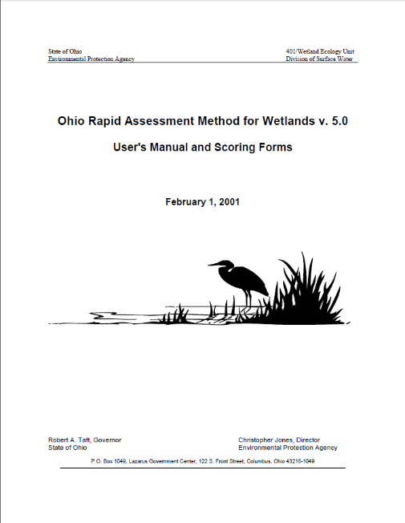
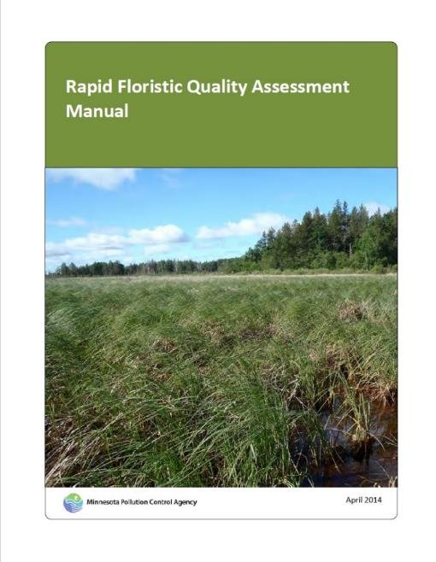
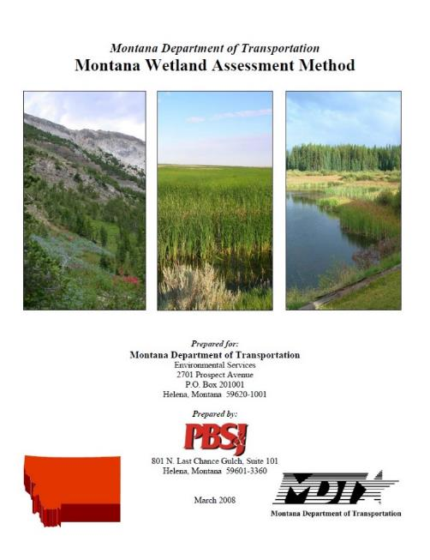
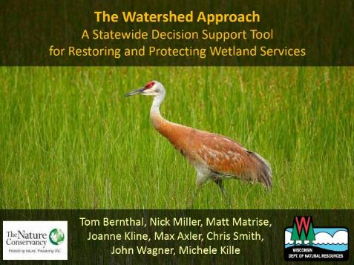
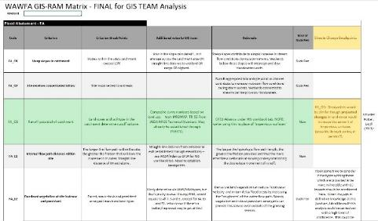
Built on the best available existing science
Notes:
Obstacle! Lack of resources and personnel
Build on shoulders of giants
Use only well-vetted approaches and metrics that have survived rigorous testing for repeatability, sensitivity, and are clearly linked to function and are RAPID
Where pockets of local expertise exist, seize them (NRCS & soils metrics)
Draw heavily on OR and WA for methods, plus CA and NatureServe for the habitat function. Extensive validation of metrics, sensitivity analysis, and repeatability tests done by literally hundreds of wetland scientists. Ohio for stressors, Minnesota for Rapid FQA, Montana for wildlife habitat, WI for GIS-RAM inspiration, plus many other states. WV benefits from the outstanding work done by many of the people in this room.

Slide 13
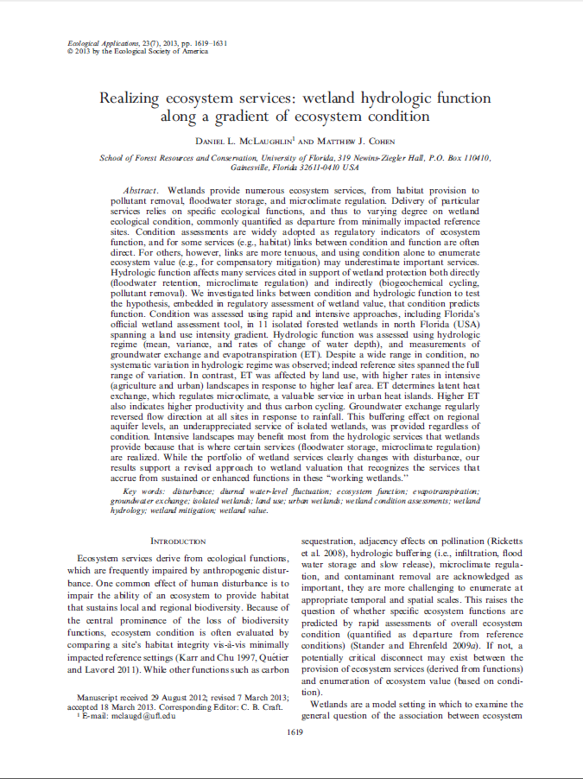
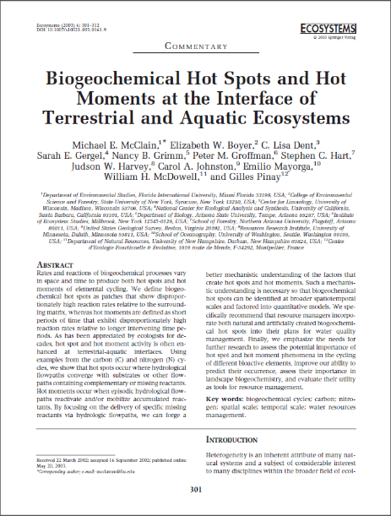
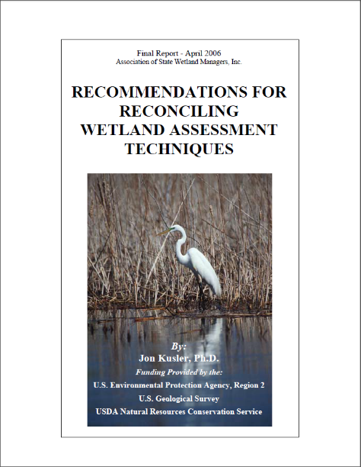
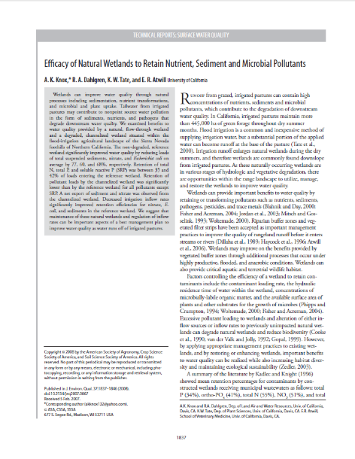
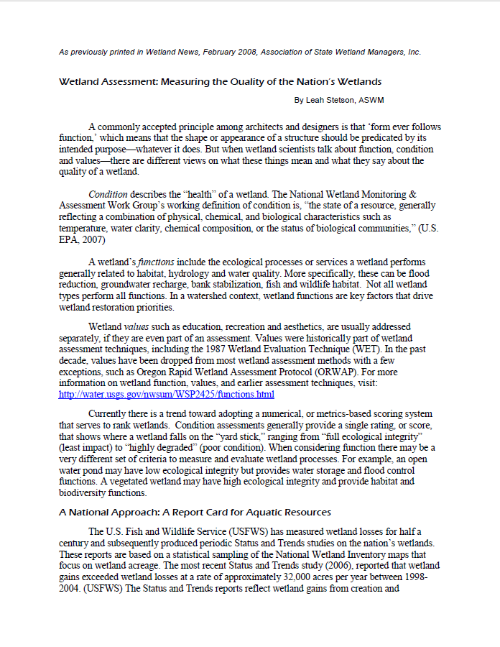
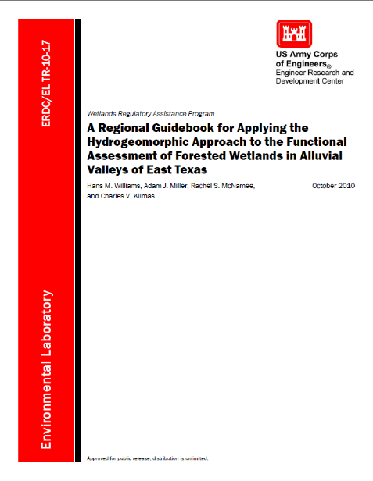
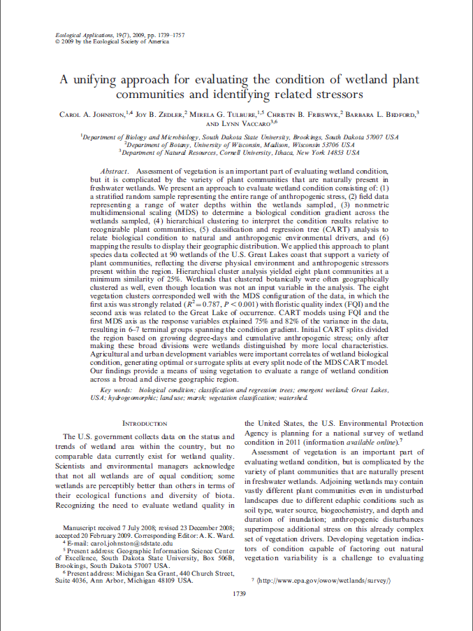
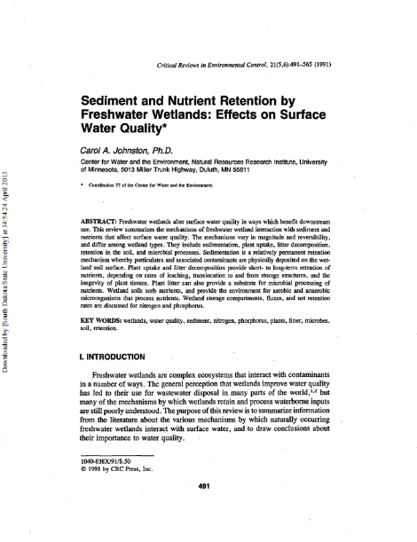
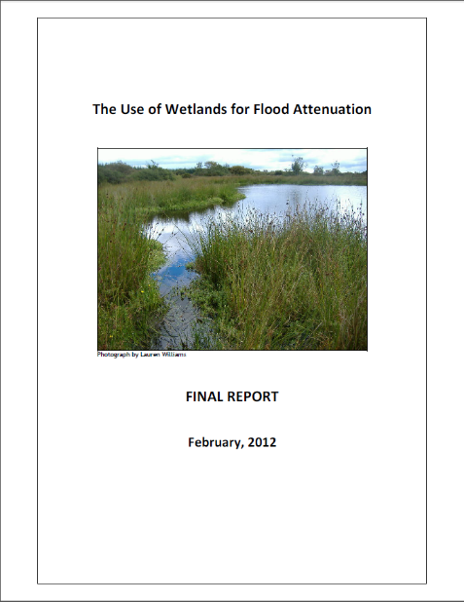
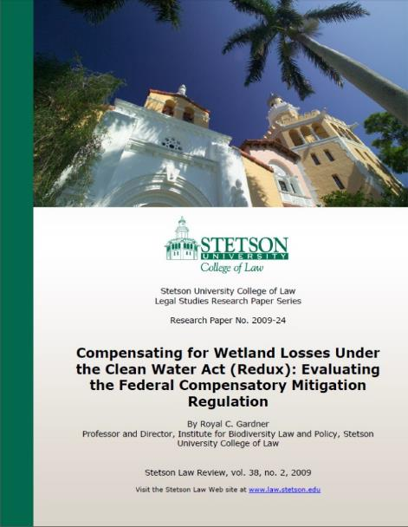
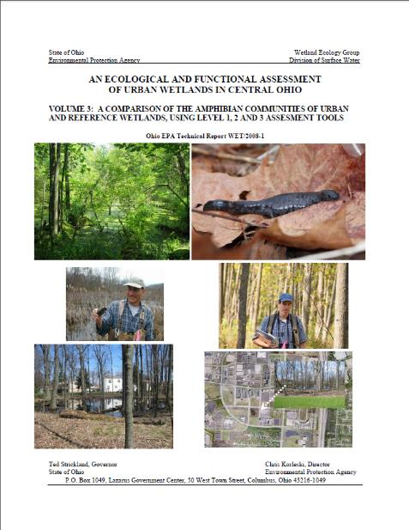
…DEP looked only at tested, validated methods & metrics
Notes:
I also searched the recent literature for any studies linking wetland functions to measurable wetland characteristics, and picked up a few more guidelines. Lots of reading in those first few months of the project!

Slide 14
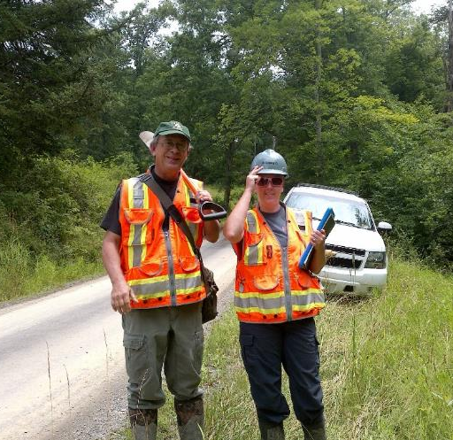
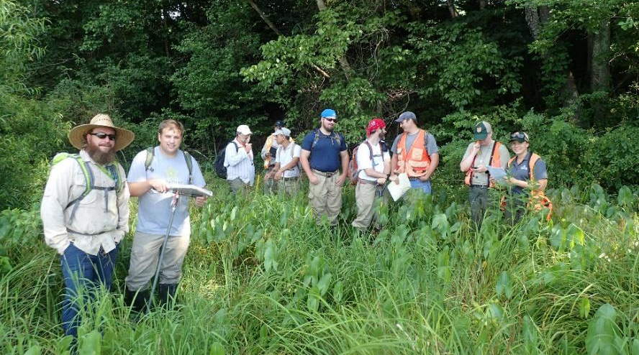
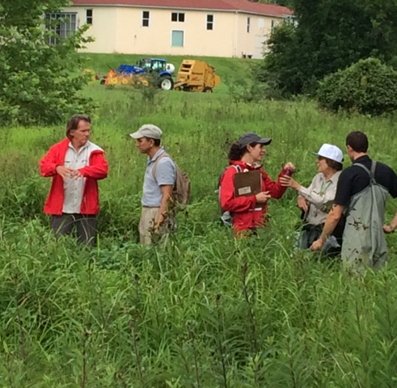
2017-18 Field-testing:
69 stakeholders from 22 organizations
Notes:
Fine-tuning metrics based on stakeholder input; building familiarity and ownership of WVWRAM. Industry, agencies, consultants, NGOs.

Slide 15
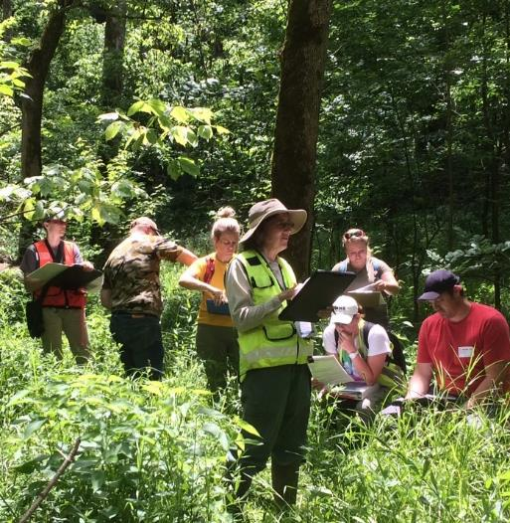
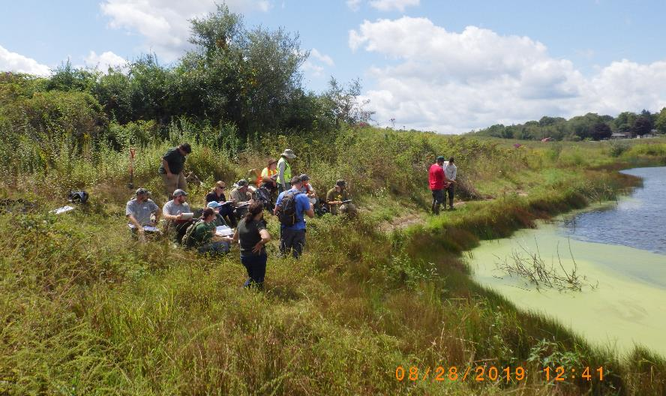
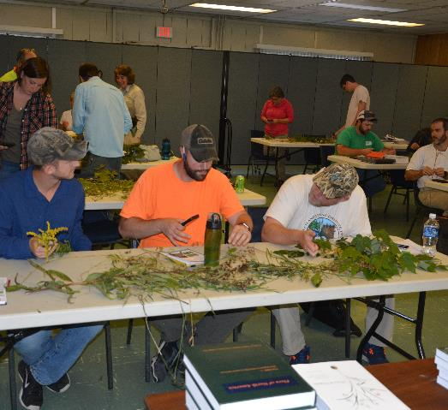
2019 Training:
112 stakeholders from 40 organizations
Notes:
Training

Slide 16
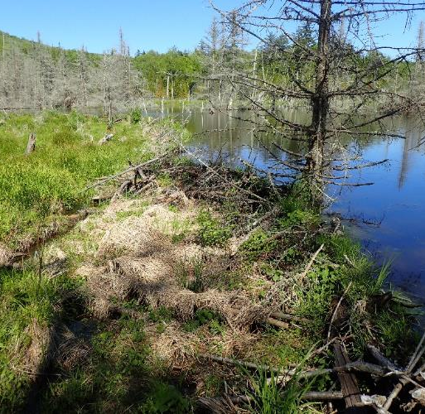
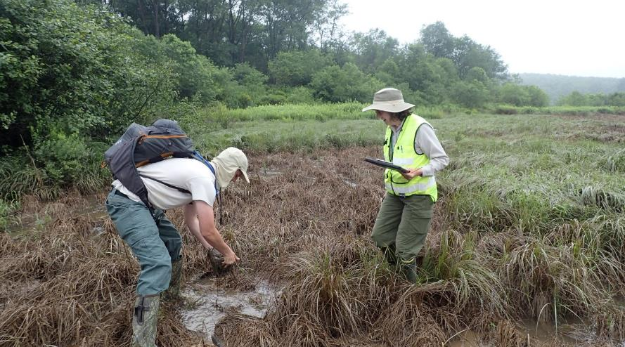
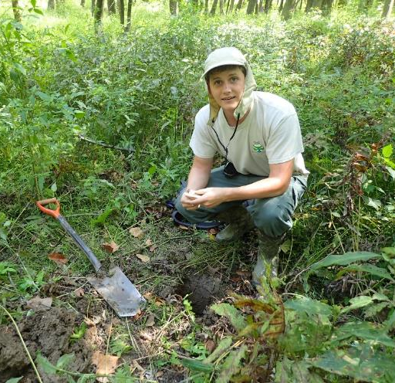
2020 Monitoring:
initiate probabilistic statewide program
Notes:
Training

Slide 17
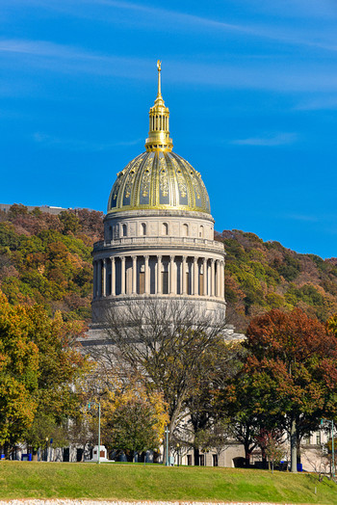
2020
public notice and moving toward agency adoption
Notes:
Obstacle! How to finish the last mile and officially adopt the new methods?
Going through the public noticing and changing the legislative rule requires buy-in from IRT, NRCS Technical Committee, and support from agencies
Presentations to stakeholders, lots of peer review, being responsive to their concerns – we need their help to get the policies adopted, and/or not to have them shot down
Not just agencies. Need industry, environmental consultants (who talk to industry), conservation organizations, anyone who might shoot it down in a public notice.

Slide 18
WVWRAM
WV Wetland Rapid Assessment Method
Background
How it works
Innovations & Refinements
Questions
Notes:
Glade Run, 100+ year old beaver wetland, CVNWR; Introduce WVWRAM to DEP leadership

Slide 19
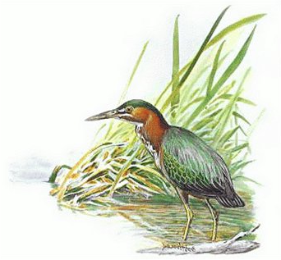


Ecological integrity & wildlife habitat
Water quality: sediment, nutrients, pollutants
Flood attenuation
3 composite functions

Slide 20
75 metrics in 9 categories
 | Intrinsic Potential | Landscape Opportunity | Value to Society
Water Quality | vegetation, soil, hydrology | 50 m buffer, contributing watershed | public use, planning
Flood Attenuation | vegetation, soil, hydrology | 50 m buffer, contributing watershed | economic risk
Habitat/ Ecological Integrity | vegetation, soil, hydrology | perimeter, 300 m / 1 km buffer, contrib. watershed | investment, public use, access
Regulatory score: 65 metrics
Notes:
Full score has 75 metrics in 9 categories

Slide 21
62 statewide GIS datasets
Biodiversity
Ecosystems
Elevation
Geology
Hydrology
Imagery
Infrastructure
Jurisdiction
Landcover
Landform
Soils
Stressors
Notes:
Amazing to me how much geospatial data is available, putting meaningful GIS-RAM within reach.

Slide 22

Roll-up of metrics into stakeholder-requested scores:
Regulatory score: physical, chemical & biological
Full function (all metrics)
State lands acquisition
Condition assessment

Slide 23
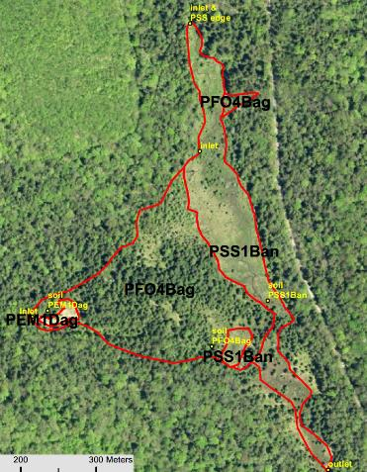
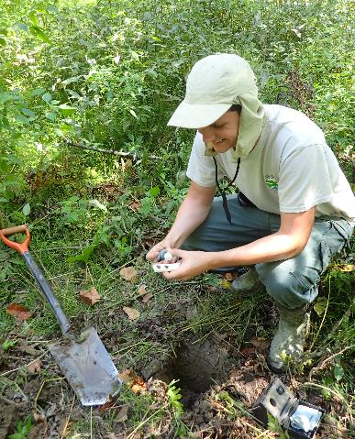
GIS plus rapid field assessment: the best of landscape-level assessment + metrics that must be obtained in the field
+
= WVWRAM
score

Slide 24
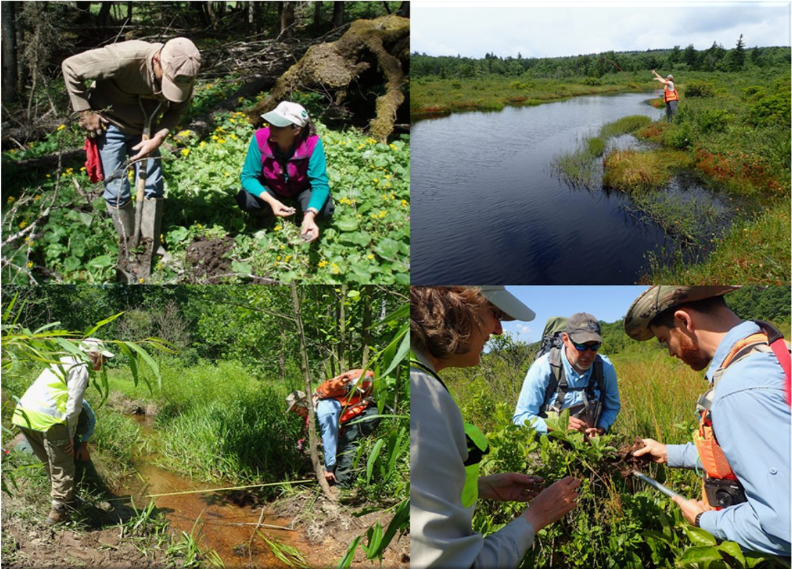
Rapid Field Assessment
Notes:
Sampling soil at Little River wetland (Jared Beard and Pam Byrne): photo by Elizabeth Byers; Sampling aquatic bed vegetation at Red Creek Plains (Danielle Elliott): photo by Elizabeth Byers; Measuring bankfull width, Jefferson County (Elizabeth Byers, John Burkhart); Sampling soil at Sleepy Creek (Elizabeth Byers, Nick Murray, John Burkhart).

Slide 25
Rapid Field Assessment
Level of effort: 2 technicians x half-day
Skill level: wetland delineation
plus 2-day training
Vegetation, Soils, Hydrology, Buffer, Stressors
Notes:
Sampling soil at Little River wetland (Jared Beard and Pam Byrne): photo by Elizabeth Byers; Sampling aquatic bed vegetation at Red Creek Plains (Danielle Elliott): photo by Elizabeth Byers; Measuring bankfull width, Jefferson County (Elizabeth Byers, John Burkhart); Sampling soil at Sleepy Creek (Elizabeth Byers, Nick Murray, John Burkhart).

Slide 26
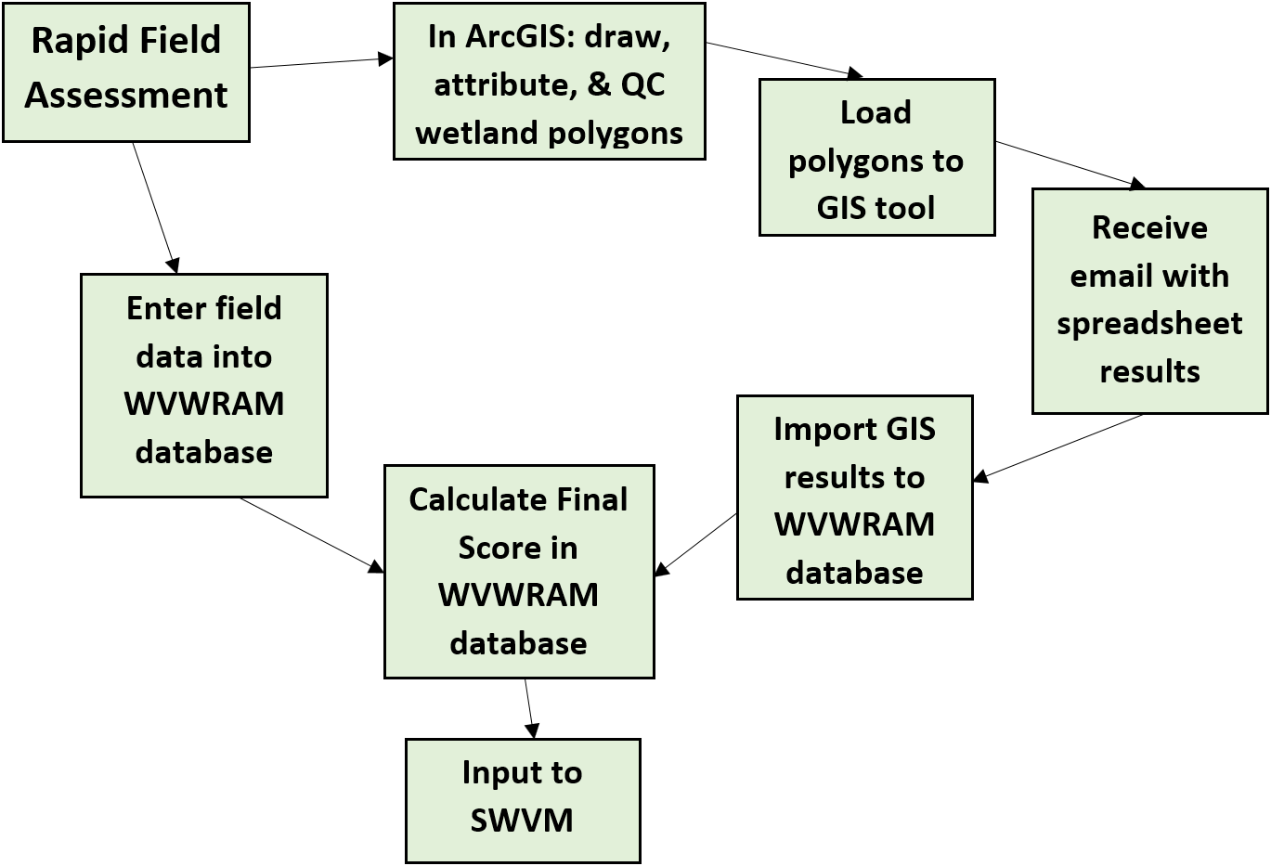
WVWRAM Work Flow
Desktop scenario planning
(if regulatory, then…)
Notes:
Flowchart of WVWRAM including GIS and Rapid Field Assessment

Slide 28
WVWRAM allows scenario planning
GIS-based desktop planning supported
Predict mitigation costs of different sites or corridors
Compare potential mitigation credits at different sites prior to land acquisition
Compare conservation outcomes within/between watersheds
WVDEP Watershed Assessment Branch
Notes:
Glade Run, 100+ year old beaver wetland, CVNWR; Getting close to roll-out; share some of the cool stuff we learned.

Slide 29


WVWRAM Manuals

Slide 30

WVWRAM Database

Slide 31

GIS Tool: https://mapwv.gov/wetlands/

Slide 32

GIS Tool: https://mapwv.gov/wetlands/

Slide 33

GIS Tool: https://mapwv.gov/wetlands/

Slide 34

GIS Tool: https://mapwv.gov/wetlands/

Slide 35


Slide 36


Preliminary Regulatory Scores (GIS only)
PEM mean = 0.46
Median score = 0.56
PFO mean = 0.65
Notes:
98% of WV wetlands have a WVWRAM score between 0 and 1.

Slide 37
Deter impacts to high-functioning wetlands
2% of wetlands are of special conservation concern (“exemplary” with documented global biodiversity significance) and score above 1.0; these get a strong deterrent multiplier of 3 to the score when entered into the SWVM
Notes:
Special conservation concern: 2% of WV’s wetlands contain documented, irreplaceable biodiversity of global significance. These wetlands provide critical habitat to vulnerable species or natural communities with fewer than 80 occurrences worldwide. No amount of mitigation can replace their functions in West Virginia. Rather than taking them off the table entirely, an economic deterrent (3 times the normal mitigation) is placed on them. Rarely will projects encounter these wetlands, and when they do, they should avoid them.

Slide 38


Preliminary GIS Score for every mapped wetland in WV
WVDEP GIS Viewer

Slide 39
WVWRAM
WV Wetland Rapid Assessment Method
Background
How it works
Innovations & Refinements
Questions
Notes:
Glade Run, 100+ year old beaver wetland, CVNWR; Introduce WVWRAM to DEP leadership

Slide 40



Link natural heritage
data to GIS tool
Wetlands of
Special Conservation Concern
based on Site Biodiversity Rank
Documented by WVDNR
Natural Heritage Data
Innovation #1
Notes:
Override is applied to wetlands with documented and significant biodiversity. B1-B3: Global (100-200); B4-B5: state (30-50); B6: county (5).

Slide 41


Python-based automation
Innovation #2
Notes:
Updated mapping or layers – no problem! Yibing Han, python programmer at WV GIS Tech Center.

Slide 42



Floristic Quality Assessment
Rapid
Innovation #3
Mean abundance-weighted CoC using 50/20 Rule vs. Full Floristics
Notes:
Pioneered by Minnesota & Pennsylvania. North Carolina now also developing Rapid FQA.

Slide 43

Level 2: Field Assessment
Field mapping of entire
wetland with NWI attributes
Refinement #1
PFO4Bag = palustrine forested needle-leaved evergreen swamp on seasonally saturated acidic organic soil
Notes:
Whitmeadow Run on Cheat Mountain; field mapping of full NWI attributes

Slide 44


Soils & Wetland Function
Refinement #2
Depth of organic material
Calcareous soil
Hydrologic regime
Compaction / Stressors

Slide 45

Make it easy to use
Type “WVWRAM” into your search engine

Slide 46

WVWRAM: robust, repeatable, rapid functional assessment for regulation, restoration, and conservation
Questions?
Elizabeth.A.Byers@wv.gov

Slide 47
Extra slides to help with answering questions

Slide 48
WVWRAM
scenarios
Standard impact to emergent
Standard impact to forested
Special conservation concern
WVDEP Watershed Assessment Branch

Slide 49


Scenario 1: standard impact emergent
WV Regional Tech Park example
0.1 acre of emergent
WVWRAM Score = 0.44
Required replacement units =
0.1 acre x 0.44 x 2 = 0.088 credits

Slide 50


Scenario 2: impact to part of forested wetland

Slide 51


Scenario 2: impact to part of forested wetland
0.1 acre of larger forested wetland
WVWRAM Score = 0.71
Required replacement units =
0.1 acre x 0.71 x 3 = 0.213 credits

Slide 52


Scenario 3: Special Concern
0.1 acre of exemplary forested wetland
WVWRAM Score = 1.46
Required replacement units =
0.1 acre x 1.46 x 3 x 3 = 1.31 credits

Slide 53
Scenario 3: Special Concern
WVWRAM Scores
Two “bins”: 98% restorable (score 0-1)
2% exemplary (score >1)

Slide 54
WVWRAM credits/debits are cost-neutral
Average amount of mitigation required statewide will not change due to WVWRAM
However, individual projects will see changes
Low-functioning wetlands will require less mitigation than under the current system
High-functioning wetlands will require more mitigation than under the current system
WVDEP Watershed Assessment Branch
Notes:
Glade Run, 100+ year old beaver wetland, CVNWR; Getting close to roll-out; share some of the cool stuff we learned.

Slide 55
Least burdensome way to comply with the 2008 mitigation rule
WV is currently in compliance with the mitigation rule for streams, but NOT for wetlands
WVWRAM was developed at the request of the Inter-Agency Review Team.
WVWRAM as part of SWVM offers simple & streamlined permitting, predictable costs
WVDEP Watershed Assessment Branch
Notes:
Glade Run, 100+ year old beaver wetland, CVNWR; Getting close to roll-out; share some of the cool stuff we learned.

Slide 56
WVWRAM will be required when:
there will be permanent impacts to wetlands
there will be temporary impacts to wetlands AND a type conversion will occur (e.g. forested to emergent)
Section 404/401 permitting is triggered
WVWRAM score will be an input to SWVM
WVDEP Watershed Assessment Branch
Notes:
Glade Run, 100+ year old beaver wetland, CVNWR; Getting close to roll-out; share some of the cool stuff we learned.

Slide 57
Representative Sampling
Wetlands that are < 1 acre in size AND with preliminary GIS scores varying < 10% from one another may be considered as a comparable assessment group.
Field assessments of a randomly selected 10% of these wetlands will be accepted as representative of the whole group.
WVDEP Watershed Assessment Branch

Slide 58
Year-round Assessment
WVWRAM is designed to produce robust, repeatable results during the growing season. Assessors are strongly encouraged to perform the assessment during the months of May-September (June-September for elevations above 3000 feet).
Outside this period, the maximum score for the Rapid Floristic Quality metric is assigned to debits, and the minimum score for Rapid Floristic Quality is assigned to credits.
WVDEP Watershed Assessment Branch

Slide 59
WVWRAM and wetland conversion
WVWRAM may be used in the future to determine mitigation requirements for a project when:
“conversion” of resource type occurs, for example when a forested wetland is converted to an emergent wetland.
WVDEP Watershed Assessment Branch
Notes:
Glade Run, 100+ year old beaver wetland, CVNWR; Getting close to roll-out; share some of the cool stuff we learned.

Slide 60
WVWRAM and banking/ILF
WVWRAM will become part of the baseline and monitoring requirements for credit release
WVWRAM will be an input to SWVM calculation of credits for restoration, enhancement, and preservation
WVDEP Watershed Assessment Branch

Slide 61
Predicting WVWRAM Scores
Prep work (checking nearby wetland scores or running desktop scenarios) before you go to the field will allow you to ballpark estimate the WVWRAM score for impatient clients while still in the field.
WVDEP Watershed Assessment Branch

Slide 62

SWVM Proposal: Wetlands Parts I-II

Slide 63

SWVM Proposal: Wetlands Part III

Slide 64

SWVM Proposal: Wetlands Parts IV-V

Slide 65






Restoration Planting Community Prediction Tool: West Virginia
Enter site data
and find similar
community targets
© 2013 West Virginia Division of Natural Resources (WVDNR) and the Carolina Vegetation Survey (CVS)
Part of research efforts at the University of North Carolina at Chapel Hill. Programming by Michael T. Lee. Plot data from the WVDNR Natural Heritage Database.
Adaptation of the software tool to West Virginia was made possible by support from The Nature Conservancy and the West Virginia Department of Environmental Protection.

Slide 66

WV Wetlands
National Wetlands Inventory (1980’s)
66,200 acres mapped
~100,000 acres probably exist
~500,000 acres historically

