Slide 1
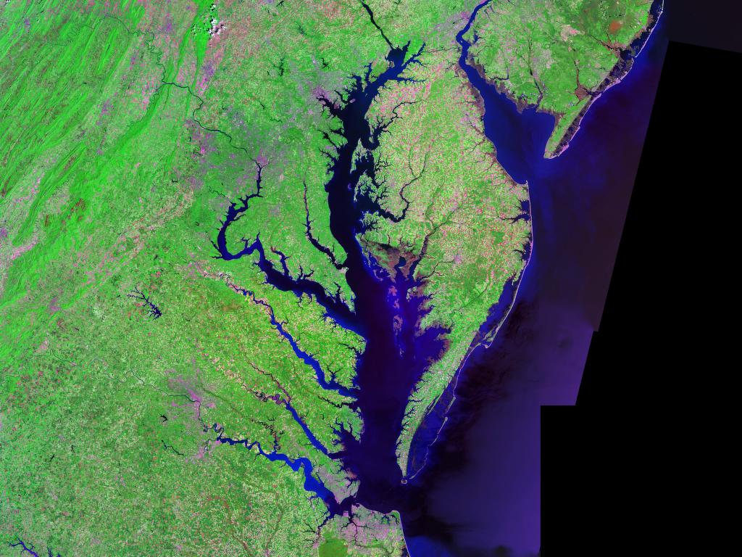
Chesapeake Bay Program
Federal Agencies and Facilities
Welcome and Introduction Training
Developed by the Federal Facility Workgroup
Finalized September 2018
Notes:
Action items: Need EPA and states to provide all POCs for reporting See slides…

Slide 2

Overview
Chesapeake Bay Program
Chesapeake Bay Program Partnership
Federal Lands and Facilities in the Chesapeake Bay Watershed
Introduction and Drivers
Roles and Responsibilities
Reporting Process
Defining BMPs and Milestones
BMP Reporting Due Dates
2017 BMP Reporting Example
Jurisdiction Specific Reporting Slides and Specific Topics
Modeling Tools
Planning Tools
Common Terms
Phase III WIPs
Resources and Team Members
Verification
Accountability
Notes:
Summary of the things the new people need to ready to contribute to. Workplan so that the WG knows what we will be doing this year.

Slide 3

Chesapeake Bay Program
Formed in 1983 due to rapid loss of aquatic life and wildlife
  Excess nitrogen and phosphorus main pollution sources
Regional partnership guiding restoration and protection efforts
  Ex: Fisheries, habitat, water quality, land conservation, stewardship
Authorized through Clean Water Act (CWA) Section 117
Multiple agreements
  2014 Chesapeake Bay Watershed Agreement
Chesapeake Bay total maximum daily load (TMDL)
  Sets targets and allocations for nitrogen, phosphorus and sediment
  Jurisdictions developed plans to reduce specific sources (i.e. wastewater treatment plants, urban stormwater, agriculture)
Notes:
We also have a larger and more regional partnership the guides the management of the restoration and protection efforts. Those efforts for example, include fisheries management, public access, land conservation, wetlands.
It is authorized under the clean water act and establishes a bay program office and executive council, made up of governors of all 7 jurisdictions. From the Executive Council there is an organizational structure the partnership follows, this is located in the back up slides.
Most recent efforts of the partnership include the signing of the 2014 Agreement, Management Strategies and development of 2016-2017 work plans.
Much of the partnership focus is on the Chesapeake Bay total maximum daily load or TMDL. The partnership agreed that nitrogen, phosphorus and sediment are the main pollutants of concern for the bay and the jurisdictions developed plans to reduce pollution from specific sources, such as wastewater treatment plants, urban stormwater and agriculture.
And so before we get into the details of the CB TMDL, the next slide provides the key players of the partnership.

Slide 4

Chesapeake Bay Program Partnership
EPA (represents U.S. Government)
Jurisdictions (VA, MD, D.C., PA, DE, WV, NY)
Chesapeake Bay Commission
Federal agencies
Academic institutions
Non-governmental organizations
  Chesapeake Bay Foundation, Nature Conservancy
Advisory Committees
  Scientific, Local Government, Citizen
Agreement Signatories

Slide 5
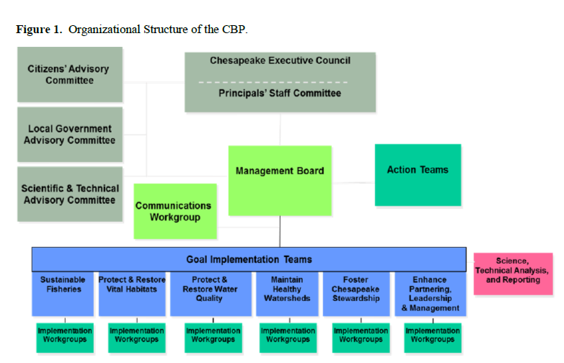
Chesapeake Bay Program Partnership
Federal Facilities WG
5

Slide 6

Other Goal Teams and Workgroups Applicable to the FFWG
Water Quality Goal Implementation Team
Watershed Technical Workgroup
Milestones Workgroup
Urban Stormwater Workgroup
Wastewater Workgroup

Slide 7
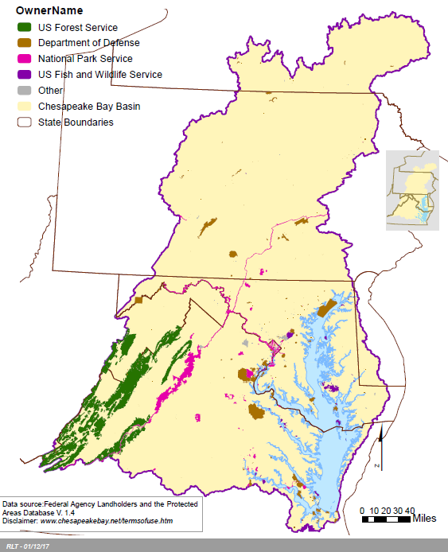
Federal Lands and Facilities in the Chesapeake Bay Watershed
Federal Department | Total Acres
FS | 2,543,167.69
DoD | 484,631.74
NPS | 410,635.97
FWS | 223,288.95
Other | 23,834.87
ARS | 6,949.81
SI | 3,966.73
GSA | 2,596.51
NASA | 2,000.17

Slide 8
Federal Agency Policy and Regulatory Drivers
CWA Section 117: “Chesapeake Bay”
  117 (f)(1): Federal agencies that own or operate a facility within the Ches. Bay watershed “shall participate in regional and sub-watershed planning and restoration programs”
  117 (f)(2): Requires that federal agencies that own property in the Ches. Bay watershed comply with the Ches. Bay agreement and any subsequent agreements and plans
    2014 Chesapeake Bay Watershed Agreement signed June 2014
  117 (g): EPA is empowered (“shall ensure”) that management plans “are developed and implementation is begun by signatories of the Ches. Bay agreement to achieve broad nutrient goals, water quality requirements, and habitat restoration”

Slide 9
2014 Chesapeake Watershed Agreement
Federal Agency Policy and Regulatory Drivers
  Re-affirms protection/restoration goals since Chesapeake 2000 Agreement
  Signatories include EPA (for US govt.), VA, MD, D.C., PA, DE, WV, NY, CBC
  Clear and concise goals (10) and outcomes (31)
  Science and ecosystem management approaches
  Integrates Chesapeake Bay Program and Executive Order 13508 goals
  Increased accountability
    Management strategies and two-year work plans
  Participation
    Federal Facility Workgroup contributes to the Water Quality: 2017 and 2025 Outcomes
Partners decide what Management Strategies they will participate in and at what level
Notes:
Include hyperlink to Agreement

Slide 10
Executive Order 13508
Federal Agency Policy and Regulatory Drivers
“Recognizes the Chesapeake Bay as a national treasure”
Federal government “should lead the effort”
  DoD, DHS, DOT, DOI (FWS/NPS/USGS), DOC (NOAA), USDA (NRCS/FS)
Renews federal commitment to control pollution for all sources as well as protecting and restoring habitat and living resources, conserving lands and improving water quality and ecosystem health
Establishes Federal Leadership Committee (FLC)
The FLC developed a strategy for the restoration of the Chesapeake Bay
Requires reports on key challenges to protecting and restoring the Chesapeake Bay
Agencies must implement land best practices “as expeditiously as possible and to the extent permitted by law”
Must balance “leading the effort” and fair implementation of CWA
Notes:
Include hyperlink to EO and Strategy
Mention FOD

Slide 11
Federal Agency Policy and Regulatory Drivers
Executive Order 13508 Strategy
Restore Clean Water Goal and Strategy Actions
  Federal agencies will contribute to Watershed Implementation Plans (WIPs)
    Estimate nutrient and sediment loads: providing property boundaries, land use, land cover, and implementation of best management practices
    Identify pollution reductions from point and non-point sources
    Commit to actions, programs, policies and resources
  States develop targets or Feds develop implementation plans
    Consider all source sectors: agriculture; forest; urban; onsite
  Implementation and Accountability
    Submit two-year water quality milestones (i.e. planned implementation)
    Report annual implementation
Notes:
FFWG agreed to keep it in.

Slide 12
Federal Agency Policy and Regulatory Drivers
Chesapeake Bay Total Maximum Daily Load (TMDL)
  “Pollution diet” sets limits on nitrogen, phosphorus and sediment
    Largest EPA TMDL
    Max allowed to meet water quality standards (i.e. dissolved oxygen, chlorophyll)
    Assigned limits are based on modeled data
    Each state developed plan
    Implementation via permits
    EPA/VA/MD issued federal pollution targets in 2015
  Goals and 2017 Mid-point Assessment
    60% reductions by 2017 for all sources (i.e. wastewater, agriculture, stormwater)
    100% BMPs in place by 2025
  Challenges
    Reviewing/commenting on changing state requirements
    Funding implementation and maintenance of BMPs
    Reporting/tracking progress

Slide 13
Federal Agency Policy and Regulatory Drivers
Watershed Implementation Plans (WIPs)
WIPs formulate jurisdictional strategies to meet the CB TMDL goals of 60% reductions by 2017 and 100% practices in place by 2025
Phases I & II complete
  County level/federal agency loads assigned in MD for all sources
  Federal agency loads assigned in DC
  County level implementation targets attempted in VA and PA
Calibration of model in 2017 will inform Phase III WIPs due June 2019
  EPA expects jurisdictions to develop local area planning goals
  Federal facility targets revised

Slide 14
Federal Agency Policy and Regulatory Drivers
National Pollutant Discharge Elimination System (NPDES) Permit Compliance
  NPDES Phase II municipal separate storm sewer system (MS4) and industrial stormwater (ISW) permits
Current NPDES stormwater permits with CB TMDL requirements
  VA MS4 and ISW Permits
  MD MS4 and ISW Permits
  PA MS4 Permit
  DC ISW Permits (EPA issued)
DOEE holds MS4 permit for the district / federal land holders pay stormwater fees
WV Compliance with stormwater management regulations associated with development/construction
Notes:
Links to each of the state’s permitting sites

Slide 15
NPDES Chesapeake Bay Jurisdictions Stormwater Program Links
  VA MS4
  www.deq.virginia.gov/Programs/Water/StormwaterManagement/VSMPPermits/MS4Permits.aspx
  VA ISW www.deq.virginia.gov/Programs/Water/PermittingCompliance/PollutionDischargeElimination/Stormwater.aspx
  MD MS4 http://mde.maryland.gov/programs/Water/StormwaterManagementProgram/Pages/storm_gen_permit.aspx
  MD ISW
  http://mde.maryland.gov/programs/Permits/WaterManagementPermits/Pages/stormwater.aspx
  DC
  https://doee.dc.gov/service/separate-storm-sewer-system-ms4-permit
  PA
  http://www.dep.pa.gov/Business/Water/CleanWater/StormwaterMgmt/Stormwater/Pages/default.aspx
  NY
  https://www.dec.ny.gov/chemical/43150.html
  WV
  https://dep.wv.gov/WWE/Programs/stormwater
Notes:
Links to each of the state’s permitting sites

Slide 16
Roles and Responsibilities
Federal Facility Workgroup (FFWG): consists of federal and state representatives.
  Federal reps may be members of the FOD
  Have a direct relationship to respective facilities within the watershed
  Responsible for annual BMP implementation progress reporting and two-year milestone development/tracking
Federal Office Directors (FOD): consists of federal representatives identified in EO 13508
  Not all agencies on the FFWG are on the FOD
  Responsible for the implementation of programmatic actions related to Chesapeake Bay protection and restoration
  Provide annual reports for CBARA and developing updates on two-year programmatic milestones
Interactions between the FFWG and FOD: TBD
            2 August discussion between the FOD and FFWG federal members
Notes:
Greg to help; see discussion about FOD, FLC, and FFWG.

Slide 17
Reporting Process
Federal Facilities Report to Federal Department Lead
Federal Department Lead reports BMPs to Jurisdictions
Jurisdictions import BMP records into NEIEN
BMP records imported into Bay Model
BMP credit calculated in Bay Model
Notes:
Need a schematic that discusses our process/cycle: Greg will take that back to see
Start with federal lands (federal data layer), used to then develop estimated loads, and then we have our targets coordinated with LAPG, BMPs, Report progress, new tools to assess progress; cycle to revise plans and go forward. Two-year milestones.

Slide 18
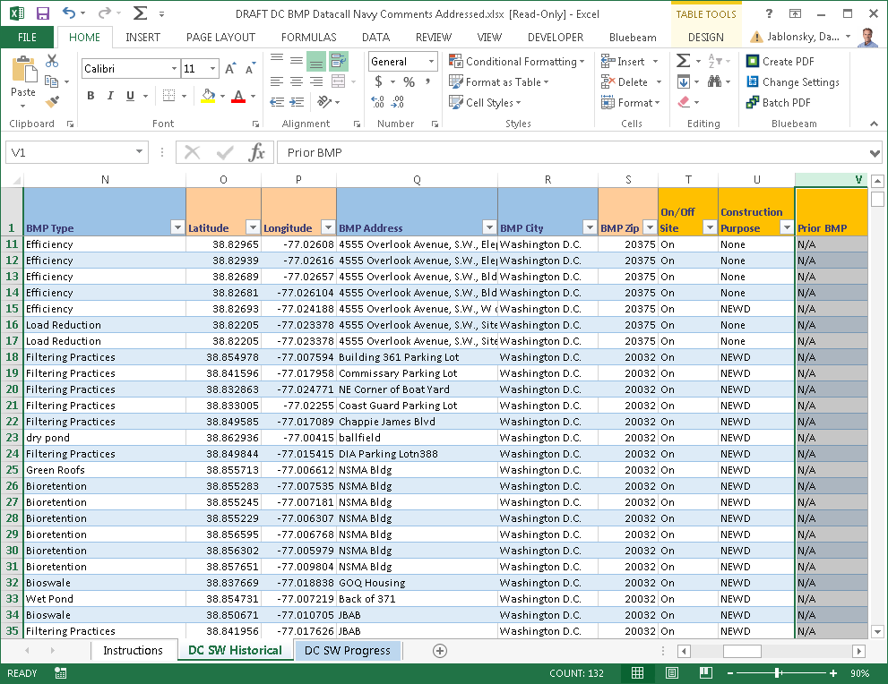
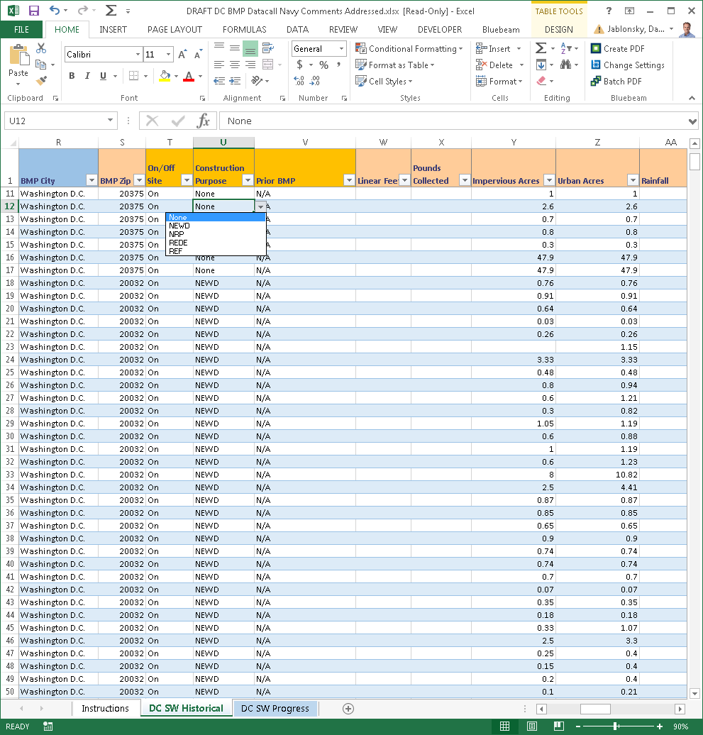
Federal Agency and Facilities Reporting Process
EPA sends request in August to Federal Office Directors and FFWG members
Requests BMP data be submitted to Jurisdictions
Unique templates are
provided by each Jurisdiction to report Progress
CAST is used to report planned BMPs

Slide 19
Defining BMPs and Milestones
Historical BMPs
  Practices installed in the past and already reported
  Revisions and updates based on new information
  Verification of inspection and maintenance required to maintain credit
  Federal data submitted to Jurisdictions for update in NEIEN
Progress BMPs
  Constructed, installed and functioning
  Jurisdiction specific reporting templates used
  Federal data submitted to Jurisdictions
  Reported in STATE fiscal year 07/01 through 6/30
  Jurisdictions enter data into NEIEN
Planned BMPs
  To be installed using best available info in STATE fiscal year
  Two year cycle requested every ODD year
  Facility level information submitted using CAST. Scenarios shared with Jurisdictions
  Federal data is consolidated with Jurisdiction submittal to EPA
Programmatic Milestones
  Agency level actions to support Water Quality
  Two-year cycle, requested every ODD year
  Reported in CALENDAR YEARS
  Submitted to EPA
Notes:
Programmatic milestones:
Most come from the FOD
Add some language: If a FF Representative they think is a programmatic milestone with a fcility focus that will help BMPs go in the ground later, that type has not bbeen real well defined and has only happened. Examples of each one.

Slide 20
BMP Reporting Due Dates to Jurisdictions
Historical BMPs
  OCT 1 every year with updates
Progress BMPs
  OCT 1 every year
Planned BMPs
  NOV 1 every odd year
Programmatic Milestones
  NOV 1 every odd year

Slide 21
2017 BMP Reporting Example
Historical BMPs
  Updates to BMPs installed from 1984 to 6/30/2016
  Need to convert records to Phase 6
Progress BMPs
  BMPs installed from 07/01/2016 through 6/30/2017
Planned BMPs
  BMPs to be installed between 7/1/2017 through 6/30/2019
Programmatic Milestones
  Agency level actions to be completed in calendar years 2018 and 2019

Slide 22
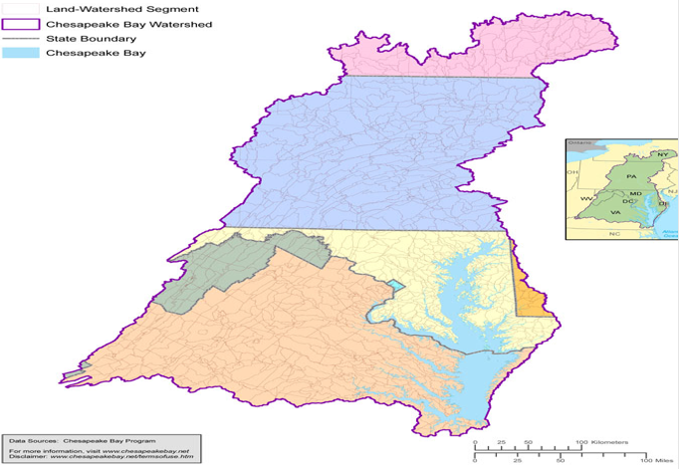
Jurisdiction Specific Reporting Slides

Slide 23
Jurisdiction Specific Slides: Virginia
Jurisdiction POC
Bill Keeling
Non-point Source Analyst
EMAIL and Phone
William.keeling@deq.virginia.gov
804-698-4342
Template Used
Excel Spreadsheet or Online: Virginia BMP Warehouse
Specific Coordination
Uses VA Warehouse online database for reporting progress

Slide 24
Jurisdiction Specific Slides: Maryland
Jurisdiction POC
Gregorio Sandi
Natural Resources Planner
EMAIL and Phone
Gregorio.sandi@maryland.gov
410-537-3742
Template Used
Excel Spreadsheet
Specific Coordination
Multiple sheets require duplicate info for various MDE departments
Notes:
There may be more than one person to report to on the States.

Slide 25
Jurisdiction Specific Slides: Pennsylvania
Jurisdiction POC
Ted Tesler
EMAIL and Phone
thtesler@pa.gov
Template Used
Excel Spreadsheet
Specific Coordination
Limited staff—ensure follow-up

Slide 26
Jurisdiction Specific Slides: District of Columbia
Jurisdiction POC
Luke Cole
Tree Policy Coordinator
EMAIL and Phone
luke.cole@dc.gov
(desk) 202-724-5348 (cell) 202-281-7634
Reporting Template Used
Excel Spreadsheet
Specific Coordination
DDOE emails Federal Facility leads to verify stormwater practices extracted from database to minimize duplicative reporting.

Slide 27
Jurisdiction Specific Slides: West Virginia
Jurisdiction POC
Alana Hartman
Basin Coordinator
EMAIL and Phone
Alana.c.hartman@wv.gov
304-822-7266 x 3623
Template Used
Excel Spreadsheet
Specific Coordination

Slide 28
Jurisdiction Specific Slides: New York
Jurisdiction POC
Lauren Townley
EMAIL and Phone
Lauren.townley@dec.ny.gov
Template Used
Excel Spreadsheet
Specific Coordination

Slide 29
Copy EPA for All Jurisdictional Submittals
EPA POCs
Greg Allen
allen.greg@epa.gov
EPA POCs
Jeff Sweeney
JSweeney@chesapeakebay.net

Slide 30
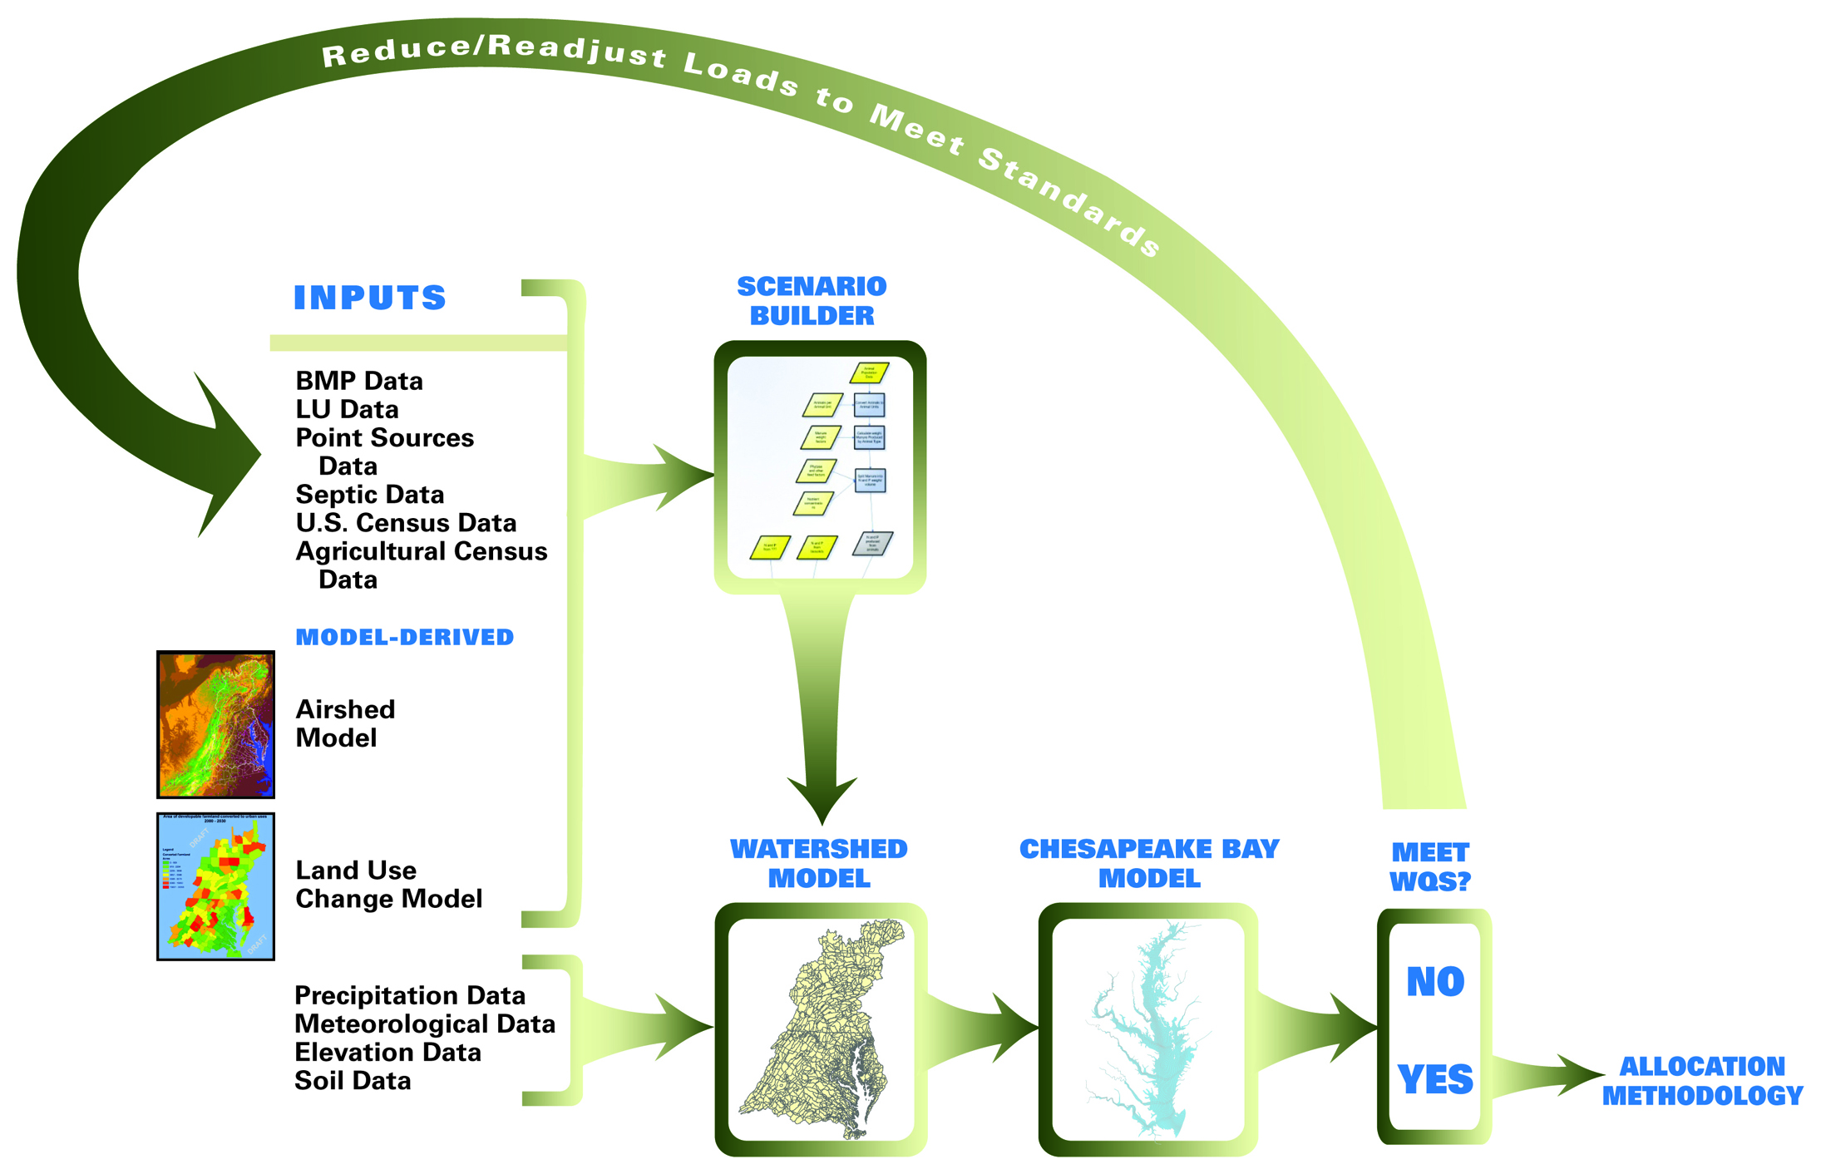
Suite of Partnership Models Used in Collaborative Decision Making

Slide 31
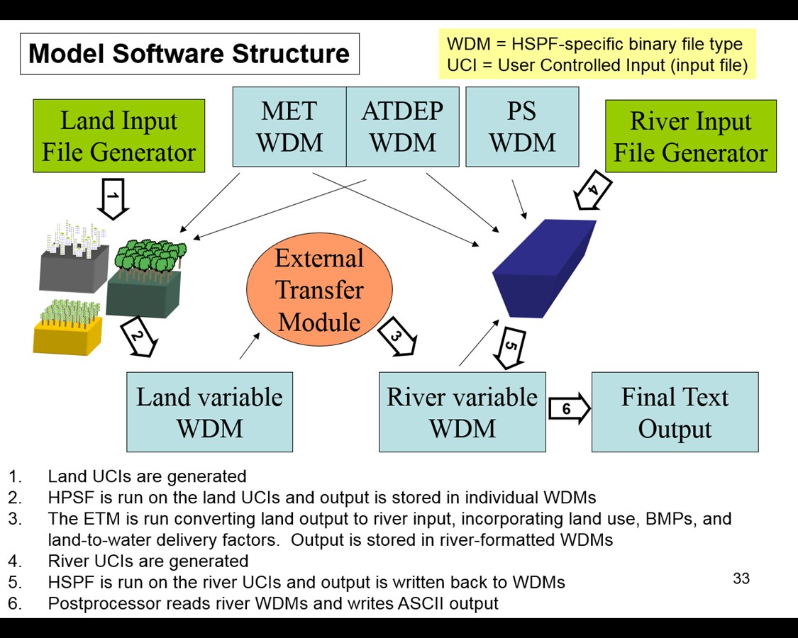
Suite of Partnership Models Used in Collaborative Decision Making
Prior Bay Watershed Models
Phase 6 Watershed Model
Average Load + Inputs * Sensitivity
Land Use Acres
BMPs
Land to Water
Stream Delivery
River Delivery
*
*
*
Direct Loads
*
*

Slide 32
Modeling Tools
Tools and resources available to federal agencies, broken out by process.
Identify Facilities and Land Uses
Indicate BMPs, Estimate Current Loads and Plan New BMPs
Set Targets
Phase 6
Facility Editor Tool
States or EPA will use the Federal Target Protocol
CAST
502 Guidance
Progress and Accountability
Track and Report
Implement
Phase 6
CAST
Watershed Model
Spreadsheets to the States
States report through NEIEN
502 Guidance
Chesapeake Bay Basinwide BMP Verification Framework

Slide 33
Chesapeake Bay Program Key Years
1985 - The Chesapeake Bay Program Partnership est. 1983; 985 provides representative "baseline" to measure progress made to date
2010 - The Chesapeake Bay TMDL was published on December 29, 2010. This year provides a second "baseline" to measure TMDL progress made to date
  Forms the basis of two key scenarios that place boundaries on possible pollution efforts.
    No Action: 2010 if no BMPs had been implemented and no wastewater treatment plant upgrades had been made
    E3: 2010 if all the theoretically possible treatment plant upgrades and BMPs had been completed
  Both are used to determine State 2025 Planning Targets
  States must account for growth in nutrient sources out to 2025
2017 - This year represents the mid-point of the TMDL process by which all actions planned by jurisdictions were to have been completed to reduce N,P and S by 60%
  This year also represents the most recent estimates of progress made to date
2025 - This is the year that ALL practices must be in place to meet water quality standards in the Chesapeake Bay and its tidal tributaries.
  States with support from local partners will be asked to develop Phase III WIPs that can achieve their pollution reduction goals by this year

Slide 34
Common Terms and Definitions
Chesapeake Bay Program Glossary includes terms used to describe the Chesapeake Bay, its ecosystem and restoration efforts: https://www.chesapeakebay.net/discover/glossary#
Federal data layer: Federal lands and facilities ownership, boundary, acreage information located in an ArcGIS Online map viewer for the Chesapeake Bay watershed. http://gis.chesapeakebay.net/fedfacs/
High-resolution data: One-meter resolution land cover dataset for the Chesapeake Bay watershed. Prior data was at the 30-meter resolution. Gives more accurate look at what’s really on the landscape. http://chesapeakeconservancy.org/conservation-innovation-center/high-resolution-data/land-cover-data-project/
Federal Land Use: Most federal land use data is captured within the high-resolution dataset. Land uses assigned to federal lands include: forest, natural, turf, developed,. Agricultural land uses were extracted from federal lands due to data gaps and uncertainty.
Allocation Air: Portion of nitrogen, phosphorus and sediment load under the oversight of EPA. Load reductions are accounted for through the CAA.
Hydrologic Unit Code (HUC): A hierarchal sequence of numbers or letters that identify a hydrologic feature like a river, river reach, lake or watershed. Longer the number sequence the smaller the average size or scale.
Scenario: Forecasted condition for planning purposes to compare against target or goal.
Calibrated model: Phase 6 model uses monitoring data to ensure model outputs mimic conditions from observed monitoring stations.
Construction General Permit Database: States have electronic reporting systems for construction permit applications. Some may use this database to bring data into their NEIEN submittal.
Regulated versus unregulated lands: Permitted versus non-permitted. Most of the implementation necessary to meet the CB TMDL will come from lands are not permitted/non-regulated.
Notes:
Reviewed glossary of terms and deleted ones that were

Slide 35
Phase III WIP Expectations for Federal Lands and Facilities
    Location and description of federal land or facility
    Description and estimate of current TN, TP, and TSS
    Estimate of anticipated growth through 2025
    Verified records of existing BMPs through 2017
    Description of existing programs, policies, and strategies used to drive BMP implementation
    Inventory of NPDES permits
    Description of facility’s stormwater management program (such as MS4 permit requirements) Planned reductions from point and nonpoint sources including addressing anticipated growth
    BMP implementation scenarios to reduce TN, TP, and TSS to reach the new facility specific targets
    Planned actions, programs, policies, and resources necessary through 2025
    Plans to address gaps in achieving reductions
    Procedure for tracking and annually reporting BMPs to the jurisdiction in a manner that is consistent with the jurisdiction’s procedures (and copy to EPA)
    Process for assessing implementation progress
Notes:
Integrating Federal Facility Targets and integrating Local Area Planning Goals; because they are new—not sure how the FFTs will be coordinated with. Good clarity that the FFT is a portion of those LAPGs that the jurisdictions base their WIPs around.

Slide 36
Phase III WIP Expectations for Federal Lands and Facilities
    Other information specified by permit conditions or as requested by jurisdictions
    EPA expects federal agencies to take the following steps:
        Assess properties to determine the feasibility of installing urban retrofit practices and nonstructural measures to meet planning targets
        Reduce, prevent, or control erosion from unpaved roads, trails, and ditches
      Provide support in source sectors where EPA is applying enhanced oversight or other actions
    Encouraged to consider multi-benefit BMPs
        Climate resiliency, fish habitat, forest buffers, healthy watersheds, protected lands, public access, stream health, toxics, tree canopy, wetland, brook trout
EPA’s Role and Support to Federal Agencies
    Coordinate with federal agencies to provide input in Phase III WIPs and federal water quality milestones
    Assist in the resolution of any disagreement between a federal agency and jurisdiction
Provide technical advice and assistance to ensure that federal actions are cost effective, timely, and in compliance with applicable standards
Notes:
Integrating Federal Facility Targets and integrating Local Area Planning Goals; because they are new—not sure how the FFTs will be coordinated with. Good clarity that the FFT is a portion of those LAPGs that the jurisdictions base their WIPs around.

Slide 37
Connecting WIPs and Federal Facility/Agency Planning Goals
UnregUrban SW
Permitted portion
of target
Un-permitted portion
of target
WWTPs
Reg Urban SW
WIPs
TOTAL FACILITY or AGENCY GOAL
Septic
Ag
Included in WIPs / not included in targets
Notes:
Add colors for regulatory funded requirement and what’s not. Circles for each source (reg vs. non reg).
Colors for what’s been funded
Discussion that would match

Slide 38
Local Area Planning Goals
MD: Final LAPGS in the fall. Will use the same methodology from Phase II WIPs, using 20% retrofit calculations.
DC: Will only be developing federal facility planning goals
NY: Will be implemented on the HUC 10 Watershed scale. HUC 10 watersheds with comparatively higher loading for agriculture, point source, or developed loads will be given a percent load reduction goal based on 2017 Phase 6 load data available from CAST. The local area planning goals are still being reviewed and are subject to change. Will not be developing federal facility planning goals.
PA: Final LAPGs in the fall; have preliminary planning goals and will conduct a pilot process with Lancaster, York and Franklin counties. Federal facilities will be separated from counties/localities and given their own goals.
VA: LAPG split between WLA and LA, and federal and non-federal. Local engagement process for Agriculture and Forestry sectors led by Soil and Water Conservation Districts. Developed, Septic and Urban Forestry sectors led by Planning District Commissions. SWCDs started meeting in May, PDCs anticipated to start meeting in July. Federal Facilities are encouraged to join the PDC meetings, though each federal department (as in the model) will be given their own LAPG.
WV: Developing LAPG July through September.

Slide 39
CB TMDL N, P, and S Federal Facility Targets (2015)
EPA/Jurisdictions defined approach to establish federal 2017/2025 targets for nitrogen, phosphorus and sediment
  Federal Facilities Targets Action Team (FFTAT) lead by EPA with VA (co-chair), PA, MD, GSA, DHS, NPS, USDA, and DoD
‘Protocol for Setting Targets, Planning BMPs, and Reporting Progress’
  Process document for setting federal targets / outlines methodologies to develop loads and pollutant reductions
  Promotes the use of CAST for EPA to assess federal agency progress toward CB TMDL

Slide 40
CB TMDL N, P, and S Federal Facility Targets (2015)
2017/2025 Target encompass permitted and non-permitted facilities and regulated and unregulated sources
Targets consistent with WIP strategies and NPDES permits
2010 baseline condition (i.e. “no-action”)
Targets posted on BayFAST
Supported Efforts
  Comprehensive list of properties
  Updated land use
    VA set targets for agriculture and urban land use classes
    MD set targets based on 20% retrofit of any untreated impervious acreage
    EPA set targets for DC/PA/WV/NY/DE urban based on 60% equivalent reduction
  Historical BMPs
  Panned implementation for 18/19 two-year water quality milestones

Slide 41
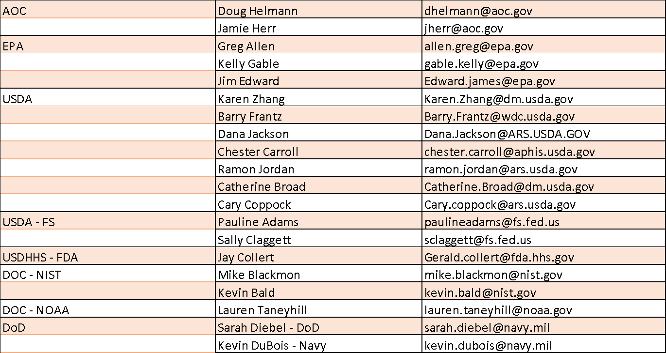
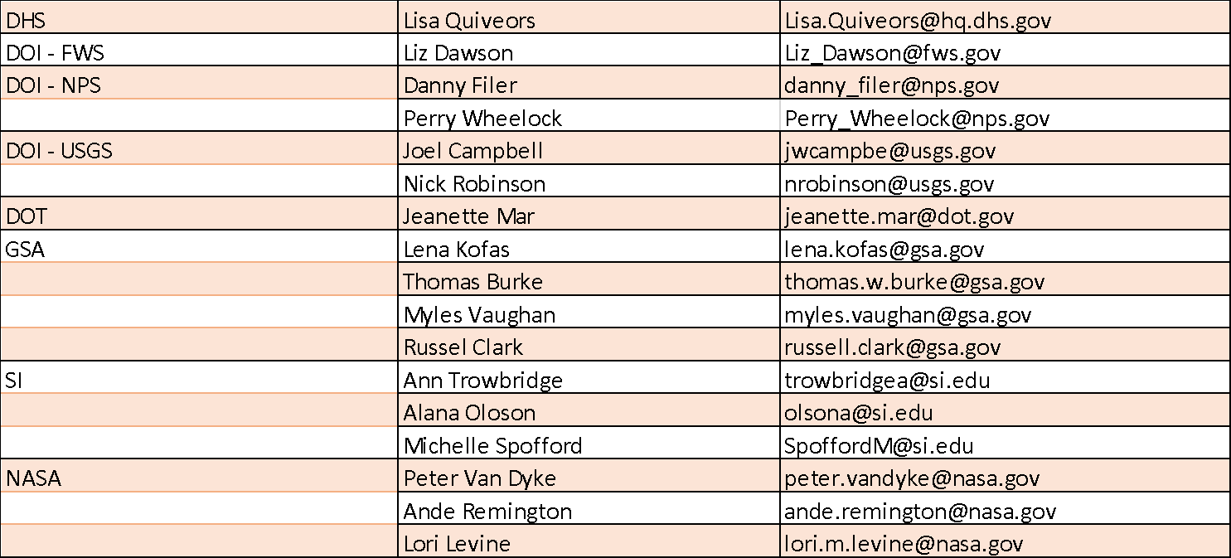
FFWG: Federal Members
Notes:
Add FFWG Members on the federal side and FOD Reps.
Add forestry Phase III WIP guide on the forestry workgroup page on the CBPO

Slide 42
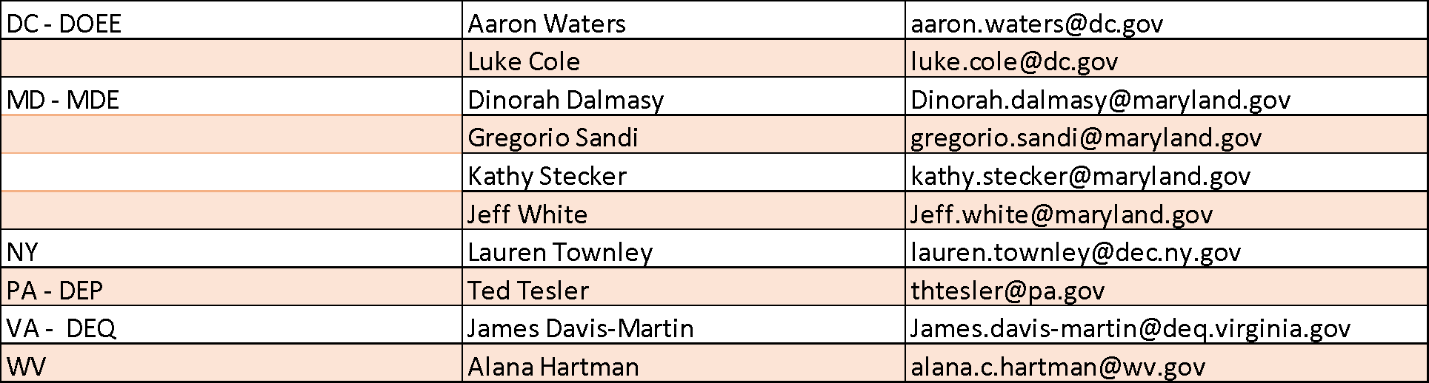
FFWG: State Members
Notes:
Add FFWG Members on the federal side and FOD Reps.
Add forestry Phase III WIP guide on the forestry workgroup page on the CBPO

Slide 43
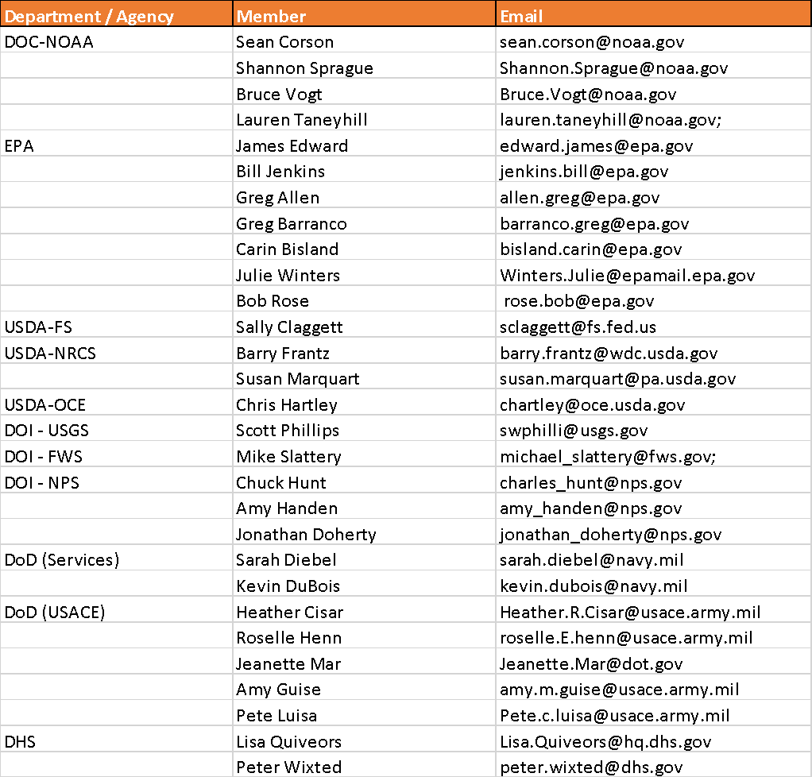
FOD Representatives
Notes:
Add FFWG Members on the federal side and FOD Reps.
Add forestry Phase III WIP guide on the forestry workgroup page on the CBPO

Slide 44
Resources
FFWG Page: https://www.chesapeakebay.net/who/group/federal_facilities
Forestry Phase III WIP Guide: https://www.chesapeakebay.net/documents/WIP_Forestry_BMP_Packet_December_2017.pdf
EPA Phase III WIP Expectations for Federal Lands & Facilities: https://www.epa.gov/sites/production/files/2018-06/documents/epa-phase-iii-wip-expectations-6-19-18.pdf
2015 Protocol: https://www.chesapeakebay.net/documents/CBP_BMP_Expert_Panel_Protocol_WQGIT_approved_7.13.15.pdf
BMP Field Guide:
  Now: https://goo.gl/5Tr7uj
  Later: https://www.chesapeakebay.net/bmpguide
CAST:
  Webinars/Trainings: https://cast.chesapeakebay.net/Documentation/Webinars
  Source Data: https://cast.chesapeakebay.net/Home/SourceData
Notes:
Add FFWG Members on the federal side and FOD Reps.

Slide 45
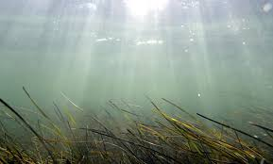
Contacts
Greg Allen – EPA Chesapeake Bay Program Office
  Allen.greg@epa.gov
Sarah Diebel – Department of Defense / FFWG Chair
  Sarah.diebel@navy.mil
  757-341-0383
Russell Clark – General Services Administration
  Russell.clark@gsa.gov
  202-704-3642
James Davis-Martin – Virginia Department of Environmental Quality / FFWG Chair
  James.davis-martin@deq.Virginia.gov

