Slide 1

Riparian Forest Buffers
Quarterly Progress Meeting - May 2018
Rebecca Hanmer
Forestry Workgroup Chair
Notes:
BACKGROUND: The Strategic Review System is the Chesapeake Bay Partnership's committed adaptive management process to regularly review progress at meeting our Watershed Agreement Outcomes and make appropriate changes. In recognition of the fact that our Outcomes vary considerably, there is no single review process that will fit all Outcomes. However, there is value in ensuring some level of consistency in how we review and discuss our Outcomes. The “Guide to your Quarterly Progress Meeting” and this powerpoint template are intended to provide that level of consistency, while also providing the necessary level of flexibility to adapt the process to your specific Outcome’s needs. The “Guide” provides specific instructions that we expect the Outcome’s lead GIT or Workgroup to follow in conducting the review. This powerpoint template provides a consistent format for presenting only the most important issues resulting from that review to the Management Board at the Quarterly Progress Meeting.
Both documents address four basic questions:
What are our assumptions?
Are we doing what we said we would do?
Are our actions having the expected effect?
How should we adapt?
We understand that you could spend your entire allotted time to any one of these questions. Please keep in mind that the Management Board is trusting that your GIT or Workgroup followed the process outlined in the Guide, and that the issues that you present in this powerpoint are limited to only those high points from that review that you need to bring to the Management Board’s attention and get their feedback.
INSTRUCTIONS: Use this presentation to highlight important AND, BUT, THEREFORE stories that the Management Board should hear, based on GIT analysis using the provided materials.
Find photos on our Flickr site: https://www.flickr.com/photos/29388462@N06/sets/
You can also browse photos by category on our website: http://www.chesapeakebay.net/photos
Find charts and data at ChesapeakeProgress.com.

Slide 2
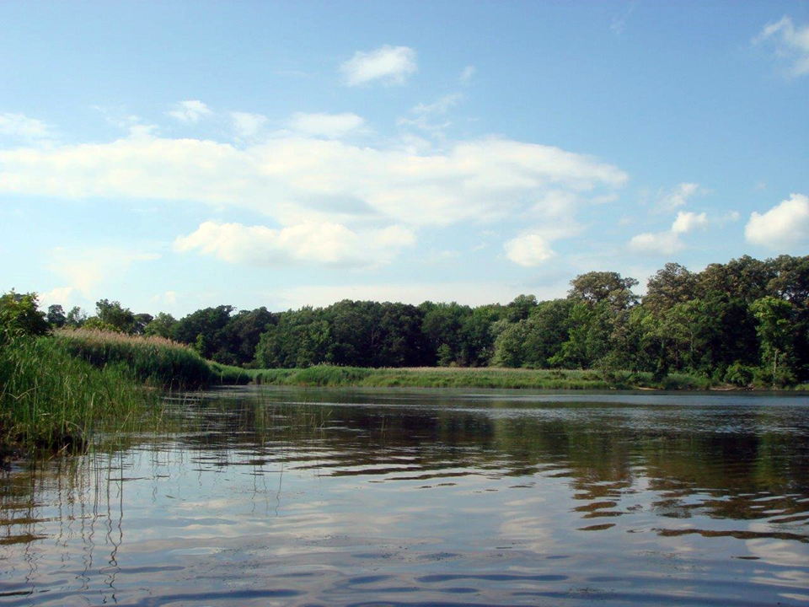

Through the Chesapeake Bay Watershed Agreement, the Chesapeake Bay Program has committed to…
Vital Habitats Goal
Riparian Forest Buffer Outcome: Restore 900 miles per year of riparian forest buffer and conserve existing buffers until at least 70 percent of riparian areas throughout the watershed are forested.
Notes:
NOTE: FWG/RFB is part of the WQ GIT!! But…
Vital Habitats Goal: Restore, enhance and protect a network of land and water habitats to support fish and wildlife, and to afford other public benefits, including water quality, recreational uses and scenic value across the watershed.
Riparian Forest Buffer Outcome: Continually increase the capacity of forest buffers to provide water quality and habitat benefits throughout the watershed. Restore 900 miles per year of riparian forest buffer and conserve existing buffers until at least 70 percent of riparian areas throughout the watershed are forested.

Slide 3

What We Want
Focus on Improved
Implementation
Elevate Buffer Needs
MB/PSC involvement:
All Hands!
Improve CREP
Develop non-CREP options
Align timing: Verification and Re-enrollment
Notes:
Forest Buffers better Recognized as fundamental WQ and Ag Practice

Slide 4
Setting the Stage:
What are our assumptions?
1
Notes:
[section header, no action required] The section that follows should provide some brief historical context for the Bay Program’s work toward this outcome. Add slides as needed while being mindful of the time you have.

Slide 5
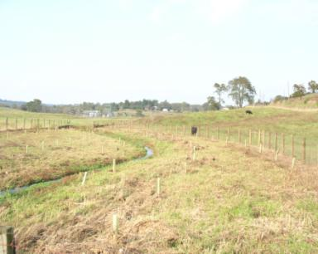
Why Is Restoration of Forested Riparian Buffers So Important?
Before
After
FORESTED RIPARIAN BUFFERS ARE NECESSARY FOR ECOSYSTEM FUNCTIONING
AND MEETING THE BAY TMDL.
Notes:
FORESTED RIPARIAN BUFFERS ARE A FUNDAMENTAL AGRICULTURE AND WATER QUALITY PRACTICE THAT ARE NECESSARY FOR ECOSYSTEM FUNCTION.
For a watershed that was originally 95% forested, forest buffers are essential for maintaining ecological functions over time — water quality, healthy indigenous aquatic life, and corridors for wildlife.
No other goal has been a goal of the partnership for 24 years and is so inexorably tied to clean water.
All of these functions led the Ches Exec Council to adopt an ambitious outcome of restoring 900 miles of buffets each year.
Riparian forest buffers are also a superb BMP, substantially reducing nitrogen from air pollution, increasing the removal efficiency of upstream Ag BMPs, and retaining nutrients and sediment.
In fact, the goals for forest buffers in the Phase II WIPs exceed the Outcome goal. While Phase III WIPs may be more realistic, forest buffers will still be needed in large numbers to restore Bay water quality.

Slide 6

Logic Behind Our Outcome
Factors
Current Efforts and Gaps
Management Approaches
Coordination
Leadership
Funding
RFB State Leads Need Help
Local offices can be disfunctional
Stable, effective staff need consistent funding
Leadership
Stable Funding
Outreach and TA
Up Conservation
More action on non-Ag buffers
Notes:
IN our current Management Strategy, in order of importance, the #1 factor was that fed/state/local leadership did NOT place sufficient emphasis on RFB as a priority practice, and allows less beneficial practices to successfully compete for limited riparian space.

Slide 7
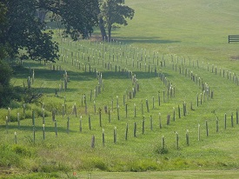
What Has Been Done to Meet the Forest Buffer Outcome?
CREP brings $$ (75% federal match) and the USDA Farm Service Agency has increased its support to Bay states since 2015, BUT it is complicated.
Riparian areas have competing uses, RFBs difficult to sell and specialists are required. BUT NRCS has other farm programs to administer, and doesn’t give priority to CREP contracts.
CREP contracts have begun to expire, and there is an added workload for re-enrollment + verification of buffer status for the Bay Program.
Notes:
What Has Been Done to Meet the RFB Outcome Goal?
Partners have been working for 24 years
Of late, efforts to boost incentive payments, agro-forestry, conservation, maintenance, outreach, and TA.
It is not enough– progress is as low as ever.
Since 2010?, the CBP strategy has been to emphasize achieving RFBs on farms, using CREP funding under the Farm Bill.
CREP is an excellent funding source, and the USDA Farm Service Agency has increased its support to Bay states. (Thank you, FSA.) However, the system is very complex, requires effective state match and partnering, and relies on NRCS for technical services. Breakdowns in the interagency chain, or major delays in getting CREP programs in place have hindered progress in every jurisdiction.
(Verbally cite VA 100% for stream fencing w. 10 ft. riparian zones - now fixed but took time. Cite MD’s state funding stopped for awhile. Cite length of time to get CREP amendment in NY. Cite WV’s new CREP person being moved from Bay RFB work.)
It is difficult enough to sell RFBs to a farmer with competing uses for land, and RFB specialists are required. As is a straight-forward system the farmer trusts. NRCS has other farm programs to administer, and doesn’t give priority to CREP contracts.
Contracts for buffers installed under CREP have begun to expire, and there is an added workload to work with those farmers on re-enrollment + verification of buffer status for the Bay Program.

Slide 8
Progress:
Are we doing what we said we would do?
2
Notes:
Graph
What rez imagery says -> minimum 70% goal; issue?
Opportunity (check with J Wolf)
And there is grasses and fences
And some buffers not effective (flow) or coming out of contract
[section header, no action required] This second section provides the AND part of the AND, BUT, THEREFORE story structure. This section provides an opportunity to talk about your progress. Use indicator data and charts from ChesapeakeProgress.com where available. If you do not have an indicator, fill in with other relevant information, charts, tables, etc. about your management approaches and workplan actions.

Slide 9
What is our progress?
Notes:
Discussion Question 1: Are you on track to achieve your Outcome by the identified date?
What is your target? What does this target represent? (e.g., the achievement we believed could be made within a particular timeframe; the achievement we believed would be necessary for an Outcome’s intent to be satisfied; etc.)?

Slide 10
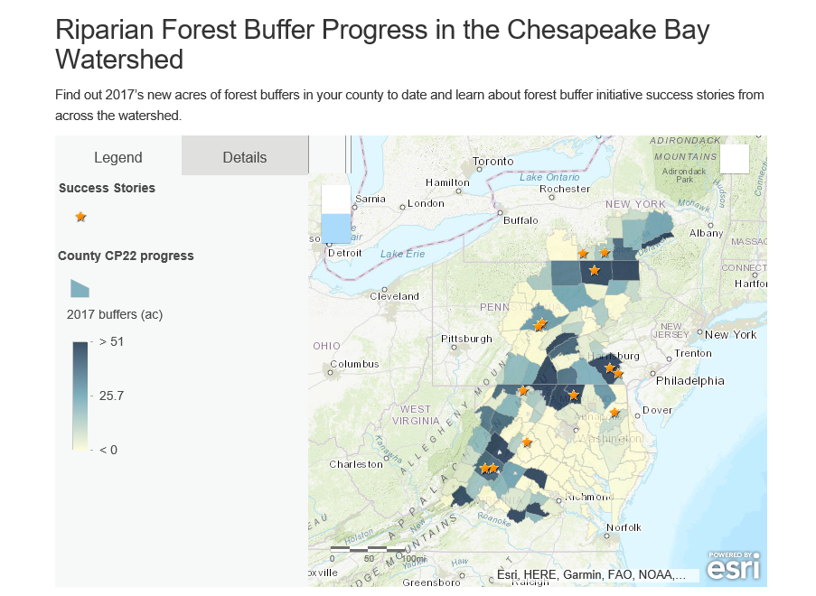
www.chesapeakeforestbuffers.net

Slide 11
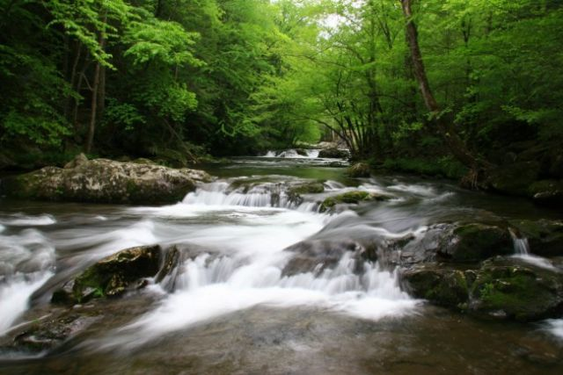
Analysis
What has worked:
        PA leadership example
Teamwork in dark
blue counties
When the landowner is asked and educated
    When there is additional $ incentive
    When there is outside assistance to maintain the buffer
    These steps have shown near perfect
    enrollment success
Notes:
INSTRUCTIONS: consider these questions and include those that are most relevant to your outcome.

Slide 12
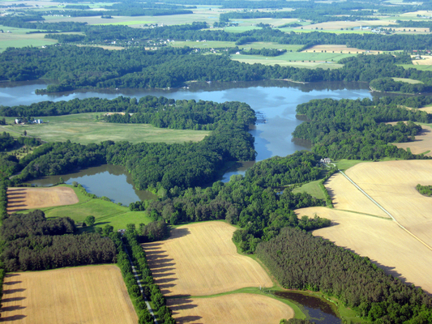
Analysis
There are ~1.4 million acres of riparian area in crop, pasture or turf in the watershed
Notes:
We would like to establish RFB as a normal landscape feature. See cross outcome map at end.

Slide 13
Challenges:
Are our actions having the expected effect?
3
Notes:
Obviously not enuf. Challenges: Leadership, will, reluctance to ‘push’ practices, people in office, boots on ground, competition for time n space
[section header, no action required] This second section provides the BUT part of the AND, BUT, THEREFORE story structure. This section provides an opportunity to talk about your challenges, based on your analysis using the logic table and the discussion questions in the SRS Quarterly Meeting Guide.

Slide 14
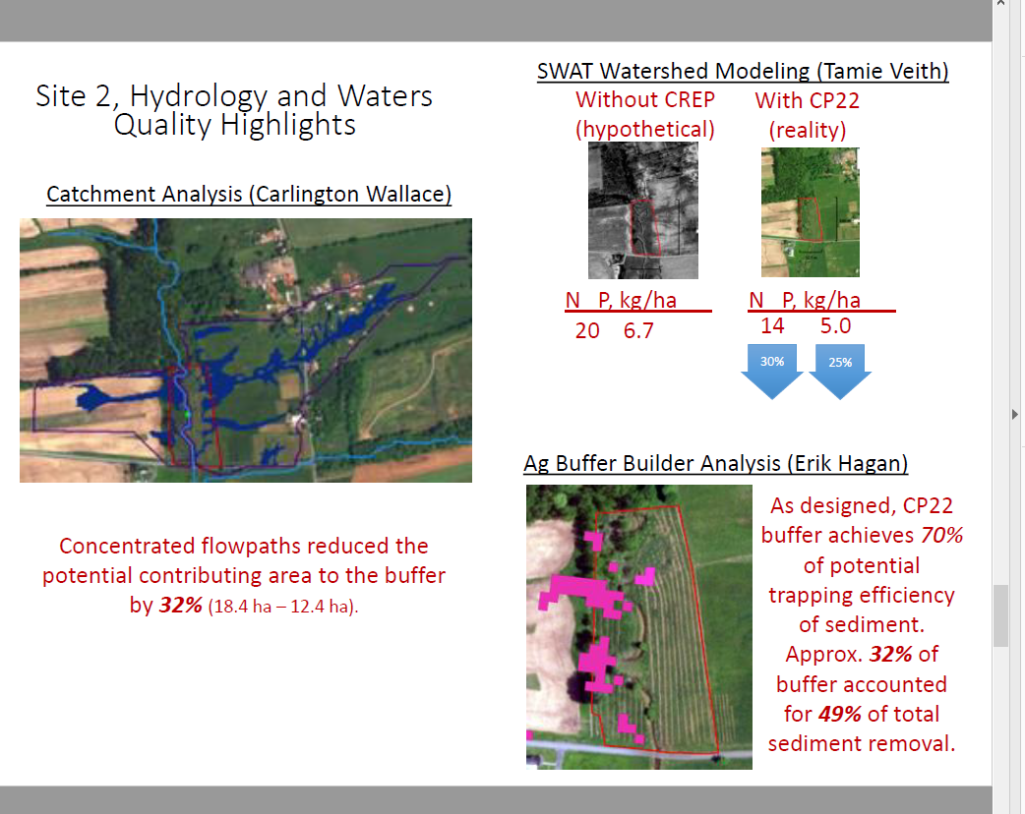
New Analysis by ARS/PennState shows Buffer By-pass (aka concentrated flow): Need for improved whole farm planning.
Notes:
Academics are taking a high-resolution look at farm hydrology. We knew concentrated flow was an issue but now we know how much of an issue and where it occurs. Buffers need to be more integrated part of whole farm planning. We will be working to address this issue along with getting more buffers planted.

Slide 15
Challenges
        Lack of sustained leadership support
        Keeping CREP fully operational in each state
Staff turnover, low numbers of TSPs
Competing programs for critical riparian area
Many localities and TSPs still don’t get it
Slow pace-- need to greatly accelerate efforts
No concerted buffer program for non-Ag lands
Buffers remain at record lows--increasing acreage is very doable but lacks strong, high-level leadership and focused implementation.
Notes:
INSTRUCTIONS: consider these questions and include those that are most relevant to your outcome.

Slide 16
Adaptations:
How should we adapt?
4
Notes:
[section header, no action required] This second section provides the THEREFORE part of the AND, BUT, THEREFORE story structure. This section provides an opportunity to talk about your adaptations and next steps, based on your analysis using the logic table and the discussion questions in the SRS Quarterly Meeting Guide.

Slide 17
Based on what we’ve learned, we plan to…
Focus on Improved Implementation
Create fully-functioning local teams everywhere needed
Integrate RFB upfront - part of whole farm planning
--Address farm flow issues that create buffer by-pass
Increase TSPs through SWCDs and trusted farm consultants (e.g., TU, Red Barn, CBF, ACB) …akin to Boots on the Ground
Make It Easy-- provide comprehensive services to farmers (sign-up, maintenance, etc.)
Notch up conservation of RFBs
Notes:
Forest Buffers Are A Fundamental WQ and Ag Practice
INSTRUCTIONS: This is the THEREFORE piece of the story! Tell the Management Board what you’re going to do with the new information, research, resources, understanding of factors, etc. Refer back to the logic table that you competed—this content could come from the Adaptation column, if you got that far in the table, or it could be a realization that you gained working within the first columns of factors, gaps, approaches, actions and responsible parties.

Slide 18
Based on what we’ve learned, we plan to…
Elevate Buffer Needs Through Policy/Leadership
Have top WQ person join with RFB lead in each state
Find stable funding/plan to keep RFB trained staff
Develop State Programs to RFBs on non-Ag lands (i.e., suburbia, other non-CREP) using state funding, 319, SRF, etc.
Revisit State Task Force Reports
Meet regularly with State Con
State CREP programs/policy should reflect WIP Phase 3 needs
Notes:
Fully-functioning buffer partnership in every county (or key locality)
Ready to accommodate a large increase in participants—eliminate backlogs and other hurdles
A process to collaboratively integrate new partners
CREP programs should reflect buffer goals of Phase 3 WIPs (capacity estimates for PA show that CREP will not get us to our goals)

Slide 19










Agreement Goals and Outcomes
Sustainable Fisheries
Vital Habitats Goal
Blue Crab Abundance
Blue Crab Management
Oyster
Forage Fish
Fish Habitat
Wetlands
Black Duck
Stream Health
Brook Trout
Fish Passage
Submerged Aquatic Vegetation (SAV)
Forest Buffer
Tree Canopy
Water Quality Goal
Toxic Contaminants Goal
2017 Watershed Implementation Plans (WIP)
2025 WIP
Water Quality Standards Attainment and Monitoring
Toxic Contaminants Research Toxic Contaminants Policy and Prevention
Healthy Watersheds Goal
Stewardship Goal
Citizen Stewardship
Local Leadership
Diversity
Healthy Waters
Land Conservation Goal
Public Access Goal
Protected Lands
Land Use Methods and
Metrics Development
Land Use Options Evaluation
Public Access Site Development
Environmental Literacy Goal
Climate Resiliency Goal
Student
Sustainable Schools
Environmental Literacy Planning
Monitoring and Assessment
Adaptation Outcome
Notes:
Optional slide if you think it contributes to your message
INSTRUCTIONS: Highlight with bold green text the outcomes which impact your outcome, or which your outcome impacts. (taken from Bruce Vogt’s March 2017 PSC presentation on oysters)

Slide 20
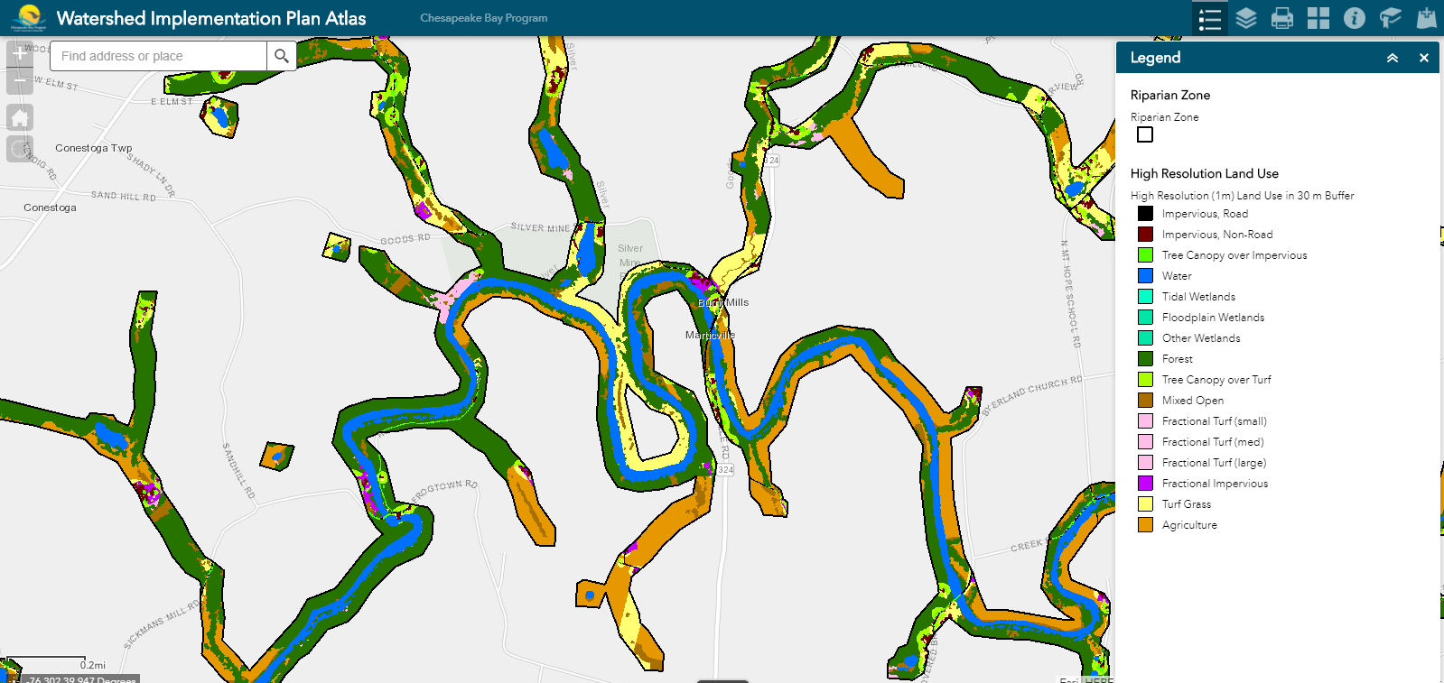
Cross-Outcome
Considerations
Notes:
INSTRUCTIONS: Highlight your past collaboration and future opportunities to collaborate across GITs.
Talking Points:
Discussion Question 6: What opportunities exist to collaborate across GITs? Can we target conservation or restoration work to yield co-benefits that would address multiple factors or support multiple actions across outcomes?

Slide 21
What We Want
Focus on Improved
Implementation
Elevate Buffer Needs
MB/PSC involvement:
All Hands!
Improve CREP
Develop non-CREP options
Align timing for Verification with Re-enrollment visits
Notes:
Forest Buffers better Recognized as fundamental WQ and Ag Practice
INSTRUCTIONS: Identify the requested actions the Management Board up front, or clue them in to what you will be asking them later. All of the information in your presentation should support this. If you don’t necessarily have an ask, identify a few key points you want the Management Board to walk away with, and structure your presentation around those points.

Slide 22
Discussion
Presentation template by SlidesCarnival.
Notes:
[time for discussion at the end of the presentation, before the next outcome presentation]

